Slide 1
Semantic cluster analysis
Deepti Saravanan

Slide 2
TAg words - glossary
TAGS | WORDS
Accounting (65) | Broker, dividend, equity, maturity, portfolio, prospectus, asset, principal debenture, yield
Finance (35) | Default, business, income, maturity, insurance, asset, exchange, price, vesting, turnover
Capital Market (69) | Liquidation, exchange, information, insider, price, margin, equity, portfolio, maturity, bond
Comm Market (15) | Delivery, margin, bid, local, range, premium, purchase, sale, merchant, contract
Banking (23) | Mortgages, alteration, bank, authorization, application, collateral, disclosures, refund, payment, transfer
Pension Funds (6) | Accrued, administrator, benefit, asset, retirement, member, pension

Slide 3
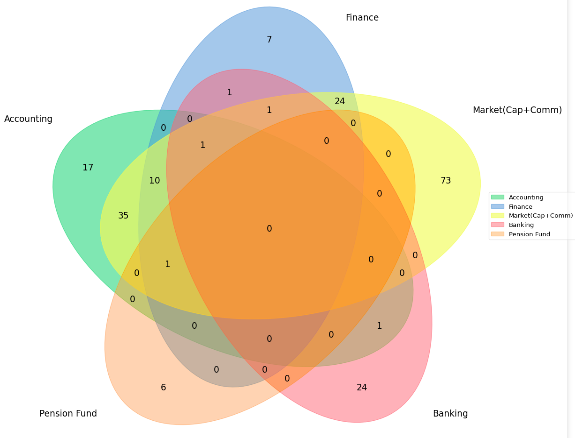
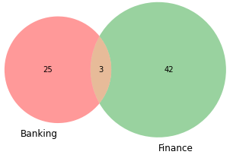
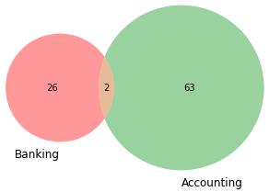
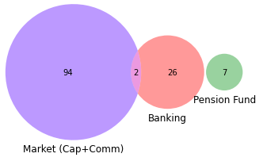
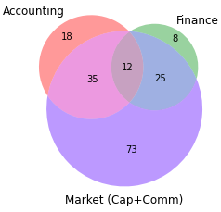
Tag words similarity
1. Pension fund and {Cap, Comm, Banking} - null
2. Pension fund and {fin, acc} - asset
3. Banking and {pf, comm} - null
4. Banking and {acc, cap} - maturity, bond
5. Banking and {fin} - maturity, insurance
6. Cap, Comm, Fin, Account – highly related -> (market)
Broker, equity, basis, margin, delivery, liquidation etc.
7. Market and pf – asset
8. Market and banking – bond, insurance, maturity

Slide 4
Tag words cluster-wise
 | CLUSTER 0 | CLUSTER 1 | CLUSTER 2
ACCOUNTING | Acquisition, equity, capital | Audit committee, accounting standards | Depository, profit and loss, balance sheet
FINANCE | Trading plan, dividend, warrant | Interest, divided, debentures, bonds | Custodian, depositories, portfolio
CAP + COMM MARKET | Goods, delivery, settlement, upsi | Stock exchange, trade, insider | Stock exchange, debenture trustees
BANKING | Interest, payment, escrow | Merchant banker, draft, application | Transfer, deposit, escrow
PENSION FUND | Benefit, pension fund regulatory, pension advisor | Compensation, benefit | Assets, benefit

Slide 5
FREQUENT WORDS (>50) CLUSTER-WISE
CLUSTER 0 | CLUSTER 1 | CLUSTER 2
Investment, fund, company, issuer, security, applicant, director, manager, person, committee, research | Exchange, director, recognise, manager, person, investment, issuer, security, offer, public, corporation, share | Company, manager, share, issuer, offer, investment, person, depository, security, acquirer, application, portfolio, public, target, issue, acquisition, specify, applicant, stock, participant, act

Slide 6
REGULATIONS CLUSTER-WISe

Slide 7
ACCOUNTING | FINANCE | CAP + COMM MARKET | BANKING | PENSION FUND
(13)The trust shall be required to hold the shares acquired through secondary acquisition for a minimum period of six months except where they are required to be transferred in the circumstances enumerated in clause (b) of sub-regulation (14) of this regulation2, whether off- market or on the platform of stock exchange. 21.(1) No person resident in India shall at any time, directly or indirectly, either individually or together with persons acting in concert, acquire or hold more than five percent of the paid up equity share capital in a Depository: Provided that,— (i)a stock exchange; (ii)a depository; (iii)a banking company; (iv)an insurance company; (v)a public financial institution, may acquire or hold, either directly or indirectly, either individually or together with persons acting in concert, upto fifteen percent of the paid up equity share capital of a Depository. | (2)Such trading plan shall:– (i)not entail commencement of trading on behalf of the insider earlier than six months from the public disclosure of the plan; (ii)not entail trading for the period between the twentieth trading day prior to the last day of any financial period for which results are required to be announced by the issuer of the securities and the second trading day after the disclosure of such financial results. (iii)entail trading for a period of not less than twelve months; 12.The listed entity shall use any of the electronic mode of payment facility approved by the Reserve Bank of India, in the manner specified in Schedule I, for the payment of the following: (a)dividends; (b)interest; (c)redemption or repayment amounts: Provided that where it is not possible to use electronic mode of payment, ‘payable-at-par’ warrants or cheques may be issued: Provided further that where the amount payable as dividend exceeds one thousand and five hundred rupees, the ‘payable-at-par’ warrants or cheques shall be sent by speed post. Grievance Redressal Mechanism. | 20.(1) All Alternative Investment Funds shall review policies and procedures, and their implementation, on a regular basis, or as a result of business developments, to ensure their continued appropriateness. Provided further that the custodian appointed by Category III Alternative Investment Fund shall keep custody of securities and goods received in delivery against physical settlement of commodity derivatives. (2)No person shall procure from or cause the communication by any insider of unpublished price sensitive information, relating to a company or securities listed or proposed to be listed, except in furtherance of legitimate purposes, performance of duties or discharge of legal obligations. | (9)Public interest directors shall be remunerated only by way of payment of sitting fees as admissible to independent directors in the Companies Act, 2013. 25.The merchant banker shall ensure that— (i)the company is able to implement the offer; (ii)the provision relating to escrow account has been complied with; (iii)firm arrangements for monies for payment to fulfill the obligations under the offer are in place; (vi)a due diligence certificate along with the draft letter of offer has been furnished to the Board; (ix)the bank with whom the escrow or special amount has been deposited releases the balance amount to the company only upon fulfillment of all obligations by the company under the regulations;…. | (3)The option, SAR, or any other benefit granted to the employee shall not be pledged, hypothecated, mortgaged or otherwise alienated in any other manner. 4.The following persons shall not be required to seek registration under regulation 3 subject to the fulfillment of the conditions stipulated therefor, Any pension advisor who offers investment advice solely on pension products and is registered with Pension Fund Regulatory and Development Authority for such activity;…..

Slide 8
ACCOUNTING | FINANCE | CAP + COMM MARKET | BANKING | PENSION FUND
(3)The statement(s) specified in sub-regulation (1), shall be placed before the audit committee for review and after such review, shall be submitted to the stock exchange(s). 48.The listed entity shall comply with all the applicable and notified Accounting Standards from time to time. | (2)The listed entity shall, in case of any amount to be paid in advance of calls on any shares stipulate that such amount may carry interest but shall not in respect thereof confer a right to dividend or to participate in profits. 50.(1) The listed entity shall give prior intimation to the stock exchange(s) at least eleven working days before the date on and from which the interest on debentures and bonds, and redemption amount of redeemable shares or of debentures and bonds shall be payable. | 43.(1) The payment and settlement in respect of a transaction in a recognized stock exchange and recognized clearing corporation shall be determined in accordance with the netting or gross procedure as specified in the bye-laws of such recognized stock exchange and recognized clearing corporation, with the prior approval of the Board 4.(1) No insider shall trade in securities that are listed or proposed to be listed on a stock exchange when in possession of unpublished price sensitive information. | (8)The lead merchant banker shall ensure that all comments received from the Board on the draft offer document are suitably taken into account prior to the filing of the offer document with the designated stock exchange. “11. (1) Three months before the expiry of the period of validity of the certificate, the investment adviser may, if he so desires, make an application in Form A for grant of renewal of certificate of registration. (2)The application for renewal under sub-regulation (1) shall be dealt with in the same manner as if it were an application made under sub-regulation (2) of regulation 3 for grant of certificate.” | 17 (5)A company may reprice the options....Provided that an employee shall, subject to the terms and conditions formulated by the compensation committee under the sub-regulation (3) of regulation 5, be entitled to retain all the vested options, SAR, or any other benefit covered by these regulations.

Slide 9
ACCOUNTING | FINANCE | CAP + COMM MARKET | BANKING | PENSION FUND
(2)Every depository shall within one month of the date of the holding of its annual general meeting, furnish to the Board a copy of its audited balance-sheet and profit and loss account for the preceding financial year. (3)Without prejudice to sub-regulation (1), every portfolio manager shall, after the end of each accounting period furnish to the Board copies of the balance sheet, profit and loss account and such other documents for the preceding five accounting years as and when required by the Board. | (2)In addition to the obligation of custodian under any other regulations, the custodian shall – (a)report to the depositories and the Board on a daily basis the transactions entered into by the foreign portfolio investor in the form and manner specified by the Board or depositories from time to time; (b)monitor investment of the foreign portfolio investors; (c)maintain the relevant true and fair records, books of accounts, and documents including the records relating to transactions of foreign portfolio investors; (d)report the holdings of foreign portfolio investors who form part of investor group to the depositories and the depositories shall club the investment limits to ensure that combined holdings of all these foreign portfolio investors remains below ten per cent of the total paid-up equity capital on a fully diluted basis of a investee company at any time. | (7) The information referred to in sub-regulation (5) shall also be placed on the websites, if any, of the debenture trustee, the issuer and the stock exchanges.” (2)Where the issuer is a body corporate to whom the Companies Act, 2013 applies, one-third of its Board shall comprise of independent directors, as defined in section 149 of the Companies Act, 2013. (3)Any change in rating shall be promptly disseminated in such manner as the stock exchange where such securities are listed may determine from time to time. (4)The issuer, the respective debenture trustees, and stock exchanges shall disseminate all information and reports regarding municipal debt securities including compliance reports filed by the issuers and the debenture trustees, to the investors and the general public by placing them on their websites. (5)The information referred to in sub-regulation (3) shall also be placed on the websites of the debenture trustee, the issuer and the stock exchanges. | 7.(1) The listed entity shall appoint a share transfer agent or manage the share transfer facility in-house: Provided that, in the case of in-house share transfer facility, as and when the total number of holders of securities of the listed entity exceeds one lakh, the listed entity shall either register with the Board as a Category II share transfer agent or appoint Registrar to an issue and share transfer agent registered with the Board. (4)In the event of the escrow account being created by way of a bank guarantee or by deposit of securities, the acquirer shall also ensure that at least one per cent of the total consideration payable is deposited in cash with a scheduled commercial bank as a part of the escrow account. | 9.(1) The trustee shall hold the REIT assets in trust for the benefit of the unit holders in accordance with the trust deed and these regulations.

