Slide 1

Beyond the Virus: The Impact of the COVID-19 Pandemic on Mental Health
Deepti Saravanan (ds6812)
João Galinho (jg6606)
CSCI-GA.3033-096 Data Analytics and Visualization in Healthcare
Professor Maria Lorena Carlo Unda

Slide 2
INTRODUCTION
The restrictive policies during COVID-19 pandemic could make us feel isolated and lonely, leading to anxiety and depression.
PROPOSED HYPOTHESES:
The COVID-19 pandemic has contributed to an increase in mental health issues.
There is a correlation between this increase and the increase in the associated consequences (suicide and substance abuse).

Slide 3
METHODOLOGY
DATA COLLECTION:
Official Websites - CDC, WHO
Data Sites - World Population Review, Our World in Data
Public Polls - KFF
Text search data - Google Trends
METHODS:
COVID-19 and Mental Health
COVID-19 and Suicide Rates
COVID-19 and Substance Abuse

Slide 4
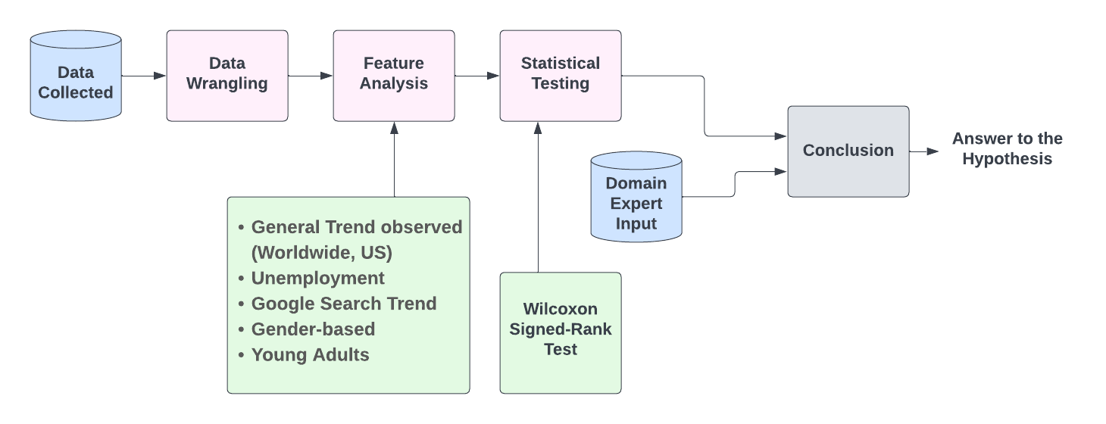
METHODOLOGY (CONTD.)

Slide 5
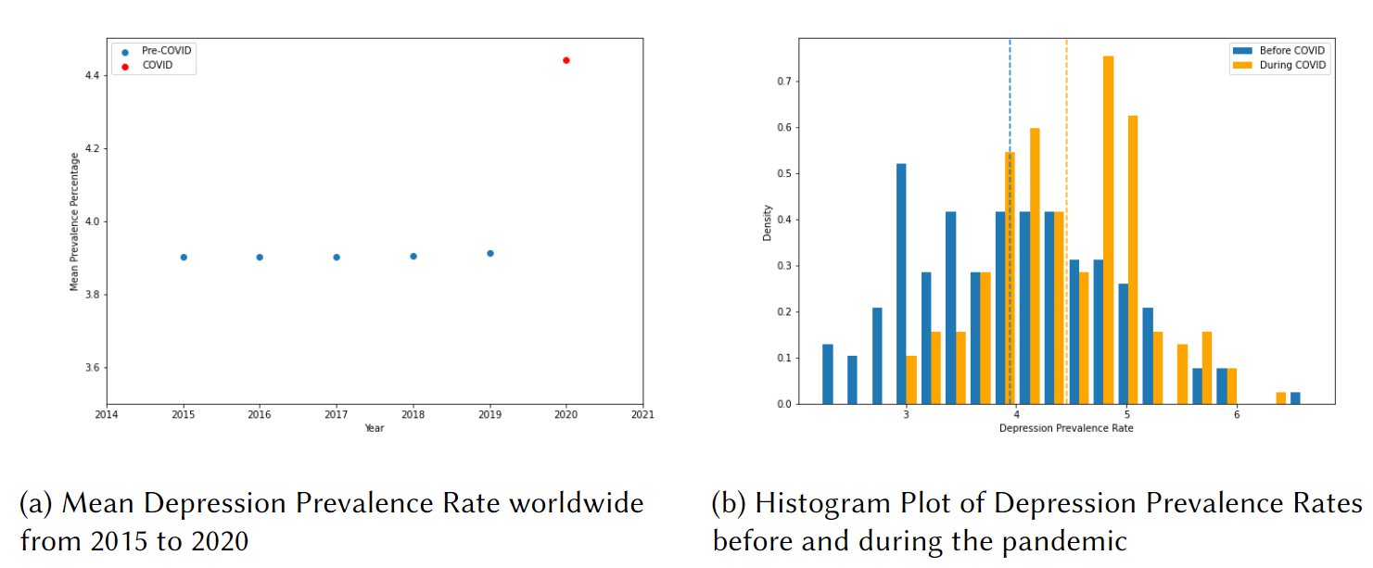
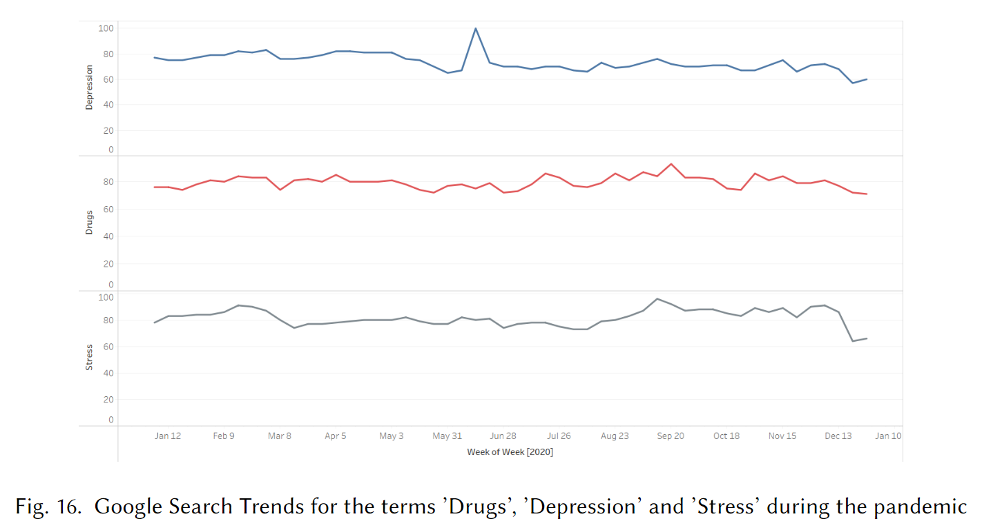
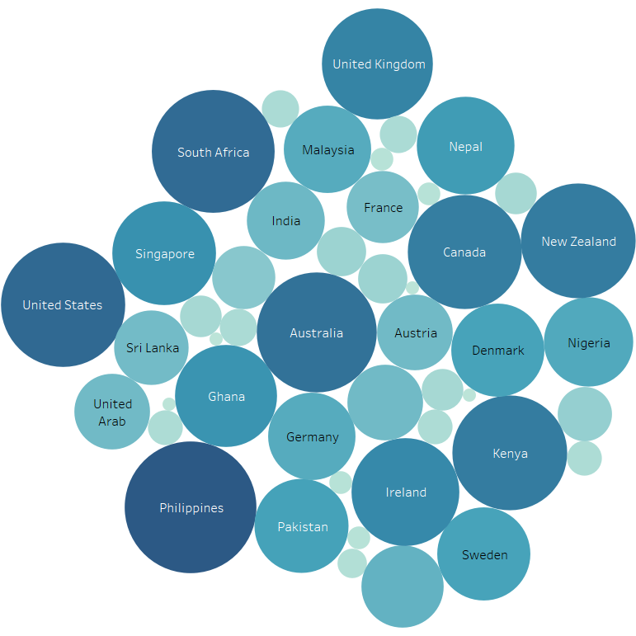
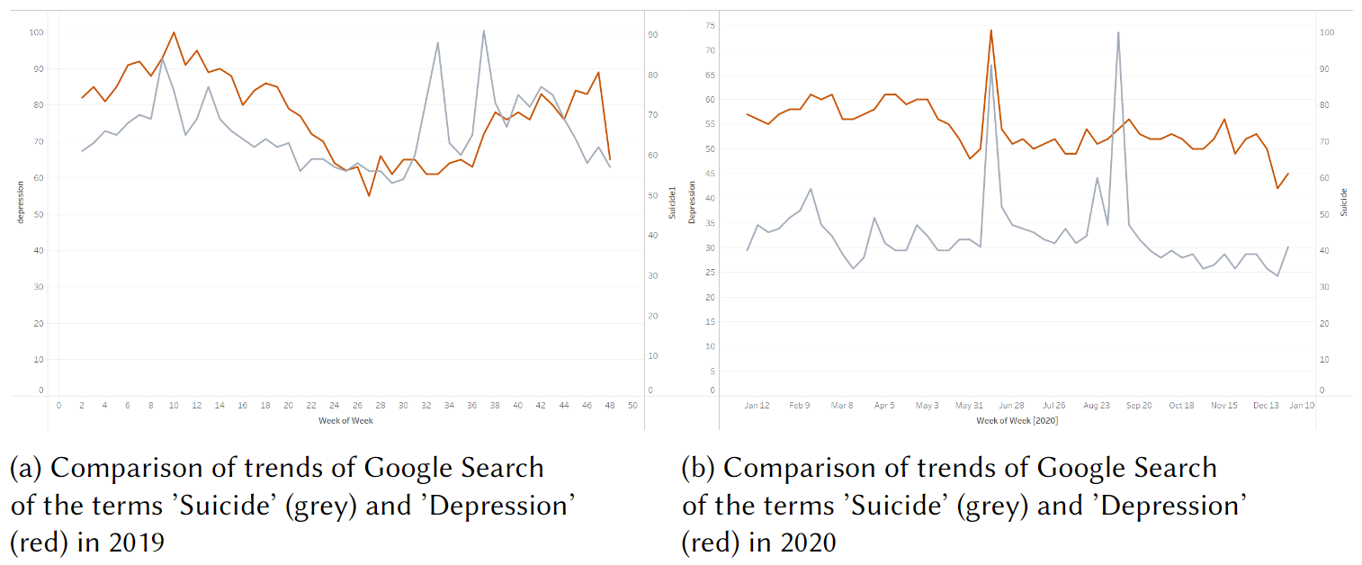

Slide 6
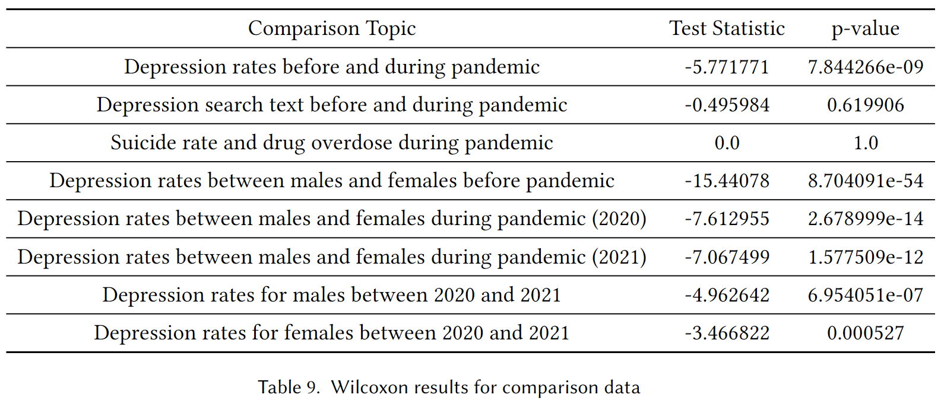
RESULTS - STATISTICAL TESTING

Slide 7
COVID-19 PANDEMIC VS MENTAL HEALTH | COVID-19 PANDEMIC VS SUICIDE RATES | COVID-19 PANDEMIC VS SUBSTANCE ABUSE | POINTERS FROM DOMAIN EXPERT
13% higher mean depression prevalence rate Histogram plot - right skewed (2019) vs left skewed (2020) Increase in depression rate in US from 2020 to 2021 by 9% Unemployment - positive weak, statistically insignificant Females more affected than males by 30% in 2020 and 23.5% in 2021 Young adults - negative weak, statistically significant - online class and sleep duration | Suicide rates in US - 8-29.3% Unemployment - positive weak, statistically insignificant ‘Suicide’ and ‘Lonely’ - search increased by 64.5% in 2020 ‘Suicide’ and ‘Depression’ - search increased by 42.5% in 2020 | Drug overdose deaths in US - 0.007-0.1% Suicide rates - positive strong, statistically significant Unemployment - positive moderate, statistically insignificant ‘Drugs’, ‘Stress’ - 0.5 and ‘Drugs’, ‘Depression’ - 0.2 | Significant increase in request for help Young adults - excessive use of digital platforms and irregular sleep patterns led to anxiety Suicidal thoughts among people who were already depressed Increased use of soft drugs, alcohol and tobacco Females - higher levels of anxiety Word of advice - balanced daily routines, new activities, physical exercise

Slide 8
CONCLUSION
There has been a significant increase in the depression prevalence rate during the pandemic, with females being affected more than males.
Analysis on Google Search Data revealed that there exists a noticeable similarity between the search trends of keywords like ’depression’, ’stress’, ’suicide’, ’drugs’, etc. during the pandemic.
Overall, both the proposed hypotheses were not rejected.
One of the main limitations was that Google search data is particularly prone to selection bias as access to and inclination to use search engines likely differ substantially between different demographics.

Slide 9
REFERENCES
[1] Kunal Chaturvedi, Dinesh Kumar Vishwakarma, and Nidhi. 2020. COVID-19 and its impact on education, social life and mental health of students: A Survey. Children and Youth Services Review (2020), 105866. https://doi.org/10.1016/j.childyouth.2020.105866
[2] Deena Dimple Dsouza, Shalini Quadros, Zainab Juzer Hyderabadwala, and Mohammed A. Mamun. 2020. Aggregated COVID-19 suicide incidences in India: Fear of COVID-19 infection is the prominent causative factor. Psychiatry Research 290 (2020), 113145. https://doi.org/10.1016/j.psychres.2020.113145
[3] Osea Giuntella, Kelly Hyde, Silvia Saccardo, and Sally Sadoff. 2021. Lifestyle and mental health disruptions during COVID-19. Proceedings of the National Academy of Sciences 118, 9 (2021), e2016632118. https://doi.org/10.1073/pnas.2016632118 arXiv:https://www.pnas.org/doi/pdf/10.1073/pnas.2016632118
[4] Emily A Halford, Alison M Lake, and Madelyn S Gould. 2020. Google searches for suicide and suicide risk factors in the early stages of the COVID-19 pandemic. PLoS One 15, 7 (July 2020), e0236777.
[5] Max Roser Hannah Ritchie and Esteban Ortiz-Ospina. 2015. Suicide. Our World in Data (2015). https://ourworldindata.org/suicide.

