Slide 1

It’s Simple!: QA-based Lexical Simplification and Controlled Text Generation
Deepti Saravanan (ds6812@nyu.edu)
Yuxuan Xia (yx2432@nyu.edu)

Slide 2
Motivation
Tc: Complex Sentence
Genetic engineering has expanded the genes available to breeders to utilize in creating desired germlines for new crops.
New plants were created with genetic engineering.
Ts: Simple Sentence
Problem Formulation:
Tc -> Ts
grammatically correct
Semantically coherent

Slide 3
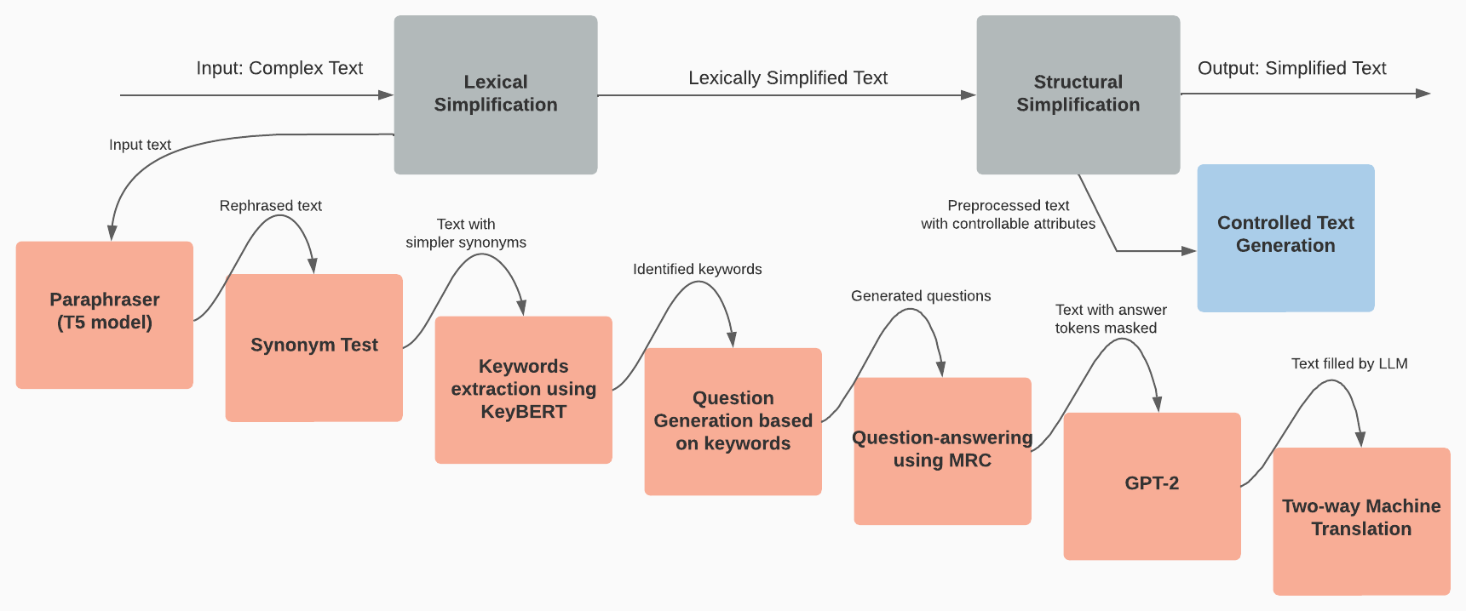
Proposed Framework

Slide 4
Lexical Simplification
Input: Genetic engineering has expanded the genes available to breeders to utilize in creating desired germlines for new crops.
Subcomponents | Intermediate Output
Paraphraser (T5 model) | genes have been extended to allow breeders to create desired germlines for new crops
Synonym Testing | gene have been widen to let breeder to make desired germlines for new crop
Keywords Extraction (KeyBERT) | desired germlines, gene, new crop
Question Generation | What is desired germlines? What does desired germlines do? How does desired germlines work?
Question-Answering (MRC) | for new crop to let breeder to make desired germlines for new crop gene have been widen
Masked Token Prediction (GPT-2) | gene have been widen to let breeder to make desired germlines for new crop
Two-way Machine Translation | The gene has been widen to leave the breeder to make desired germ lines for a new culture

Slide 5
Structural Simplification – Controlled Text Generation
Base: AudienCe-CEntric Sentence Simplification (ACCESS)
Original ACCESS Model
Modified ACCESS Model
Compression Ratio
Compression Ratio
Length of the sentence
Dependency Clauses Ratio
Phrase-level dependency
Dependency Tree Depth
Dependency Tree Depth
Token-level dependency
Token-level variety of syntactic categories
Number of Distinct POS tags ratio

Slide 6
Evaluation / Ablation Studies
SARI Score | Additional Processors | No Additional Processors
Include Preprocessing | 36.07 (Proposed Model) | 34.17
No Preprocessing | 35.63 | 36.3 (Original ACCESS)
Dataset: Turk Simplification Dataset for English sentences
Domain-specific data – Proposed might perform better due to more dependency clauses.
Original Input: Genetic engineering has expanded the genes available to breeders to utilize in creating desired germlines for new crops
Model Output: The gene has found been used to leave the breeder to make germ lines for a new culture

Slide 7
Conclusion
Q-A Based Lexical Simplification.
Controlled Text Generation Based Structural Simplification
Limitation and Future Work –
Absence of domain-specific labeled dataset to test Adaptability.

Slide 8
Related Work
Paper | What did they do?
Vy Vo, Weiqing Wang, and Wray Buntine. 2022. Unsupervised sentence simplification via dependency parsing. | Employed a decoder for structure simplification and a back-translation for lexical simplification
Sneha Mehta, Huzefa Rangwala, and Naren Ramakrishnan. 2022. Improving zero-shot event extraction via sentence simplification. | Showed how context simplification could improve the performance of MRC-based event extraction by more than 5\% for actor extraction and more than 10\% for target extraction.
Renliang Sun, Zhixian Yang, and Xiaojun Wan. 2023. Exploiting summarization data to help text simplification. | Proposed that summarization is sometimes a kind of simplification and uses summarization dataset to create simplification data pairs and expand the training dataset.
Louis Martin, Angela Fan, Éric de la Clergerie, Antoine Bordes, and Benoît Sagot. 2021. Muss: Multilingual unsupervised sentence simplification by mining paraphrases. | Proposed a novel approach to sentence simplification that can overcome the unavailability of labeled data by training models using sentence-level paraphrase data.
Xinyu Lu, Jipeng Qiang, Yun Li, Yunhao Yuan, and Yi Zhu. 2021. An unsupervised method for building sentence simplification corpora in multiple languages. | Leveraged the technique of translation to Germany and back to English for lexical simplification.
Renliang Sun, Hanqi Jin, and Xiaojun Wan. 2021. Document-level text simplification: Dataset, criteria and baseline. In Proceedings of the 2021 Conference on Empirical Methods in Natural Language Processing, pages 7997–8013, Online and Punta Cana, Dominican Republic. Association for Computational Linguistics. | Performed document-level simplification, built the corresponding dataset and introduced modified evaluation metrics.
Mert Cemri, Tolga Çukur, and Aykut Koç. 2022. Unsupervised simplification of legal texts. | Domain-specific simplification using an unsupervised approach that circumvents the labeled data unavailability

Slide 9
Open to Questions!

