Slide 1







Stack Overflow Developer Survey
Deepti Patnaik
2024 Apr 11

Slide 2



OUTLINE
Executive Summary
Introduction
Methodology
Results
Visualization – Charts
Dashboard
Discussion
Findings & Implications
Conclusion
Appendix

Slide 3

EXECUTIVE SUMMARY
Programming Language Trends
Trends-Visualizing current and expected
Programing Language
Database
Web framework Trends
OS Platform
Discussions-Overall findings
Conclusion
Appendix

Slide 4

INTRODUCTION
Methodology-Current technology usage and future trends based on different demographics.
Result-Draw conclusions based on visualizations used.
Dashboards
Findings
Implications

Slide 5

METHODOLOGY
Data Sources :
https://cf-courses-data.s3.us.cloud-object-storage.appdomain.cloud/IBM-DA0321EN-SkillsNetwork/LargeData/m5_survey_data_demographics.csv
https://cf-courses-data.s3.us.cloud-object-storage.appdomain.cloud/IBM-DA0321EN-SkillsNetwork/LargeData/m5_survey_data_technologies_normalised.csv
Extract and Explore Datasets
Sanitized Dataset
Exploratory Data Analysis
Data Visualizations
Dashboard creation using IBM Cognos

Slide 6
RESULTS
Most of the Respondents chose Javascript and Html/CSS
Few of the Respondents are currently using PHP and C++
Future estimates-very few may choose Go and Kotlin
Majority of the Respondents are currently working with MYSQL
Data shows that in future PostgreSQL will be desired
Firebase and Elastic are barely considered by most respondents
Dashboards show Top 10 Languages, Webframeworks and Platforms preferred by most respondents
It's evident that majority of the respondents identify as male.

Slide 7
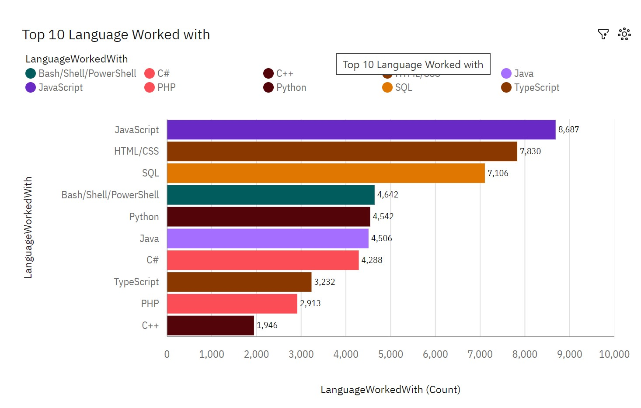
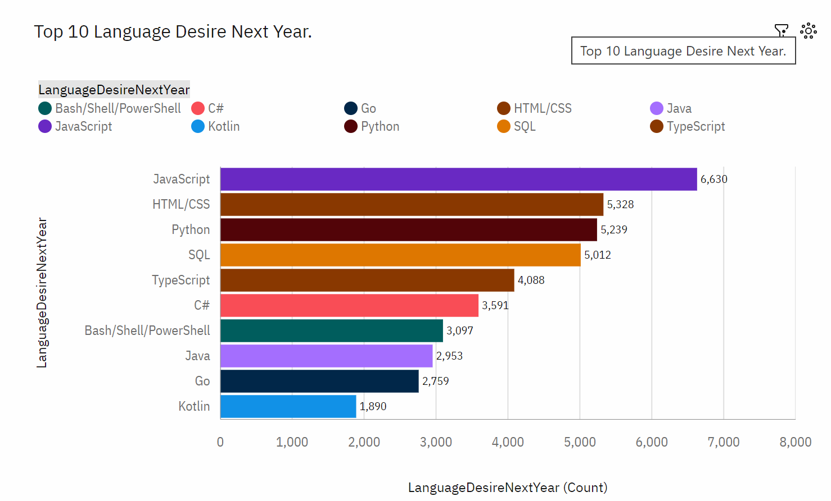
PROGRAMMING LANGUAGE TRENDS
Current Year
Next Year
<Bar chart of top 10 programming languages for the current year goes here.>
< Bar chart of top 10 programming languages for the next year goes here.>

Slide 8
PROGRAMMING LANGUAGE TRENDS - FINDINGS & IMPLICATIONS
Findings
Javascript and Html/CSS are mostly used
PHP, C++ are not currently not favored
Go and Kotlin will be less desired in future.
Great interest in TypeScript
Implications
Most of our respondents desire Javascript and Html/CSS
Few of the respondents are currently using PHP or C++
In the future we estimate that very few respondents will use Go and Kotlin
Possible developers migration from JavaScript to TypeScript.

Slide 9
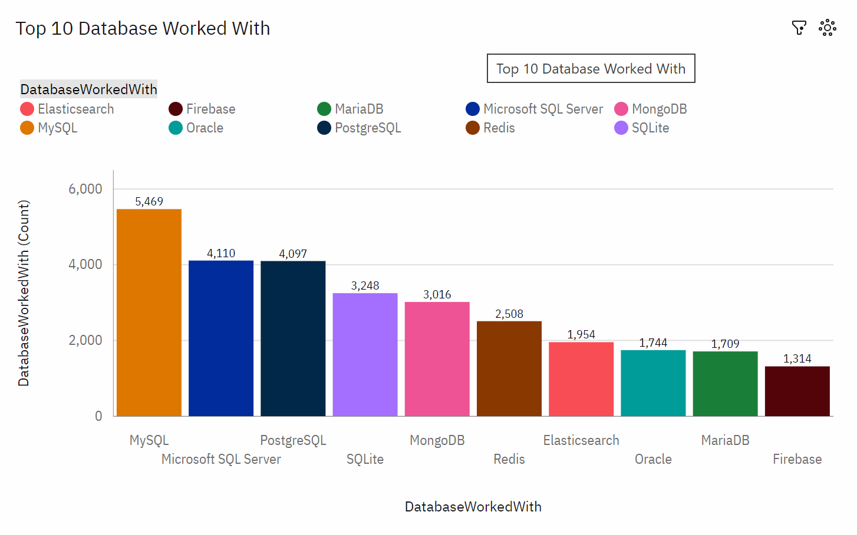
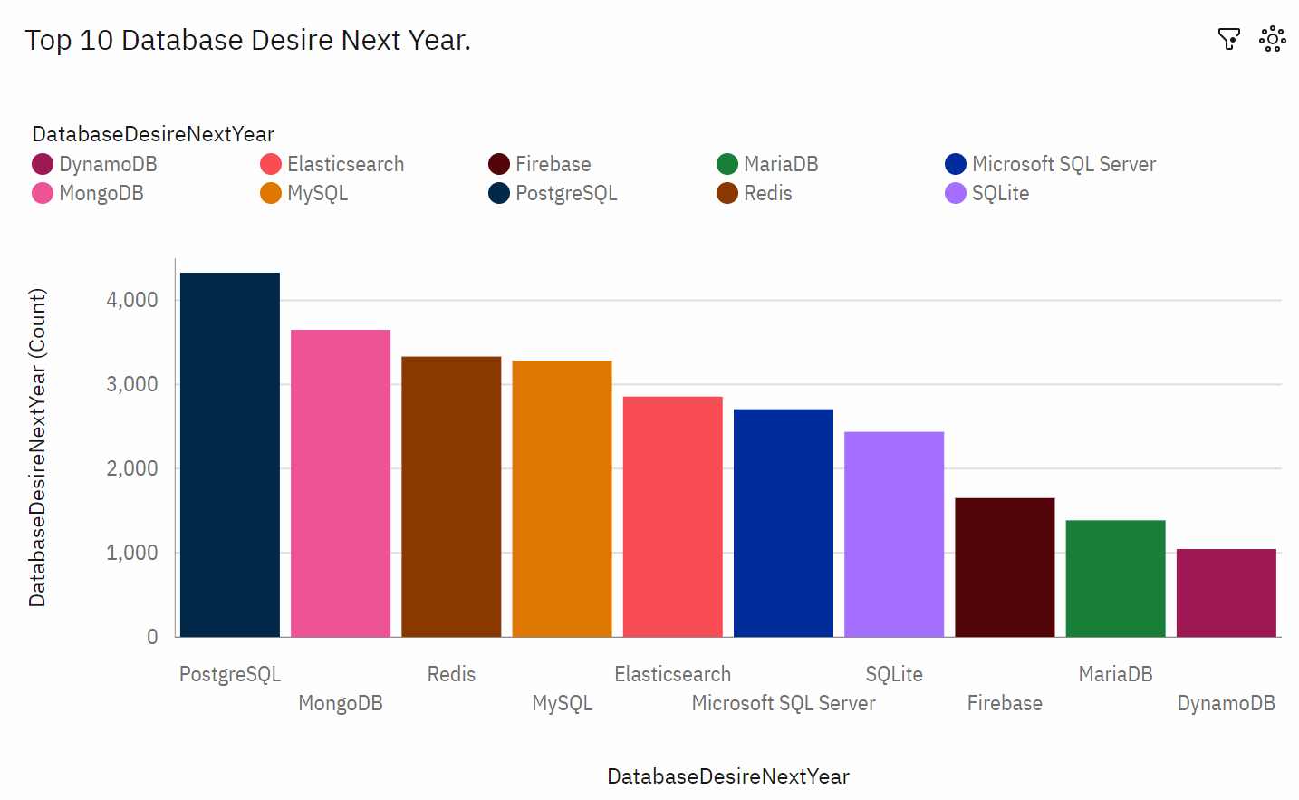
DATABASE TRENDS
Current Year
Next Year
< Bar chart of top 10 databases for the current year goes here >
< Bar chart of top 10 databases for the next year goes here.>

Slide 10
DATABASE TRENDS - FINDINGS & IMPLICATIONS
Findings
According to current data MySql is most used.
Lack of interest in Microsoft SQL server.
Future trend shows an increasing demand for PostgreSQL
Firebase and Elastic search are barely used.
Implications
Most respondents are currently working with MySql
With developing technology it seems there will be an increase in demand for PostgreSQL and MongoDB.
Microsoft SQL server and SQLite losing its demand in the market.

Slide 11

DASHBOARD
https://github.com/DeeptiVeena/Capstone-Project/blob/main/Capstone%20Project.pdf

Slide 12
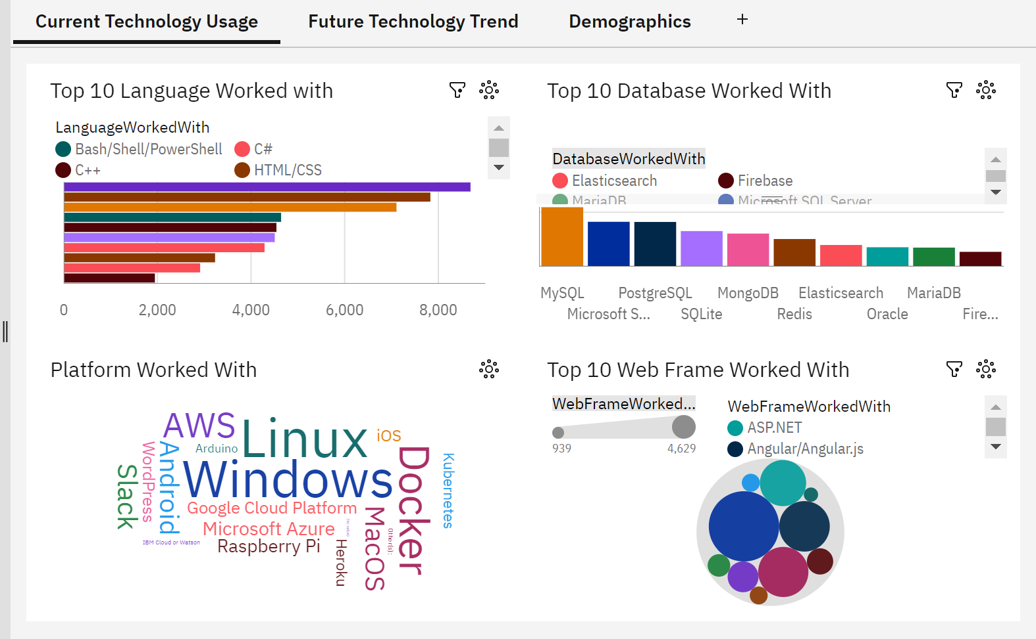
DASHBOARD TAB 1
Screenshot of dashboard tab 1 goes here

Slide 13
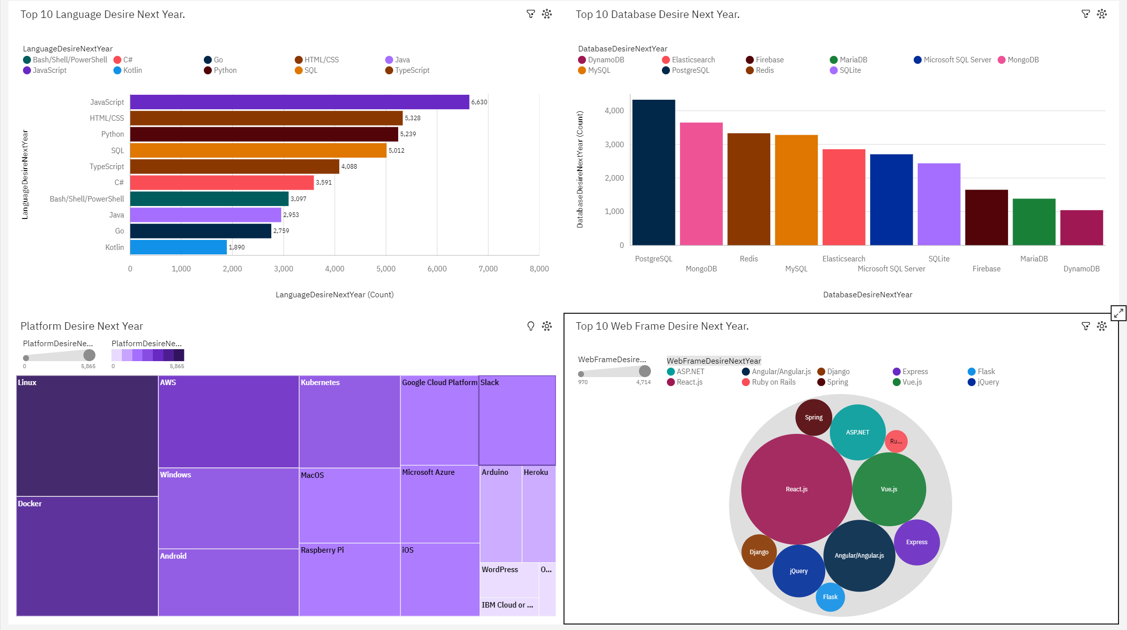
DASHBOARD TAB 2
Screenshot of dashboard tab 2 goes here

Slide 14
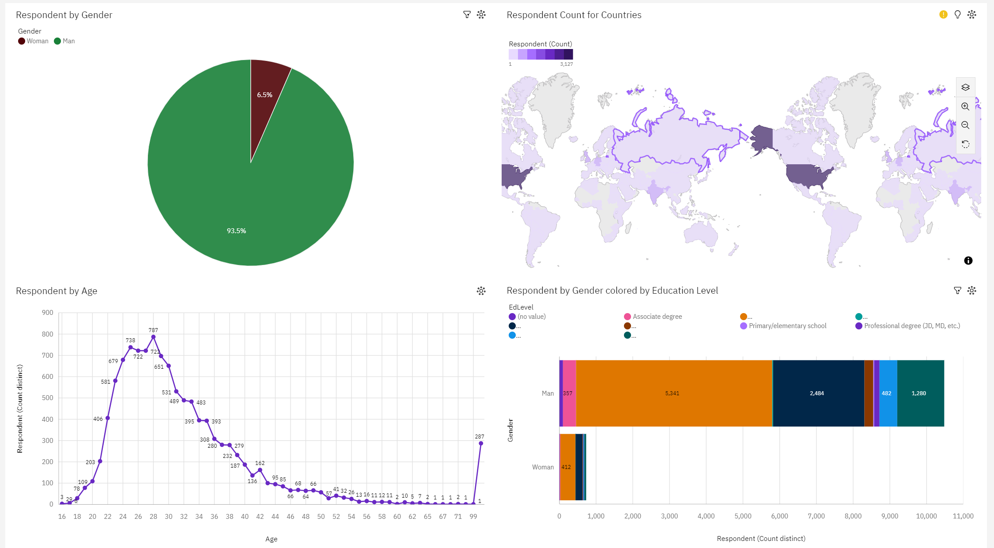
DASHBOARD TAB 3
Screenshot of dashboard tab 3 goes here

Slide 15
DISCUSSION
Dashboards shows top languages, Webframeworks, platforms preferred by most respondents.
There is an increasing popularity for MongoDB and PostgreSQL

Slide 16
OVERALL FINDINGS & IMPLICATIONS
Findings
Javascript is mostly used.
Most desired database is MySQL
United States have more respondents than any other country
Over 90% young male developers.
Implications
Javascript will continue to be popularly used.
Most SQL developers may change to PostgreSQL and MongoDB developer in future.
Majority of respondents have identified as male.
Majority young developers are not post graduates.

Slide 17

CONCLUSION
Javascript is the most preferred language
MySQL is the most preferred database
Majority of the respondents identify as men
PostgreSQL and MongoDB are continuing to become popular.

Slide 18
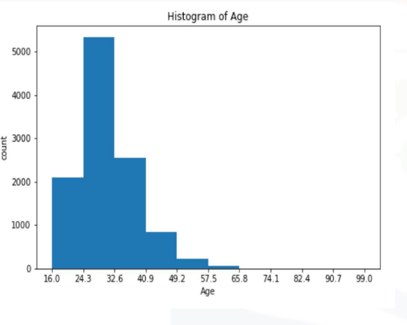

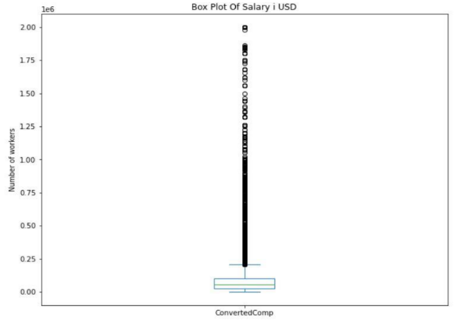
APPENDIX
Include any relevant additional charts, or tables that you may have created during the analysis phase.

Slide 19
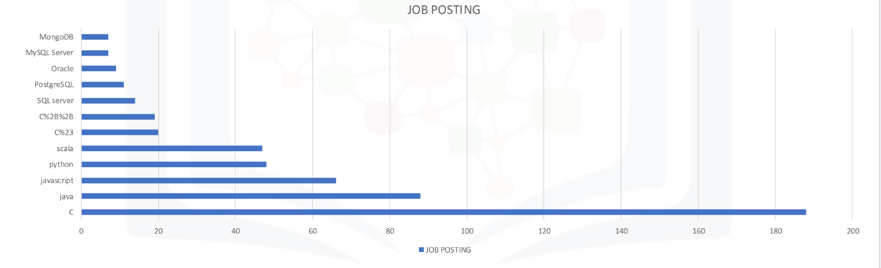
JOB POSTINGS
In Module 1 you have collected the job posting data using Job API in a file named “job-postings.xlsx”. Present that data using a bar chart here. Order the bar chart in the descending order of the number of job postings.

Slide 20
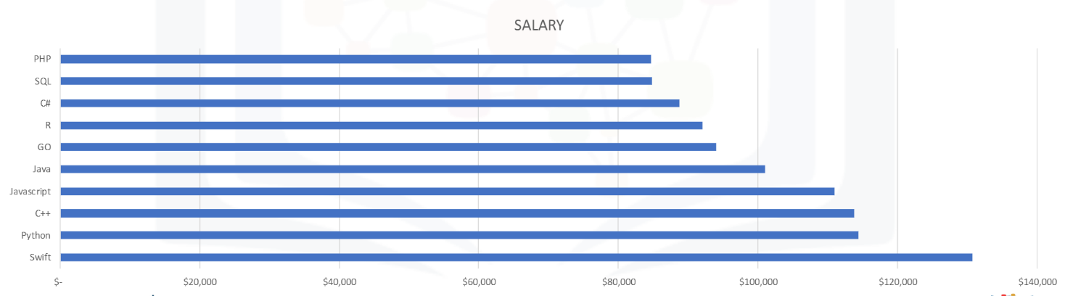
POPULAR LANGUAGES
In Module 1 you have collected the job postings data using web scraping in a file named “popular-languages.csv”. Present that data using a bar chart here. Order the bar chart in the descending order of salary.

