Slide 1

Beacons
by Deeptiman Pattnaik

Slide 2
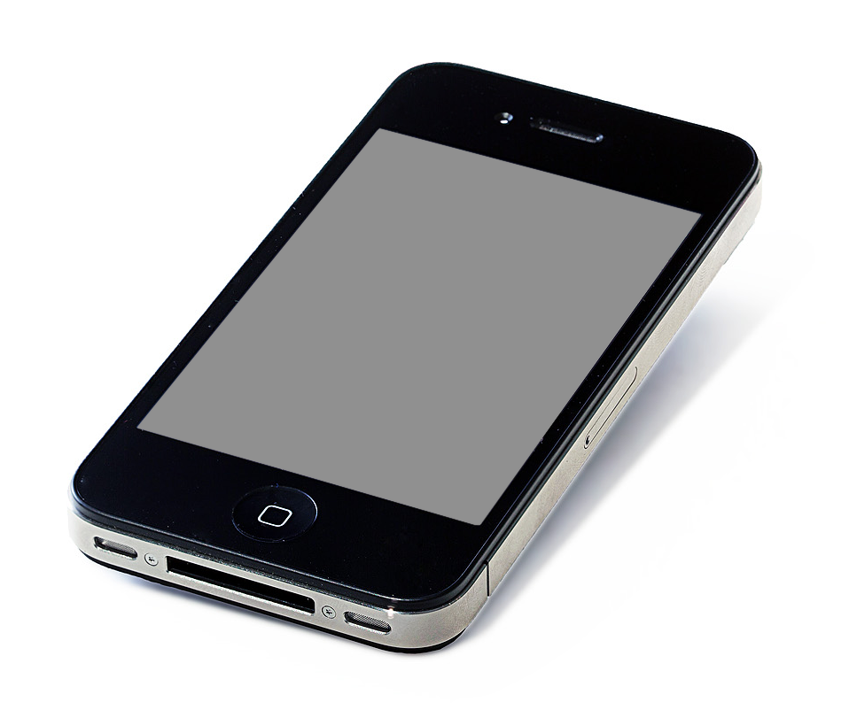
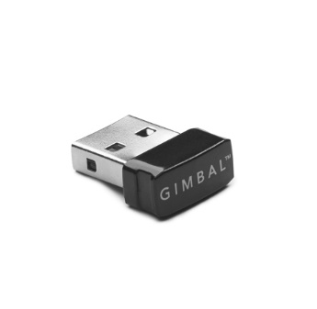
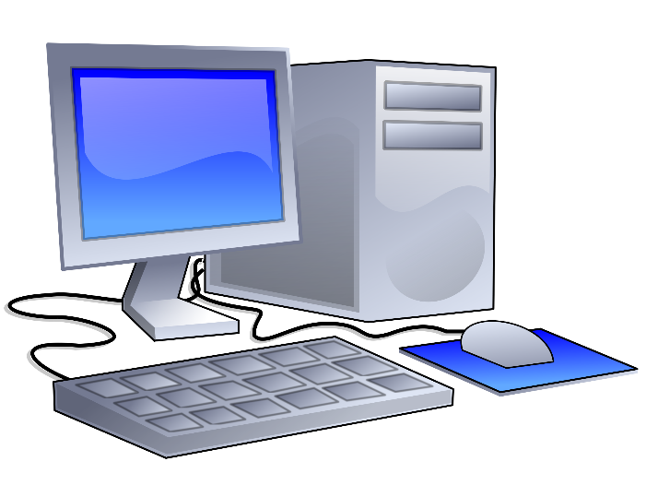
What is a Beacon?
Beacon is a Bluetooth Low Energy signal transmitter used to communicate with any Bluetooth Low Energy devices in the proximity.
Bluetooth Low Energy Devices

Slide 3
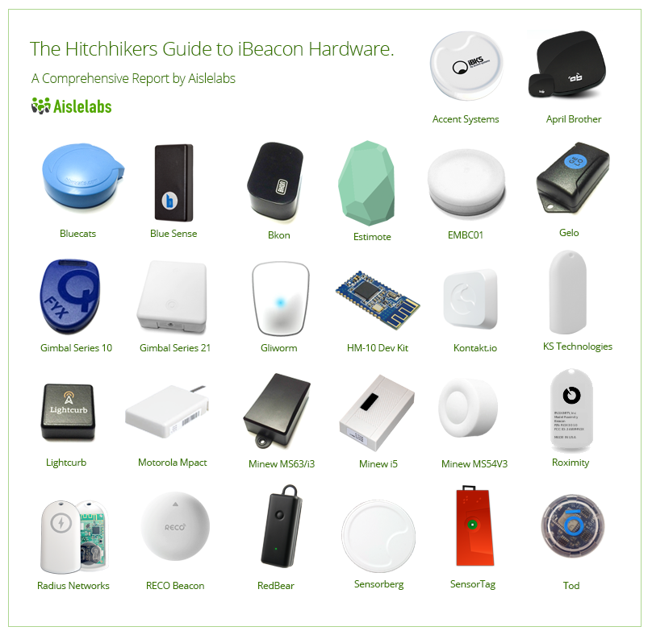

Slide 4
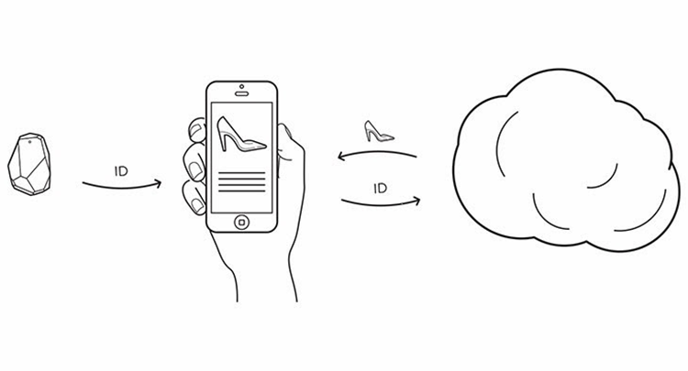
How it works?
It’s simple

Slide 5
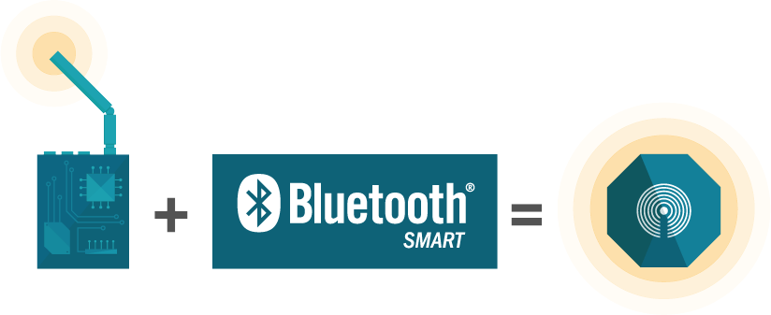
Beacon Technology
Chipset , Battery , Firmware

Slide 6




Chipset
A board with combination of circuits , controllers , processors , switch and many electronic modules to perform a computation task.
Beacon Chipset Vendors

Slide 7
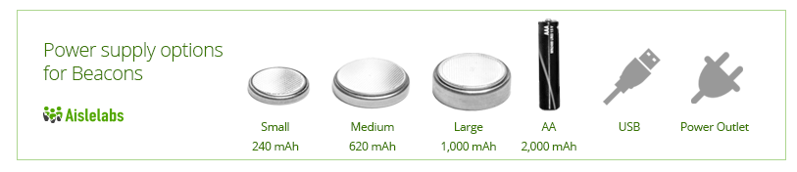
Beacon Battery
Beacons chipset uses Lithium coin cell battery with various power choice.
Beacon also uses Alkaline battery with 2000 mAh power.
USB beacons don’t need battery replacement.

Slide 8
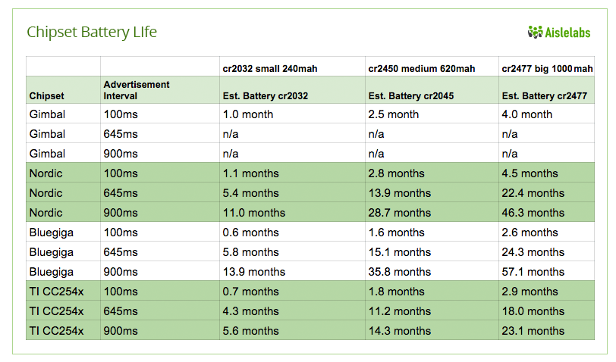
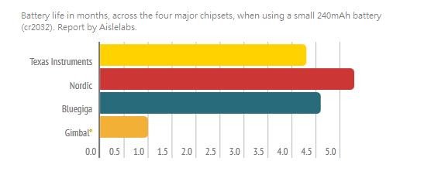

Aislelabs Report

Slide 9
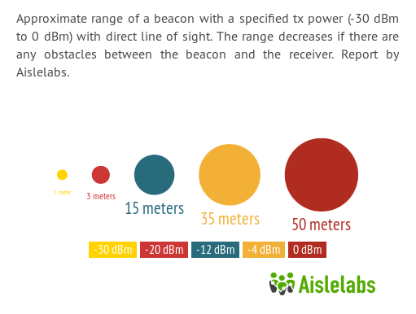
Beacon Firmware
Beacon firmware consists of TX power , Advertising Interval , GATT profile.
Transmit Power
Beacon chipset has signal transmission power.
TX power measures by decibels milliwatt (dBm) unit. 1 mW = 0.001 W.
Higher the TX power , Longer the signal strength.
Lower the TX power , lower battery consumption.
Advertising Interval
The frequency rate at which a beacon transmit signal.
Higher the advertising interval , Higher the battery life.
If advertising interval 100ms means signal emit 10 times a single second.

Slide 10
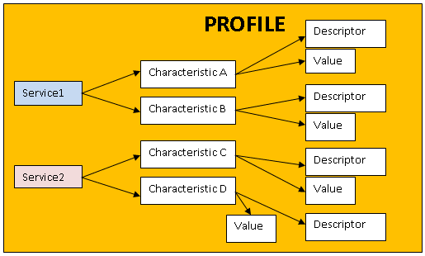
GATT (Generic Attribute Profile )
GATT defines a hierarchical data structure connected to BLE devices.
Example
ALERT_NOTIFICATION_SERVICE
ALERT_LEVEL
ALERT_NOTIFICATION_CONTROL_POINT
ALERT_STATUS

Slide 11
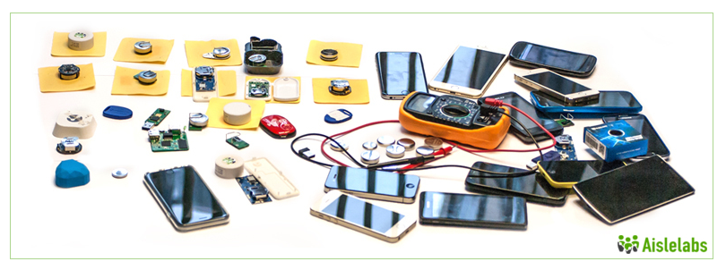
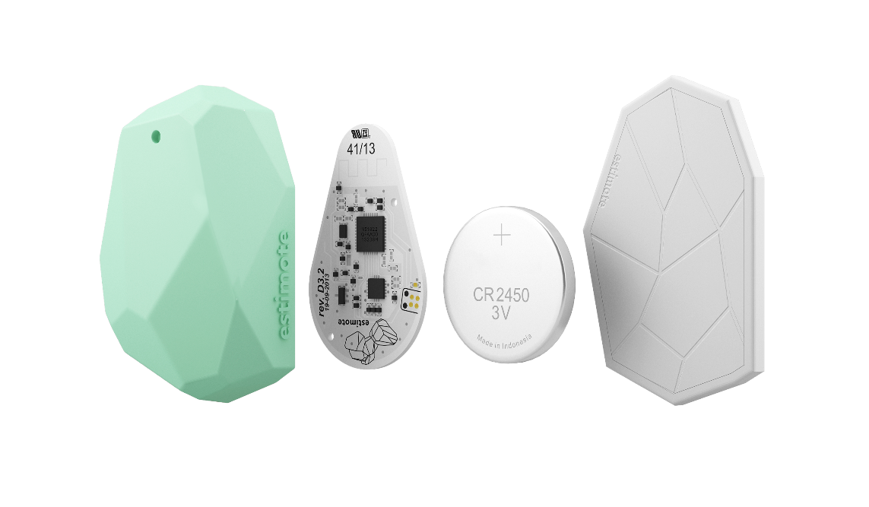
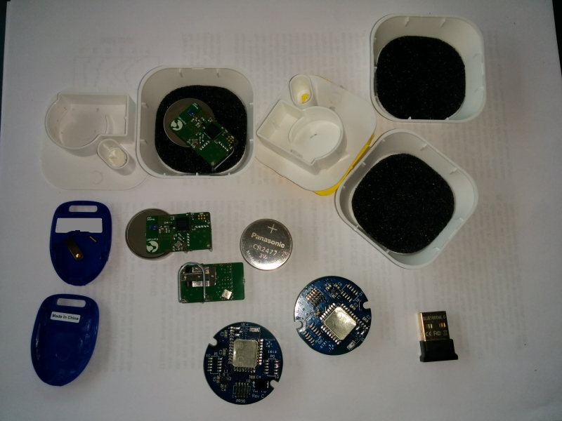
That’s all in Hardware

Slide 12


Beacon Protocol

Slide 13
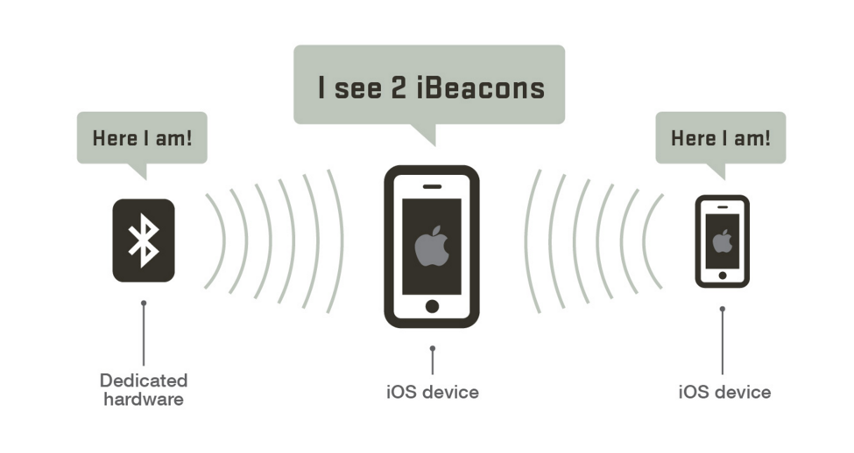
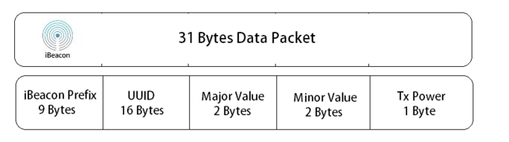
iBeacon introduced by Apple. It works on both iOS and Android platform. It allows app developers to code Beacons apps using the BLE APIs in both the platform.
iBeacon UUID (16 digit string number) with Major (4 digits) and Minor (4 digits).
iBeacon can transmit 31 bytes of data with a rate of 100ms advertising interval.

Slide 14
iBeacon packet format
1A | FF | .. | . . | UUID (16 bytes) | Major | Minor | TX
Manufacturer Specific Data
4C000215585CDE931B0142CC9A1325009BEDC65E000000005
4C00 | 02 | 15 | 585CDE931B0142CC9A1325009BEDC65E | 0000 | 0000 | C5
Apple Company Identifier | 0x004c | -
Data Type | 0x02 | -
Data Length | 0x15 | 21
UUID | 585CDE931B0142CC9A1325009BEDC65E | -
Major | 0000 | -
Minor | 0000 | -
TX Power | 0xC5 | -59

Slide 15

Eddystone standard introduced by Google.
Eddystone has three different format type : Eddystone – URL , Eddystone – UID , Eddystone – TLM.
Eddystone can transmit 31 bytes of data with a rate of 1-2sec advertising interval. So , this format beacons are more battery efficient.
Service UUID
Service Data
03 | 03 | FEAA
… | 16 | FEAA | 00 | TX | Namespace ID (10 bytes) | Instance ID (6 bytes)

Slide 16
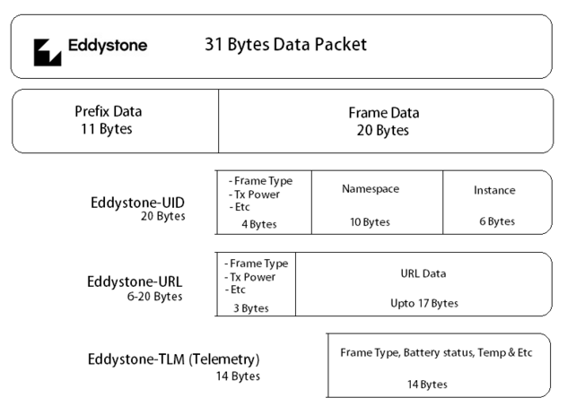
Eddystone packet format
8B0CA750-E7A7-4E14-BD99-095477CB3E77
8B0CA750 | 095477CB3E77

Slide 17
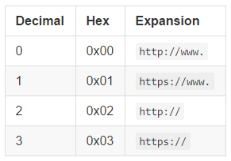
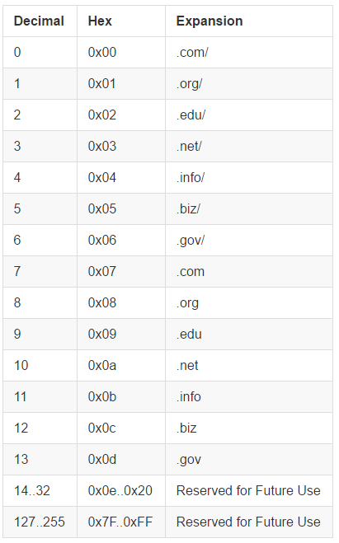
Eddystone URL
It’s a beacon broadcast format that send out URL to smartphone device.
The beacon signal can be read by Chrome browser widget or Physical Web beacon app in iOS and Android.
No need to code separate Beacon app , the URLs can be picked up in notification tab in smartphones.
Eddystone URL standard also knows as Physical Web.
http:// | g | o | o | . | g | l | / | y | I | x | w | E | w
02 | 67 | 6F | 6F | 2E | 67 | 6C | 2F | 79 | 49 | 78 | 77 | 45 | 77
http://goo.gl/yIxwEw

Slide 18
Eddystone TLM (Telemetry)
Eddystone TLM transmit sensor data like battery power , beacon temperature , time since device powered on and number of advertising packet transmit since powered on.
Service UUID
Service Data
03 | 03 | FEAA
.. | 16 | FEAA | 20 | … | BATT | TEMP | ADV_CNT | ELASPED

Slide 19
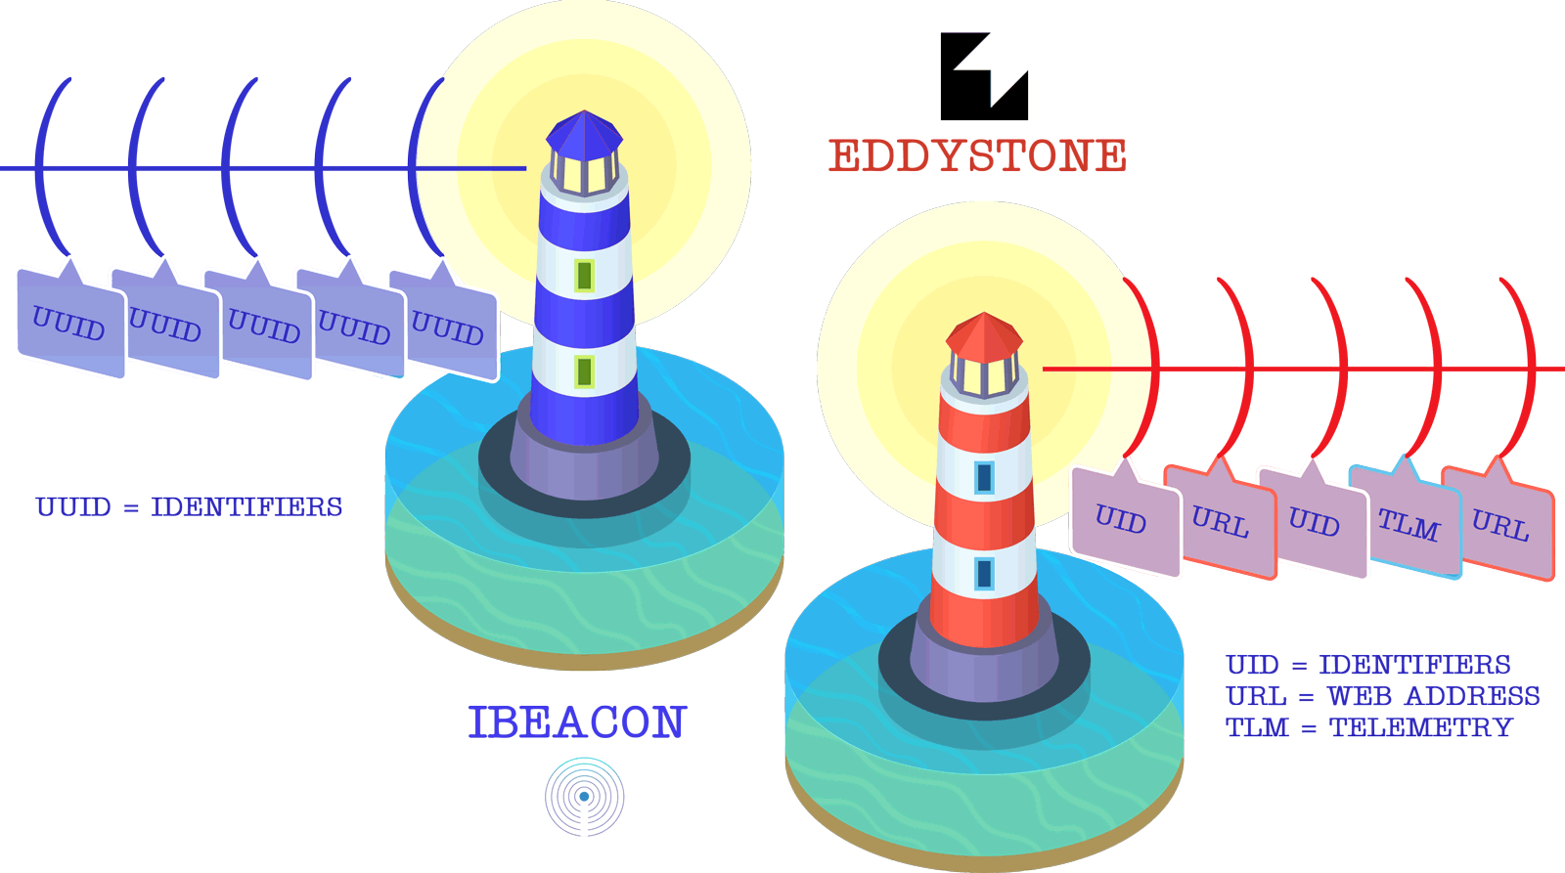

Slide 20
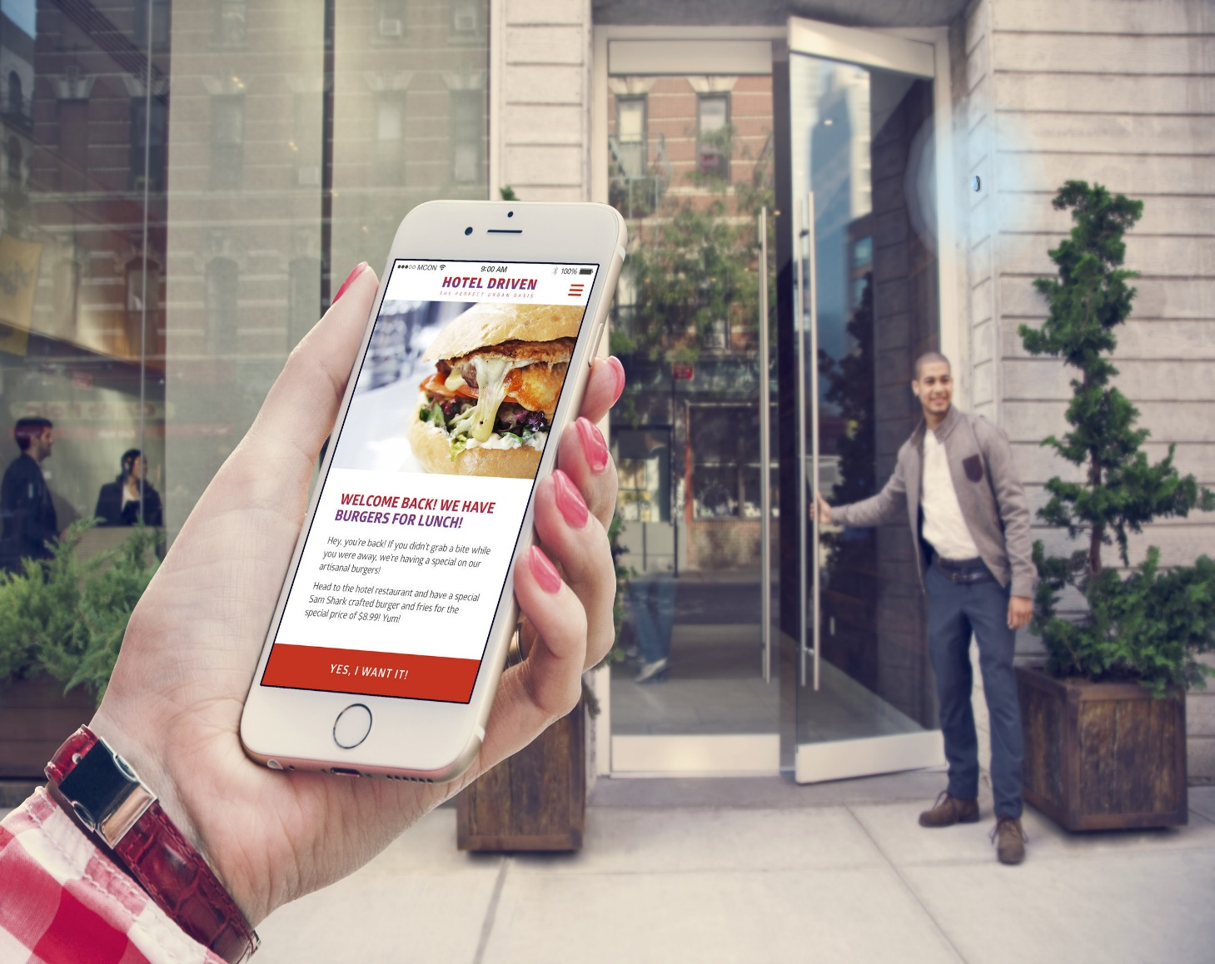
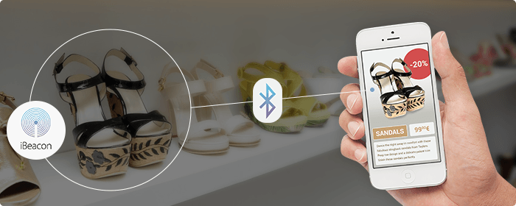
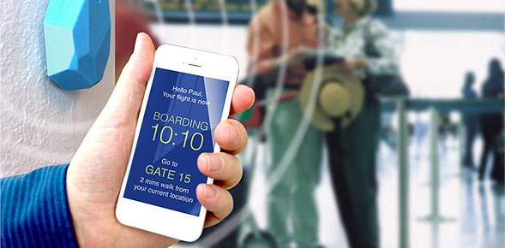
Beacon in use
Beacons used in many real world scenarios like Hotels , Supermarket , Airport , Museum and many more

Slide 21
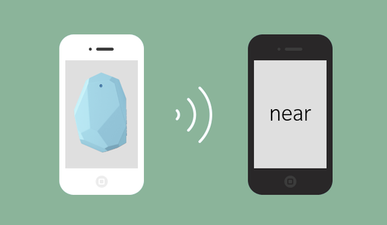
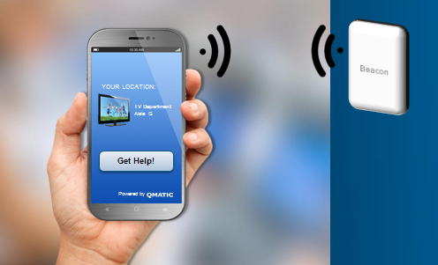
Beacon Demo

Slide 22
Reference
http://www.aislelabs.com/reports/beacon-guide/
https://newcircle.com/s/post/1786/2016/01/04/bluetooth-uuids-and-interoperable-advertisements
http://mindbowser.com/blog/what-is-internet-of-things-and-bluetooth-smart/
https://developer.bluetooth.org/gatt/services/Pages/ServicesHome.aspx?_ga=1.31027256.607688153.1461568231
https://www.youtube.com/watch?v=TZf4WquRGJU
https://www.youtube.com/watch?v=s-4J7cijPAo
http://stackoverflow.com/questions/17870189/android-4-3-bluetooth-low-energy-unstable
http://stackoverflow.com/questions/21398766/android-ble-connection-time-interval
http://stackoverflow.com/questions/27017224/why-the-app-doesnt-reconnect-to-the-ble-device-when-set-autoconnect-to-true-in
http://stackoverflow.com/questions/35903325/android-ble-characteristics-getvalue-returns-null/
http://stackoverflow.com/questions/35937529/how-to-transfer-data-between-two-android-devices-using-beacon
http://stackoverflow.com/questions/36054187/how-many-urls-can-be-written-to-a-physical-web-beacon/

Slide 23
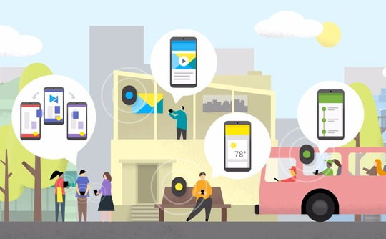
Thank you

