Slide 1
FRAUD DETECTION · BITS PILANI PROJECT
SYNCHRONY
Explainable, self-improving fraud detection for payment transactions
Score in real time → Explain every alert → Learn from analyst review
2023A7PS0591P

Slide 2
THE PROBLEM
Fraud is rare, costly in both directions
Payment fraud is under 1% of transactions, but a fraud system fails two ways at once:
Miss it — money is gone, and it is rarely recovered.
Over-flag it — genuine customers are blocked and analysts drown in false alarms.
Analysts also need to know why a payment was flagged before they act — and the system should get better every time they correct it.
<1%
2
of transactions are fraud
ways to fail
PaySim base rate
miss it, or over-flag it
SYNCHRONY scores, explains, and learns
Real-time decision — approve, review, or block
A plain-language reason for every alert
Learns from every analyst review
SYNCHRONY · 2023A7PS0591P
2

Slide 3
APPROACH
Three signals, one decision
score = 0.80 × XGBoost probability + 0.20 × similarity to past fraud
review at 0.30 or more · block at 0.70 or more · AMOUNT_CAP and LEARNED_FRAUD_PATTERN can force a decision
Rules
XGBoost
Similarity search
Full balance drain, night hours, new receiver + high amount, amount cap. Shown as evidence to analysts; only the amount cap and the learned pattern can force a decision.
Trained on 1.66M PaySim transactions. Produces the fraud probability, and SHAP explains which features drove it.
The 10 nearest past cases in pgvector (exact search). Fraud share becomes the similarity score, and it grows sharper as analysts confirm cases.
Every alert also gets a plain-language explanation (Claude Haiku, guardrail-checked, with a template fallback) and a Confirm fraud / Mark genuine action for the analyst.
SYNCHRONY · 2023A7PS0591P
3

Slide 4
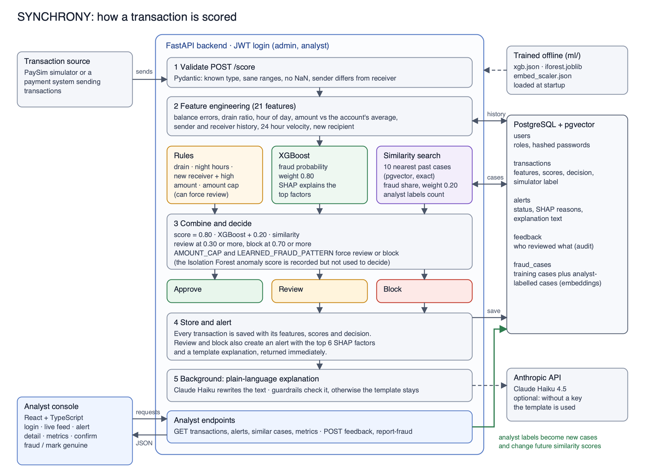
ARCHITECTURE
How a transaction is scored
SYNCHRONY · 2023A7PS0591P
4

Slide 5
RESULTS — OFFLINE MODEL
XGBoost on the held-out PaySim test set
554,082 transactions held out for testing, 4,260 of them fraud. Never seen during training.
99.9%
99.6%
0.9999
precision
recall
PR-AUC
4 false alarms, of 549,822 genuine
19 missed, of 4,260 fraud
near-perfect ranking of risk
Confusion matrix on the test set
 | Predicted genuine | Predicted fraud
Actual genuine | 549,818 | 4
Actual fraud | 19 | 4,241
How the threshold is chosen: every possible cutoff is tried on the validation set, and the one with the best F1 score (the balance of precision and recall) is kept — 0.7778 here — then applied once to this test set. The live app does not use this cutoff directly; it combines the raw probability with similarity before deciding.
SYNCHRONY · 2023A7PS0591P
5

Slide 6
RESULTS — LIVE SYSTEM
The running pipeline, end to end
A simulator replay through the real API: validate → features → score → store → alert → analyst review.
100%
0.10%
97.8%
Decisions
Approve | 95.5%
Review | 0.1%
Block | 4.4%
catch rate
false-positive rate
precision
178 of 178 fraud flagged
4 of 3,897 genuine flagged
178 of 182 flagged were fraud
Read this with care
PaySim is synthetic, and its fraud has a clean signature (the sender's balance goes to exactly zero) that real fraud does not. These numbers show the pipeline works correctly end to end — detection, explanation, storage, human review and learning all connect — not how it would perform on real traffic. 28 analyst-labelled cases so far (25 fraud, 3 genuine), growing with every review.
SYNCHRONY · 2023A7PS0591P
6

Slide 7
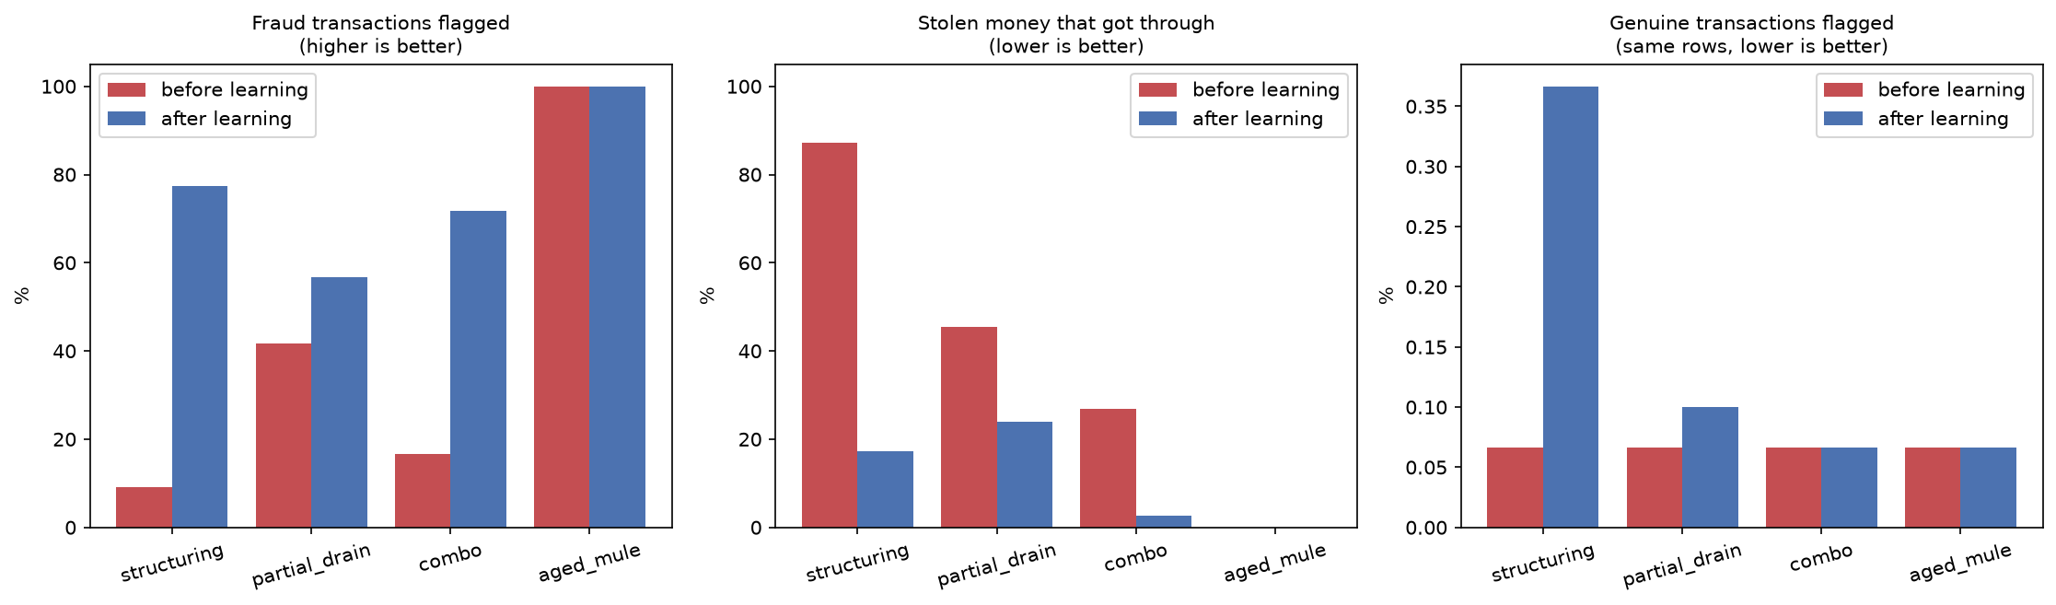
ROBUSTNESS
Red-team: can evasive fraud beat it?
Real held-out fraud rewritten into evasive variants — only what an attacker controls changes. 60 attacks scored, then 20 labelled by analysts, then 60 fresh attacks scored again.
Variant | Flagged before | Flagged after
Structuring | 9% | 77%
Combo | 17% | 72%
Partial drain | 42% | 57%
Groomed mule (control) | 100% | 100%
Structuring (splitting a transfer under the rule threshold) went from 9% to 77% flagged after 20 analyst labels. Partial drains stay the hardest case. Learning costs a few extra reviews on genuine transactions, and clearing false alarms turns the extra flags back off.
SYNCHRONY · 2023A7PS0591P
7

Slide 8
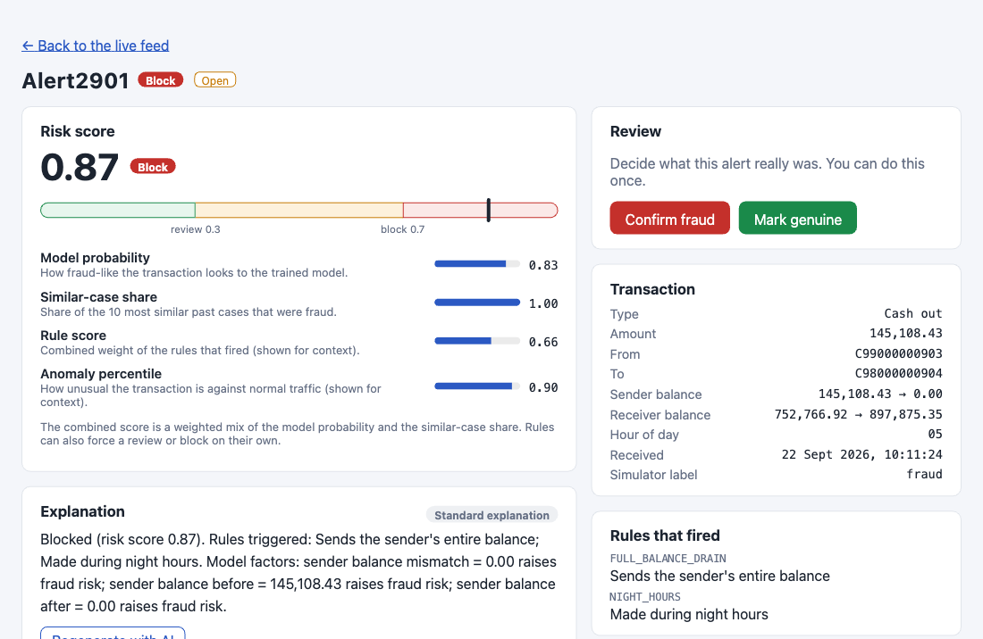
DEMO
A structuring attack, caught live
What this shows
Risk score 0.87 against the review / block thresholds
Model, similarity, rule and anomaly breakdown
One-time Confirm fraud / Mark genuine action
Full transaction detail and the rules that fired
This is alert 2901 — leg 5 of a structuring attack from the red-team script, caught the moment the drain became visible after four smaller legs slipped through as approved. Real screenshot of the running app, not a mockup.
Full video: 3–5 minutes — live stream, fraud caught, explanation, analyst feedback, red-team attack caught.
SYNCHRONY · 2023A7PS0591P
8

Slide 9
RESPONSIBLE AI
Human in the loop, by design
Human in the loop
Fairness & error cost
The system flags; people decide. Uncertain cases default to review, not block. Every verdict is recorded with who and when.
No personal attributes are used, only transaction and account-behaviour features. The metrics page tracks the false-positive rate explicitly.
Explainability
Feedback can be abused
Every alert shows its SHAP factors, the rules that fired, the score breakdown, and the nearest similar past cases.
Mitigated by an audit trail and a 3-case minimum. Role checks are not yet enforced end to end — a known next step.
LLM safeguards
Privacy & known limits
The LLM only rewrites the explanation — it never decides, and sees no account IDs. Guardrail failures fall back to the safe template.
No names or contact details are stored. PaySim is synthetic, so these results are optimistic, and this is a demonstration project.
SYNCHRONY · 2023A7PS0591P
9

Slide 10
DEPLOYMENT PLAN
SYNCHRONY on AWS (pilot scale)
Part | Plan
Frontend | React build on S3, served through CloudFront with ACM TLS and a WAF rate-limiting rule in front.
Backend | FastAPI in a Docker image on ECR, run on ECS Fargate behind an Application Load Balancer, auto-scaled on request count and CPU.
Database | Amazon RDS for PostgreSQL (pgvector extension) in private subnets, Multi-AZ, automated backups and point-in-time recovery.
Secrets & CI/CD | JWT secret, DB credentials and the Anthropic key in Secrets Manager, read via least-privilege IAM task roles. GitHub Actions builds, tests and deploys on every merge.
Observability | CloudWatch Logs and alarms on latency, error rate and queue depth; X-Ray tracing across the API and the LLM call.
A pilot-scale plan: single region, one ECS service, one RDS instance. Multi-region, read replicas and a managed model-serving tier are the natural next step at higher volume.
SYNCHRONY · 2023A7PS0591P
10

Slide 11
SYNCHRONY
Scores in real time. Explains every decision. Learns from every review.
Built on synthetic PaySim data — a proof that the pipeline works end to end, not a claim about real-world fraud rates.
2023A7PS0591P

