Slide 1
SHIPMENT SUCCESS METRICS DASHBOARD DETAILS

Slide 2
Business Understanding & Overview
On-time in-full (OTIF) is a supply chain metric for measuring performance in the logistics industry. OTIF generally refers to a supplier’s ability to deliver product within prescribed delivery windows and at full quantities ordered.
OTIF was designed to improve store operations within Walmart itself and quickly led to a series of major changes as it was quickly adopted by other retailers and companies.
The data about Orders, Salesperson, Customer and City is given.
So, we have to find
The OTIF Performance over Time
The Order delivery status over Time?
the Highest OTIF Performances
Key Influencers

Slide 3
Understanding the data
We need to make a separate column for the status of delivery. Divide that column into three categories of status - In time or Early deliveries, On time deliveries and Late deliveries.
Order date, Scheduled delivery date, Actual delivery date, Salesperson, Team, Customer, Service channel, City- these are important columns. So, we are going to analyze each of them.
Only 0.44% percent of the data in column ‘Actual delivery date’ and ‘City’ is missing. From looking at the data, we can understand that these missing data indicates, 0.44% of the total deliveries are not happened or cancelled.
In column ‘Scheduled delivery date’ only two values are missing. So, drop two rows.

Slide 4
Analysis
Let's do some analysis based on following categories.
Overall analysis
In time or early deliveries
On time deliveries
Late deliveries

Slide 5
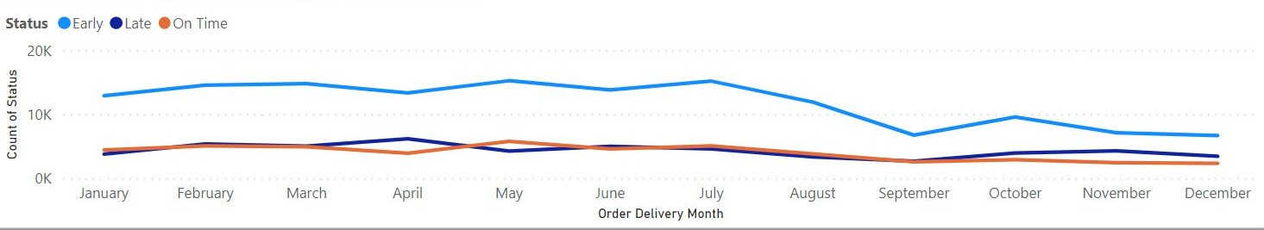
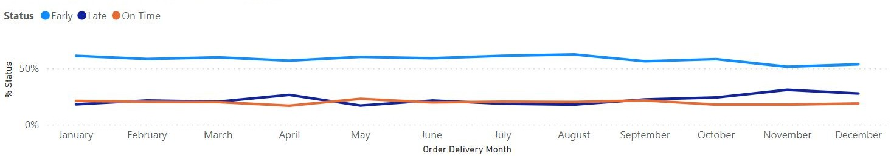
Overall Analysis
1. Months by Total successful deliveries
Findings:
Out of the total successful deliveries, 58.64% deliveries were Early deliveries, 19.84% were On time deliveries and remaining 21.53% were Late deliveries.

Slide 6
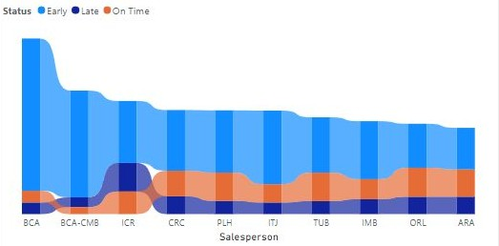
2. Salespersons by Total successful deliveries
Findings:
In figure, we can see top 10 salespersons whose customers received maximum no. of deliveries. Customers of salesperson ‘BCA’ gave highest no of orders (3.88%) followed by ‘BCA-CMA’ and ‘ICR’,
respectively.

Slide 7
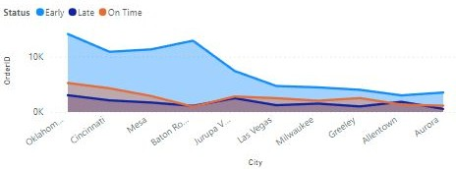
3. City vs Total no. of successful deliveries
Findings:
From figure, we can see top 10 cities according to total no. deliveries. Maximum no. of deliveries happened in Oklahoma city, Cincinnati, Mesa respectively.

Slide 8
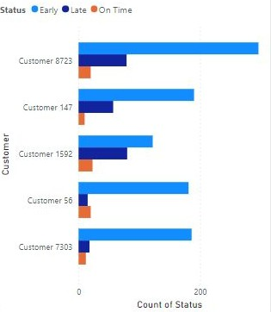
4. Team vs Total no. of successful deliveries
Findings:
Customer 8723 , customer 147,
customer 1592, customer 56 and
customer 7303 received maximum no. of deliveries so we can say that they are repetitive customers.

Slide 9
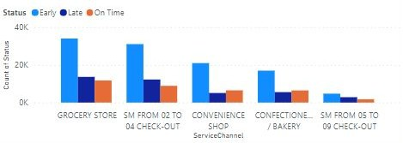
5. Service channel vs Total no. of successful deliveries
Findings:
Maximum no. of orders came from grocery store, SM From 02 to 04 check-out, convenience shop, confectionery/bakery respectively.

Slide 10
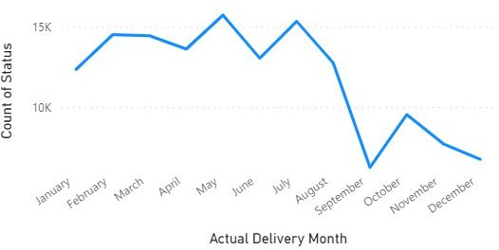
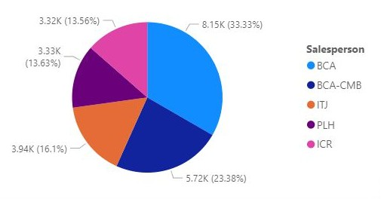
In time or Early deliveries
1. Month vs Early deliveries 2. Salesperson vs Early deliveries
Findings:
Maximum no. of Early deliveries happened in May, August and February respectively.
Customers of salespersons ‘BCA’, ‘BCA-CMA’ and ‘ITJ’ received maximum no. of Early deliveries.

Slide 11
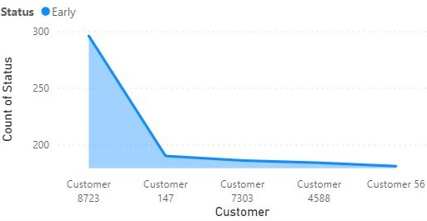
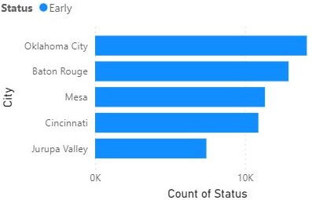
3. Customers by Early deliveries
4 Cities by Early deliveries
Findings:
Customer 8723 received maximum no. of Early deliveries.
Maximum no. of Early deliveries happened in Oklahoma city, Baton Rouge, Mesa and Cincinnati respectively.

Slide 12
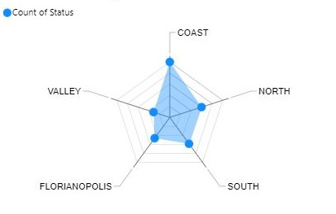
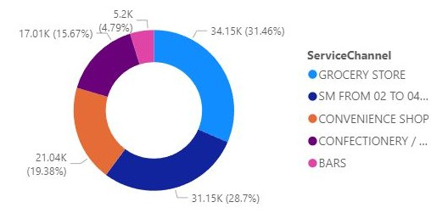
5. Teams by Early deliveries
6. Service channel by Early deliveries
Findings:
Orders from Team's-Coast, North, South received maximum no. of Early deliveries.
Service channels-Grocery store, Sm from 02 to 04 check out and Convenience shop received maximum no. of Early orders respectively.

Slide 13
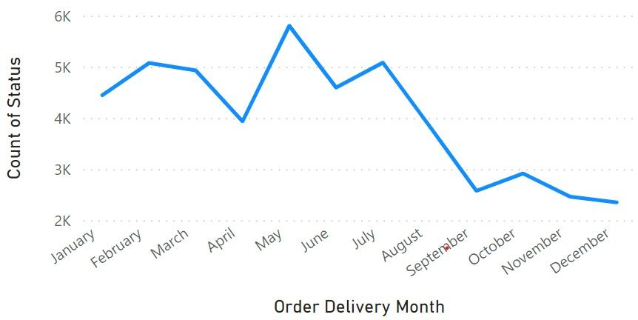
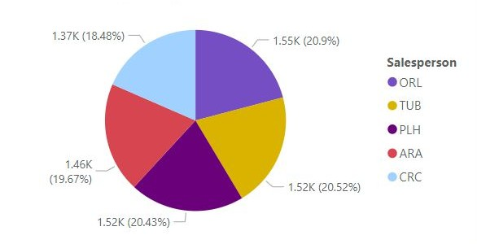
On time Deliveries
1. Month by On time deliveries
2. Salespersons by On time deliveries
Findings:
Maximum no. of On time deliveries happened in May, July, February respectively.
Customers of salespersons ORL, TUB and PLH received maximum no of On time deliveries.

Slide 14
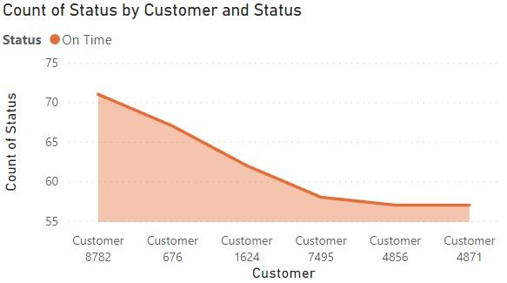
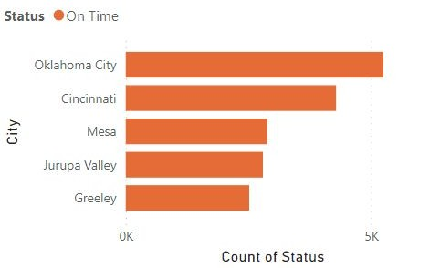
3. Customers by On time deliveries
4. Cities by On time deliveries
Findings:
Customer 8782, Customer 676 and Customer 1624 received maximum no. of On time deliveries.
Maximum no. of On time deliveries happened in Oklahoma city and Cincinnati respectively.

Slide 15
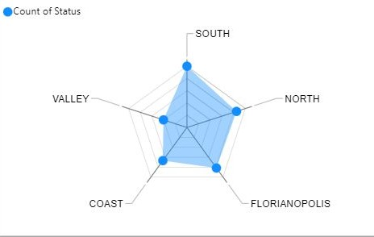
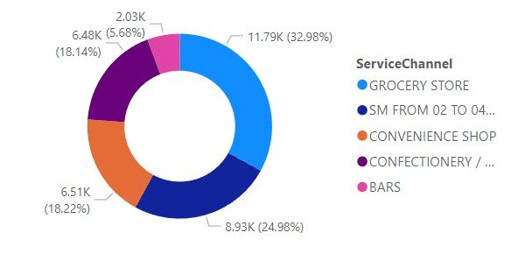
5. Teams by On time deliveries
6. Service channel by On time deliveries
Findings:
Orders from Team's- South, North and Florianopolis received maximum no of On time deliveries.
Service channels-Grocery store, Sm from 02 to 04 check out and Convenience shop received maximum no. of On time orders.

Slide 16
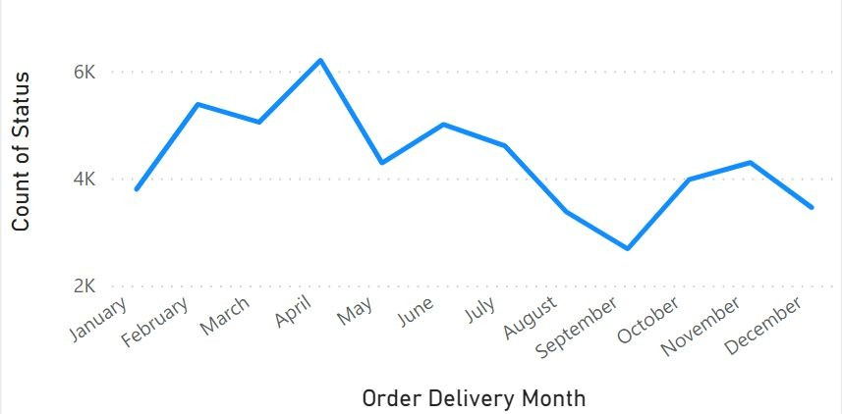
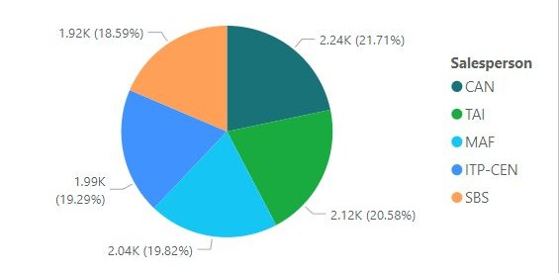
Late deliveries
1. Month by Late deliveries
2. Salespersons by Late deliveries
Findings:
Maximum no. of Late deliveries happened in April, February and March respectively.
Customers of salespersons CAN, TAI and MAF received maximum no of Late deliveries.

Slide 17
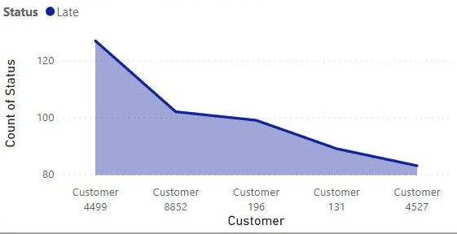
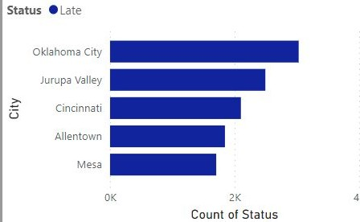
3. Customers by Late deliveries
4. Cities by Late deliveries
Findings:
Customer 4499, Customer 8852 and Customer 196 received maximum no. of Late deliveries.
Maximum no. of Late deliveries happened in Oklahoma city, Jurupa valley and Cincinnati respectively.

Slide 18
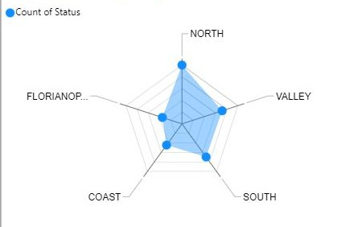
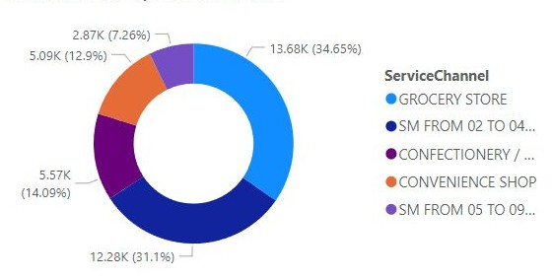
5. Teams by Late deliveries
6. Service channel by Late deliveries
Findings:
Orders from Team's- North, Valley and South received maximum no of Late deliveries.
Service channels-Grocery store and Sm from 02 to 04 check out received maximum no. of Late orders.

Slide 19
Final Thoughts
Characters related to | Max. Early deliveries | Max. On time Deliveries | Max. Late Deliveries
Months | May, July, March | May, July, February | April, February, March
Salespersons | BCA, BCA-CMD, ITJ | ORL, TUB, PLH | CAN, TAI, MAF
Customers | Customer 8723 | Customers-8782, 676, 1624 | Customers-4499, 8852, 196
Cities | Oklahoma city, Baton Rouge | Oklahoma city, Cincinnati | Oklahoma city, Jurupa valley
Teams | Coast, North, South | South, North, Florianopolis | North, Valley, South
Service channels | Grocery store, SM from 02 to 04 check out | Grocery store, SM from 02 to 04 check out | Grocery store, SM from 02 to 04 check out

Slide 20
THANK YOU
………………………………………………………………………………………………

