Slide 1

WIPRO NGA Program – 25SUB5332_DWS_Batch_7
Capstone Project Presentation – 12th March & 13th March 2026
Project Title - Dependency Chain Deployment for Multi‑App Stack using SCCM
Presented by – LOGADEEPAK PADMANABAN
www.rpsconsulting.in

Slide 2

Project Overview
Objective:
Demonstrate Dependency‑Chain Deployment using Microsoft Configuration Manager (SCCM).
Problem Statement:
Many enterprise applications require runtime components such as .NET Runtime or Visual C++ Redistributable before installation.
If these prerequisites are missing, application installation may fail.
Solution:
Use SCCM dependency groups to automatically install required runtime components before deploying the main application.

Slide 3
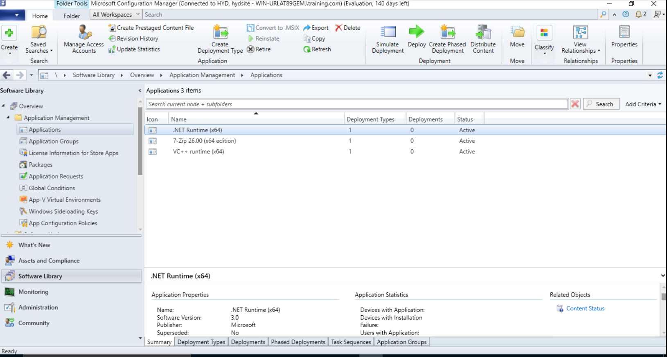
Implementation Steps
Step 1: Created dependency applications
.NET Runtime (x64)
VC++ Runtime (x64)
Step 2: Created main application
7‑Zip (MSI package)

Slide 4
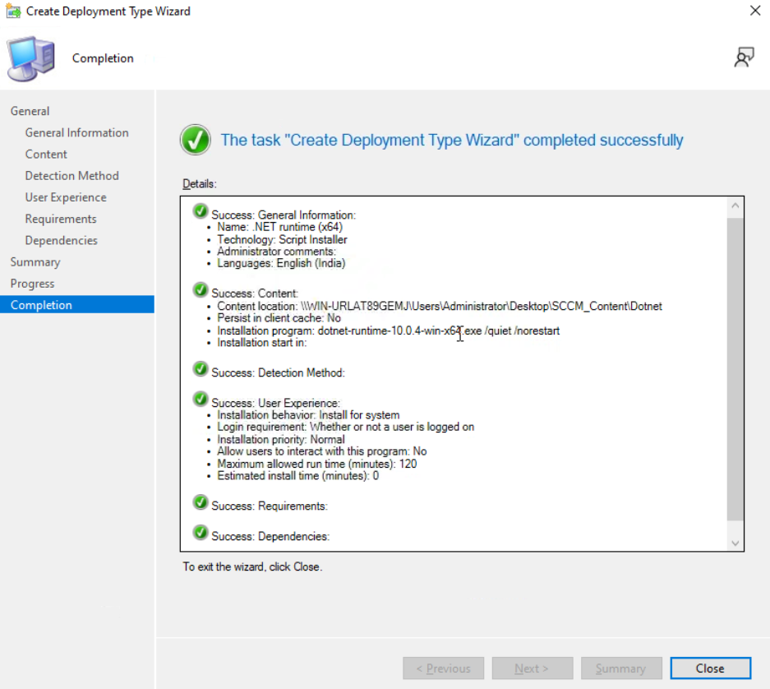
Step 3: Configured Dependency Group
Added .NET Runtime and VC++ Runtime as prerequisites for 7‑Zip

Slide 5
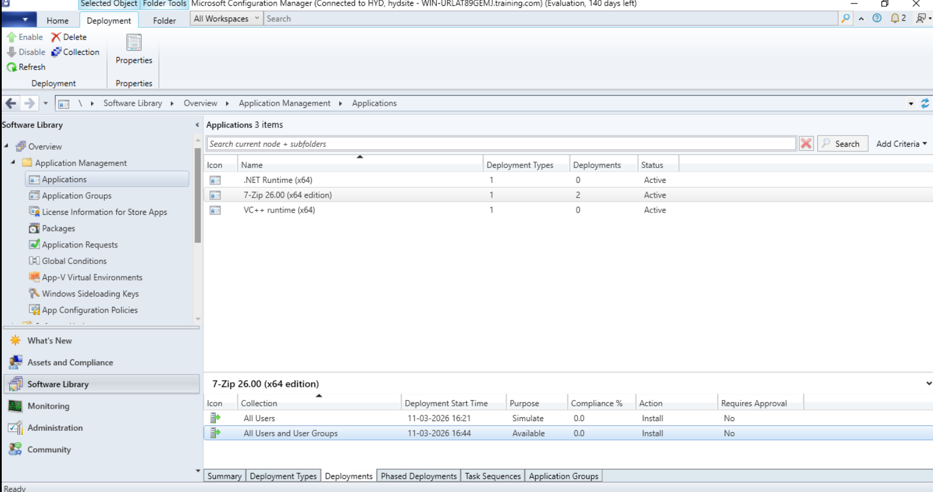
Step 4: Deployment Testing
Simulated deployment to validate dependency logic
Created Available deployment for user installation

Slide 6
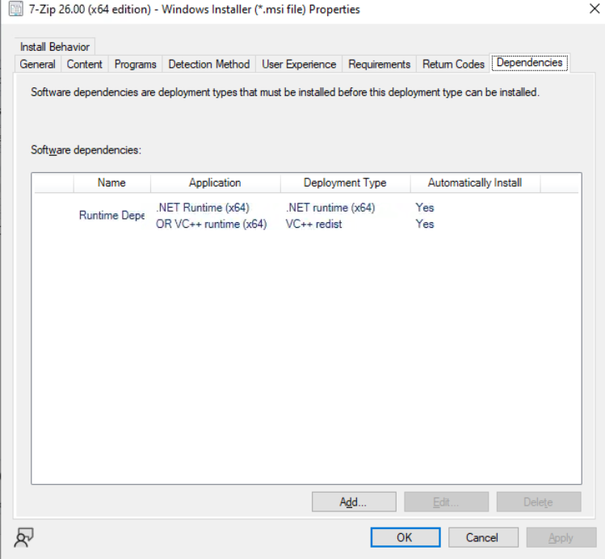
Deployment Flow (Dependency Chain)
Client Machine Request
↓
Check .NET Runtime
↓
Check VC++ Runtime
↓
Install Missing Dependencies
↓
Install Main Application (7‑Zip)
Result:
SCCM ensures all prerequisites are satisfied before installing the main application.

Slide 7
Conclusion
This project demonstrates how SCCM manages application dependencies using the Application Model.
Key Learnings:
Understanding SCCM Application and Deployment Types
Configuring dependency groups for prerequisite software
Using Simulate Deployment to validate deployment logic
Benefit:
Ensures reliable and automated software deployment in enterprise environments.

