Slide 1
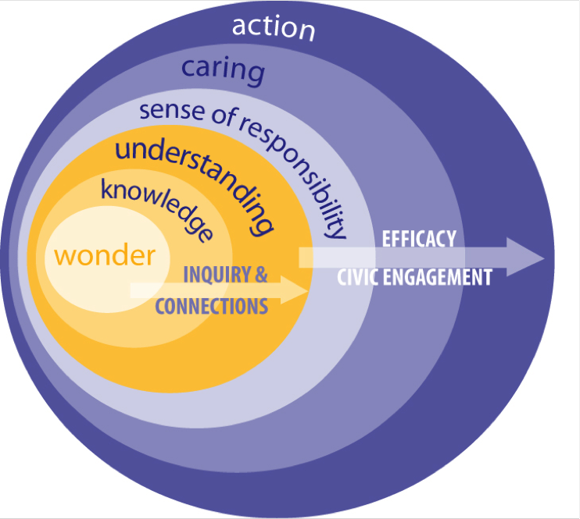
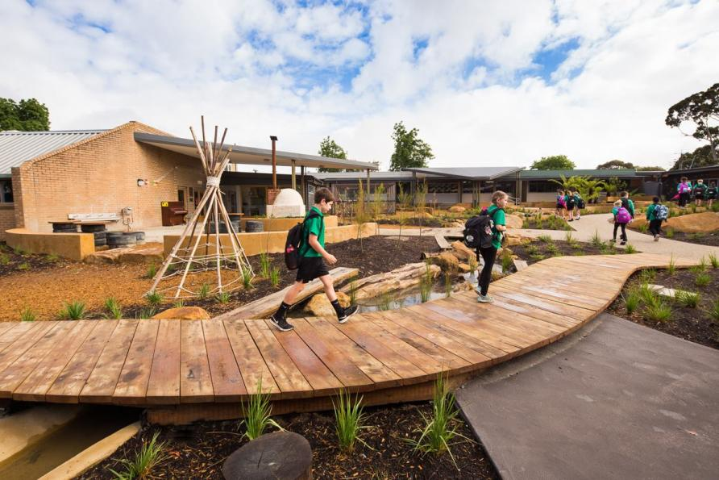

WORKING TOWARDS THE SUSTAINABLE TRANSFORMATION OF EDUCATION SYSTEMS LINKED WITH TECH-TRAD METHODS
Deepu Kumar
TY - B.Sc Environmental Science
(514026)

Slide 2
Introduction
Ideas enhanced from the individual departments & specific facilities in rural areas of schools with respects to their subjects code to create amazing surrounding to enhance learning.
Education for Sustainable Development means including key sustainable development issues into teaching and learning by new technique with vision in urban region.
Education for sustainability develops the knowledge, skills, values and world-views necessary for people to act in ways that contribute to more sustainable patterns of living.
It enables individuals and communities to reflect on ways of engaging with the world.

Slide 3
Review of Literature
Title | Author | Descriptions | Year
Issues and trends in Education for Sustainable Development | A. Leicht, J. Heiss and W. J. Byun | Conventional education and training knowledge transfer and skills development but level of the whole institution | 2018
Environmental Education and Education for Sustainability Projects: Inspiring and Facilitating Implementation | Ashley Williams | The research skills they need change for the environment and environmental project based learning projects | 2010
Environmental Education and Sustainable Development: A Further Appraisal | Lucie Sauvé, Université du Québec à Montréal | Ultimate goal of the Man-environment relationship - the whole educational process reshaped for sustainable development | 1996
Gaps in sustainability education: The impact of higher education coursework on perceptions of sustainability | P. Brian Fisher Erin McAdams | Systems-level lead to unsustainability demand new approaches to teaching and learning | 2015
Sustainable Management of Digital Transformation in Higher Education: Global Research Trends | Emilio Abad-Segura, Mariana-Daniela González-Zamar, Juan C. Infante-Moro and Germán Ruipérez García | Human society and behavior multidisciplinary global vision of environmental sciences. It implications and scope of interest for the international scientific community. | 2020

Slide 4
Research Gap
Traditional environmental concerns of ecosystems and nature, and human relationships to environment.
Growing interests in building and energy efficiency, including waste minimization.
Community and participation as a form of sustaining well-being and prosperity.
Systemic change and innovation as a form of macro-transformation of interconnected systems with technologies.

Slide 5
Aim
Objectives
Will Education system be transformable in the manners of Sustainability connecting with traditional & Modern education system?
To improve the quality of education by Targeting fourth of the SDGs
Method for achieving attendances in institutional areas and bringing curiosity in students.

Slide 6
Methodology
Aim of studying and analyzing scientific activity.
A quantitative analysis has been performed, it has contributed to the review of scientific knowledge in different fields.
The methodology followed was to perform by a survey methods to complete search in the database.
Feedback from the communities for ideas in improvements.

Slide 7
Significance
Help in learning in environments bring interest.
Improvement in attendance in the Institutions.
Conjugate new educational background pattern to traditional time periods education
To enhance the knowledge on education patterns variation with time to time, to avoid lack of interests of students reason for absences in institutions, bringing some practical knowledge.
Practice with technologies in traditional manners.

Slide 8
References
Abad-Segura, E., González-Zamar, M. D., Infante-Moro, J. C., & García, G. R. (2020). Sustainable management of digital transformation in higher education: Global research trends. Sustainability (Switzerland), 12(5).
Brian Fisher, P., & McAdams, E. (2015). Gaps in sustainability education: The impact of higher education coursework on perceptions of sustainability. International Journal of Sustainability in Higher Education, 16(4), 407–423.
Sauvé, L. (1996). Environmental Education and Sustainable Development: A Further Appraisal. Canadian Journal of Environmental Education (CJEE), 1(Spring), 7–34.
UNESCO. (2018). Issues and Trends in Education for Sustainable Development. In UNESCO Publishing.
Williams, A. (2010). Environmental Education and Education for Sustainability Projects: Inspiring and Facilitating Implementation.

Slide 9
Thanking You

