Slide 1
UML & Software Modeling

Slide 2
Reference Materials
Text:
    Craig Larman，Applying UML and Patterns: An Introduction to Object-Oriented Analysis and Design（3rd), Prentice Hall,2004
    UML Distilled: A Brief Guide to the Standard Object Modeling Language (3rd Edition) , Addison-Wesley Professional,2003
Reference Book:
  Dennis A, Wixom B, and Tegarden D (2005) ,System Analysis and Design with UML version 2 ,second edition, Wiley
  Bennett, S., McRobb, S. and Farmer, R. (2002) Object-Oriented Systems Analysis and Design using UML, 2nd Edition, McGraw-Hill

Slide 3
Chapter 1 : Object Oriented Analysis and Design
1.1 The UML, Patterns, and Object-Oriented Analysis and Design
These are the essential skills for the creation of well-designed, robust and maintainable software systems using object technology:
  It is not enough to know an object-oriented programming languages (C++, Java, C#, Smalltalk) or know how to use an OO CASE tool;
  Knowing how to “think in objects” is critical.
UML : Unified Modeling Language. A very large set of notations (mostly diagrammatic):
  Useful for expressing and discussing OOA and D decisions.
OOD is mostly about assigning responsibilities to classes:
  How should objects interact? What classes should do what?

Slide 4
We will use case studies to illustrate how to apply the UML and patterns during OOA and D activities within an agile approach to the Unified Process.
Requirements analysis will be started using use cases:
  Trying to discover what it is that we must develop.
There are many potential SE activities from requirements through to implementation : notion of development process.
  We will see an agile (light, flexible) version of the Unified Process (UP) : an iterative development process.
  See Fig 1.1 for range of topics and skills covered.

Slide 5
OOA & D
OO Patterns
UML notation
Topics and Skills
Principles and
Requirements
guidelines
analysis
Iterative
development with
an agile Unified
Process
Fig 1.1 Topics and Skills Covered

Slide 6
1.2 Assigning Responsibilities
A most important ability in object-oriented analysis and design is to skilfully assign responsibilities to software objects.
  This is really the link between describing what we want and how it will be concretised.
  Given a responsibility (e.g. which class will be handle player’s personal information?) many choices will be available: not all lead to a good overall design; while many choices are very small, there can be hundreds of them : skilful responsibility assignment leads to better design.
  Larman identifies 9 fundamental OOD patterns (GRASP : General Responsibility Assignment Software Patterns or Principles).

Slide 7
1.3 What is Analysis and Design?
Analysis emphasises an investigation of the problem rather than how a solution is to be built:
  “Do the right thing”
Design emphasises a logical solution, how the system fulfils the requirements:
  Low level implementation details are overlooked.
  Designs can be implemented in software and hardware.
  “Do the thing right”
Notes:
What is the difference between OO analysis and OO design?
What is common between OO analysis and OO design?

Slide 8
1.4 What is Object-Oriented Analysis and Design?
In essence, to consider a problem domain and logical solution from the perspective of objects (things, concepts, or entities).
OOA: emphasis on finding and describing the objects-or concepts-in the problem domain.
OOD: emphasis on defining logical software objects and how they should collaborate (via method calls or course) to fulfil the requirements.
OOProgramming: commitment to code.
E.g. a flight information system:
  OOA : concepts identification : Plane, Flight, Pilot etc;
  OOD : responsibilities assignment : a Plane object must have at tailNumber attribute and a getFlightHistory method;
  OOP : coding : a.g. a Plane class in Java.
See. Fig. 1.2

Slide 9

Plane
2
visualization of
1
domain concept
tailNumber
domain concept
3
representation in an
public class Plane
{
object
-
oriented
private String tailNumber
;
programming language
public List getFlightHistory
()
{
...
}
}
Fig 1.2 Object-orientation revolves around objects.

Slide 10
1.5 An Analogy : Organising Chaos
An example of business re-engineering.
1.5.1 Growing Fast ...
Imagine, a fast growing software start-up company.
Everyone shares the work; Many new employees join….
1.5.2 What are the Business Process?
What the business must do?
  Making sales, paying employees and creditors, developing software
This is similar to requirements analysis within OOA.
Use cases are textual narrative descriptions of the processes in an enterprise or system:
  Use Case: Place an Order
  Description: This use case begins when a customer phones a sales representative to request a purchase. The sales representative records the customer and product information in a new order.

Slide 11
1.5.3 What are the Roles in the Organisation?
Identify the roles of people who will be involved in the processes: customer, sales representative, software engineer and so on.
Similar to to domain modelling within OOA.
A domain model illustrates the different categories of things in the domain (not just the roles of people, but all things of interest)

Slide 12
1.5.4 Who does What? How do they Collaborate?
How to fulfil the processes : a design (I.e. solution oriented) activity.
Define the responsibilities of employees to complete the tasks needed to fulfil a process.
Also need to define how people will collaborate or share work.
This is similar to OOD with a responsibility assignment emphasis.
Responsibility assignment means to allocate tasks and responsibilities to the various software objects in the application.
Design class diagrams and collaboration diagrams show the definition of classes and the flow of messages between software objects.

Slide 13
1.6 An Example of Object-Oriented Analysis and Design
A dice(骰子) game: a player rolls two dice, if the total is seven he/she wins; otherwise he/she loses.
1.6.1 Defining Use Cases
Understanding the requirements includes understanding the domain processes and the external environment (external actors who participate in processes).
  Use Case: Play a Game
  Actors: Player
  Description: Player requests to roll the dice. System presents results. If the dice face value totals seven, player wins; otherwise player loses.
1.6.2 Defining a Domain Model
A decomposition of the problem domain involves an identification of the concepts, attributes and associations in the domain that are considered important.

Slide 14
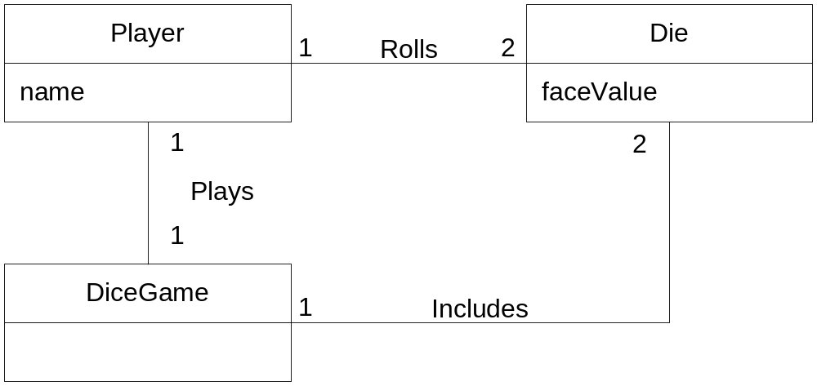
Example of a conceptual model Fig 1.3:
The conceptual model is not a description of software components; it represents concepts in the real-world problem domain.
Fig 1.3 Partial domain model of the dice game.

Slide 15
1.6.3 Defining Interaction Diagrams
An essential step in OOD is the allocation of responsibilities to objects and illustrating how they interact via messages, expressed in sequence diagrams.
Sequence diagrams show the flow of messages between instances and the invocation of methods.
E.g. a simulation in software of the dice game
Fig 1.4 illustrates the essential step of playing by sending messages to instances of the Die class.
Note that although in the real world a player rolls the dice, in the software design the DiceGame object rolls the dice (that is sends messages to the Die objects): software object designs and programs do take some inspiration from real-world domains, but they are not direct models or simulations of the real world (Do you see the subtlety?)

Slide 16
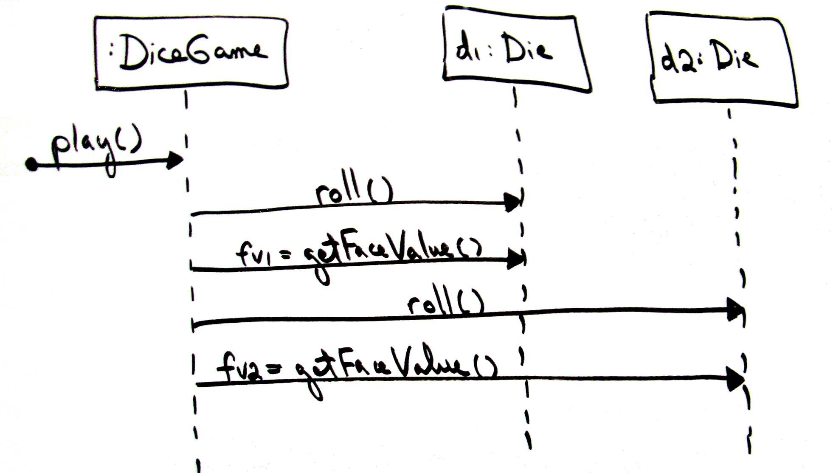
Fig 1.4 Sketched sequence diagram
1.6.4 Defining Design Class Diagrams
How do objects connect to other objects?
What are the methods of a class?

Slide 17
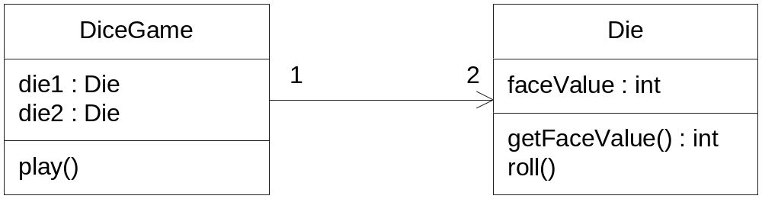
Inspect the sequence diagrams (dynamic view) which suggests the necessary connections between objects and the methods that each software class must define : a design class diagram (a static view).
Since a play message is sent to the DiceGame instance, the DiceGame class requires a play method, while the Die class requires a roll and getFaceValue method. See Fig 1.5.
Design class diagrams describes software components.
Fig 1.5 Partial design class diagram

Slide 18
1.6.5 Summary of the Dice Game Example
A very simple example : gives an overview of the steps and artefacts in OOA&D.
1.7 Object Versus Function-Oriented Analysis and Design
Prior to OOA&D structured analysis and design was popular : decomposition of a problem by function or process resulting in a hierarchical breakdown of processes rather than by objects.
OOA&D : emphasis on decomposing a problem space by objects rather than functions.
The concepts of object is transcendental during in an OO software development process (What does this mean?)
The boundary between OO analysis and OO design is fuzzy (even more so than in traditional SE):
  Difference between investigation (analysis) and solution (design).
  During analysis we emphasise understanding the problem while deferring issues related to the solution, performance, and so on.

Slide 19
What is the UML?
“The Unified Modeling Language is a family of graphical notations, backed by a single meta-model, that help in describing and designing software systems, particularly software systems built using the object-oriented style.”
UML first appeared in 1997
UML is standardized. Its content is controlled by the Object Management Group (OMG), a consortium of companies.

Slide 20
What is the UML?
Unified
  UML combined the best from object-oriented software modeling methodologies that were in existence during the early 1990’s.
  Grady Booch, James Rumbaugh, and Ivor Jacobson are the primary contributors to UML.

Slide 21
What is the UML?
Modeling
  Used to present a simplified view of reality in order to facilitate the design and implementation of object-oriented software systems.
  All creative disciplines use some form of modeling as part of the creative process.
  UML is a language for documenting design
  Provides a record of what has been built.
  Useful for bringing new programmers up to speed.

Slide 22
What is the UML?
Language
  UML is primarily a graphical language that follows a precise syntax.
  UML 2 is the most recent version
  UML is standardized. Its content is controlled by the Object Management Group (OMG), a consortium of companies.

Slide 23
How We Got to the UML
OO modeling languages made their appearance in the late 70’s. Smalltalk was the first widely used OO language.
As the usefulness of OO programming became undeniable, more OO modeling languages began to appear.
By the start of the 90’s there was a flood of modeling languages, each with its own strengths and weaknesses.

Slide 24
How We Got to the UML
In 1994 the UML effort officially began as a collaborative effort between Booch and Rumbaugh. Jacobson was soon after included in the effort.
The goal of UML is to be a comprehensive modeling language (all things to all people) that will facilitate communication between all members of the development effort.

Slide 25
UML Diagrams
UML 2 supports 13 different types of diagrams
Each diagram may be expressed with varying degrees of detail
Not all diagrams need be used to model a SW system
The UML does not offer an opinion as to which diagrams would be most helpful for a particular type of project

Slide 26
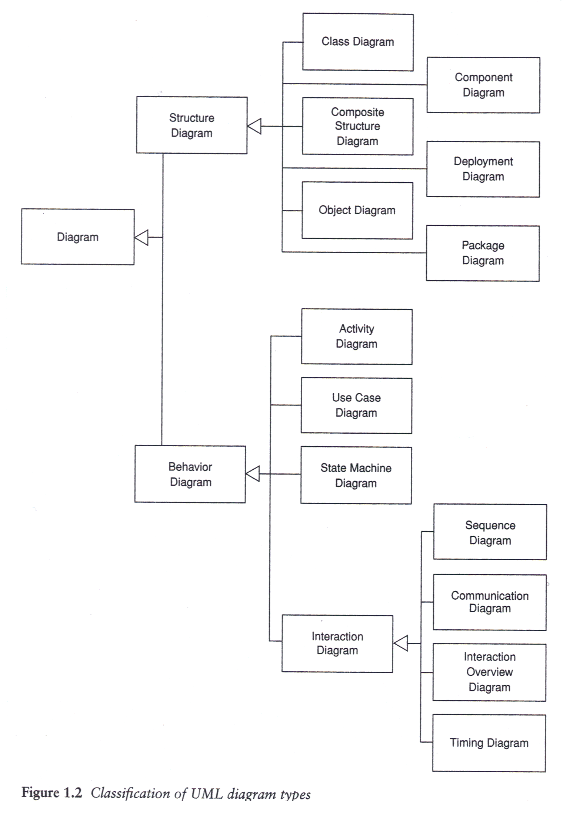
UML Diagrams

Slide 27
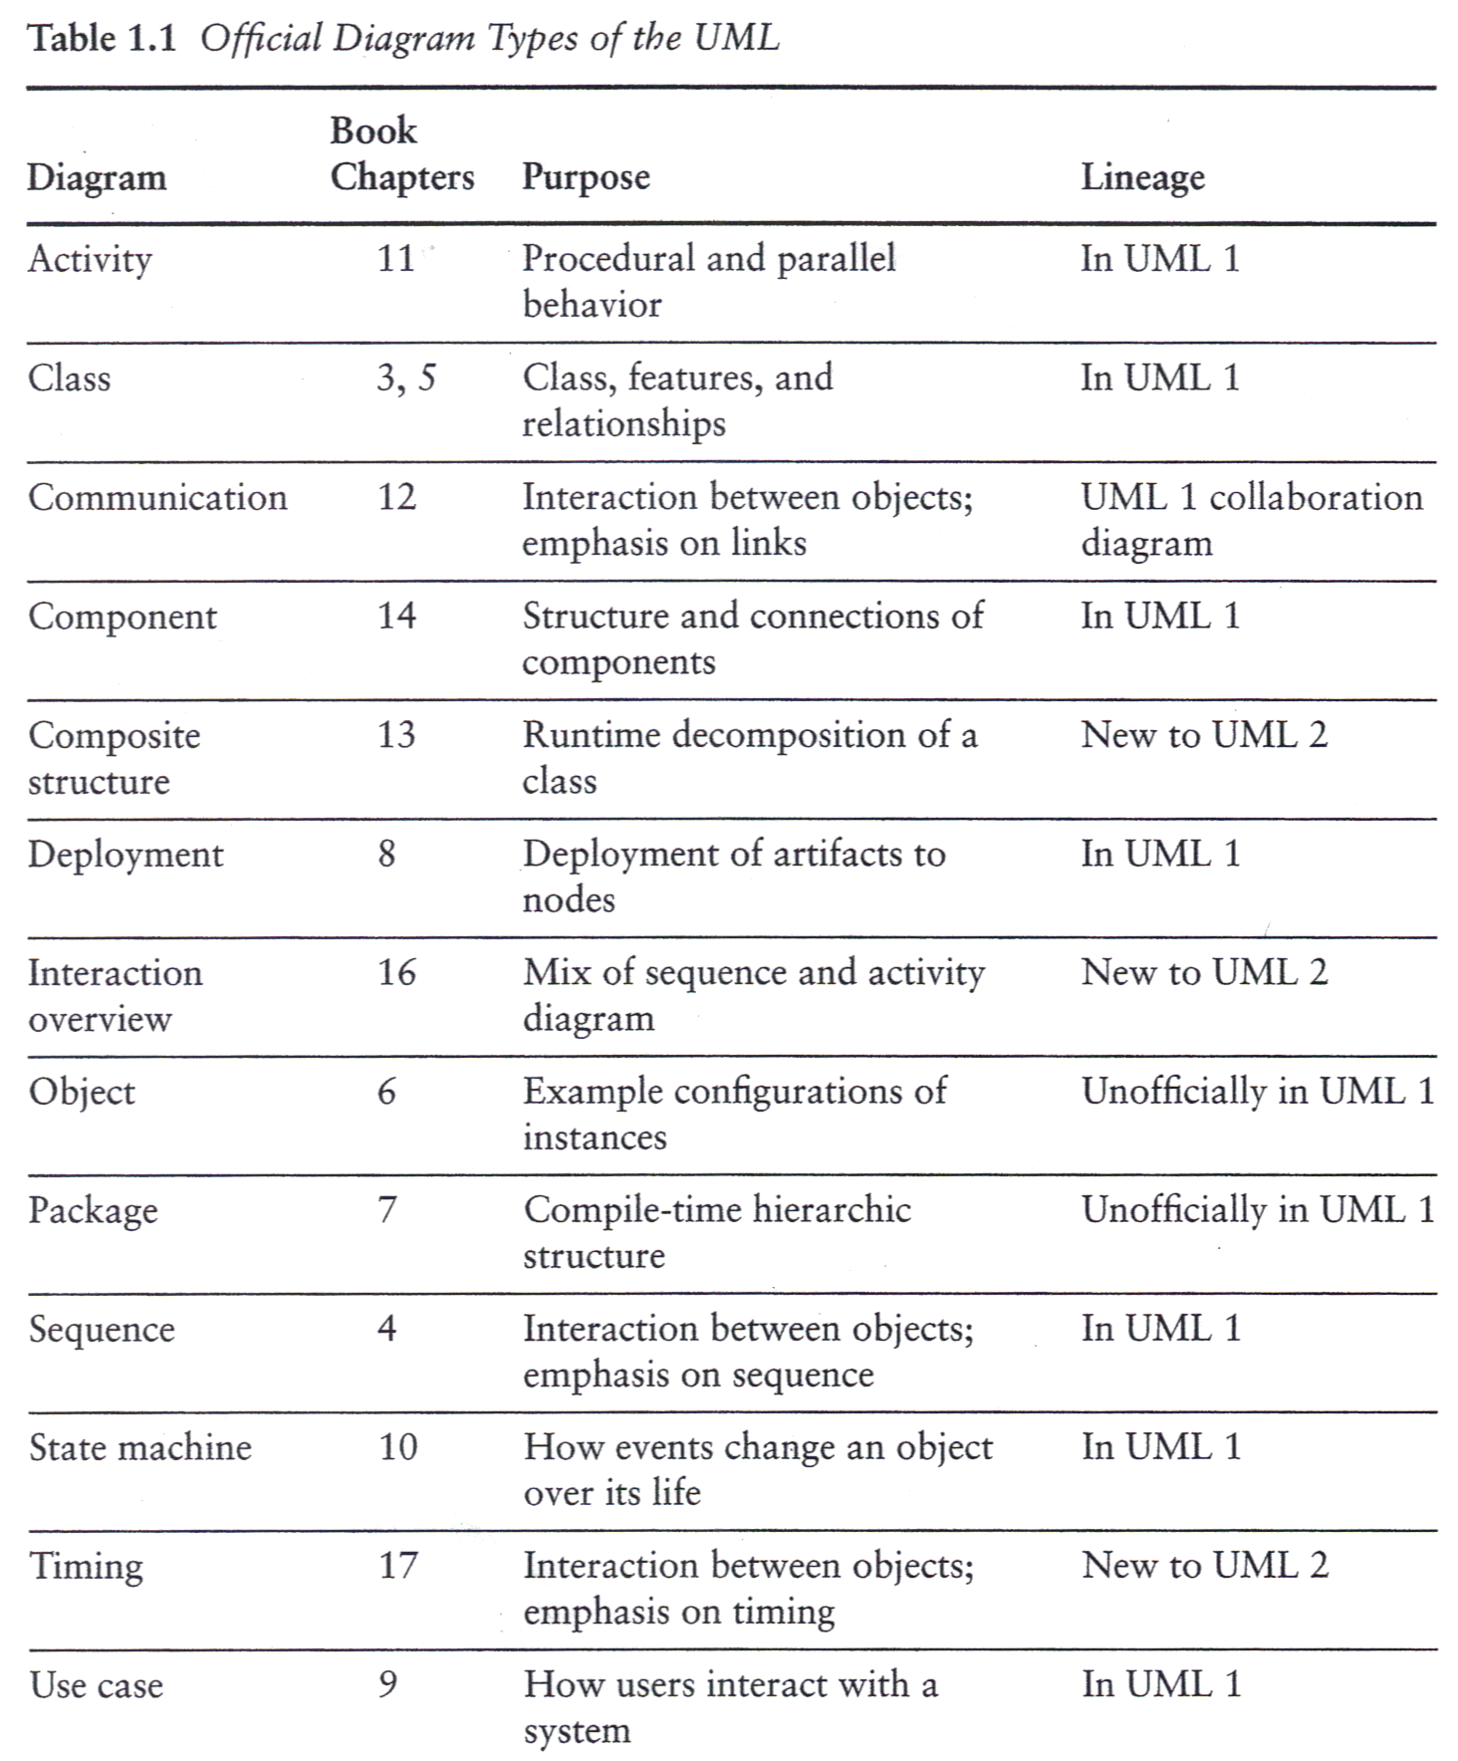
UML Diagrams

Slide 28
What is Legal UML?
Even though UML is standardized by the OMG developers will take liberties with syntax.
These “liberties” have a way of becoming standard conventions in later releases of the language.
The same holds true for natural languages.

Slide 29
The UML is not Enough
Even if the UML is your primary modeling language, don’t hesitate to use other diagrams to model your design.

Slide 30
A Conceptual Model of the UML
A conceptual model needs to be formed by an individual to understand UML.
UML contains three types of building blocks: things, relationships, and diagrams.
Things
  Structural things
    Classes, interfaces, collaborations, use cases, components, and nodes.
  Behavioral things
    Messages and states.

Slide 31
A Conceptual Model of the UML
  Grouping things
    Packages
  Annotational things
    Notes
Relationships: dependency, association, generalization and realization.
Diagrams: class, object, use case, sequence, collaboration, statechart, activity, component and deployment.

Slide 32
Architecture
Architecture refers to the different perspectives from which a complex system can be viewed.
The architecture of a software-intensive system is best described by five interlocking views:
  Use case view: system as seen by users, analysts and testers.
  Design view: classes, interfaces and collaborations that make up the system.
  Process view: active classes (threads).
  Implementation view: files that comprise the system.
  Deployment view: nodes on which SW resides.

Slide 33
Software Development Life Cycle
UML is involved in each phase of the software development life cycle.
The UML development process is
  Use case driven
  Architecture-centric
  Iterative and incremental

Slide 34
Tools
Rational Rose
ArgoUML
StarUML
Microsoft visio
Borland Together
……

Slide 35
An example of UML
import java.awt.Graphics;
class HelloWorld extends java.applet.Applet
{
public void paint(Graphics g)
{
g.drawString(“Hello, World!”, 10, 10);
}
}

Slide 36
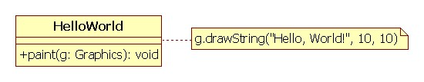
HelloWorld class diagram1
class
annotation

Slide 37
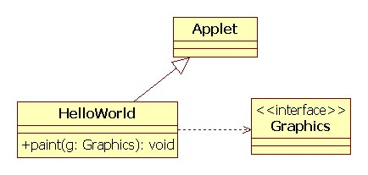
HelloWorld diagram 2
generalization
dependency

Slide 38
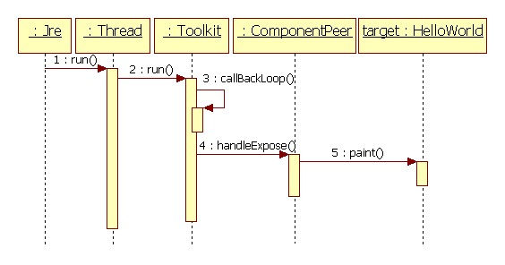
HelloWorld sequence diagram

Slide 39
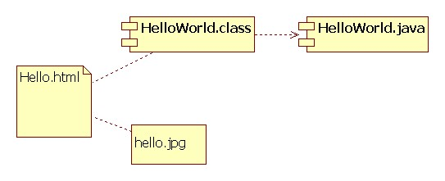
HelloWorld component diagram

Slide 40
Three possible ways to use the UML (by Fowler):
  UML as sketch : informal and incomplete;
  UML as blueprint : (for Software Engineering or Software Reverse Engineering) detailed and consistent diagrams using a CASE tool.
  UML as a programming language : it is coming.

Slide 41
Class and Terminology : we use the term ‘class’ pretty much all the time, but sometimes we will want to be a little more precise depending on the context:
  Within OOA, developing a Domain Model, via a domain diagram, classes are called domain concepts or conceptual classes;
  Within OOD, developing a Design Model, via a design diagram, classes are called design classes or software classes;
  Within OOP, developing an implementation model, via code in an OOPL, classes are called implementation classes.

Slide 42

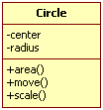
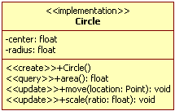

Slide 43
1.9 Conclusion
We will learn how to do OOA and D to parts of a project using the UML and within an agile software development process.
Resources:
  www.omg.org (the Object Management Group)
  www.uml.org (the Unified Modeling Language)

