Slide 1
Chapter 2
Use Cases

Slide 2
Use Cases
“Use cases are a technique for capturing the functional requirements of a system. Use cases work by describing the typical interactions between the users of a system and the system itself, providing a narrative of how the system is used”
Use case development process …
  Develop multiple scenarios
  Distill the scenarios into one or more use cases where each use case represents a functional requirement
  Establish associations between the use cases and actors

Slide 3
Use Cases
A use case ...
  Specifies the behavior of a system or some subset of a system
  Is a set of scenarios tied together by a common user goal
  Does not indicative how the specified behavior is implemented, only what the behavior is.
  Performs a service for some user of the system.
    A user of the system is known as an actor.
  During the analysis phase, facilitates communication between the customer, users of the system and the developers of the system.

Slide 4
Use Cases
A use case ...
  Represents a functional requirement of the system
    A requirement …
      Is a design feature, property, or behavior of a system
      States what needs to be done, but not how it is to be done
      Is a contract between the customer and the developer
      Can be expressed in various forms, including use cases
  Is graphically represented as an oval with the name of its functionality written inside.
    Functionality is always expressed as a verb or a verb phrase.
  may exist in relationships with other use cases much in the same way as classes maintain relationships with other classes.

Slide 5
Actors
An actor ...
  is a role that the user plays with respect to the system
  is associated with one or more use cases
  does not have to be human, Actors are roles played by people, organisations, other software and devices that interact with the application.
  is a user of the system
  is most typically represented as a stick figure of a person labeled with its role name
    Role names should be nouns

Slide 6
Actors
An actor …
  may be drawn as a stereotyped class or a graphical image of your own design
  are connected to use cases by associations
  exist outside the system boundaries

Slide 7
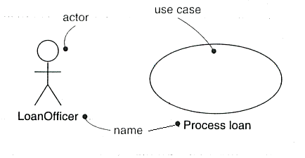
Actors and Use Cases
Graphical representation of an actor and a use case

Slide 8
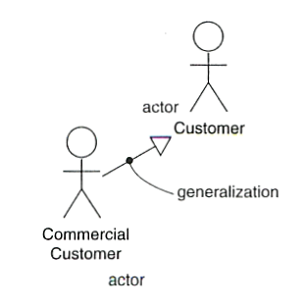
Actors and Use Cases
Generalization between actors

Slide 9
Contents of a Use Case
Use cases and Flow of Events
  A use case, by itself, does not describe the flow of events needed to carry out the use case.
  Flow of events can be described using informal text, pseudocode, or activity diagrams.
    May use a note to attach flow of events documentation to a use case.
    Rose can link an activity diagram to a use case
  Be sure to address exception handling (error conditions) when describing flow of events.
  “The amount to detail you need in a use case depends on the amount of risk in that use case”

Slide 10
Use Case Diagrams
Organizing Use Cases
  A use case diagram is a graphical table of contents
  A cases may have a relationship with other use cases
    Generalization between use cases is used to extend the behavior of a parent use case.
    An <<include>> relationship between use cases means that the base use case explicitly incorporates the behavior of another use case at a location specified in the base.

Slide 11
Use Case Diagrams
    Sometimes the <<uses> stereotype is used instead of <<include>>
    An <<extend>> relationship between use cases means that the base use case implicitly incorporates the behavior of another use case at a location specified indirectly by the extending use case
    Extended behavior is optional behavior, while included behavior is required behavior

Slide 12
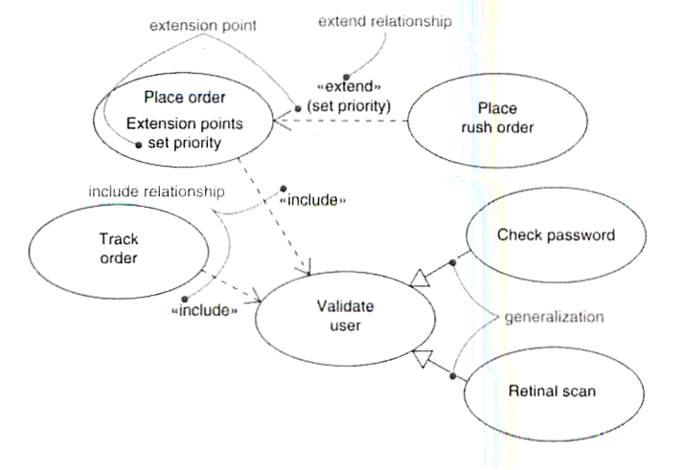
Use Case Diagrams

Slide 13
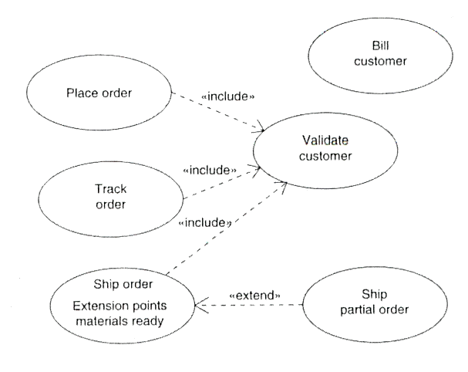
Use Case Diagrams

Slide 14
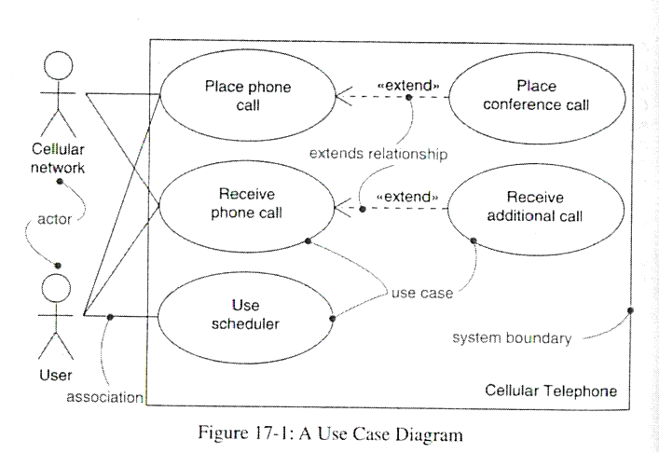
Use Case Diagram

Slide 15
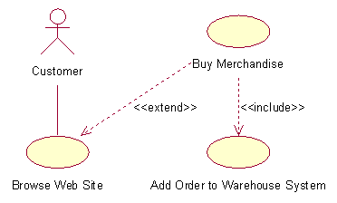
Use Case Diagram

Slide 16
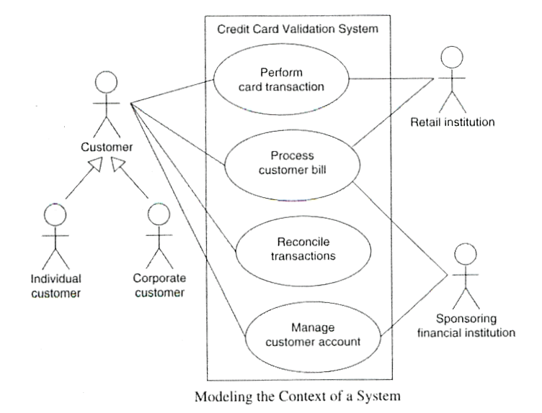
Use Case Diagrams

Slide 17
Contents of a Use Case
Example
Informally, use cases are text stories of some actor using a system to meet goals. Here is an example brief format use case:
  Process Sale: A customer arrives at a checkout with items to purchase. The cashier uses the POS system to record each purchased item. The system presents a running total and line-item details. The customer enters payment information, which the system validates and records. The system updates inventory. The customer receives a receipt from the system and then leaves with the items.
More detailed use cases are usually also needed, but even at such a high-level, use cases are very useful as communication tool during requirements analysis.
Instead of recording requirements as a list (the system will do : …), use cases capture the requirements in the following style:
  This actor does this and the system responds this way etc.
by little stories … (advantages?)

Slide 18
Definitions
A scenario (aka a use case instance) is a specific sequence of actions and interactions between actors and the system : it is one particular story of using a system, or one path through a use case.
So a use case can be seen as a collection of related success and failure scenarios that describe an actor using a system to support a goal.

Slide 19
Example a casual format use case with alternate scenarios:
  Handle Returns
  Main Success Scenario: A customer arrives at a checkout with items to return. The cashier uses the POS system to record each returned item … (as before)
  Alternate Scenarios:
    If the customer paid by credit, and the reimbursement transaction to their credit account is rejected, inform the customer and pay them with cash.
    If the item identifier is not found in the system, notify the Cashier and suggest manual entry of the identifier code (perhaps it is corrupted).
    If the system detects failure to communicate with the external accounting system, …
Hence a use case contains a set of scenarios.

Slide 20
Notation: What are Three Common Use Case Formats?
Use cases can be written in different formats and levels of formality:
  Brief Use Case : Terse one-paragraph summary, usually of the main success scenario. Created during early requirements analysis, to get a quick sense of subject and scope. May take only a few minutes to create;
  Casual Use Case : Informal paragraph format. Multiple paragraphs that cover various scenarios. A refinement of a brief use case;
  Fully Dressed Use Case : All steps and variations are written in detail, and there are supporting sections, such as preconditions and success guarantees. Cretaed after many use cases have been identified and written in a brief format, then during the first requirements workshop a few (such as 10%) of the architecturally significant and high-value use cases are written in this format.

Slide 21
Example: Process Sale, Fully Dressed Style
Roughly 10% of the use cases should be written in this style during the inception phase.
Example of a possible template:
Use Case Section | Comment
Use Case Name | Start with a verb.
Scope | The system under design.
Level | "user-goal" or "subfunction"
Primary Actor | Calls on the system to deliver its services.
Stakeholders and Interests | Who cares about this use case, and what do they want?
Preconditions | What must be true on start?
Success Guarantee | What must be true on successful completion, and worth telling the reader.
Main Success Scenario | A typical path scenario of success.
Extensions | Alternate scenarios of success or failure.
Special Requirements | Related non-functional requirements.

Slide 22
… continued
Use Case Section | Comment
Technology and Data Variations List | Varying I/O methods and data formats.
Frequency of Occurrence | Influences investigation, testing, and timing of implementation.
Miscellaneous | Such as open issues.
The following is an example for our POS application:
  Use Case UC1 : Process Sale
  Scope: NextGen POS application
  Level: user goal
  Primary Actor: Cashier
  Stakeholders and Interests:
    Cashier: Wants accurate, fast entry, and no payment errors, as cash drawer shortages are deducted from his/her salary.
    Salesperson: Wants sales commissions updated.

Slide 23
… continued
    Customer: Wants purchase and fast service with minimal effort. Wants easily visible display of entered items and prices. Wants proof of purchase to support returns.
    Company: Wants to accurately record transactions and satisfy customer interests. Wants to ensure that Payment Authorization Service payment receivables are recorded. Wants some fault tolerance to allow sales capture even if server components (e.g., remote credit validation) are unavailable. Wants automatic and fast update of accounting and inventory.
    Manager: Wants to be able to quickly perform override operations, and easily debug Cashier problems.
    Government Tax Agencies: Want to collect tax from every sale. May be multiple agencies, such as national, state, and county.
    Payment Authorization Service: Wants to receive digital authorization requests in the correct format and protocol. Wants to accurately account for their payables to the store.
  Preconditions: Cashier is identified and authenticated.
  Success Guarantee (aka Postconditions): Sale is saved. Tax is correctly calculated. Accounting and Inventory are updated. Commissions recorded. Receipt is generated. Payment authorization approvals are recorded.

Slide 24
… continued
  Main Success Scenario (or Basic Flow):
    Customer arrives at POS checkout with goods and/or services to purchase.
    Cashier starts a new sale.
    Cashier enters item identifier.
    System records sale line item and presents item description, price, and running total. Price calculated from a set of price rules.
    Cashier repeats steps 3-4 until indicates done.
    System presents total with taxes calculated.
    Cashier tells Customer the total, and asks for payment.
    Customer pays and System handles payment.
    System logs completed sale and sends sale and payment information to the external Accounting system (for accounting and commissions) and Inventory system (to update inventory).
    System presents receipt.
    Customer leaves with receipt and goods (if any).

Slide 25
… continued
  See rest of UC1 on separate document …
This is a very detailed Use Case:
  You may not require this level of details;
  The sections probably need to be customised to your application domain;
  It would take a long time to arrive at this level of details;
  The more details the more likely that contradictions have crept in;
  You cannot produce something like this on your own: all relevant stakeholders must be heavily and directly involved (e.g. in a workshop);
  A detailed, fully-dressed, consistent, use case that has been approved by everyone is very valuable;

Slide 26
What do the Sections Mean?
Scope : because we can apply use cases to various entities (SW, SW+HW, SW+HW+Business etc.) we can clarify the scope of the current use case.
Level :
  A user-goal level use case is the common kind that describe the scenarios to fulfill the goals of a primary actor to get work done;
  A subfunction-level use case describes substeps required to support a user goal, and is usually created to factor out duplicate substeps shared by several regular use cases; e.g. ‘Pay by Credit’ use cases.
Primary Actor : the principal actor.
Stakeholders and Interests List (Important) :
  The use cases detail the functional part of the contract between the application and all the stakeholders: by focusing on what the stakeholders want out of a given use case we are less likely to miss important requirements.

Slide 27
Preconditions :
  What must always be true before any of the scenarios in the use case can begin. Preconditions are not tested within the use case; rather, they are conditions that are assumed to be true.
Success Guarantees (aka Postconditions) :
  What must be true on successful completion of the use case either the main success scenario or some alternate path. The guarantee should meet the needs of all stakeholders (for consistency and cross-checking).
Main Success Scenario (aka Basic Flow) :
  It describes a typical successful flow path of execution that satisfies all stakeholders involved;
  It does not usually includes branching conditions;
  It can contain description of internal system processes if known at this stage (e.g. the financial transaction is logged, the best scores are recorded);

Slide 28
Extensions (aka Alternate Flows) :
  Usually the longest part of a use case;
  They indicate all the other scenarios (either successful or failed);
  Extensions scenarios are branches from the main success scenario : hence the numbering is based on it. E.g. at Step 3, of the main success scenario, there may be an invalid item identifier, either because it was incorrectly entered or unknown to the system. An extension is labeled "3a"; it first identifies the condition and then the response. Alternate extensions at Step 3 are labeled "3b" and so forth;
  In UC1, the example given, the extensions are themselves quite detailed: they may include extensions themselves … (see 3a);
  Steps annotated *a, *b etc. can occur at any time;
  Other use cases can be ‘called’ within an extension (e.g. to perfom a common non-trivial activity);

Slide 29
Special Requirements :
  Notwithstanding the fact that other artifacts are necessary to record other, mainly non-functional, requirements, if a specific quality or constraint relates specifically to a use case (and is therefore not application-wide) then they should be mentionned here (e.g. connection to game server must be established within 5s seconds maximum);
  All the use cases’ special requirements sections can always be summarised and collected later in the supplementary specification document;
Technology and Data Variations List :
  Often there are technical variations in how something must be done, but not what. A common example is a technical constraint imposed by input or output technologies. For example, a stakeholder might say, "The POS system must support credit account input using a card reader and the keyboard."
  Note that these are examples of early design decisions or constraints; in general, it is skillful to avoid premature design decisions : just make a decision of them in this section;

Slide 30
Notation: Alternatives
What we presented is just one possible use case notation; many alternatives exist : the specific do not matter;
A main alternative use case notation is to present the use case as a conversation between the actors and the system in a two column format:
Main Success Scenario:
Actor Action (or Intention) System Responsibility
1. Customer arrives at a POS checkout with
goods and/or services to purchase.
2. Cashier starts a new sale
3. Cashier enters item identifier.
4. Records each sale line item,presents
item description and running total.
Cashier repeats steps 3-4 until indicates done.
5.Presents total with taxes calculated.
6.Cashier tells Customer the total, and asks
for payment.
7.Customer pays.
8.Handles payment.
9…

Slide 31
How to Find Use Cases
Use cases are defined to satisfy the goals of the primary actors. Hence, the basic procedure is:
  Choose the system boundary. Is it just a software application, the hardware and application as a unit, that plus a person using it, or an entire organization?
  Identify the primary actors those that have goals fulfilled through using services of the system.
  Identify the goals for each primary actor.
  Define use cases that satisfy user goals; name them according to their goal.
Of course, in iterative and evolutionary development, not all goals or use cases will be fully or correctly identified near the start. It's an evolving discovery.

Slide 32
Step 1: Choose the System Boundary
  For this case study, the POS system itself is the system under design; everything outside of it is outside the system boundary, including the cashier, payment authorization service, and so on.
  If the definition of the boundary of the system under design is not clear, it can be clarified by further definition of what is outsidethe external primary and supporting actors. Once the external actors are identified, the boundary becomes clearer. For example, is the complete responsibility for payment authorization within the system boundary? No, there is an external payment authorization service actor.
Steps 2 and 3: Find Primary Actors and Goals
  Guideline: Brainstorm the primary actors first, as this sets up the framework for further investigation.
  In addition to obvious primary actors and goals, the following questions help identify others that may be missed:
  Who starts and stops the system? Who does system administration? Who does user and security management? Is "time" an actor because the system does something in response to a time event? In addition to human primary actors, are there any external software that call upon services of the system?

Slide 33
  We can create use case diagrams (see later) to record the results of the brainstorming session in a table:
Actor | Goal/Use Case
Cashier | process sales, process rentals, handle returns, cash in, cash out, …
Manager | start up, shut down, …
System Administrator | add users, modify users, delete users, manage security, manage system tables, …
… | …

Slide 34
  The customer is not viewed as a primary actor because he/she does not interact with the system directly (everything goes through the Cashier): A self-checkout system would be different …
  Another approach to aid in finding actors, goals, and use cases is to identify external events. What are they, where from, and why?
External Event | From Actor | Goal/Use Case
Enter sale line item | Cashier | Process a sale
Enter payment | Cashier or Customer | Process a sale
… | … | …

Slide 35
Step 4: Define Use Cases
  Start the name of use cases with a verb.
  Some of the goals may overlap and can be re-grouped into single use cases: we do not want use case that are too small at this stage (e.g. ‘Move Avatar’ rather than ‘Move left’, ‘Move right’, ‘Jump’ etc.)

Slide 36
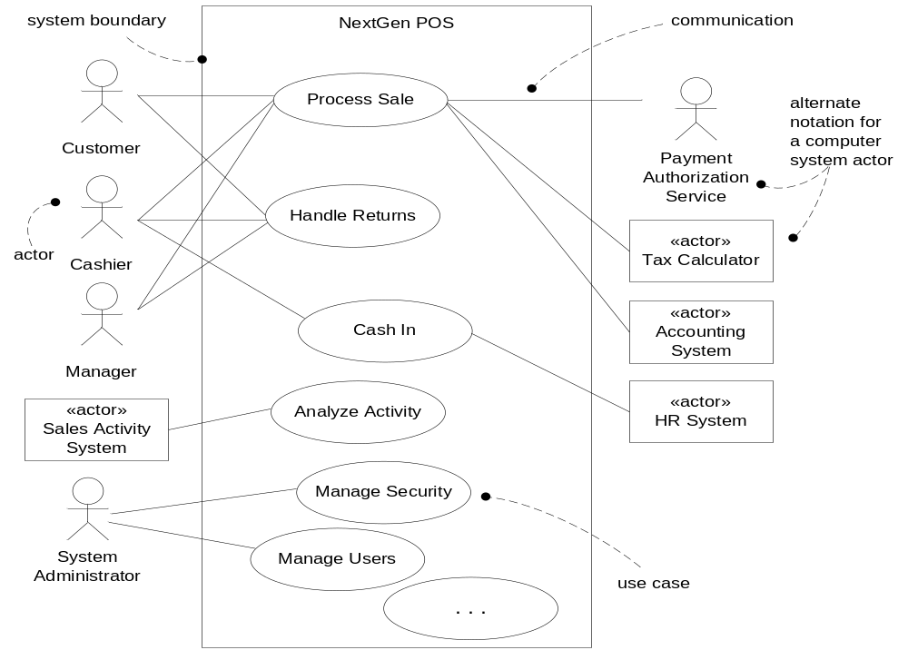
Figure : Partial Use Case Diagram

Slide 37
Use cases are not the only necessary requirements artifact. Non-functional requirements, report layouts, domain rules, and other hard-to-place elements are better captured in the UP Supplementary Specification.

Slide 38
Use Cases in an Iterative Process
The UP encourages use-case driven development :
  The main way to record requirements is via use cases (The Supplementary Specification is secondary) ;
  We schedule iterations according to entire use cases (or at least use case scenarios) ;
  Use cases drive the design : we try to fulfill the requirements of a use case
See separate document for an example of effort across early iterations.
Only about 10% of use cases are written in details during inception (those that are risky, architecturaly significant or represent the selling point of the software) : in our POS case study this may mean Process Sale and Handle Returns .

Slide 39
At the end of the elaborations most of the use cases are available in a detailed format; the very core of the software has also been designed and implemented (it is important for these to be of high quality so that they withstand future expansions …)
During the UP Construction phase, use cases need to be kept up to date with any changes necessary. Maybe minor remaining use case are fully detailed.
Brainstorming sessions are useful to discover and flesh-out use cases, especially during the inception phase. If possible these should involve :
  End Users
  Customers
  Developers
  Software Architect
  Project Manager …

Slide 40
POS use cases for the inception phase:
Fully Dressed | Casual | Brief
Process Sale Handle Returns | Process rental Analyse Sales Activity Manage Security … | Cash In Cash Out Manage Users Start Up Shut Down Manage System Tables …

Slide 41
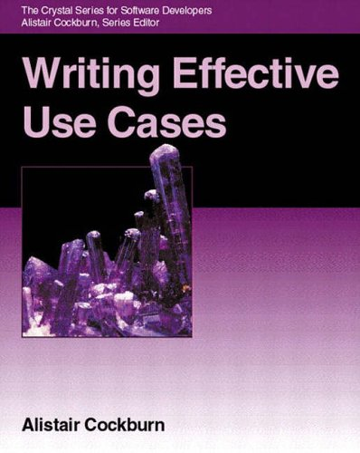
Conclusion
Use Cases are very useful but not the complete requirements, use cases should not be too small, use case diagrams are useful summaries.
Resources:
“Writing Effective Use Cases”,
Alistair Cockburn, Addison Wesley, 2000, ISBN : 0201702258

