Slide 1
Chapter 15: UML Interaction Diagrams
15.1 Introduction
Interaction diagrams illustrate how objects interact via messages to carry out tasks: they model the dynamic aspect of objects.
2 types of interaction diagrams:
  Sequence interaction diagrams;
  Communication(Collaboration) interaction diagrams;

Slide 2
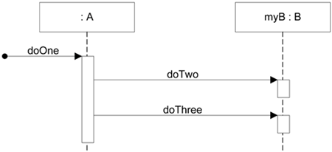
15.2 Sequence and Communication Diagrams
Both kind of diagrams have the same role within the UML.
UML modeling tools allow the software engineer to translate one style into the other style : they are equivalent.
Hence :
  use whatever style you like;
  Sequence diagrams emphasise the order of messages between objects (communication diagrams rely on numbering of the messages);
  Communication diagrams are more space efficient, especially if many objects are involved;
Example of a sequence diagram :

Slide 3
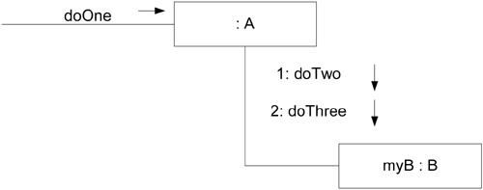
Skeleton sample code for the previous example:
public class A
{
private B myB = new B();
public void doOne()
{
myB.doTwo();
myB.doThree();
}
// …
}
Equivalent communication diagram:

Slide 4
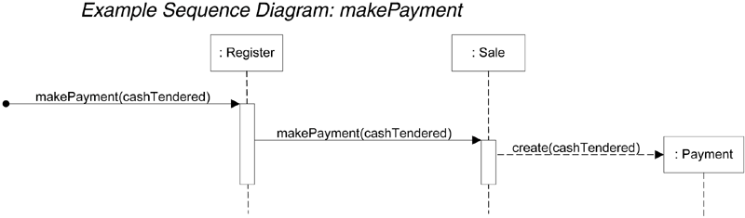
Another Sequence Diagram : makePayment
  Which can be read as follows:
  The message makePayment is sent to an instance of a Register. The sender is not identified.
  The Register instance sends the makePayment message to a Sale instance.
  The Sale instance creates an instance of a Payment.

Slide 5
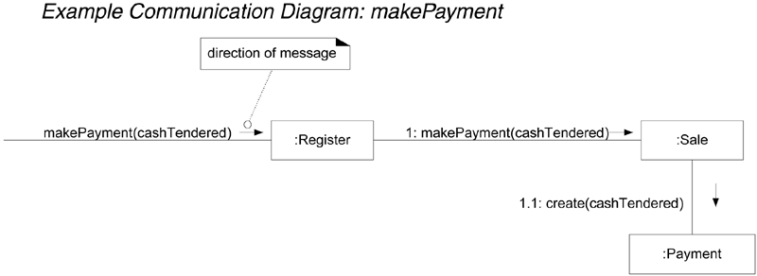
Code for the makePayment method of the Sale Class:
public class Sale
{
private Payment payment;
public void makePayment( Money cashTendered )
{
payment = new Payment( cashTendered );
//…
}
// …
}
Equivalent communication diagram:

Slide 6
15.3 Interaction Diagrams and Class Diagrams
Most of the effort during OOD should be spent on creating interaction diagrams not the class diagram:
  Interaction diagrams are much more valuable : they detail the algorithms for each method; dynamic view;
  A class diagram is just a summary; static view; it is very easily created after the interaction diagrams;
Coding will be much easier form the interaction diagrams since they detail the many design decisions that have been made: class diagrams do not detail the algorithm of methods, but rather the structure of the classes organisation;
Jumping from the analysis to the class diagram directly is hard;
Jumping from the class diagram to coding is hard;
Interaction diagrams are an intermediary step between analysis and design, and also between design and coding: they are very valuable.

Slide 7
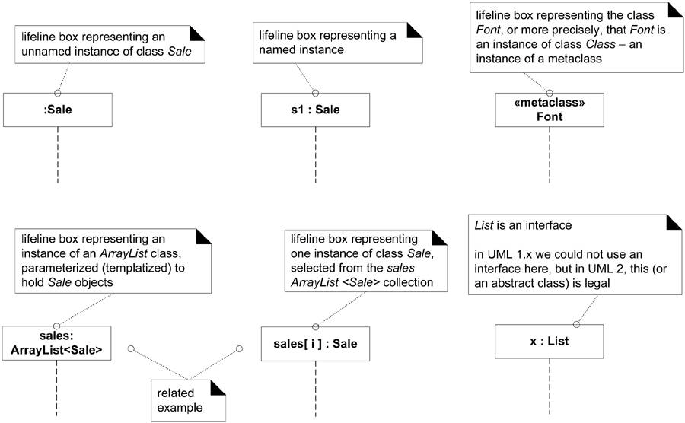
15.4 Common UML Interaction Diagram Notation
Lifeline Boxes :

Slide 8
Message syntax :
  return = message(parameter : parameterType) : returnType
  Examples:
  initialize(code)
  Initialize
  d = getProductDescription(id)
  d = getProductDescription(id:ItemID)
  d = getProductDescription(id:ItemID) : ProductDescription

Slide 9
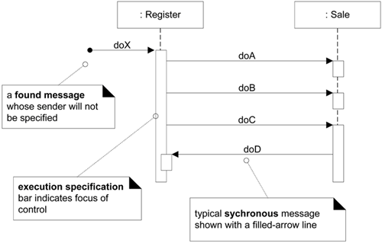
15.5 Basic Sequence Diagram Notation
Messages :

Slide 10
Many of the details of the notation are optional and are only typically shown whenever using a CASE tool to create the diagrams. Optional elements include:
  The execution specification bar;
  The solid bar on a found message;
  The type information of messages;
  Using an agile approach, it is reasonable not to show these features except maybe the type information which is useful.
Message returns :
  There are two ways to show the return result from a message:
    Using the message syntax return Var = message(parameter).
    Using a reply message line at the end of an activation bar.
  For an example see Figure 15.2

Slide 11
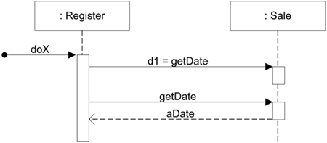
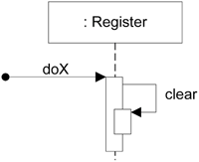
Figure 15.2 : Two Ways to Show a Return Result from a Message
Messages to ‘self’ or ‘this’ :

Slide 12
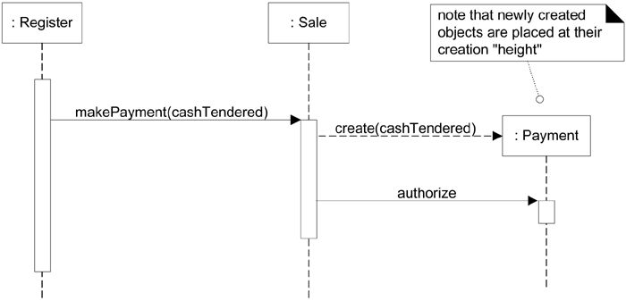
Creation of instances :
  Typically we use the language independent create message:

Slide 13
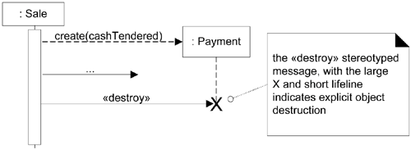
Object Lifelines and Object Destruction :
  We may show the explicit destruction of an object

Slide 14
Asynchronous and Synchronous Calls :
  An asynchronous message is one where the sender doesn’t wait for the result of the message, instead it processes the result when and if it ever comes back. Up until this point all other messages have been synchronous, messages where the sender waits for the result before continuing on. It is common to send asynchronous messages to hardware devices, autonomous software services (threads).
  See figure 15.10 for an example of an active object that runs on its own thread started by an asynchronous message.

Slide 15
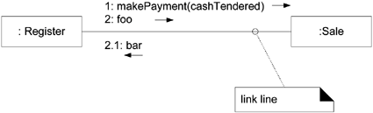
15.6 Basic Communication Diagram Notation
Links :
  A link is a connection between two objects
Messages :
  Each message between objects is represented with a message expression and small arrow indicating the direction of the message. Many messages may flow along this link. A sequence number is added to show the sequential order of messages in the current control.
  See Figure 15.11

Slide 16
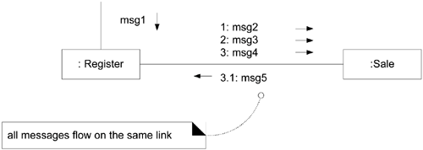
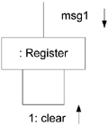
Figure 15.11 Messages
Messages to ‘self’ or ‘this’ :

Slide 17
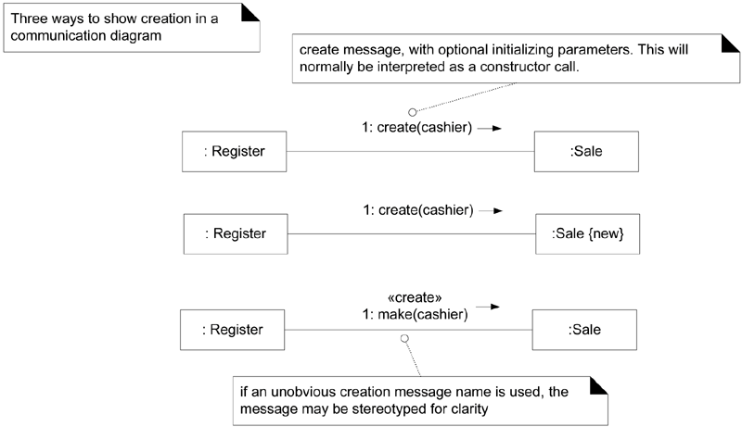
Creation of instances :
  Typically we use the language independent create message:

Slide 18
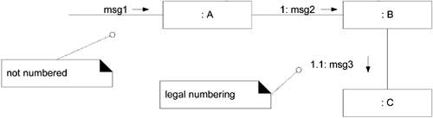
Messages Number Sequencing :
  In Communication Diagrams we need to explicitly number the messages;
  Nested messages are also shown:
  See Figure 15.12 for a more complex example

Slide 19
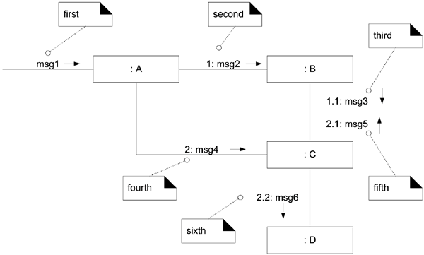
Figure 15.12 Complex Sequence Numbering

Slide 20
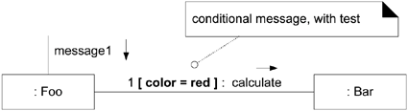
Conditional Messages :
  A conditional message is shown by following a sequence number with a conditional clause in square brackets, similar to an iteration clause. The message is only sent if the clause evaluates to true.

Slide 21
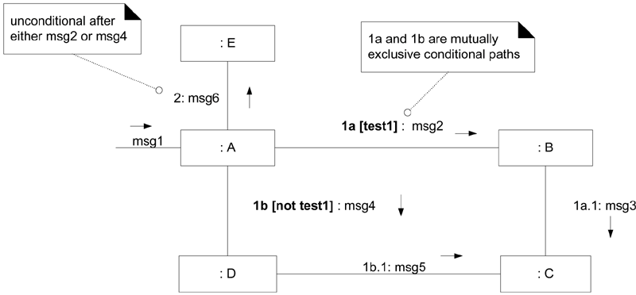
Mutually exclusive conditional paths :
  To show mutually exclusive messages we must modify the sequence expressions with a conditional path letter. The first letter used is ‘a’, by convention.

Slide 22
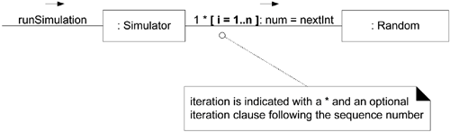
Iterations :
  If the details of the iteration clause are not important to the modeler, a simple * can be used.

Slide 23
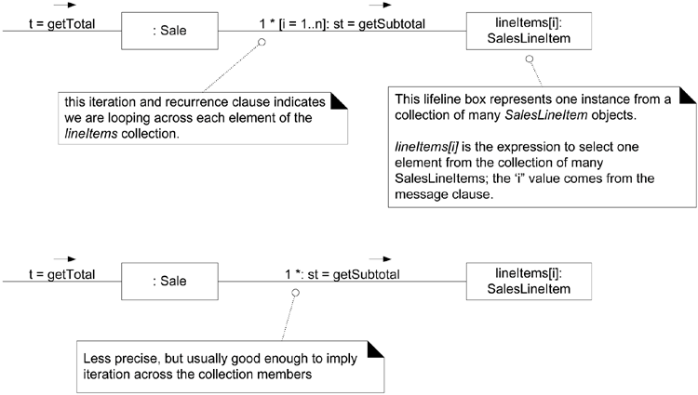
Iteration over a collection :
  For example:

Slide 24
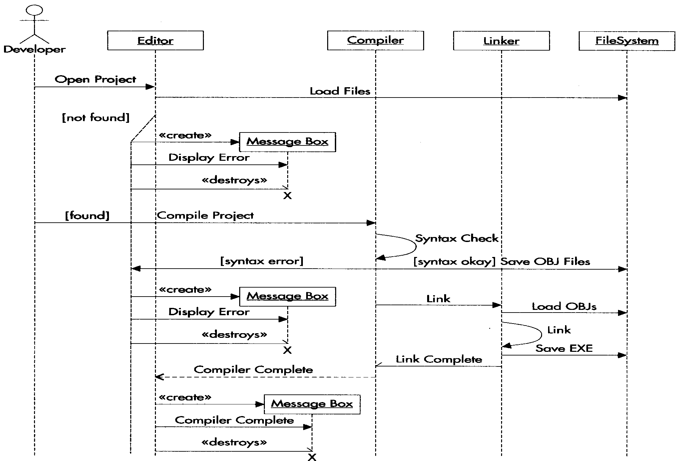
An Example

Slide 25
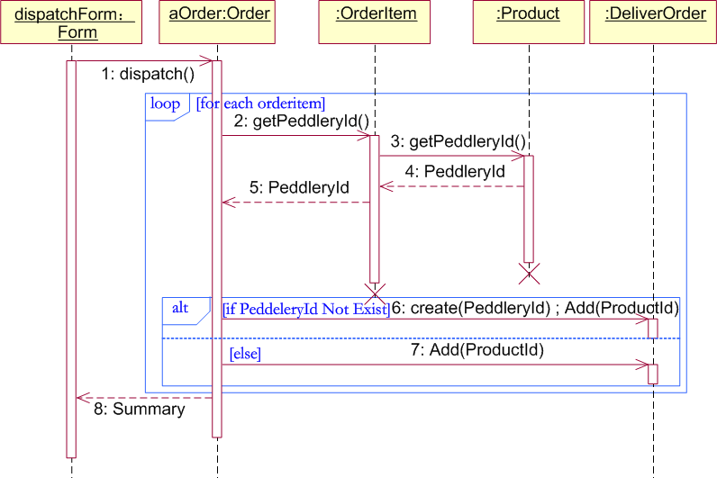
An Example

Slide 26
13.3 Object-Oriented Analysis: The Elevator Problem Case Study
A product is to be installed to control n elevators in a building with m floors. The problem concerns the logic required to move elevators between floors according to the following constraints:
1. Each elevator has a set of m buttons, one for each floor. These illuminate when pressed and cause the elevator to visit the corresponding floor. The illumination is canceled when the corresponding floor is visited by the elevator
2. Each floor, except the first and the top floor, has two buttons, one to request an up-elevator, one to request a down-elevator. These buttons illuminate when pressed. The illumination is canceled when an elevator visits the floor, then moves in the desired direction
3. If an elevator has no requests, it remains at its current floor with its doors closed

Slide 27
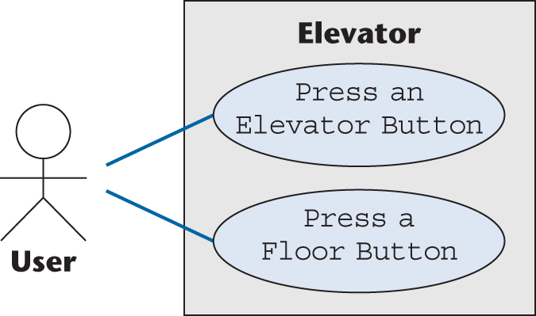
Use Cases
For the elevator problem, there are only two possible use cases
  Press an Elevator Button, and
  Press a Floor Button
Figure 13.2

Slide 28
Scenarios
A use case provides a generic description of the overall functionality
A scenario is an instance of a use case
Sufficient scenarios need to be studied to get a comprehensive insight into the target product being modeled

Slide 29
Noun Extraction (contd)
Stage 2. Identify the nouns
  Identify the nouns in the informal strategy
  Buttons in elevators and on the floors control the movement of n elevators in a building with m floors. Buttons illuminate when pressed to request the elevator to stop at a specific floor; the illumination is canceled when the request has been satisfied. When an elevator has no requests, it remains at its current floor with its doors closed
Use the nouns as candidate classes

Slide 30
Noun Extraction (contd)
Nouns
  button, elevator, floor, movement, building, illumination, request, door
  floor, building, door are outside the problem boundary — exclude
  movement, illumination, request are abstract nouns — exclude (they may become attributes)
Candidate classes:
  Elevator Class and Button Class
Subclasses:
  Elevator Button Class and Floor Button Class

Slide 31
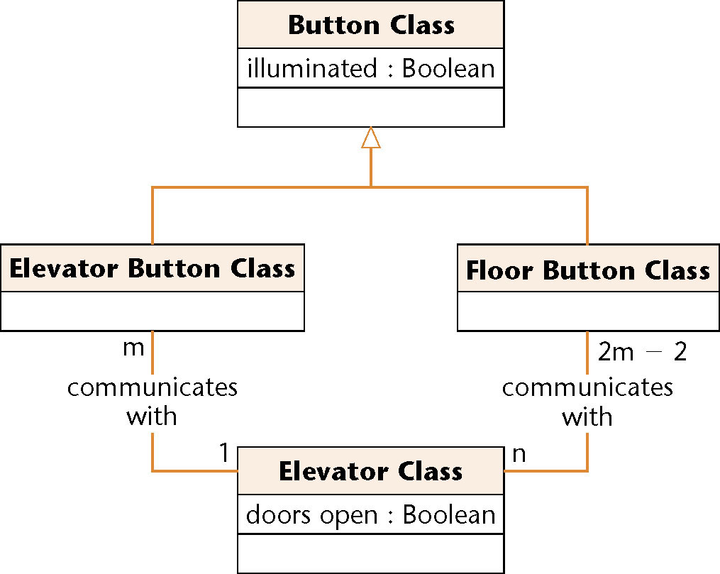
First Iteration of Class Diagram
Figure 12.5
Problem
  Buttons do not communicate directly with elevators
  We need an additional class: Elevator Controller Class

Slide 32
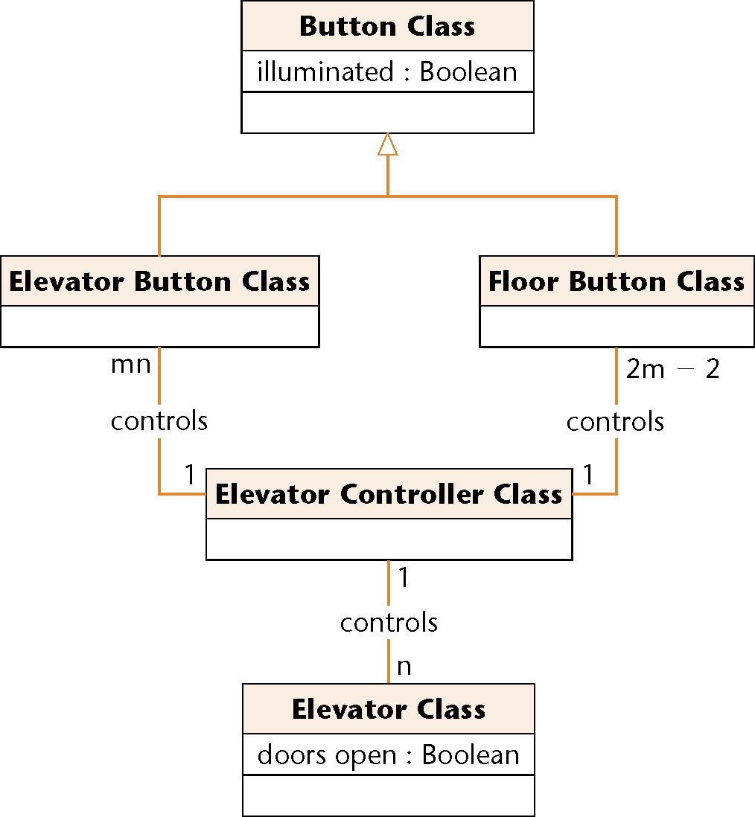
Second Iteration of Class Diagram
All relationships are now 1-to-n
  This makes design and implementation easier
Figure 12.6

Slide 33
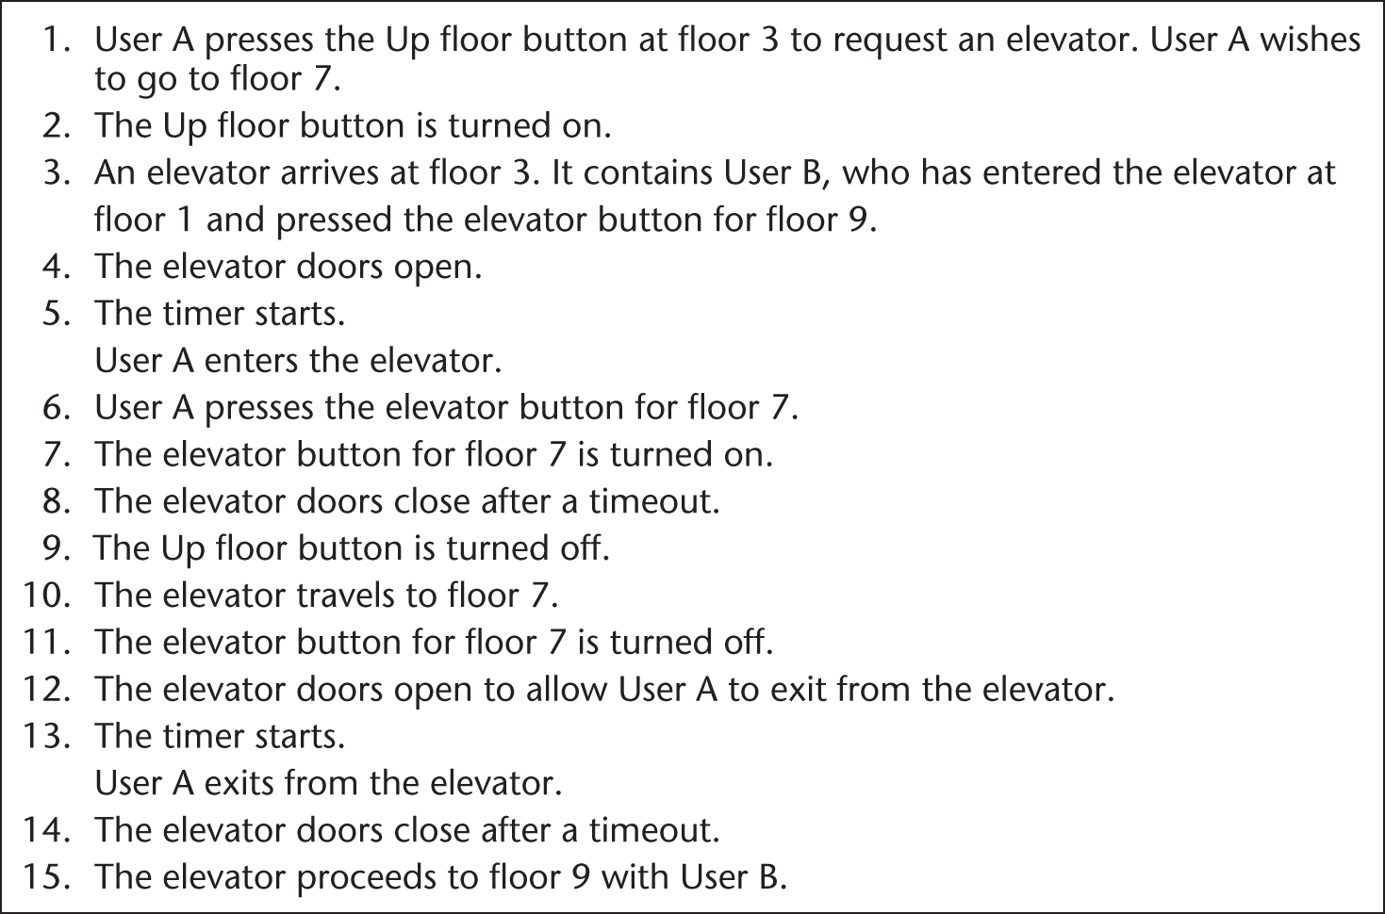
Normal Scenario: Elevator Problem
Figure 13.3

Slide 34
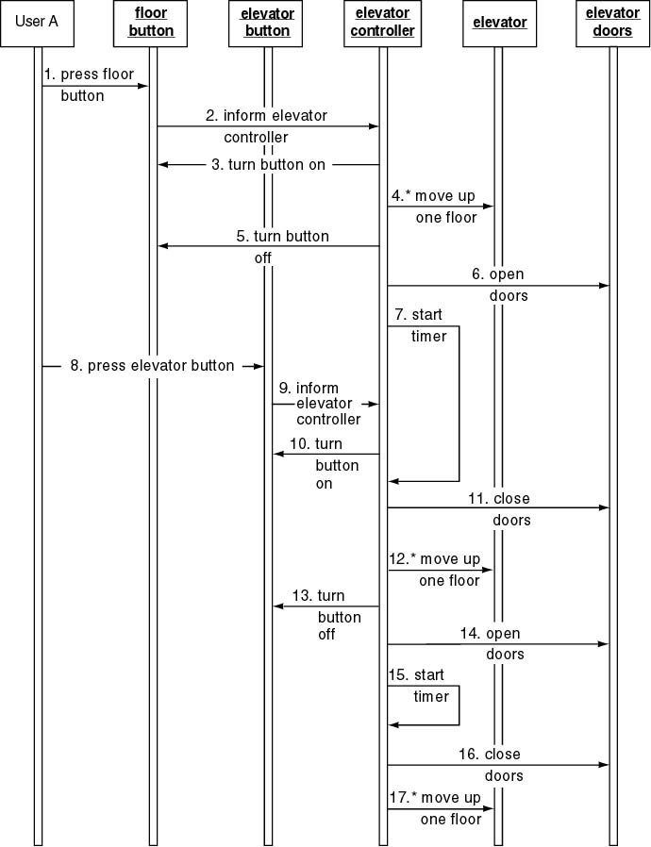
Elevator Problem: OOD (contd)
Sequence
diagram

Slide 35
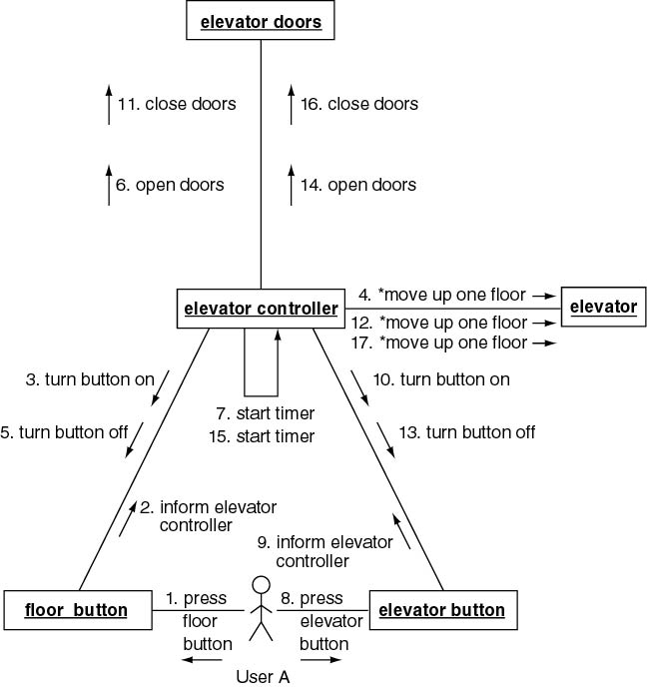
Elevator Problem: OOD (contd)
Collaboration diagram

Slide 36
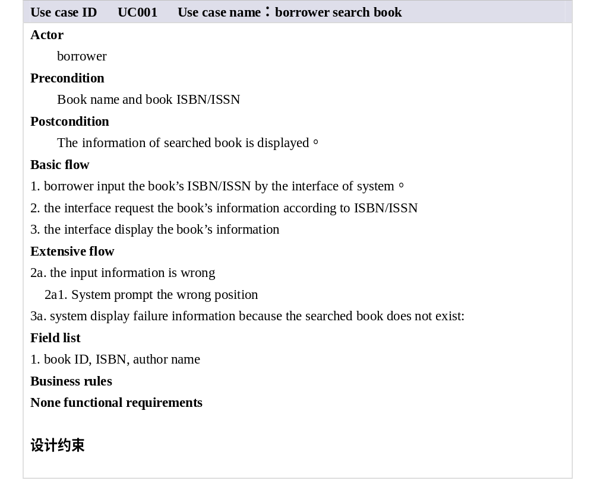
A library system

Slide 37
