Slide 1
Chapter 17: GRASP : Designing Objects with Responsibilities
17.1 Introduction
Since the UML is simply a standard visual modeling language, knowing its details doesn't teach you how to think in objects…
This chapter and the next present the heart of OOD : they explain fundamental skills in OOD and are therefore very important.
We emphasise the design of the dynamic view of the software solution (via the interaction diagrams) rather than the static view of the software (i.e. the design class diagram).

Slide 2
17.2 Design in an Iterative Process
We assume that many activities have already taken place generating many useful artifacts prior to design:
  Vision;
  Supplementary Specification;
  Domain Model;
  Use Cases;
  System Sequence Diagrams;
  Operation Contracts;
  In an agile approach however, not all artifacts may be fully detailed while additional others may well be needed… Common artefacts are summarised on Figure 17.1
It would be a big mistake however to start designing if we are having problems creating the artifacts above :
  in particular if your contracts are poor it is without doubt because you are on the wrong track … The level of quality of the contracts is a very good indicator of future success for the iteration and therefore the project …

Slide 3
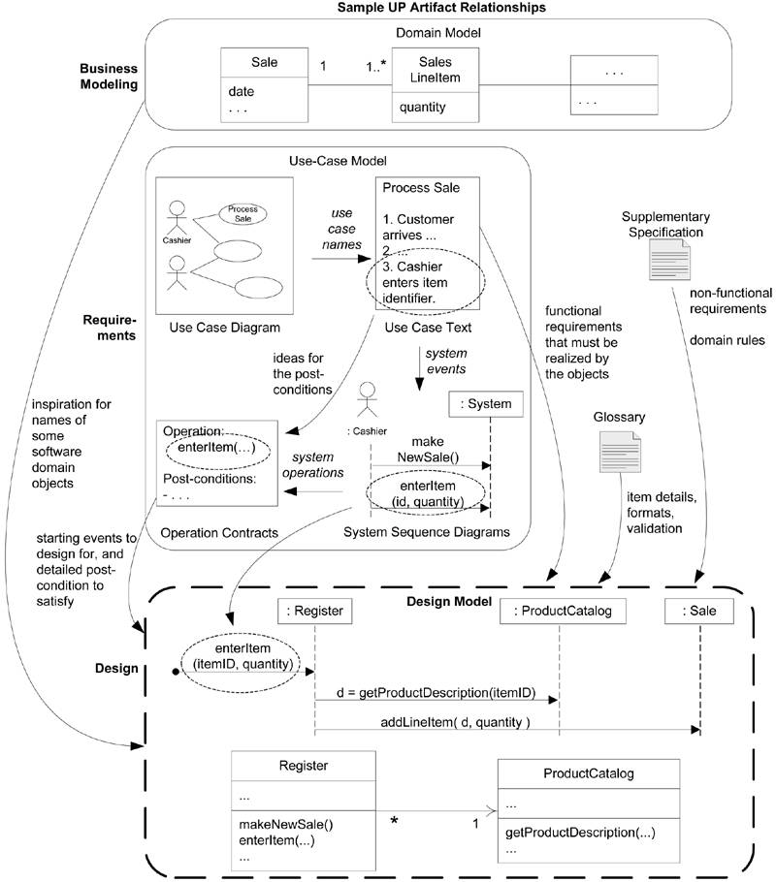

Slide 4
During OOD, using the previously generated artifacts and via the UML we explore visually the necessary relationships between the objects to fulfil the requirements (we may only do so for the difficult parts of the design that we wish to explore before coding: for the obvious parts, coding can be started as soon as what we have to do has been agreed (e.g. as described in a contract and supported by the domain model):
  We may update previous artifacts or explore them further in case of problems;
  We sketch both interaction diagrams and complementary class diagrams (dynamic and static modeling) applying general OO design patterns (aka principles);
  We may record our effort using a fully fledged UML modeling tool (but remembering that in an agile approach we build models primarily to understand and communicate not to document) [this does not mean that documentation is not necessary!] ;
  We may intertwine coding half-days in between modeling half-days within a single iteration;
We must remain agile (but honest with ourselves).

Slide 5
Hence what we will see now may only apply to the most difficult parts of the software (these tend to be front-loaded in an evolutionary project, so that more time may be spent on hard OOD in the first few iterations than in the subsequent ones were direct coding may be acceptable) : but obviously we will apply what we learn on simple examples …

Slide 6
17.3 Responsibilities and Responsibility-Driven Design
A good way to design a solution in terms of collaborating objects is to think in terms of responsibilities:
  Responsibilities are related to the obligations or behaviour of an object in terms of its role;
  Objects (and therefore classes) will be assigned responsibilities during OOD;
Two types of responsibilities, doing and knowing:
  Doing responsibilities of an object include:
    doing something itself, such as creating an object or doing a calculation;
    initiating action in other objects;
    controlling and coordinating activities in other objects;
  Knowing responsibilities of an object include:
    knowing about private encapsulated data;
    knowing about related objects;
    knowing about things it can derive or calculate;

Slide 7
So during OOD we may decide for example that "a Sale is responsible for creating SalesLineItems" (a doing responsibility), or "a Sale is responsible for knowing its total" (a knowing responsibility);
Assigning some responsibilities can be obvious, for example if the domain model Sale class has a time attribute, it is obvious that a Sale object should be responsible for knowing its time. (no need for OOD to find that out …)
On the other hand some responsibilities may involve hundreds of objects and rely on hundred of methods…
  A responsibility is not the same thing as a method : methods fulfil responsibilities.
  Responsibilities are implemented by means of methods that either act alone or collaborate with other methods and objects.

Slide 8
Responsibility Driven Design is a general metaphor for thinking about OO software design. Think of software objects as similar to people with responsibilities who collaborate with other people to get work done. Responsibility Driven Design leads to viewing an OO design as a community of collaborating responsible objects.
  We use interaction diagram to illustrate these collaborations between objects.
Given a responsibility there are usually many potential solutions in terms of collaborating objects:
  Patterns are there to guide us towards good solutions …

Slide 9
17.4 Patterns
A pattern is a named and well-known problem/solution pair that can be applied in new contexts, with advice on how to apply it in novel situations and discussion of its trade-offs, implementations, variations, and so forth:
  There are hundreds of OO design patterns, only a few a fundamentals;
  Patterns do not express new software engineering ideas : quite the opposite in fact. Patterns codifies good solutions to well-known recurring problems. In fact many OOD patterns originate from traditional non-OO software engineering;
  Patterns have names which allow easier communication: we can talk of the low-coupling pattern, or the controller pattern and everyone knows what is being talked about.

Slide 10

An example of a basic pattern :
  Pattern Name: Information Expert
  Problem: What is a basic principle by which to assign responsibilities to objects?
  Solution: Assign a responsibility to the class that has the information needed to fulfill it.
  this is a very basic pattern, and one of the most useful (even just asking ourselves the question ‘who should be responsible for doing/knowing so and so?’ yields an obvious answer).
  A very well known design pattern book by the “gang of four” (GoF) is “Design patterns : elements of reusable object-oriented software” by Erich Gamma, Richard Helm, Ralph Johnson, John Vissides. Addison Wesley, 1995, ISBN: 0201633612.

Slide 11
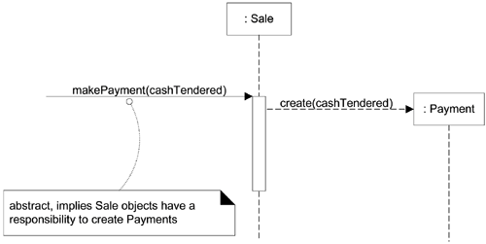
17.5 Responsibilities, Patterns, Interaction Diagrams and Coding
We need to assign responsibilities to objects while coding or while sketching;
Creating interaction diagrams implies making decisions about responsibilities allocation : we use patterns to guide us. E.g.:

Slide 12
The previous figure, indicates that Sale objects have been given a responsibility to create Payments, which is concretely invoked with a makePayment message and handled with a corresponding makePayment method. Furthermore, the fulfillment of this responsibility requires collaboration to create the Payment object and invoke its constructor.
The patterns that we will use are the
  GRASP (General Responsibility Assignment Software Patterns) 9 patterns (Craig Larman’s);
  Some GoF patterns;

Slide 13
17.7 The GRASP
GRASP stands for General Responsibility Assignment Software Patterns [Craig Larman]; there are 9 such OOD patterns:
  Creator, Information Expert, Low coupling, Controller, High Cohesion, Polymorphism, Pure Fabrication, Indirection, Protected Variations;
We now see the first 5 in more details, and we will apply them more systematically on our case studies in the next chapter. The remaining four patterns will be seen later.

Slide 14
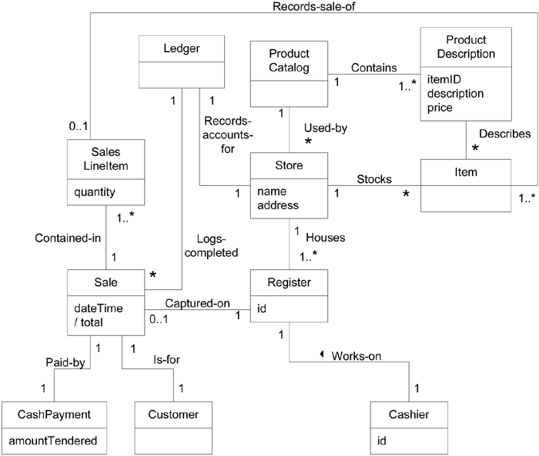
Recall the POS domain model (from chapter 9):

Slide 15
17.8 The Creator Pattern
It helps with the creation of objects: a very common activity obviously. The proper assignment of object creation responsibilities can support low coupling, and overall cleaner, simpler designs.
Creator Pattern:
  Problem Who should be responsible for creating a new instance of some class?
  Solution Assign class B the responsibility to create an instance of class A (to make B the creator of A objects) if one of these is true:
      B contains, compositely aggregates, or records A.
      B closely uses A.
      B has the initializing data for A that will be passed to A when it is created. Thus B is an Expert with respect to creating A.

Slide 16
E.g. in the POS case study, who should be responsible for creating a SalesLineItem instance?
  by Creator, Sale is a good candidate to have the responsibility of creating SalesLineItem instances;
  Other choices are possible: e.g. the Register (since it is the information expert here), but that would increase the coupling in the design …
Composite aggregates Part, Container contains Content and Recorder records Recorded : all very common relationships between classes. Creator suggests that the enclosing container or recorder class is a good candidate for the responsibility of creating the thing contained or recorded.
Sometimes you can identify a creator by looking for the class that has the initializing data that will be passed in during creation.

Slide 17
17.9 The Information Expert Pattern
During object design, when the interactions between objects are defined, we make choices about the assignment of responsibilities to software classes. If we've chosen well, systems tend to be easier to understand, maintain, and extend, and our choices afford more opportunity to reuse components in future applications.
Expert Pattern:
  Problem What is a general principle of assigning responsibilities to objects?
  Solution Assign a responsibility to the information expert, the class that has the information necessary to fulfill the responsibility.
E.g. in the POS case study, some object needs to know the grand total of the current sale:
  Always start by stating clearly the problem: “Who should be responsible for knowing the grand total of a sale?”

Slide 18
  By expert, we should look for that class of objects that has the information needed to determine the total.
  What information do we need? We need to know about all the SalesLineItem instances of a sale and the sum of their subtotals.
  Therefore, by expert, a Sale object, since it contains all the SalesLineItem instances, should be responsible for knowing the grand total of a Sale.
  Next, who should be responsible for knowing the subtotal of a SalesLineItem?
  What information do we need? We need the quantity of items being purchased and its price (from ProductDescription class).
  Therefore, by expert, a SalesLineItem should determine the subtotal (since it knows its quantity and is associated with the appropriate ProductDescription).
  In terms of an interaction diagram, this means that the Sale should send getSubtotal messages to each of the SalesLineItems and sum the results:

Slide 19
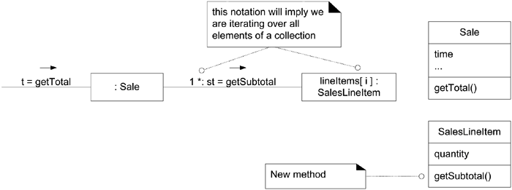
  We are not finished yet! To fulfill the responsibility of knowing and answering its subtotal, a SalesLineItem has to know the product price.
  The ProductDescription is an information expert on answering its price; therefore, SalesLineItem sends it a message asking for the product price.

Slide 20
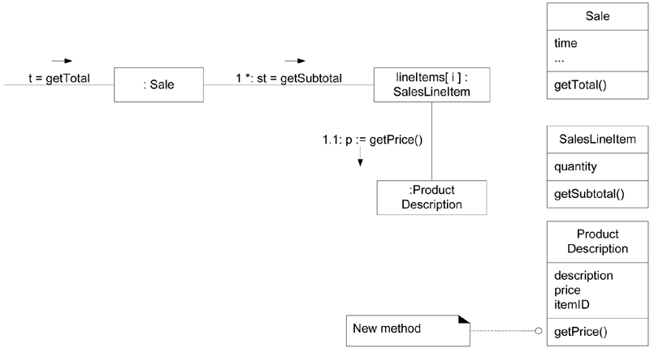
The expert pattern is obviously used all the time; it not always right however, or may lead to several candidate classes…

Slide 21
17.10 The Low Coupling Pattern
Coupling is a measure of how strongly one element is connected to, has knowledge of, or relies on other elements.
  A class with low coupling is not dependent on too many (subjective) other classes, and has simple relationships with them.
  A class with high coupling relies on many other classes. This is undesirable because:
    Forced local changes because of changes in related classes.
    Harder to understand in isolation.
    Harder to reuse because its use requires the additional presence of the classes on which it is dependent.
Low Coupling Pattern:
  Problem How to support low dependency, low change impact, and increased reuse?
  Solution Assign a responsibility so that coupling remains low. Use this principle to evaluate alternatives.

Slide 22
E.g. in the POS case study, consider the following classes : Payment, Register and Sale, assume we need to create a Payment instance and associate it with the Sale. What class should be responsible for this?
  Since a Register "records" a Payment in the real-world domain, the Creator pattern suggests Register as a candidate for creating the Payment. The Register instance could then send an addPayment message to the Sale, passing along the new Payment as a parameter:

Slide 23
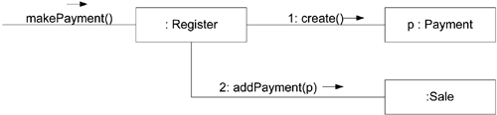
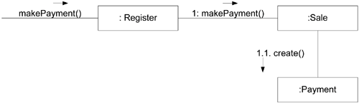
Another solution is:
Both work. Both are correct. But which is best?
  Design 1, in which the Register creates the Payment, adds coupling of Register to Payment; Design 2, in which the Sale does the creation of a Payment, does not increase the coupling. (see domain model for current coupling)

Slide 24
Hence here the low coupling pattern helps us to steer away from less desirable design… It just points us in the right direction.
Low Coupling encourages you to assign a responsibility so that its placement does not increase the coupling to a level that leads to the negative results that high coupling can produce.
A class hierarchy based on inheritance (superclass/subclasses) creates strong coupling and must be used with care: i.e. only when it is logical to do so, not just for the sake of it.
Low Coupling supports the design of classes that are more independent (a very very good thing).
The low coupling pattern must kept in check by the high cohesion pattern … otherwise we may end up with one class that does all the work (no coupling at all!!!). Remember too that our classes must not become too big.

Slide 25
In general, classes that are inherently generic in nature and with a high probability for reuse should have especially low coupling.
High coupling to stable elements and to pervasive elements is seldom a problem. E.g. coupling to development kit classes, or class libraries.
On the other hand high coupling to elements that are unstable, is to be avoided.
The notion of coupling is fundamental to modular designs in general: the level of coupling must be kept in check not be higher than is necessary.

Slide 26
17.11 The Controller Pattern
System operations are the major input events generated by actors.
  For example, when a cashier using a POS terminal presses the "End Sale" button, he is generating a system event indicating "the sale has ended." Similarly, when a writer using a word processor presses the "spell check" button, he is generating a system event indicating "perform a spell check."
A controller is the first object beyond the UI layer that is responsible for receiving or handling a system operation message.
  This is in accordance with the understanding that the UI layer shouldn't contain application logic, UI layer objects must delegate work requests to another layer.

Slide 27
Controller Pattern:
  Problem What first object beyond the UI layer receives and coordinates ("controls") a system operation?
  Solution Assign the responsibility to a class representing one of the following choices:
  Represents the overall "system," a "root object," a device that the software is running within, or a major subsystem (aka a facade controller).
  Represents a use case scenario within which the system event occurs, often named <UseCaseName>Handler, <UseCaseName>Coordinator, or <UseCaseName>Session (use case or session controller).
    Use the same controller class for all system events in the same use case scenario.
    Informally, a session is an instance of a conversation with an actor. Sessions can be of any length but are often organized in terms of use cases (use case sessions).

Slide 28
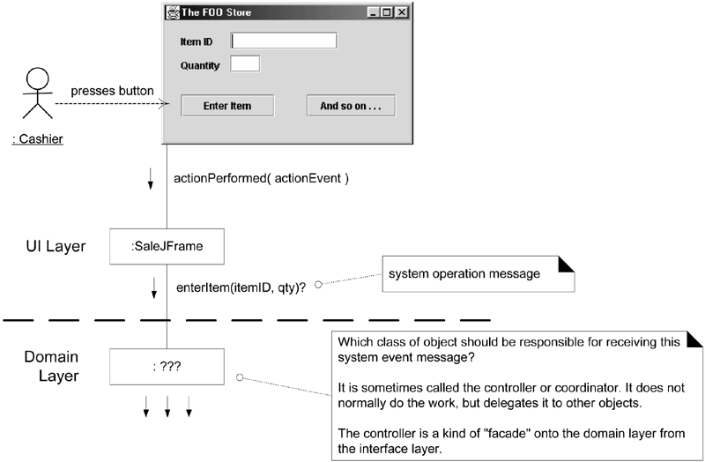
E.g. in the POS case study, during analysis, we discovered many system-level operations: endSale(), enterItem(), makeNewSale(), makePayment(), for which we wrote contracts … :

Slide 29
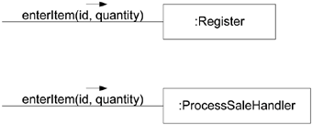
  Who should be the controller for system events such as enterItem and endSale?
  By the Controller pattern, here are some choices:
    “Represents the overall "system," "root object," device, or subsystem” : Register
    “Represents a receiver or handler of all system events of a use case scenario” : ProcessSaleHandler
  So:
  which?
  At this stage it does not really matter, but let’s see what may happen later: more and more system operations are considered and since we prefer to keep the same controller class for all system events within a use case the following will occur:

Slide 30
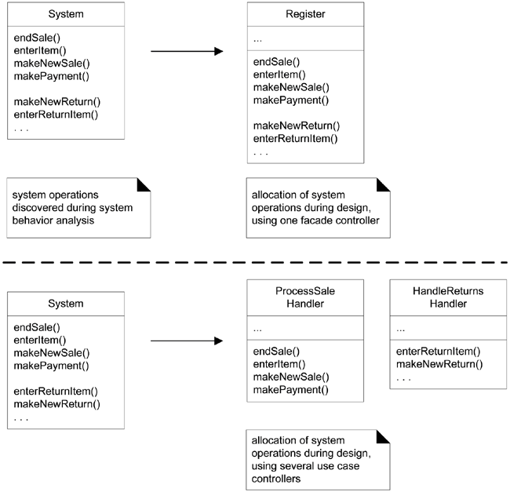

Slide 31
  We prefer to use the same controller class for all the system events of one use case so that the controller can maintain information about the state of the use case. Such information is useful, for example, to identify out-of-sequence system events (for example, a makePayment operation before an endSale operation). Different controllers may be used for different use cases.
  Normally, a controller should delegate to other objects the work that needs to be done; it coordinates or controls the activity. It does not do much work itself.
  Facade controllers are suitable when there are not "too many" system events.
  If you choose a use case controller, then you will have a different controller for each use case. This kind of controller is not a domain object; it is an artificial construct to support the system (a Pure Fabrication in terms of the GRASP patterns). For example, if the NextGen application contains use cases such as Process Sale and Handle Returns, then there may be a ProcessSaleHandler class and so forth.

Slide 32
A common defect in the design of controllers results from over-assignment of responsibility: it does do many unrelated work and does not delegate enough. A controller then suffers from low cohesion, violating the principle of High Cohesion (e.g. see the previous Register class for example). We call these bloated controllers:
  Use case controllers are a good choice when there are many system events across different processes. They can replace a bloated facade controller.
  Or ensure that your controller delegates as much as possible.
For the POS case study, the Register might initially be chosen as controller, and we could ensure that most of the work is delegated. But we should keep in mind that it may become bloated in which case we may revert to use case controllers instead later. See general principle on next figure.

Slide 33
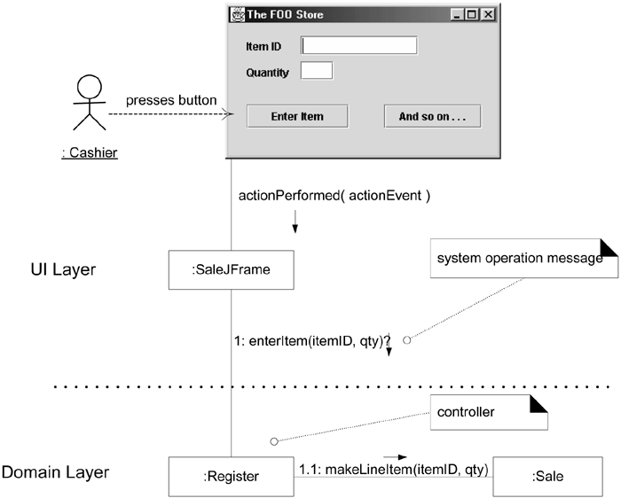

Slide 34
17.12 The High Cohesion Pattern
Cohesion is a measure of how strongly related and focused the responsibilities of an element are. An element with highly related responsibilities that does not do a tremendous amount of work has high cohesion. These elements include classes, subsystems, and so on.
High Cohesion Pattern:
  Problem How to keep objects focused, understandable, and manageable, and as a side effect, support Low Coupling?
  Solution Assign a responsibility so that cohesion remains high. Use this to evaluate alternatives.
A class with low cohesion does many unrelated things or does too much work. Such classes are undesirable; they suffer from the following problems:
  hard to comprehend;
  hard to reuse;
  hard to maintain;
  delicate; constantly affected by change;

Slide 35
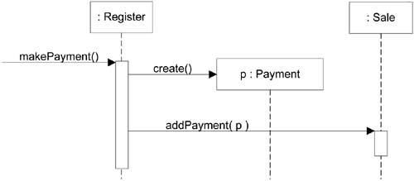
E.g. in the POS case study, recalling the previous example:
Or as a sequence diagram:
This assignment of responsibilities places the responsibility for making a payment in the Register. The Register is taking on part of the responsibility for fulfilling the makePayment system operation.

Slide 36
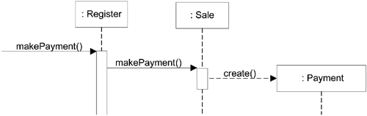
In this isolated example, this is acceptable; but if we continue to make the Register class responsible for doing some or most of the work related to more and more system operations, it will become increasingly burdened with tasks and become incohesive.
  Imagine fifty system operations, all received by Register. If Register did the work related to each, it would become a "bloated" incohesive object.
The other alternative, which as seen keeps the coupling low,
  by delegating the payment creation responsibility to the Sale, also supports higher cohesion in the Register...

Slide 37
So, since the second design supports both high cohesion and low coupling, it is desirable.
Low coupling and high cohesion often go hand in hand, they usually reinforce each other;
  Of course the opposite is often true: high coupling goes with low cohesion: that’s to be avoided.
Beyond correctness, the quality of an OO design is strongly related to its level of coupling and cohesion:
  Many small design decisions are made during OOD, each one must be evaluated against the two evaluative low coupling and high cohesion patterns;
  A poor design is not something that can be easily fixed afterwards...;

Slide 38
The only contraindication to the low coupling, high cohesion patterns is in relation to performance.
  In fact while our classes should in general be quite small and cohesive this can lead to a fine-grained OOD (which is good most of the time: loads of small classes, a rich set of classes);
  However this leads to communications overheads and is therefore maybe not suited for the innermost core of an application (e.g. we probably should not model each pixel as an object ...);
  A compromise must be reached but in general we must go for a large set of small, cohesive, lowly coupled classes.

Slide 39
17.13 Conclusions
We’ve introduced here the notion of design patterns, performed some design activities, and review 5 patterns in detail:
  Creator;
  Information Expert;
  Low coupling;
  Controller;
  High Cohesion;
These are the most basic, most useful, OOD patterns.
In the next chapter we will see a systematic way to use them to end up with more often than not, a correct, good style OOD.

