Slide 1
Chapter 23: GRASP : More Objects with Responsibilities
23.1. Introduction
Previously, we applied five GRASP patterns:
  Information Expert, Creator, High Cohesion, Low Coupling, and Controller
The final four GRASP patterns are covered in this chapter. They are:
  Polymorphism
  Pure Fabrication
  Indirection
  Protected Variations

Slide 2
23.2 Polymorphism
Problem: How handle alternatives based on type? Or, how to create pluggable software components?
  alternatives based on type : very often in traditional software engineering we end up in situations such as :
    switch shapetype
      line : call drawline(data)
      circle : call drawcircle(data)
      rect : call drawrect(data)
      poly : call drawpoly(data)
      etc.
    This is repeated throughout the code making it harder to extend it.
  pluggable software components : we wish to support the creation of future plugins, or we have to handle many similar APIs within our system e.g. OpenGL or DirectX APIs, various sound APIs etc. These offer the same kind of services but their APIs are different: how to write the rest of the application to offer choice?

Slide 3
Solution : When related alternatives or behaviours vary by type (class), assign responsibility for the behavior using polymorphic operations to the types for which the behavior varies.
  In other words, use polymorphic operations that are implemented differently in each type (aka class) concerned;
  To create plugins take this idea to the extreme and create interfaces;
Discussion : There are many variations between OOPLs for implementing polymorphism or interfaces.
  Java and C# for example have a specific interface construct for example while C++ does not;

Slide 4
Example : POS Case Study
  Here the problem is more extreme because it is not just a simple operation that is polymorphic (depending on the type of Tax Calculator used) but rather an entire API.
  In such situtations where various similar (or currently unknown) APIs need to be accomodated (or for future-proofing your application, or allow third party plugin developments) we can create an actual polymorphic interface.
  A few words about interface classes [Alhir]:
    An interface is a class that may have operations but may not have attributes, associations, or methods. An interface defines a service or contract as a collection of public operations.
    An interface is shown as a class marked with the interface keyword, and because interfaces don't have attributes, the second compartment is always empty and, therefore, not shown.
    You can think of interfaces as application programming interfaces (APIs), because they define a collection of operations that are commonly used together and thus define a more general service. Because interfaces do not have methods but merely represent services, they do not have instances.

Slide 5
  Hence for the POS where there are multiple external third-party tax calculators that must be supported (such as Tax-Master and Good-As-Gold TaxPro); the system needs to be able to integrate with different ones. Each tax calculator has a different interface, so there is similar but varying behavior to adapt to each of these external fixed interfaces or APIs.
  Since the behavior of calculator adaptation varies by the type of calculator, by Polymorphism we should assign the responsibility for adaptation to different calculator (or calculator adapter) objects themselves, implemented with a polymorphic getTaxes operation; these calculator adapter objects are not the external calculators, but rather, local software objects that represent the external calculators, or the adapter for the calculator. By sending a message to the local object, a call will ultimately be made on the external calculator in its native API.

Slide 6
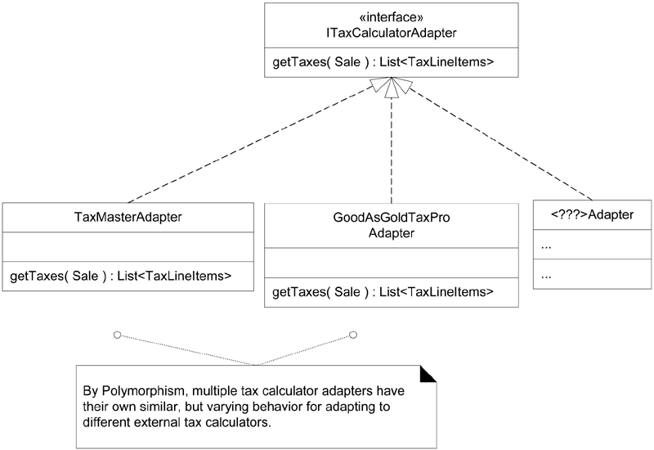

Slide 7
  Each getTaxes method takes the Sale object as a parameter, so that the calculator can analyze the sale. The implementation of each getTaxes method will be different: TaxMasterAdapter will adapt the request to the API of Tax-Master, and so on.
Conclusions on the Polymorphism pattern:
  Related patterns: Protected Variations, Choosing Message, Don't Ask “What Kind?”

Slide 8
23.3 Pure Fabrication
Problem: What object should have the responsibility, when you do not want to violate High Cohesion and Low Coupling, or other goals, but solutions offered by Expert (for example) are not appropriate?
  Sometimes our set of classes (generated from the problem domain during analysis mostly) are insufficient (or increases the coupling, or decrease the cohesion beyond what is reasonable) to support new requirements
Solution: Assign a highly cohesive set of responsibilities to an artificial or convenience (a ‘pure fabrication’) class that does not represent a problem domain concept-something made up- to support high cohesion, low coupling, and reuse.

Slide 9
Example : POS Case Study
  For example, suppose that support is needed to save Sale instances in a relational database. By Information Expert, there is some justification to assign this responsibility to the Sale class itself, because the sale has the data that needs to be saved. But:
    The task requires a relatively large number of supporting database-oriented operations, none related to the concept of a sale, so the Sale class becomes incohesive.
    The Sale class has to be coupled to the relational database interface, so its coupling goes up.
    Saving objects in a relational database is a very general task for which many classes need support. Placing these responsibilities in the Sale class suggests there is going to be poor reuse or lots of duplication in other classes that do the same thing.
  Thus, even though Sale is a logical candidate by virtue of Information Expert to save itself in a database, it leads to a design with low cohesion, high coupling, and low reuse potential.
  Hence, by Pure Fabrication pattern a reasonable solution is to create a new class that is solely responsible for saving objects in some kind of persistent storage medium, such as a relational database; call it the PersistentStorage.

Slide 10
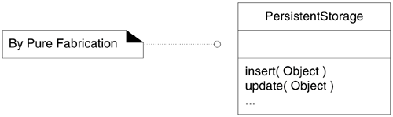
  This solution addresses the following problems:
    The Sale remains well-designed, with high cohesion and low coupling.
    The PersistentStorage class is itself relatively cohesive, having the sole purpose of storing or inserting objects in a persistent storage medium.
    The PersistentStorage class is a very generic and reusable object.
Discussion :
  As always this solution can be abused and overused: it may lead to too many behavior objects that have responsibilities not co-located with the information required for their fulfillment, which can adversely affect coupling.

Slide 11
  However, sometimes a solution offered by Information Expert is not desirable. Even though the object is a candidate for the responsibility by virtue of having much of the information related to the responsibility, in other ways, its choice leads to a poor design.
  A Pure Fabrication usually takes on responsibilities from the domain class that would be assigned those responsibilities based on the Expert pattern.
  Related patterns: low coupling, high cohesion, most other design patterns introduce pure fabrications.
23.4 Indirection
Problem: Where to assign a responsibility, to avoid direct coupling between two (or more) things? How to de-couple objects so that low coupling is supported and reuse potential remains higher?
Solution: Assign the responsibility to an intermediate object to mediate between other components or services so that they are not directly coupled.

Slide 12
  In effect we introduce another level of indirection via a pure fabrication object;
  This pattern is often a side benefit of other patterns, e.g. Polymorphism when used to introduce interfaces introduces indirection, and pure fabrication often also the benefit of indirection;
Example: POS case study
  By introducing a ITaxCalculatorAdapter interface realised (aka implemented) by a specific TaxCalulatorAdapter (e.g. TaxMasterAdapter) we have introduced a level of indirection which is beneficial to the design.
  These Adpater objects act as intermediaries to the external tax calculators. Via polymorphism, they provide a consistent interface to the inner objects and hide the variations in the external APIs. By adding a level of indirection and adding polymorphism, the adapter objects protect the inner design against variations in the external interfaces :

Slide 13
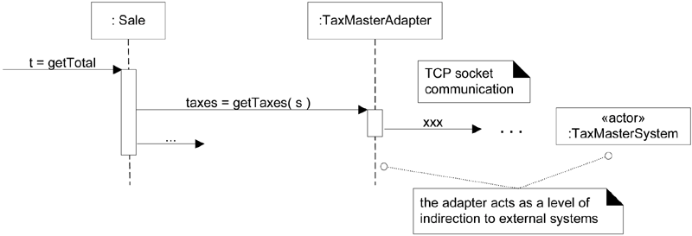
E.g. :
  Also, the Pure Fabrication example of decoupling the Sale from the relational database services through the introduction of a PersistentStorage class is also an example of assigning responsibilities to support Indirection. The PersistentStorage acts as a intermediary between the Sale and the database.

Slide 14
Discussion :
  Related patterns: Low Coupling, Pure Fabrication, Protected Variations
23.5 Protected Variations
Problem: How to design objects, subsystems, and systems so that the variations or instability in these elements does not have an undesirable impact on other elements?
Solution: Identify points of predicted variation or instability; assign responsibilities to create a stable interface around them.
  Note: The term "interface" is used in the broadest sense of an access view; it does not literally only mean something like a Java interface.

Slide 15
Example: POS Case Study
  For example, the prior external tax calculator problem and its solution with Polymorphism illustrate Protected Variations. The point of instability or variation is the different interfaces or APIs of external tax calculators. The POS system needs to be able to integrate with many existing tax calculator systems, and also with future third-party calculators not yet in existence.
  By adding a level of indirection, an interface, and using polymorphism with various ITaxCalculatorAdapter implementations, protection within the system from variations in external APIs is achieved. Internal objects collaborate with a stable interface; the various adapter implementations hide the variations to the external systems.
Discussion:
  Protecting our design against low-level, highly changeable, components or aspects of the application is an essential characteristic of good design.
  We want the core of our application to be free of such variations/instability.

Slide 16
  This has the following benefits:
    Extensions required for new variations are easy to add, including third-party extensions and customisations (e.g. skins);
    Coupling is lowered;
    The impact or cost of changes can be lowered, thus improving maintainability;
    Allows for quick experimentations in object behaviours (e.g. in AI behaviours, physics rules etc.) via pluggable rules.
  The Protected Variation design pattern is a root principle motivating most of the mechanisms and patterns in programming and design to provide flexibility and protection from variations; variations in data, behaviour, hardware, software components, operating systems, and more.
  Many basic software engineering solutions help to protect against variations (hence implement the Protected Variations pattern): Data encapsulation, interfaces, polymorphism, indirection, and standards (e.g. XML, SQL, network protocols);
  In addition, data-driven solutions are a general solution against variations permeating our design.

Slide 17
25.3.1 Data Driven Design
This covers a broad family of solutions:
  Basic configuration files that are read-in at run-time and configure or parameterise, the application:
    Aspects of the system that can be configured are factored-out to an external data file (typically a simple format text-file e.g. physics constants, but also technology specific files e.g. mesh files, sound files, level designers files that can be imported at run-time);
    This allows users and developers to quickly experiment and extend the system without having to change the code or even without having to re-compile the application;
  Configuration files can also be written in a specific syntax to ensure:
    Validity (proper formating can ensure that the application is not trying to process-parse-invalid data);
    Efficiency : to read and save;
    Standardisation amongst product families or actual industry standard;
    Third party tools for creation;

Slide 18
  Configuration files can be very sophisticated for describing data, behaviours, game rules, layouts etc :
    Use basic Text;
    Use an application-specific language (a made up text-based language);
    Use a meta-language : XML (edited using an XML editor to save time);
    Be compressed for saving space and disk access time (but must be decompressed : more CPU intensive);
    In Binary format, for saving space, disk access time, and overall loading time (but harder to edit : must use an external application);
    Use full-blown scripting language (usually interpreted at run-time) : Python, Lua, Ruby etc.
  Typically these require the implementation of a parser in your application to read-in configuartion information (XML parsers are widely available, parsers can be created for most luanguages using tools such as Lex and Yacc). Run-time information may also be saved in a specific language.
  The parser may be called at loading time or at any time necessary during execution.

Slide 19
Some disavantages:
  Performance : parsing can be slow;
  Extra work : over-engineered;
Examples:
  We could have a complex class hierarchy of classes for entities in our game, and populate them at initalisation time using a file describing their properties: nothing is hard coded!!

Slide 20
In conclusion, data-driven design is a way of applying the Protected Variations design pattern:
  Don’t hard code anything (even the AI can be described in separate files and not hardcoded: the role of the code is then simply to interpret and implement the behaviour as described)
  This offers great flexibility during game development for tweaking values (e.g. physics constants), allows non programmers to work indirectly on the code, offer customisation potential for users, and improves greatly future maintenance (e.g. release of special editions, or localised products for different markets).
23.5.2 Conclusion Protected Variations
A great design pattern but:
  It can be abused (over-engineered) : only future proof, or allow flexibility of features, that vary a lot. If something is unlikely to change don’t protect it against variations (waste of time and effort).
  Requires extra work.

