Slide 1
Unit 2. Interfaces: Creating with Visual Basic, Evaluating with Usability Heuristics

Slide 2
Unit 2. Interfaces: Creating with Visual Basic, Evaluating with Usability Heuristics
2.1 Creating with Labels— Evaluating with Two Heuristics
2.2 Creating with Buttons — Evaluating with Three Heuristics
2.3 Creating with Checkboxes and Radio Buttons — Evaluating with One Heuristic
2.4 Creating with ListBoxes and ComboBoxes — Evaluating with One Heuristic
2.5 Creating with Combinations
2.6 Creating with Containers — Evaluating with One Heuristic
2.7 Two More Heuristics for Evaluating Interfaces
2.8 Menu Controls and Some Example UARs

Slide 3
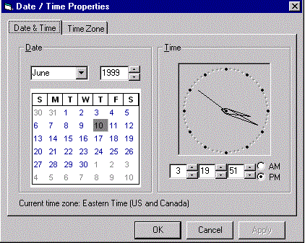
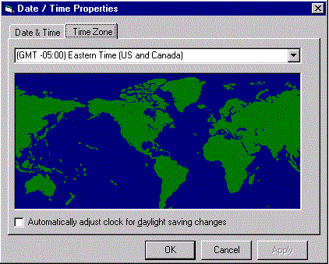
Overview of the Windows Date/Time Control Panel
its implementation vary across the Windows platforms
basic function and appearance are same/similar.
consist of two tabbed pages
E.g., show the control panel on this machine

Slide 4
The Date & Time Page — Its Purpose and Operation
The Date & Time page allows users to set the system date and time
controls
  provided by two frames
  Date frame features a drop-down list for selecting a month
  a Textbox with up-down arrows for selecting a year
  a clickable graphical calendar for selecting a day
  in some implementations, radio buttons ( change A.M./P.M. settings)

Slide 5
The Date & Time Page — Its Purpose and Operation
Operation: users set the system time by manipulating the relevant controls on the page's Time frame
  Click
  TAB : navigate forwards,
  SHIFT+TAB: navigate backwards
  Ctrl+TAB : move from one tabbed page to the next
E.g., Operation under MSDOS

Slide 6
The Time Zone Page — Its Purpose and Operation
The Time Zone page allows users to set the system clock to a time zone of their choosing
Controls
  drop-down box: displays a list of standard time zones
  pictureBox: map
  Checkbox: automatically to reflect changes in daylight savings

Slide 7
2.1 Creating with Labels, Shapes, and Lines (VB6) — Evaluating with Two Heuristics
2.1.1 Labels
2.1.2 HE: Match System to Real World
2.1.3 HE: Visibility of System Status

Slide 8
2.1.1 Labels
Label Controls
  Label Controls
  Label Control Properties

Slide 9
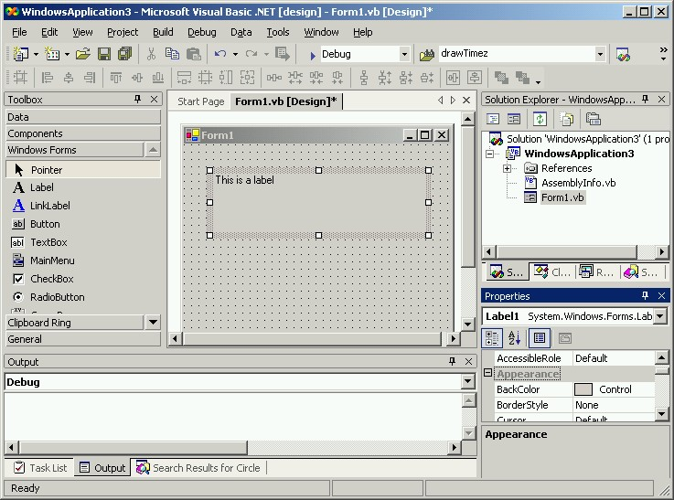
Label Controls- the simplest control
provides a simple textual message

Slide 10
Label Control Properties-(name)
(Name)
  indicates the identifier that your program code can use to refer to the control
  used as part of the name of the subroutine that handles events for the control
  it cannot be changed at runtime
  Every control is given a default name when it is created.
  it's a good idea to change it to something more meaningful in order to improve the readability of code.

Slide 11
Hints of Property-(name)
Hint 1 ：VB does not automatically update code to reflect control names changes
  You should rename controls immediately when they are created and to think carefully about the names you choose
Hint 2 : a control must have the form of a valid identifier in VB
  a good convention is to capitalize the second and subsequent words (e.g., "aMultipleWordName").
  Another convention is to separate the words with an underscore ("_") character (e.g., "a_multiple_word_name").

Slide 12
Label Control Properties
Text
  The Text property controls what text the Label displays.
  Changing the property (either at design time or at runtime) changes the text that appears on the screen.

Slide 13
Label Control Properties
Location (X, Y), Size(Width, Height)
  They control where the top-left corner of the control appears in a "container" object,
  its dimensions controlled by - Size(Width, Height).
  By default, these properties use pixels as the unit of measurement.
When to set
  Under most circumstances, you do not type values into these properties directly. Instead you typically place and resize the control interactively (using its handles).
  However occasionally, you might want to use a precise value, or to ensure that a number of different controls have the same value. In those cases, it's useful to enter a numeric value directly in one or more of these properties.

Slide 14
Label Control Properties
AutoSize
  takes on a Boolean value (True or False).
  If the AutoSize property's value is True, then the control's Width and Height properties are automatically (re)calculated so that the control is the size needed by whatever text is being displayed. If this property's value is False, then the control's width and height are fixed, and text that does not fit within this size is clipped away and is not visible (though the text is still in the control).
BackColor, ForeColor
  determine the color used for the background of the text and the text itself

Slide 15


Label Control Properties
BorderStyle
  This property determines the display style of the control. It determines, for example, whether a control will display a raised (pseudo-3D) appearance or a flat appearance. when
  " Fixed3D "
  " FixedSingle "

Slide 16
Label Control Properties
Visible
  Determines whether the Label appears at all in the final display (as shown below).
  "False" - make the Label disappear.
  "True" - insure that the Label is displayed.
Font
  Controls the font used to display the text of the Label.

Slide 17
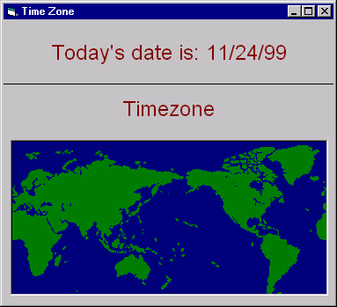
2.1.2 HE: Match system to Real world
Real-World Concepts
Real-World Language
Real-World Conventions
Cultural Issues
Date/Time Control Panel Applications of this Heuristic
Example UAR: Aspect 1 — Date Label is Good, It Speaks the Users' Language
Example UAR: Aspect 2 — Map Very Prominent But Not Interactive, Does Not Follow Real-World Conventions

Slide 18
Real-World Concepts
Many computer systems can benefit from using real-world concepts in their interfaces --
  In Macintosh and Windows operating systems,--
    ”desktop”
    Folders
    Documents
    trash can
which are all very familiar to office workers, e.g.,
  users immediately know (based on their knowledge of the real world) that they can put documents in folders
  also know that they can put either documents or whole folders into the trash
  can as well as change their minds and take them out again

Slide 19
Real-World Concepts
Finding a suitable metaphor for a system requires that
  a design team understand the task domain
  the design team will include a domain expert
    who can guide the search for a suitable real-world metaphor
it is important to understand that the computer system is likely to go beyond the real-world concept
  E.g., in an operating system, make a pointer to a document , place it on the desktop or in many different folders, then you will be able to access the same document from all of these places
  The real world has no analogous facility, In the real world, you would have to make many copies of the same document and put them in all the different places you wanted them in.
  changed one copy, you'd have to make copies of the new version and replace the copies of the old version in all those places
the operating system is giving the user a powerful capability that does not exist in the real world.

Slide 20
Real-World Concepts
real-world concepts help the user make contact between their prior knowledge and the new system
it is important to understand that the computer system is likely to go beyond the real-world concept, so
  the parallel will not be perfect, nor should it be.
  After all, the computer system will only be better than the real-world system it is replacing
to the extent that the computer gives the user more power than they have in the real world.

Slide 21
Real-World Language
"Speak the user's language . "
computer application should use the same vocabulary that the user would use to describe
  concepts
  objects
  processes

Slide 22
Real-World Language
Avoid technical jargon that only computer scientists will understand. E.g.,
  "abort“, common in computer science and had no negative connotations, stop some process
  in the real world, (especially the United States in the late 20th century) this word is politically charged and is seen to be rather violent
  Sensitivity to the real-world meanings of this term has led to its almost disappearance from the systems we see today.

Slide 23

Real-World Language
example of a violation of this heuristic
  computer systems give error messages that use systems terms instead of user's language
    an application will quit unexpectedly and a dialog box will appear that says something like the following:
user will not know what an "Error of Type 01" is
user will only be confused by this information
The information needs to be put into words that make sense to the user.

Slide 24
Real-World Conventions
conventions that make the real world more manageable
conventions are what people have come to expect from their years of living
conventions should be carried over and maintained as much as possible in computer systems

Slide 25
Common conventions
Printed matter is read in a specific order (for English, this is left-to-right, top-to-bottom).
Things that are the biggest are probably the most important.
Things that are visually grouped together probably have something to do with each other semantically.
  Things that are separated by white space are less likely to be related.
Something that happens right after you do something is probably caused by what you just did.

Slide 26
Cultural Issues
when you move from users of one culture to users of another culture, conventions are apt to change
cultures defined by
  geographic area,
  language
  age
  E.g., printed matter is ordered in a different way for English than it is for Japanese

Slide 27
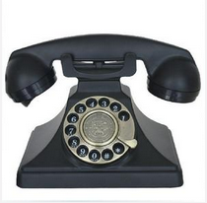
Cultural Issues
Computer systems that have a global market need to be especially sensitive to this issue throughout the design.
Generational issues
  designing computer systems for different age-populations also have to be careful
  Eg. "dial a telephone," instead of "press a telephone“

Slide 28
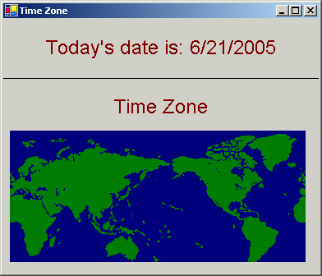
Date/Time Control Panel Applications of this Heuristic
your first Visual Basic prototype in exercise 3.
We will examine two aspects of this small interface
  using the match between system and real world heuristic
  demonstrate how to write UARs for our conclusions

Slide 29
Example UAR: Aspect 1 — Date Label is Good, It Speaks the Users' Language
One aspect of this interface is that it presents the day's date in straightforward language that is familiar to users.
Here a UAR to document this good aspect of the interface
Use this first example of a UAR to discuss issues of how to write a good UAR as well.

Slide 30
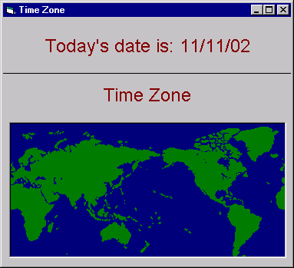
Example UAR: Aspect 2 — Map Very Prominent But Not Interactive, Does Not Follow Real-World Conventions

Slide 31
introduction
This is an example of a violation of the match between system and real world heuristic.
In this simple interface simulates the Windows 98 control panel quite closely
the image of the map is very big, taking up most of the space in the control panel.
  This implies, through real-world conventions, that it is very important to the user in understanding and interacting with the control panel.
  However, in this preliminary prototype, and in the real control panel, the user cannot actually interact with the map.
  It doesn't respond when the user clicks it.

Slide 32
introduction
In real word standard forms
  a similar control panel on the Macintosh does allow interactivity—the user can both specify points on the map by clicking on it and move its view by dragging.)
  In the actual Windows 98 control panel, the map does change when the user resets the time zone, but only in a very subtle way—it re-centers around the city or region that the time zone is set to (you will program this in Visual Basic in a later exercise).
  However, it doesn't indicate the time zone boundaries with any lines.
    Thus, even the actual control panel has a very impoverished interactivity.
    Thus, even the actual control panel violates this heuristic by ignoring the real-world convention that the biggest things tend to be the most important.

Slide 33
2.1.3 HE: Visibility of System Status
Provide Feedback — Keep the User Informed About the Stages of a Process
Don’t Make the User Guess
Date/Time Control Panel Applications of this Heuristic
Example UAR: Date Label Is Good — It Shows the Date the Computer Is Set To

Slide 34
Provide Feedback — Keep the User Informed About the Stages of a Process
Have you meet ?
  initiated a command but there is no immediate activity
  Nothing indicate that the command has been received and is being executed
As above,Often Cause users become uncomfortable
it is important that the user receives informative feedback whenever a command has been issued
  E.g. opening a file
    selects the File/Open command
    a file dialog box appears
    confirms that the File/Open command has been received
  E.g. Copy/move indicator bar
    showing the progress of the process
    approximately how much information has been transferred
    how much information has yet to be transferred

Slide 35
Provide Feedback — Keep the User Informed About the Stages of a Process
The hourglass and watch hand
  The hourglass and watch hand : common signals that the computer is doing something
  but they provide no hint about what the something is or how far along the process is
Dial-Up process
  following series of messages appears
    dialing *00862768778132…
    verifying username and password
    registering user on network
    …
  it keeps the user informed about the stages of the dial-up operation

Slide 36
Feedback methods
methods
  an icon changing shape,
  a menu item blinking briefly as it is selected,
  a message,
  a dialog box,
  an alarm,
  an audio clip,
  or an animation
Dialog boxes and messages can be used to
  confirm actions, warn of irreversible actions
  guide users along a multi-step path
Messages should be in the user’s terminology, not computerese

Slide 37
Don’t Make the User Guess
keeping the user informed
  the stages of a process
  the current task situation
E.g.,
  Showing the filename on the title bar of a document
    keeps users informed about what files are in each window.
  Dimming or shading a menu option:
    tells users the status of the option—that the option is not currently available.
  Icons show the presence of applications or documents.

Slide 38
Date/Time Control Panel Applications of this Heuristic
examine an aspect of this small interface using the visibility of system status heuristic
write a UAR for conclusions.

Slide 39
2.2 Creating with Buttons — Evaluating with Three Heuristics
2.2.1 Buttons
2.2.2 HE: Consistency and Standards.
2.2.3 HE: User Control and Freedom.
2.2.4 HE: Flexibility and Efficiency of Use.

Slide 40
2.2.1 Buttons
Button Control Description
Properties
  Text
  TabStop, TabIndex
  Enabled
  Font
Events

Slide 41





Button Control Description
Changes in the colors of lines make a button appear to be pressed.
The underlined "P" reminds us of the shortcut character.
Sample : ButtonDemo
The dotted border signifies that the button is in focus.
A button can be decorated with an image.
E.g., the window media player’s buttons

Slide 42
Properties - Text
determines the textual label displayed on the button
shortcut
  character: placing an "&" just before the character
  indicated to the user by an underline and
  can be invoked by holding down the ALT key and pressing the shortcut character
  It is up to the programmer to ensure that shortcut characters are unique across all controls.
note:
  the system provides the same initial default,
  the Text property of a control (which is displayed to the user) is distinct from
  the name of the control (which is used programmatically).

Slide 43
Properties
TabStop
  Determines either allows the focus to stop at the button or causes the focus to skip over it.
TabIndex
  The TabIndex values within a form start at zero and proceed to N-1 (where N is the number of controls in the form).
  When the Tab key is pressed, the focus moves to the control with the next highest TabIndex value that also has its TabStop property set to "True" (wrapping around from N-1 to zero if necessary).

Slide 44
Note of TabStop,TabIndex
Whenever you define a TabIndex property, Visual Basic automatically renumbers the TabIndex properties of all other controls in the form.
Consequently, TabIndex numbers will always be within the designated zero to N-1 range.
  If not explicitly specify a TabIndex value, TabIndexes will be assigned by the system in the order in which controls were created.

Slide 45
Note of TabStop,TabIndex
Current focus is indicated visually, there is no visual indication given of where the next focus will be.
  Consequently, it is important to set the TabIndex properties of all controls carefully in order to avoid behavior that is unexpected by the user.
As a rule of thumb, focus should move within a logically related group of controls before moving to an unrelated group.
  In a group, focus should move in reading order.
  Similarly, when moving between groups, movement in reading order is often preferred.
Finally, focus should begin
  either with the default control (see the Default property )
  or with the first control of the first logical group of controls (in reading order).

Slide 46

Properties
Enabled
  Indicates whether the button is enabled.
  Disabled buttons do not operate when clicked and are drawn to appear "shaded" (as shown below) to indicate that they have been disabled:
Font
  controls the font used to display the caption of the button.

Slide 47
Events
Input events that correspond to user manipulation of input devices are delivered to the controls of a Visual Basic interface
  Visual Basic should then respond to these input events.
The controls process the events in order to
  provide visual feedback and
  invoke the actions specified by the programmer.

Slide 48
Events
These actions are performed in Visual Basic by event handler subroutines.
Note
  the situations that lead to the calling of these subroutines are also referred to as events.

Slide 49
Event handler subroutines
Event handler subroutines for a particular control are named in a specific way in VB.
  The name of all the event handlers for a given control begin with the name of the control followed by an underscore character ("_") and then end with the name of the event they are to respond to.
E.g., Click a button named "myButton" event.
  the subroutine named "myButton_Click" would be called when that button was clicked.
  Code responding to the activation of that button would then be placed in the body of the mybutton_Click subroutine:
  Private Sub myButton_Click(ByVal sender as Object, ByVal e As System.Windows.Forms.MouseEventArgs) Handles myButton.Click
  <put code to respond to button activation here>
  End Sub

Slide 50
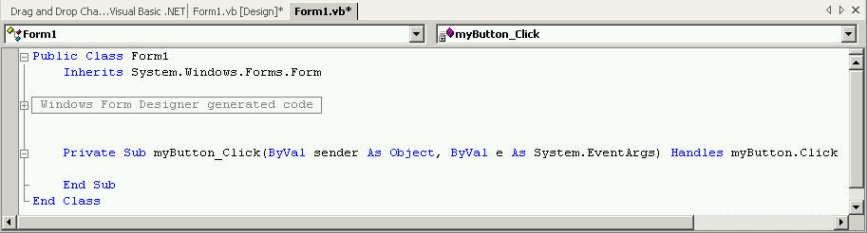
Operation in VB.net 2005
double click on any control, Visual Basic will automatically create code for the most common event handler routine associated with that control (if it does not already exist) and place you in the code editor at that routine.

Slide 51
Edit another event handler
move to the code associated with a particular control by choosing the control name from the pull-down list of names at the left.
move to a particular area of the code (such as global declarations or functions and subroutines not associated with events) by selecting items from these pull-down lists.

Slide 52
Application routines code
The code that responds to the activation of a button normally carries out some action.
Typically, this involves modifying information in the model that pertains to the objects of interest by calling their
  set accessor routines and/or
  one or more of the subroutines that make up the application.
Application routines may modify model objects.
  changes model objects by updating the properties of any controls that are related to them.

Slide 53
additional information of events
The Click event for buttons does not have additional information associated with it.
Other events, however, may have additional information.
  E.g., the KeyDown event not only has
    an integer code that indicates which key was pressed but also
    a second integer code that indicates the states of the modifier keys (SHIFT, CONTROL, and ALT) at the time the key was pressed.
    This additional information about the event is passed as parameters to the particular event handling routine.

Slide 54
events associated with button
Private Sub name_Click(ByVal sender as Object, ByVal e As System.EventArgs)
  invoked whenever the control is activated (by a mouse press and release).
Private Sub name_MouseDown(ByVal sender as Object, ByVal e As System.Windows.Forms.MouseEventArgs)
Private Sub name_MouseUp(ByVal sender as Object, ByVal e As System.Windows.Forms.MouseEventArgs)
  invoked when a mouse button is pressed or released over a button respectively. Information about the state of the mouse when a button is pressed is accessible via the e parameter.
  E.G., e.Button can be used to determine if the right, left or middle button was pressed. Similarly, the location of the mouse when the button was pressed or relased can be determined using e.X and e.Y

Slide 55
events associated with button
Private Sub name_MouseMove(ByVal sender as Object, ByVal e As System.Windows.Forms.MouseEventArgs)
  called whenever the mouse moves over the control
Note
  if no event handler routine is declared for a given event, it is simply ignored.

Slide 56
2.2.2 HE: Consistency and Standards
Don’t Frustrate the User
Maintain Platform Consistency
Maintain Application Consistency
Date/Time Control Panel Applications of this Heuristic
Example UAR: Aspect 1 — Button Labels Are Good
Example UAR: Aspect 2 — Button Names Are Very Similar
Important — When Heuristics Conflict

Slide 57
Brief introduction before
Information that is the same should appear to be the same
  same words
  icons
  positions on the screen
Information that is different should be expressed differently.
This consistency should be maintained within
  a single application
  within a platform (therefore developers need to know platform conventions).

Slide 58
Don’t Frustrate the User
Users become accustomed to certain actions and sequences
they become confused or frustrated
  When they encounter unexpected behavior
users will expect the same series of actions to be required under similar conditions
  Open file
  Exit application
  help

Slide 59
Maintain Platform Consistency
Products should conform to the conventions of the platform
  Same style
    Windows
    Mac
    Linux
Products adhere to platform conventions may minimize frustration
E.g. .
  The location of the File menu ——leftmost item
  The contents of the File menu ——opening, closing, saving, printing, and quitting
Users are able to learn, but they don’t have to
  they can concentrate on learning the commands that are unique to the product —— the own function of the software

Slide 60
Maintain Application Consistency
Consistency within an application is also important
location consistency(in menu)
  commands should not move around between menus
  commands should not appear and disappear from menus.
  menu items that aren’t available should be dimmed (or shaded) instead of being removed from the menu.
keyboard shortcuts
  keyboard shortcuts should comply with platform and application standards.( ctrl + x, ctrl + o, ctrl + c, ctrl + v)
Messages, warnings, and alarms
  should be consistent in their wording and in where they appear
Color semantics
  used as codes, should keep the same meaning throughout
  E.g., red for error , yellow for warn

Slide 61
Maintain Application Consistency
Formatting should be kept consistent
  date and time,
  monetary units,
  numbers
Data presentation should be kept consistent
  data presentation such as,
    labeling,
    capitalization,
    font face, use of bold and italic, and the placement of fields)
Dialog boxes should be consistent in their presentations
Terminology
  words used to describe actions, behaviors, and commands should be kept consistent.

Slide 62
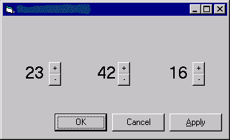
Date/Time Control Panel Applications of this Heuristic
The following picture shows what your first Visual Basic prototype will look like when you have completed Exercise 4. We will examine two aspects of this small interface using the consistency and standards heuristic and write UARs for our conclusions.

Slide 63
Important — When Heuristics Conflict
heuristic gives conflicting design advice
the very nature of heuristic evaluation
  it uses heuristics
  heuristics are not guaranteed to lead to a solution
  just point in a direction of a solution
What to do?
  think hard about whether the conflicting advice makes any real difference to the user
  do an error analysis

Slide 64
error analysis
error analysis suggests that
  the cost of confusing the two buttons
  because their labels do not reflect the actual differences in their functions is relatively small.
But other case will be a more severe consequence of error
  it will be more important to resolve the conflict in some other way
it is better to go with the standard labels because there really are great benefits to be had from adhering to platform standards.
Click the image to run the application and analyze

Slide 65
Rearrange UARs
Go back and put this error analysis in the UARs
  Record the design decision you have made
  If the question comes up again, you'll know why you made this decision.

Slide 66
What shall we do when in more complicate case?
some case, the error analysis is probably the end of the controversy
in other instances
  more severe consequence of error
  more important to resolve the conflict in some other way.
E.g.,
  dialog boxes that are more difficult to get back to if you hit OK mistakenly instead of Apply (and undo doesn't usually work to get a dialog box back!).
  In these cases, you should use another technique (e.g., the think-aloud technique) to get more information about the issue.

Slide 67
2.2.3 User Control and Freedom
Let the User Be in Control
Provide an Undo Mechanism
Require Confirmation
Provide an Escape Route
Date/Time Control Panel Applications of this Heuristic
Example UAR: Aspect 1 — Cancel Button Is Good
Example UAR: Aspect 2 — UARs Sometimes Lead to More UARs.

Slide 68
Let the User Be in Control
"who's in charge "
  strongly affects how a user feels about an application
  Users get frustrated when they don’t feel in control of the computer
users should initiate actions, not the computer
carefully arrange the wording of messages
  their tone should suggest
  the computer is ready and compliant
  not commanding or threatening

Slide 69
Provide an Undo Mechanism
The user should be able to
  reverse the steps in a process and
  retreat back to a previous state
Some of the ways applications implement undo
  An undo command that reverses the most recent command
    The simplest form only allows to reverse the most recent command
    Some applications allow the user to reverse several steps
  A "Reset" or "Factory Settings" button : reverse certain edits
    The Reset button will reverse settings that have been set in the current editing session
    The Factor Settings button will cause the settings to be returned to their out-of-the-box configuration. ( e.g., your cell phone)

Slide 70
Require Confirmation
When initiate an irreversible action
  You should warned the user
Before allowing an irreversible step to be set in motion.
  require an explicit confirmation

Slide 71
Provide an Escape Route
Users should be able to halt processes.
Offer a Cancel button at all times
when canceling a process may leave the computer in an unstable state, E.g.,
  canceling an install process when only a subset of the necessary files have been transferred,
Warn user that canceling could have negative consequences
Advise user an alternative way to halt or reverse the process

Slide 72
Date/Time Control Panel Applications of this Heuristic

Slide 73
2.2.4 HE: Flexibility and Efficiency of Use
Provide Keyboard Shortcuts
Allow for Customization
Date/Time Control Panel Applications of this Heuristic
Example UAR: Button Accelerators Exist
Not Every Facet of Every Heuristic Applies to Every Interface

Slide 74
Provide Keyboard Shortcuts
Keyboard shortcuts provide alternative ways of issuing commands
using a keyboard shortcut is faster than using the mouse
  when a user uses a keyboard shortcut, their hands need not leave the keyboard.
  Using the mouse: keyboard > mouse > target > clicking > keyboard
E.g.,
  MAC: the button outlined in bold can be "pressed" by hitting the RETURN key
  WIN: Ctrl + O , Ctrl + C , Ctrl + V
  The underlined letter of a menu item letter together, Alt + F , Alt + H
  When open a file :
    Alt + f > Alt+ O
    Ctrl + O

Slide 75
Allow for Customization
users control how their computer looks and behaves
allows users to tailor their environment to suit their preferences
gives users a sense of being in charge
allows users with special needs to adapt their computing environment to meet their needs

Slide 76
Allow for Customization
E.g.,
  Convenience: a user with difficulty using their left hand can move important keyboard shortcuts to the right side of the keyboard.
  Speed: Power users want to maximize speed, typically by adding keyboard shortcuts in order to reduce the amount of time they use the mouse.
  Appearance: Giving users control over secondary menus and toolbars within an application as well as icon placement on the background.
  Readability: Giving users control over the computer’s background, font face and size, and other display settings allows users to adapt these according to their needs and preferences.
  -> MS Office , Winamp

Slide 77
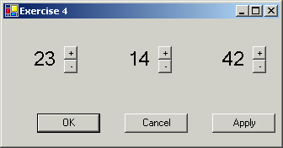
Date/Time Control Panel Applications of this Heuristic
The following picture shows what your first Visual Basic prototype will look like when you have completed Exercise 4. We will examine one aspect of this small interface using the flexibility and efficiency of use heuristic and write a UAR for our conclusions.

Slide 78
Not Every Facet of Every Heuristic Applies to Every Interface
See example below:
  there is no way for users to tailor their frequent actions in this control panel.
  However, this facet of the flexibility and efficiency of use heuristic doesn't apply to this control panel.
First, this is a control panel that won't be used very often, so users will not really have "frequent actions. "
Second, the actions on this control panel are so simple that they are already quite efficient.
question: whether every facet of
  a heuristic applies or not
Answer: often be "no"

