Slide 1
Machine-Level Programming II: Control 15-213: Introduction to Computer Systems 6th Lecture, Sep. 17, 2015
Carnegie Mellon
Carnegie Mellon

Slide 2
Today
Carnegie Mellon
Control: Condition codes
Conditional branches
Loops
Switch Statements

Slide 3
Processor State (x86-64, Partial)
Carnegie Mellon
Information about currently executing program
Temporary data ( %rax, … )
Location of runtime stack ( %rsp )
Location of current code control point ( %rip, … )
Status of recent tests ( CF, ZF, SF, OF )
Registers
%rax
%r8
%rbx
%r9
%rcx
%r10
%rdx
%r11
%rsi
%r12
%rdi
%r13
%rsp
%r14
%rbp
%r15
%rip
Instruction pointer
Current stack top
CF
ZF
SF
OF
Condition codes

Slide 4
Condition Codes (Implicit Setting)
Carnegie Mellon
Single bit registers
CF Carry Flag (for unsigned) SF Sign Flag (for signed)
ZF Zero Flag OF Overflow Flag (for signed)
Implicitly set (think of it as side effect) by arithmetic operations
Example: addq Src,Dest ↔ t = a+b
CF set if carry out from most significant bit (unsigned overflow)
ZF set if t == 0
SF set if t < 0 (as signed)
OF set if two’s-complement (signed) overflow (a>0 && b>0 && t<0) || (a<0 && b<0 && t>=0)
Not set by leaq instruction

Slide 5
Condition Codes (Explicit Setting: Compare)
Carnegie Mellon
Explicit Setting by Compare Instruction
cmpq Src2, Src1
cmpq b,a like computing a-b without setting destination
CF set if carry out from most significant bit (used for unsigned comparisons)
ZF set if a == b
SF set if (a-b) < 0 (as signed)
OF set if two’s-complement (signed) overflow (a>0 && b<0 && (a-b)<0) || (a<0 && b>0 && (a-b)>0)

Slide 6
Condition Codes (Explicit Setting: Test)
Carnegie Mellon
Explicit Setting by Test instruction
testq Src2, Src1
testq b,a like computing a&b without setting destination
Sets condition codes based on value of Src1 & Src2
Useful to have one of the operands be a mask
ZF set when a&b == 0
SF set when a&b < 0

Slide 7
Def and Use of condition codes
Def:
Explicit set by Compare and Test instructions
Implicit set by almost all arithmetic instructions
Use:
SetX instruction class: write 0/1 into one-byte register
conditional jump
conditional movement

Slide 8
Reading Condition Codes
Carnegie Mellon
SetX Instructions
Set low-order byte of destination to 0 or 1 based on combinations of condition codes
Does not alter remaining 7 bytes
SetX | Condition | Description
sete | ZF | Equal / Zero
setne | ~ZF | Not Equal / Not Zero
sets | SF | Negative
setns | ~SF | Nonnegative
setg | ~(SF^OF)&~ZF | Greater (Signed)
setge | ~(SF^OF) | Greater or Equal (Signed)
setl | (SF^OF) | Less (Signed)
setle | (SF^OF)|ZF | Less or Equal (Signed)
seta | ~CF&~ZF | Above (unsigned)
setb | CF | Below (unsigned)

Slide 9
x86-64 Integer Registers
%rax
%r8
%al
%r8b
%rbx
%r9
%bl
%r9b
%rcx
%r10
%cl
%r10b
%rdx
%r11
%dl
%r11b
%rsi
%r12
%sil
%r12b
%rdi
%r13
%dil
%r13b
%rsp
%r14
%spl
%r14b
%rbp
%r15
%bpl
%r15b
Can reference low-order byte

Slide 10
Reading Condition Codes (Cont.)
Carnegie Mellon
SetX Instructions:
Set single byte based on combination of condition codes
One of addressable byte registers
Does not alter remaining bytes
Typically use movzbl to finish job
32-bit instructions also set upper 32 bits to 0
Register | Use(s)
%rdi | Argument x
%rsi | Argument y
%rax | Return value
int gt (long x, long y)
{
return x > y;
}
cmpq %rsi, %rdi # Compare x:y
setg %al # Set when >
movzbl %al, %eax # Zero rest of %rax
ret

Slide 11
SetX instruction for C syntax
sete
return x == y
z = (x == y)
sets
return x < 0
y = x < 0
……

Slide 12
Today
Carnegie Mellon
Control: Condition codes
Conditional branches
Loops
Switch Statements

Slide 13
Jumping
Carnegie Mellon
jX Instructions
Jump to different part of code depending on condition codes
jX | Condition | Description
jmp | 1 | Unconditional
je | ZF | Equal / Zero
jne | ~ZF | Not Equal / Not Zero
js | SF | Negative
jns | ~SF | Nonnegative
jg | ~(SF^OF)&~ZF | Greater (Signed)
jge | ~(SF^OF) | Greater or Equal (Signed)
jl | (SF^OF) | Less (Signed)
jle | (SF^OF)|ZF | Less or Equal (Signed)
ja | ~CF&~ZF | Above (unsigned)
jb | CF | Below (unsigned)

Slide 14
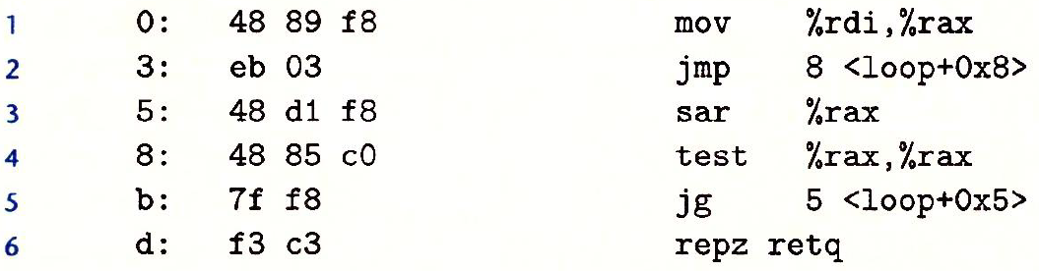
PC-relative encodings for jump-targets
Line 2: eb 03 → jmp 8?
Line 5: 7f f8 → jg 5?
PC relative encodings for jump-targets (???):
encodings + PC = jump-target
03 + 5 = 8
f8(-8）+ d = 5

Slide 15
Conditional Branch Example (Old Style)
Carnegie Mellon
Generation
shark> gcc –Og -S –fno-if-conversion control.c
absdiff:
cmpq %rsi, %rdi # x:y
jle .L4
movq %rdi, %rax
subq %rsi, %rax
ret
.L4: # x <= y
movq %rsi, %rax
subq %rdi, %rax
ret
long absdiff
(long x, long y)
{
long result;
if (x > y)
result = x-y;
else
result = y-x;
return result;
}
Register | Use(s)
%rdi | Argument x
%rsi | Argument y
%rax | Return value

Slide 16
Expressing with Goto Code
Carnegie Mellon
C allows goto statement
Jump to position designated by label
long absdiff
(long x, long y)
{
long result;
if (x > y)
result = x-y;
else
result = y-x;
return result;
}
long absdiff_j
(long x, long y)
{
long result;
int ntest = x <= y;
if (ntest) goto Else;
result = x-y;
goto Done;
Else:
result = y-x;
Done:
return result;
}

Slide 17
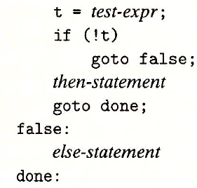
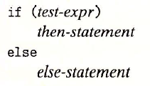
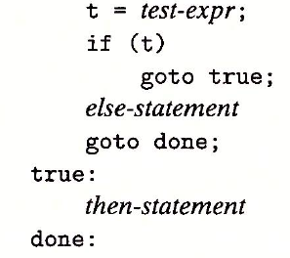
General form for if-else in C

Slide 18
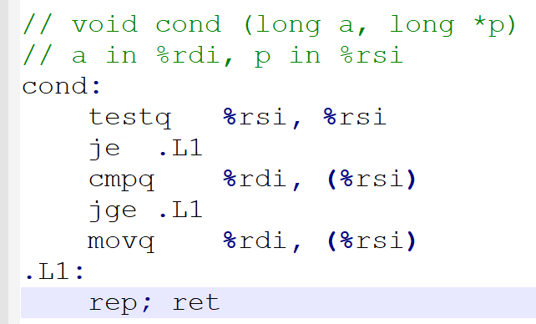
Exercise:
Q1: write C version for the following assembly code

Slide 19
General Conditional Expression Translation (Using Branches)
Carnegie Mellon
C Code
val = Test ? Then_Expr : Else_Expr;
val = x>y ? x-y : y-x;
Goto Version
ntest = !Test;
if (ntest) goto Else;
val = Then_Expr;
goto Done;
Else:
val = Else_Expr;
Done:
. . .
Create separate code regions for then & else expressions
Execute appropriate one

Slide 20
Using Conditional Moves
Carnegie Mellon
Conditional Move Instructions
Instruction supports:
if (Test) Dest ← Src
Supported in post-1995 x86 processors
GCC tries to use them
But, only when known to be safe
Why?
Branches are very disruptive to instruction flow through pipelines
Conditional moves do not require control transfer
C Code
val = Test
? Then_Expr
: Else_Expr;
Goto Version
result = Then_Expr;
eval = Else_Expr;
nt = !Test;
if (nt) result = eval;
return result;

Slide 21
Conditional Move Example
Carnegie Mellon
long absdiff
(long x, long y)
{
long result;
if (x > y)
result = x-y;
else
result = y-x;
return result;
}
Register | Use(s)
%rdi | Argument x
%rsi | Argument y
%rax | Return value
absdiff:
movq %rdi, %rax # x
subq %rsi, %rax # result = x-y
movq %rsi, %rdx
subq %rdi, %rdx # eval = y-x
cmpq %rsi, %rdi # x:y
cmovle %rdx, %rax # if <=, result = eval
ret

Slide 22
Bad Cases for Conditional Move
Carnegie Mellon
Expensive Computations
val = Test(x) ? Hard1(x) : Hard2(x);
Both values get computed
Only makes sense when computations are very simple
Risky Computations
val = p ? *p : 0;
Both values get computed
May have undesirable effects
Computations with side effects
val = x > 0 ? x*=7 : x+=3;
Both values get computed
Must be side-effect free

Slide 23
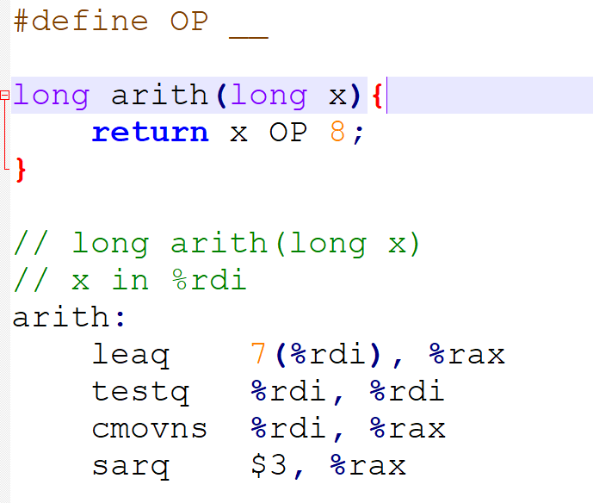
Exercise:
Q1: Guess what is OP?

Slide 24
Today
Carnegie Mellon
Control: Condition codes
Conditional branches
Loops
Switch Statements

Slide 25
“Do-While” Loop Example
Carnegie Mellon
C Code
Goto Version
long pcount_do
(unsigned long x) {
long result = 0;
do {
result += x & 0x1;
x >>= 1;
} while (x);
return result;
}
long pcount_goto
(unsigned long x) {
long result = 0;
loop:
result += x & 0x1;
x >>= 1;
if(x) goto loop;
return result;
}
Count number of 1’s in argument x (“popcount”)
Use conditional branch to either continue looping or to exit loop

Slide 26
“Do-While” Loop Compilation
Carnegie Mellon
Goto Version
long pcount_goto
(unsigned long x) {
long result = 0;
loop:
result += x & 0x1;
x >>= 1;
if(x) goto loop;
return result;
}
Register | Use(s)
%rdi | Argument x
%rax | result
movl $0, %eax # result = 0
.L2: # loop:
movq %rdi, %rdx
andl $1, %edx # t = x & 0x1
addq %rdx, %rax # result += t
shrq %rdi # x >>= 1
jne .L2 # if (x) goto loop
rep; ret

Slide 27
General “Do-While” Translation
Carnegie Mellon
C Code
Goto Version
do
Body
while (Test);
loop:
Body
if (Test)
goto loop
Body:
{
Statement₁;
Statement₂;
…
Statement_{n};
}

Slide 28
General “While” Translation #1
Carnegie Mellon
“Jump-to-middle” translation
Used with -Og
Goto Version
goto test;
loop:
Body
test:
if (Test)
goto loop;
done:
While version
while (Test)
Body

Slide 29
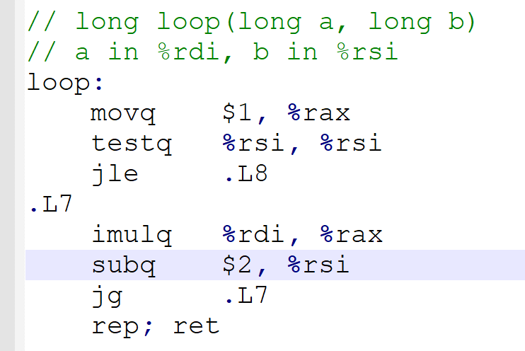
Exercise:
Q1: Write a while-loop version for the following code?

Slide 30
While Loop Example #1
Carnegie Mellon
C Code
Jump to Middle Version
long pcount_while
(unsigned long x) {
long result = 0;
while (x) {
result += x & 0x1;
x >>= 1;
}
return result;
}
long pcount_goto_jtm
(unsigned long x) {
long result = 0;
goto test;
loop:
result += x & 0x1;
x >>= 1;
test:
if(x) goto loop;
return result;
}
Compare to do-while version of function
Initial goto starts loop at test

Slide 31
General “While” Translation #2
Carnegie Mellon
While version
“Do-while” conversion
Used with –O1
while (Test)
Body
Goto Version
Do-While Version
if (!Test)
goto done;
loop:
Body
if (Test)
goto loop;
done:
if (!Test)
goto done;
do
Body
while(Test);
done:

Slide 32
While Loop Example #2
Carnegie Mellon
C Code
Do-While Version
long pcount_while
(unsigned long x) {
long result = 0;
while (x) {
result += x & 0x1;
x >>= 1;
}
return result;
}
long pcount_goto_dw
(unsigned long x) {
long result = 0;
if (!x) goto done;
loop:
result += x & 0x1;
x >>= 1;
if(x) goto loop;
done:
return result;
}
Compare to do-while version of function
Initial conditional guards entrance to loop

Slide 33
“For” Loop Form
Carnegie Mellon
Init
General Form
i = 0
for (Init; Test; Update )
Body
Test
i < WSIZE
#define WSIZE 8*sizeof(int)
long pcount_for
(unsigned long x)
{
size_t i;
long result = 0;
for (i = 0; i < WSIZE; i++)
{
unsigned bit =
(x >> i) & 0x1;
result += bit;
}
return result;
}
Update
i++
Body
{
unsigned bit =
(x >> i) & 0x1;
result += bit;
}

Slide 34
“For” Loop → While Loop
Carnegie Mellon
For Version
for (Init; Test; Update )
Body
While Version
Init;
while (Test ) {
Body
Update;
}

Slide 35
For-While Conversion
Carnegie Mellon
long pcount_for_while
(unsigned long x)
{
size_t i;
long result = 0;
i = 0;
while (i < WSIZE)
{
unsigned bit =
(x >> i) & 0x1;
result += bit;
i++;
}
return result;
}
Init
i = 0
Test
i < WSIZE
Update
i++
Body
{
unsigned bit =
(x >> i) & 0x1;
result += bit;
}

Slide 36
“For” Loop Do-While Conversion
Carnegie Mellon
Goto Version
C Code
long pcount_for_goto_dw
(unsigned long x) {
size_t i;
long result = 0;
i = 0;
if (!(i < WSIZE))
goto done;
loop:
{
unsigned bit =
(x >> i) & 0x1;
result += bit;
}
i++;
if (i < WSIZE)
goto loop;
done:
return result;
}
long pcount_for
(unsigned long x)
{
size_t i;
long result = 0;
for (i = 0; i < WSIZE; i++)
{
unsigned bit =
(x >> i) & 0x1;
result += bit;
}
return result;
}
Init
!Test
Body
Update
Test
Initial test can be optimized away

Slide 37
Exercise:
Q1: Write a for-loop version for the following code?

Slide 38
Today
Carnegie Mellon
Control: Condition codes
Conditional branches
Loops
Switch Statements

Slide 39
Switch Statement Example
Carnegie Mellon
long switch_eg
(long x, long y, long z)
{
long w = 1;
switch(x) {
case 1:
w = y*z;
break;
case 2:
w = y/z;
/* Fall Through */
case 3:
w += z;
break;
case 5:
case 6:
w -= z;
break;
default:
w = 2;
}
return w;
}
Multiple case labels
Here: 5 & 6
Fall through cases
Here: 2
Missing cases
Here: 4

Slide 40
Jump Table Structure
Carnegie Mellon
Switch Form
Jump Table
Jump Targets
switch(x) {
case val_0:
Block 0
case val_1:
Block 1
• • •
case val_n-1:
Block n–1
}
jtab:
Targ0
Targ0:
Code Block
0
Targ1
Targ2
Targ1:
Code Block
1
•
•
•
Targ2:
Code Block
2
Targn-1
•
•
•
Translation (Extended C)
goto *JTab[x];
Targn-1:
Code Block
n–1

Slide 41
Switch Statement Example
Carnegie Mellon
long switch_eg(long x, long y, long z)
{
long w = 1;
switch(x) {
. . .
}
return w;
}
Setup:
Register | Use(s)
%rdi | Argument x
%rsi | Argument y
%rdx | Argument z
%rax | Return value
switch_eg:
movq %rdx, %rcx
cmpq $6, %rdi # x:6
ja .L8
jmp *.L4(,%rdi,8)
What range of values takes default?
Note that w not initialized here

Slide 42
Switch Statement Example
Carnegie Mellon
long switch_eg(long x, long y, long z)
{
long w = 1;
switch(x) {
. . .
}
return w;
}
Jump table
.section .rodata
.align 8
.L4:
.quad .L8 # x = 0
.quad .L3 # x = 1
.quad .L5 # x = 2
.quad .L9 # x = 3
.quad .L8 # x = 4
.quad .L7 # x = 5
.quad .L7 # x = 6
Setup:
switch_eg:
movq %rdx, %rcx
cmpq $6, %rdi # x:6
ja .L8 # Use default
jmp *.L4(,%rdi,8) # goto *JTab[x]
Indirect jump

Slide 43
Assembly Setup Explanation
Carnegie Mellon
Table Structure
Each target requires 8 bytes
Base address at .L4
Jumping
Direct: jmp .L8
Jump target is denoted by label .L8
Indirect: jmp *.L4(,%rdi,8)
Start of jump table: .L4
Must scale by factor of 8 (addresses are 8 bytes)
Fetch target from effective Address .L4 + x*8
Only for 0 ≤ x ≤ 6
Jump table
.section .rodata
.align 8
.L4:
.quad .L8 # x = 0
.quad .L3 # x = 1
.quad .L5 # x = 2
.quad .L9 # x = 3
.quad .L8 # x = 4
.quad .L7 # x = 5
.quad .L7 # x = 6
Map: case-value -> code-block

Slide 44
Jump Table
Carnegie Mellon
Jump table
switch(x) {
case 1: // .L3
w = y*z;
break;
case 2: // .L5
w = y/z;
/* Fall Through */
case 3: // .L9
w += z;
break;
case 5:
case 6: // .L7
w -= z;
break;
default: // .L8
w = 2;
}
.section .rodata
.align 8
.L4:
.quad .L8 # x = 0
.quad .L3 # x = 1
.quad .L5 # x = 2
.quad .L9 # x = 3
.quad .L8 # x = 4
.quad .L7 # x = 5
.quad .L7 # x = 6

Slide 45
Code Blocks (x == 1)
Carnegie Mellon
switch(x) {
case 1: // .L3
w = y*z;
break;
. . .
}
.L3:
movq %rsi, %rax # y
imulq %rdx, %rax # y*z
ret
Register | Use(s)
%rdi | Argument x
%rsi | Argument y
%rdx | Argument z
%rax | Return value

Slide 46
Handling Fall-Through
Carnegie Mellon
long w = 1;
. . .
switch(x) {
. . .
case 2:
w = y/z;
/* Fall Through */
case 3:
w += z;
break;
. . .
}
case 2:
w = y/z;
goto merge;
case 3:
w = 1;
merge:
w += z;

Slide 47
Code Blocks (x == 2, x == 3)
Carnegie Mellon
.L5: # Case 2
movq %rsi, %rax
cqto
idivq %rcx # y/z
jmp .L6 # goto merge
.L9: # Case 3
movl $1, %eax # w = 1
.L6: # merge:
addq %rcx, %rax # w += z
ret
long w = 1;
. . .
switch(x) {
. . .
case 2:
w = y/z;
/* Fall Through */
case 3:
w += z;
break;
. . .
}
Register | Use(s)
%rdi | Argument x
%rsi | Argument y
%rdx | Argument z
%rax | Return value

Slide 48
Code Blocks (x == 5, x == 6, default)
Carnegie Mellon
switch(x) {
. . .
case 5: // .L7
case 6: // .L7
w -= z;
break;
default: // .L8
w = 2;
}
.L7: # Case 5,6
movl $1, %eax # w = 1
subq %rdx, %rax # w -= z
ret
.L8: # Default:
movl $2, %eax # 2
ret
Register | Use(s)
%rdi | Argument x
%rsi | Argument y
%rdx | Argument z
%rax | Return value

Slide 49
Alternatives to jump-table
if-else-if-else
pros/cons
the time to switch is independent of the number of switch cases
need a regular pattern
When to use:
a number of cases （>= 4)
span a small range of values

Slide 50
Summarizing
Carnegie Mellon
C Control
if-then-else
do-while
while, for
switch
Assembler Control
Conditional jump
Conditional move
Indirect jump (via jump tables)
Compiler generates code sequence to implement more complex control
Standard Techniques
Loops converted to do-while or jump-to-middle form
Large switch statements use jump tables
Sparse switch statements may use decision trees (if-elseif-elseif-else)

Slide 51
Summary
Carnegie Mellon
Today
Control: Condition codes
Conditional branches & conditional moves
Loops
Switch statements
Next Time
Stack
Call / return
Procedure call discipline

