Slide 1
Machine-Level Programming III: Procedures 15-213: Introduction to Computer Systems 7th Lecture, Sep. 22, 2015
Carnegie Mellon

Slide 2
Mechanisms in Procedures
P(…) {
•
•
y = Q(x);
print(y)
•
}
Passing control
To beginning of procedure code
Back to return point
Passing data
Procedure arguments
Return value
Memory management
Allocate during procedure execution
Deallocate upon return
Mechanisms all implemented with machine instructions
x86-64 implementation of a procedure uses only those mechanisms required
int Q(int i)
{
int t = 3*i;
int v[10];
•
•
return v[t];
}

Slide 3
Today
Carnegie Mellon
Procedures
Stack Structure
Calling Conventions
Passing control
Passing data
Managing local data
Illustration of Recursion

Slide 4
x86-64 Stack
Carnegie Mellon
Stack “Bottom”
Region of memory managed with stack discipline
Grows toward lower addresses
Register %rsp contains lowest stack address
address of “top” element
Increasing
Addresses
Stack Grows
Down
Stack Pointer: %rsp
Stack “Top”

Slide 5
x86-64 Stack: Push
Carnegie Mellon
Stack “Bottom”
pushq Src
Fetch operand at Src
Decrement %rsp by 8
Write operand at address given by %rsp
Increasing
Addresses
Stack Grows
Down
Stack Pointer: %rsp
-8
Stack “Top”

Slide 6
x86-64 Stack: Pop
Carnegie Mellon
Stack “Bottom”
popq Dest
Read value at address given by %rsp
Increment %rsp by 8
Store value at Dest (must be register)
Increasing
Addresses
Stack Grows
Down
Stack Pointer: %rsp
+8
Stack “Top”

Slide 7
Today
Carnegie Mellon
Procedures
Stack Structure
Calling Conventions
Passing control
Passing data
Managing local data
Illustration of Recursion

Slide 8
Code Examples
void multstore
(long x, long y, long *dest) {
long t = mult2(x, y);
*dest = t;
}
0000000000400540 <multstore>:
400540: push %rbx # Save %rbx
400541: mov %rdx,%rbx # Save dest
400544: callq 400550 <mult2> # mult2(x,y)
400549: mov %rax,(%rbx) # Save at dest
40054c: pop %rbx # Restore %rbx
40054d: retq # Return
long mult2
(long a, long b)
{
long s = a * b;
return s;
}
0000000000400550 <mult2>:
400550: mov %rdi,%rax # a
400553: imul %rsi,%rax # a * b
400557: retq # Return

Slide 9
Procedure Control Flow
Carnegie Mellon
Use stack to support procedure call and return
Procedure call: call label
Push return address on stack
Jump to label
Return address:
Address of the next instruction right after call
Example from disassembly
Procedure return: ret
Pop address from stack
Jump to address

Slide 10
Control Flow Example #1
•
•
•
0x130
0000000000400540 <multstore>:
•
•
400544: callq 400550 <mult2>
400549: mov %rax,(%rbx)
•
•
0x128
0x120
%rsp
0x120
%rip
0x400544
0000000000400550 <mult2>:
400550: mov %rdi,%rax
•
•
400557: retq

Slide 11
Control Flow Example #2
•
•
•
0x130
0000000000400540 <multstore>:
•
•
400544: callq 400550 <mult2>
400549: mov %rax,(%rbx)
•
•
0x128
0x120
0x118
0x400549
%rsp
0x118
%rip
0x400550
0000000000400550 <mult2>:
400550: mov %rdi,%rax
•
•
400557: retq

Slide 12
Control Flow Example #3
•
•
•
0x130
0000000000400540 <multstore>:
•
•
400544: callq 400550 <mult2>
400549: mov %rax,(%rbx)
•
•
0x128
0x120
0x118
0x400549
%rsp
0x118
%rip
0x400557
0000000000400550 <mult2>:
400550: mov %rdi,%rax
•
•
400557: retq

Slide 13
Control Flow Example #4
•
•
•
0x130
0000000000400540 <multstore>:
•
•
400544: callq 400550 <mult2>
400549: mov %rax,(%rbx)
•
•
0x128
0x120
%rsp
0x120
%rip
0x400549
0000000000400550 <mult2>:
400550: mov %rdi,%rax
•
•
400557: retq

Slide 14
Today
Carnegie Mellon
Procedures
Stack Structure
Calling Conventions
Passing control
Passing data
Managing local data
Illustrations of Recursion & Pointers

Slide 15
Procedure Data Flow
Carnegie Mellon
Registers
Stack
First 6 arguments
Return value
• • •
%rdi
%rsi
Arg n
%rdx
• • •
%rcx
%r8
Arg 8
%r9
Arg 7
%rax
Only allocate stack space when needed

Slide 16
Data Flow Examples
void multstore
(long x, long y, long *dest) {
long t = mult2(x, y);
*dest = t;
}
0000000000400540 <multstore>:
# x in %rdi, y in %rsi, dest in %rdx
• • •
400541: mov %rdx,%rbx # Save dest
400544: callq 400550 <mult2> # mult2(x,y)
# t in %rax
400549: mov %rax,(%rbx) # Save at dest
• • •
long mult2
(long a, long b)
{
long s = a * b;
return s;
}
0000000000400550 <mult2>:
# a in %rdi, b in %rsi
400550: mov %rdi,%rax # a
400553: imul %rsi,%rax # a * b
# s in %rax
400557: retq # Return

Slide 17
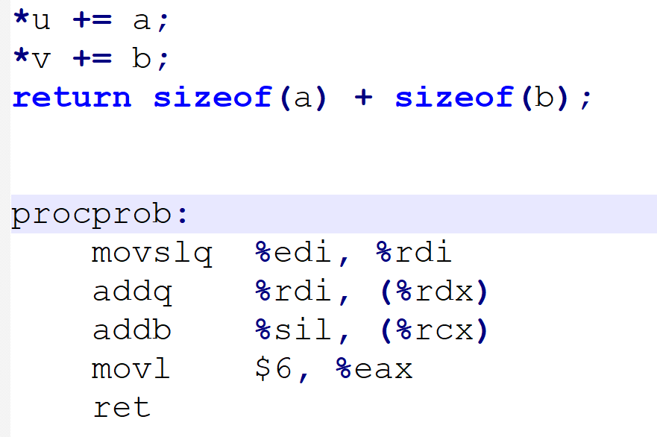
Exercise:
What is the function prototype for procprob?

Slide 18
Today
Carnegie Mellon
Procedures
Stack Structure
Calling Conventions
Passing control
Passing data
Managing local data
Illustration of Recursion

Slide 19
Stack-Based Languages
Carnegie Mellon
Languages that support recursion
e.g., C, Pascal, Java
Code must be “Reentrant”
Multiple simultaneous instantiations of single procedure
Need some place to store state of each instantiation
Arguments
Local variables
Return pointer
Stack discipline
State for given procedure needed for limited time
From when called to when return
Callee returns before caller does
Stack allocated in Frames
state for single procedure instantiation

Slide 20
Call Chain Example
Carnegie Mellon
Example
Call Chain
yoo(…)
{
•
•
who();
•
•
}
yoo
who(…)
{
• • •
amI();
• • •
amI();
• • •
}
who
amI(…)
{
•
•
amI();
•
•
}
amI
amI
amI
amI
gdb /bt/info frame
Procedure amI() is recursive

Slide 21
Stack Frames
Carnegie Mellon
Previous Frame
Frame for proc
Contents
Return information
Local storage (if needed)
Temporary space (if needed)
Management
Space allocated when enter procedure
“Set-up” code
Includes push by call instruction
Deallocated when return
“Finish” code
Includes pop by ret instruction
Frame Pointer: %rbp
(Optional) x
Stack Pointer: %rsp
Stack “Top”
When no need of frame?

Slide 22
Example
Carnegie Mellon
Stack
yoo
yoo(…)
{
•
•
who();
•
•
}
yoo
%rbp
yoo
who
%rsp
amI
amI
amI
amI

Slide 23
Example
Carnegie Mellon
Stack
yoo
who
yoo(…)
{
•
•
who();
•
•
}
yoo
who(…)
{
• • •
amI();
• • •
amI();
• • •
}
yoo
who
%rbp
amI
amI
%rsp
amI
amI

Slide 24
Example
Carnegie Mellon
Stack
yoo
who
amI
yoo(…)
{
•
•
who();
•
•
}
yoo
who(…)
{
• • •
amI();
• • •
amI();
• • •
}
yoo
amI(…)
{
•
•
amI();
•
•
}
who
amI
amI
%rbp
amI
%rsp
amI

Slide 25
Example
Carnegie Mellon
Stack
yoo
who
amI
amI
yoo(…)
{
•
•
who();
•
•
}
yoo
who(…)
{
• • •
amI();
• • •
amI();
• • •
}
yoo
amI(…)
{
•
•
amI();
•
•
}
who
amI(…)
{
•
•
amI();
•
•
}
amI
amI
amI
%rbp
amI
%rsp

Slide 26
Example
Carnegie Mellon
Stack
yoo
who
amI
amI
amI
yoo(…)
{
•
•
who();
•
•
}
yoo
who(…)
{
• • •
amI();
• • •
amI();
• • •
}
yoo
amI(…)
{
•
•
amI();
•
•
}
who
amI(…)
{
•
•
amI();
•
•
}
amI
amI
amI(…)
{
•
•
amI();
•
•
}
amI
amI
%rbp
%rsp

Slide 27
Example
Carnegie Mellon
Stack
yoo
who
amI
amI
yoo(…)
{
•
•
who();
•
•
}
yoo
who(…)
{
• • •
amI();
• • •
amI();
• • •
}
yoo
amI(…)
{
•
•
amI();
•
•
}
who
amI(…)
{
•
•
amI();
•
•
}
amI
amI
amI
%rbp
amI
%rsp

Slide 28
Example
Carnegie Mellon
Stack
yoo
who
amI
yoo(…)
{
•
•
who();
•
•
}
yoo
who(…)
{
• • •
amI();
• • •
amI();
• • •
}
yoo
amI(…)
{
•
•
amI();
•
•
}
who
amI
amI
%rbp
amI
%rsp
amI

Slide 29
Example
Carnegie Mellon
Stack
yoo
who
yoo(…)
{
•
•
who();
•
•
}
yoo
who(…)
{
• • •
amI();
• • •
amI();
• • •
}
yoo
who
%rbp
amI
amI
%rsp
amI
amI

Slide 30
Example
Carnegie Mellon
Stack
yoo
who
amI
yoo(…)
{
•
•
who();
•
•
}
yoo
who(…)
{
• • •
amI();
• • •
amI();
• • •
}
yoo
amI(…)
{
•
•
amI();
•
•
}
who
amI
amI
%rbp
amI
%rsp
amI

Slide 31
Example
Carnegie Mellon
Stack
yoo
who
yoo(…)
{
•
•
who();
•
•
}
yoo
who(…)
{
• • •
amI();
• • •
amI();
• • •
}
yoo
who
%rbp
amI
amI
%rsp
amI
amI

Slide 32
Example
Carnegie Mellon
Stack
yoo
yoo
yoo(…)
{
•
•
who();
•
•
}
%rbp
yoo
who
%rsp
amI
amI
amI
amI

Slide 33
x86-64/Linux Stack Frame
Carnegie Mellon
Current Stack Frame (“Top” to Bottom)
“Argument build:” Parameters for function about to call
Local variables If can’t keep in registers
Saved register context
Old frame pointer (optional)
Caller Stack Frame
Return address
Pushed by call instruction
Arguments for this call
Caller
Frame
Arguments
7+
Frame pointer %rbp
Return Addr
Old %rbp
(Optional)
Saved
Registers
+
Local
Variables
Argument
Build
(Optional)
Stack pointer
%rsp

Slide 34
Example: incr
Carnegie Mellon
long incr(long *p, long val) {
long x = *p;
long y = x + val;
*p = y;
return x;
}
incr:
movq (%rdi), %rax
addq %rax, %rsi
movq %rsi, (%rdi)
ret
Register | Use(s)
%rdi | Argument p
%rsi | Argument val, y
%rax | x, Return value

Slide 35
Example: Calling incr #1
Carnegie Mellon
Initial Stack Structure
long call_incr() {
long v1 = 15213;
long v2 = incr(&v1, 3000);
return v1+v2;
}
. . .
Rtn address
%rsp
call_incr:
subq $16, %rsp
movq $15213, 8(%rsp)
movl $3000, %esi
leaq 8(%rsp), %rdi
call incr
addq 8(%rsp), %rax
addq $16, %rsp
ret
Resulting Stack Structure
. . .
Rtn address
15213
%rsp+8
Unused
%rsp

Slide 36
Example: Calling incr #2
Carnegie Mellon
Stack Structure
long call_incr() {
long v1 = 15213;
long v2 = incr(&v1, 3000);
return v1+v2;
}
. . .
Rtn address
15213
%rsp+8
Unused
%rsp
call_incr:
subq $16, %rsp
movq $15213, 8(%rsp)
movl $3000, %esi
leaq 8(%rsp), %rdi
call incr
addq 8(%rsp), %rax
addq $16, %rsp
ret
Register | Use(s)
%rdi | &v1
%rsi | 3000

Slide 37
Example: Calling incr #3
Carnegie Mellon
Stack Structure
long call_incr() {
long v1 = 15213;
long v2 = incr(&v1, 3000);
return v1+v2;
}
. . .
Rtn address
18213
%rsp+8
Unused
%rsp
call_incr:
subq $16, %rsp
movq $15213, 8(%rsp)
movl $3000, %esi
leaq 8(%rsp), %rdi
call incr
addq 8(%rsp), %rax
addq $16, %rsp
ret
Register | Use(s)
%rdi | &v1
%rsi | 3000

Slide 38
Example: Calling incr #4
Carnegie Mellon
Stack Structure
long call_incr() {
long v1 = 15213;
long v2 = incr(&v1, 3000);
return v1+v2;
}
. . .
Rtn address
18213
%rsp+8
Unused
%rsp
call_incr:
subq $16, %rsp
movq $15213, 8(%rsp)
movl $3000, %esi
leaq 8(%rsp), %rdi
call incr
addq 8(%rsp), %rax
addq $16, %rsp
ret
Register | Use(s)
%rax | Return value
Updated Stack Structure
. . .
Rtn address
%rsp

Slide 39
Example: Calling incr #5
Carnegie Mellon
Updated Stack Structure
long call_incr() {
long v1 = 15213;
long v2 = incr(&v1, 3000);
return v1+v2;
}
. . .
Rtn address
%rsp
call_incr:
subq $16, %rsp
movq $15213, 8(%rsp)
movl $3000, %esi
leaq 8(%rsp), %rdi
call incr
addq 8(%rsp), %rax
addq $16, %rsp
ret
Register | Use(s)
%rax | Return value
Final Stack Structure
. . .
%rsp

Slide 40
Register Saving Conventions
Carnegie Mellon
When procedure yoo calls who:
yoo is the caller
who is the callee
Can register be used for temporary storage?
Contents of register %rdx overwritten by who
This could be trouble ➙ something should be done!
Need some coordination
yoo:
• • •
movq $15213, %rdx
call who
addq %rdx, %rax
• • •
ret
who:
• • •
subq $18213, %rdx
• • •
ret

Slide 41
Register Saving Conventions
Carnegie Mellon
When procedure yoo calls who:
yoo is the caller
who is the callee
Can register be used for temporary storage?
Conventions
“Caller Saved”
Caller saves temporary values in its frame before the call
“Callee Saved”
Callee saves temporary values in its frame before using
Callee restores them before returning to caller

Slide 42
x86-64 Linux Register Usage #1
Carnegie Mellon
%rax
Return value
Also caller-saved
Can be modified by procedure
%rdi, ..., %r9
Arguments
Also caller-saved
Can be modified by procedure
%r10, %r11
Caller-saved
Can be modified by procedure
Return value
%rax
%rdi
%rsi
%rdx
Arguments
%rcx
%r8
%r9
%r10
Caller-saved
temporaries
%r11

Slide 43
x86-64 Linux Register Usage #2
Carnegie Mellon
%rbx, %r12, %r13, %r14,%15
Callee-saved
Callee must save & restore
%rbp
Callee-saved
Callee must save & restore
May be used as frame pointer
Can mix & match
%rsp
Special form of callee save
Restored to original value upon exit from procedure
%rbx
%r12
Callee-saved
Temporaries
%r13
%r14, %r15
%rbp
Special
%rsp

Slide 44
When paras >= 6?
use stack frame for parameters storage
data size rounded up to be multiples of eight
When needs local storage?
not enough registers
&x, needs a address for a local
array or structures

Slide 45
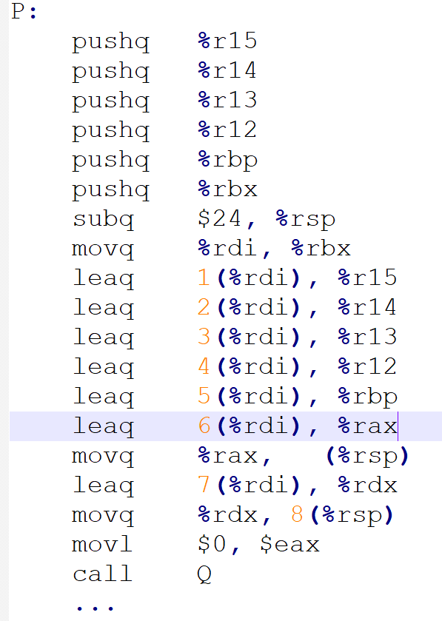
Exercise:
Assume function P with 8 locals in C version: a0 ~ a7
Explain the storage of these locals: registers or stack frames?

Slide 46
Callee-Saved Example #1
Carnegie Mellon
Initial Stack Structure
long call_incr2(long x) {
long v1 = 15213;
long v2 = incr(&v1, 3000);
return x+v2;
}
. . .
Rtn address
%rsp
call_incr2:
pushq %rbx
subq $16, %rsp
movq %rdi, %rbx
movq $15213, 8(%rsp)
movl $3000, %esi
leaq 8(%rsp), %rdi
call incr
addq %rbx, %rax
addq $16, %rsp
popq %rbx
ret
Resulting Stack Structure
. . .
Rtn address
Saved %rbx
15213
%rsp+8
Unused
%rsp

Slide 47
Callee-Saved Example #2
Carnegie Mellon
Resulting Stack Structure
long call_incr2(long x) {
long v1 = 15213;
long v2 = incr(&v1, 3000);
return x+v2;
}
. . .
Rtn address
Saved %rbx
15213
%rsp+8
call_incr2:
pushq %rbx
subq $16, %rsp
movq %rdi, %rbx
movq $15213, 8(%rsp)
movl $3000, %esi
leaq 8(%rsp), %rdi
call incr
addq %rbx, %rax
addq $16, %rsp
popq %rbx
ret
Unused
%rsp
Pre-return Stack Structure
. . .
Rtn address
%rsp

Slide 48
Today
Carnegie Mellon
Procedures
Stack Structure
Calling Conventions
Passing control
Passing data
Managing local data
Illustration of Recursion

Slide 49
Recursive Function
Carnegie Mellon
pcount_r:
movl $0, %eax
testq %rdi, %rdi
je .L6
pushq %rbx
movq %rdi, %rbx
andl $1, %ebx
shrq %rdi
call pcount_r
addq %rbx, %rax
popq %rbx
.L6:
rep; ret
/* Recursive popcount */
long pcount_r(unsigned long x) {
if (x == 0)
return 0;
else
return (x & 1)
+ pcount_r(x >> 1);
}

Slide 50
Recursive Function Terminal Case
Carnegie Mellon
/* Recursive popcount */
long pcount_r(unsigned long x) {
if (x == 0)
return 0;
else
return (x & 1)
+ pcount_r(x >> 1);
}
pcount_r:
movl $0, %eax
testq %rdi, %rdi
je .L6
pushq %rbx
movq %rdi, %rbx
andl $1, %ebx
shrq %rdi
call pcount_r
addq %rbx, %rax
popq %rbx
.L6:
rep; ret
Register | Use(s) | Type
%rdi | x | Argument
%rax | Return value | Return value

Slide 51
Recursive Function Register Save
Carnegie Mellon
pcount_r:
movl $0, %eax
testq %rdi, %rdi
je .L6
pushq %rbx
movq %rdi, %rbx
andl $1, %ebx
shrq %rdi
call pcount_r
addq %rbx, %rax
popq %rbx
.L6:
rep; ret
/* Recursive popcount */
long pcount_r(unsigned long x) {
if (x == 0)
return 0;
else
return (x & 1)
+ pcount_r(x >> 1);
}
Register | Use(s) | Type
%rdi | x | Argument
. . .
Rtn address
Saved %rbx
%rsp

Slide 52
Recursive Function Call Setup
Carnegie Mellon
/* Recursive popcount */
long pcount_r(unsigned long x) {
if (x == 0)
return 0;
else
return (x & 1)
+ pcount_r(x >> 1);
}
pcount_r:
movl $0, %eax
testq %rdi, %rdi
je .L6
pushq %rbx
movq %rdi, %rbx
andl $1, %ebx
shrq %rdi
call pcount_r
addq %rbx, %rax
popq %rbx
.L6:
rep; ret
Register | Use(s) | Type
%rdi | x >> 1 | Rec. argument
%rbx | x & 1 | Callee-saved

Slide 53
Recursive Function Call
Carnegie Mellon
/* Recursive popcount */
long pcount_r(unsigned long x) {
if (x == 0)
return 0;
else
return (x & 1)
+ pcount_r(x >> 1);
}
pcount_r:
movl $0, %eax
testq %rdi, %rdi
je .L6
pushq %rbx
movq %rdi, %rbx
andl $1, %ebx
shrq %rdi
call pcount_r
addq %rbx, %rax
popq %rbx
.L6:
rep; ret
Register | Use(s) | Type
%rbx | x & 1 | Callee-saved
%rax | Recursive call return value

Slide 54
Recursive Function Result
Carnegie Mellon
/* Recursive popcount */
long pcount_r(unsigned long x) {
if (x == 0)
return 0;
else
return (x & 1)
+ pcount_r(x >> 1);
}
pcount_r:
movl $0, %eax
testq %rdi, %rdi
je .L6
pushq %rbx
movq %rdi, %rbx
andl $1, %ebx
shrq %rdi
call pcount_r
addq %rbx, %rax
popq %rbx
.L6:
rep; ret
Register | Use(s) | Type
%rbx | x & 1 | Callee-saved
%rax | Return value

Slide 55
Recursive Function Completion
Carnegie Mellon
pcount_r:
movl $0, %eax
testq %rdi, %rdi
je .L6
pushq %rbx
movq %rdi, %rbx
andl $1, %ebx
shrq %rdi
call pcount_r
addq %rbx, %rax
popq %rbx
.L6:
rep; ret
/* Recursive popcount */
long pcount_r(unsigned long x) {
if (x == 0)
return 0;
else
return (x & 1)
+ pcount_r(x >> 1);
}
Register | Use(s) | Type
%rax | Return value | Return value
. . .
%rsp

Slide 56
Observations About Recursion
Carnegie Mellon
Handled Without Special Consideration
Stack frames mean that each function call has private storage
Saved registers & local variables
Saved return pointer
Register saving conventions prevent one function call from corrupting another’s data
Unless the C code explicitly does so (e.g., buffer overflow in Lecture 9)
Stack discipline follows call / return pattern
If P calls Q, then Q returns before P
Last-In, First-Out
Also works for mutual recursion
P calls Q; Q calls P

Slide 57
x86-64 Procedure Summary
Carnegie Mellon
Important Points
Stack is the right data structure for procedure call / return
If P calls Q, then Q returns before P
Recursion (& mutual recursion) handled by normal calling conventions
Can safely store values in local stack frame and in callee-saved registers
Put function arguments at top of stack
Result return in %rax
Pointers are addresses of values
On stack or global
Caller
Frame
Arguments
7+
Return Addr
%rbp
(Optional)
Old %rbp
Saved
Registers
+
Local
Variables
Argument
Build
%rsp

