Slide 1
Workforce Performance Dashboard
Deeshna c k

Slide 2
Business Problem
Increase in team quality issues.
Limited visibility into analyst performance and SLA compliance.
Difficulty identifying workload and performance gaps.

Slide 3
Project Objective
Build an interactive dashboard to monitor workforce performance and support operational decision-making.

Slide 4
Dataset Overview
Dummy operational dataset containing Analyst Name, Lead ID, SLA Status, Processing Date, and Productivity metrics.

Slide 5
KPIs Defined
Overall SLA %
Total Active Employees
Total Leads Processed
Analyst Productivity
SLA Compliance Trend

Slide 6
Data Preparation
Data cleaning
Handling missing values
KPI calculations
Data modeling for Tableau

Slide 7
Key Insights
Top performers identified
SLA fluctuations observed
Workload imbalance detected
Productivity vs SLA relationship analyzed

Slide 8
Recommendations
Rebalance workload
Coach low-performing analysts
Monitor SLA risk proactively
Improve workforce planning

Slide 9
Business Impact
Single source of truth for managers, faster decision-making, and better operational visibility.

Slide 10
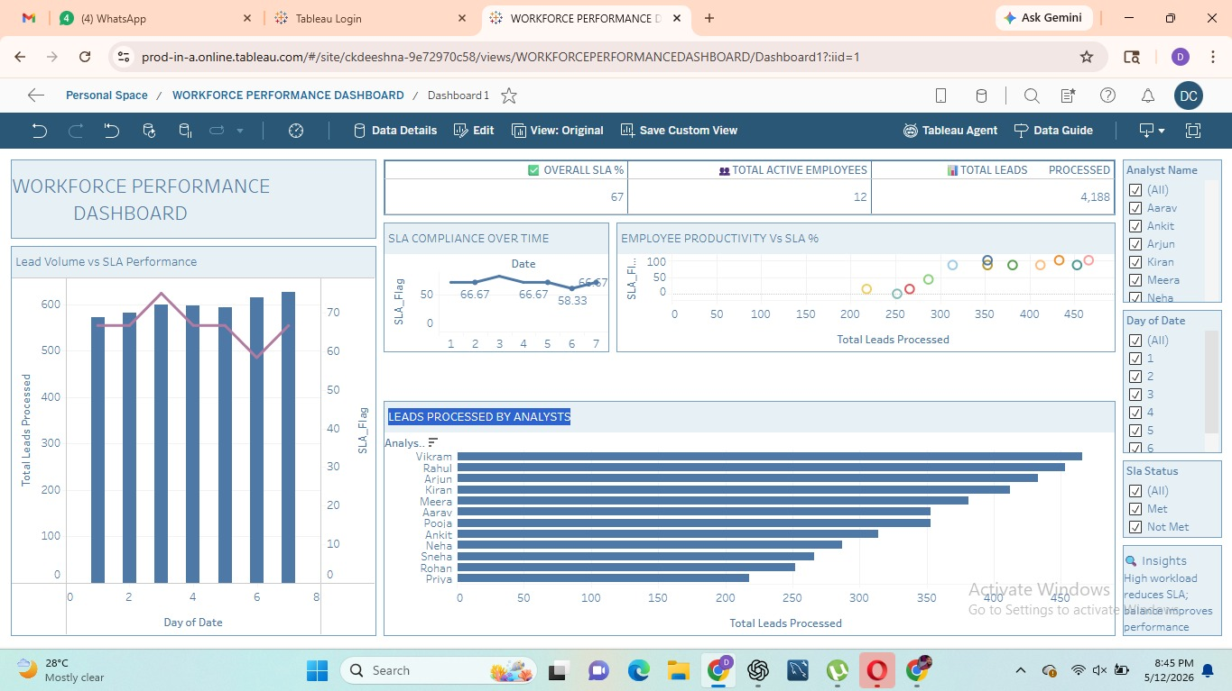
Dashboard Screenshot

