Slide 1
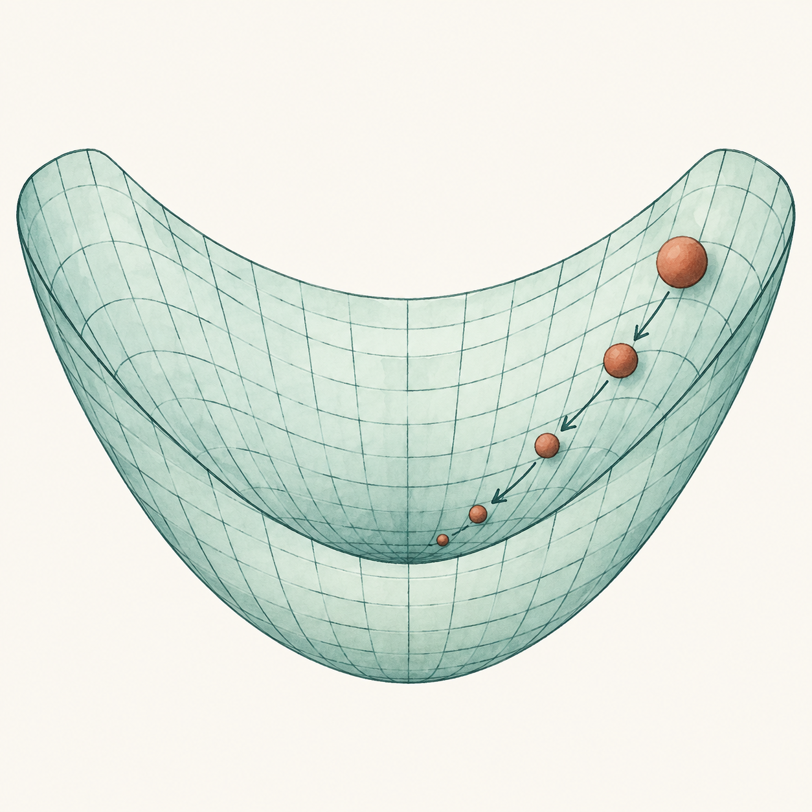
Gradient Descent
& Backpropagation
How neural networks learn from error
Notes:
Opening: Today we will connect the neural network's prediction to the calculations that allow it to learn. We will see how every parameter, gradient, and update happens. Then we will examine what changes in deeper networks, including vanishing and exploding gradients.
Learning objectives: By the end, you should be able to explain the roles of the forward pass, the loss, backpropagation, and gradient descent.
We will continue with the lab that we did in the last session, we will train the network that we build in the last session
We will see how we use gradient descent and backpropagation to train a network and how they help a model to reduce its prediction error

Slide 2
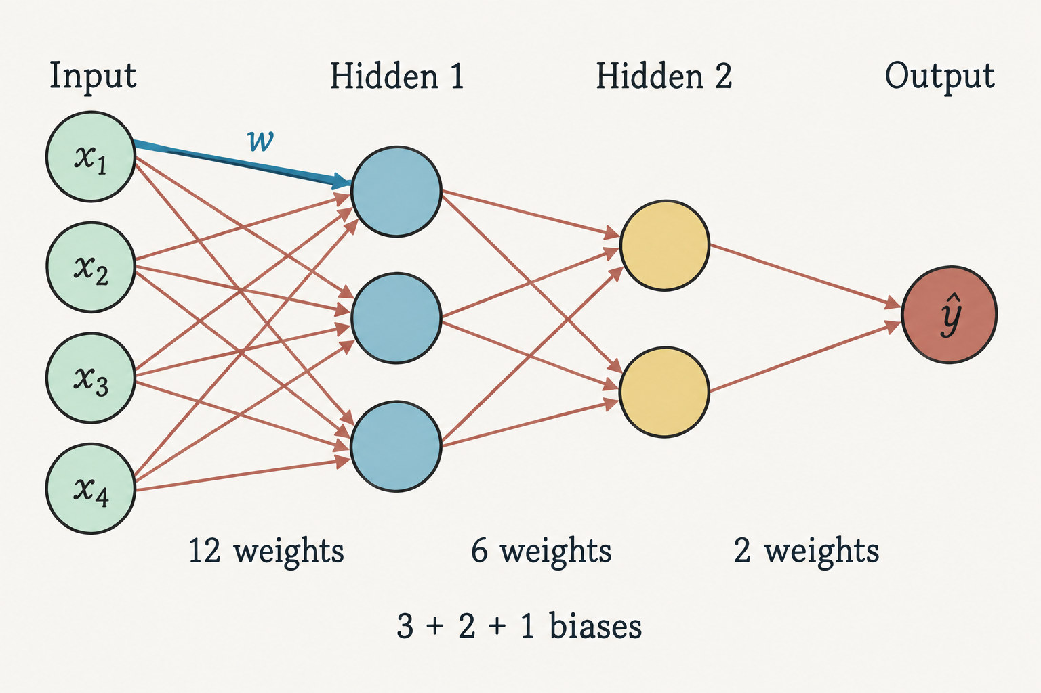
Recap: the network and its parameters
The earlier spam example used a multilayer perceptron (MLP).
Weights
Scale the influence
of each input.
Biases
Shift each neuron’s
weighted sum.
20 weights + 6 biases = 26 trainable parameters. Input nodes have no bias.
01
Notes:
Explain: In the earlier network, four input features feed layers with three neurons, then two neurons, then one output. Count the connections: four times three gives twelve weights, three times two gives six, and two times one gives two. That makes twenty weights. Each receiving neuron also has a bias, giving three plus two plus one, or six biases. These twenty-six parameters are the values training changes. Input features describe the email; they are not trainable parameters in this example.
Audience question: Why do input nodes have no bias here? Answer: They simply supply the feature values to the first learned layer.
Transition: Each receiving neuron performs the same basic calculation.
Reference details
Source: neural_networks.pptx, slides 4, 8–10 and 15–16. Weights scale inputs; biases shift each receiving neuron’s weighted sum. Diagram generated with the built-in image tool to illustrate the source architecture.

Slide 3
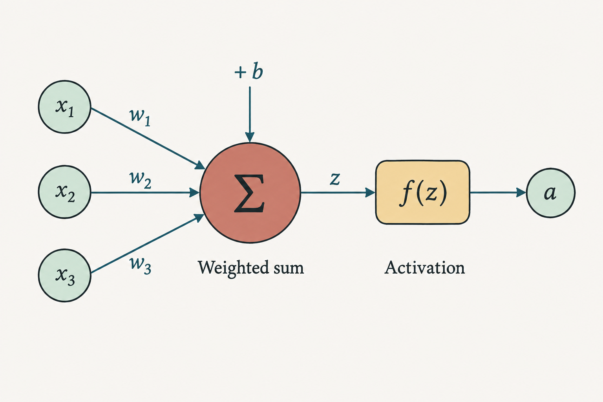
Recap: the calculation inside a neuron
Each neuron combines its inputs, adds a bias, and applies an activation.
z = Σ wᵢxᵢ + b
a = f(z)
ReLU: max(0, z)
Sigmoid: 1 / (1 + e⁻ᶻ)
Hidden layers use ReLU. The binary output uses sigmoid.
Example from the earlier deck: z = 2.6 − 0.5 = 2.1, so ReLU(z) = 2.1.
02
Notes:
Explain: A neuron first multiplies each input by its weight and adds those contributions. It then adds a bias and applies an activation function. A weight controls how strongly one input contributes, while a bias shifts the weighted sum. In the earlier example, the weighted inputs total 2.6 and the bias is minus 0.5, so z equals 2.1. ReLU returns 2.1 because this value is positive. A sigmoid instead maps a finite score to a number between zero and one.
Audience question: What would ReLU return for z equal to minus two? Answer: Zero.
Transition: At the output, we interpret the sigmoid value as the model's spam probability.
Reference details
Source: neural_networks.pptx, slides 5–10 and 14. Diagram uses three generic inputs for readability; the earlier email example has four inputs. A finite sigmoid input produces a result strictly between 0 and 1. Image generated with the built-in image tool.

Slide 4
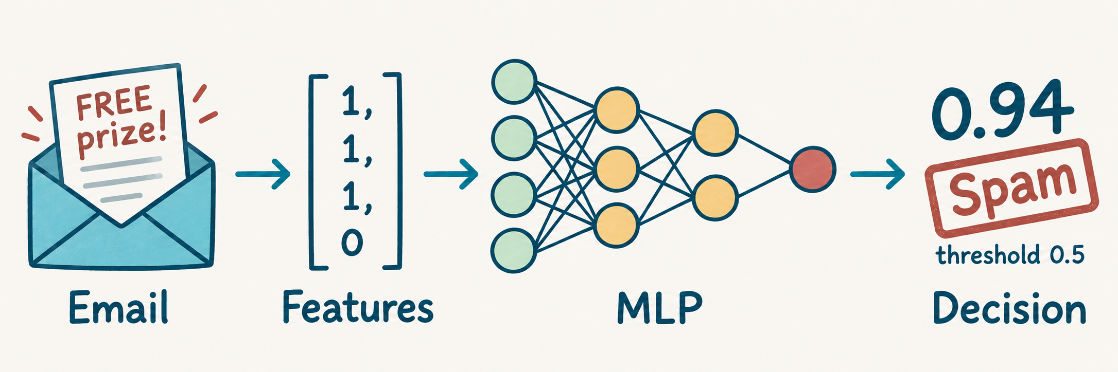
Recap: prediction, decision, and learning
The same email representation supports prediction and training.
Prediction
Training
Use the current weights and biases.
Compare with y = 1, then update parameters.
The smaller training example starts at ŷ = 0.6225. It uses different illustrative parameters.
03
Notes:
Explain: We keep a fixed feature order when converting an email into numbers. The network uses its current parameters to calculate a probability, and a threshold turns that probability into a class decision. Training requires an additional piece of information: the true label. We compare the predicted probability with that label to calculate the loss. The earlier larger network gave a probability around 0.94. The smaller worked example that follows starts at 0.6225 because it uses different illustrative parameters.
Audience question: Can we train just from the word “spam” produced by the threshold? Explain that the differentiable probability and loss provide the signal used by backpropagation.
Transition: This separates prediction from the backward calculation.
Reference details
Source: neural_networks.pptx, slides 12–13 and 17–21. Fixed input feature order is [spam-like words, suspicious link, aggressive formatting, trusted sender]. Earlier output is sigmoid(2.75) ≈ 0.94, threshold 0.5, known label y=1. Training compares the unthresholded probability to its label. Image generated with the built-in image tool.

Slide 5
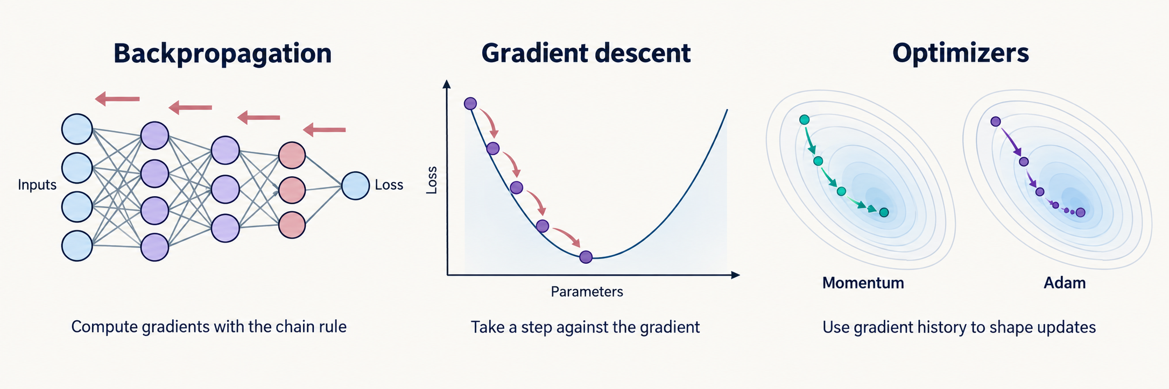
Gradient descent, backpropagation and optimizers
Backpropagation computes gradients. An optimizer uses them to update weights and biases.
Forward pass
Backpropagation
Gradient descent
Other optimizers
Make a prediction
Calculate the loss
Apply the chain rule
Compute gradients
Step against the gradient
θnew = θold − η∇L
Momentum: smooth steps
Adam: adapt step sizes
Gradient descent is a basic optimizer. Momentum and Adam use gradient history to shape updates.
The learning rate η controls the step size. Repeat the forward pass, backward pass and update.
04a
Notes:
A forward pass computes a prediction and loss using the current weights and biases. Backpropagation applies the chain rule from the output toward earlier layers to compute the loss gradient for each parameter. These gradients describe how sensitive the loss is to small parameter changes.
Gradient descent is a basic optimizer. For each weight or bias, the update is: new value = old value - learning rate times gradient. The negative gradient points downhill locally. A suitably small step can reduce loss, while an excessively large step may increase it. Mini-batch SGD estimates the gradient from a subset of training examples.
Momentum accumulates a running direction from past gradients, which can reduce oscillation. Adam tracks moving averages of gradients and squared gradients to scale updates for individual parameters. These optimizers still use gradients from backpropagation. Their effectiveness depends on the problem and settings.
Visual guide: The diagrams show backward gradient flow, a downhill gradient descent step, and schematic optimizer paths. The Momentum and Adam paths illustrate concepts, not measured performance. Illustration generated with the built-in image generation tool.
Audience check: Which method computes gradients, and which changes the parameters? Backpropagation computes gradients. The optimizer changes parameters. Gradient descent is one optimizer.
Transition: Next, we examine what a gradient tells us before working through the update step.

Slide 6
Two directions through the network
A forward pass predicts. A backward pass computes gradients.
Input
Hidden layer
Prediction
Loss
x
h
ŷ
L
Forward: activations
Backward: gradients
Gradient descent then updates the parameters: w_new = w_old − η · ∂L/∂w.
04
Notes:
Follow the forward direction first. Inputs pass through weighted sums and activations until the network produces its prediction and loss. Backpropagation then works backward through those same operations to calculate how the loss changes with each parameter. The optimizer uses those derivatives to update the parameters. Backpropagation computes gradients; gradient descent uses them. Keeping these roles separate makes the training loop easier to understand.

Slide 7
One email, one forward pass
A tiny network makes every calculation visible. The true label is y = 1 (spam).
Input x
ReLU hidden h
Sigmoid ŷ
Loss L
w₁ = 0.5
w₂ = 1
1
0.5
0.6225
0.4741
b₁ = 0
b₂ = 0
h = ReLU(w₁x + b₁)
ŷ = σ(w₂h + b₂)
Illustrative values. Both weighted sums are 0.5 before the update.
07
Notes:
Walk through the calculation: Set x=1, w1=0.5, b1=0, w2=1, and b2=0. The hidden score is 0.5 times 1 plus zero, giving 0.5. ReLU leaves it unchanged, so h=0.5. The output score is 1 times 0.5 plus zero, also 0.5. Applying sigmoid gives approximately 0.6225. Because the true label is one, binary cross-entropy is minus the natural logarithm of this probability, approximately 0.4741.
Emphasize: Keep the intermediate values from this forward pass. Backpropagation will reuse them.
Audience question: Which quantities are parameters and which are intermediate results?
Transition: Let us examine why this loss rewards a better prediction.
Reference details
w₁=.5,b₁=0,w₂=1,b₂=0,x=1. h=.5, z₂=.5, sigmoid(z₂)=.6224593312. BCE with y=1 is .4740769842.

Slide 8
Backpropagation follows the chain rule
Multiply local derivatives along a path from the loss back to a weight.
w₂
z₂
ŷ
L
× h
× ŷ(1−ŷ)
× (−1/ŷ)
∂L/∂w₂ = (ŷ − y) · h = −0.1888
Sigmoid + cross-entropy simplifies the output error to δ₂ = ŷ − y = −0.3775.
10
Notes:
Explain: Follow the output weight through the output score, the sigmoid prediction, and finally the loss. The chain rule multiplies the local derivatives along this path. For sigmoid paired with binary cross-entropy, the derivative of loss with respect to the output score simplifies to prediction minus label. Here that is 0.6225 minus 1, or approximately -0.3775. The derivative of the score with respect to w2 is the hidden activation, 0.5. Their product gives the output weight gradient, approximately -0.1888.
Audience question: What does the negative sign suggest? Answer: Increasing this weight slightly should reduce the loss locally.
Transition: The same error signal continues into the hidden layer.
Reference details
For y=1, ∂L/∂ŷ=−1/ŷ. ∂ŷ/∂z₂=ŷ(1−ŷ), and ∂z₂/∂w₂=h. Output bias gradient ∂L/∂b₂=δ₂=−.3775406688. For general y, sigmoid plus BCE still gives δ₂=ŷ−y.

Slide 9
The loss measures the prediction error
For a spam email (y = 1), higher predicted probability means lower loss.
Our example
ŷ = 0.6225
L = 0.4741
L = −log(ŷ)
Binary cross-entropy: L = −[y log(ŷ) + (1−y) log(1−ŷ)].
08
Notes:
Explain: Binary cross-entropy measures how well the predicted probability agrees with a binary label. For this email the label is one, so the formula simplifies to minus log of the prediction. As the probability approaches one, the loss approaches zero. A probability near zero gives a large loss for this positive example. For a negative example, y=0, the formula becomes minus log of one minus the prediction, which rewards a low spam probability. These logarithms are natural logarithms.
Audience question: What happens to the loss if this spam probability rises from 0.6 to 0.8? Answer: It decreases.
Transition: The class decision can stay the same during that improvement.
Reference details
Natural log. The chart plots the exact binary cross-entropy for y=1. As ŷ approaches 0, loss grows without bound.

Slide 10
What a gradient tells us
The tangent slope shows how loss changes near the current parameter value.
Negative slope
Increase w
Positive slope
Decrease w
ΔL ≈ (∂L/∂w) Δw
Subtracting a small multiple of the gradient moves the parameter downhill locally.
05
Notes:
Explain: The tangent represents the local slope of the loss with respect to a weight. A positive slope means a small increase in the weight would increase the loss, so a downhill step decreases the weight. A negative slope means a small increase in the weight would reduce the loss, so the update increases it. The gradient generalizes this idea to all parameters at once. The local approximation shown on the slide is most useful for small changes.
Audience question: If the gradient is negative, why do we increase the weight? Answer: The update subtracts a negative value.
Transition: The quadratic curve makes both directions easy to see.
Reference details
Source: gradient_descent_backpropagation_visual_reformatted.pptx, slides 2–3 and 6–8. Chart data calculated from L(w)=w²; tangents at w=−1 and w=1 have slopes −2 and +2. Full gradient ∇L contains one derivative per parameter.

Slide 11
Gradient descent moves downhill
For L(w) = w², both sides point toward the minimum at w = 0.
Left of zero
∂L/∂w < 0
Increase w
Right of zero
∂L/∂w > 0
Decrease w
Subtract the gradient. A sufficiently small step lowers the loss locally.
06
Notes:
Explain: For L(w)=w squared, the derivative is 2w. At w=1 the derivative is positive two, and at w=-1 it is negative two. Subtracting a small multiple of either derivative moves the weight toward zero. The minimum of this particular loss is at zero. Neural-network losses involve many parameters and are usually more complicated, so this bowl is a teaching example rather than a complete picture of the optimization landscape.
Audience question: What is the derivative at the minimum? Answer: Zero. A zero derivative alone does not guarantee a minimum for every possible loss.
Transition: We now apply the same update idea to a tiny neural network.
Reference details
Analytic chart of L(w)=w². Highlighted points are (−1,1) and (1,1). A zero gradient is not generally proof of a minimum.

Slide 12
Step size changes the path
Same loss L(w) = w², same start w = 1, three learning rates.
η = 0.1
η = 0.5
η = 1.1
Small step
At the minimum
Overshoots
One update: w = 0.8 (L = 0.64), w = 0 (L = 0), or w = −1.2 (L = 1.44).
16
Notes:
Explain: Each case starts at the same point on L(w)=w squared, where the gradient is two. A learning rate of 0.1 gives w=0.8 and loss 0.64. A learning rate of 0.5 gives w=0 and reaches this simple minimum in one step. A learning rate of 1.1 gives w=-1.2 and loss 1.44, worse than the starting loss of one. The direction initially points downhill, but a large step can go too far.
Audience question: Does a larger learning rate always learn faster? Answer: No; it may overshoot and become unstable.
Transition: Repeating these updates reveals the longer-term behavior.
Reference details
Analytic quadratic with derivative 2w. Colored segments connect successive iterates rather than tracing the loss surface between them. These learning-rate outcomes are specific to this example.

Slide 13
Repeated steps on a quadratic loss
L(w) = w² gives wₜ₊₁ = (1 − 2η)wₜ. Each run starts at w₀ = 1.
Small steps
Approach zero gradually.
At the minimum
Reach zero in one step.
Overshoot
Alternate and move away.
For this quadratic, 0 < η < 1 converges. The suitable range differs for other losses.
17
Notes:
Explain: Substituting the quadratic derivative into the update rule gives w at the next step equal to (1-2η) times the current w. Convergence from a nonzero start requires the magnitude of this multiplier to be less than one, which here gives 0<η<1. With η=0.1, the weight shrinks gradually. With η=0.5, it reaches zero immediately. With η=1.1, the multiplier is -1.2, so the sign alternates while the magnitude grows. This range applies to this exact loss, not to every neural network.
Audience question: What happens at η=1? Answer: The weight alternates between 1 and -1 without approaching zero.
Transition: Real training also combines information from multiple examples.
Reference details
Derived from the supplied gradient descent deck, slides 3 and 10. Exact data for steps 0,1,2,3: η=.1:[1,.8,.64,.512]; η=.5:[1,0,0,0]; η=1.1:[1,−1.2,1.44,−1.728]. The divergent path alternates sides and increases its distance from zero.

Slide 14
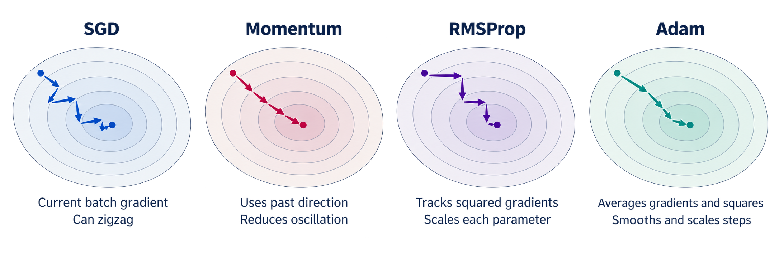
Different optimisers
Same gradient information, different update rules. Paths below are schematic, not a speed comparison.
AdamW applies weight decay separately from Adam's adaptive update.
04b
Notes:
Backpropagation supplies gradients to every optimiser shown here. The optimiser defines the update rule.
SGD means stochastic gradient descent. In mini-batch training, it subtracts the learning rate times the current batch gradient. It keeps no gradient history. Batch sampling introduces noise, and steep valleys can cause zigzagging.
Full-batch gradient descent uses the whole training set.
Momentum adds a running direction from earlier gradients. It can accelerate consistent progress and reduce oscillation, but excessive momentum or learning rate can overshoot.
RMSProp keeps an exponentially weighted average of squared gradients. Dividing by its square root, with a small stabilising constant, rescales each parameter's update.
Adam combines an average of gradients with an average of squared gradients and corrects their initial bias. It uses direction history and adaptive scaling. It still needs learning-rate tuning.
AdamW applies weight decay separately from Adam's adaptive gradient update. This separates regularisation from gradient scaling.
Audience question: Which methods keep gradient history? Momentum, RMSProp and Adam. Plain SGD does not.
Transition: Next, inspect what a gradient tells us, then work through a basic descent step.

Slide 15
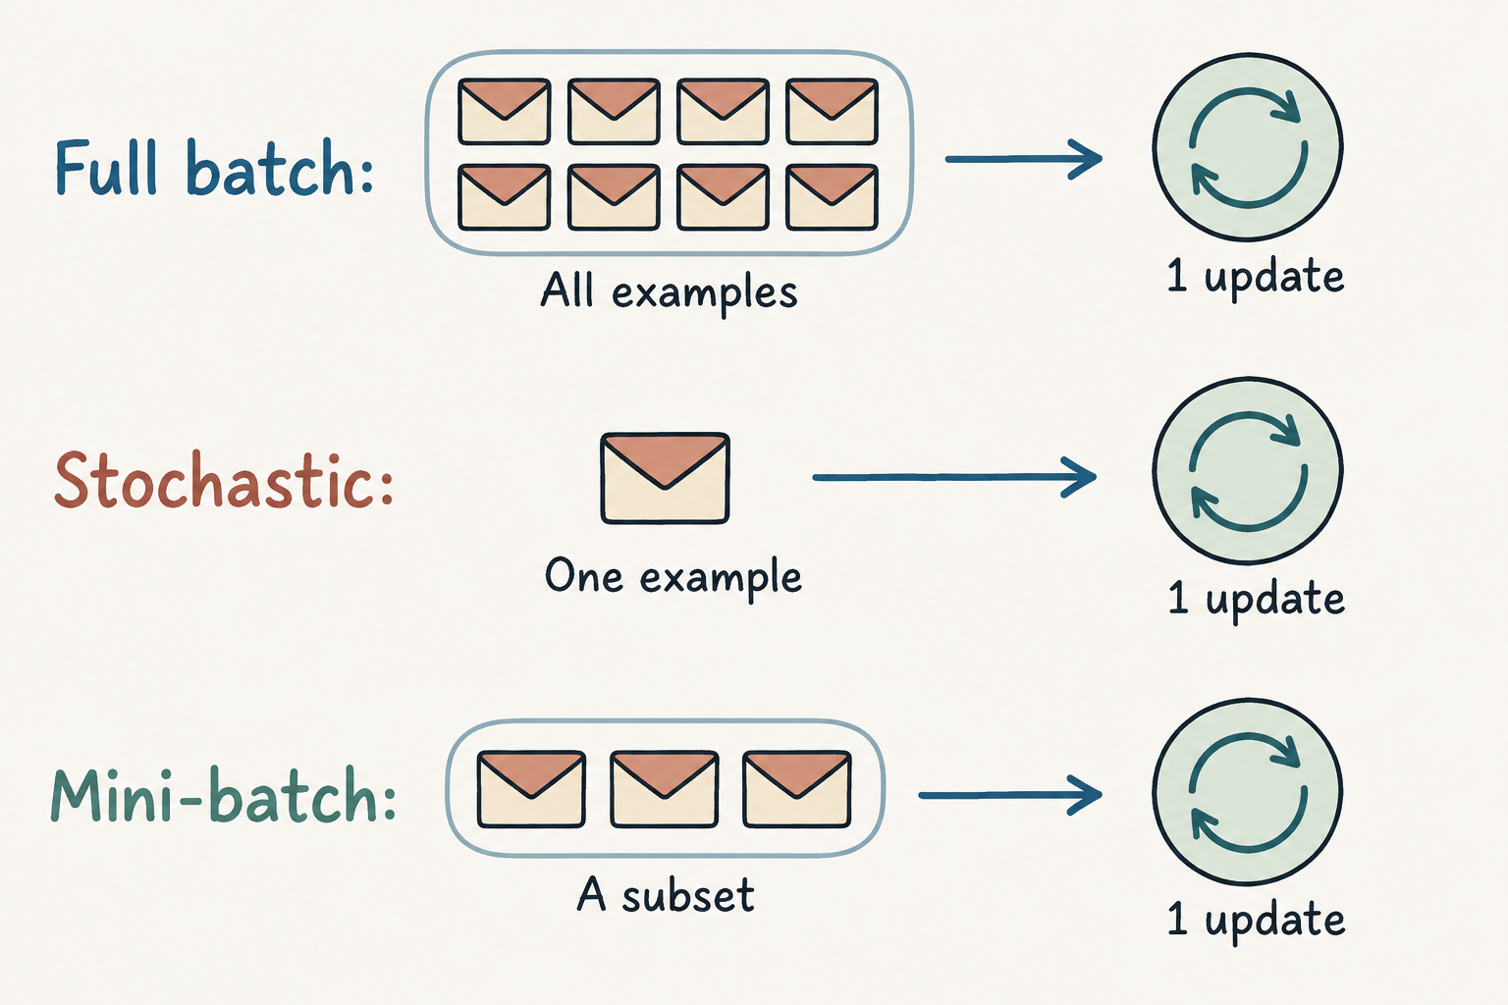
Batch size and training progress
The grouping of examples determines how often the parameters change.
Full batch
Stable gradient estimate.
More work per update.
Stochastic
Frequent, noisy updates.
Mini-batch
Balances frequency
and averaging.
1,000 emails with batch size 100 gives 10 updates per epoch. An epoch uses every email once.
19
Notes:
Explain: Full-batch training computes a gradient using the whole training set for each update. Stochastic training uses one example per update. Mini-batch training uses a subset. With 1,000 training emails and batch size 100, one epoch contains ten updates when each email is used once. Smaller batches often provide noisier gradient estimates, while larger batches require more examples for each update. Batch size and learning rate are separate choices.

Slide 16
A batch combines many gradients
Average the example gradients, then make one parameter update.
Email 1
g₁
Email 2
g₂
mean
step
Email 3
g₃
g_batch = (g₁ + g₂ + g₃) / 3
Repeat over batches. One full pass is an epoch. Held-out validation data guides tuning and stopping.
18
Notes:
Explain: Each email supplies a gradient vector, with one entry for every parameter. For the mean batch loss, we average those vectors and take one update. Different examples may agree or disagree about how a weight should change. As an extra scalar example, gradients -0.6, +0.3, and -0.3 average to -0.2. At learning rate 0.1, that parameter increases by 0.02. This example illustrates averaging and is separate from the earlier four-parameter network.

Slide 17
The learning loop
Predictions travel forward. Gradients travel backward. Updates start the next pass.
Predict
Measure loss
Backpropagate
Update weights
θ_new = θ_old − η∇L
20
Notes:
Read the loop in order. First predict using the current parameters. Then compare the prediction with the label to compute the loss. Next, backpropagate to calculate gradients. Finally, let the optimizer update the parameters. The next pass uses these new parameter values. In common software, clear old accumulated gradients before computing a fresh batch unless gradient accumulation is intentional. If clipping is needed, it happens after the backward pass and before the optimizer step.

Slide 18
Gradient flow through deep networks
The chain rule repeatedly multiplies local derivatives during the backward pass.
gₖ = g₀ × c₁ × c₂ × … × cₖ
Each c is a local derivative along a simple chain.
Local magnitudes below 1
Local magnitudes above 1
Gradient magnitude can shrink.
Earlier layers receive very small updates.
Gradient magnitude can grow.
Parameter updates can become unstable.
Illustration: g₀ = 1 and the same factor c at every step gives gₖ = cᵏ.
The combined effect of weights and activation derivatives determines the gradient scale.
22
Notes:
Explain: Along a scalar chain, the chain rule multiplies local derivatives. Each factor includes the effect of the relevant operation, such as a weight multiplication or an activation. If the repeated magnitudes are below one, the product can shrink. If they repeatedly exceed one, it can grow. In a full network we use Jacobian matrices and sum contributions across paths, but this scalar model isolates the basic mechanism.
Demonstrate: Begin with one and multiply by one-half several times. Then repeat with two. The contrast becomes larger as the chain gets longer.
Transition: We will first look at the shrinking case, which can make earlier layers learn very slowly.

Slide 19
Vanishing gradients
Very small gradients can make the earlier layers learn slowly.
g₆ = 0.5⁶
= 0.015625
Small gradients produce
small weight changes.
Saturated sigmoid or tanh
hidden units can make
this effect stronger.
Six factors of 0.5 reduce a starting gradient of 1 to 0.015625.
23
Notes:
The horizontal axis counts backward steps away from the output, not training epochs. Start with a gradient magnitude of one and multiply by 0.5 at each step. After six steps the magnitude is 0.015625, only one sixty-fourth of its original size. For plain gradient descent with learning rate 0.1, a parameter gradient of that size produces an update magnitude of 0.0015625. Very small early-layer gradients may slow learning even when later layers continue changing.

Slide 20
Why sigmoid saturation weakens gradients
A sigmoid hidden unit becomes less sensitive when its input is far from zero.
At z = 0
σ = 0.5
σ′ = 0.25
At z = 5
σ ≈ 0.9933
σ′ ≈ 0.0066
σ′(z) = σ(z)[1 − σ(z)] reaches 0.25 at z = 0 and approaches zero at either end.
24
Notes:
Explain: The sigmoid curve flattens when its input is strongly positive or negative. Backpropagation multiplies by the slope, so a nearly flat hidden activation passes back a much smaller gradient. Point to the centre of this derivative chart, where z=0 and the derivative is 0.25. At z=5 it is only about 0.0066. If weight factors are 1, multiplying six hidden sigmoid derivatives no larger than 0.25 gives at most 0.25^6, or 0.000244. Actual networks also multiply weights and sum over paths, so this is an illustration rather than a universal bound on the network gradient.

Slide 21
Exploding gradients
Large gradients can create abrupt weight changes and unstable loss.
g₆ = 2⁶ = 64
At learning rate η = 0.1:
|Δw| = 0.1 × 64
= 6.4
A large step can move
far beyond a useful region.
Six factors of 2 amplify a starting gradient of 1 to 64.
25
Notes:
This graph uses the same backward-depth interpretation, but every local factor is now two. Starting from one, the magnitude becomes sixty-four after six steps. With plain gradient descent and learning rate 0.1, a scalar gradient of sixty-four changes the parameter by magnitude 6.4. This can send the model into a region with much higher loss. Very large values may also cause numerical overflow. The plot is calculated teaching data, not a measured training run.

Slide 22
Healthier gradient flow
The remedy depends on whether gradients shrink, grow, or stop at specific layers.
When gradients vanish
When gradients explode
ReLU has derivative 1 for positive inputs.
Inactive ReLU units still have zero gradient.
Gradient clipping limits large gradients
before the update.
Suitable initialization helps preserve scale:
He for ReLU, Xavier for tanh.
A smaller learning rate reduces step size.
Check initialization and activation scale.
Residual connections provide
shorter paths for the backward signal.
Track gradient norms and loss together.
Loss spikes alone do not identify the cause.
Gradient norms by layer help reveal where the backward signal weakens or grows.
27
Notes:
Explain: For vanishing gradients, consider whether hidden activations are saturated and whether the initial weight scale suits the activation. ReLU has derivative one for positive inputs, though inactive units still have zero derivative. He initialization is designed for rectifiers, while Xavier initialization is a common choice for tanh. Residual connections provide another path for the backward signal. For large gradients, clipping can control their magnitude, while a smaller learning rate reduces the size of a plain gradient-descent step.
Emphasize: No single technique guarantees stable training. Monitor the loss and the gradients together, and avoid diagnosing the cause from one loss spike.
Transition: Let us look more closely at the additional path created by a residual connection.

Slide 23
Diagnosing training problems
Compare the loss curve with gradient measurements before choosing a remedy.
Observation | What to inspect | Possible response
Tiny early-layer gradients and stalled training | Activation saturation and initialization | ReLU / suitable initialization Residual connections
Large gradients and loss spikes | Gradient norms and update size | Gradient clipping A smaller learning rate
Training loss falls, validation loss rises | Generalization and data split | Early stopping Review model capacity
A small gradient near convergence can be expected. Context matters.
Change one setting at a time and compare runs using the same validation procedure.
29
Notes:
This table is a starting point for investigation, not an automatic diagnosis. A small gradient may be appropriate near convergence, but very small early-layer gradients with stalled training can suggest poor signal flow. Check activations and initialization in that case. Very large gradients alongside loss spikes suggest checking the update size and considering clipping. If training loss improves while validation loss worsens, the problem may be overfitting rather than gradient propagation. Validation data should guide these decisions, while the test set remains reserved for the final evaluation.
Demonstrate: Compare gradient norms by layer and across successive batches. For layers with very different parameter counts, include a per-parameter scale such as the root-mean-square gradient, since raw norms depend on the number of parameters.

Slide 24
Training progress and unseen examples
An illustrative learning curve shows how overfitting can emerge.
Best shown validation
Epoch 5
Training loss keeps falling
as validation loss rises.
Possible overfitting
Validation guides tuning and stopping. A separate test set estimates final performance.
30
Notes:
Explain: These curves are illustrative. Training loss keeps falling, but validation loss reaches its lowest shown value at epoch five and then rises. That divergence suggests the model is fitting the training data more closely without improving on unseen examples. Early stopping can save a checkpoint with good validation performance. In practice, allow for noise and use a suitable patience rule rather than assuming one upward point settles the decision. Use validation data for tuning and a separate test set for the final evaluation.
Audience question: Which checkpoint looks best on the validation values shown? Answer: Epoch five.
Transition: We will finish by checking the update calculations ourselves.

Slide 25
Recap of one training update
Forward pass creates a prediction. Backpropagation supplies the gradients for a gradient descent step.
Predict
Measure loss
Backpropagate
Update weights
Forward pass
ŷ = 0.6225
Compare ŷ with y
L = 0.4741
Apply the chain rule
Find each gradient
Gradient descent
θnew = θold − η∇L
After one update, spam probability rises from 0.6225 to 0.6512. Loss falls from 0.4741 to 0.4290.
Small, repeated updates help the network reduce training loss over many examples.
33
Notes:
Closing explanation: We have connected the complete learning cycle. A forward pass produces a probability. The loss compares it with the true label. Backpropagation applies the chain rule to calculate parameter gradients. Gradient descent uses those gradients and a learning rate to update the parameters.
In deep networks, repeated derivative products can vanish or explode. Initialization, activation choice, residual paths, and clipping address different parts of that problem. Validation checks whether learning also helps on unseen examples.
Final audience check: Can you explain the difference between backpropagation and gradient descent, and name one observation that would prompt you to inspect the gradients?

