Slide 1
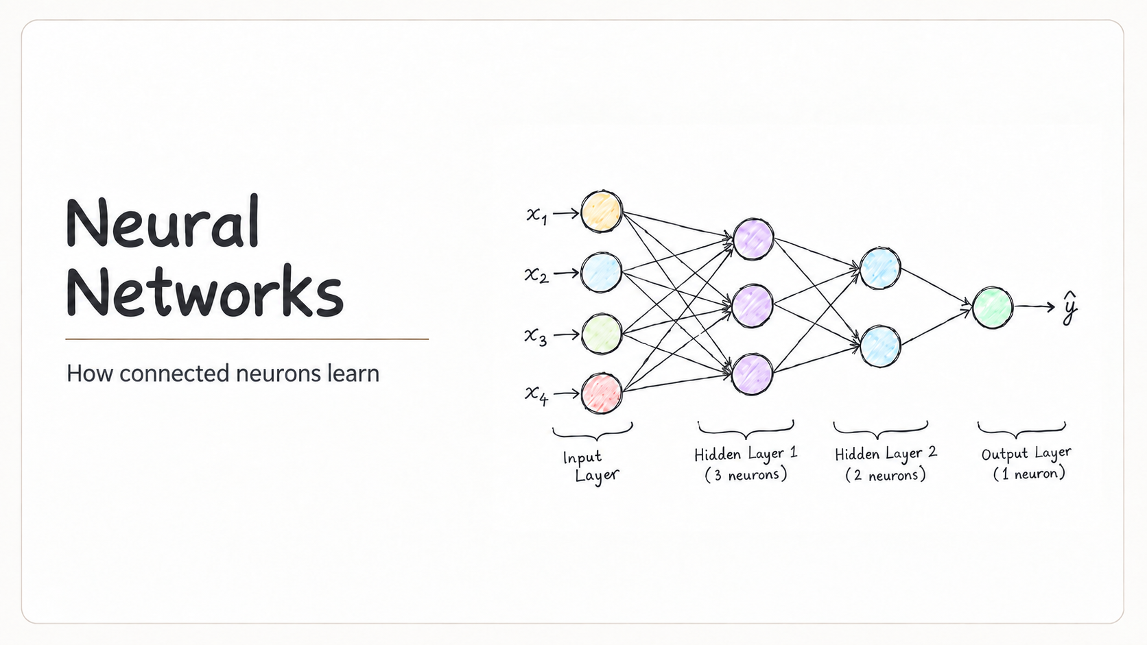
Notes:
Introduce neural networks as connected mathematical units that learn parameters from examples. The presentation follows a small MLP for binary spam classification.

Slide 2
What we will cover
Neural network fundamentals, followed by a worked spam classification example.
01
Neural network overview
04
From probability to a decision
Layers, neurons, and the multilayer perceptron
Using a threshold to classify an email
02
Preparing the spam example
05
How the network learns
Turning an email into numeric features
Loss, backpropagation, and weight updates
03
How the network makes a prediction
06
Putting it all together
Weights, biases, activations, and forward propagation
Shared patterns and the complete prediction pipeline
By the end: explain one neuron, follow a prediction, and describe how training changes it.
Contents
Notes:
Learning objectives: identify inputs, weights, biases and activations; calculate one neuron; follow a forward pass; distinguish probability from class; explain loss, gradients and parameter updates.

Slide 3
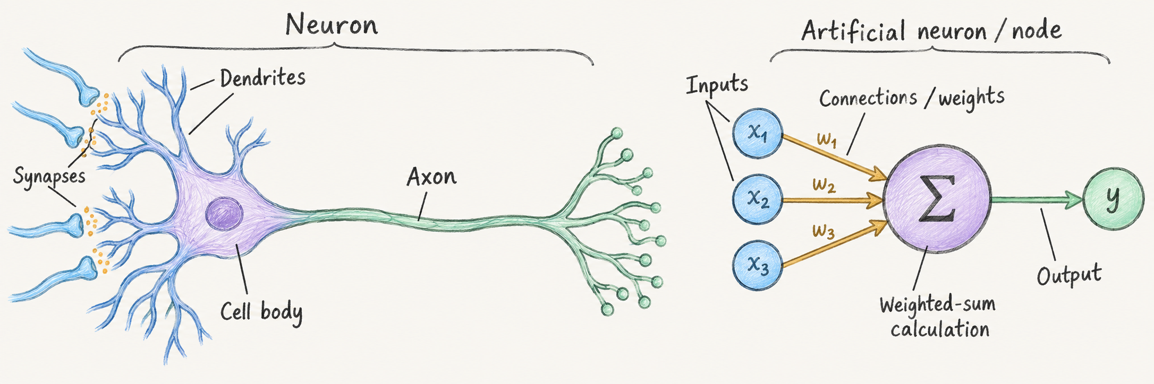
Neural networks and the brain
Biological structures inspired a simplified mathematical model.
Biological brain
Artificial neural network
Synaptic strength
Weight value
Learning
Adjusting weights
Networks of neurons
Layers of artificial neurons
A simplified analogy: real brains use richer circuitry and learning mechanisms.
02
Notes:
The comparison is a loose analogy. Biological neurons integrate signals and communicate through synapses. Changes in synaptic efficacy contribute to learning and memory. Artificial neurons compute functions of weighted numeric inputs, and the MLP in this deck uses backpropagation and gradient descent to update weights and biases. This does not imply that the brain runs this same training algorithm. Biological learning involves many mechanisms beyond this simplified comparison. Sources: IBM, What is Machine Learning?, https://www.ibm.com/think/topics/machine-learning ; NIH Intramural Research Program, How the brain powers communication between neurons, https://irp.nih.gov/accomplishments/how-the-brain-powers-communication-between-neurons ; NIMH, Shining a Light on Memory, https://www.nimh.nih.gov/news/science-updates/2014/shining-a-light-on-memory .

Slide 4
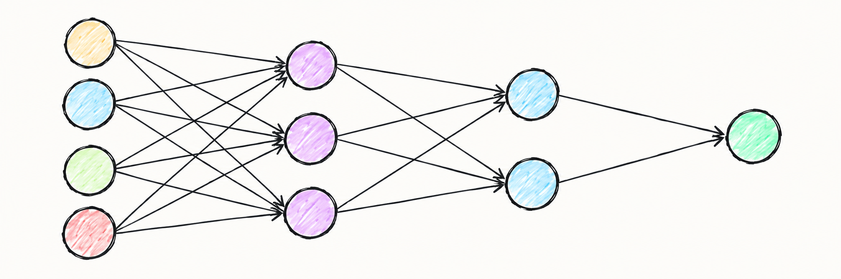
Neural network overview
MLP means multilayer perceptron: connected layers transform numeric inputs into predictions.
Connections
Weights and biases
Neurons
Links carry signals between neurons.
Weights scale each signal.
Biases shift a neuron’s activation.
Each unit receives inputs
and applies an activation
function.
Numeric inputs
Hidden layer 1
Hidden layer 2
Prediction
x₁
0.9
+ b
Inside one neuron
0.8
w
0.7
z = Σ(w × input) + b
x₂
0.4
output = f(z)
0.3
0.9
x₃
0.7
For ReLU, the threshold is 0:
negative z gives 0,
positive z passes through.
0.2
x₄
0.6
0.2
Propagation functions
Learning rule
Sum weighted inputs, apply f(z),
and pass outputs to the next layer.
Prediction error guides repeated updates
to weights and biases to improve accuracy.
03
Notes:
MLP stands for multilayer perceptron. The numeric values in this overview are illustrative and separate from the later binary spam example. Weights belong to connections. Biases belong to receiving neurons. A neuron sums weighted inputs plus bias and applies an activation. ReLU has a zero cutoff. During inference data moves forward. During training gradients flow backward to support parameter updates.

Slide 5
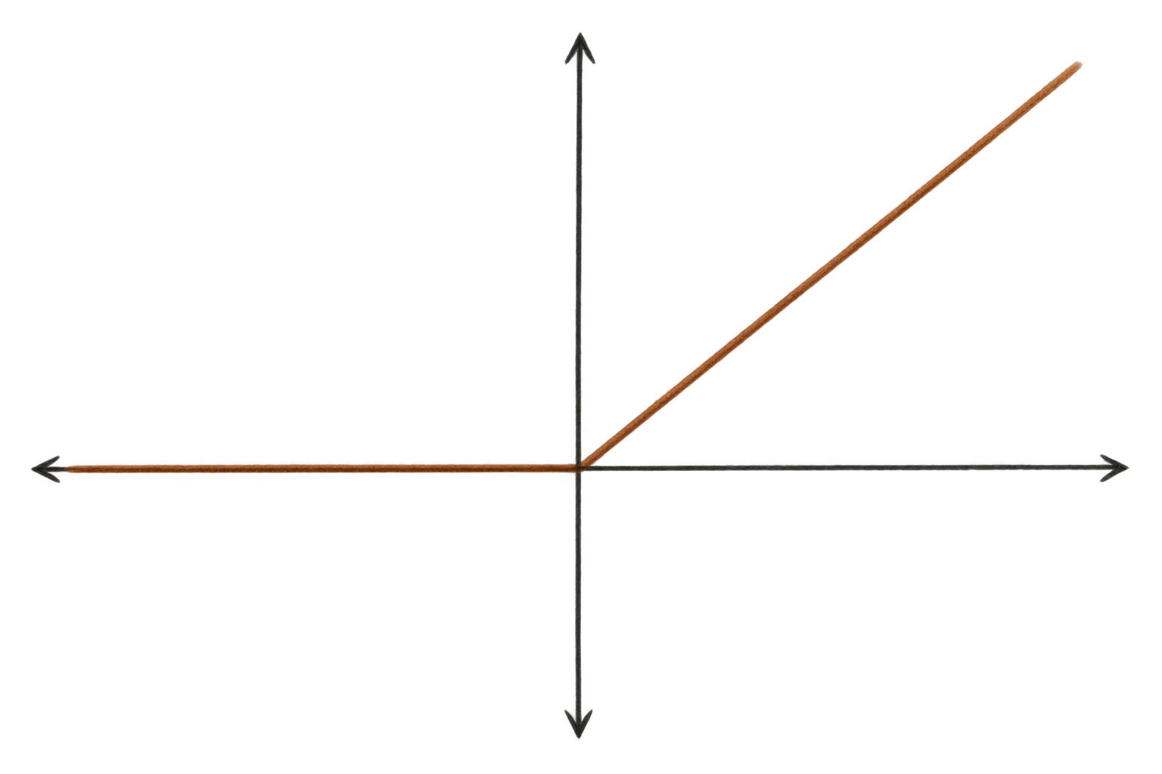
ReLU keeps positive signals
Hidden neurons pass positive weighted sums forward and replace negative values with zero.
ReLU = rectified linear unit
a = ReLU(z)
ReLU(z) = max(0, z)
Output range
0 to ∞
Typical role
Hidden layers
0
z
z ≤ 0: output 0
z > 0: output z
The bend at zero makes ReLU nonlinear.
This lets layers learn more complex relationships.
Examples: ReLU(−1.2) = 0, ReLU(0) = 0, ReLU(2.1) = 2.1
12
Notes:
ReLU stands for rectified linear unit and returns max(0,z). For z<0 its derivative is zero and for z>0 its derivative is one. Implementations choose a convention at zero. Nonlinear activations are essential: without them, stacked affine layers collapse into one affine transformation. Persistently negative pre-activations can leave a ReLU neuron inactive.

Slide 6
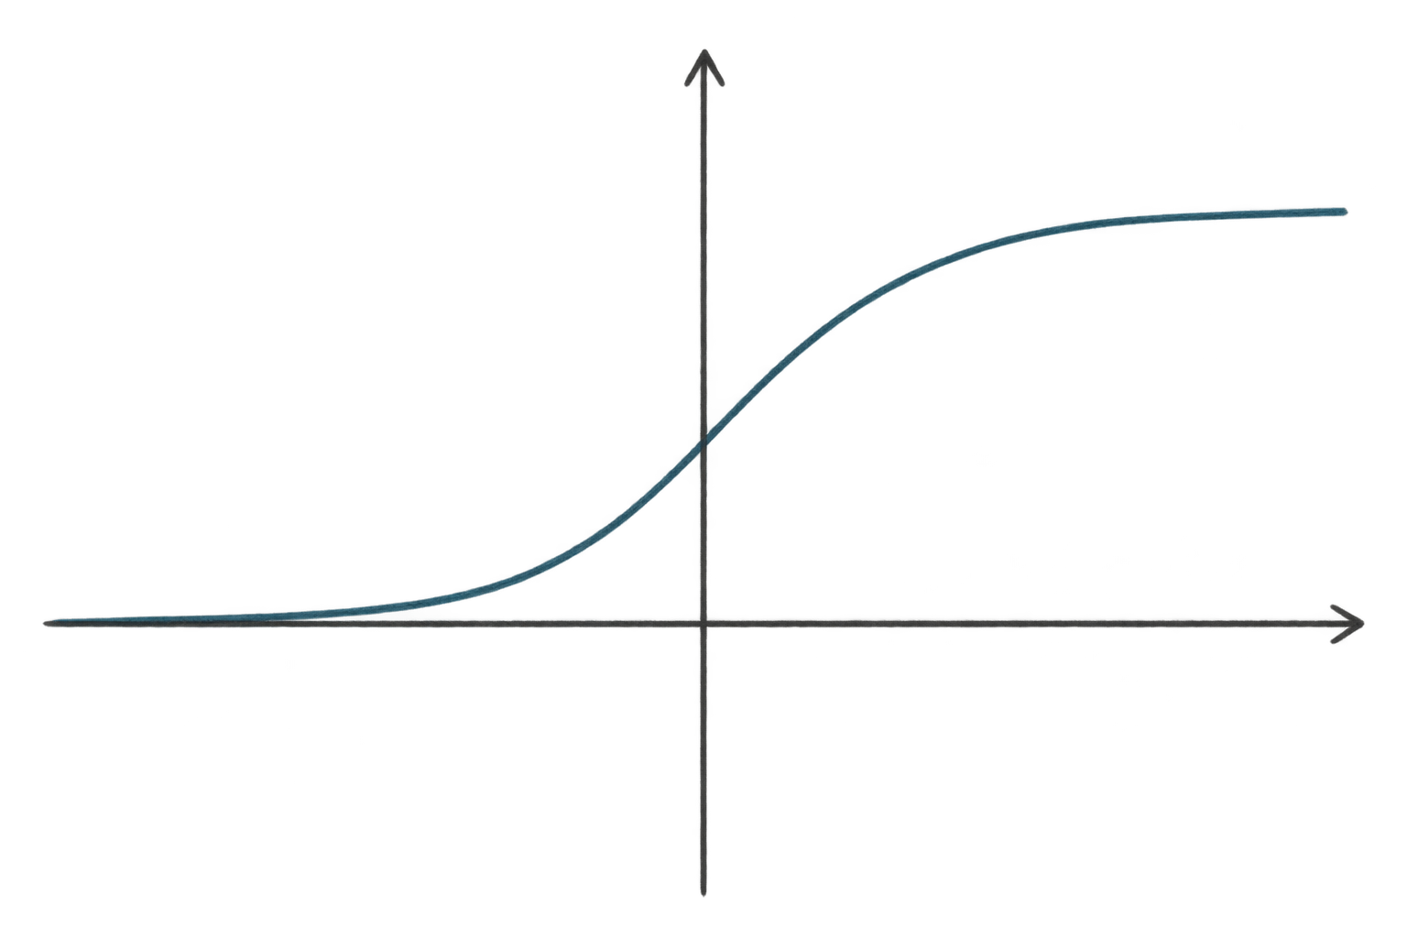
Sigmoid maps scores to probabilities
The output changes smoothly from 0 to 1, which fits binary classification.
Sigmoid output
p = σ(z)
σ(z) = 1 / (1 + e⁻ᶻ)
1
Output range
0 to 1
0.5
Typical role
Binary output layer
0
z
z is the score before activation.
Negative scores favor class 0.
Positive scores favor class 1.
z = 0
Example: a score z ≈ 2.75 gives p ≈ 0.94. A threshold then chooses the class.
13
Notes:
Sigmoid maps a real-valued score z to an output strictly between zero and one for finite z. z=0 maps to 0.5. In this binary example its output estimates P(spam). The decision threshold is a separate step. The estimated probability need not be perfectly calibrated. Large positive and negative scores make sigmoid saturate.

Slide 7
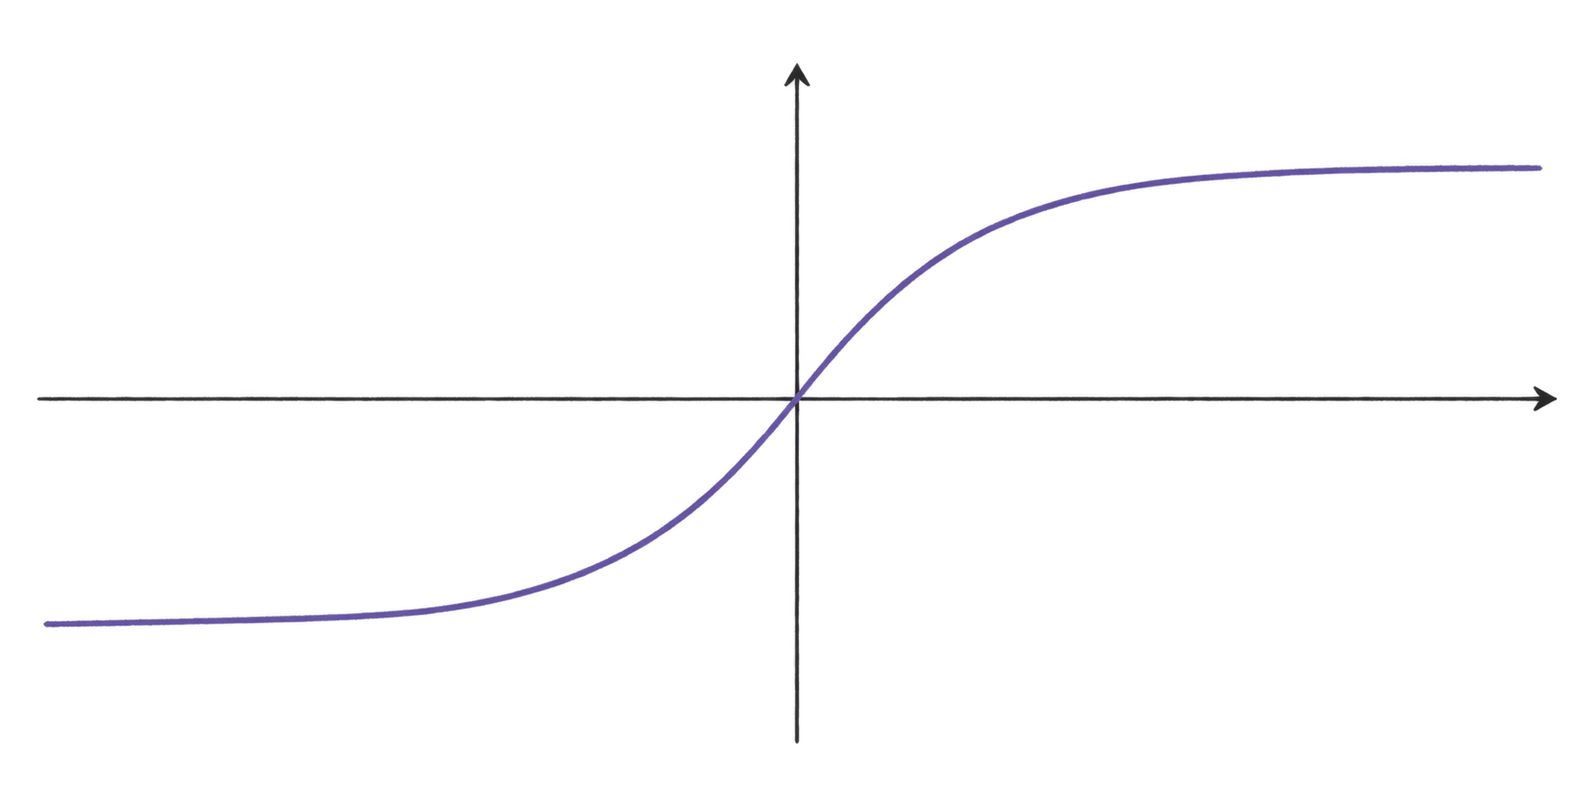
Tanh centers activations around zero
The output stays between −1 and 1, preserving the sign of the weighted sum.
Tanh = hyperbolic tangent
a = tanh(z)
tanh(z) = (eᶻ − e⁻ᶻ) / (eᶻ + e⁻ᶻ)
+1
Output range
−1 to 1
0
z
Typical role
Alternative hidden layers
−1
Tanh keeps positive and negative signals.
At large |z|, the curve flattens and
gradients become small.
Examples: tanh(−1) ≈ −0.76, tanh(0) = 0, tanh(1) ≈ 0.76
14
Notes:
Tanh, the hyperbolic tangent, has outputs strictly between -1 and 1 for finite inputs. It is centered at zero and preserves input sign. tanh(1)≈0.7616 and tanh(-1)≈-0.7616. Its derivative is 1-tanh(z)^2, which becomes small when the output approaches ±1. Our worked MLP uses ReLU rather than tanh in the hidden layers.

Slide 8
Weights control each input’s influence
A weight controls how strongly an input affects the weighted sum.
z = w₁x₁ + w₂x₂ + ⋯ + wₙxₙ + b
x = input w = weight b = bias
Size and direction
Learned during training
Positive weight: increasing x raises z.
Negative weight: increasing x lowers z.
Weight near zero: little effect per unit.
The network starts with initial weights.
Training adjusts them to reduce errors.
Weights scale individual inputs.
Bias shifts the combined total.
Larger |w| = a stronger effect per unit of input.
Weight = how much and in which direction an input matters.
04
Notes:
Adapted from the explanation supplied by the user. A weight sets the change in the pre-activation weighted sum z per unit change in its input, holding other inputs fixed: dz/dx_i = w_i. The sign tells direction and magnitude tells sensitivity. Raw weight size is not a universal measure of feature importance because input scale and correlations matter. A near-zero weight gives little change in z for a unit input change. The bias is an additive offset before activation; for a thresholded activation it shifts the activation boundary. Initial weights yield predictions, a loss measures error, backpropagation calculates gradients, and an optimizer such as gradient descent updates weights and biases. Mental model: weight = how much and in what direction an input matters; bias = an offset shifting the activation boundary. Formula: output = f(sum_i w_i x_i + b).

Slide 9
Bias shifts a neuron’s activation
The bias adds an offset before activation, giving the neuron flexibility to shift its response.
z = w₁x₁ + ⋯ + wₙxₙ + b y = f(z)
b is the bias. Without it, z is only the weighted sum of the inputs.
A linear neuron: bias is the intercept
A ReLU neuron: bias moves the threshold
Without bias, the line passes through (0, 0).
Adding b = 3 shifts it upward by 3.
With w = 1 and b = −5, the output stays zero
until x > 5, when it becomes positive.
Weights control input influence. Bias shifts the function and its activation boundary.
05
Notes:
Based on the user-provided explanation and formulas. Bias is an additive offset in z = sum_i w_i x_i + b, followed by y = f(z). For a simple linear neuron with identity activation, the model without bias y = wx passes through the origin. With bias y = wx + b, the intercept is b. The plotted examples hold w = 2 fixed and compare b = 0 with b = 3. For a ReLU neuron with w = 1, compare b = 0 with b = -5: max(0,x-5) is zero for x <= 5 and positive for x > 5. The ReLU threshold itself remains z = 0; bias shifts the corresponding boundary in input space. This is different from the vertical shift of a linear output. All chart values are calculated directly from these user-supplied equations, not observed data. Bias increases flexibility because a relationship need not pass through zero. In general, weights set influence and direction while bias shifts the activation boundary. Bias is learned during training alongside the weights.

Slide 10
Propagation function
The propagation function combines weighted inputs and bias into a single value, z.
z = w₁x₁ + w₂x₂ + ⋯ + wₙxₙ + b
What the symbols mean
Three simple steps
xᵢ = input
1. Multiply each input by its weight
wᵢ = weight
2. Add the weighted inputs
b = bias
z = combined value
3. Add the bias
Remember
Multiply → Add → Add bias
06
Notes:
Based on the user-provided explanation. Here propagation function refers to the pre-activation calculation z = sum_i w_i x_i + b, equivalently z = w^T x + b. It combines the input values with weights and bias. The activation function then produces a = f(z). ReLU is shown only as the general symbolic rule a = max(0,z), with no numerical worked example. Forward propagation refers to repeating the layer computations from inputs to outputs using the current parameters. This is distinct from backpropagation, which computes gradients during training.

Slide 11

NEURAL NETWORKS
Spam or
Not Spam?
How an MLP turns
email features into a decision
Worked example: four input features
and two possible classes.
07
Notes:
This is a deliberately small teaching example. Four manually selected features let us see every stage. A full spam classifier typically needs richer features and representative labeled data.

Slide 12
The classification problem
An email becomes numeric features, then a probability and a class.
Input x: numeric features
Spam
EXAMPLE EMAIL
You WON a FREE iPhone!
[1, 1, 1, 0]ᵀ
p = 0.94
MLP
Congratulations!
Click here now to claim your prize.
Feature extraction
Not Spam
special-offer@deals.com
Other possible outcome
p estimates P(spam). Here, P(not spam) = 1 − 0.94 = 0.06.
Training pairs features x with a known label y: Spam = 1, Not Spam = 0.
08
Notes:
The feature vector x describes an email. The target y is its known class during training. The model output p is an estimated probability for class 1, spam. A value p=0.94 leaves an estimated probability 0.06 for class 0. The probability for one example is not the model’s overall accuracy.

Slide 13
Four clues become four numbers
Each binary feature answers one yes-or-no question about the example email.
1 = feature present 0 = feature absent
“FREE”, “WON”, “prize”
Spam-like words
x₁
1
“Click here” link
Suspicious link
x₂
1
CAPITALS and !!!
Aggressive formatting
x₃
1
Unknown sender
Trusted sender
x₄
0
Keep this feature order for every email. x₄ = 0 means the trusted-sender feature is absent.
x = [1, 1, 1, 0]ᵀ
TF-IDF and embeddings provide richer numeric text features.
09
Notes:
Binary input values mean a feature is present or absent, not whether the whole email is spam. The fourth feature asks whether the sender is trusted; an unknown sender therefore gives zero. Apply exactly the same feature definition and order to every training and prediction example. TF-IDF weights words by their occurrence and relative rarity. Embeddings encode learned text features as vectors.

Slide 14
Inside one neuron
A worked example: multiply inputs by weights, add a bias, then apply an activation.
1 Multiply each input by its weight
2 Add the contributions
Inputs from the email: x = [1, 1, 1, 0]
1.5 + 0.3 + 0.8 + 0 = 2.6
x₁ × w₁ = 1 × 1.5 = 1.5
x₂ × w₂ = 1 × 0.3 = 0.3
A zero input contributes 0, whatever its weight.
x₃ × w₃ = 1 × 0.8 = 0.8
x₄ × w₄ = 0 × w₄ = 0
3 Add the bias
z = 2.6 + (−0.5) = 2.1
The bias shifts the total. z is the value
before activation.
4 Apply ReLU and pass the result
a = max(0, 2.1) = 2.1
Positive z passes through. Negative z becomes 0.
Training learns the weights and bias.
Activation a = 2.1 feeds the next layer.
10
Notes:
The first three inputs are one. Weights 1.5, 0.3 and 0.8 give contributions 1.5, 0.3 and 0.8. The fourth input is zero so its contribution is zero for any fourth weight. Their sum is 2.6; bias -0.5 yields z=2.1. ReLU(z)=max(0,z) yields a=2.1. This is a hidden activation and can exceed one. Bias and weights are learned parameters, while inputs come from the email.

Slide 15
A network of weighted connections
In this fully connected MLP, each neuron receives every output from the previous layer.
Input layer
4 inputs
Hidden layer 1
3 neurons
Hidden layer 2
2 neurons
Output
1 neuron
Weights scale signals
Example: input 1 × weight 1.5
contributes 1.5 to the next neuron.
A larger magnitude has more influence.
The sign adds or subtracts
for nonnegative inputs.
x₁
w = 1.5
+ b₁
x₂
x₃
Biases shift the total
Each hidden and output neuron
has its own bias, added before
the activation function.
x₄
4 × 3 = 12 weights
3 × 2 = 6 weights
2 × 1 = 2 weights
Training adjusts both
At each neuron: z = Σ(w × input) + b, then a = f(z)
Updates to weights and biases
help reduce prediction error.
20 weights + 6 biases = 26 trainable parameters. Input nodes have no bias.
11
Notes:
The fully connected architecture has 4×3+3×2+2×1=20 weights and 3+2+1=6 biases, totaling 26 trainable parameters. Input nodes do not have biases. The magnitude of a weight scales a fixed input; with nonnegative inputs its sign determines addition or subtraction. Each neuron has separate parameters. Line colors and dash styles identify paths rather than encode numeric weight signs.

Slide 16
The 4–3–2–1 MLP in matrix notation
W = weights, b = biases, z = totals before activation, a = activations. Superscripts label layers.
Input vector x = [x₁ x₂ x₃ x₄]ᵀ ∈ ℝ⁴
W⁽¹⁾ = ⎡w₁₁⁽¹⁾ w₁₂⁽¹⁾ w₁₃⁽¹⁾ w₁₄⁽¹⁾⎤
⎢w₂₁⁽¹⁾ w₂₂⁽¹⁾ w₂₃⁽¹⁾ w₂₄⁽¹⁾⎥
⎣w₃₁⁽¹⁾ w₃₂⁽¹⁾ w₃₃⁽¹⁾ w₃₄⁽¹⁾⎦
b⁽¹⁾ = ⎡b₁⁽¹⁾⎤
⎢b₂⁽¹⁾⎥
⎣b₃⁽¹⁾⎦
Hidden layer 1
3 neurons
z⁽¹⁾ = W⁽¹⁾x + b⁽¹⁾
a⁽¹⁾ = ReLU(z⁽¹⁾)
Hidden layer 2
2 neurons
z⁽²⁾ = W⁽²⁾a⁽¹⁾ + b⁽²⁾
a⁽²⁾ = ReLU(z⁽²⁾)
W⁽²⁾ = ⎡w₁₁⁽²⁾ w₁₂⁽²⁾ w₁₃⁽²⁾⎤
⎣w₂₁⁽²⁾ w₂₂⁽²⁾ w₂₃⁽²⁾⎦
b⁽²⁾ = ⎡b₁⁽²⁾⎤
⎣b₂⁽²⁾⎦
Output layer
1 neuron
z⁽³⁾ = W⁽³⁾a⁽²⁾ + b⁽³⁾
ŷ = σ(z⁽³⁾)
W⁽³⁾ = [w₁₁⁽³⁾ w₁₂⁽³⁾]
b⁽³⁾ = [b₁⁽³⁾]
Rows = receiving neurons. Columns = inputs. Weight matrices: 3×4, 2×3, 1×2.
Each bias vector has one value per receiving neuron: 3, 2, then 1.
15
Notes:
The superscript identifies the layer, not an exponent. W stores weights, b biases, z pre-activation totals and a outputs after activation. A row in W is one receiving neuron’s weight vector. A column corresponds to an input from the preceding layer. Multiplication shapes: (3×4)(4×1)+(3×1)=(3×1), then (2×3)(3×1)+(2×1)=(2×1), then (1×2)(2×1)+(1×1)=(1×1). Activations apply element by element.

Slide 17
Forward propagation produces a probability
Hidden activations feed the output neuron. Sigmoid converts its score to a value from 0 to 1.
Input
Hidden 1
Hidden 2
Output
1
2.1
1
2.6
1.4
0.94
1
0.2
0
0
Hidden layers use ReLU.
These values illustrate one forward pass.
Example output weights: [1, 1], bias: −0.05
z = 2.6 + 0.2 − 0.05 = 2.75
Sigmoid(2.75) ≈ 0.94. A forward pass uses the current weights and biases without changing them.
16
Notes:
The hidden activations are illustrative. To make the final step concrete, the added output-layer example chooses weights [1,1] and bias -0.05. Given activations [2.6,0.2], its score is 2.75. Sigmoid(2.75)≈0.9399, which rounds to 0.94. These output parameters illustrate a compatible calculation, not reported training results. A forward pass does not update parameters.

Slide 18
A threshold turns probability into a class
At a threshold of 0.5, this email falls on the Spam side.
Decision rule
threshold = 0.5
p < 0.5: Not Spam
p ≥ 0.5: Spam
0.94
0
0.25
0.5
0.75
1
Not Spam
Spam
0.94 ≥ 0.5: classify as Spam
Higher threshold: fewer legitimate emails flagged, but more spam missed.
Lower threshold: more spam caught, but more legitimate emails flagged.
17
Notes:
Here p>=0.5 means Spam and p<0.5 means Not Spam. The output 0.94 is above the threshold. A false positive means flagging a legitimate email as spam. A false negative means allowing spam through. Increasing the threshold generally reduces false positives while increasing false negatives; decreasing it reverses that trade-off. Choose a threshold using validation data and the costs of errors.

Slide 19
Training learns from prediction errors
Compare the prediction with the true label, then send gradients backward.
Predict
Compare label
Measure error
ŷ = 0.35
y = 1
Loss
Earlier training prediction
Known label: Spam
Binary cross-entropy:
L = −ln(0.35) ≈ 1.05
Gradients measure how each parameter affects the loss.
Backpropagate
Update w and b
w
=
w
− η
∂L
new
old
∂w
η is the learning rate: it sets the update size. ∂L/∂w is the weight’s gradient.
Backpropagation computes gradients. Gradient descent updates weights and biases.
18
Notes:
This slide shows an earlier training prediction of 0.35, separate from the illustrative trained output 0.94. For binary cross-entropy L=-[y ln(p)+(1-y)ln(1-p)]. With y=1 and p=0.35, L=-ln(0.35)≈1.05. Backpropagation uses the chain rule to compute gradients. Gradient descent updates w_new=w_old-eta*dL/dw, and similarly b_new=b_old-eta*dL/db. Eta is the learning rate. For example, eta=0.1 and gradient 0.2 reduce a weight by 0.02. Training typically averages loss over a batch and repeats over many batches and epochs.

Slide 20
Examples teach shared patterns
The same learned weights process both training emails and new emails.
Labeled training emails
Shared weights
“FREE prize!!! Click now”
Spam
“You won $10,000”
Spam
“Verify your account here”
Spam
“Meeting moved to 3 PM”
Not Spam
“Here is the report”
Not Spam
Possible learned combinations:
promotional words, urgent links,
and trusted-sender cues
Learn from the training set. Check performance
on separate emails the model has never seen.
These are possible learned combinations. Individual neurons need not match human-readable concepts.
19
Notes:
Generalization means performing well on new examples. The same parameters process all emails; training changes them across examples rather than creating separate networks. The messages and labels are illustrative. Individual neurons need not correspond to human concepts. Use a training set for learning, a validation set for choices such as threshold and model settings, and a held-out test set for final evaluation. Memorizing training examples is overfitting.

Slide 21
The whole pipeline
One forward pass transforms an email into a spam decision.
Email
Features
MLP
P(spam)
Decision
Weights + biases
ReLU, then sigmoid
Raw text
[1, 1, 1, 0]ᵀ
0.94
Spam
Fixed feature order
Estimated probability
Threshold: p ≥ 0.5
During training
Prediction
Loss
Gradients
Update w, b
Prediction uses the learned parameters. Training updates them using examples with known labels.
20
Notes:
The pipeline is email to fixed-order numeric features to weighted layers to sigmoid probability to thresholded decision. Hidden layers use ReLU and the output uses sigmoid. During training, known labels support a loss calculation, backpropagation computes gradients and an optimizer updates weights and biases. During ordinary prediction, the learned parameters stay fixed.

