Slide 1
Introduction to Galaxy
HPC @ Uni.lu and LCSB
Sarah Diehl

Slide 2
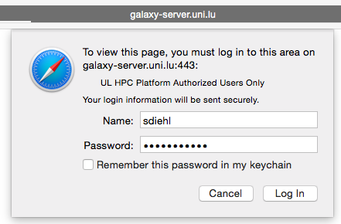
Log in
http://galaxy-server.uni.lu
Accept certificate and login with your HPC credentials

Slide 3
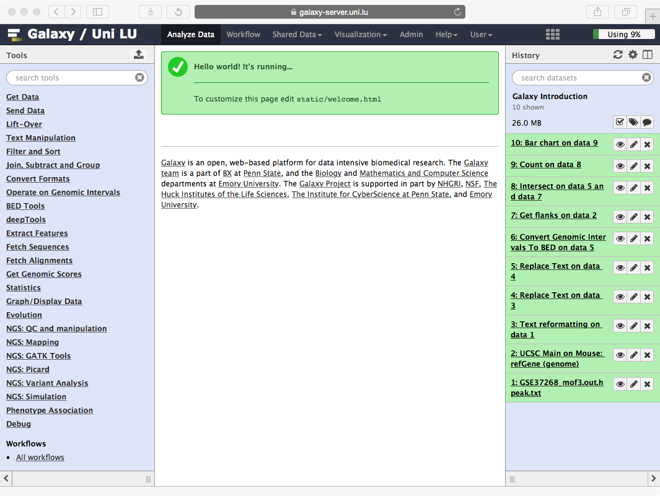
Top menu
Tools
History
Main frame

Slide 4
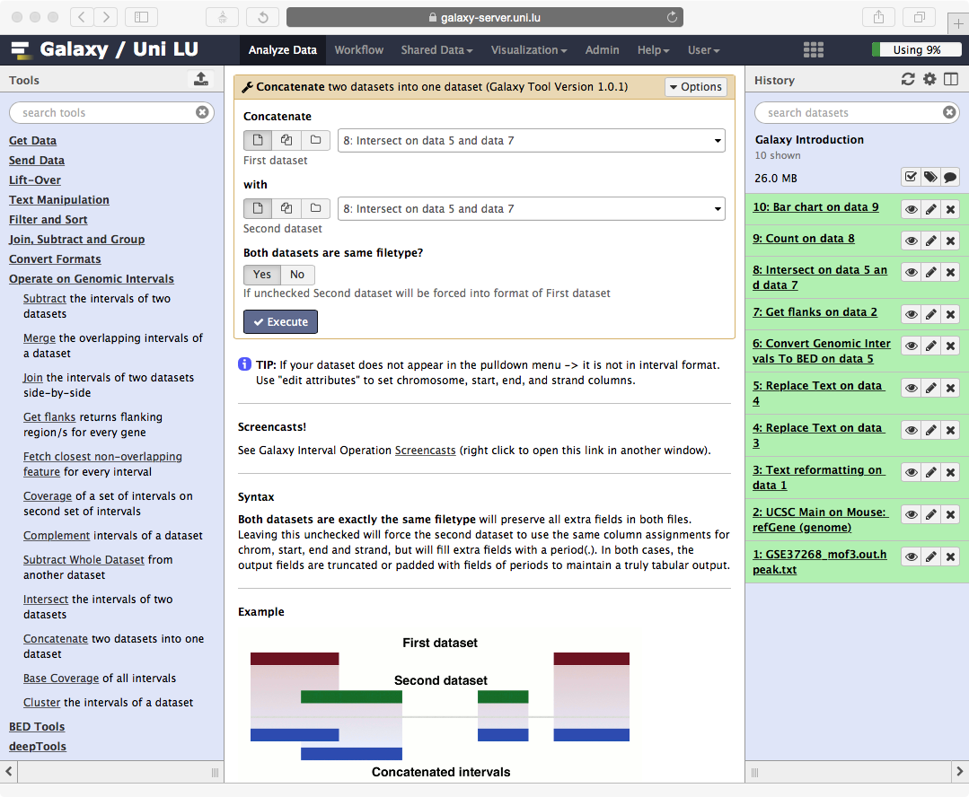
Upload
data
Tool options
History options
Click category name to expand
Click tool name to use
Tool help
dataset

Slide 5
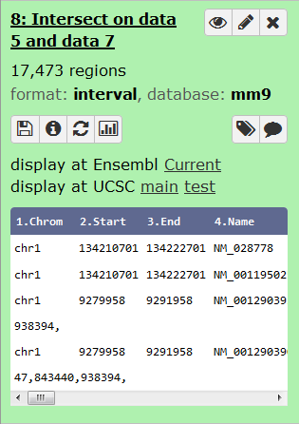

Datasets
delete
download
more info
edit attributes
display in main frame
links to display in genome browser
rerun tool
visualise
preview
Click dataset name to expand

Slide 6



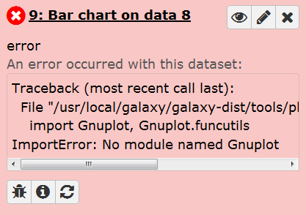
Dataset states
Waiting to be run
Running
Successfully finished
Failed
Send bug report

Slide 7
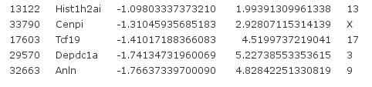
Formats: tabular
Column-based format
Separated by tabs
Similar to Excel

Slide 8
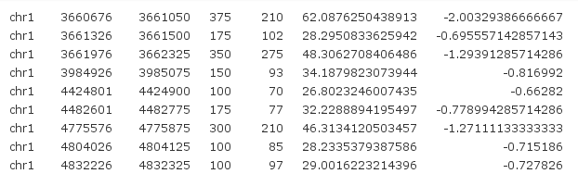
Formats: interval
For genomic regions
Column 1: chromosome
Column 2: start position
Column 3: end position
Other columns: anything

Slide 9
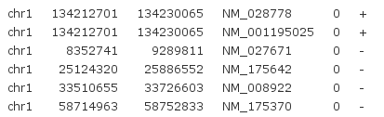
Formats: BED
Most common format for genomic regions genome.ucsc.edu/FAQ/FAQformat.html#format1
Column 1-3: same as interval
Column 4: name
Column 5: score
Column 6: strand

Slide 10
Formats: other
Sequences
Coverage
FASTA wikipedia.org/wiki/FASTA_format
FASTQ wikipedia.org/wiki/FASTQ_format
BedGraph genome.ucsc.edu/goldenPath/help/bedgraph.html
Wiggle genome.ucsc.edu/goldenPath/help/wiggle.html
BigWig(gle) genome.ucsc.edu/goldenPath/help/bigWig.html

Slide 11
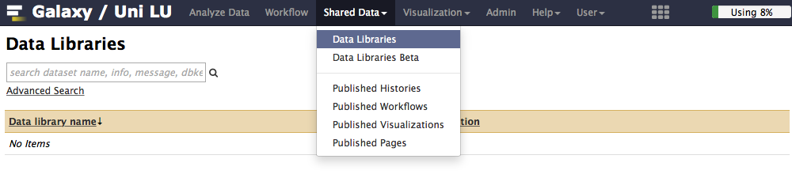
Data Libraries
Top menu -> Shared Data -> Data Libraries
Access restricted by permissions
Deposit for generally useful data
Place for sharing
Access to your project data (by request)

Slide 12
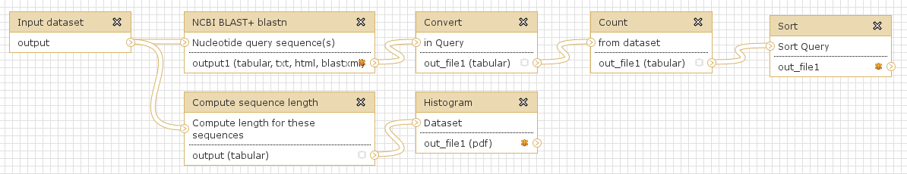
Workflows
Automate repeating analysis
Help to stay organized
Share them
Use other people‘s

Slide 13
Why use local server?
Special tools
More disk space and computing power for you
Data stays in-house
Fast and personalised help

Slide 14
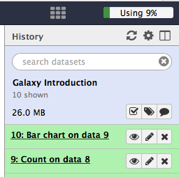
Warnings
Watch your disk usage!
For some tools or tasks it‘s perfectly normal to run for a day or more
You cannot upload data > 2 GB through your browser

Slide 15
Help
Top Menu -> Help
Send bug report
Contact me

Slide 16
