Slide 1
TensorRT Tutorial
leowgyang

Slide 2
2、编译 TensorRT 的开源源码
（1）编译使用github上的源码
环境版本：gcc5.3.1 cuda10.0 cudnn-7.6.5
下载源码：
git clone -b release/6.0 https://github.com/nvidia/TensorRT
cd TensorRT && git submodule update --init --recursive
export TRT_SOURCE=`pwd`
下载库：
tar -xvzf TensorRT-6.0.1.5.Ubuntu-18.04.2.x86_64-gnu.cuda-10.1.cudnn7.6.tar.gz
export TRT_RELEASE=`pwd`/TensorRT-6.0.1.5
编译命令：
cmake .. -DTRT_LIB_DIR=$TRT_RELEASE/lib -DTRT_BIN_DIR=`pwd`/out -DCUDA_VERISON=10.0 -DPROTOBUF_VERSION=3.6.1
（2）编译库中带的sample

Slide 3
2、编译 TensorRT 的开源源码-总结
GCC 版本 >= 5.x
需要联网下载protobuf
如果只需要sample的话，可以用库里带的源码

Slide 4
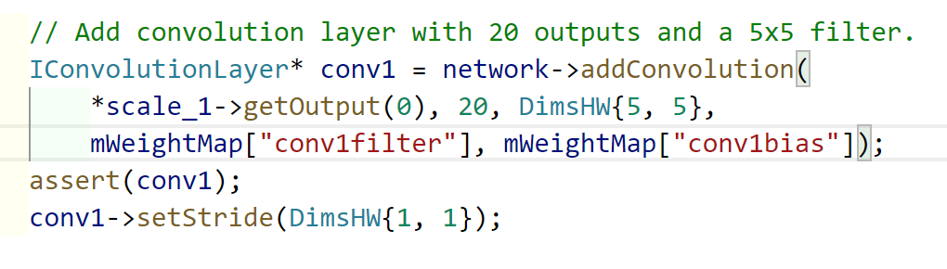
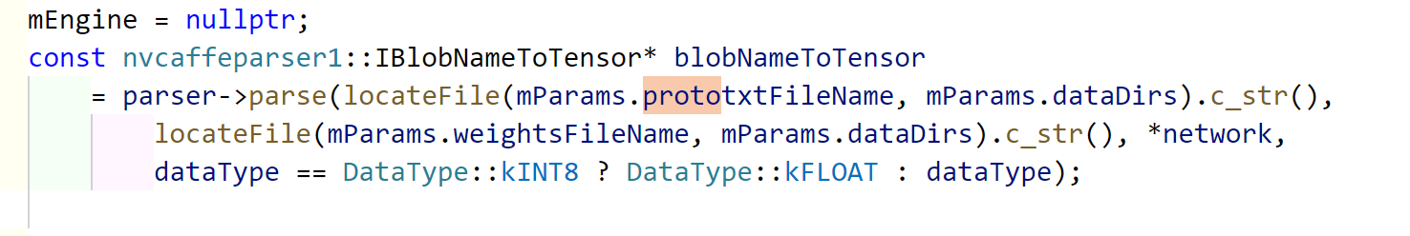
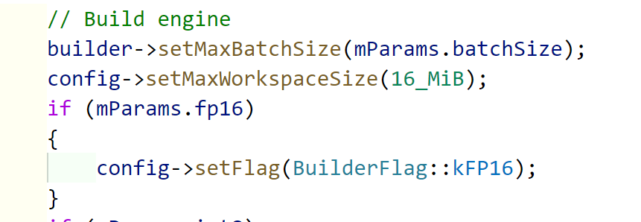
auto builder = createInferBuilder(ILogger);
auto network = builder->createNetwork();
auto config = builder->createBuilderConfig();
API
Network Definition
Parser
Builder Config
auto engine = buildEngineWithConfig(*network, *config)
auto memory = engine->serialize()
auto context = engine->createExecutionContext();
bool status = context->execute(batchSize, buffers);
auto engine = deserializeCudaEngine(blob, size)

Slide 5
2、Plugin
UffPoolPluginV2Creator::getPluginName()
void setPluginNamespace
int getNbOutputs()
DataType getOutputDataType(int index)
IPluginV2Ext* clone()
Dims getOutputDimensions()
bool supportsFormatCombination(int pos)
UffPoolPluginV2Creator::getFieldNames()
UffPoolPluginV2Creator::createPlugin(const char* name)
UffPoolPluginV2::构造函数
void configurePlugin()
size_t getWorkspaceSize(int maxBatchSize)
int initialize()
void destroy()
auto engine = buildEngineWithConfig(*network, *config)
auto memory = engine->serialize()
auto context = engine->createExecutionContext();
bool status = context->execute(batchSize, buffers);
auto engine = deserializeCudaEngine(blob, size)

Slide 6
如何构建自己的plugin库
pluginType
编写plugin
pluginVersion
编写plugin creator
pluginName
pluginVersion
注册plugin creator
REGISTER_TENSORRT_PLUGIN
getPluginRegistry()->registerCreator(*mCreator, libNamespace);
序列化
将参数和权值写到文件中
反序列化过程和原理
从文件中读取pluginType和pluginVersion
根据pluginType和pluginVersion从getPluginRegistry获得creator
使用creator根据参数生成plugin，并addPlugin到network中

