Slide 1



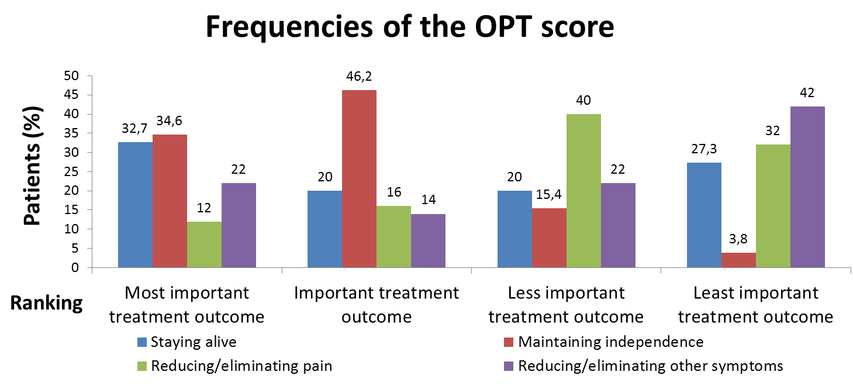
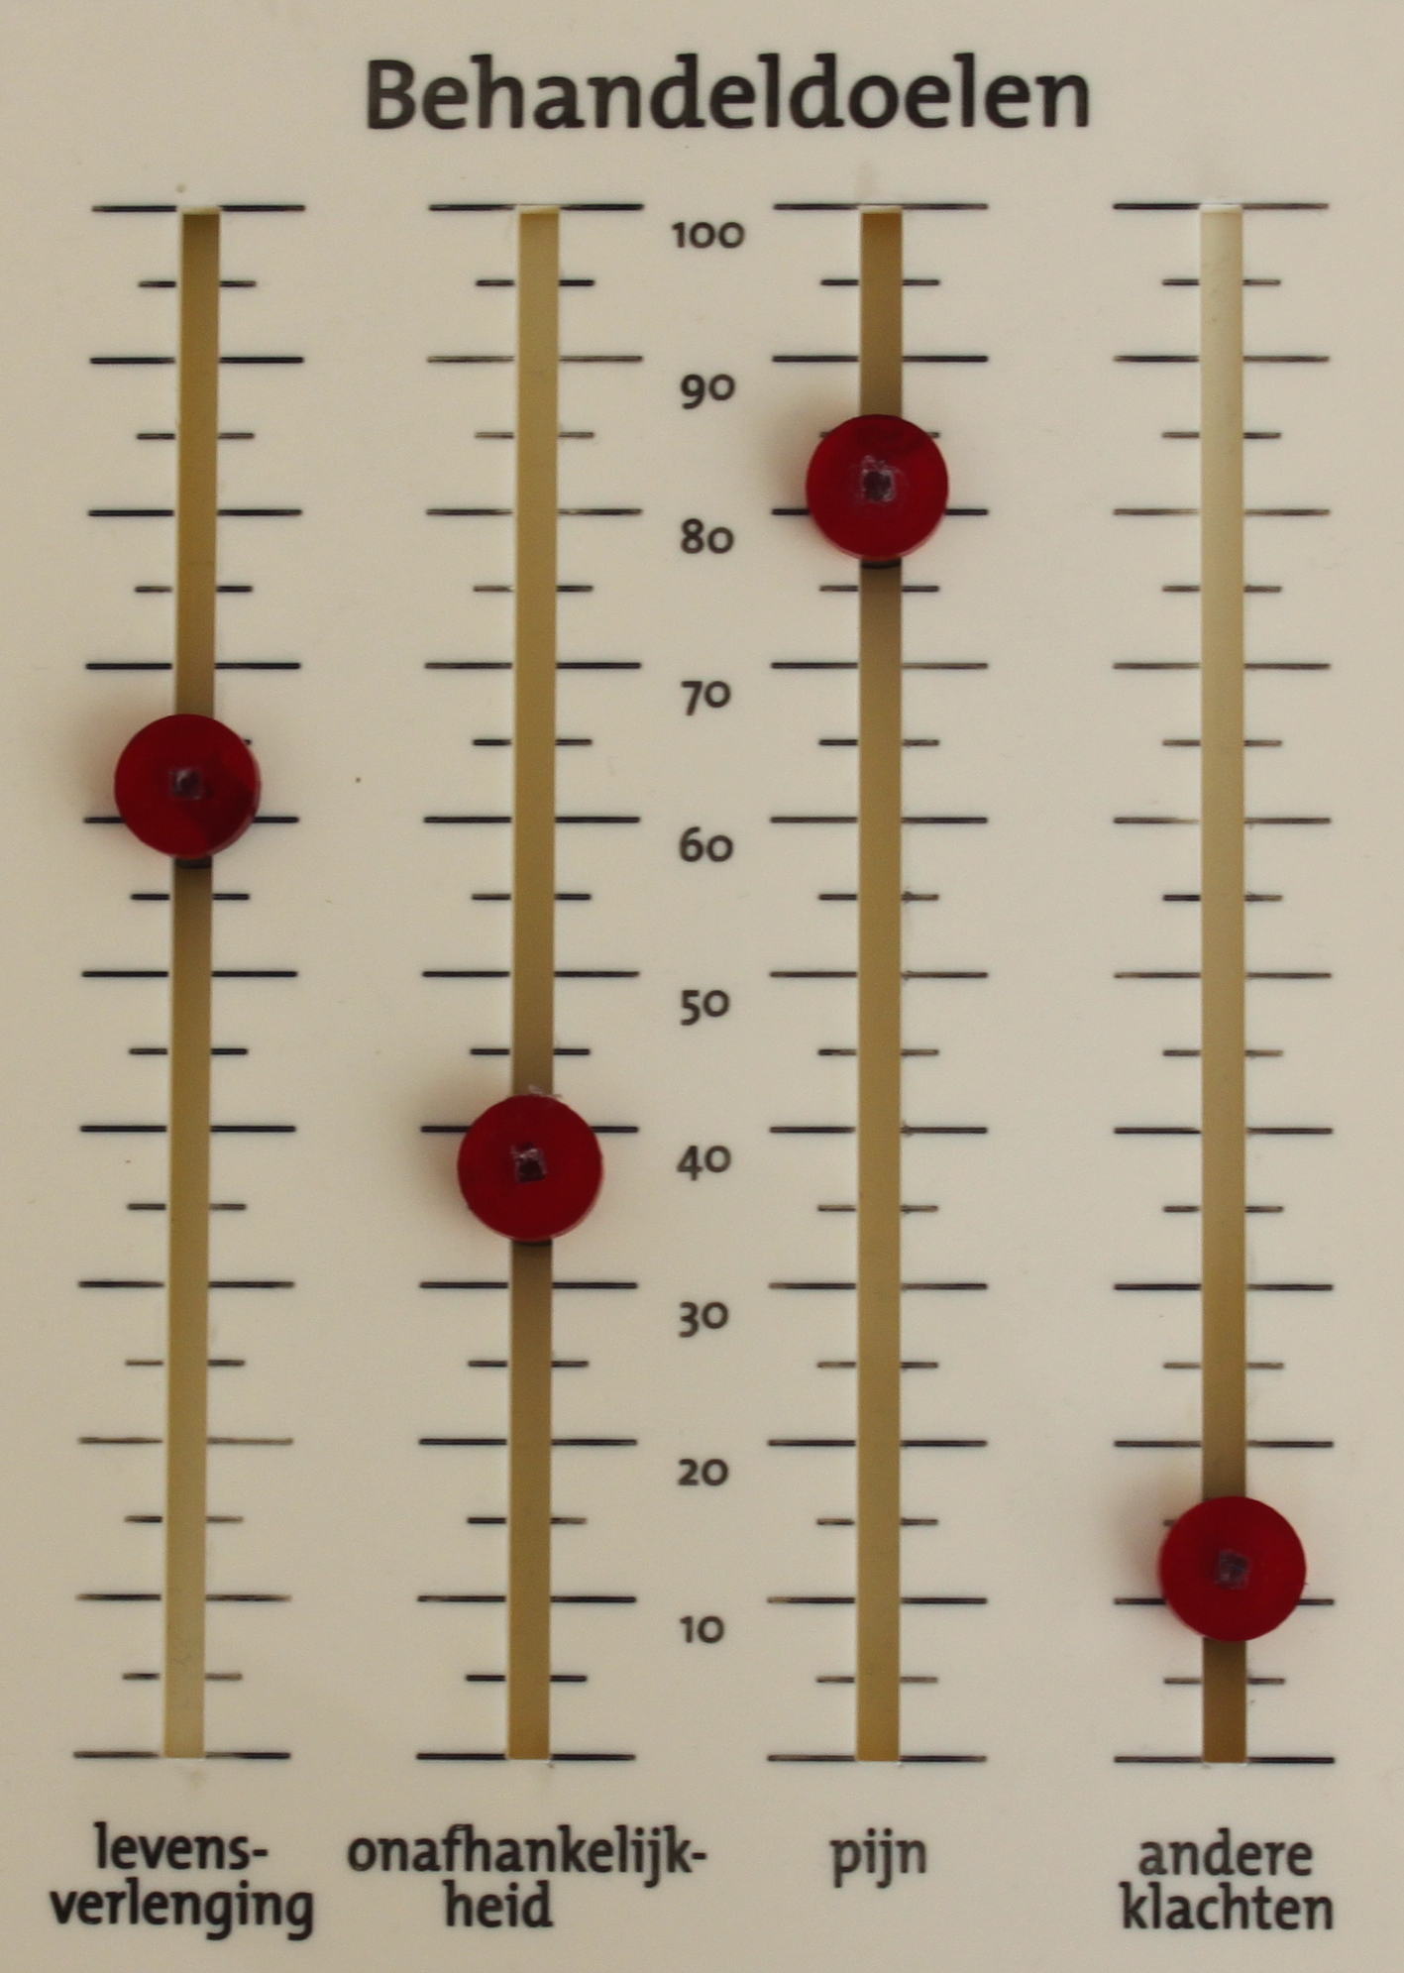


Medication review in elderly patients with polypharmacy: effects of the use of the Outcome Prioritization Tool (OPT)
JJGT van Summeren¹, J. Schuling¹, F.M. Haaijer-Ruskamp²
^{[1]} University of Groningen, University Medical Centre Groningen, Department General practice, Holland.
^{[2]} ] University of Groningen, University Medical Centre Groningen, Department of Clinical Pharmacy and Pharmacology Holland.
Correspondence: j.j.g.t.van.summeren@umcg.nl
INTRODUCTION
CONCLUSIONS
Treatment according to disease specific guidelines results rapidly in polypharmacy.¹
Medication review is mainly based on inappropriate medications (PIMs).
The focus of care has to shift from diseases and their drugs to the patient and his preferences.
Elderly patients can prioritize between 4 general treatment outcomes: 1) staying alive, 2) maintaining independence, 3) reducing pain and
4) reducing other symptoms.²
This prioritization may facilitate patient involvement in medication review.
The OPT tool appears to contribute to medication changes in elderly.
Stopping medication is the most frequent change.
Treatment outcomes ‘staying alive’ and ‘reducing other symptoms’ appear to induce medication changes.
Future research is needed to explore the effect of systematic weighing of patients preferences in medication review.
PATIENT CHARACTERISTICS
Table 1: Patient characteristics (N=60, derived from 14 GPs)
Age | 83.85 ± 4.16 years
Women | 31/60
Use of baxter | 12/52
Living condition
Independent | 30/56
Home for the aged | 6/56
Prescriptions per patient | 8.8 ± 2.73
RESEARCH QUESTIONS
Does medication change after medication review by GPs in elderly patients using the OPT tool?
METHODS
RESULTS I
  Cross-sectional pilot study
  October 2013 - April 2014
    Inclusion criteria: ≥80 year, ≥2 chronic diseases, ≥ 5 drugs.
    Exclusion criteria: cognitive disturbances, life expectancy < 6 months based on perception of GP.
      Outcomes:
        OPT score
        Medication changes
Fig 2. Percentageof patients ranking treatment outcome on the concerning rank.
OPT
RESULTS II
Fig 1. OPT.³ By moving the buttons the patient prioritize the treatment outcomes according to the trade-off principle. This results in a OPT score. The GP discussed the implications of the score for drug use with the patient.
In 33% of patients medication was changed.
7.1 % of prescriptions was changed.
Table 2: Number and percentage of prescriptions changed in N= 58 patients
 | Prescriptions (N=510) | Prescriptions (%) | Patients (N=58)ª | Patients (%)ª
Sort of medication change
Start | 0 | 0 | 0 | 0
Stop | 22 | 4.3 | 16 | 27.6
Dosis+ | 3 | 0.6 | 3 | 5.2
Dosis- | 5 | 1.0 | 4 | 6.9
Switch | 6 | 1.2 | 3 | 5.2
Medication change per treatment outcome
Staying alive | 14 | 2.7 | 10 | 17.2
Maintaining independence | 3 | 0.6 | 2 | 3.4
Reducing/eliminating pain | 3 | 0.6 | 2 | 3.4
Reducing/eliminating other symptoms | 16 | 3.1 | 10 | 17.2
Total | 36 | 7.1 | 19ª | 33ª
ª One patient can have more than one (changed) prescription
Staying alive
Maintaining independence
Reducing pain
Reducing other symptoms
References:
Tinetti et al. (2004). New Eng. J. of Med, 351 (27), 2870-2874
Fried et al. (2011). Patient Educ Counsel, 83 (2), 278-282.
Schuling et al. (2013). NTVG 157, A6491
Stichting Stoffels-Hornstra

