Slide 1
VIRTUAL SERVER LOGS PIPELINE DATA ENGINEERING USE CASE ANALYSIS
RITHIN PAUL THOMAS
Data engineer intern
13/03/2026

Slide 2
objectives
The Sample Dataset is to be ingested into Azure Data Lake Storage Gen2, after which it would be transformed, curated, and then analyzed using Power BI to identify KPIs. The pipelines created needed to
Ingest data from the staging container -> raw container
Transform data located in raw container and perform appropriate checks to validate and protect data.
Store transformed data in the processed container, which would be aggregated and sent to the curated container for analysis-ready data.
Pull data from the Azure Data Lake Storage to Power BI, to showcase trends and performance indicators or bottlenecks.

Slide 3
Data Ingestion pipeline
This pipeline extracts the data from the staging container and copies it to the raw container for traceability.
Scheduled Triggers run the pipeline, where validation activity checks for the existence of log files in staging container.
If validated, file names are extracted via ‘GetMetadata’ activity and sent to a ‘ForEach’ activity, where they are copied to the raw container, after performing checks for file size and type. Else, ‘Fail’ activity stops the pipeline.
Files in staging are moved to an archive folder to prevent recopying the same files on the next pipeline run.
‘ExecutePipeline’ Activity is used after copying to start the transformation pipeline.

Slide 4
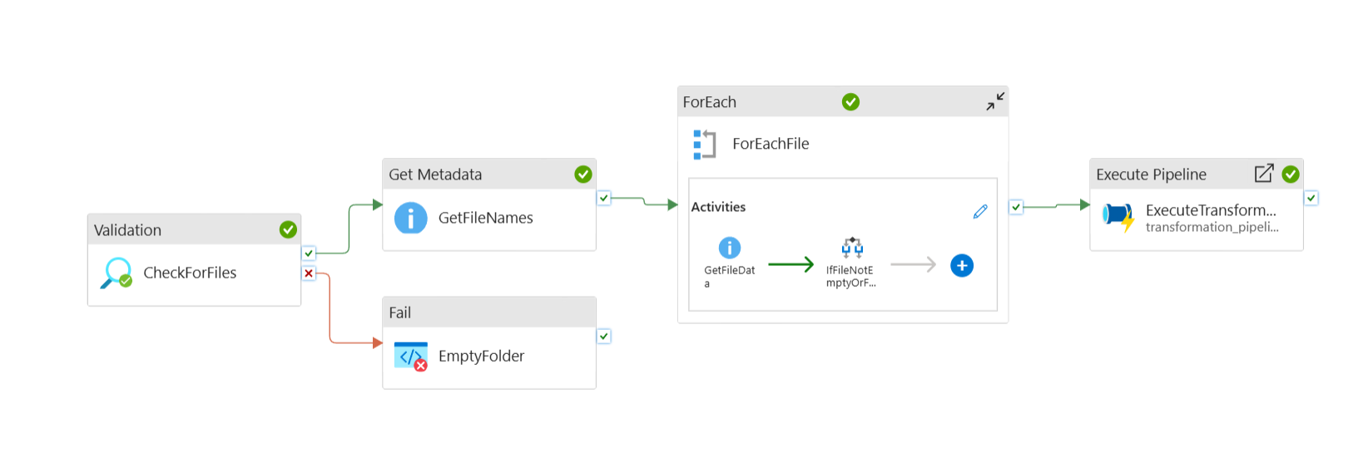
DATA INGESTION PIPELINE

Slide 5
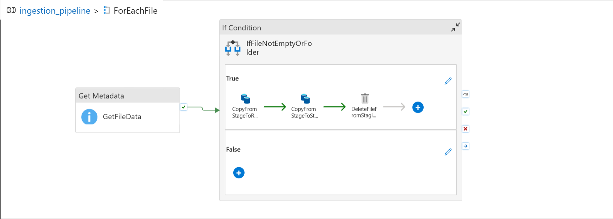
INSIDE ‘ForEachFile’ ACTIVITY

Slide 6
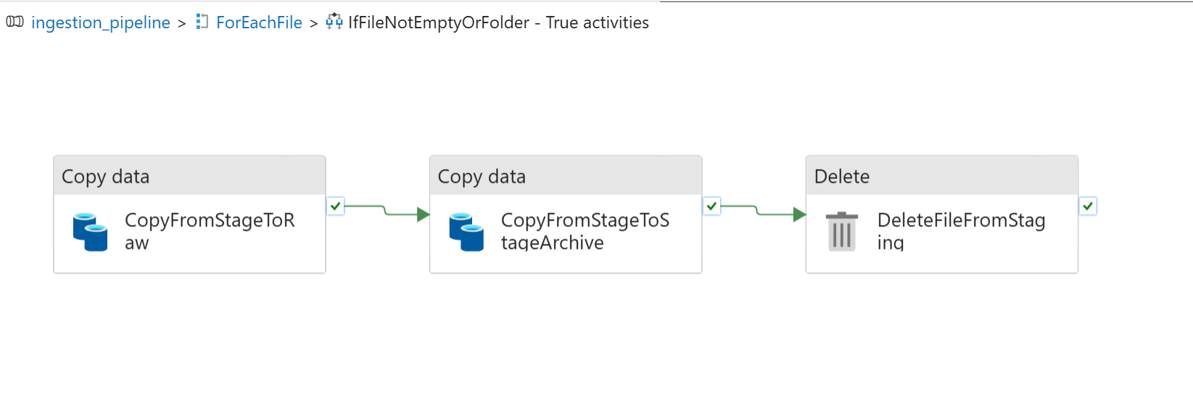
INSIDE ‘IfFileNotEmptyOrFolder’ ACTIVITY

Slide 7
DATA transformation pipeline
This pipeline extracts the data from the raw container and transforms the data and stores it in the processed container, where it will be ready for curation.
Data Types are appropriately assigned to the columns
Data quality checks took place to ensure that data was not valid. Eg CPU_Utilization > 100%
Metrics were derived from existing columns, such as Uptime_Utilization%, Server Load Categorization, Total Network traffic.
PII protection was implemented using sha-256 hashing, for columns such as IP_Address, Hostname, Admin_email and Admin_Phonenumber.
Files that were transformed in raw were also sent to an archive folder, as those files did not require processing again in the future.
Transformation Pipeline then triggers the Curation Pipeline via the ‘Execute Pipeline’ Activity.
Files were saved in the .parquet format.

Slide 8
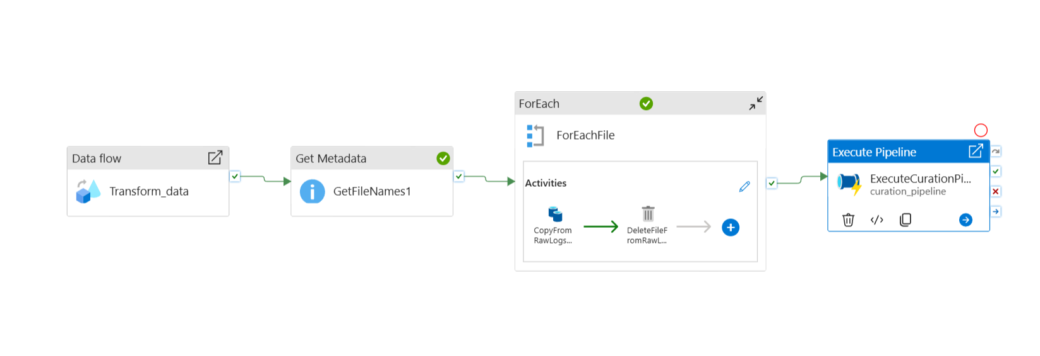
DATA TRANSFORMATION PIPELINE

Slide 9
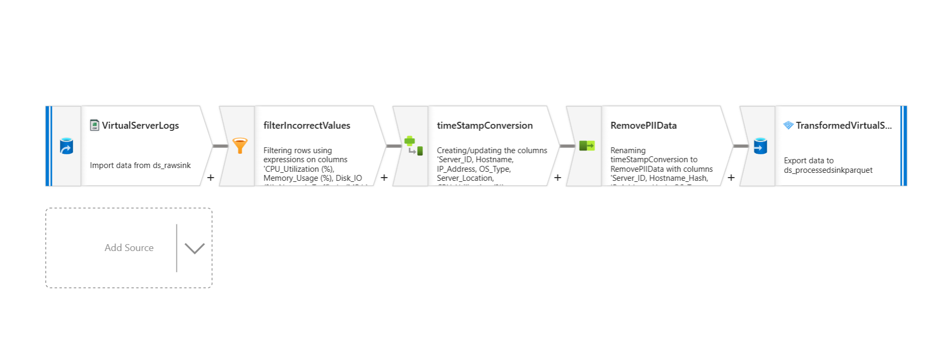
INSIDE ‘Transform_Data’ DATAFLOW

Slide 10
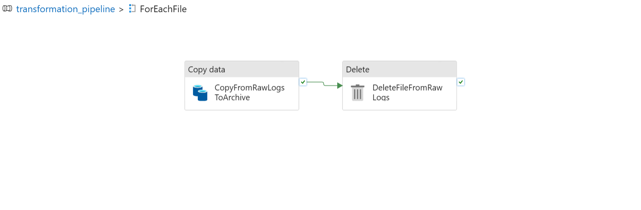
INSIDE ‘ForEachFile’ ACTIVITY

Slide 11
DATA CURATION PIPELINE
This pipeline extracts the transformed data from the processed layer, and performs aggregations on it, making it business ready.
Data is aggregated via 5 key factors i.e. Timestamp, Location, OS_Types, Host and Server Load.
After performing aggregations on the data, it is saved in separate directories, such as ‘server_metrics_by_time’, ‘server_metrics_by_location’, ‘server_metrics_by_OS_types’, ‘server_metrics_by_Host’, ‘server_metrics_by_load’.
These curated datsets provide summarized views of these separate factors.
Power BI imports the parquet files from these directories, using an Access Key, and creates dashboards on the data.

Slide 12
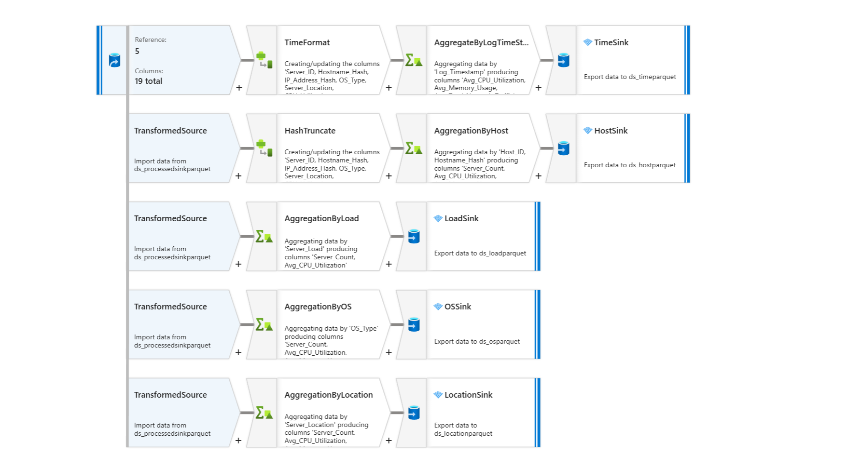
DATA CURATION PIPELINE/DATA FLOW

Slide 13
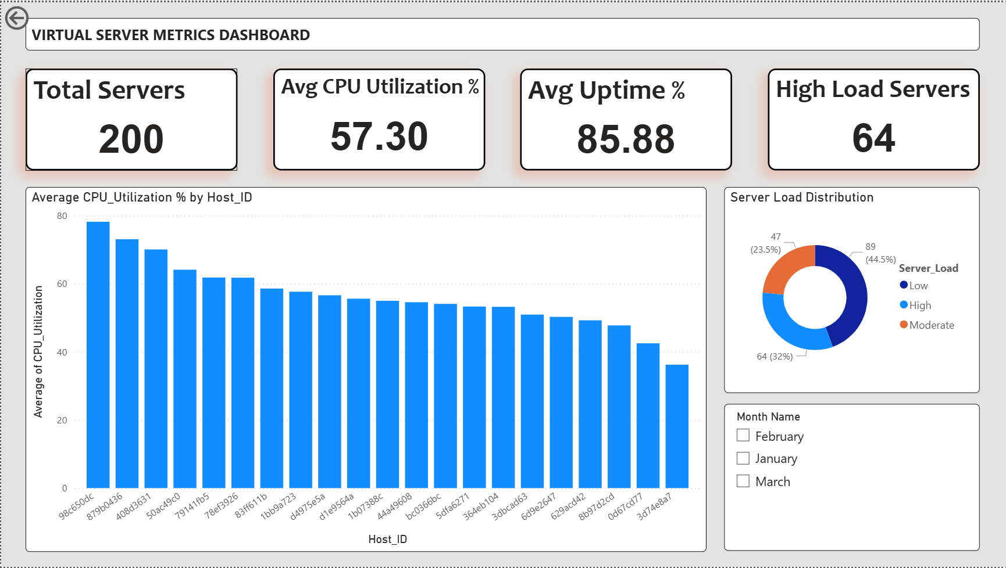
POWER BI DASHBOARDS
Overview and Server Health

Slide 14
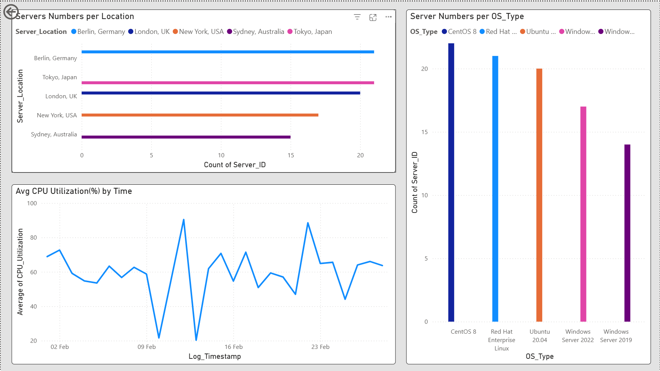
POWER BI DASHBOARDS
Infrastructure Overview and Performance Trends

Slide 15
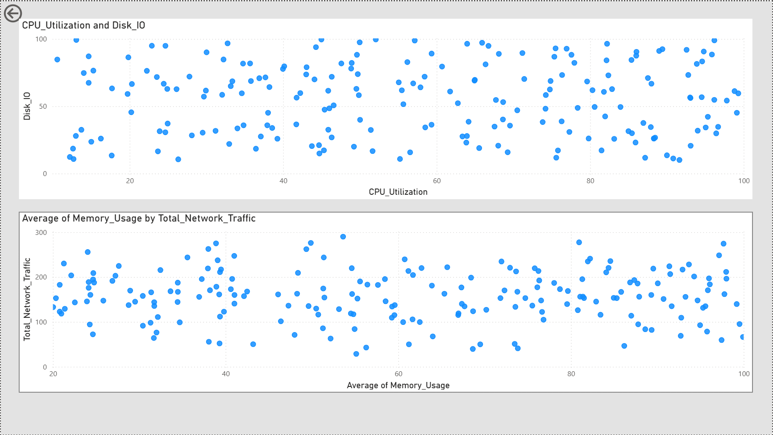
POWER BI DASHBOARDS
Resource Utilization

Slide 16
POWER BI INSIGHTS
Features such as Drill Through were used, with some DAX measures to help in visualizations
KPI Indicators at the top showcase the average system health and performance usage
‘Average CPU Utilization by Host’ is also displayed, with all visuals affected by the filters applied on ‘Server Load Distribution’, and the ‘Month Name’ slicers.
Drill through feature allows these filters to be pushed to the Infrastructure and Resource Utilization page.
‘Average CPU Utilization by Time’ shows the trends in performance, ‘Server Load Distributions’ show infrastructure usage levels, ‘Servers by location and OS’ show infrastructure distribution, and the ‘Resource Utilization’ Page shows the relationship between CPU and I/O operations, and Network-Memory relationship.

Slide 17
ASSUMPTIONS MADE & CHALLENGES FACED
Assumptions
Logs are uploaded directly into the staging container.
Multiple servers are run by the same host.
Server Load determined using CPU Utilization values.
Challenges
Preventing duplicate processing of files uploaded in staging container.
Maintaining readable dashboards where host names are included, by displaying partial hash value for host names.

