Slide 1
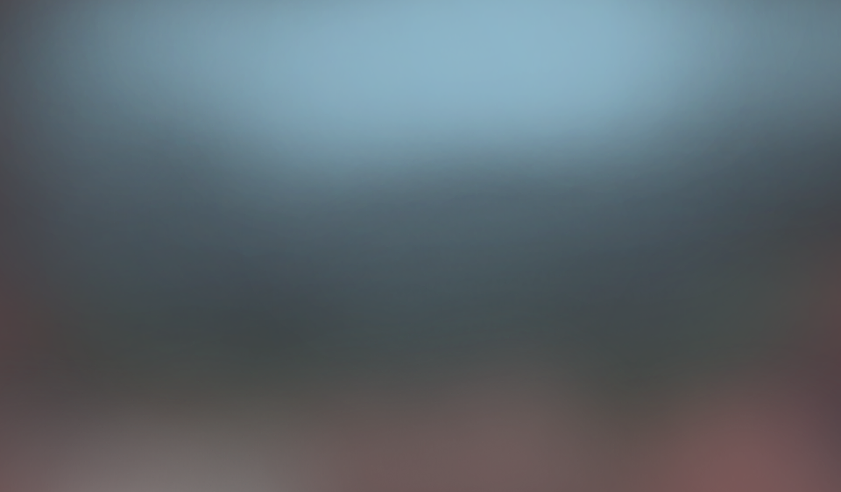
<<DefaUlt >>
Andriy Pytel - head
Kris Zgaschchak – graphic designer
Marian Sydor - responsible for music
Vitaliy Savchyn - screenwriter
Serhiy Shchehelskiy -responsible for animation
Iryna Didoshak - artist

Slide 2
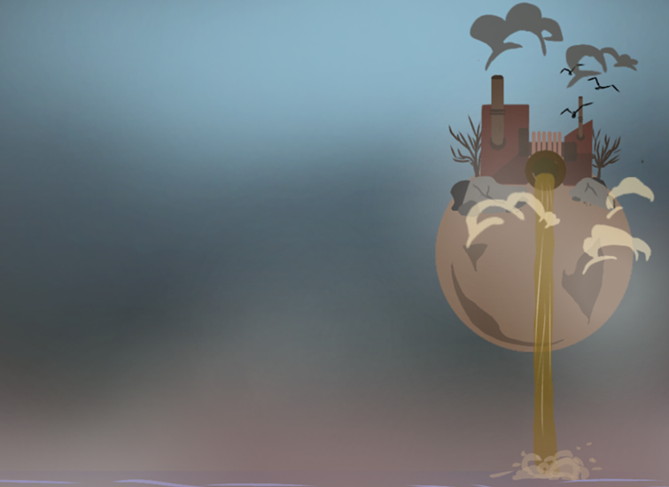
Restoration
2-d game
Take the last chance…

Slide 3
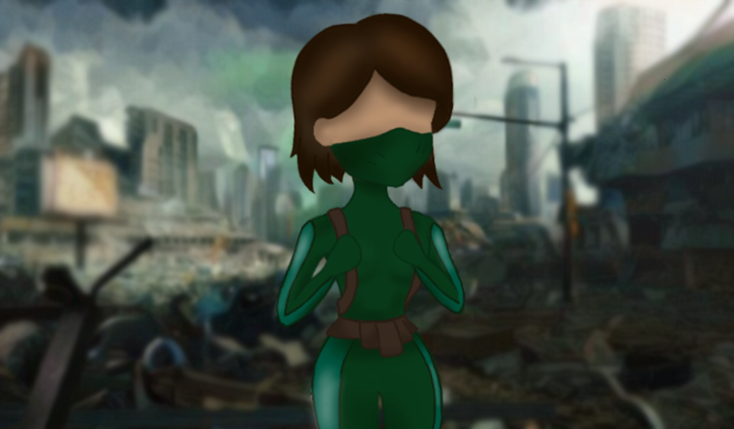
The plot of the game
The idea of ​​this game is to draw the attention of mankind to the consequences of their activities on the planet that serves us as a home. For several years now, we have been improving technologies, building intelligent machinery and designing giant , modern cities. However, not everyone cares about the planet that gives us life. The consequences are global warming and drastic climate change in recent years. The protagonist of our game is experiencing an era in which mankind completely exhausted life on this planet, after which people were forced to turn over to another planet. Anyone who did not find a place in the last carriage of salvation, had no other choice , but to stay on a planet and burn like a wax candle.
Sadly, this is the very real future we might face one day. And we want to show to the human race that we need to take care not only of ourselves, but also of the planet, which is the only home we have. Our game is a call to stop, because otherwise it will be too
late ...

Slide 4
Some words about our work
Our team intercepted a lot of work, deciding to take up this project. And all because we decided to do everything ourselves. Up to writing your own music.

Slide 5
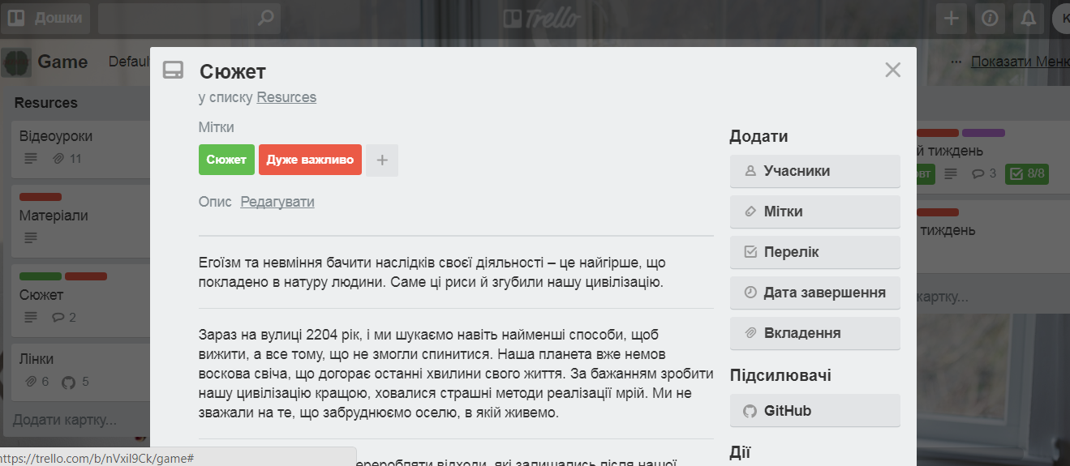
Getting Started
It all starts with writing a script. Let it be a character or some kind of picture in the game - we record it all in the script. And for that we created our own board in the "trallo" application, where our script writer writes the details so we can do the next job.

Slide 6
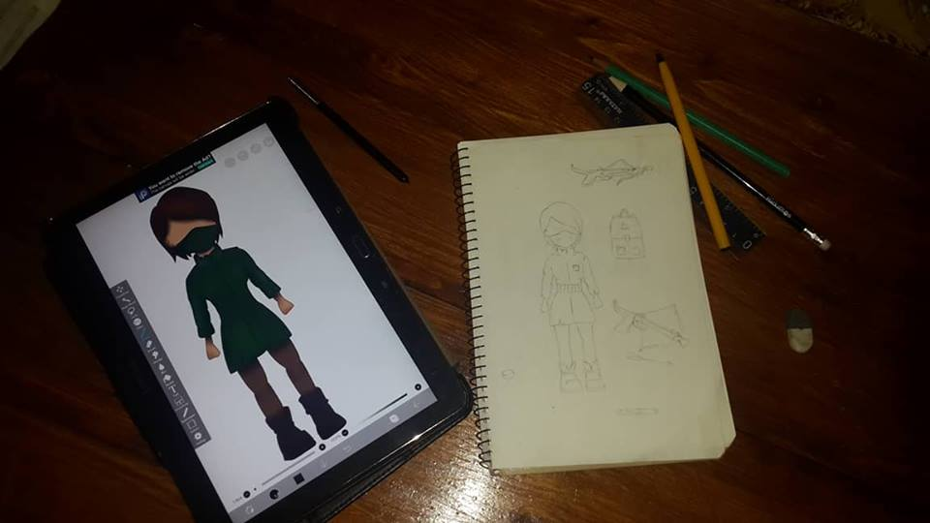
Sketches
The next step is painting sketch by our artist, which then will be the basis for drawing in a graphic editor.

Slide 7
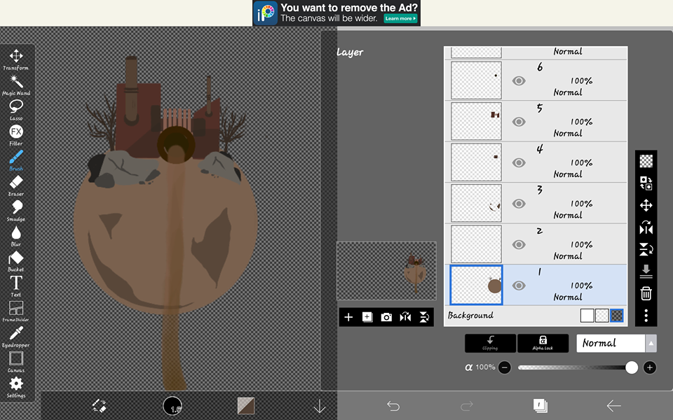
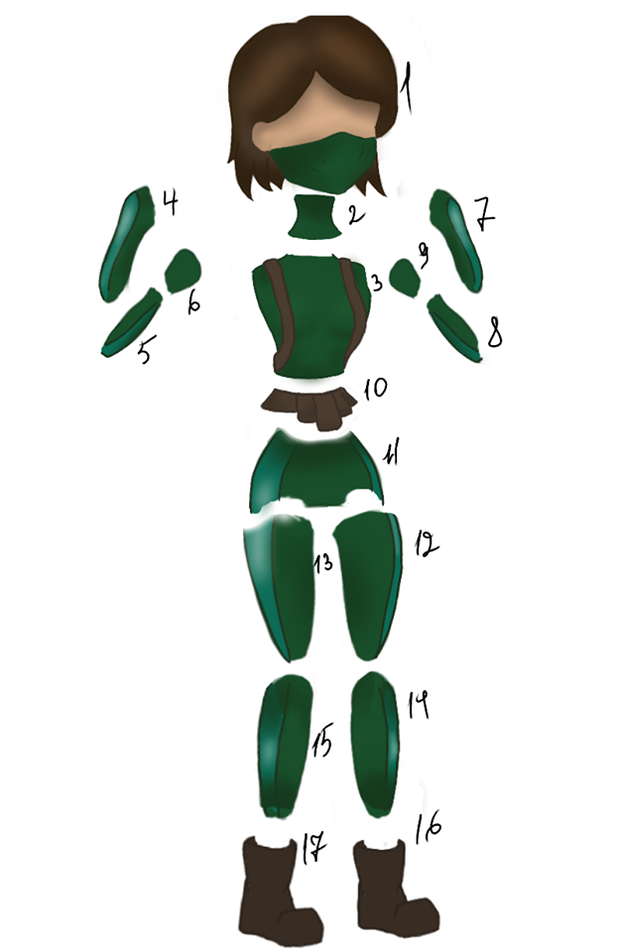
Drawing sprites
When sketches are drawn, a graphic designer can begin to take his part part of the work, namely drawing sprites. Each of these sprites is divided into small parts, in order to that they can work with it in the future.

Slide 8
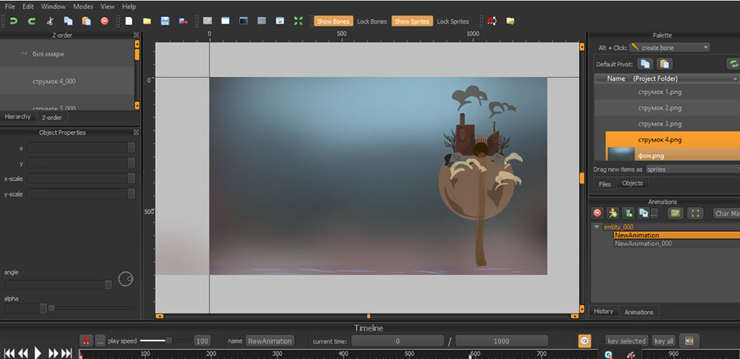
Animation
Now these little pieces are animated to make our game appealing and give it a certain atmosphere.

Slide 9
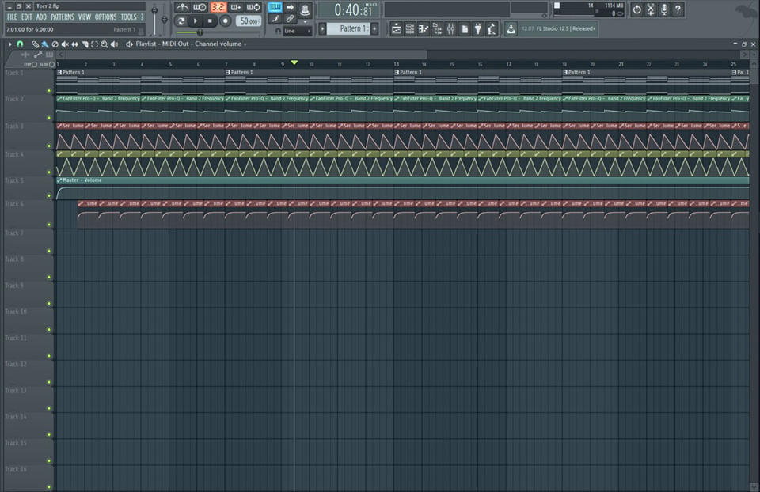
Music
To make our work even more unique, we also decided to write our music, which then will give the game the atmosphere we need.

Slide 10
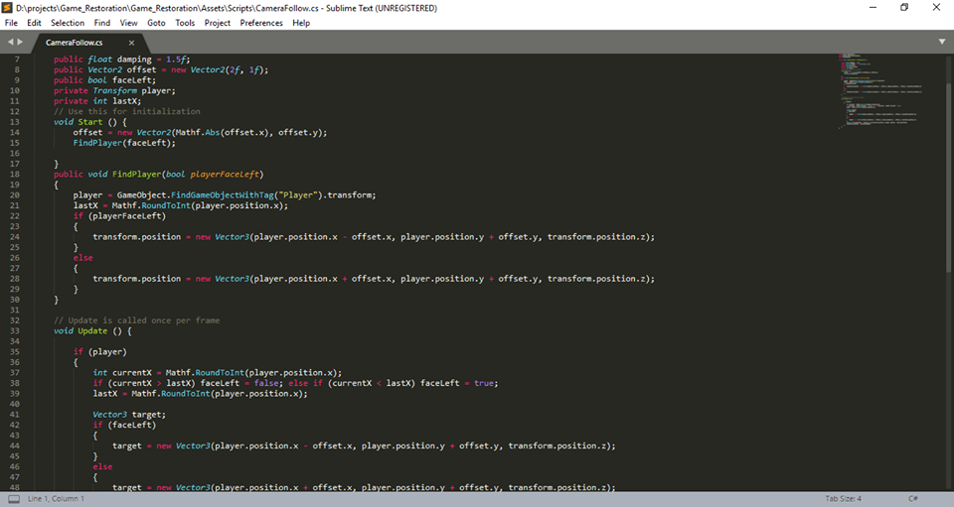
Programming
The last and most difficult part of our work, which is performed by the head of our team - writing code. This is what you see on the screen - a piece of code in order for our character to move on the map.

Slide 11
Now our team is in the midst of the implementation of this project, and we hope that at the end of the semester, our project will be one of the best.

Slide 12
Thank for attention!

Slide 13
