Slide 1
R-DB V2 Red Discord Bot
SW ENG 3XA3 2018 Group 31

Slide 2

Our Team
Jason Tsui, Hareem Arif, Abdul Elrahwan

Slide 3


ABOUT US
Reimplementation of a Discord Bot
What is a discord bot you may ask?
Discord is a VoIP proprietary freeware designed for video gaming communities that specializes in text, image, video, and audio communication.
So we have used this freeware to create a community of our own, for users to join in on, and communicate on various topics in various ways.

Slide 4


What does it do?
Connect. Communicate. Discuss.
Allows people to communicate on an online server
Real-time talk and text
Servers have channels (Rooms)
Discuss:
Music, News, Movies.

Slide 5
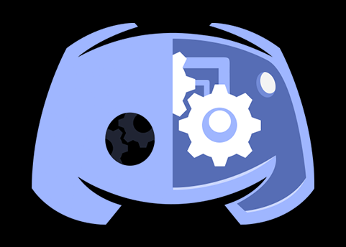
Our Product – RDB V2
Discord Chat Bot
Regulate and moderate general members
Help administration team manage community
Provide tools to improve community quality of life
Administration. Moderation. Community

Slide 6
Current Features
Connect – Communicate – Discuss
1
2
3
4
Music.py
Level.py
Comm.py
Image.py
Built-in music player to share in channels
Member leveling system for community participation
Log and manage messages
Image search

Slide 7

Qualities
Installability
Portability
Learnability
Maintainability

Slide 8


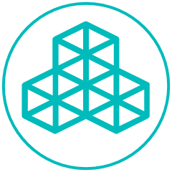
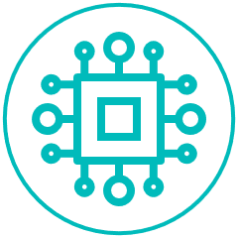
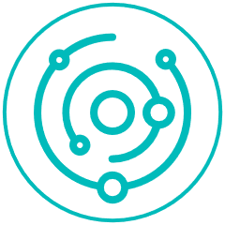
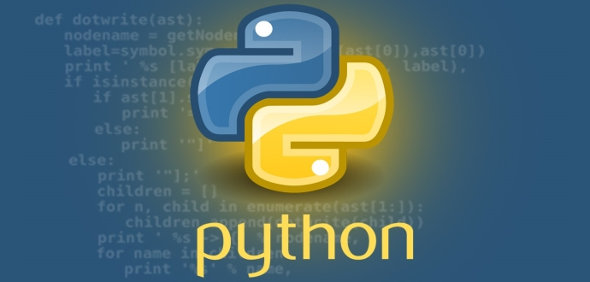
R-DB V2
Installability
Discord is available as a browser, Windows, macOS, Linux, OS and Android application.
Portability
The project itself is programmed through Python, coupled with the accessibility of the server, the product is portable on many systems
Learnability
Documentation describing all of the commands is in the works
Maintainability
Modules have high cohesion and low coupling. The project has extensive documentation.

Slide 9

The Design.
Why it is the way it is
Simple implementation
Modules inspired by previous implementation
High fan-out

Slide 10

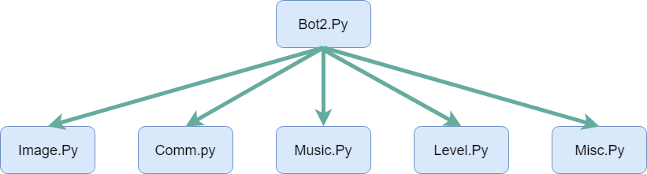
DEMO

Slide 11
Future Features
Building on what’s there
Music.py
Broaden Discussion
Expand Connections
Support More 3rd party applications
Soundcloud, Spotify
Build on the current available topics of discussion and integrate deeper level of details on each
Create more channels (rooms) to provide more variety of topics of discussion and be able to host them accordingly
Image.py
Internal Design
Support more image hosting platforms
Giphy
Incorporate helpful principles of Software Engineering in greater extent.
Modularity
Information Hiding

Slide 12
THANK YOU!

Slide 13
References
“Can You Learn Python Programming in a Month?” TechWorm, TechWorm, 5 Apr. 2017, www.techworm.net/2017/04/can-learn-python-programming-month.html.
“Discord Bots.” Discord Bots, discordbots.org/.
Hald, Grasia. “Chatbot 101: Everything You Ever Wanted to Know about Chatbots.” Medium.com, Medium, 15 Nov. 2017, medium.com/botsupply/chatbot-101-everything-you-ever-wanted-to-know-about-chatbots-478c0b825dd0.
“The Battle of the Operating Systems.” 3 Top Benefits of a Product Roadmap Planning | EPages Developer Portal, developer.epages.com/blog/tech-stories/the-battle-of-the-operating-systems/.

