Slide 1


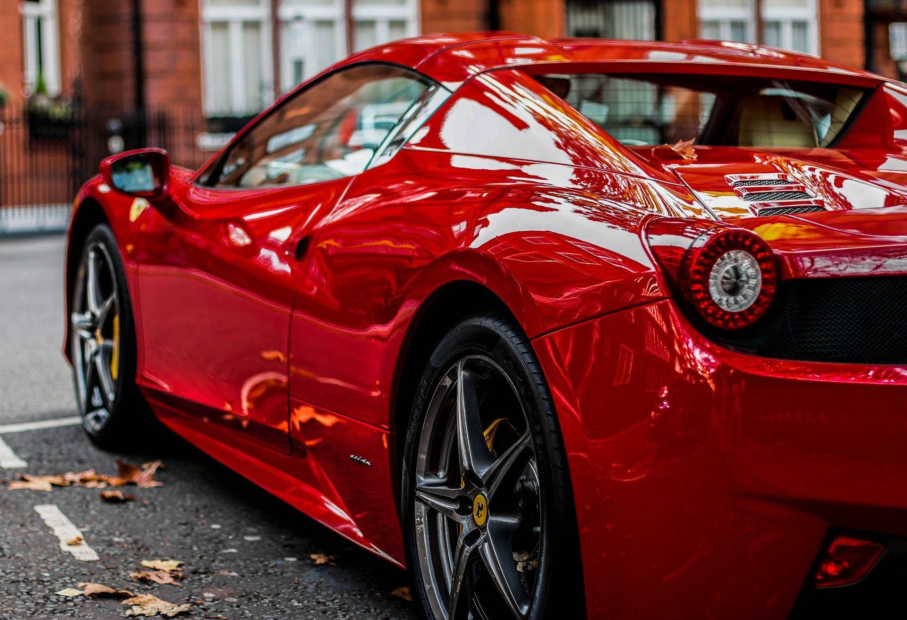
Josh Crisostomo

