Slide 1
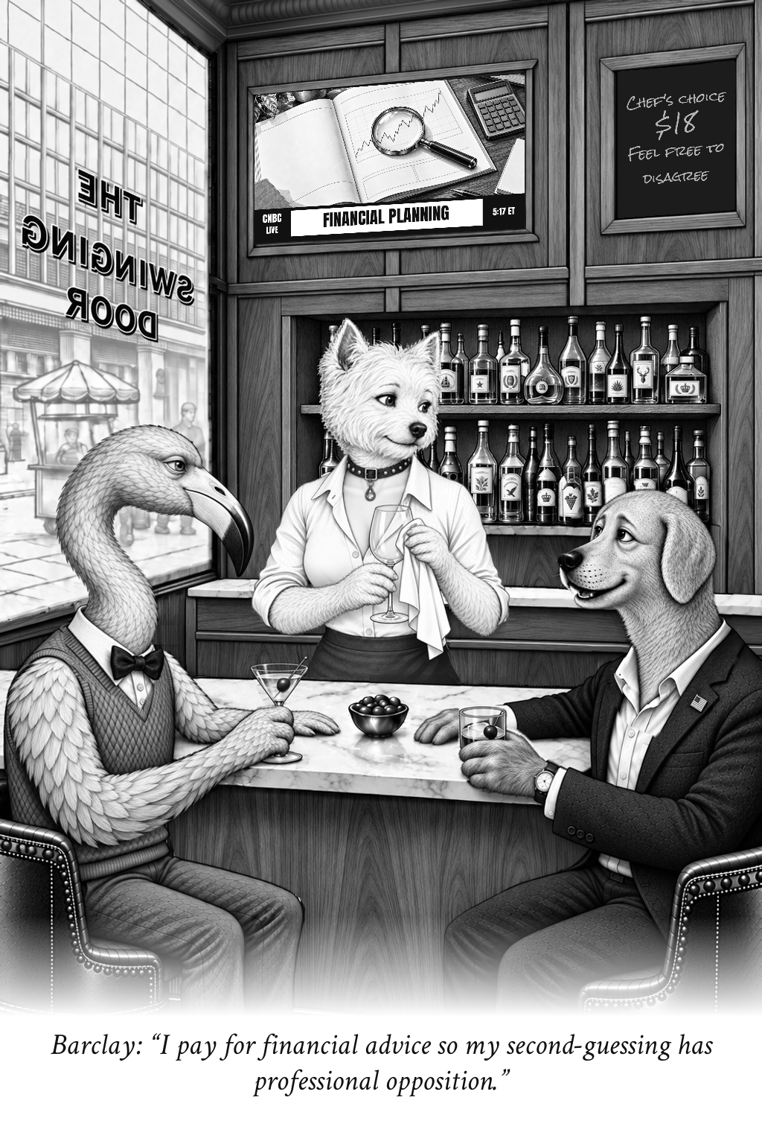
The Swinging Door
Cartoons and local edition production
A presentation for Rick Swider
September 15, 2026
Zechariah Myrick
AI Dream Builders LLC
Notes:
Original artwork: /gallery/best-of-v1/originals/professional-opposition.png
Caption: I pay for financial advice so my second-guessing has professional opposition.
Speaker: Barclay. Retained selected cartoon. Not a record of a real conversation.
No claim that this existing selected image was created by the new unattended run.

Slide 2

Three familiar voices
Drew notices the absurdity in the system.
Barclay feels it in his wallet.
Abby has the last word.
The matching speaking pose keeps the mouth open and the listeners turned toward the speaker.
Notes:
Original artwork: /gallery/best-of-v1/originals/divide-the-credit.png
Caption: I'll split the bill. You can divide the credit for predicting the market.
Speaker: Abby. Retained selected cartoon. Not a record of a real conversation.
No claim that this existing selected image was created by the new unattended run.

Slide 3
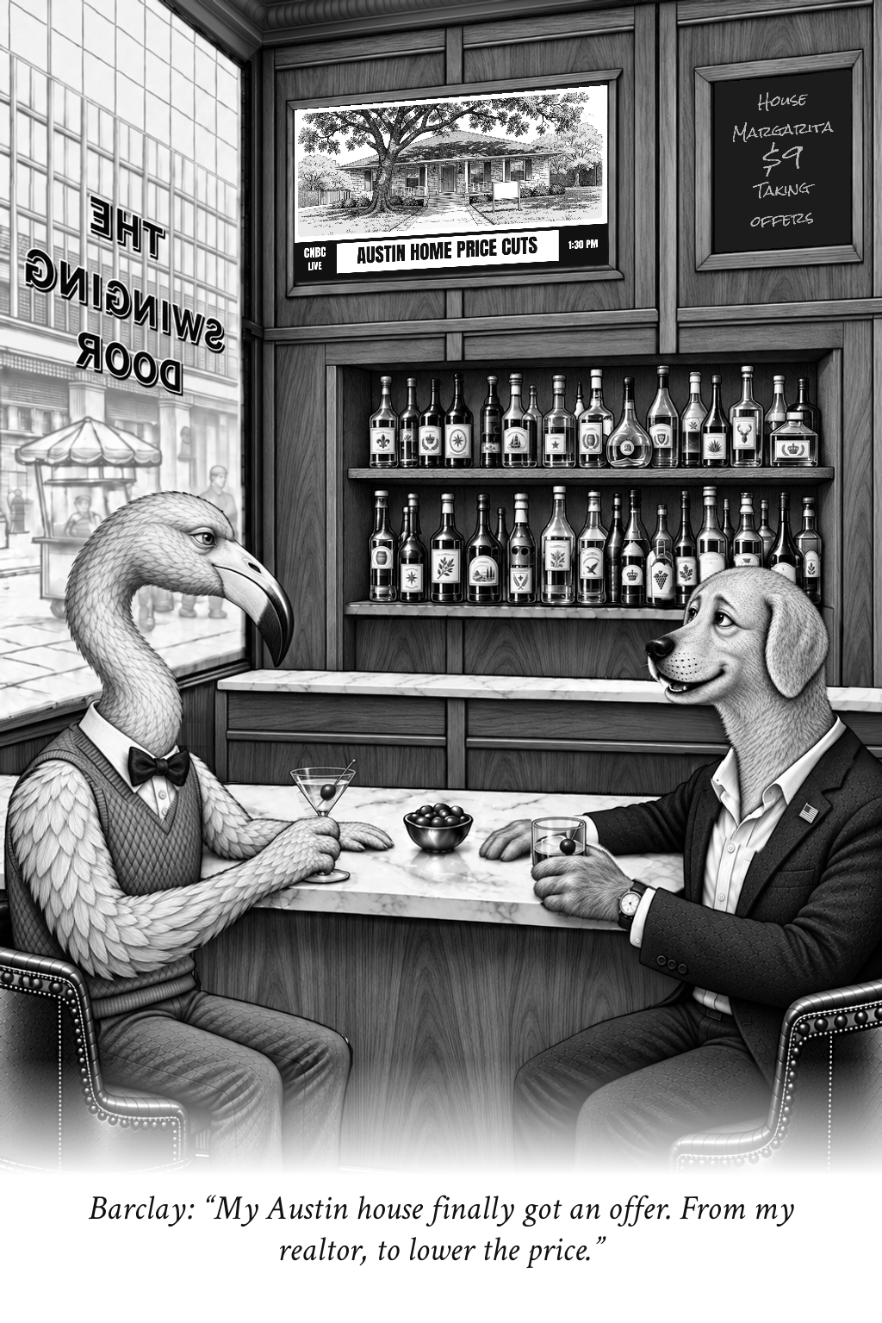
Austin, Texas
Taking Offers
Barclay:
“My Austin house finally got an offer. From my realtor, to lower the price.”
Housing supplies the subject. The TV sets it up, the caption turns it, and the chalkboard adds a second joke.
Selected example from the gallery, not the result of a new live request.
Notes:
Original artwork: /gallery/city-editions-20260914/austin-taking-offers.png
Caption: My Austin house finally got an offer. From my realtor, to lower the price.
Speaker: Barclay. Source context: https://www.realtor.com/news/local/austin-tx/real-estate-market-austin-tx-august-2026/
No claim that this existing selected image was created by the new unattended run.

Slide 4
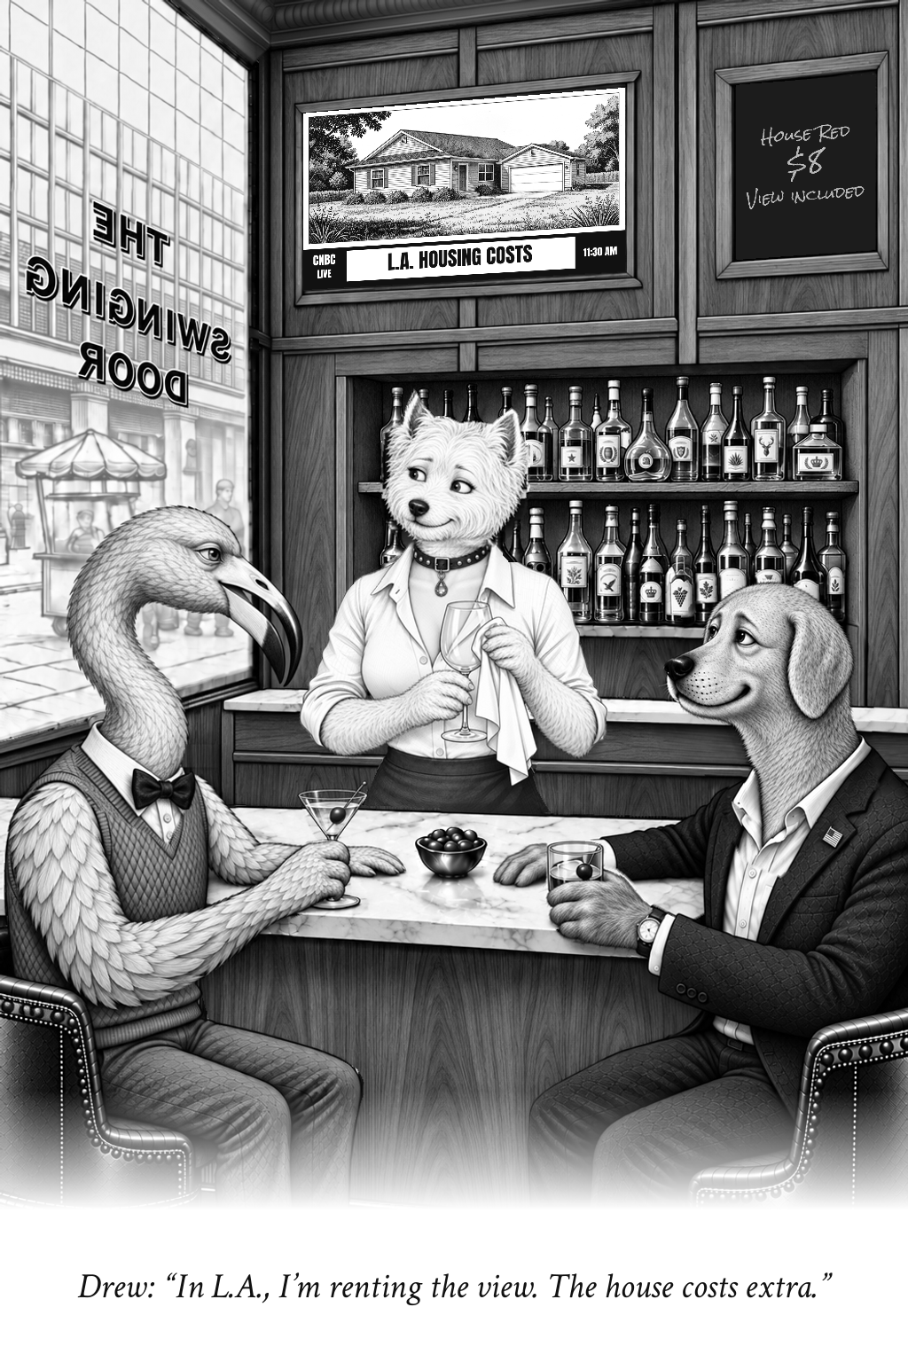
Los Angeles, California
The View Is Extra
Drew:
“In L.A., I’m renting the view. The house costs extra.”
A different city and a different joke, with the same familiar room and cast.
Selected example from the gallery. New requests need their own local research and artwork.
Notes:
Original artwork: /gallery/city-editions-20260914/los-angeles-view-included.png
Caption: In L.A., I’m renting the view. The house costs extra.
Speaker: Drew. Source context: https://gov.car.org/en/aboutus/mediacenter/newsreleases/2026releases/2qtr2026HAI
No claim that this existing selected image was created by the new unattended run.

Slide 5
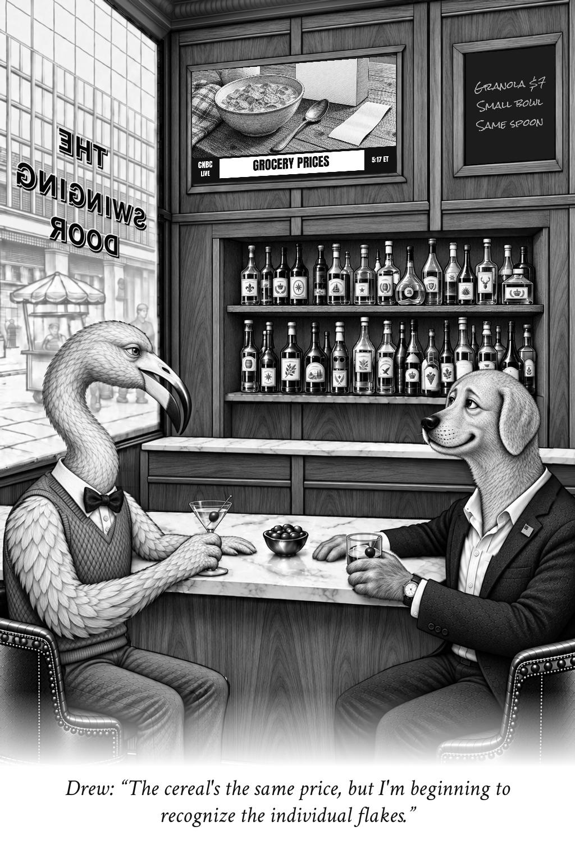
Everyday money
Individual Flakes
Drew:
“The cereal's the same price, but I'm beginning to recognize the individual flakes.”
A familiar purchase makes the setup immediate. The reader needs no financial jargon to enjoy the line.
Notes:
Original artwork: /gallery/best-of-v1/originals/individual-flakes.png
Caption: The cereal's the same price, but I'm beginning to recognize the individual flakes.
Speaker: Drew. Retained selected cartoon. Not a record of a real conversation.
No claim that this existing selected image was created by the new unattended run.

Slide 6
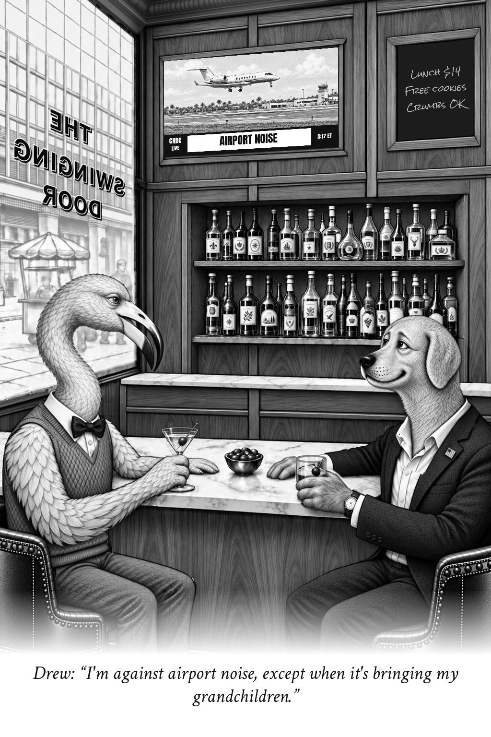
Local life, a light touch
Quiet Arrivals
Drew:
“I'm against airport noise, except when it's bringing my grandchildren.”
The joke finds a recognizable contradiction without taking a political side.
The editorial review checks warmth, clarity and originality before publication.
Notes:
Original artwork: /gallery/best-of-v1/originals/quiet-arrivals.png
Caption: I'm against airport noise, except when it's bringing my grandchildren.
Speaker: Drew. Retained selected cartoon. Not a record of a real conversation.
No claim that this existing selected image was created by the new unattended run.

Slide 7
A simple generation flow
01
Choose
Enter a city, a state and a cartoon count. Generate saves the request before production starts.
02
Research and write
Dated sources guide the subject. The writer and reviewer revise the caption and matching TV and chalkboard ideas.
03
Draw and assemble
The RTX 4090 creates TV art. The compositor preserves the room and matching cast, then adds chalk and dialogue.
04
Review
Progress reports completed stages, not a time estimate. Finished images appear with downloads and source records.
Notes:
Source: repository automation worker, queue contract and website implementation. Progress reports completed milestones, never a timer. Machine quality review does not constitute human approval. Dedicated hosting remains a future infrastructure decision.

Slide 8
The system behind the screen
01
GitHub and Vercel
GitHub holds the code and selected art. Vercel serves the website and authenticated request endpoints.
02
Supabase
The database retains the queue and recovery checkpoints. Private storage holds generated images and evidence.
03
The local RTX 4090
Requests wait when the PC is offline or its GPU is busy. The latest approved cast still awaits activation in the scheduled worker.
04
The longer-term host
A dedicated always-on GPU can replace the PC. Monitoring and a tested recovery process remain essential.
Notes:
Source: repository automation worker, queue contract and website implementation. Progress reports completed milestones, never a timer. Machine quality review does not constitute human approval. Dedicated hosting remains a future infrastructure decision.

Slide 9
Print size changes the detail
Artwork size | Effective PPI | Use
3.4 x 5.1 inches | 301 | Fine-detail proof
4 x 6 inches | 256 | Classic print
5 x 7.5 inches | 205 | Medium review
6 x 9 inches | 171 | Large review
The source is 1024 x 1536 pixels. Enlarging the picture does not create new detail.
The website exports exact-size PDFs on Letter or A4. Use Actual size in the print dialog and confirm the publication’s requirements.
Notes:
Effective PPI = 1024 pixels divided by print width in inches, rounded. Source: lib/cartoon-print.ts. The embedded original remains 1024 x 1536 pixels. No upsampling or press certification.

Slide 10

An editor’s view
Cartoons, slides and newspaper layouts
The Presentation tab browses all 40 cartoons in full-screen slides.
Choose up to 12 cartoons for a print packet. Compare four artwork sizes or switch on the 11 x 17 inch newspaper layout study.
Every generated edition still needs editorial review before publication.
Notes:
Original artwork: /gallery/best-of-v1/originals/rare-opportunity-street.png
Caption: The listing calls it a ‘rare opportunity’—there are twelve more on the same street.
Speaker: Drew. Retained selected cartoon. Not a record of a real conversation.
No claim that this existing selected image was created by the new unattended run.

