Slide 1
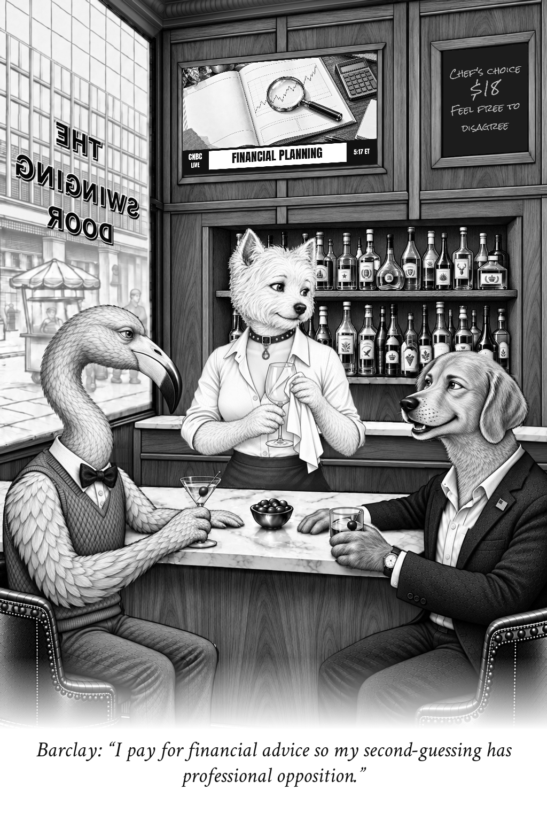
The Swinging Door
Cartoons and local edition production
A presentation for Rick Swider
September 14, 2026
Zechariah Myrick
AI Dream Builders LLC
Notes:
Original artwork: /gallery/best-of-v1/originals/professional-opposition.png
Caption: I pay for financial advice so my second-guessing has professional opposition.
Speaker: Barclay. Retained selected cartoon. Not a record of a real conversation.
No claim that this existing selected image was created by the new unattended run.

Slide 2

Three familiar voices
Drew notices the absurdity in the system.
Barclay feels it in his wallet.
Abby has the last word.
The matching speaking pose keeps the mouth open and the listeners turned toward the speaker.
Notes:
Original artwork: /gallery/best-of-v1/originals/divide-the-credit.png
Caption: I'll split the bill. You can divide the credit for predicting the market.
Speaker: Abby. Retained selected cartoon. Not a record of a real conversation.
No claim that this existing selected image was created by the new unattended run.

Slide 3
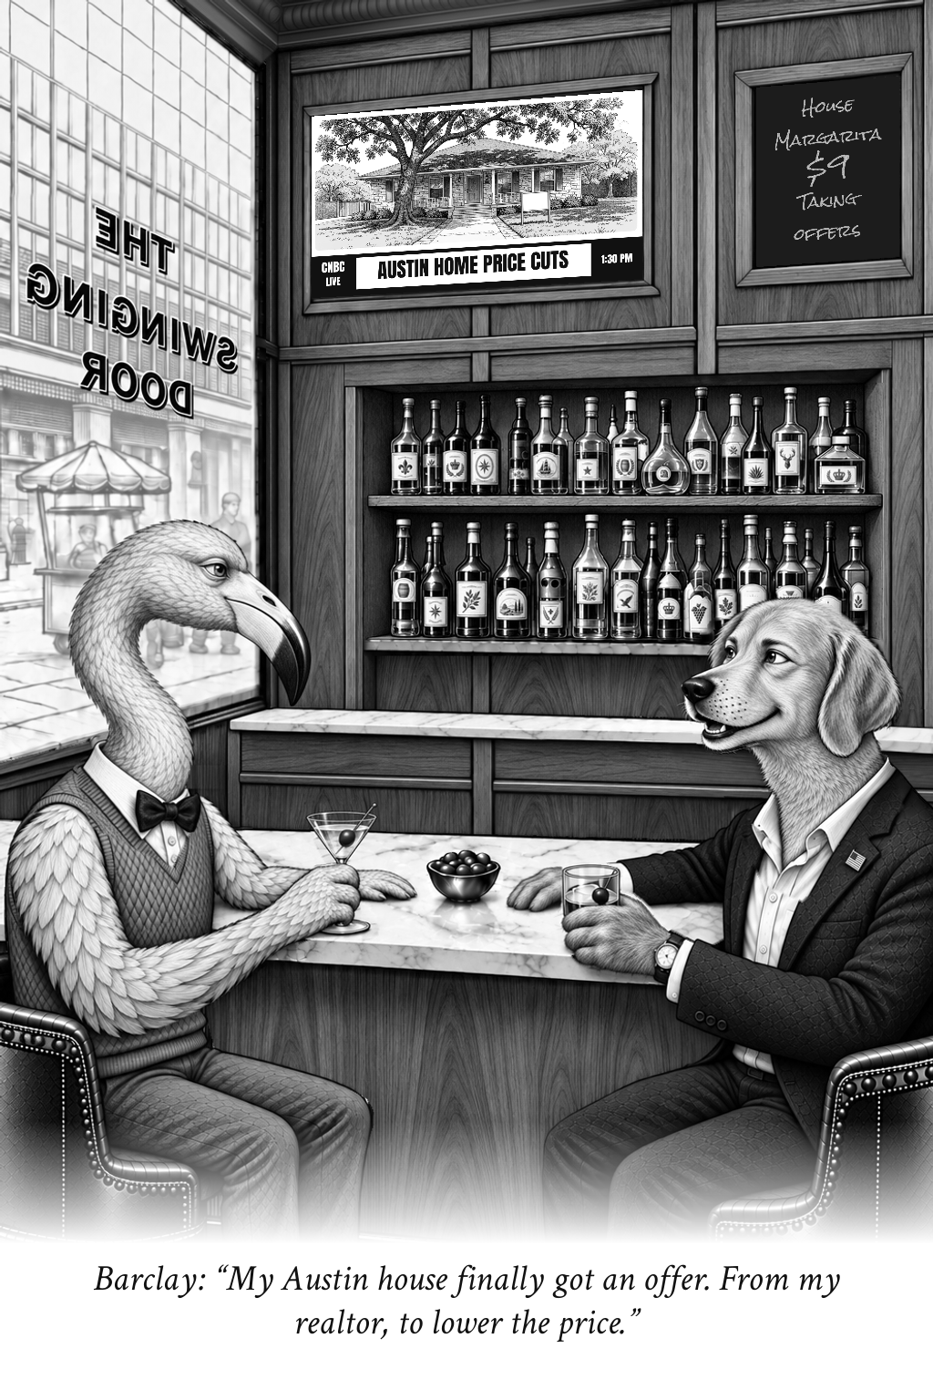
Austin, Texas
Taking Offers
Local housing provides the subject.
The caption, television picture and chalkboard approach the same subject from different angles.
This is an existing selected cartoon. It demonstrates the target visual format.
Notes:
Original artwork: /gallery/city-editions-20260914/austin-taking-offers.png
Caption: My Austin house finally got an offer. From my realtor, to lower the price.
Speaker: Barclay. Source context: https://www.realtor.com/news/local/austin-tx/real-estate-market-austin-tx-august-2026/
No claim that this existing selected image was created by the new unattended run.

Slide 4
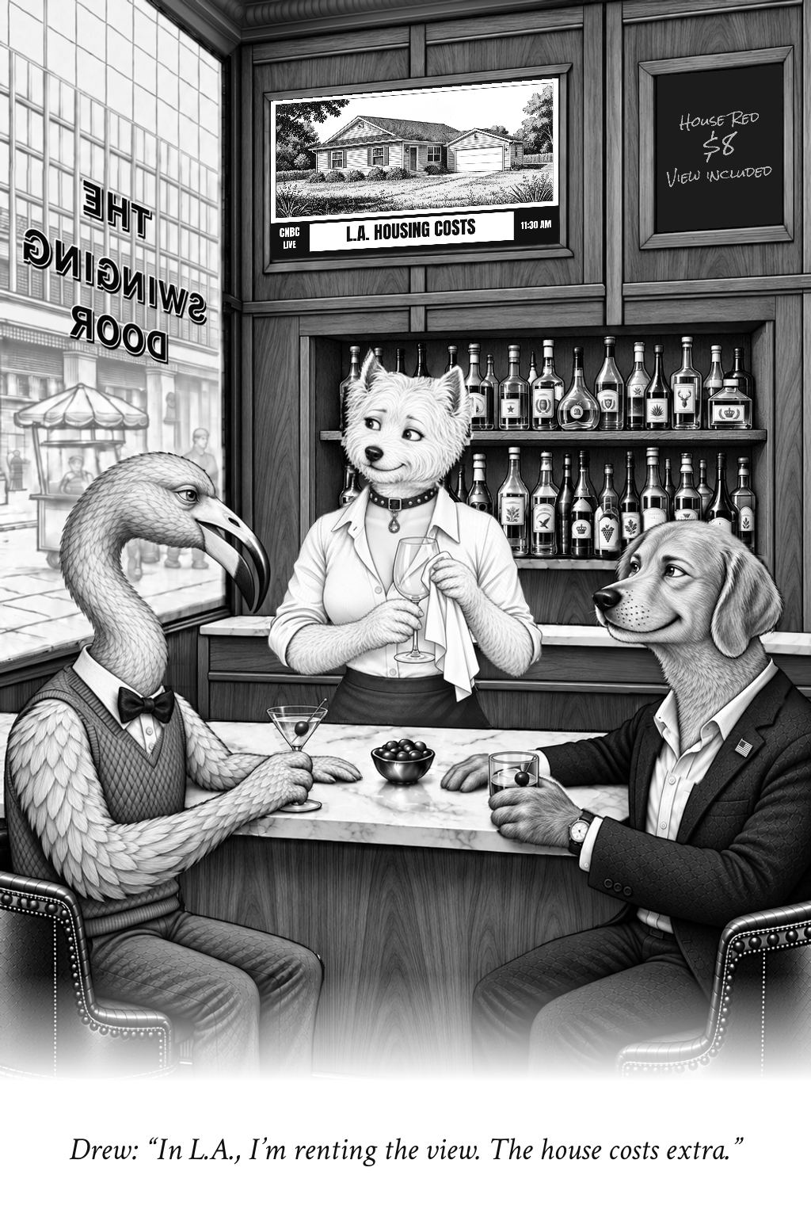
Los Angeles, California
The View Is Extra
A different place and a different joke.
The bar, cast and black-and-white treatment remain consistent.
This is an existing selected cartoon. Each new automated request produces its own caption and television picture.
Notes:
Original artwork: /gallery/city-editions-20260914/los-angeles-view-included.png
Caption: In L.A., I’m renting the view. The house costs extra.
Speaker: Drew. Source context: https://gov.car.org/en/aboutus/mediacenter/newsreleases/2026releases/2qtr2026HAI
No claim that this existing selected image was created by the new unattended run.

Slide 5
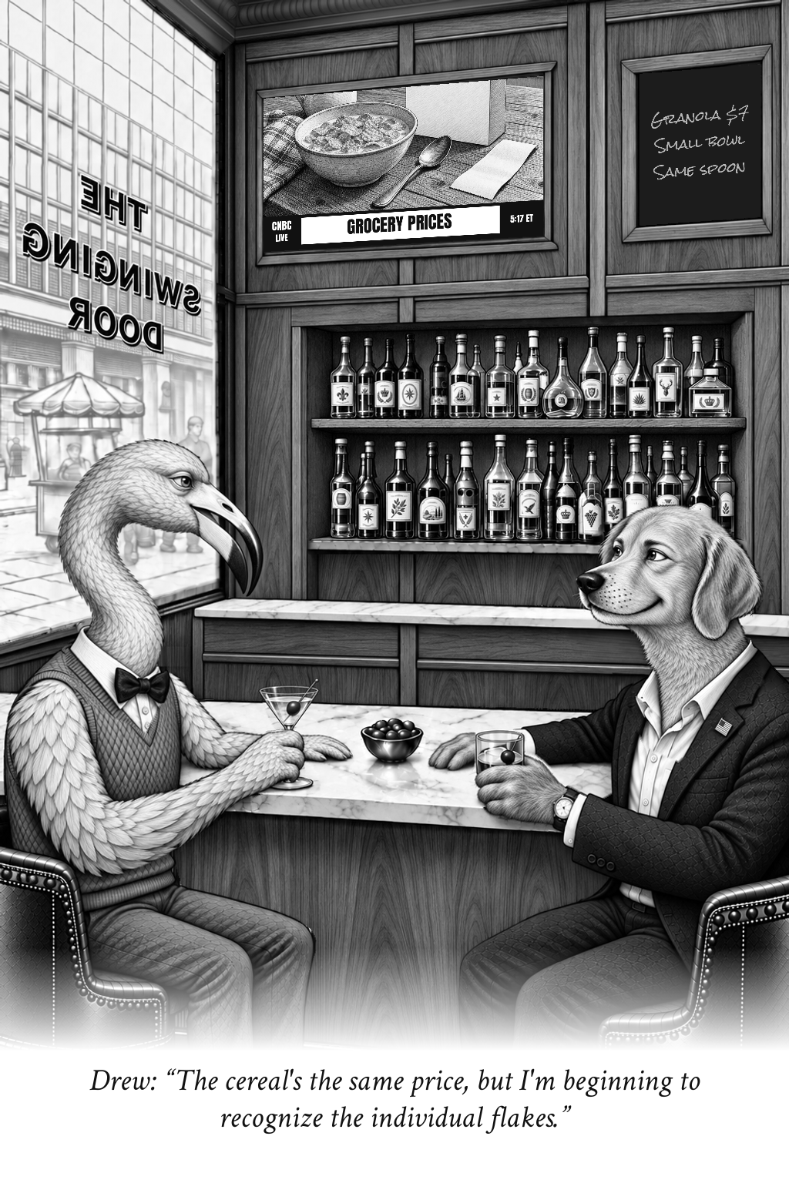
Everyday money
Individual Flakes
A familiar purchase supplies the setup. A concrete detail supplies the comic turn.
The reader can enjoy the line without knowing financial jargon or reading a long explanation.
Notes:
Original artwork: /gallery/best-of-v1/originals/individual-flakes.png
Caption: The cereal's the same price, but I'm beginning to recognize the individual flakes.
Speaker: Drew. Retained selected cartoon. Not a record of a real conversation.
No claim that this existing selected image was created by the new unattended run.

Slide 6
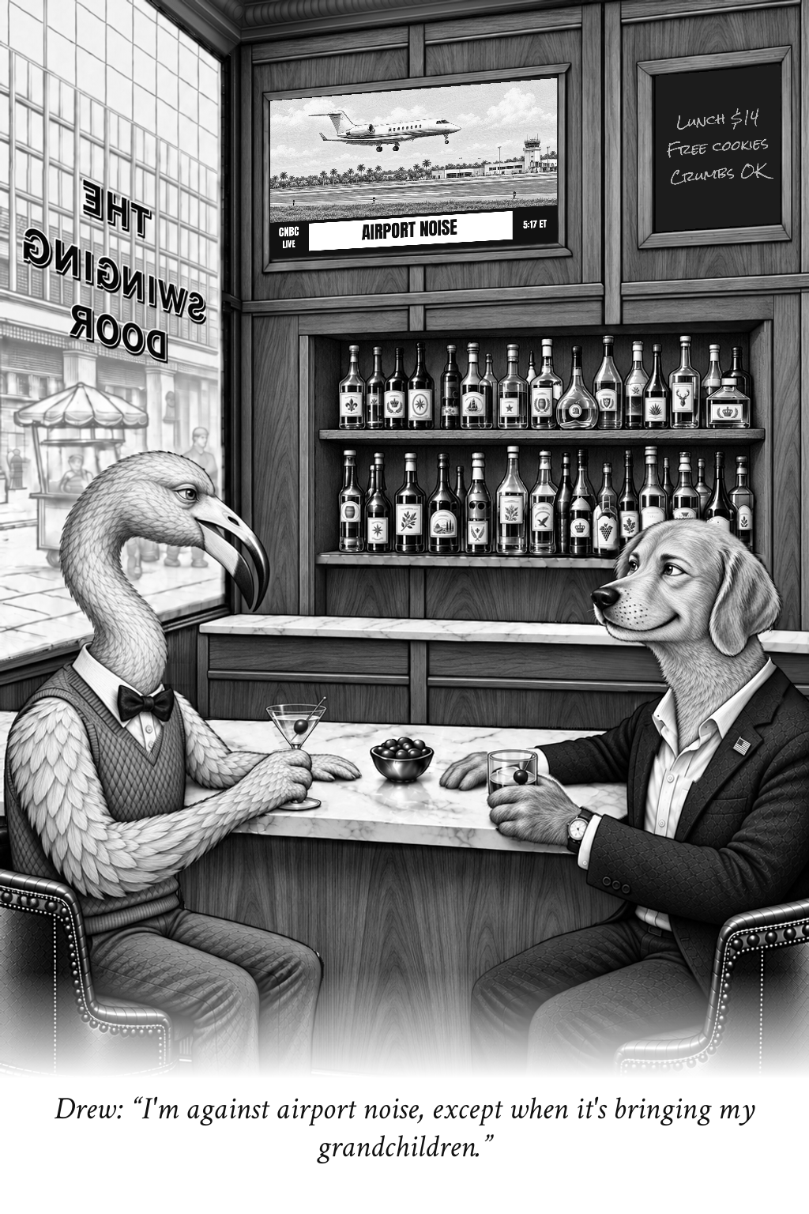
Local life, a light touch
Quiet Arrivals
The humor comes from a recognizable human contradiction.
Warmth matters. The editorial checks screen for partisan attacks, cruelty, weak grammar and recycled punchlines.
Notes:
Original artwork: /gallery/best-of-v1/originals/quiet-arrivals.png
Caption: I'm against airport noise, except when it's bringing my grandchildren.
Speaker: Drew. Retained selected cartoon. Not a record of a real conversation.
No claim that this existing selected image was created by the new unattended run.

Slide 7
A simple generation flow
01
Choose
Enter a city, a state and a cartoon count. Generate saves the request before production starts.
02
Research and write
Dated sources guide the subject. The writer and reviewer revise the caption and matching TV and menu ideas.
03
Draw and assemble
The RTX 4090 creates TV art. The compositor preserves the room and matching cast, then adds chalk and dialogue.
04
Review
The bar follows real production stages. Finished images appear automatically with downloads and source records.
Notes:
Source: repository automation worker, queue contract and website implementation. Progress reports completed milestones, never a timer. Machine quality review does not constitute human approval. Dedicated hosting remains a future infrastructure decision.

Slide 8
The system behind the screen
01
GitHub and Vercel
GitHub holds the website code and selected art. Vercel serves the website and authenticated request endpoints.
02
Supabase
The database retains the queue, job state and receipts. Private storage holds generated images and evidence.
03
The local RTX 4090
A worker polls for due jobs and runs local models. Requests wait while the studio is offline. Completed steps have recovery checkpoints.
04
The longer-term host
A dedicated always-on GPU machine can take over production. It will still need monitoring, storage and recovery testing.
Notes:
Source: repository automation worker, queue contract and website implementation. Progress reports completed milestones, never a timer. Machine quality review does not constitute human approval. Dedicated hosting remains a future infrastructure decision.

Slide 9
Print size changes the detail
Artwork size | Effective PPI | Use
3.4 x 5.1 inches | 301 | Fine-detail proof
4 x 6 inches | 256 | Classic print
5 x 7.5 inches | 205 | Medium review
6 x 9 inches | 171 | Large review
The source is 1024 x 1536 pixels. Enlarging the picture does not create new detail.
The website exports exact-size PDFs on Letter or A4. Use Actual size in the print dialog and confirm the publication’s requirements.
Notes:
Effective PPI = 1024 pixels divided by print width in inches, rounded. Source: lib/cartoon-print.ts. The embedded original remains 1024 x 1536 pixels. No upsampling or press certification.

Slide 10

An editor’s view
Cartoons, slides and newspaper layouts
The Presentation tab browses all 40 cartoons in full-screen slides.
Choose up to 12 cartoons for a print packet. Compare four artwork sizes or switch on the 11 x 17 inch newspaper layout study.
Every generated edition still needs editorial review before publication.
Notes:
Original artwork: /gallery/best-of-v1/originals/rare-opportunity-street.png
Caption: The listing calls it a ‘rare opportunity’—there are twelve more on the same street.
Speaker: Drew. Retained selected cartoon. Not a record of a real conversation.
No claim that this existing selected image was created by the new unattended run.

