Slide 1

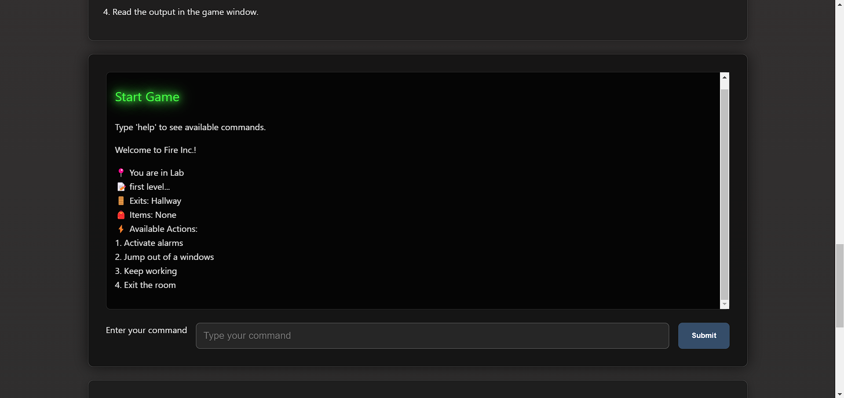

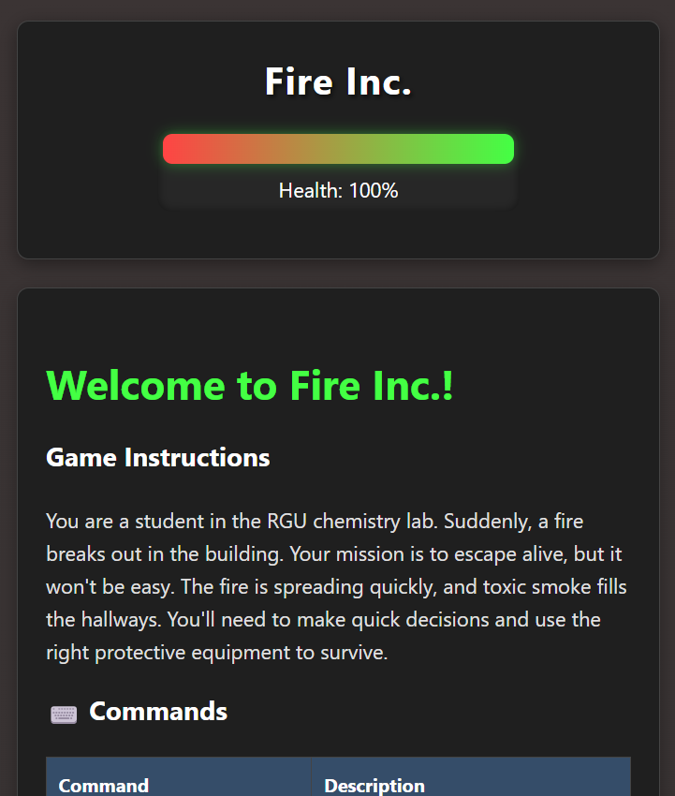
Fire Inc.
Don’t just learn, have fun while doing it

Slide 2
Outline
The Problem
Solution Proposal
Prototype
Scalability

Slide 3
The Problem

Slide 4
Problem statement
Learning Health and Safety
Health and Safety is important
But health and safety classes are boring.
What does that translate into?

Slide 5
Solution Proposal

Slide 6
Solution description
We made a fun, engaging and yet efficient way to learn Health and Safety

Slide 7
Why it’s better than existing solutions
Do you every “hit the wall”?
When you learn in a fun way you are more likely to enjoy it and retain the information.

Slide 8
Wireframes

Slide 9
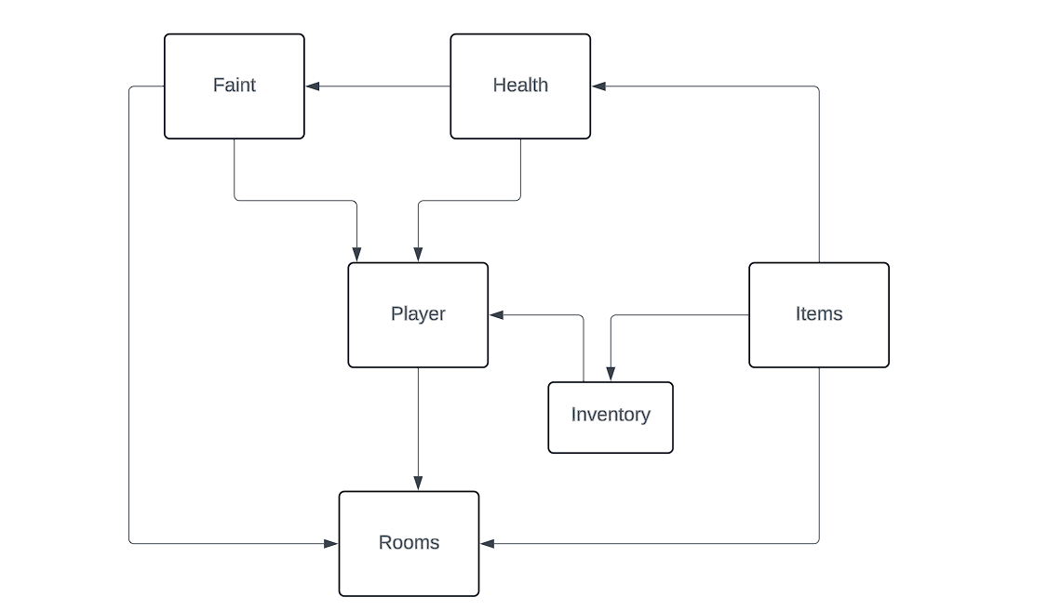

Information architecture

Slide 10
Path
lab→option 1: takes you to Lab 2 (change let block_checker to true);
lab→option 4: takes you to Lab Hallway (change let block_checker = false;)
lab2→option 3: takes you to hallway
Hallway→option 2: takes you to BlockedLobby
Hallway→option 4: takes you Lobby if let block_checker = true; otherwise take you to BlockedLobby
Lobby→ option 1 takes you to Assembly Point
Assembly Point→ any options takes you to win.
ANY OTHER OPTION TAKES YOU TO LOSE AND RESET.

Slide 11
Health Condition
1 start with 100% health
2 If reached 0% or lower restart the game.
3 If item in inventory is negative impact take away 40% health
4 if item in inventory is positive reduce room damage
5 all rooms reduce health damage unless the user has the required positive impact items in the inventory required by each room.

Slide 12
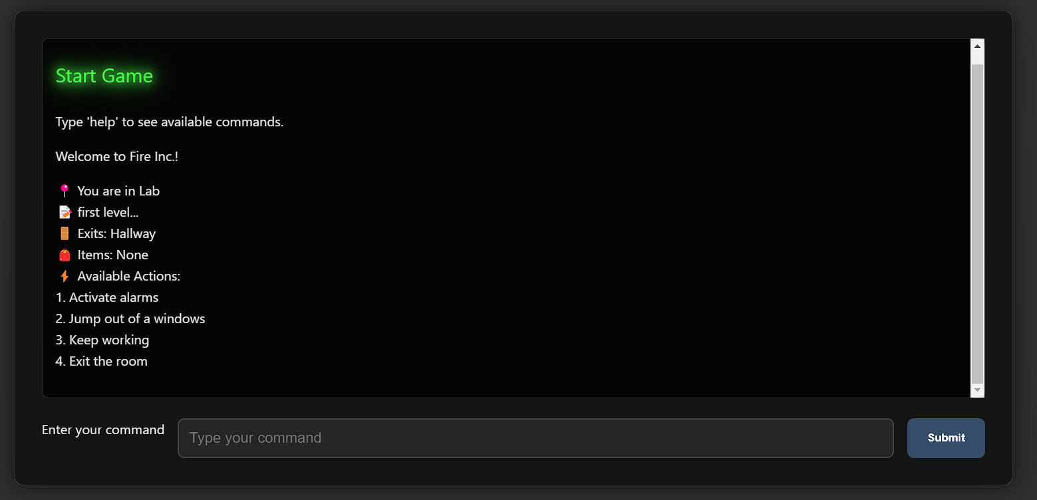
Component Browser
https://gustavoelprofe.com/rguhack2025
Key parts
Balsamiq Tip | Use the Balsamiq add-on to make your own wireframe.

Slide 13
Next Steps

Slide 14
What next?
Gamification and certifications
Different crisis themes (Earthquakes, Storms, etc)
User testing plan.
Different Platforms

Slide 15
Questions?

