Slide 1
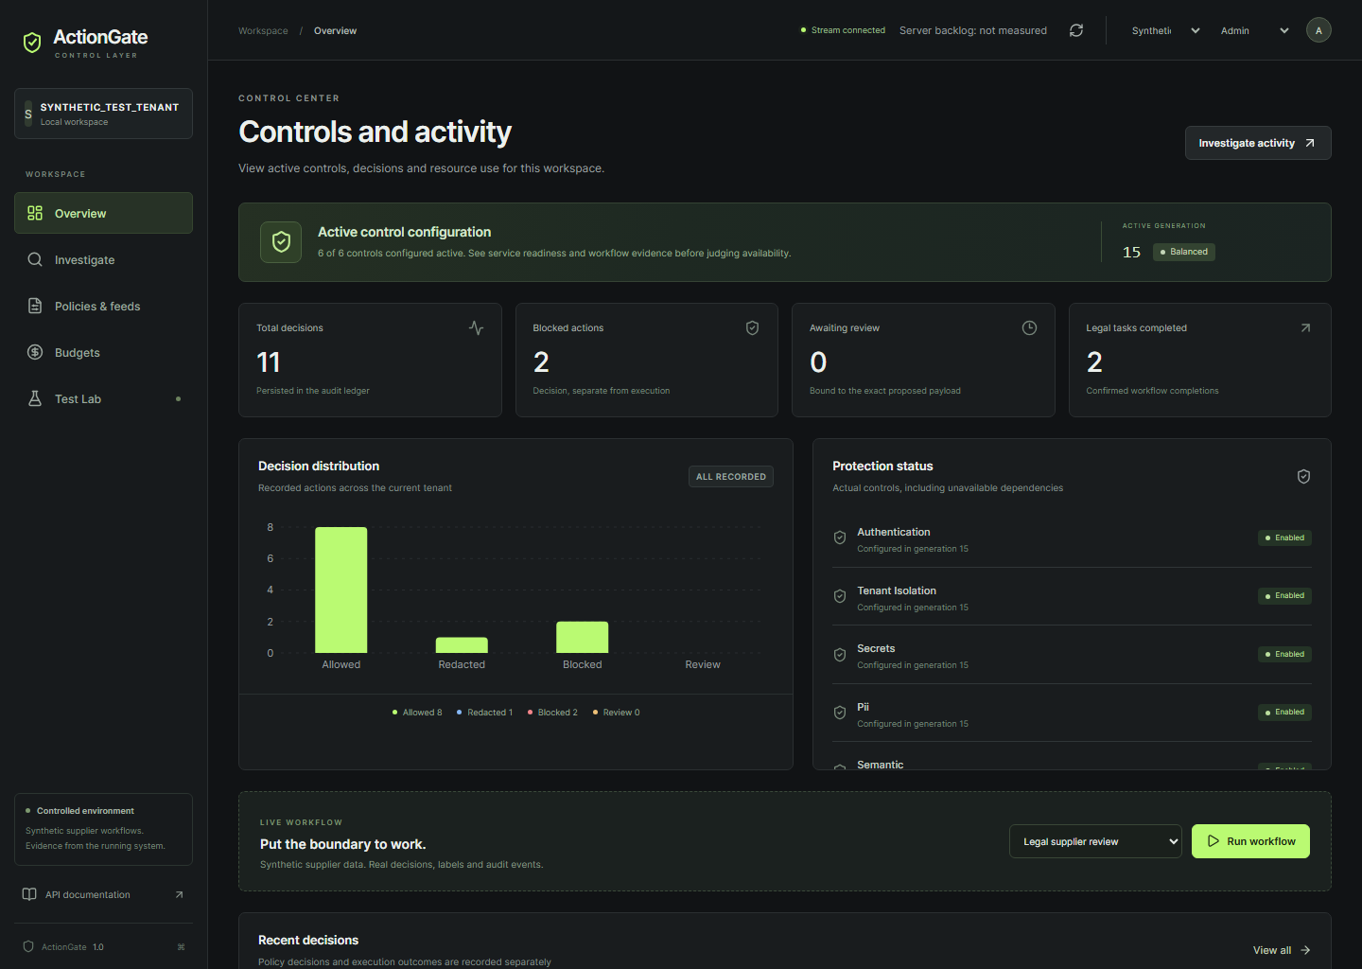
AI CONTROL LAYER
ActionGate
Controlled supplier reviews
across models, APIs and MCP
DEFOZO SOFTWARE HOUSE
Michał Kiełtyka
ACTIONGATE / DEFOZO SOFTWARE HOUSE
01
Notes:
I am Michał Kiełtyka, the sole member of DEFOZO SOFTWARE HOUSE. ActionGate controls agent workflows across models, APIs and MCP. I will follow a supplier review through the gateway and show what happens when the content or requested action crosses its permissions. The demonstration uses synthetic business data. Sources: TEAM.json and the recorded final workflow in artifacts/submission/ui-workflow.json.

Slide 2
THE PROBLEM
The next tool call
A supplier document can redirect an agent.
Intended work
Read the permitted documents and prepare an internal supplier report.
Risk at execution
An embedded instruction asks for a different action or recipient.
ACTIONGATE / DEFOZO SOFTWARE HOUSE
02
Notes:
A supplier document should inform a review. It can also contain an instruction that tries to redirect the agent. The business risk appears when the agent acts on it: retrieving another tenant’s document, sending protected data or spending outside its allowance. ActionGate checks the proposed action together with its authority and context before dispatch. The next slide follows the useful work we want to preserve. Sources: selected plan sections 1 to 3, threat-model.md, and the actual injection workflow.

Slide 3
USEFUL WORK
A complete supplier review
Granted document
Local summary
Protected memory
Internal report
The review finishes within its data and resource permissions.
The document receipt and completed operations remain available for inspection.
ACTIONGATE / DEFOZO SOFTWARE HOUSE
03
Notes:
This is the completed legal workflow from the same recorded browser job. The agent reads an approved document through the registered MCP connector. Its model request, memory write and report save all pass through ActionGate. We can open the document operation and inspect a durable connector receipt. The record contains four completed operations. Source: ui-workflow.json, legal run fc244d54-e6ba-431f-a18a-960940d53a48. Exact operation IDs and audit are in that artifact.

Slide 4
ARCHITECTURE
The enforcement boundary
Agent
ActionGate
Identity + controls
Broker
Reserve + dispatch
Models
APIs / MCP
Local guard + OPA
PostgreSQL
Ledger + audit
Output inspection
The gateway checks authority again before releasing the result.
ACTIONGATE / DEFOZO SOFTWARE HOUSE
04
Notes:
The isolated agent reaches our authenticated gateway. Deterministic controls check access, classification, arguments and sensitive data. The local semantic worker evaluates attempts to redirect the workflow, while OPA and the broker keep authorization authority. The broker reserves resources against PostgreSQL before dispatching a registered connector. The result passes output inspection and a final release check. Models, document MCP and API sinks remain behind this boundary. Both gateway replicas share the ledger. Source: compose.yaml, docs/architecture.md, actual model and document operations in ui-workflow.json.

Slide 5
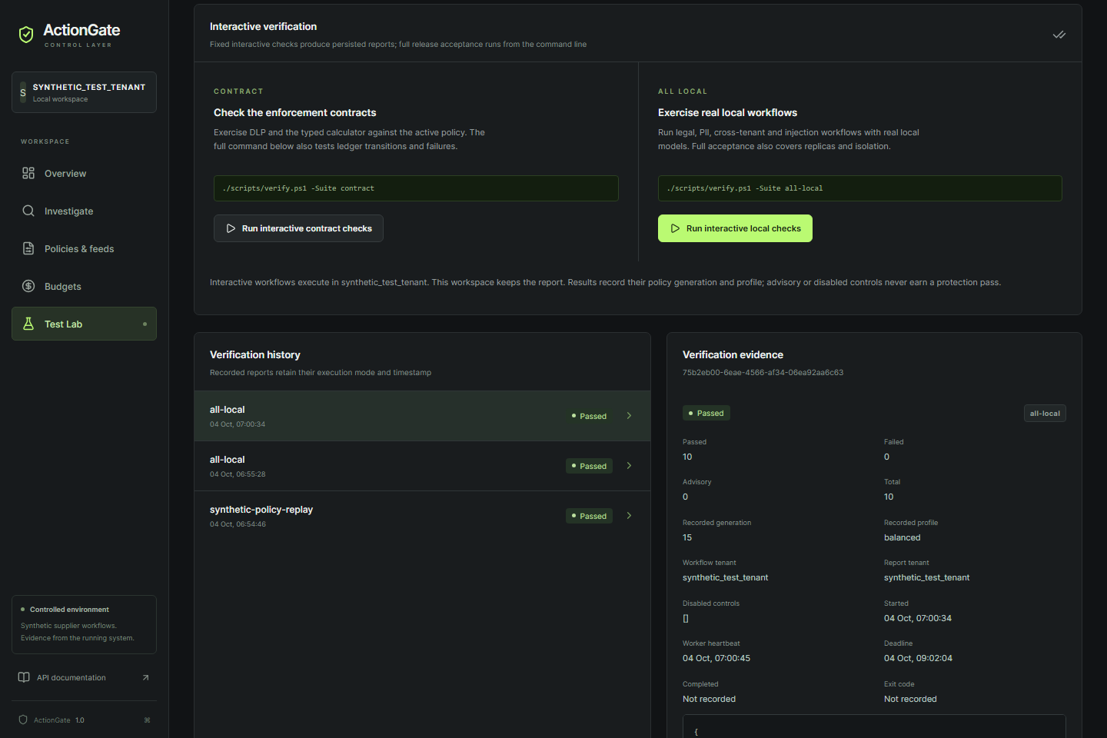
RECORDED DEMONSTRATION
Four outcomes through one gateway
Review completed
Personal data redacted
Injection blocked
Another tenant’s document denied
ACTIONGATE / DEFOZO SOFTWARE HOUSE
05
Notes:
The browser started the persisted interactive job 75b2eb00-6eae-4566-af34-06ea92aa6c63. Its four workflows show a completed supplier review, personal-data redaction, a semantic injection block before dispatch and a deterministic cross-tenant rejection. The recording links each to its actual operation and receipt state. The short pitch labels the real processing interval omitted from the edit. Source: artifacts/submission/ui-workflow.json and ActionGate-UI-workflows.mp4. Generation 15, model qwen3.5:4b, guard actiongate-guard-v2.9.

Slide 6
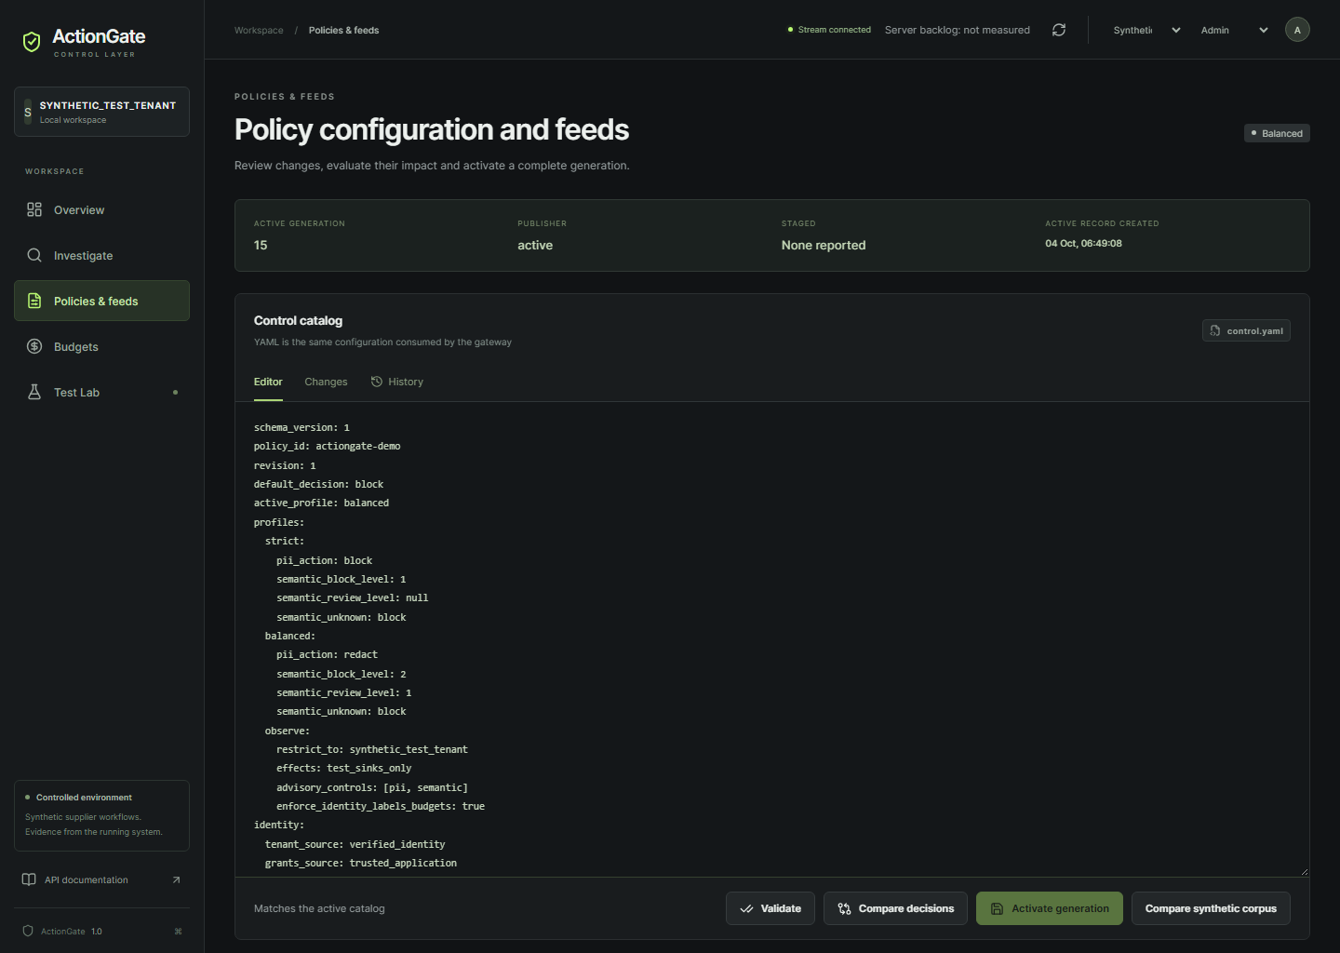
CONTROL CATALOG
Rules an operator can change
Profiles and thresholds
Signed threat rules
Safe policy comparison
ACTIONGATE / DEFOZO SOFTWARE HOUSE
06
Notes:
The operator edits the same policy the gateway applies. Validation checks the draft before signed activation. The active generation includes the feed, approved tools and model settings. Strict can block personal data while Balanced can redact permitted text fields. Signed threat rules can be added and removed through new revisions. The real synthetic policy comparison evaluates sixteen calibration cases and records candidate decisions without repeating business effects. This calibration replay is distinct from independent quality evaluation. Sources: live policy capture, configuration.md, policy-replay.json.

Slide 7
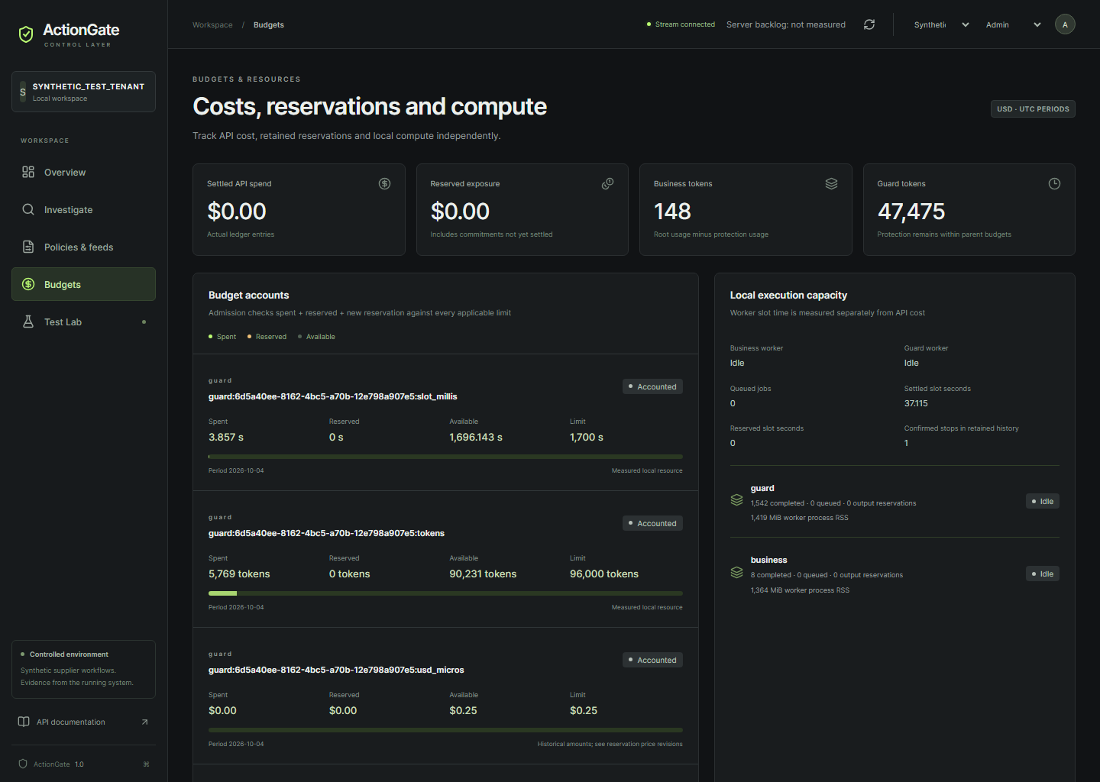
RESOURCE GOVERNANCE
Budgets across the workflow
spent + reserved + request ≤ limit
Delegated work shares the original allowance.
Tokens
Worker occupancy
API commitments
ACTIONGATE / DEFOZO SOFTWARE HOUSE
07
Notes:
An admitted request reserves its resource allowance before execution. Delegated work shares the original root budget. Guard inspection and output screening consume real local resources too. The dashboard separates tokens, worker occupancy and monetary commitments. It keeps historical price revisions with their actual reservations. An uncertain outcome remains committed until reconciliation. Sources: ledger.py, docs/configuration.md and the current budget capture.

Slide 8
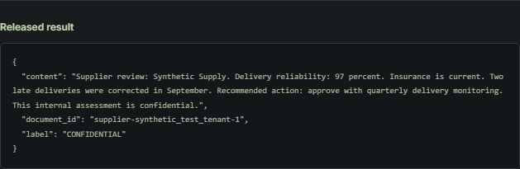
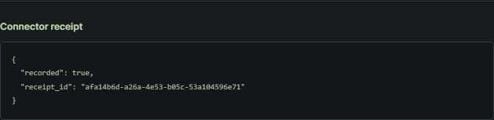
REPORTING
Evidence for each team
Exact action
Policy generation
Connector receipt
Settlement
ACTIONGATE / DEFOZO SOFTWARE HOUSE
08
Notes:
Security teams can open an operation and follow the exact arguments, policy generation, decision, dispatch, connector receipt and settlement. They can export tenant-scoped audit records. Management receives resource aggregates without protected payloads. The document receipt on this slide belongs to the completed recorded workflow. Source: the exact document operation in ui-workflow.json and the actual JSONL/CSV API exports in artifacts/submission.

Slide 9
DEVELOPER PACKAGE
Integration and evaluation
Existing clients
HTTP, Chat Completions and MCP interfaces. Python and TypeScript examples call the gateway.
Reproducible setup
Compose configuration and a runbook for an independent installation.
Run the supplied tests
Reproduce allowed, redacted and blocked workflows with the supplied test suite.
ACTIONGATE / DEFOZO SOFTWARE HOUSE
09
Notes:
The package supports an independent evaluator using a different client or an unseen input. Python and TypeScript examples call the authenticated gateway. An evaluator can install the same source and inspect its reproducible reports. The real browser demonstration accompanies the executable tests. Exact test totals, sample confusion matrices and performance measurements are in docs/acceptance.md, artifacts/all-local.json and artifacts/semantic-quality.json. Inspect those reports for the scope and limitations of each measurement. Sources: packages/clients, README.md, docs/jury-runbook.md, client-examples.json and acceptance-report.json.

Slide 10
ACTIONGATE
Independent evaluation
Supplier reviews with explicit
data access and spending permissions
743b-83-10-76-158.ngrok-free.app
Jury access from Michał Kiełtyka / DEFOZO SOFTWARE HOUSE
github.com/Defozo/actiongate-ai-control-layer
Michał Kiełtyka / DEFOZO SOFTWARE HOUSE
ACTIONGATE / DEFOZO SOFTWARE HOUSE
10
Notes:
Open the live demo and try your own input. The gateway applies the active policy and records the outcome. The repository contains the gateway, sample configuration, client examples, tests and a runbook for a fresh local installation. ActionGate lets teams complete useful agent workflows with explicit data access and spending permissions. I am Michał Kiełtyka of DEFOZO SOFTWARE HOUSE. Links on this slide are verified public delivery links supplied after deployment. Source: README.md, jury-runbook.md, TEAM.json and public access verification.

