Slide 1
Byzantine Agreement
Sometimes called “reliable broadcast”
or “distributed consensus”

Slide 2
Plan
Byzantine Agreement
Setup & Agreement definition
Lower Bound Theorems
Intuition
Authenticated Byzantine Agreement
Setup / definitions
Lower Bound Theorems

Slide 3
Setup: communication
Communication is
Point-to-point and complete
Any two processes can communicate
You can’t hear what other processes are saying to each other
Synchronous
We proceed in rounds
You must send your message in this round before you’ve received what others send you this round

Slide 4
Setup: processes
Some processes are honest
They follow the protocol exactly
Others exhibit “Byzantine failures”
They can do whatever they like
Stop
Change their minds
Lie about what they’ve heard
Send different reports to different people
etc
Notes:
Byzantine palace vs Byzantine generals

Slide 5
Setup: the General
There’s a universe of possible values
We’ll use {0,1} (but it doesn’t really matter)
We’ll designate one special process called the General who sends out a value v to everyone.
And then joins in the agreement process
If the general is honest, he sends the same v to everyone.
Not all formulations of Byzantine Agreement use a General: you could also think of v as coming from independent sensors etc
It’s just a convenient way of thinking about whether the initial data is inconsistent, or whether it’s consistent but people lie about it
Unfortunately there’s an off-by-one discrepancy between different descriptions in the literature as a result

Slide 6
Agreement (Consensus)
Agreement: No two honest processes decide on different values
Validity: If the general is honest, then all honest processes decide on the value he sends
Termination: All honest processes eventually decide
Notes:
Motivate with Voting

Slide 7
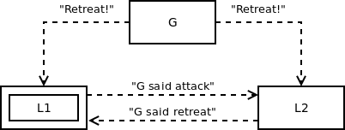
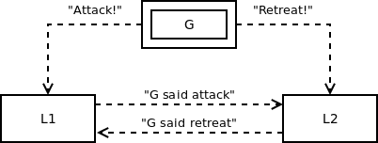
It’s hard to identify the traitor
L2 sees the same messages
Whether it’s L1 or G who cheats
So how can L2 decide what to do?
Notes:
These pictures are copied from Nancy Lynch “Distributed Algorithms”, Morgan Kaufman 1996.

Slide 8
Exercise
Try to design a successful protocol
A general and 2 other processes (3 in total)
Tolerate one traitor
A general and 3 other processes (4 in total)
Tolerate one traitor

Slide 9
Lower Bound Theorems for Byzantine Agreement
Agreement in the possible presence of t traitors requires
t+1 rounds of communication
Not counting the General’s initial order
And 3t + 1 participants in total.
For rigorous proofs (non-examinable) see
Nancy Lynch “Distributed Algorithms” Ch 6.
(Morgan Kaufmann ‘96)
Or Sec 17.2 and 17.4 of dcg.ethz.ch/lectures/podc_allstars/lecture/podc.pdf

Slide 10
Plan
Byzantine Agreement
Setup & Agreement definition
Lower Bound Theorems
Intuition
Solution
Authenticated Byzantine Agreement
Setup & definitions
Lower Bound Theorems
Solution

Slide 11
Authenticated Byzantine Agreement
Use digital signatures on each message
Assume everyone knows a valid public key for everyone else
A dishonest general can still send different initial values
A dishonest process
Can stop
But not restart
Can not lie about what it has received
Because it can’t generate a valid digital signature on someone else’s message

Slide 12
Agreement with Authentication
Agreement: No two honest processes decide on different values
Validity: If the General sends all processes exactly one validly-signed value v, then v is the only possible decision value for an honest process

Slide 13
Theorems for authenticated agreement
Agreement in the possible presence of f failures requires f+1 rounds of communication
Not counting the General’s initial order
With authentication, we can tolerate any number of faults
Notes:
Still f+1 rounds. Why? Because that’s how long it takes to propagate the information that the general cheated, given f-1 conspirators who try to keep the information to themselves.

Slide 14
Lower bound : intuition
Why does it still take t+1 rounds?
Because that’s how long it takes to propagate the information that the general cheated, given t conspirators who try to keep the information to themselves.
We can prevent them from lying, but we can’t make them talk
In t+1 rounds, at least one honest participant must find out and tell all the others

