Slide 1
Audio Transcription App
Creating an app using OpenAI Whisper for efficient audio transcription.

Slide 2
Introduction
This presentation explores the development of an audio transcription application using OpenAI Whisper, highlighting its features and implementation strategies.

Slide 3
What is OpenAI Whisper?
OpenAI Whisper is a robust AI model designed for automated speech recognition. It converts spoken language into text with high accuracy and can handle various accents and background noises, making it ideal for transcription applications. Its capabilities extend to multilingual support and real-time transcription, catering to diverse user needs.

Slide 4
Key Features of Audio Transcription Apps
Audio transcription apps powered by AI, like those using OpenAI Whisper, offer several key features: automatic transcription of diverse audio formats, speaker identification, integration with cloud services for storage, editing tools for correcting transcriptions, and user-friendly interfaces. These features enhance productivity and accessibility for different users.

Slide 5
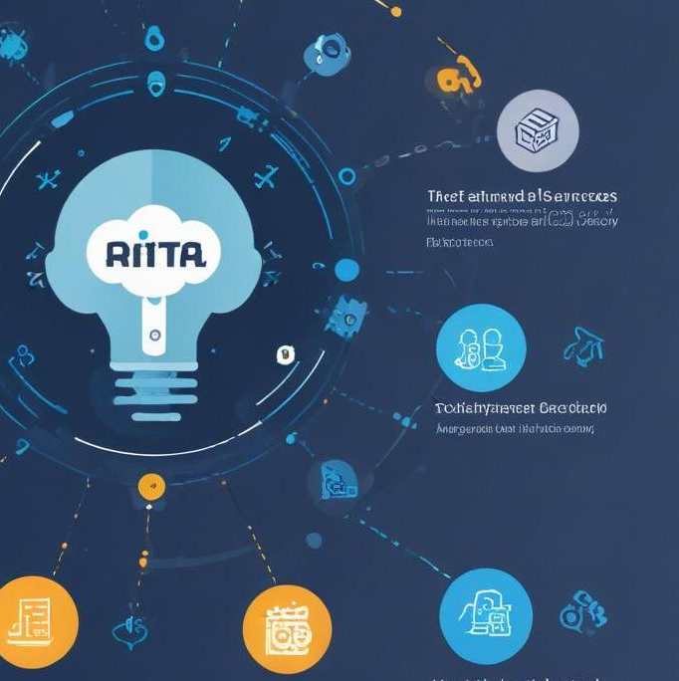
Benefits of Using AI for Transcription
Utilizing AI for transcription offers numerous advantages, including increased accuracy, rapid processing of audio to text, and the ability to handle large volumes of data efficiently. AI models, such as OpenAI Whisper, can learn from diverse audio inputs, resulting in improved performance over time. Additionally, they provide features such as real-time processing, cost-effectiveness due to reduced human labor, and the ability to adapt to multiple languages and dialects, making them versatile for various industries.

Slide 6
Setting Up OpenAI API
To set up the OpenAI API for transcription, begin by signing up for an API key from OpenAI's website. After obtaining the key, you will need to install the necessary libraries in your programming environment, such as 'openai' for Python. Create a configuration file to store your API credentials securely. Familiarize yourself with the API documentation to understand the endpoints available for transcription tasks. Lastly, conduct initial tests to ensure that the setup is functioning correctly.

Slide 7
Integrating Whisper in Your App
Integrating Whisper into your application involves calling the OpenAI API to utilize its transcription capabilities. You will need to build the logic in your app to send audio recordings to the Whisper model, fetch the transcribed text output, and display it comprehensively within your interface. Consider how users will interact with the app, optimizing for both usability and performance. Implement error handling to manage any potential issues that may arise during transcription requests.

Slide 8

Testing and Optimization Techniques
After integration, rigorous testing is crucial to ensure that the transcription functionality works as expected. Conduct unit tests on individual components, followed by end-to-end tests to verify the entire workflow. Monitor the transcription accuracy and the app's performance under different conditions. Optimize your app by reducing latency, refining error handling mechanisms, and gathering user feedback for continuous improvement. Using analytics tools can help track usage patterns to identify further areas for enhancement.

Slide 9
Conclusion
Implementing an audio transcription app using OpenAI Whisper can drastically improve the efficiency and accuracy of converting speech to text. The benefits of AI-driven transcription, combined with effective integration and optimization strategies, can lead to a powerful application that meets user needs across various contexts.

Slide 10
Thank you!
Do you have any questions?
+91 620 421 838

