Slide 1
Agentic RAG Chatbot for Multi-Format Document QA
Implementing Model Context Protocol (MCP)

Slide 2
Problem Statement
Business need for document-based QA
Challenges with traditional search
Requirements:
- Multi-format support
- Agent-based architecture
- Traceable responses

Slide 3
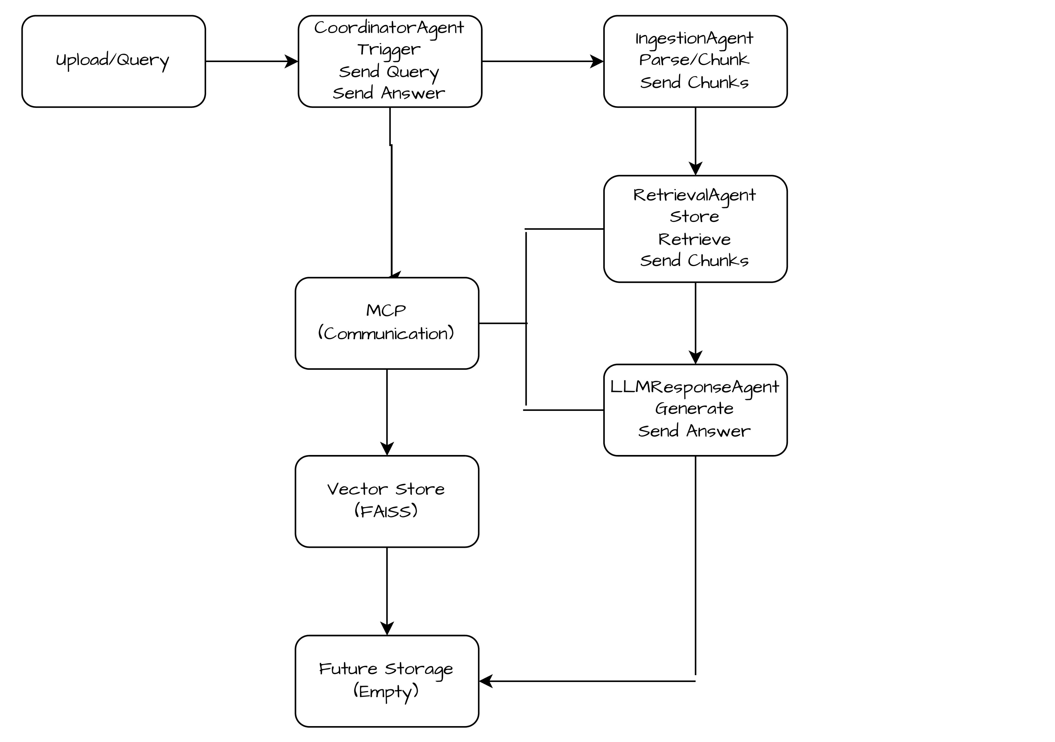
System Architecture

Slide 4
Technical Implementation
Code Structure
MCP Message Example
{ "sender": "RetrievalAgent",
"receiver": "LLMResponseAgent",
"type": "RETRIEVAL_RESULT",
"payload": { "query": "Q1 KPIs?",
"context": ["Revenue: $1.5M..."] } }
Key libraries: PyPDF2, python-pptx, FAISS, transformers

Slide 5
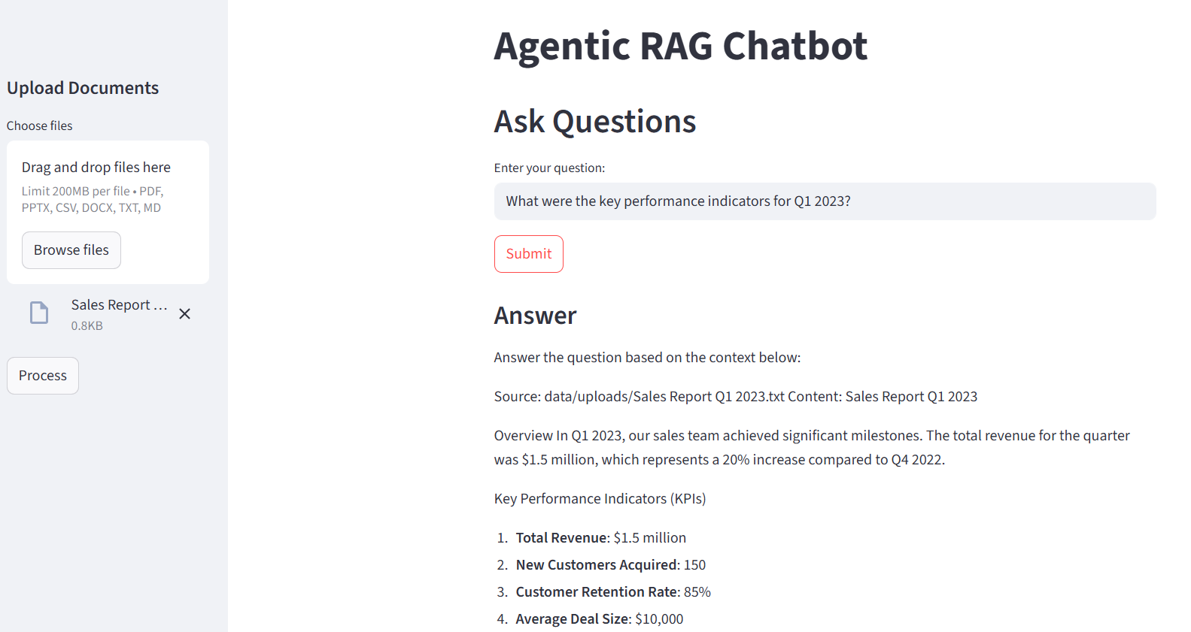
Demo Screenshots

Slide 6
Challenges & Solutions
Challenge | Solution
PDF text extraction | PyPDF2 with fallback handling
Cross-format parsing | Unified DocumentParser class
Context limitation | Dynamic chunk sizing

Slide 7
Future Work
GPU acceleration
Fine-tuned embeddings
Advanced query understanding

