Slide 1
LIVER DAMAGE DETECTION

Slide 2
Contents
Business objective
Business Constraints
Project Architecture
Data collection and details
Exploratory Data Analysis
Visualization
Modeling
Evaluation
Deployment
Notes:
Change

Slide 3
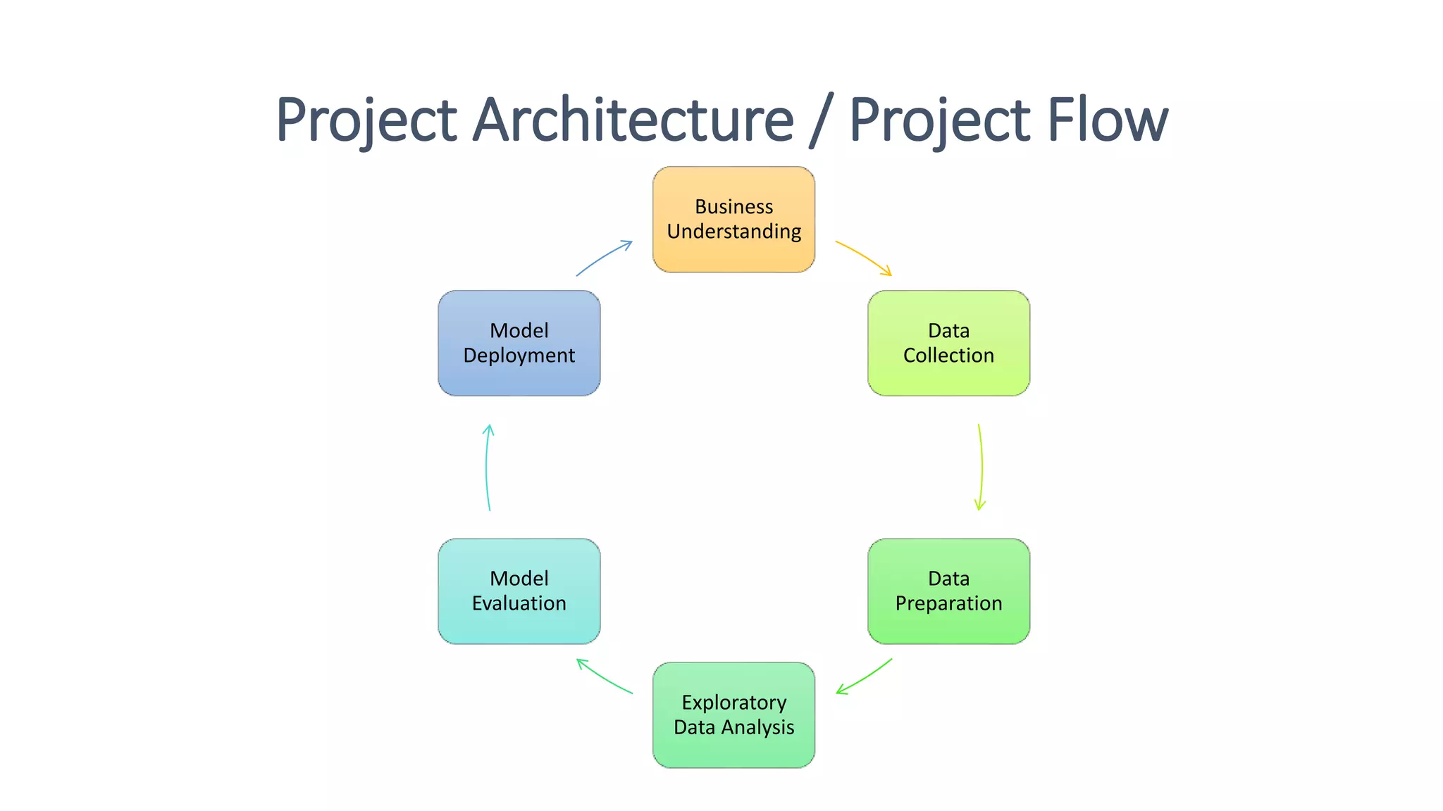
Project Overview and Scope

Slide 4
Business Problem
Current liver damage detection relies heavily on manual analysis by hepatologists, making early diagnosis and risk assessment time-consuming and prone to human error. There is a need for AI-driven solutions to analyze histopathology images and patient healthcare data to assist in making more accurate, faster decisions for early intervention.

Slide 5
OBJECTIVE
To build a deep learning model capable of classifying liver tissue images into Normal, HCC, and CC categories with high accuracy to aid in early diagnosis.
To automate the detection of liver abnormalities using convolutional neural networks (CNNs) to reduce diagnostic time and support medical experts.
To design a robust image classification system that can differentiate between healthy and cancerous liver tissues using histopathological images.
To leverage transfer learning with EfficientNetB0 for accurate detection and classification of liver damage types in medical images.
To enhance diagnostic reliability by applying advanced deep learning techniques for multiclass classification of liver diseases.
To minimize human error and increase efficiency in liver disease diagnosis through automated image-based analysis.
To integrate medical imaging and AI to facilitate non-invasive and early-stage detection of liver cancer.
To develop a scalable and interpretable AI model for identifying specific liver damage patterns in histopathology slides.

Slide 6
CONSTRAINTS
Limited Dataset Size – Availability of labeled histopathology images for all three classes (Normal, HCC, CC) may be limited, affecting model generalization.
Class Imbalance – Uneven distribution of Normal, HCC, and CC samples can bias the model toward majority classes.
Image Quality Variations – Differences in resolution, staining, and artifacts in histopathology slides may impact model accuracy.
Computational Resources – High-performance GPUs or TPUs are required for training deep learning models like EfficientNetB0.
Time Constraints – The model must be trained, validated, and tested within a limited project timeline.
Interpretability – Deep learning models may lack transparency, making clinical adoption more challenging without proper explainability tools (e.g., Grad-CAM).
Overfitting Risk – Due to high model complexity and limited data, there’s a risk of overfitting, especially without proper regularization or augmentation.
Deployment Limitation – The model's real-time performance and integration into clinical workflows may face practical or regulatory hurdles.
Data Privacy – Patient data must be anonymized and handled securely in compliance with medical data protection standards (e.g., HIPAA or GDPR).
Domain Expertise – Continuous collaboration with medical experts is required to ensure clinically meaningful results and correct annotation of images.

Slide 7
Success Criteria
Business Success Criteria: Reduce manual efforts in liver damage assessment
by 20–30% through AI-driven insights.
ML Success Criteria: Achieve a prediction accuracy greater than 85% in detecting liver damage.
Economic Success Criteria: Achieve at least a 15% cost reduction in diagnosis by
minimizing errors and optimizing workflows.

Slide 8
CRISP-ML(Q) Methodology
There are six stages of CRISP-ML(Q) Methodology
1.Business and data understanding
2.Data preparation
3.model building
4.Model evaluation
5.Model deployment
6.Monitoring and maintenance

Slide 9
Technical Stacks
Programming Language – Python
Deep Learning Frameworks - TensorFlow / Keras, PyTorch
Image Processing & Augmentation – OpenCV, Keras ImageDataGenerator
Data Handling & Visualization – NumPy, Pandas, Matplotlib, Seaborn
Model Evaluation - Scikit-learn (confusion matrix, classification report, ROC curve, etc.)
Pre-trained Models (Transfer Learning) - EfficientNetBo, VGG16, DEnseNet121
Development Environment - Google Colab
Deployment Tools - Streamlit / Flask

Slide 10
Data Collection and Understanding
Data Sources:
Histopathology images of liver tissue (Normal, HCC, CC).
Clinical patient healthcare data (demographics, liver function test results, etc.).
Data Characteristics:
Images: High-resolution biopsy images.
Clinical Data: Tabular structured data.

Slide 11
Data Information
Dataset Source
Custom dataset or medical imaging database
Data Type
Histopathology Images (Microscopic liver tissue images)
Classes (Labels)
Normal – Healthy liver tissue
HCC (Hepatocellular Carcinoma) – Primary liver cancer
CC (Cholangiocarcinoma) – Cancer of the bile ducts
Image Format
JPEG / PNG / TIFF
Image Dimensions
Varying resolutions (resized to fixed size, e.g., 224×224 pixels for model input)
Data Splits
Training Set: 70%
Validation Set: 15%
Test Set: 15%
Preprocessing Steps
Image resizing
Normalization (scaling pixel values between 0 and 1)
Data augmentation (rotation, flip, zoom, etc.)
Label encoding

Slide 12
Data Dictionary
Feature Name | Description | Data Type | Example
image_id | Unique identifier for each histopathology image | String | img_001, HCC_123
image | Histopathology image file | Image (Array) | 224x224x3 pixel RGB image
label | Target class indicating liver tissue type | Categorical (string) | Normal, HCC, CC
label_encoded | Numeric encoding of the label | Integer | 0 = Normal, 1 = HCC, 2 = CC
source | Dataset or medical center from where the image was sourced | String | Hospital_A, Dataset_XYZ
Augmentation_applied | Whether image augmentation was applied (used for training data) | Boolean | True, False

Slide 13
System Requirements
Software Requirements
Operating System: Windows 10/11, Linux (Ubuntu), or macOS
Programming Language: Python 3.7 or above
Libraries & Frameworks:
TensorFlow / Keras
NumPy, Pandas
OpenCV, PIL, Albumentations
Matplotlib, Seaborn
Scikit-learn
(Optional) Streamlit / Flask for deployment
(Optional) Grad-CAM, SHAP for explainability
IDE/Notebook: Jupyter Notebook / VS Code / Google Colab
Hardware Requirements
Processor: Intel i5/i7 or AMD Ryzen 5/7 (or higher)
RAM: Minimum 8 GB (16 GB recommended for large datasets)
Storage: At least 10 GB free space (for images, models, and logs)
GPU:
Recommended: NVIDIA GPU with CUDA support (e.g., RTX 3060 or higher)
Alternative: Use Google Colab Pro / Kaggle GPU for training

Slide 14
Exploratory Data Analysis [EDA]
Image Analysis: Visualize different tissue classes (Normal vs. Damaged liver).
Data Balancing: Check if data is balanced across Normal, HCC, and CC classes.
Statistical Summary: Age distribution, test result ranges in patient data.
Correlation Study: Find important clinical features correlating with liver damage.
Notes:
EDA is used for seeing what the data can tell us before the modeling task.
Change

Slide 15
Data Preprocessing
Image Preprocessing:
Resizing, normalization, augmentation (flip, rotate, zoom).
Notes:
Keep observations

Slide 16
Model Building
Model Selection
Choose a pre-trained model (e.g., EfficientNetB0) for transfer learning.
Freeze initial layers and add a custom classification head (dense layers + softmax).
Model Architecture
Input layer: Shape (224, 224, 3).
Pre-trained model (e.g., EfficientNetB0).
Custom classification head with fully connected layers.
Output layer with 3 neurons (Normal, HCC, CC).
Model Compilation
Optimizer: Adam.
Loss function: Categorical Crossentropy.
Metrics: Accuracy.
Model Training
Train with batch size (32 or 64) and epochs (50-100).
Use early stopping and model checkpoint callbacks.
Model Evaluation
Evaluate test accuracy.
Use confusion matrix and ROC curves for performance analysis.
Notes:
classification is the task of predicting a discrete class label. Regression is the task of predicting a continuous quantity.
What is classification techniques in machine learning?
The Classification algorithm is a Supervised Learning technique that is used to identify the category of new observations on the basis of training data. In Classification, a program learns from the given dataset or observations and then classifies new observation into several classes or groups.
What is regression techniques in machine learning?
Regression is a technique for investigating the relationship between independent variables or features and a dependent variable or outcome. It's used as a method for predictive modeling in machine learning, in which an algorithm is used to predict continuous outcomes.

Slide 17
Model Accuracy Comparison
Training and Evaluation
Train all models (EfficientNetB0, VGG16, DenseNet) using the same training and validation datasets.
Ensure identical preprocessing steps (image resizing, normalization, augmentation) and hyperparameters (e.g., batch size, epochs).
Model | Accuracy (%) | Precision (Normal) | Precision (HCC) | Precision (CC) | F1-Score | AUC (ROC)
EfficientNetB0 | 82.3 | 81.5 | 83.1 | 81.8 | 0.82 | 0.85
VGG16 | 89.5 | 88.2 | 90.5 | 89.0 | 0.89 | 0.92
DenseNet | 91.0 | 90.1 | 92.5 | 90.6 | 0.91 | 0.93

Slide 18
Best Model – DenseNet121
Why DenseNet?
DenseNet outperforms traditional convolutional neural networks (CNNs) in many computer vision tasks because of its unique architecture:
Better Gradient Flow: Dense connections help prevent the vanishing gradient problem, ensuring that deeper layers learn effectively.
Feature Reuse: Layers can directly access features from all previous layers, which reduces the need for learning redundant features.
Compact Models: DenseNet tends to use fewer parameters than traditional CNNs for the same or better performance.
In the case of Liver Damage Detection, DenseNet can effectively capture intricate patterns in histopathology images (Normal, HCC, CC) due to its powerful feature extraction capabilities.
Notes:
Why Random Forest Regression is good?
A Random Forest Regression model is powerful and accurate. It usually performs great on many problems, including features with non-linear relationships
How is XGBoost different from random forest?
One of the most important differences between XG Boost and Random forest is that the XGBoost always gives more importance to functional space when reducing the cost of a model while Random Forest tries to give more preferences to hyperparameters to optimize the model..
n_estimators — the number of decision trees you will be running in the model

Slide 19
Model Deployment - Strategy
The trained DenseNet model is exported in .keras format.
A Streamlit web application
Users can upload liver histopathology images through the app.
The app preprocesses the image and uses the DenseNet model to predict one of three classes: Normal, HCC, or CC.
The predicted class and its probability score are displayed. A bar chart can visualize class probabilities.
The app is run locally using streamlit run app.py.
For public access, the app is deployed on Streamlit Cloud by linking a GitHub repository.
Continuous monitoring and periodic updates are planned for performance improvement and UI enhancements.

Slide 20
Challenges
Limited number of biopsy images.
High similarity between CC and HCC classes made it harder to differentiate.
Overfitting during early training — solved using heavy augmentation and dropout.
Computational resource limitations for training DenseNet.

Slide 21
Future Scopes
Collect more annotated biopsy images to improve model robustness.
Explore advanced models like EfficientNetV2, Vision Transformers (ViT).
Implement model explainability (e.g., Grad-CAM) to highlight which part of the tissue
image influenced predictions.
Deploy a fully functional web app for real-time predictions.

Slide 22


