Slide 1
Determining The Best ATM Location

Slide 2
Business Understand
My client wants to find out the best location for planting an ATM machine to extend services to their customers. He wants to know which place is more accessible, busy and highly profitable to the organization.
In meeting the clients vision, we needed to know the factors that are considered to set up an ATM among which are:
Busy place
Distant from another bank’s ATM or Branch.
Population density of the area.

Slide 3
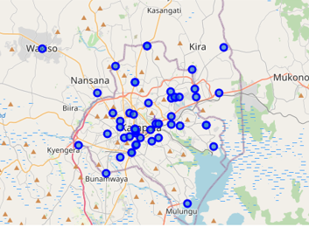
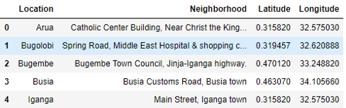
Data sampling and cleaning
https://www.centenarybank.co.ug/index.php/branches/index
https://en.wikipedia.org/wiki/List_of_cities_and_towns_in_Uganda.

Slide 4
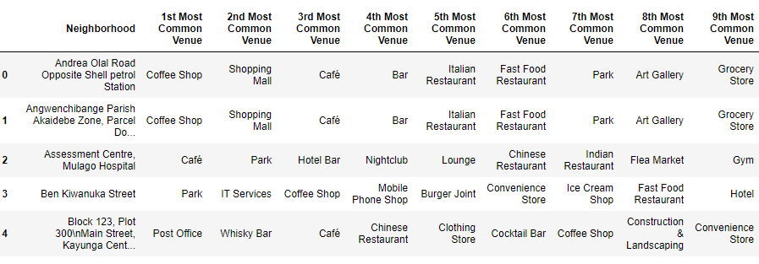
Data sampling and cleaning Foursquare API to locate venues

Slide 5
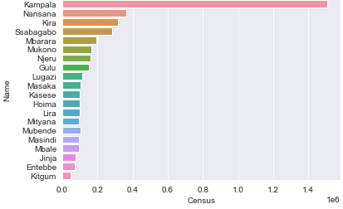
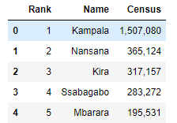
Data Analysis

Slide 6
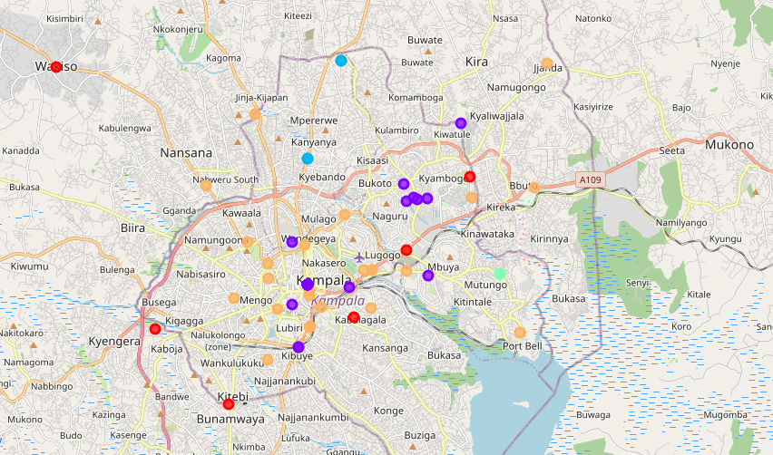
K-mean method

Slide 7
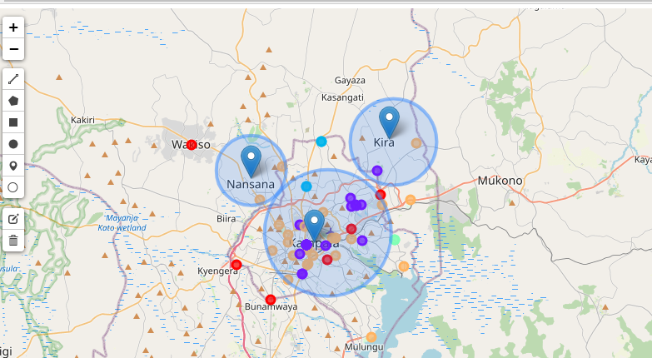
Conclusion: The best place to place an ATM is Kira

