Slide 1

Creating Music Using Machine Learning
Presented By :
Revant Lala (18BEC085)
Dehit Trivedi (18BEC119)

Slide 2
Presentation Outline
Introduction
Recurrent Neural Network
Memory Cell
Long Short-Term Memory Neural Network
Methodology
Preparing Data
Training
Testing
Code Implementation
Result
GAN
Conclusion
References

Slide 3
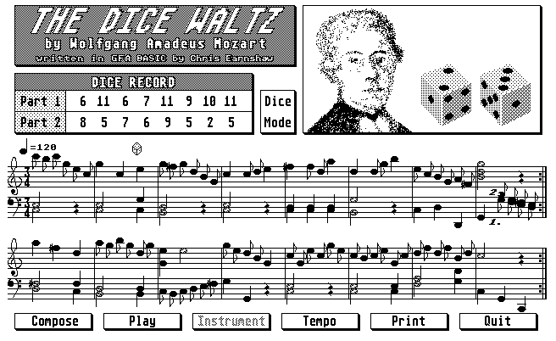
Introduction
Music is not just an art but an ultimate language. Many of the artist throughout the history have composed pieces that were both creative and deliberate.
It all started by randomly selecting sounds and combining them to form a piece of music.
In 1878,Mozart proposed a dice game for these random sound selection.
Recently, Machine Learning has become a state of art for Automatic Music Generation.
We will discuss about our approach towards Automatic Music Composition using RNN and LSTM architecture.

Slide 4
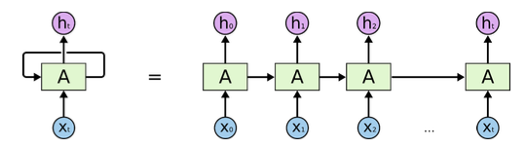
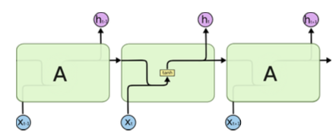
Recurrent Neural Network
They are a class of artificial neural networks that take time and sequence into account.

Slide 5
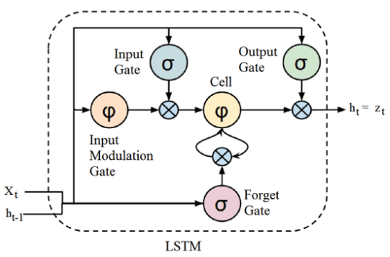
Memory Cells
The Structure of Memory Cell describes us that it has 3 gates
Input : This gates control how much the data is inputted into the memory.
Output : This gates control the data passed to next layer.
Forget : This gate controls the loss or tearing in the stored memory.
These gates contains sigmoid and hyperbolic tangent function with a low computational complexity.

Slide 6
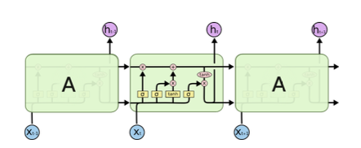
Long Short Term Memory
Long Short Term Memory networks – usually just called “LSTMs” – are a special kind of RNN, capable of learning long-term dependencies.
A LSTM architecture is as shown;

Slide 7
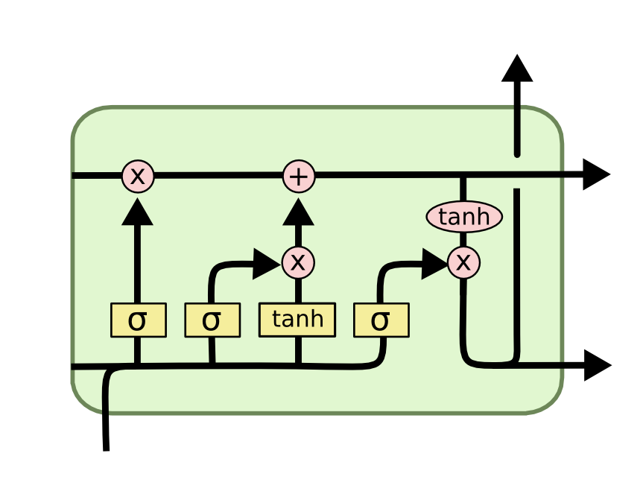
Algorithm of LSTM
There are 4 major steps in the LSTM Algorithm.
Forget gate layer
New information
Combination of previous steps
Output

Slide 8
Preparing Data
Music21 toolkit for python to convert midi files into a list of notes & chords
Put all the notes in a sequential list by appending the pitch, offset, duration in string
Put all the chords in sequential list by encoding id of every note in the chord together
Mapping function from above categorical data to numerical data
Creating input & output to train the model:
Choose a sequence length as input and the output will be the first note/chord that comes after that sequence
We can try here different sequence lengths to see how it impacts the model.

Slide 9
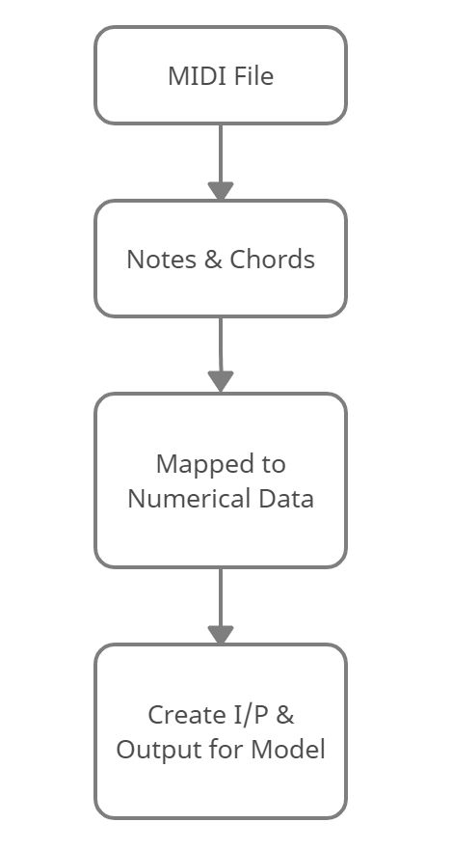
Preparing Data

Slide 10
Training
1. LSTM
First layer should have same number of nodes as the number of outputs the system has so that it maps to one of our classes.
2. Dropout - to regularize by setting a fraction of input to 0 at each update during training to prevent overfitting.
Determine what fraction to drop.
3. Dense - fully connected neural net where each input node is connected to an output node.
4. Activation - what activation function to use to calculate output.
5. Determine how many of each layer we need.
6. Calculate loss for each iteration of training. Loss functions in Keras:
Get the weights to use for model

Slide 11
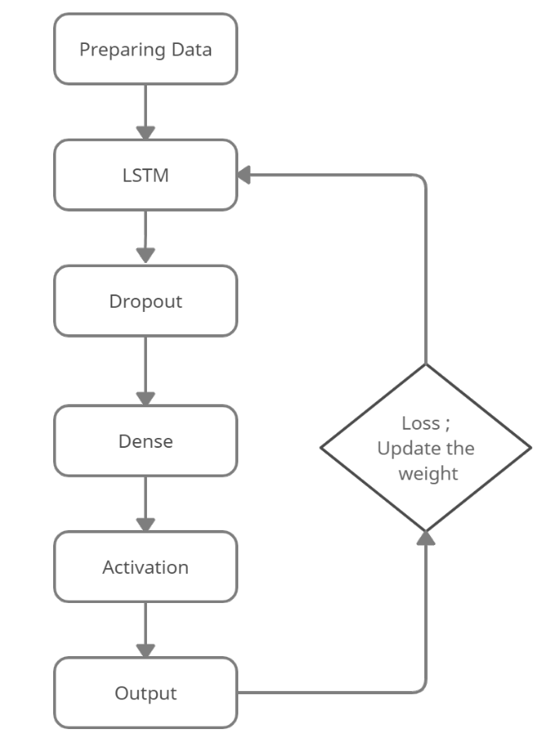
Training

Slide 12
Testing
Pick a random note from the list of notes as starting point, run generation code to get next sequence, then remove the first note from original sequence append the generated sequence and generate a following note, etc.
Map back from numerical data to categorical data.
Convert back to midi file.

Slide 13
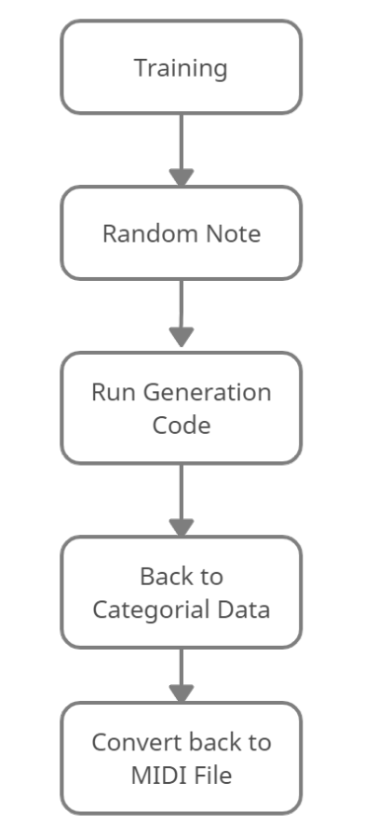
Testing

Slide 14
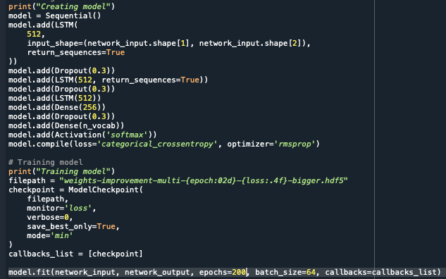
Code implementation
Beside id the code snippet for creating a model.
The model consist of total 9 layers
3 LSTM
3 Dropout
2 Dense
1 Activation
The LSTM layer has 512 unit or nodes and the model has a dropout rate of 0.3.

Slide 15
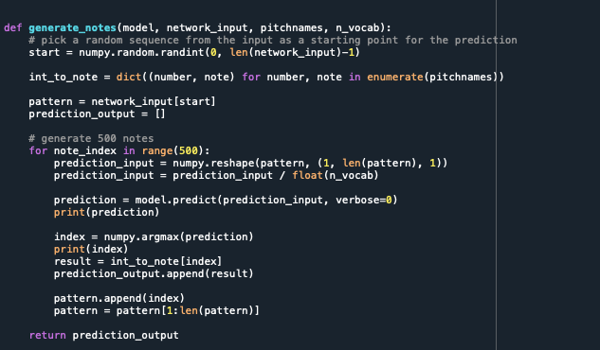
Code implementation
The beside code is for generating the music.
Basically it test the model made and creates a new sequence from the random note.
Then the prediction output which is a numerical data is converted to categorical data and hence at last to the MIDI file.

Slide 16
Results

Slide 17
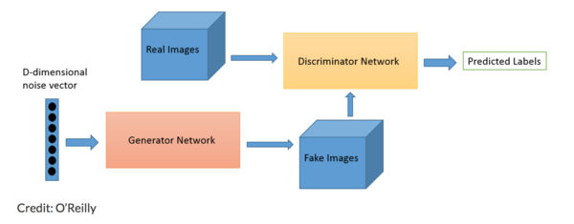
Generative Alternative Networks (GAN)
GAN is an alternative technique for music generation
GANs are, in fact, two neural networks working against each other.
One of them, called the “generator”, generates new data instances.
The “discriminator”, tries to determine whether the new data instance was generated or if it belongs to the training dataset

Slide 18
Conclusion
The algorithm discussed in this project enable the machine to create their own music. Therefore narrowing the gap between human brain and CPU.
This project discusses on the concept of RNN, LSTM, Music Theory, MIDI files, and several literature.
Many companies like Google, Microsoft, OpenAI are developing this algorithm more efficiently making the machine capable of composing music.
We would like to conclude that this project is technical as well as artistic as it has the power to bring people from both the background together.
By doing this we would be able to create a new efficient decision rule, network model which can improve the performance of the machine to generate all kinds of music without human intervention.

Slide 19
References
Agarwala, N., Inoue, Y., & Sly, A. (2017). Music composition using recurrent neural networks. [online]. Web.stanford.edu.
Chen, C. (2001). Creating melodies with evolving recurrent neural networks. [ebook]. Washington, DC: IEEE.
Eck, D., & Schmidhuber, J. (2002). A first look at music composition using LSTM recurrent neural networks. [ebook]. Manno, Switzerland: Instituto Dalle Molle di Studi Sull’ Intelligenza Artificiale.
Y. Nikhil Kotecha, “Generating music using an lstm network,” 2018.
K. S. Geoffrey Hinton with Nitish Srivastava, “Neural networks for machine learning.”

