Slide 1

Basic 16 Bit SIMD Processor
(Special Assignment : 2EC601 - Computer Architecture)
SANIKA JOSHI (18BEC046)
VIMOLI MEHTA (18BEC056)
SUYASH MALIK (18BEC112)
DEHIT TRIVEDI (18BEC119)
Department of Electronics & Communication Engineering,
Institute of Technology, Nirma University, Ahmedabad, INDIA
Prepared by:
SANIKA JOSHI (18BEC046)
VIMOLI MEHTA (18BEC056)
SUYASH MALIK (18BEC112)
DEHIT TRIVEDI (18BEC119)

Slide 2
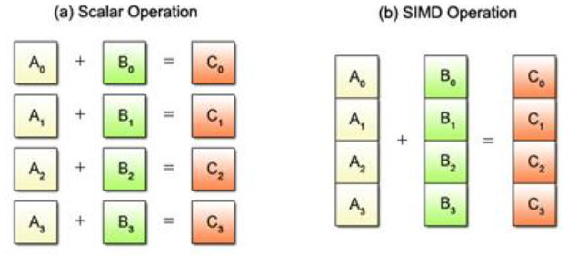
What is SIMD?
SIMD stands for Single Instruction Multiple Data, it is an architecture which takes an operation specified in one instruction and applies it to more than one set of data elements at the same time. Most modern CPU designs include SIMD instructions in order to improve the performance of multimedia use.
For example, in a traditional scalar microprocessor, an add operation would add together a single pair of operands and produce a single result.
In SIMD processing, a number of independent operand pairs are added together to produce the same number of independent sums.
Fig. Scalar vs SIMD

Slide 3
SIMD Processing
Instructions perform add, multiply etc. on all the data in parallel as shown below:
X3 | X2 | X1 | X0
Y3 | Y2 | Y1 | Y0
OP
OP
OP
OP
X3 OP Y3 | X2 OP Y2 | X1 OP Y1 | X0 OP Y0

Slide 4
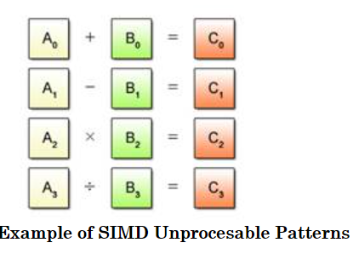
Pros and Cons of SIMD
PROS | CONS
Require Lower Instruction Bandwidth: Reduced by fewer fetches and decodes Easier Addressing of Main Memory:Load/Store units access memory with known pattern Elimination of Memory Wastage Simplification of Control Hazards: Loop-related control hazards from the loop are eliminated Scalable Platform :Increase performance by using more hardware resources Reduced Code Size: Short, single instruction can describe N operations | Larger registers and functional units use more chip area and power Difficult to parallelize some algorithms (Amdahl's Law) Parallelization requires explicit instructions from the programmer SIMD operations cannot be used to process multiple data in different ways.

Slide 5
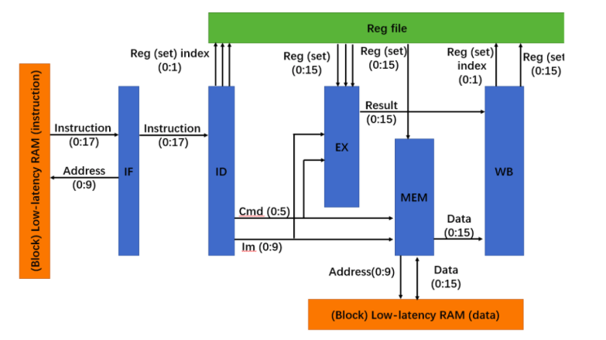
Simple SIMD architecture

Slide 6
Implementing SIMD in Verilog
Input | 18 bit instruction, 16 bit i/p data, clk and reset
Output | 16 bit o/p data, 10 bit data address, 10 bit instruction address
Important variable | 3 bit current state, 10 bit program counter, and next program counter.
Register file | 4 sets of 16 bit H, 3 sets of 16 bit O, 3 sets of 16 bit Q, 10 bit immediate register
Index for register file | 2bit R0, R1, R2, and R3
Control signals | Hreg1, Hreg2, Hreg3, Him, Oreg1, Oreg, Oreg3, Oim, Qreg1, Qreg2, Qreg3, Qim.

Slide 7
Register File
A 16 bit register is used to store two data values each of 08 bits.
Used for 8 bit registers (3 sets)- {O1,O2},{O3,O4},{O5,O6}
A 16 bit register is used to store four data values each of 04 bits.
Used for 4 bit registers(3sets)-{Q1,Q2,Q3,Q4},{Q5,Q6,Q7,Q8},{Q9,Q10,Q11,Q12}
1st data value of 8 bits [15:8] 2nd data value of 8 bits [7:0]
1st [15:12] 2nd [11:8] 3rd [7:4] 4th [3:0]

Slide 8
Register Instruction Format
R-type Instruction Format
The instruction is considered of total 18 bits.
Opcode of [5 bits] | Index Register 0 [2 bits] | Index Register 1 [2 Bits] | Index Register 2 [2 bits] | Index Register 3 [2 bits]
Opcode [17:12] | R0[11:10] | R1[5:4] | R2[3:2] | R3 [1:0]
Example : add16bit H3, H2
000000_00000000_11_10
Opcode _*_H3_H2

Slide 9
Register Instruction Format
2. I-type Instruction Format
Opcode of [5 bits] | Index Register 0 [2 bits] | Immediate Operand
Opcode [17:12] | R0[11:10] | Imm register [9:0]
Example : load16bit H0, immediate
100110_00_0000000000
Opcode_H0_immediate

Slide 10
Register instruction format
3. J-type instruction format
Example : loopjump im
100100_00_0000010000
Opcode_*_immediate
Opcode of [5 bits] | Index Register 0 [2 bits] | Immediate Operand
Opcode [17:12] | R0[11:10] | Imm register [9:0]

Slide 11
Opcode and Instruction
Opcode | Instruction
000000 | Add 16 bit
000001 | Add 8 bit
000010 | Add 4 bit
000011 | Add 16 immediate
000100 | Add 8 bit immediate
000101 | Add 4 bit immediate
Opcode | Instruction
000110 | Sub 16 bit
000111 | Sub 8 bit
001000 | Sub 4 bit
001001 | Sub 16 bit immediate
001010 | Sub 8 bit immediate
001011 | Sub 4 bit immediate

Slide 12
Opcode and instruction
Opcode | Instruction
001100 | Mul 16 bit
001101 | Mul 8 bit
001110 | Mul 4 bit
001111 | Mul 16 bit immediate
010000 | Mul 8 bit immediate
010001 | Mul 4 bit immediate
Opcode | Instruction
010101 | Lsl 16 bit
010110 | Lsl 8 bit
010111 | Lsl 4 bit
011000 | Lsr 16 bit
011001 | Lsr 8 bit
011010 | Lsr 4 bit

Slide 13
Opcode and instruction
Opcode | Instruction
100110 | Load 16 bit
100111 | Load 8 bit
101000 | Load 4 bit
101001 | Store 16 bit
101010 | Store 8 bit
101011 | Store 4 bit
100100 | Loop Jump to value in immediate

Slide 14
Current state of Processor
Current state | Purpose
State_idle | Idle
State_IF | Instruction Fetch
State_Id | Instruction decoder
State_ex | Execution
State_mem | Memory
State_wb | Write back
State_halt | Halt

Slide 15
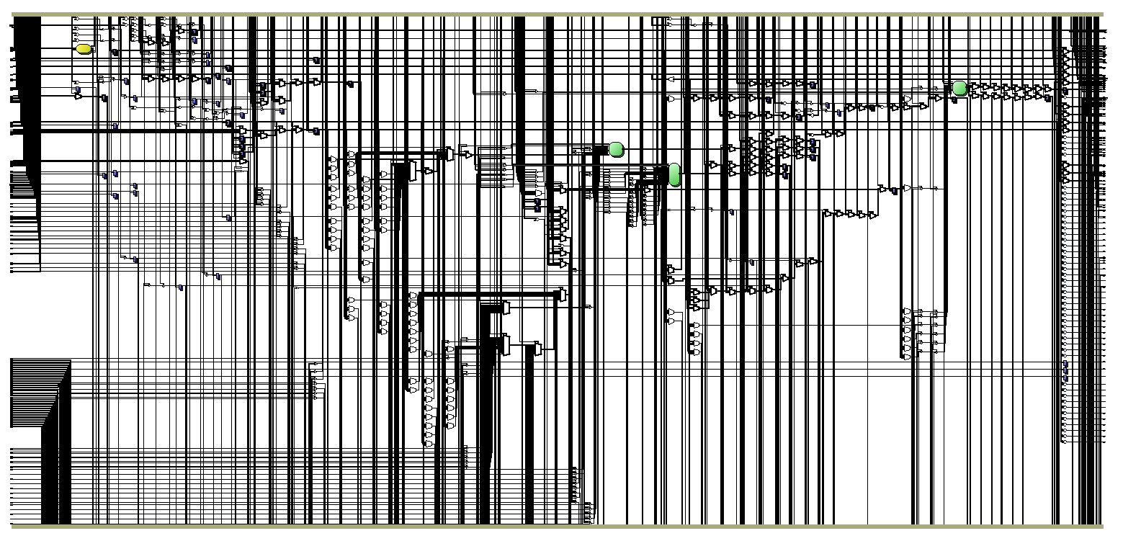
RTL of SIMD processor

Slide 16
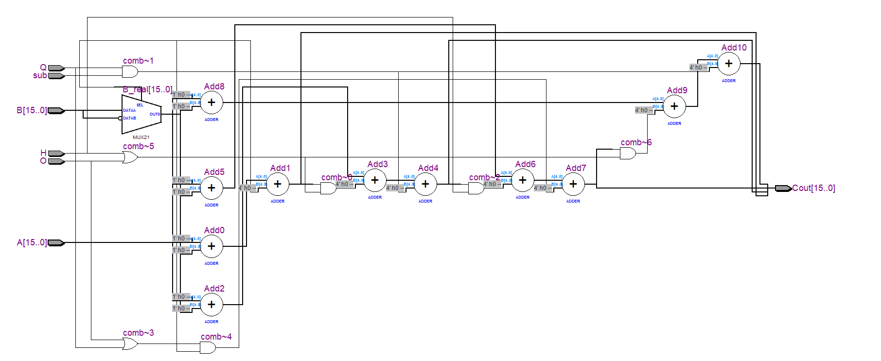
RTL of SIMD ADDER

Slide 17
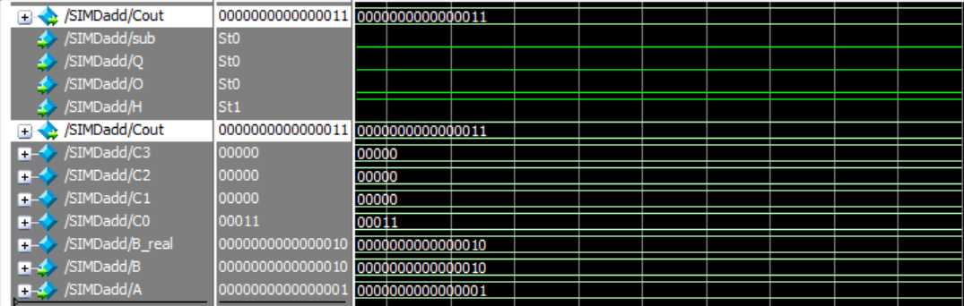
Simulation of Adder

Slide 18
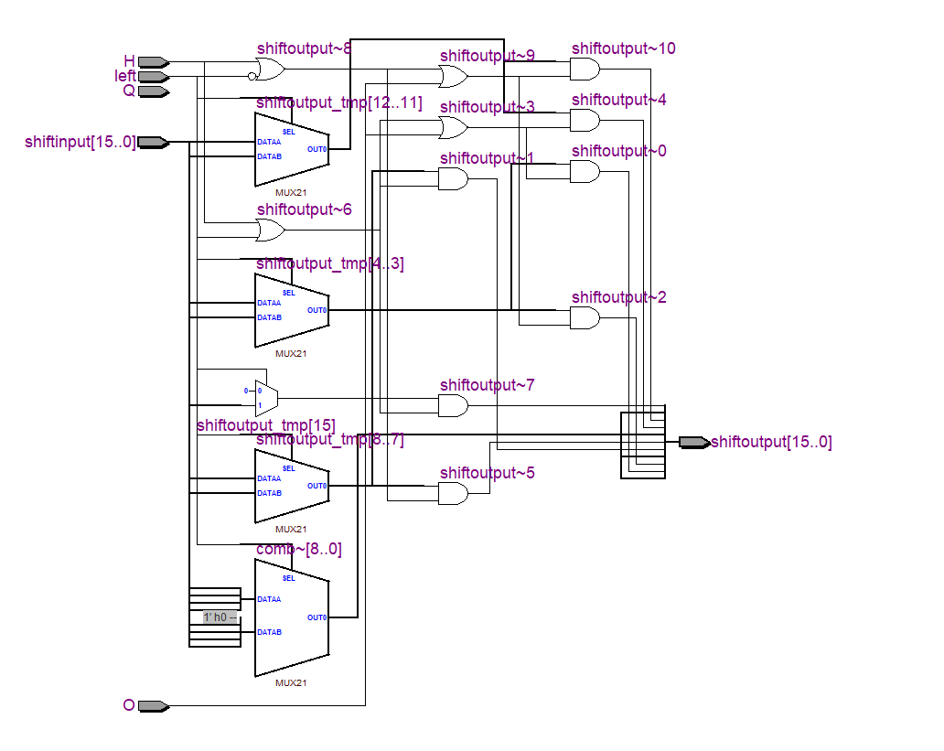
RTL of SIMD SHIFTER

Slide 19
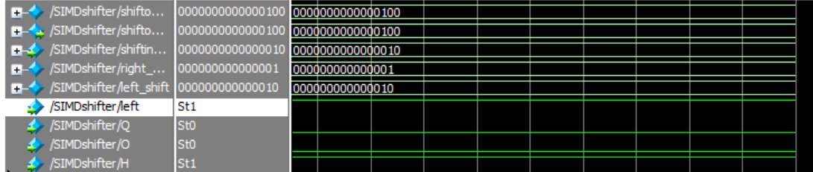
Simulation of Shifter

Slide 20
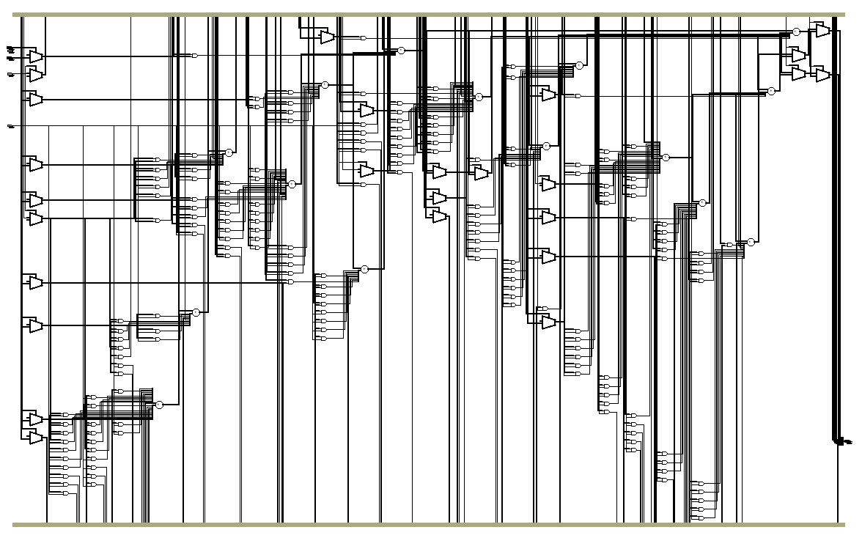
RTL of SIMD MULTIPLIER

Slide 21
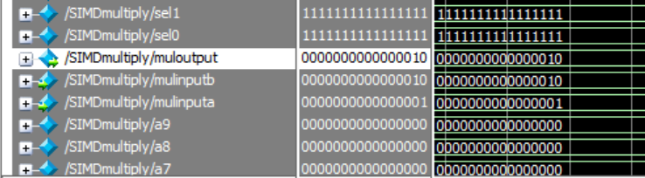
Simulation of Multiplier

Slide 22
Application of SIMD
Provide substantial speed up for
3D graphics
3D physics
Image processing
Signal processing
Numerical processing
Video encoding and decoding

Slide 23
Future Scope
With the new enhancements in the processor architectures, the current modern processors started supporting 256- bit vector implementations. Moreover, the interest on SIMD architectures by the computer architecture research community is increasing. Most CPU’s produced have SIMD architectures some of them are Intel SSE(Streaming SIMD Instructions) introduced in Pentium III processor and MMX ARM Neon introduced in Cortex-A8 and Cortex-A9 processors and MIPS MDMX. In the near future, the new powerful machines are expected to make new high-Performance multiple data applications available with the enhanced SIMD architectures.

Slide 24
Conclusion
There is no doubt that future processors will differ significantly from the current designs and will reshape the way of thinking about programming. SIMD is one of the most important advancements of modern CPUs. This project deals with SIMD and how you to realize a 16-bit SIMD processor using Verilog. SIMD architectures have numerous applications in the field of audio, video and signal processing systems. It also states that SIMD is used to increase the performance of the processor and details of work related to the topic and various tool and technologies used.

Slide 25
References
[1] Solmaz, G., Rahmatizadeh, R. and Ahmadian, M., A study on SIMD architecture.
[2] Li, S.Y., Cheuk, G.C., Lee, K.H. and Leong, P.H.W., 2003, April. FPGA-based SIMD processor. In 11th Annual IEEE Symposium on Field-Programmable Custom Computing Machines, 2003. FCCM 2003. (pp. 267-268). IEEE.
[3]https://www.fpga4student.com/2017/04/verilog-code-for-16-bit-risc-processor.html

