Slide 1
EBAY PERFORMANCE DASHBORD PRESENTATION
BY DEIRDRE GOUTA MMOLOTSA

Slide 2
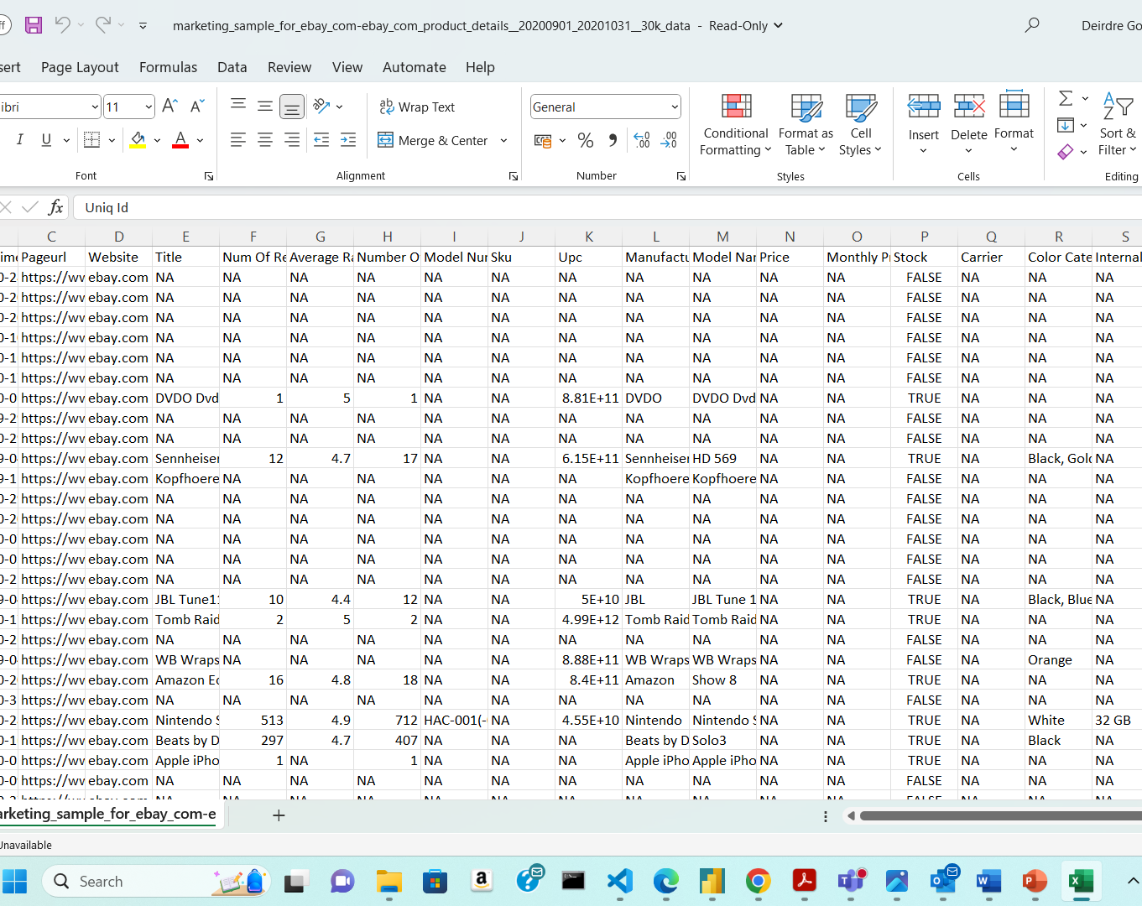
RAW DATA
This is a view of eBay’s raw dataset in excel. There are missing, inconsistent and repetitive values in the rows and columns.

Slide 3
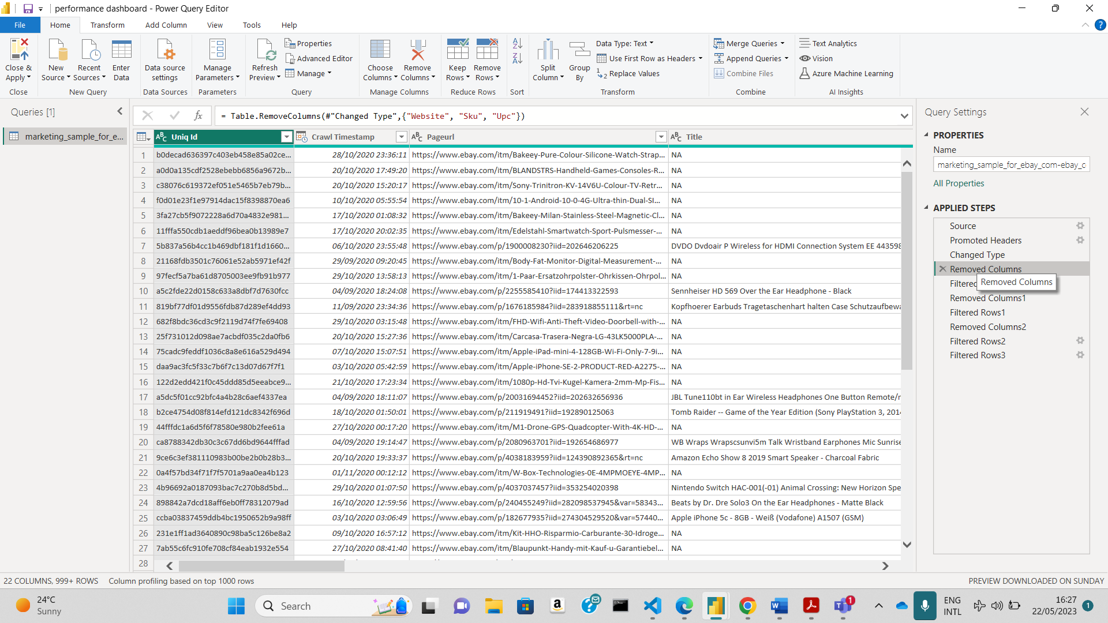
Dataset in power query editor
After extracting the excel file and saving it as a csv file to OneDrive, on the POWER BI APP, get data (as an excel sheet) and select transform data, which will automatically open POWER QUERY EDITOR.

Slide 4
Many operations / functions are applied to the different rows and columns to standardize the data.
Unnecessary columns were removed and rows were filtered to remove inconsistencies.
All steps taken to shape the data are recorded and each time the query connects to the data source, it automatically applies the steps to the dataset.
After standardizing the data, apply changes and close the Power BI Query Editor.

Slide 5
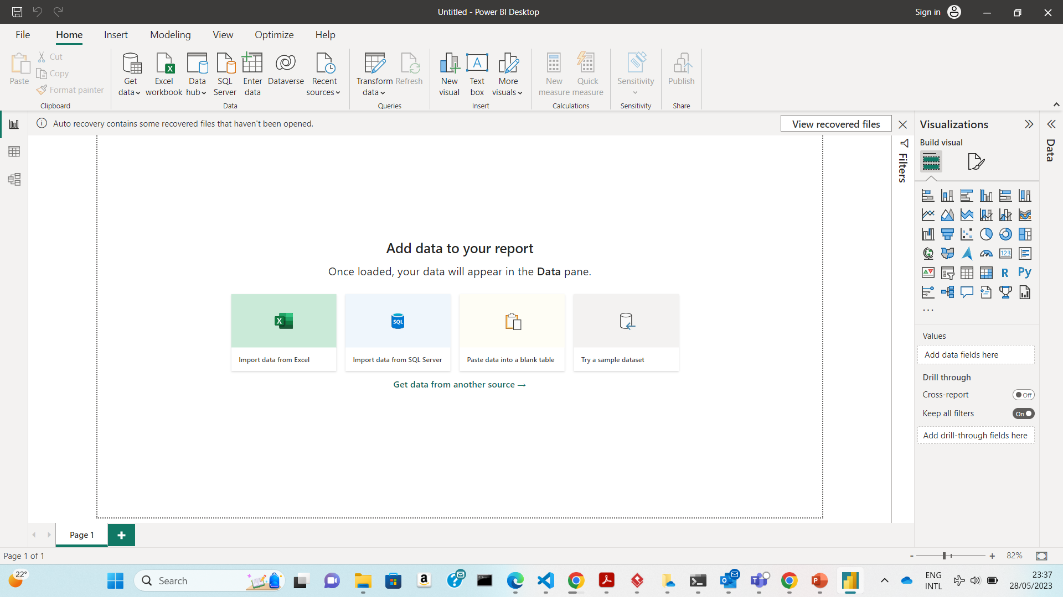
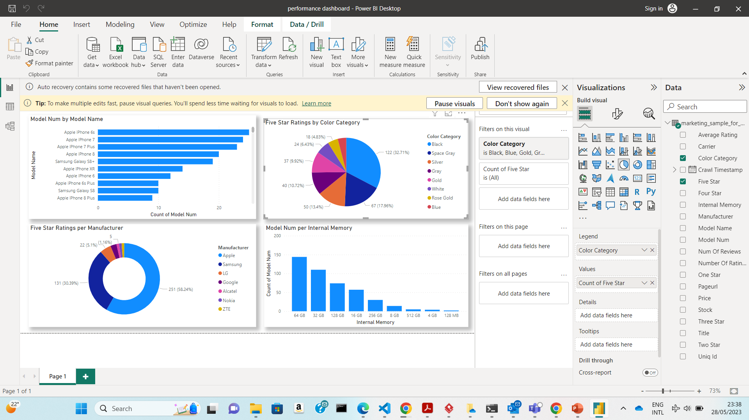
THE REPORT/ DASHBOARD
Building visuals, based on the standardized dataset on Power BI Report View
This is achieved by selecting graphs and charts( drag and drop on report pane) which will demonstrate how the data is related.
Filters are applied so that only data that we want to focus on appears on the visuals.

Slide 6

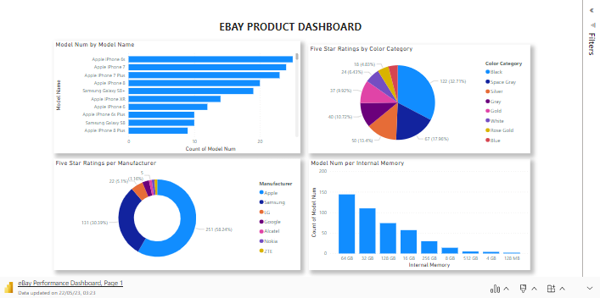
The REPORT FOCUSES THE NUMBER OF PHONES with a specific INTERNAL MEMORY type, Number of different model types and RATINGS OF THEIR MANUFACTURERS AND COLOR PREFERENCES..

Slide 7
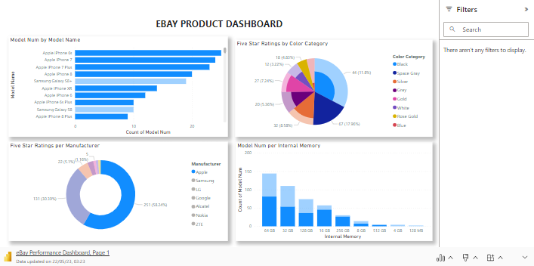
* This visual SHOWS THAT the manufacturer with the highest number of 5 star ratings is Apple and it has the highest phone model count as compared to other brands. * it also ILLUSTRATES that range of these iphones’ internal memory is fairly distributed across different STORAGE capacities. * IPHONES HAVE A VARIETY OF COLOR CATEGORIES TO CHOOSE FROM WHICH CORRELATE WITH THE AESTHETIC DESIGN OF THE DIFFERENT MODELS.

Slide 8
INTERNAL STORAGE?
The brand with the second highest number of five star rating is Samsung, which focuses on solely producing different models with an internal memory of 64GB.

Slide 9
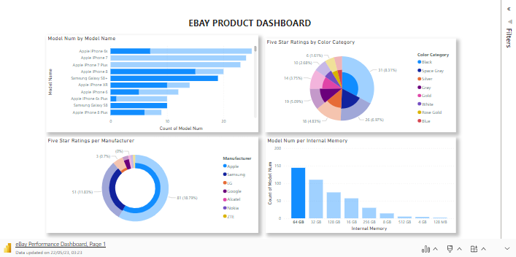
Microsoft Power BI

Slide 10
INTERNAL STORAGE?
Nokia being the only brand that has the lowest internal memory of 128MB, does not provide a wide variety of models and of different colour categories.
Therefore this could be a possible reason as to why it has the lowest number of five star ratings.

Slide 11
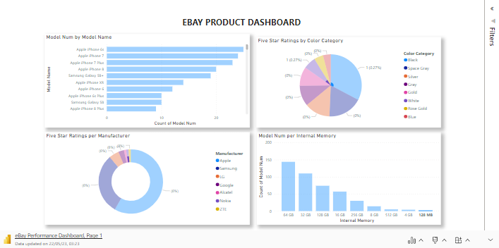
Microsoft Power BI

Slide 12
Conclusion
These insights can be used in analysis, to help brands focus on producing models which are highly preferred by customers instead of wasting resources to produce those that don’t even have good reviews.

