Slide 1
Java Database Connectivity (JDBC)

Slide 2
Introduction
Structured Query Language
  Queries relational databases
  Can write Java programs to use SQL queries
Host Language, combination of
    Data definition language (DDL) - defines database objects
    Data manipulation language (DML) - specifies processing
SQL has DDL and DML
Relational Database Model
  Logical representation of data
  Consider relationships between data
    Not concerned with implementation

Slide 3
Relational Database Model
Relational database
  Composed of tables
    Rows called records
    Columns are fields (attributes)
  First field usually primary key
    Unique for each record
    Primary key not required

Slide 4
Relational Database Model
Relational Database Structure
Table: Employee
Number
Name
Department
Salary
Location
23603
JONES, A.
413
1100
NEW JERSEY
24568
KERWIN, R.
413
2000
NEW JERSEY
A record
34589
LARSON, P.
642
1800
LOS ANGELES
35761
MYERS, B.
611
1400
ORLANDO
47132
NEUMANN, C.
413
9000
NEW JERSEY
78321
STEPHENS, T.
611
8000
ORLANDO
Primary Key
A column

Slide 5
Relational Database Model
Operations
  Projection
    Taking a subset of a table
  Join
    Combining tables to form a larger one

Slide 6
Relational Database Model
Table: Employee
Number
Name
Department
Salary
Location
23603
JONES, A.
413
1100
NEW JERSEY
24568
KERWIN, R.
413
2000
NEW JERSEY
34589
LARSON, P.
642
1800
LOS ANGELES
35761
MYERS, B.
611
1400
ORLANDO
47132
NEUMANN, C.
413
9000
NEW JERSEY
78321
STEPHENS, T.
611
8000
ORLANDO
Projection (subset)
Department
Location
413
NEW JERSEY
611
ORLANDO
642
LOS ANGELES

Slide 7
Relational Database Model
Advantages of relational databases
  Tables easy to use, understand, and implement
  Easy to convert other database structures into relational scheme
    Universal
  Projection and join operations easy to implement
  Easy to modify - very flexible
  Greater clarity and visibility than other models
OODBs

Slide 8
Relational Database Overview: The Books.mdb Database
Overview tables in Books.mdb database
  Used to introduce database concepts
  Consists of four tables
    Authors
    Publishers
    AuthorISBN
    Titles

Slide 9
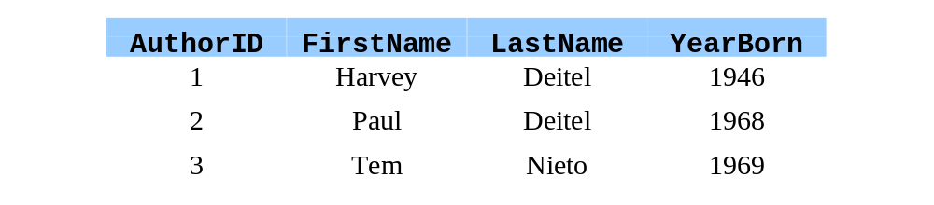
Relational Database Overview: The Books.mdb Database
Authors table
  Four fields
    AuthorID - ID number
    FirstName
    LastName
    YearBorn

Slide 10

Relational Database Overview: The Books.mdb Database
Publishers table
  Two fields
    PublisherID - ID number
    PublisherName - abbreviated name of publisher

Slide 11
Relational Database Overview: The Books.mdb Database
AuthorISBN table
  Two fields
    ISBN - ISBN number of book
    AuthorID - ID number of author
  Helps link author with title of book
  Table on next slide

Slide 12
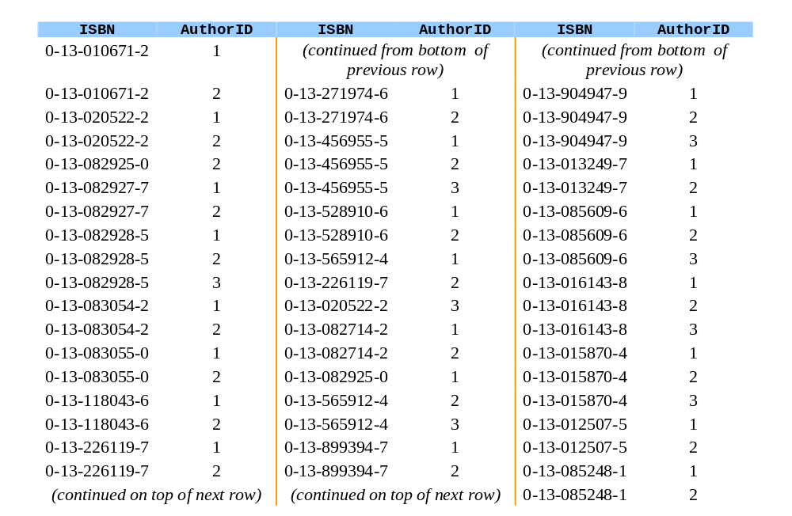
Relational Database Overview: The Books.mdb Database

Slide 13
Relational Database Overview: The Books.mdb Database
Titles table
  Six fields
    ISBN
    Title - title of book
    EditionNumber
    YearPublished
    Description
    PublisherID
  Table on next slide
    Description field not shown

Slide 14
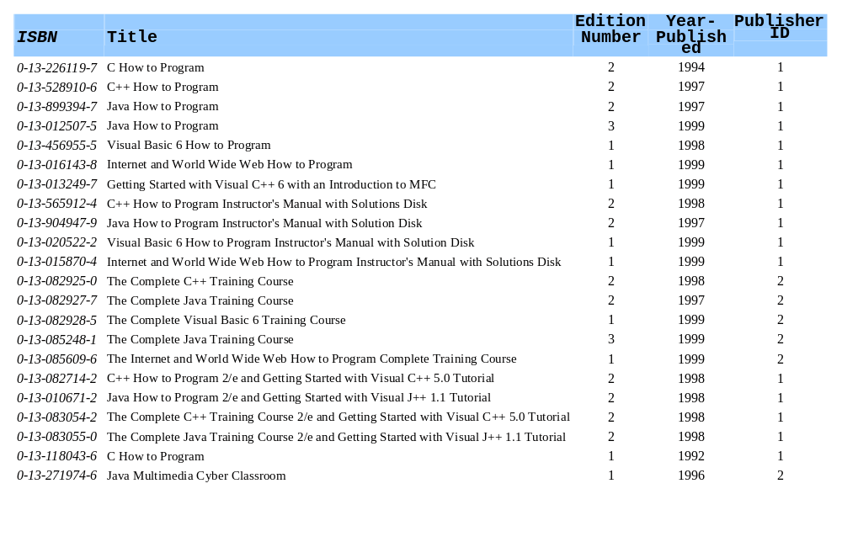
Relational Database Overview: The Books.mdb Database

Slide 15
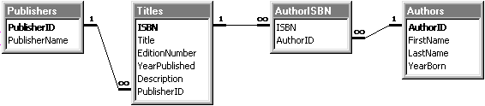
Relational Database Overview: The Books.mdb Database
Relationship between tables
  Primary key in bold
  Rule of Entity Integrity
    Every record has unique entry in primary key field

Slide 16
Relational Database Overview: The Books.mdb Database
Lines represent relationship
  Line between Publishers and Titles
    One to many relationship
    Every PublisherID can appear many times in Titles table
Foreign key
  Field in table that is primary field of another table
    Maintains Rule of Referential Integrity
    Used to join tables
    One to many relationship between primary key and corresponding foreign key
  PublisherID is foreign key in Titles table

Slide 17
Relational Database Overview: The Books.mdb Database
Other relationships
  One AuthorID can appear many times in AuthorISBN table
    Author wrote many books
  One ISBN can appear many times in AuthorISBN
    Book had multiple authors

Slide 18
Structured Query Language
Overview of SQL
  SQL keywords discussed in context of complete queries
    Some keywords beyond scope of text
  Used to
    Query a database
    Insert records into a database
    Update existing records in a database
SQL keywords
  SELECT, FROM, WHERE, GROUP BY, HAVING, ORDER BY

Slide 19
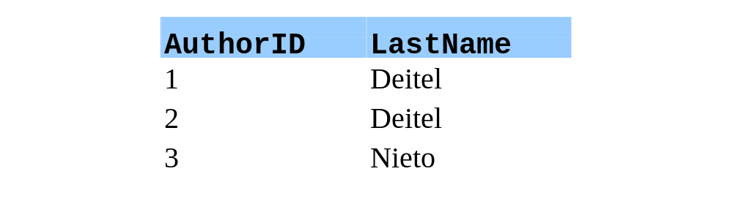
Basic SELECT Query
SELECT Query
  Selects information from one more tables
  Format
    SELECT * FROM TableName
    Asterisk * - select all
  SELECT * FROM Authors
    Selects entire Authors table
Selecting specific fields
  Replace asterisk (*) with comma separated list
    SELECT AuthorID, LastName FROM Authors
  Ordered left to right

Slide 20
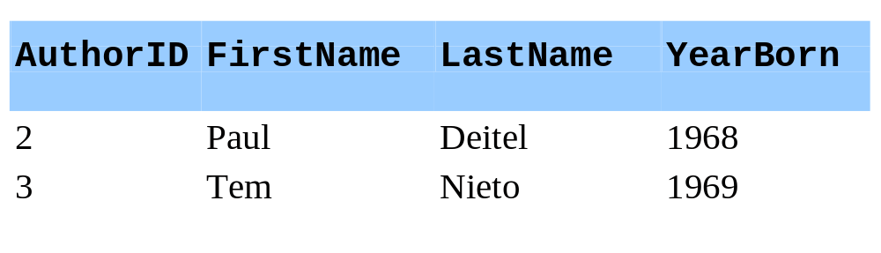
WHERE Clause
Selection with criteria
  Only select data that meets requirement
  SELECT * FROM TableName WHERE criteria
  Example
    SELECT * FROM Authors WHERE YearBorn > 1960

Slide 21
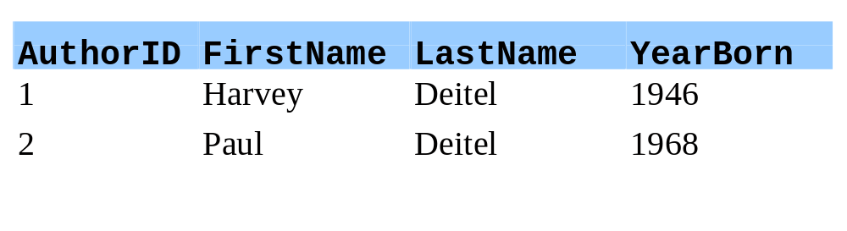
WHERE Clause
Conditions
  Can use <, >, <=, >=, =, <> and LIKE
  LIKE - used for pattern matching
    Search for similar strings
    Wildcard characters * and ?
  * - Any number of consecutive characters at asterisk's location
    SELECT * FROM Authors WHERE LastName LIKE 'd*'
    LastName starts with 'd' followed by any number of characters

Slide 22
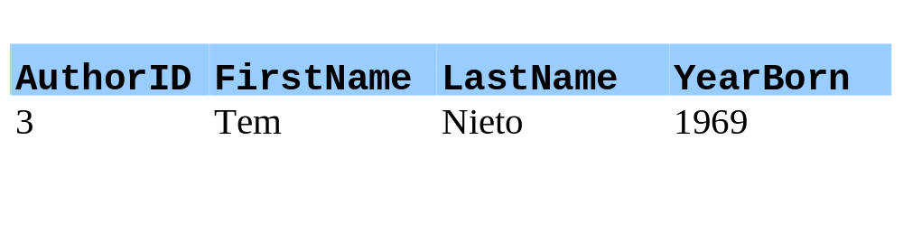
WHERE Clause
Conditions
  ? - any single character at location
  SELECT * FROM Authors WHERE LastName LIKE '?i*'
  LastName begins with any character, 'i' for second character, followed by any number of characters

Slide 23
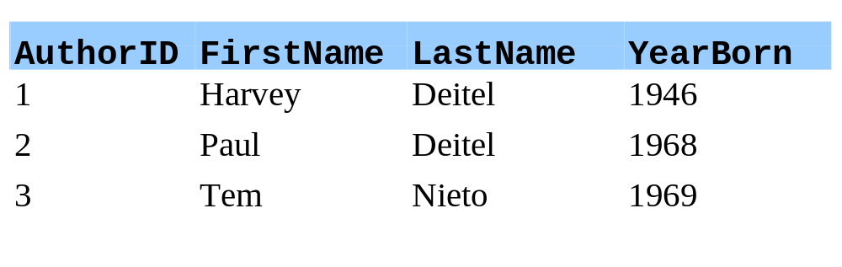
WHERE Clause
Conditions
  Range of characters
    [startValue-endValue]
  SELECT * FROM Authors WHERE LastName LIKE '?[a-i]*'
  Start with any letter, second letter between a and i, followed by any number of characters
    All authors fit range

Slide 24
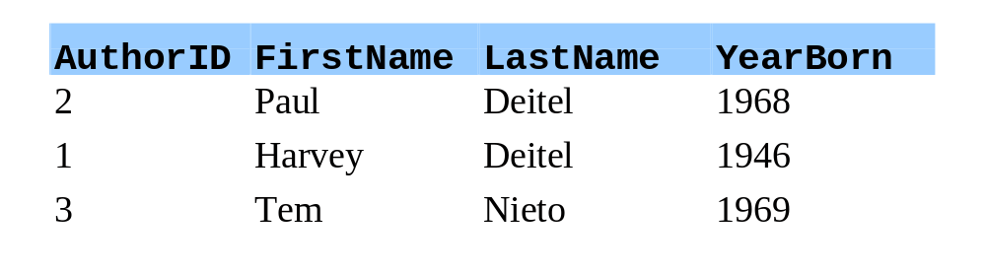
ORDER BY Clause
Arrange results in order
  SELECT * FROM TableName ORDER BY field ASC
  SELECT * FROM TableName ORDER BY field DESC
  field - field used to order
  ASC/DESC - ascending/descending sort
    ASC default
  SELECT * FROM Authors ORDER BY LastName ASC

Slide 25
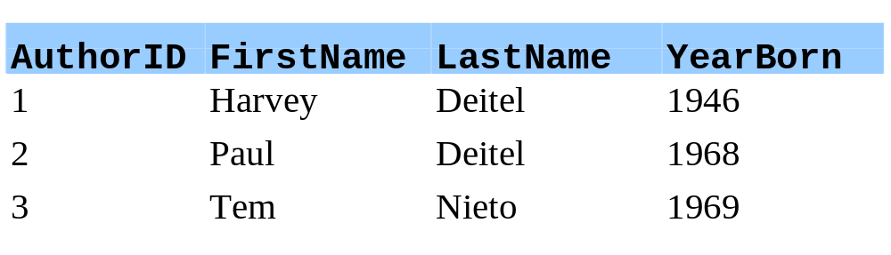
ORDER BY Clause
Multiple fields
  ORDER BY field1 SortingOrder, field2 SortingOrder, ...
  SortingOrder does not have to be same
  If field1 identical for two records, sorts by field2 in order specified
  SELECT * FROM Authors ORDER BY LastName, FirstName

Slide 26
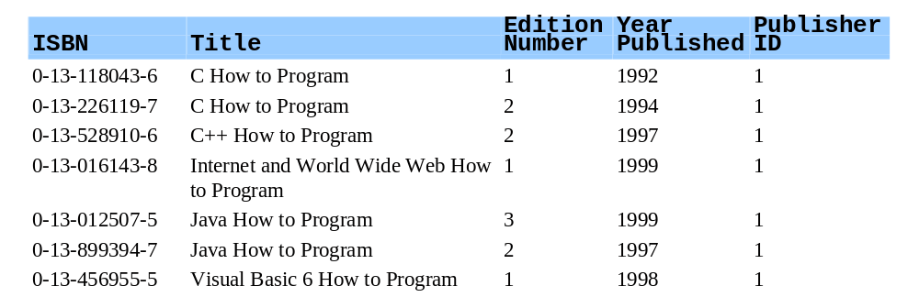
ORDER BY Clause
Combining clauses
  SELECT * FROM Titles
  WHERE Title LIKE '*How to Program'
  ORDER BY Title ASC
    Multiple lines for readability

Slide 27
Using INNER JOIN to Merge Data from Multiple Tables
Merging data
  Combine multiple tables (join) by merging records
  SELECT * FROM Table1 INNER JOIN Table2 ON Table1.field = Table2.field
    ON - "on condition that"
      Specifies fields to be compared for records to be merged
  Syntax
    If two tables have same field, use TableName.fieldName
    Can be used in any query to distinguish fields
  SELECT FirstName, LastName, ISBN
  FROM Authors INNER JOIN AuthorISBN
  ON Authors.AuthorID = AuthorISBN.AuthorID
  ORDER BY LastName, FirstName

Slide 28
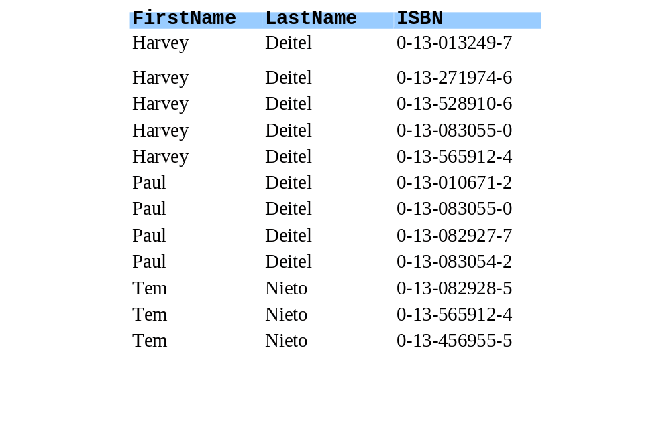
Using INNER JOIN to Merge Data from Multiple Tables
Portion of returned table

Slide 29
Query Example
Query Example
  --
    Returns table with book title, ISBN, first name, last name, year published, publisher's name
    Indentation for readability
    Go through step by step
1 SELECT Titles.Title, Titles.ISBN, Authors.FirstName,
2 Authors.LastName, Titles.YearPublished,
3 Publishers.PublisherName
4 FROM
5 (Publishers INNER JOIN Titles
6 ON Publishers.PublisherID = Titles.PublisherID)
7 INNER JOIN
8 (Authors INNER JOIN AuthorISBN ON
9 Authors.AuthorID = AuthorISBN.AuthorID)
10 ON Titles.ISBN = AuthorISBN.ISBN
11 ORDER BY Titles.Title

Slide 30
Query Example
  Specify order of fields to be returned
  Publishers and Titles tables joined ON condition that PublisherID matches
    Table returned, will be INNER JOINed with another
1 SELECT Titles.Title, Titles.ISBN, Authors.FirstName,
2 Authors.LastName, Titles.YearPublished,
3 Publishers.PublisherName
4 FROM
5 (Publishers INNER JOIN Titles
6 ON Publishers.PublisherID = Titles.PublisherID)

Slide 31
Query Example
8 (Authors INNER JOIN AuthorISBN ON
  INNER JOIN Authors and AuthorsISBN if AuthorID's match
    Remember, each AuthorISBN can have multiple authors
    Returns table
    INNER JOIN two returned tables, ON condition that ISBN fields match
9 Authors.AuthorID = AuthorISBN.AuthorID)
4 FROM
5 (Publishers INNER JOIN Titles
6 ON Publishers.PublisherID = Titles.PublisherID)
7 INNER JOIN
8 (Authors INNER JOIN AuthorISBN ON
9 Authors.AuthorID = AuthorISBN.AuthorID)
10 ON Titles.ISBN = AuthorISBN.ISBN

Slide 32
Query Example
  Ascending order (default) by Title
11 ORDER BY Titles.Title

Slide 33
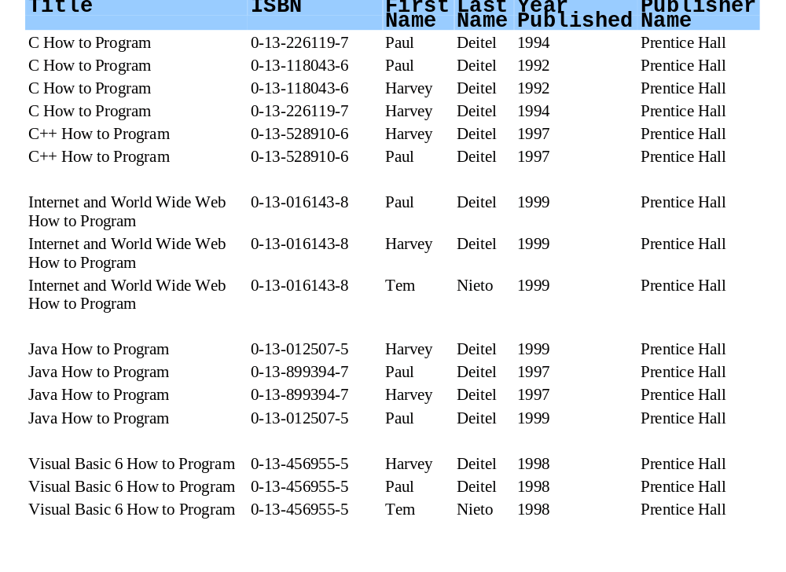
TitleAuthor Query from Books.mdb

Slide 34
A First Example
Perform query on Books.mdb database
  Connect to database
  Query
  Display results
  Has classes and interfaces for using relational databases
  Declares Connection reference
    Implements interface Connection
    Manages connection between database and program
4 import java.sql.*;
11 private Connection connection;

Slide 35
A First Example
  Database URL (location), username to log in, password
  URL
    Protocol for communication (jdbc)
    Subprotocol (odbc) - indicates Microsoft ODBC data source
      ODBC allows generic access to database systems
      Driver allowing Java to access any ODBC source:
        sun.jdbc.odbc.JdbcOdbcDriver
    Database name (Books)
19 String url = "jdbc:odbc:Books";
20 String username = "anonymous";
21 String password = "guest";

Slide 36
A First Example
25 Class.forName( "sun.jdbc.odbc.JdbcOdbcDriver" );
  static method forName (class Class)
    Load class definition for database driver (complete package name)
    Throws ClassNotFoundException
  static method getConnection (class DriverManager)
    Attempt connection to database
    Name and password required (set up that way in 18.6.1)
27 connection = DriverManager.getConnection(
28 url, username, password );

Slide 37
A First Example
49 Statement statement;
  Statement object (implements interface Statement)
    Submits query to database
    Method createStatement (of Connection)
  Method executeQuery (of Statement)
    Returns ResultSet object containing results
  statement closed when done
55 statement = connection.createStatement();
50 ResultSet resultSet;
53 String query = "SELECT * FROM Authors";
56 resultSet = statement.executeQuery( query );
58 statement.close();

Slide 38
A First Example
  In method displayResultSet
  Method next (of ResultSet)
    Positions to the next record
    Initially starts before first record
    Returns true if positioned to next record
  Create Vectors to store column names and rows
    Vector - array like class, can dynamically grow and shrink
      Method addElement( element )
    Used to initialize JTable (later)
69 boolean moreRecords = rs.next();
81 Vector columnHeads = new Vector();
82 Vector rows = new Vector();

Slide 39
A First Example
86 ResultSetMetaData rsmd = rs.getMetaData();
  Gets meta data
    Class ResultSetMetaData
    Describes contents of a ResultSet
      Gets names of column heads
      Process ResultSet dynamically
  Methods getColumnCount, getColumnName
    Class ResultSetMetaData
    Returns number and name of columns in ResultSet
88 for ( int i = 1; i <= rsmd.getColumnCount(); ++i )
89 columnHeads.addElement( rsmd.getColumnName( i ) );

Slide 40
A First Example
92 do {
  Call utility method getNextRow
    Returns a Vector containing data for one row
  rs.next
    Moves cursor (current record)
    When no more, returns false (ends loop)
  JTable GUI component
    Constructor - takes Vector of Vectors (like a double scripted array) for row data, another Vector for column heads
93 rows.addElement( getNextRow( rs, rsmd ) );
94 } while ( rs.next() );
97 table = new JTable( rows, columnHeads );

Slide 41
A First Example
108 private Vector getNextRow( ResultSet rs,
109 ResultSetMetaData rsmd )
110 throws SQLException
  Utility method getNextRow
    Returns Vector containing data for one row
111 {
112 Vector currentRow = new Vector();

Slide 42
A First Example
114 for ( int i = 1; i <= rsmd.getColumnCount(); ++i )
115 switch( rsmd.getColumnType( i ) ) {
  Method getColumnType (of ResultSetMetaData)
    Returns constant integer (of class Types)
      Types.VARCHAR - strings
      Types.INTEGER - long integers
  Method getString( i ), getLong( i )
    Class ResultSet
    Returns contents of column i
  Terminates connection
116 case Types.VARCHAR:
117 currentRow.addElement( rs.getString( i ) );
119 case Types.INTEGER:
120 currentRow.addElement(
121 new Long( rs.getLong( i ) ) );
134 connection.close();

Slide 43
1 // Fig. 18.24: TableDisplay.java
2 // This program displays the contents of the Authors table
3 // in the Books database.
1. import
1.1 Declarations
1.2 Constructor
1.3 url, username, password
1.4 forName
1.5. getConnection
4 import java.sql.*;
Import the sql package.
5 import javax.swing.*;
6 import java.awt.*;
7 import java.awt.event.*;
8 import java.util.*;
9
10 public class TableDisplay extends JFrame {
Specify url, username, and password. The database has password protection (next section).
11 private Connection connection;
12 private JTable table;
13
14 public TableDisplay()
15 {
16 // The URL specifying the Books database to which
17 // this program connects using JDBC to connect to a
18 // Microsoft ODBC database.
19 String url = "jdbc:odbc:Books";
Load class definition for database driver (static method Class.forName).
20 String username = "anonymous";
21 String password = "guest";
22
23 // Load the driver to allow connection to the database
Attempt to connect to database. Use static method getConnection, of class DriverManager (java.sql).
24 try {
25 Class.forName( "sun.jdbc.odbc.JdbcOdbcDriver" );
26
27 connection = DriverManager.getConnection(
28 url, username, password );

Slide 44
29 }
30 catch ( ClassNotFoundException cnfex ) {
31 System.err.println(
2. Method getTable
2.1 createStatement
2.2 executeQuery
32 "Failed to load JDBC/ODBC driver." );
33 cnfex.printStackTrace();
34 System.exit( 1 ); // terminate program
35 }
36 catch ( SQLException sqlex ) {
37 System.err.println( "Unable to connect" );
38 sqlex.printStackTrace();
39 }
40
41 getTable();
42
43 setSize( 450, 150 );
44 show();
45 }
46
47 private void getTable()
48 {
49 Statement statement;
Create a Statement object that will query the database.
50 ResultSet resultSet;
51
52 try {
53 String query = "SELECT * FROM Authors";
54
Returns a ResultSet object containing results.
55 statement = connection.createStatement();
56 resultSet = statement.executeQuery( query );

Slide 45
57 displayResultSet( resultSet );
statement closed when not needed.
58 statement.close();
59 }
2.3 close
3. Method displayResultSet
3.1 next
3.2 Vector
3.3 getMetaData
60 catch ( SQLException sqlex ) {
61 sqlex.printStackTrace();
62 }
63 }
64
65 private void displayResultSet( ResultSet rs )
66 throws SQLException
67 {
Positions to first record in ResultSet (initially before first record).
68 // position to first record
69 boolean moreRecords = rs.next();
70
71 // If there are no records, display a message
72 if ( ! moreRecords ) {
73 JOptionPane.showMessageDialog( this,
74 "ResultSet contained no records" );
Create new Vectors, similar to dynamic arrays.
75 setTitle( "No records to display" );
76 return;
77 }
78
79 setTitle( "Authors table from Books" );
80
81 Vector columnHeads = new Vector();
Get meta data, which describes contents of ResultSet.
82 Vector rows = new Vector();
83
84 try {
85 // get column heads
86 ResultSetMetaData rsmd = rs.getMetaData();

Slide 46
87
88 for ( int i = 1; i <= rsmd.getColumnCount(); ++i )
89 columnHeads.addElement( rsmd.getColumnName( i ) );
3.4 getColumnCount
3.5 getColumnName
3.6 getNextRow
3.7 JTable
4. getNextRow
90
Get names of column heads, add to Vector.
91 // get row data
92 do {
93 rows.addElement( getNextRow( rs, rsmd ) );
94 } while ( rs.next() );
Utility method getNextRow returns a Vector with row data. Creates a Vector of Vectors (like double scripted array).
95
96 // display table with ResultSet contents
97 table = new JTable( rows, columnHeads );
98 JScrollPane scroller = new JScrollPane( table );
99 getContentPane().add(
100 scroller, BorderLayout.CENTER );
Create a JTable, takes Vector of Vectors and Vector of column heads.
101 validate();
102 }
103 catch ( SQLException sqlex ) {
104 sqlex.printStackTrace();
105 }
106 }
107
108 private Vector getNextRow( ResultSet rs,
109 ResultSetMetaData rsmd )
110 throws SQLException
Create Vector to hold one row of data.
111 {
112 Vector currentRow = new Vector();
113

Slide 47
114 for ( int i = 1; i <= rsmd.getColumnCount(); ++i )
115 switch( rsmd.getColumnType( i ) ) {
116 case Types.VARCHAR:
4.1 getColumnType
4.2 getString
4.3 getLong
5. Method shutDown
5. close
117 currentRow.addElement( rs.getString( i ) );
118 break;
119 case Types.INTEGER:
120 currentRow.addElement(
Test for column type, add appropriate type of element to Vector.
121 new Long( rs.getLong( i ) ) );
122 break;
123 default:
124 System.out.println( "Type was: " +
125 rsmd.getColumnTypeName( i ) );
126 }
127
128 return currentRow;
129 }
130
131 public void shutDown()
132 {
133 try {
134 connection.close();
135 }
136 catch ( SQLException sqlex ) {
137 System.err.println( "Unable to disconnect" );
138 sqlex.printStackTrace();
139 }
140 }
141

Slide 48
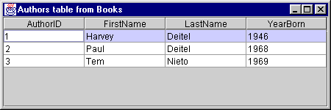
142 public static void main( String args[] )
143 {
144 final TableDisplay app = new TableDisplay();
6. main
Program Output
145
146 app.addWindowListener(
147 new WindowAdapter() {
148 public void windowClosing( WindowEvent e )
149 {
150 app.shutDown();
151 System.exit( 0 );
152 }
153 }
154 );
155 }
156 }

Slide 49
Registering Books.mdb as an ODBC Data Source
Preceding example
  Assumes Books.mdb already registered as ODBC data source
  Need Microsoft Access installed
  Animated walkthrough of setup

Slide 50
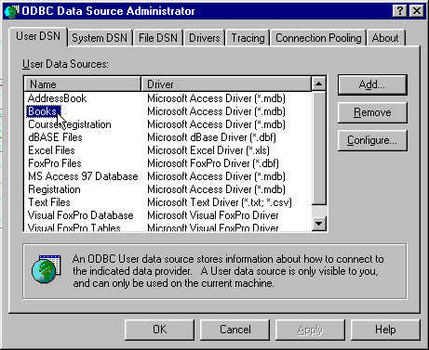
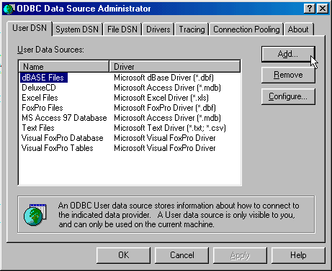
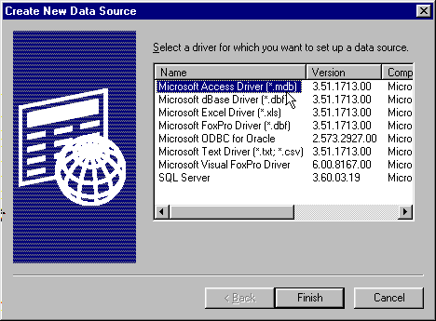
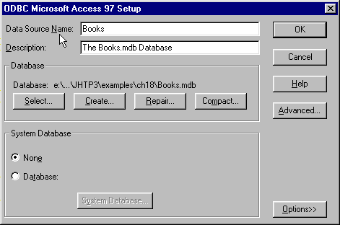
Registering Books.mdb as an ODBC Data Source
Setup dialog appears. Enter name used to reference database and description (optional).
Use Select... to choose database file.
Use Advanced... to create a username (anonymous) and password (guest). When done, click OK
ODBC Data Source Administrator now has Books. We can now access ODBC data source using JDBC to ODBC driver.
The data source must be registered with system. Go to Control Panel -> ODBC Data Source Administrator.
This allows us to register our User Data Source Name.
Go to the User DSN tab and click Add...
We are using Access, so select Microsoft Access Driver, then Finish

Slide 51
Querying the Books.mdb Database
Enhance previous program
  Allow user to enter any query into program
  Utility method getTable gets text from JTextArea
    Creates Statement, executes query as before

Slide 52
1 // Fig. 18.29: DisplayQueryResults.java
2 // This program displays the ResultSet returned by a
3 // query on the Books database.
1. import
1.1 Declarations
1.2 Constructor
4 import java.sql.*;
5 import javax.swing.*;
6 import java.awt.*;
7 import java.awt.event.*;
8 import java.util.*;
9
10 public class DisplayQueryResults extends JFrame {
11 // java.sql types needed for database processing
12 private Connection connection;
13 private Statement statement;
14 private ResultSet resultSet;
15
16 private ResultSetMetaData rsMetaData;
17
18 // javax.swing types needed for GUI
19 private JTable table;
20 private JTextArea inputQuery;
21 private JButton submitQuery;
22
23 public DisplayQueryResults()
24 {
25 super( "Enter Query. Click Submit to See Results." );
26
27 // The URL specifying the Books database to which
28 // this program connects using JDBC to connect to a

Slide 53
29 // Microsoft ODBC database.
30 String url = "jdbc:odbc:Books";
31 String username = "anonymous";
2. Connect to database
2.1 GUI
32 String password = "guest";
33
34 // Load the driver to allow connection to the database
35 try {
36 Class.forName( "sun.jdbc.odbc.JdbcOdbcDriver" );
37
38 connection = DriverManager.getConnection(
39 url, username, password );
40 }
41 catch ( ClassNotFoundException cnfex ) {
42 System.err.println(
43 "Failed to load JDBC/ODBC driver." );
44 cnfex.printStackTrace();
45 System.exit( 1 ); // terminate program
46 }
47 catch ( SQLException sqlex ) {
48 System.err.println( "Unable to connect" );
49 sqlex.printStackTrace();
50 System.exit( 1 ); // terminate program
Create JTextArea for user to enter query.
51 }
52
53 // If connected to database, set up GUI
54 inputQuery =
55 new JTextArea( "SELECT * FROM Authors", 4, 30 );
56 submitQuery = new JButton( "Submit query" );

Slide 54
57 submitQuery.addActionListener(
58 new ActionListener() {
59 public void actionPerformed( ActionEvent e )
2.2 Event handler (call getTable)
2.3 GUI
60 {
61 if ( e.getSource() == submitQuery )
62 getTable();
63 }
64 }
65 );
66
67 JPanel topPanel = new JPanel();
68 topPanel.setLayout( new BorderLayout() );
69
70 topPanel.add( new JScrollPane( inputQuery),
71 BorderLayout.CENTER );
72 topPanel.add( submitQuery, BorderLayout.SOUTH );
73
74 table = new JTable( 4, 4 );
75
76 Container c = getContentPane();
77 c.setLayout( new BorderLayout() );
78 c.add( topPanel, BorderLayout.NORTH );
79 c.add( table, BorderLayout.CENTER );
80
81 getTable();
82
83 setSize( 500, 500 );
84 show();
85 }
86

Slide 55
87 private void getTable()
88 {
89 try {
3. Methods getTable and displayResultSet as before
90 String query = inputQuery.getText();
91
92 statement = connection.createStatement();
93 resultSet = statement.executeQuery( query );
94 displayResultSet( resultSet );
95 }
96 catch ( SQLException sqlex ) {
97 sqlex.printStackTrace();
98 }
99 }
100
101 private void displayResultSet( ResultSet rs )
102 throws SQLException
103 {
104 // position to first record
105 boolean moreRecords = rs.next();
106
107 // If there are no records, display a message
108 if ( ! moreRecords ) {
109 JOptionPane.showMessageDialog( this,
110 "ResultSet contained no records" );
111 setTitle( "No records to display" );
112 return;
113 }
114

Slide 56
115 Vector columnHeads = new Vector();
116 Vector rows = new Vector();
117
118 try {
119 // get column heads
120 ResultSetMetaData rsmd = rs.getMetaData();
121
122
123 for ( int i = 1; i <= rsmd.getColumnCount(); ++i )
124 columnHeads.addElement( rsmd.getColumnName( i ) );
125
126 // get row data
127 do {
128 rows.addElement( getNextRow( rs, rsmd ) );
129 } while ( rs.next() );
130
131 // display table with ResultSet contents
132 table = new JTable( rows, columnHeads );
133 JScrollPane scroller = new JScrollPane( table );
134 Container c = getContentPane();
135 c.remove( 1 );
136 c.add( scroller, BorderLayout.CENTER );
137 c.validate();
138 }
139 catch ( SQLException sqlex ) {
140 sqlex.printStackTrace();
141 }
142 }
143

Slide 57
144 private Vector getNextRow( ResultSet rs,
145 ResultSetMetaData rsmd )
146 throws SQLException
4. Methods getNextRow and Shutdown as before
147 {
148 Vector currentRow = new Vector();
149
150 for ( int i = 1; i <= rsmd.getColumnCount(); ++i )
151 switch( rsmd.getColumnType( i ) ) {
152 case Types.VARCHAR:
153 case Types.LONGVARCHAR:
154 currentRow.addElement( rs.getString( i ) );
155 break;
156 case Types.INTEGER:
157 currentRow.addElement(
158 new Long( rs.getLong( i ) ) );
159 break;
160 default:
161 System.out.println( "Type was: " +
162 rsmd.getColumnTypeName( i ) );
163 }
164
165 return currentRow;
166 }
167
168 public void shutDown()
169 {
170 try {
171 connection.close();
172 }

Slide 58
173 catch ( SQLException sqlex ) {
174 System.err.println( "Unable to disconnect" );
175
5. main
176 sqlex.printStackTrace();
177 }
178 }
179
180 public static void main( String args[] )
181 {
182 final DisplayQueryResults app =
183 new DisplayQueryResults();
184
185 app.addWindowListener(
186 new WindowAdapter() {
187 public void windowClosing( WindowEvent e )
188 {
189 app.shutDown();
190 System.exit( 0 );
191 }
192 }
193 );
194 }
195 }
196

Slide 59
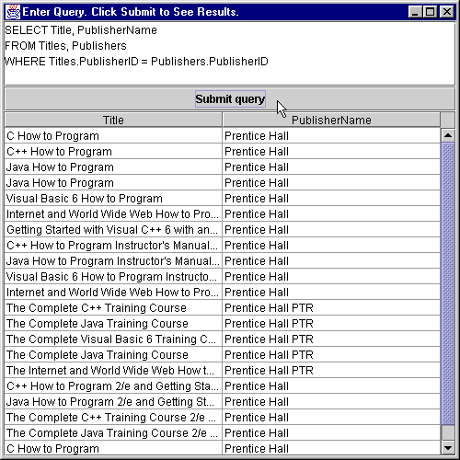
Program Output

Slide 60
Reading, Inserting, and Updating a Microsoft Access database
Upcoming example
  Manipulates a simple address book
  AddressBook database has one table with 11 columns
    ID, FirstName, LastName, Address, City, StateOrProvince, PostalCode, Country, EmailAddress, HomePhone and FaxNumber
    All strings except ID, a long integer
  Create database as an ODBC data source, access using JDBC to ODBC bridge database driver

Slide 61
Reading, Inserting, and Updating a Microsoft Access database
Classes
  AddressBook
    Driver, sets up GUI, contains main
  Event handling classes:
    AddRecord - Add button
    FindRecord - Find button
    UpdateRecord - Update button
    Help - Help button
    ClearFields - Clear button
  ScrollingPanel
    Contains JTextFields for making queries
  ControlPanel
    Creates buttons and registers event handlers

Slide 62
Reading, Inserting, and Updating a Microsoft Access database
Class AddressBook
  Adds ControlPanel and ScrollingPanel objects to content pane
    Add JTextArea for status window
  Connects to database using previous techniques
23 scrollArea = new ScrollingPanel();
26 c.add( new JScrollPane( scrollArea ),
27 BorderLayout.CENTER );
28 textpane = new JScrollPane( output );
29 c.add( textpane, BorderLayout.SOUTH );
59 controls =
60 new ControlPanel( connect, scrollArea, output);
61 c.add( controls, BorderLayout.NORTH );

Slide 63
1 // Fig. 18.30: AddressBook.java
2 // Inserting into, updating and searching through a database
3 import java.sql.*;
1. import
1.1 Declarations
2. Constructor
2.1 GUI components
4 import java.awt.*;
5 import java.awt.event.*;
6 import javax.swing.*;
7
8 public class AddressBook extends JFrame {
9 private ControlPanel controls;
10 private ScrollingPanel scrollArea;
11 private JTextArea output;
12 private String url;
13 private Connection connect;
14 private JScrollPane textpane;
15
16 public AddressBook()
17 {
18 super( "Address Book Database Application" );
19
20 Container c = getContentPane();
21
22 // Start screen layout
23 scrollArea = new ScrollingPanel();
24 output = new JTextArea( 6, 30 );
25 c.setLayout( new BorderLayout() );
26 c.add( new JScrollPane( scrollArea ),
27 BorderLayout.CENTER );
28 textpane = new JScrollPane( output );
29 c.add( textpane, BorderLayout.SOUTH );

Slide 64
30
31 // Set up database connection
32 try {
2.2 Connect to database
33 url = "jdbc:odbc:AddressBook";
34
35 Class.forName( "sun.jdbc.odbc.JdbcOdbcDriver" );
36 connect = DriverManager.getConnection( url );
37 output.append( "Connection successful\n" );
38 }
39 catch ( ClassNotFoundException cnfex ) {
40 // process ClassNotFoundExceptions here
41 cnfex.printStackTrace();
42 output.append( "Connection unsuccessful\n" +
43 cnfex.toString() );
44 }
45
46 catch ( SQLException sqlex ) {
47 // process SQLExceptions here
48 sqlex.printStackTrace();
49 output.append( "Connection unsuccessful\n" +
50 sqlex.toString() );
51 }
52 catch ( Exception ex ) {
53 // process remaining Exceptions here
54 ex.printStackTrace();
55 output.append( ex.toString() );
56 }
57

Slide 65
58 // Complete screen layout
59 controls =
60 new ControlPanel( connect, scrollArea, output);
3. main
61 c.add( controls, BorderLayout.NORTH );
62
63 setSize( 500, 500 );
64 show();
65 }
66
67 public static void main( String args[] )
68 {
69 AddressBook app = new AddressBook();
70
71 app.addWindowListener(
72 new WindowAdapter() {
73 public void windowClosing( WindowEvent e )
74 {
75 System.exit( 0 );
76 }
77 }
78 );
79 }
80 }
81

Slide 66
Reading, Inserting, and Updating a Microsoft Access database
Class AddRecord
  Event handling class for Add button
  Constructor
    Connection - creates Statement for manipulating database
    ScrollingPanel - has JTextFields
    JTextArea - output area for messages
  Create Statement
94 public AddRecord( Connection c, ScrollingPanel f,
95 JTextArea o )
105 Statement statement = connection.createStatement();

Slide 67
Reading, Inserting, and Updating a Microsoft Access database
SQL statement for inserting data
  INSERT INTO tableName ( columnName1, columnName2,... )
  VALUES ( 'value1', 'value2', ... )
  Columns to be updated in comma-separated list
  Value for columns specified comma-separated list after VALUES
  Create INSERT INTO statement using JTextFields
109 String query = "INSERT INTO addresses (" +
110 "firstname, lastname, address, city, " +

Slide 68
Reading, Inserting, and Updating a Microsoft Access database
  Method executeUpdate
    Updates database
    Returns 1 if successful
    Clear fields if unsuccessful
127 int result = statement.executeUpdate( query );
129 if ( result == 1 )
130 output.append( "\nInsertion successful\n" );

Slide 69
82 // Fig. 18.30: AddRecord.java
83 // Class AddRecord definition
84 import java.awt.*;
1. import
1.1 Declarations
1.2 Constructor
2. actionPerformed
2.1 createStatement
2.2 INSERT INTO
85 import java.awt.event.*;
86 import java.sql.*;
87 import javax.swing.*;
88
89 public class AddRecord implements ActionListener {
90 private ScrollingPanel fields;
91 private JTextArea output;
92 private Connection connection;
93
94 public AddRecord( Connection c, ScrollingPanel f,
95 JTextArea o )
96 {
97 connection = c;
98 fields = f;
99 output = o;
100 }
101
Use the column names for the INSERT INTO statement.
102 public void actionPerformed( ActionEvent e )
103 {
104 try {
105 Statement statement = connection.createStatement();
106
107 if ( !fields.last.getText().equals( "" ) &&
108 !fields.first.getText().equals( "" ) ) {
109 String query = "INSERT INTO addresses (" +
110 "firstname, lastname, address, city, " +

Slide 70
111 "stateorprovince, postalcode, country, " +
112 "emailaddress, homephone, faxnumber" +
113 ") VALUES ('" +
2.3 getText
2.4 executeUpdate
114 fields.first.getText() + "', '" +
115 fields.last.getText() + "', '" +
116 fields.address.getText() + "', '" +
117 fields.city.getText() + "', '" +
Access JTextArea instance variables of fields (a ScrollingPanel object).
Use text in VALUES.
118 fields.state.getText() + "', '" +
119 fields.zip.getText() + "', '" +
120 fields.country.getText() + "', '" +
121 fields.email.getText() + "', '" +
122 fields.home.getText() + "', '" +
123 fields.fax.getText() + "')";
124 output.append( "\nSending query: " +
125 connection.nativeSQL( query )
126 + "\n" );
127 int result = statement.executeUpdate( query );
128
129 if ( result == 1 )
130 output.append( "\nInsertion successful\n" );
Attempt to update the database
131 else {
132 output.append( "\nInsertion failed\n" );
133 fields.first.setText( "" );
134 fields.last.setText( "" );
135 fields.address.setText( "" );
136 fields.city.setText( "" );
137 fields.state.setText( "" );
138 fields.zip.setText( "" );
139 fields.country.setText( "" );

Slide 71
140 fields.email.setText( "" );
141 fields.home.setText( "" );
142 fields.fax.setText( "" );
143 }
144 }
145
146 else
147 output.append( "\nEnter at least first and " +
148 "last name then press Add\n" );
149
150 statement.close();
151 }
152 catch ( SQLException sqlex ) {
153 sqlex.printStackTrace();
154 output.append( sqlex.toString() );
155 }
156 }
157 }
158

Slide 72
Reading, Inserting, and Updating a Microsoft Access database
Class FindRecord
  Event handler for Find button
  Searches AddressBook database using last name
    Creates Statement from connection
  Use query:
    SELECT * FROM addresses
    WHERE lastname = 'Name entered by user'
  Submits query, returns ResultSet
  Call utility method
190 ResultSet rs = statement.executeQuery( query );
191 display( rs );

Slide 73
Reading, Inserting, and Updating a Microsoft Access database
  next
    Move to first record
  getInt - get ID number
  getString - get other fields
  Arguments refer to column numbers
207 public void display( ResultSet rs )
208 {
210 rs.next();
212 int recordNumber = rs.getInt( 1 );
214 if ( recordNumber != 0 ) {
215 fields.id.setText( String.valueOf( recordNumber));
216 fields.first.setText( rs.getString( 2 ) );

Slide 74
159 // Fig. 18.30: FindRecord.java
160 // Class FindRecord defintion
161 import java.awt.*;
1. import
1.1 Declarations
1.2 Constructor
2. Event handler
2.1 createStatement
2.2 query
162 import java.awt.event.*;
163 import java.sql.*;
164 import javax.swing.*;
165
166 public class FindRecord implements ActionListener {
167 private ScrollingPanel fields;
168 private JTextArea output;
169 private Connection connection;
170
171 public FindRecord( Connection c, ScrollingPanel f,
172 JTextArea o )
173 {
174 connection = c;
175 fields = f;
176 output = o;
177 }
178
179 public void actionPerformed( ActionEvent e )
180 {
181 try {
182 if ( !fields.last.getText().equals( "" ) ) {
183 Statement statement =connection.createStatement();
184 String query = "SELECT * FROM addresses " +
185 "WHERE lastname = '" +
186 fields.last.getText() + "'";
187 output.append( "\nSending query: " +
188 connection.nativeSQL( query )
189 + "\n" );

Slide 75
190 ResultSet rs = statement.executeQuery( query );
191 display( rs );
192 output.append( "\nQuery successful\n" );
2.3 executeQuery
2.3 display
2.5 Method display
2.6 getInt
2.7 getString
193 statement.close();
194 }
195
196 else
197 fields.last.setText(
198 "Enter last name here then press Find" );
199 }
200 catch ( SQLException sqlex ) {
201 sqlex.printStackTrace();
202 output.append( sqlex.toString() );
203 }
204 }
205
206 // Display results of query. If rs is null
207 public void display( ResultSet rs )
208 {
209 try {
210 rs.next();
211
212 int recordNumber = rs.getInt( 1 );
213
214 if ( recordNumber != 0 ) {
215 fields.id.setText( String.valueOf( recordNumber));
216 fields.first.setText( rs.getString( 2 ) );
217 fields.last.setText( rs.getString( 3 ) );
218 fields.address.setText( rs.getString( 4 ) );
219 fields.city.setText( rs.getString( 5 ) );
220 fields.state.setText( rs.getString( 6 ) );

Slide 76
221 fields.zip.setText( rs.getString( 7 ) );
222 fields.country.setText( rs.getString( 8 ) );
223 fields.email.setText( rs.getString( 9 ) );
224 fields.home.setText( rs.getString( 10 ) );
225 fields.fax.setText( rs.getString( 11 ) );
226 }
227 else
228 output.append( "\nNo record found\n" );
229 }
230 catch ( SQLException sqlex ) {
231 sqlex.printStackTrace();
232 output.append( sqlex.toString() );
233 }
234 }
235 }
236

Slide 77
Reading, Inserting, and Updating a Microsoft Access database
Class UpdateRecord
  Event handler for Update button
  UPDATE SQL statement
    UPDATE tableName SET columnName1 = 'value1', columnName2 = 'value2', ...
    WHERE criteria
  Use ID as criteria
  Use method executeUpdate to update
264 String query = "UPDATE addresses SET " +
265 "firstname='" + fields.first.getText() +
266 "', lastname='" + fields.last.getText() +
267 "', address='" + fields.address.getText() +

Slide 78
237 // Fig. 18.30: UpdateRecord.java
238 // Class UpdateRecord definition
239 import java.awt.*;
1. import
1.1 Declarations
1.2 Constructor
2. Event handler
2.1 UPDATE
240 import java.awt.event.*;
241 import java.sql.*;
242 import javax.swing.*;
243
244 public class UpdateRecord implements ActionListener {
245 private ScrollingPanel fields;
246
247 private JTextArea output;
248 private Connection connection;
249
250 public UpdateRecord( Connection c, ScrollingPanel f,
251 JTextArea o )
252 {
253 connection = c;
254 fields = f;
255 output = o;
Use an SQL UPDATE statement as the query string.
256 }
257
258 public void actionPerformed( ActionEvent e )
259 {
260 try {
261 Statement statement = connection.createStatement();
262
263 if ( ! fields.id.getText().equals( "" ) ) {
264 String query = "UPDATE addresses SET " +
265 "firstname='" + fields.first.getText() +
266 "', lastname='" + fields.last.getText() +
267 "', address='" + fields.address.getText() +

Slide 79
268 "', city='" + fields.city.getText() +
269 "', stateorprovince='" +
270 fields.state.getText() +
2.2 executeUpdate
271 "', postalcode='" + fields.zip.getText() +
272 "', country='" + fields.country.getText() +
273 "', emailaddress='" +
274 fields.email.getText() +
275 "', homephone='" + fields.home.getText() +
276 "', faxnumber='" + fields.fax.getText() +
277 "' WHERE id=" + fields.id.getText();
278 output.append( "\nSending query: " +
279 connection.nativeSQL( query ) + "\n" );
280
281 int result = statement.executeUpdate( query );
282
283 if ( result == 1 )
284 output.append( "\nUpdate successful\n" );
285 else {
286 output.append( "\nUpdate failed\n" );
287 fields.first.setText( "" );
288 fields.last.setText( "" );
289 fields.address.setText( "" );
290 fields.city.setText( "" );
291 fields.state.setText( "" );
292 fields.zip.setText( "" );
293 fields.country.setText( "" );
294 fields.email.setText( "" );
295 fields.home.setText( "" );
296 fields.fax.setText( "" );
297 }
298

Slide 80
299 statement.close();
300 }
301 else
302 output.append( "\nYou may only update an " +
303 "existing record. Use Find to " +
304 "locate the record, then " +
305 "modify the information and " +
306 "press Update.\n" );
307 }
308 catch ( SQLException sqlex ) {
309 sqlex.printStackTrace();
310 output.append( sqlex.toString() );
311 }
312 }
313 }
314

Slide 81
Reading, Inserting, and Updating a Microsoft Access database
Class Help
  Event handler for Help button
  Adds text to message area
Class ControlPanel
  Extends JPanel
  Adds buttons and registers event handlers

Slide 82
315 // Fig. 18.30: Help.java
316 // Class Help definition
317 import java.awt.*;
1. import
1.1 Event handler
----------------
1. import
318 import java.awt.event.*;
319 import javax.swing.*;
320
321 public class Help implements ActionListener {
322 private JTextArea output;
323
324 public Help( JTextArea o )
325 {
326 output = o;
327 }
328
329 public void actionPerformed( ActionEvent e )
330 {
331 output.append( "\nClick Find to locate a record.\n" +
332 "Click Add to insert a new record.\n" +
333 "Click Update to update " +
334 "the information in a record.\n" +
335 "Click Clear to empty" +
336 " the textfields.\n" );
337 }
338 }
339
340 // Fig. 18.30: ControlPanel.java
341 // Class ControlPanel definition
342 import java.awt.*;
343 import java.awt.event.*;

Slide 83
344 import java.sql.*;
345 import javax.swing.*;
346
1.1 Constructor
1.2 JButtons
1.3 Event handlers
347 public class ControlPanel extends JPanel {
348 private JButton findName, addName,
349 updateName, clear, help;
350
351 public ControlPanel( Connection c, ScrollingPanel s,
352 JTextArea t )
353 {
354 setLayout( new GridLayout( 1, 5 ) );
355
356 findName = new JButton( "Find" );
357 findName.addActionListener( new FindRecord( c, s, t ) );
358 add( findName );
359
360 addName = new JButton( "Add" );
Create buttons and register event handlers using event handling classes.
361 addName.addActionListener( new AddRecord( c, s, t ) );
362 add( addName );
363
364 updateName = new JButton( "Update" );
365 updateName.addActionListener(
366 new UpdateRecord( c, s, t ) );
367 add( updateName );
368
369 clear = new JButton( "Clear" );
370 clear.addActionListener( new ClearFields( s ) );
371 add( clear );
372

Slide 84
373 help = new JButton( "Help" );
374 help.addActionListener( new Help( t ) );
375 add( help );
376 }
377 }
378

Slide 85
Reading, Inserting, and Updating a Microsoft Access database
Class ScrollingPanel
  Has JLabels and JTextFields for ID, name, address, etc.
Class ClearFields
  Event handler for Clear button
  Clears all fields (empty string)

Slide 86
379 // Fig. 18.30: ScrollingPanel.java
380 // Class ScrollingPanel
381 import java.awt.*;
1. import
1.1 Declarations
1.2 labels[]
1.3 Constructor
1.4 Loop and create JLabels
382 import java.awt.event.*;
383 import javax.swing.*;
384
385 public class ScrollingPanel extends JPanel {
386 private JPanel labelPanel, fieldsPanel;
387 private String labels[] =
388 { "ID number:", "First name:", "Last name:",
389 "Address:", "City:", "State/Province:",
390 "PostalCode:", "Country:", "Email:",
391 "Home phone:", "Fax Number:" };
392 JTextField id, first, last, address, // package access
393 city, state, zip,
Declare JTextFields and array to hold titles of JLabels.
394 country, email, home, fax;
395
396 public ScrollingPanel()
397 {
398 // Label panel
399 labelPanel = new JPanel();
400 labelPanel.setLayout(
401 new GridLayout( labels.length, 1 ) );
402
403 ImageIcon ii = new ImageIcon( "images/icon.jpg" );
404
405 for ( int i = 0; i < labels.length; i++ )
406 labelPanel.add( new JLabel( labels[ i ], ii, 0) );
407

Slide 87
408 // TextField panel
409 fieldsPanel = new JPanel();
410 fieldsPanel.setLayout(
1.5 Create JTextFields
411 new GridLayout( labels.length, 1 ) );
412 id = new JTextField( 20 );
413 id.setEditable( false );
414 fieldsPanel.add( id );
415 first = new JTextField( 20 );
Create a JTextField for each column in AddressBook database.
416 fieldsPanel.add( first );
417 last = new JTextField( 20 );
418 fieldsPanel.add( last );
419 address = new JTextField( 20 );
420 fieldsPanel.add( address );
421 city = new JTextField( 20 );
422 fieldsPanel.add( city );
423 state = new JTextField( 20 );
424 fieldsPanel.add( state );
425 zip = new JTextField( 20 );
426 fieldsPanel.add( zip );
427 country = new JTextField( 20 );
428 fieldsPanel.add( country );
429 email = new JTextField( 20 );
430 fieldsPanel.add( email );
431 home = new JTextField( 20 );
432 fieldsPanel.add( home );
433 fax = new JTextField( 20 );
434 fieldsPanel.add( fax );
435

Slide 88
436 setLayout( new GridLayout( 1, 2 ) );
437 add( labelPanel );
438 add( fieldsPanel );
1. import
1.1 Event handler
1.2 setText
439 }
440 }
441
442 // Fig. 18.30: ClearFields.java
443 // Class ClearFields definition
444 import java.awt.*;
445 import java.awt.event.*;
446
447 public class ClearFields implements ActionListener {
448 private ScrollingPanel fields;
449
450 public ClearFields( ScrollingPanel f )
451 {
452 fields = f;
453 }
454
455 public void actionPerformed( ActionEvent e )
456 {
457 fields.id.setText( "" );
458 fields.first.setText( "" );
459 fields.last.setText( "" );
460 fields.address.setText( "" );
461 fields.city.setText( "" );
462 fields.state.setText( "" );
463 fields.zip.setText( "" );
464 fields.country.setText( "" );
465 fields.email.setText( "" );

Slide 89
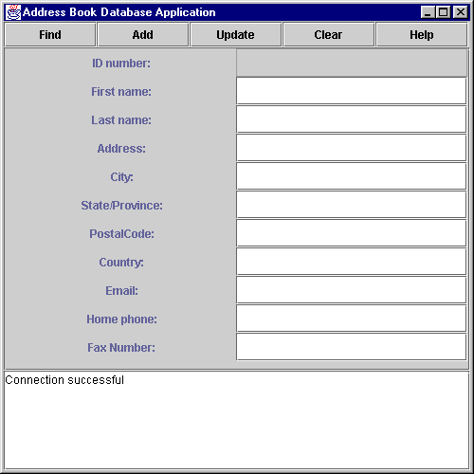
466 fields.home.setText( "" );
467 fields.fax.setText( "" );
468 }
469 }
Program Output

Slide 90
Transaction Processing
Transaction processing
  Changes can be undone
  Interface Connection
Method setAutoCommit
  true - each SQL statements performed individually
  false - several statements grouped as a transaction
    Terminating Statement that executes SQL statements
      Method commit - commit changes to database
      Method rollback - return database to previous state
  Method getAutoCommit
    Returns auto commit state

