Slide 1
BasketballVR
A simple basketball VR game

Slide 2
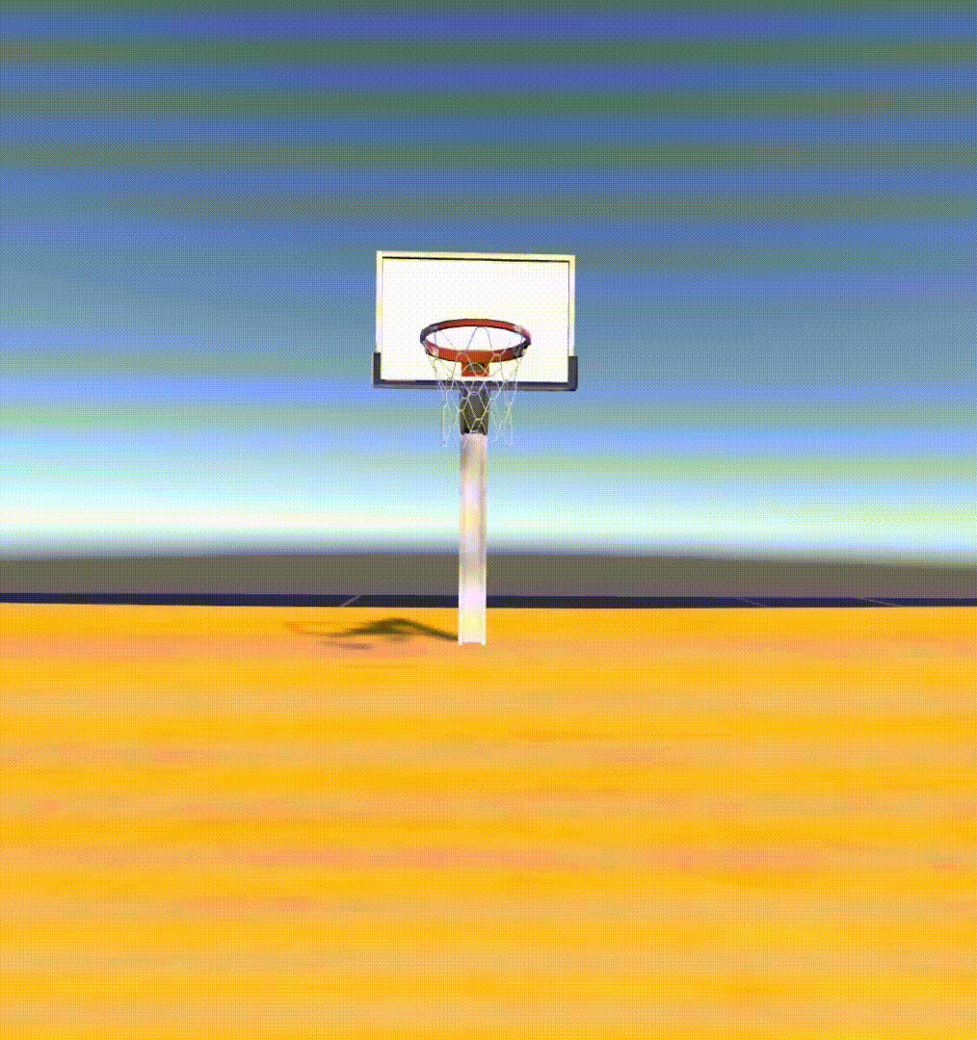
The scene
Assets used:
Free Sports Kit: https://assetstore.unity.com/packages/3d/characters/free-sports-kit-239377
BasketballRing:
https://assetstore.unity.com/packages/3d/props/basketballring-297800

Slide 3
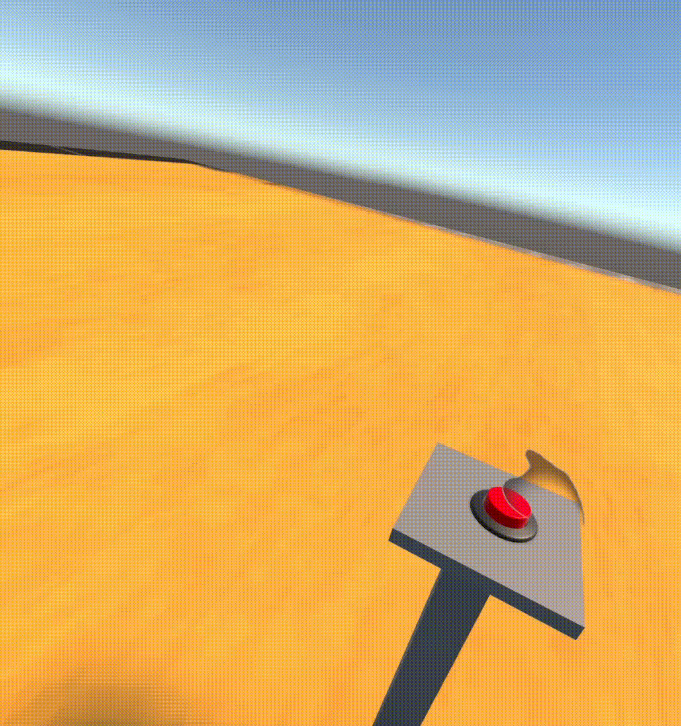
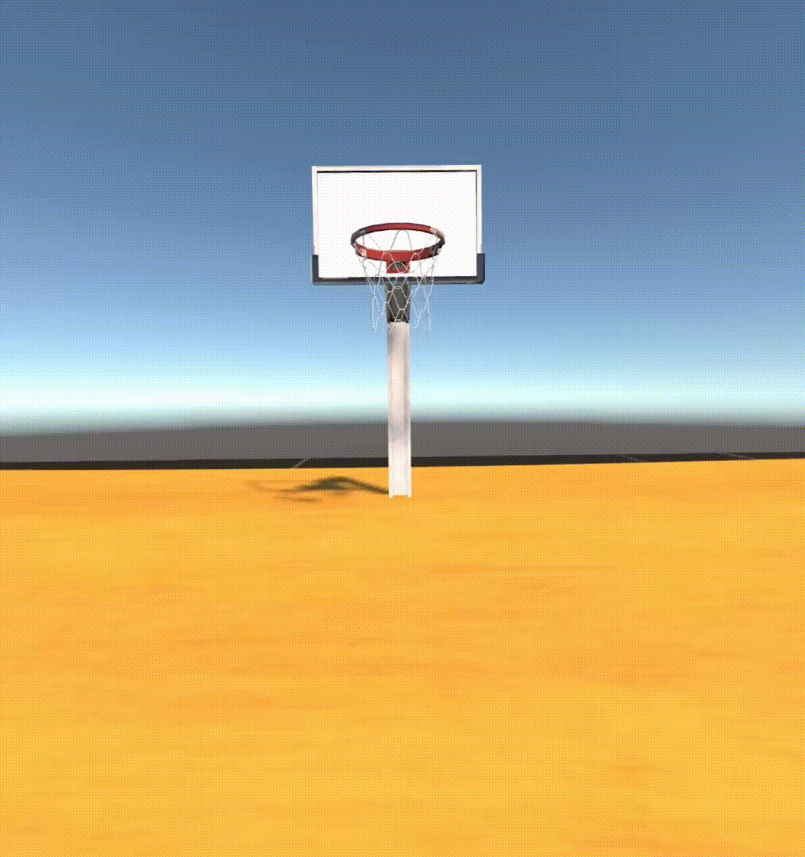
Interactions

Slide 4
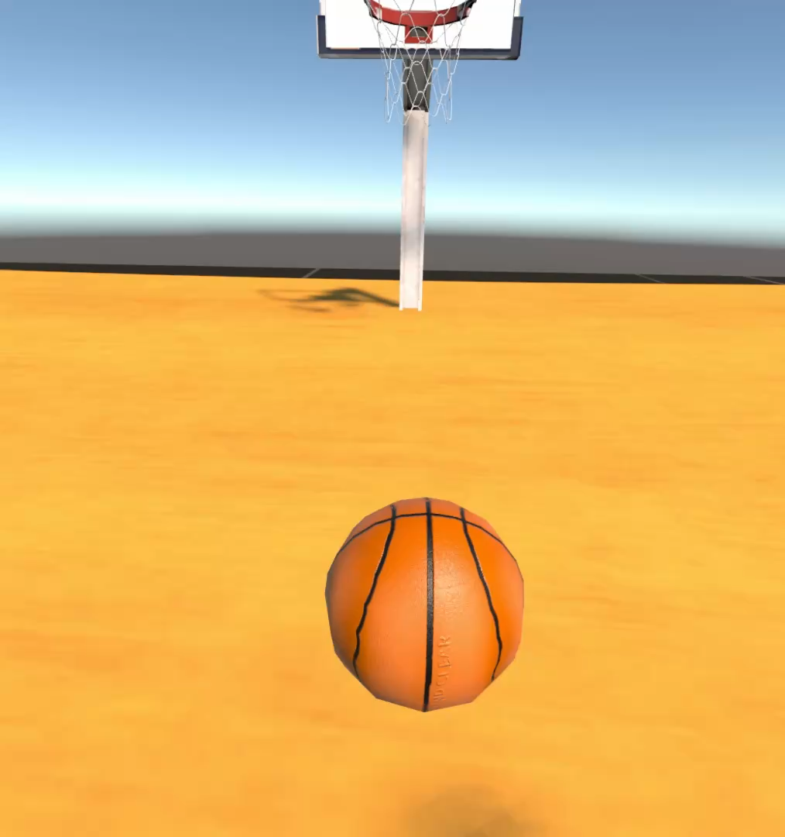
Audio feedback

Slide 5


