Slide 1


Slide 2

Neural networks and Backpropagation
Katarina Mićić
31. July 2020.

Slide 3
Agenda
Introduction to neural networks
History and development
Elements of neuron
Types of neural networks
Tranining methods
Feed forward neural networks
Backpropagation
Best practices

Slide 4
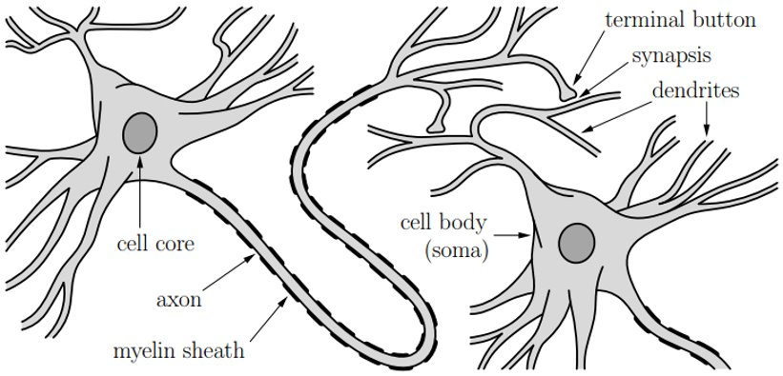
Introduction to neural networks​
Artificial neural networks were inspired by human nervous system​
Biological neuron representation

Slide 5
Introduction to neural networks History and development
1943, Warren McCulloch (neurophysiologist) and Walter Pitts (mathematician) wrote a paper on how neurons might work
1949, Hebb’s learning law
Donald Hebb The Organization of Behavior
“Neurons that fire together, wire together”
Neural pathways strengthen over each successive use, especially between neurons that tend to fire almost at the same time (presynaptic neuron fires a bit before postsynaptic neuron)
Unsupervised learning rule for feed forward network

Slide 6
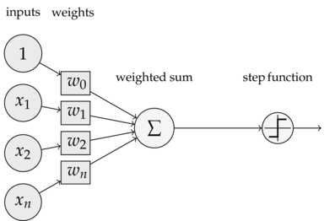
Introduction to neural networks History and development
1958, Perceptron - Frank Rosenblatt (neurobiologist)
Activation function – hard limiter
Limited to linearly separable classification problems
Insufficient compute power to perform training
1959, ADALINE and MADALINE - Bernard Widrow and Marcian Hoff
ADALINE – activation function – linear threshold unit
MADALINE (Multiple ADAptive LINear Elements) - First neural network built and applied in a real-world problem
1962, Widrow-Hoff learning rule
Supervised learning rule
Least mean square (LMS) algorithm
Error – difference between current output and desired output

Slide 7
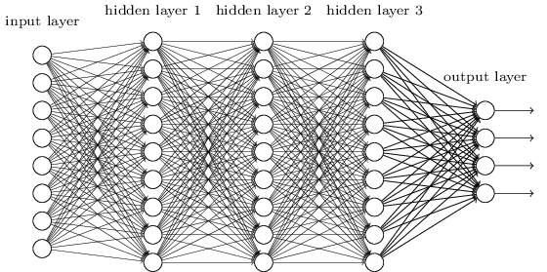
Introduction to neural networks History and development
Stagnant until 80s
1980-1995, Multilayer perceptron
1995 - Stagnant again
More complex problems, lacks data and compute
Other techniques more popular (SVM)
2006, Deep neural networks
Very popular technique until today

Slide 8
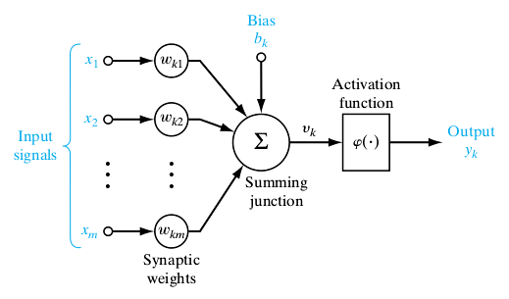

Elements of neuron
Input $x={[x_{1},…,x_{m}]}^{T}$
Weights $w=\left[w_{1},…,w_{m}\right]$
Bias $b$
Net input $v = \sum_{i}{x_{i} w_{i} }+b$
($v=wx+b$)
Activation function $φ(⦁)$
Output $y=φ(v)$
$y=φ(\sum_{i}{x_{i} w_{i} }+b)$
The weight $w_{ij}$ represents the strength of the synapse (called the connection or link), connecting neuron j (source) to neuron i (destination).
Each input is weighted, and the sum is passed through a non-linear function

Slide 9
Elements of neuron Activation function
The activation function is used to turn an unbounded input into an output that has a nice, predictable form
Nonlinear activation function will allow networks to compute nontrivial problems
If linear functions would be used, model would have unstable convergence!
Various types of functions are used as activation function in neural networks, most common is sigmoid

Slide 10
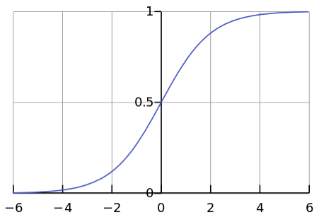
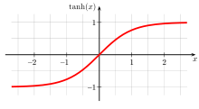
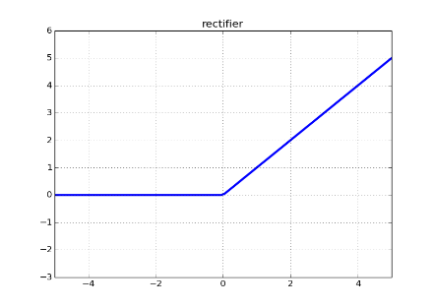

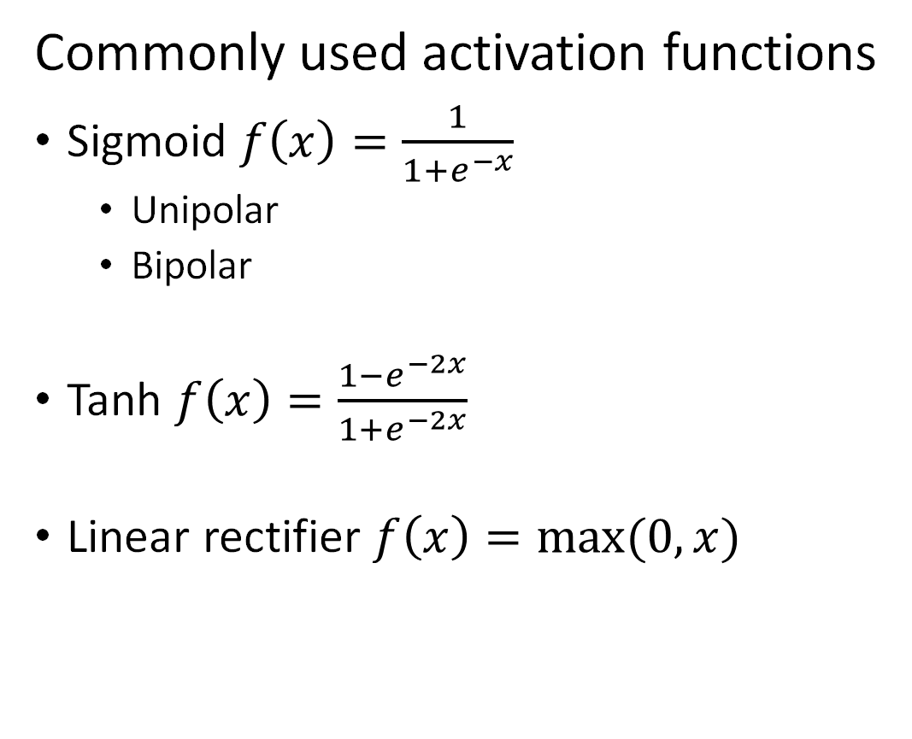
Elements of neuron Activation function
Commonly used activation functions
Sigmoid $f\left(x\right)=\frac{1}{1+e^{−x}}$
Unipolar
Bipolar
Tanh $f\left(x\right)=\frac{1−e^{−2x}}{1+e^{−2x}}$
Linear rectifier $f\left(x\right)=max⁡(0,x)$
Hard limiter $f\left(x\right)=\left\{\begin{aligned}1, x≥0 \\ −1, x<0\end{aligned}\right.$
Step function $f\left(x\right)=\left\{\begin{aligned}1, x≥0 \\ 0, x<0\end{aligned}\right.$
Perceptron neuron

Slide 11
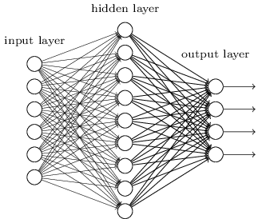
Neural networks – Overview
Neuron – a basic unit of a neural network
It takes input signals, processes them and produces some output signal
Neural network – parallel distributed information processing structure of neurons
It’s connections (weights) hold the knowledge
Learning by adjusting the connection weights
Computational power is in its collective behavior
Wide range of application
Classification problems (pattern recognition)
Regression analysis (function approximation)
Other (data compression, fraud detection)

Slide 12
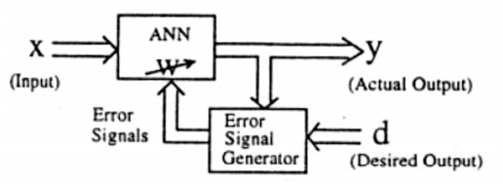
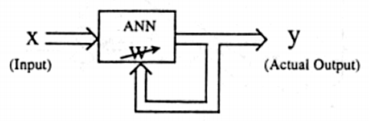
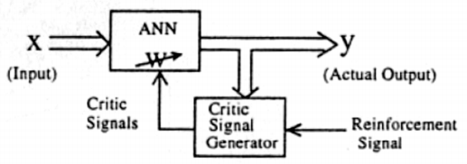
Training a network
Network training consist of parameter learning and structural modifications
Learning procedures can be divided into three categories:
Supervised (learning with a teacher) Unsupervised
Reinforcement (learning with a critic)

Slide 13
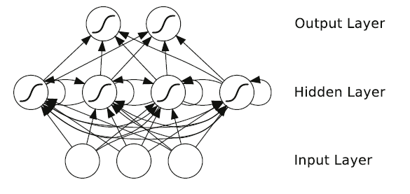
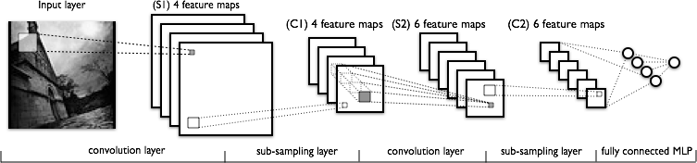
Types of neural networks
Feed forward networks Recurrent networks
1) Fully connected feedforward networks
2) Convolutional networks

Slide 14
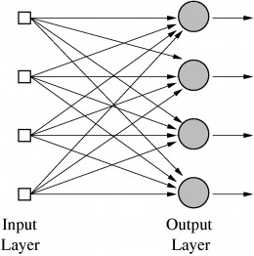
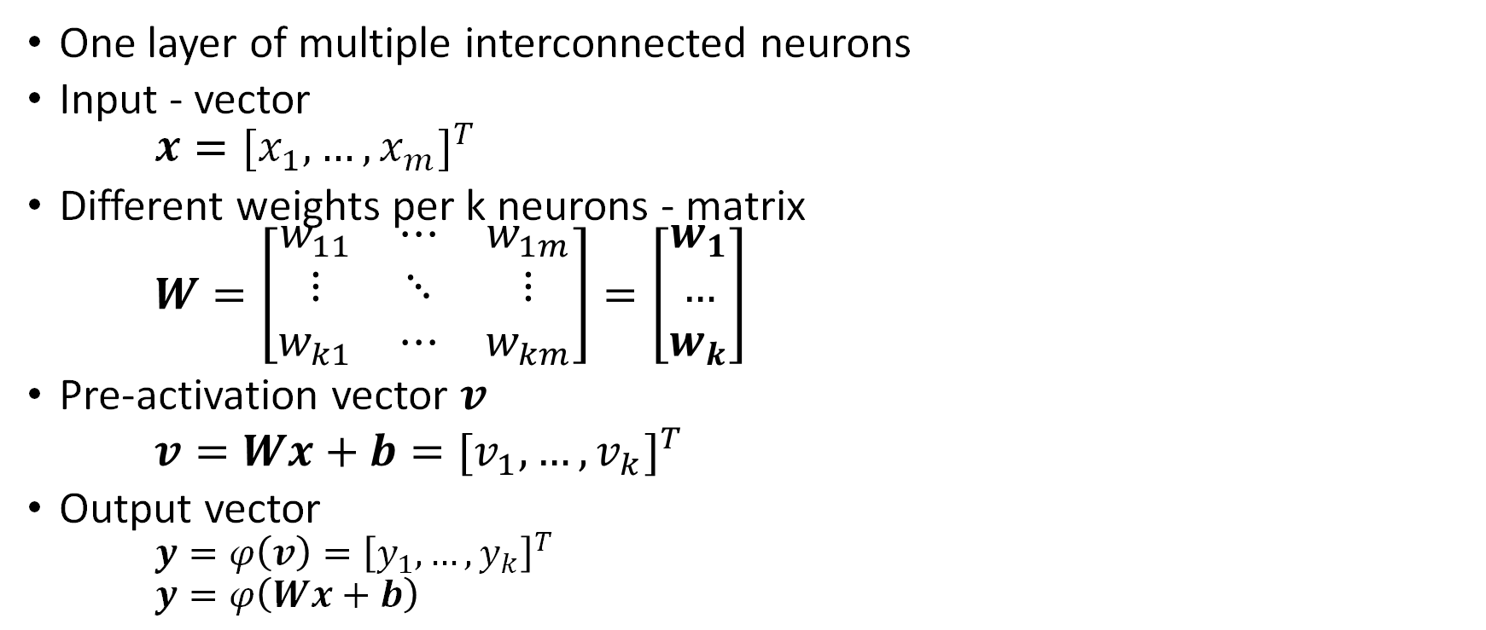
Feed forward neural networks Single layer
One layer of multiple interconnected neurons
Input - vector
$$x={{[x}_{1},…,x_{m}]}^{T}$$
Different weights per k neurons - matrix
$$W=\left[\begin{matrix}w_{11} & ⋯ & w_{1m} \\ ⋮ & ⋱ & ⋮ \\ w_{k1} & ⋯ & w_{km}\end{matrix}\right]=\left[\begin{matrix}w_{1} \\ … \\ w_{k}\end{matrix}\right]$$
Pre-activation vector $v$
$v=Wx+b={[v_{1},…,v_{k}]}^{T}$
Output vector
$y=φ\left(v\right)={\left[y_{1},…,y_{k}\right]}^{T}$
$y=φ\left(Wx+b\right)$

Slide 15
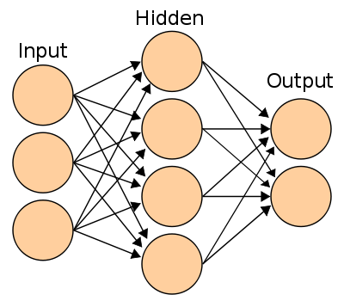
Feed forward neural networks Multiple layers
Combination of several layers
Input layer
– no computation in this layer
Hidden layer(s)
– Intermediate computation
– Extract features
Output layer
– Final computation and decision making
Can model arbitrarily complex function

Slide 16
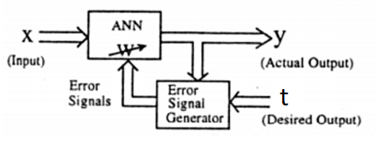
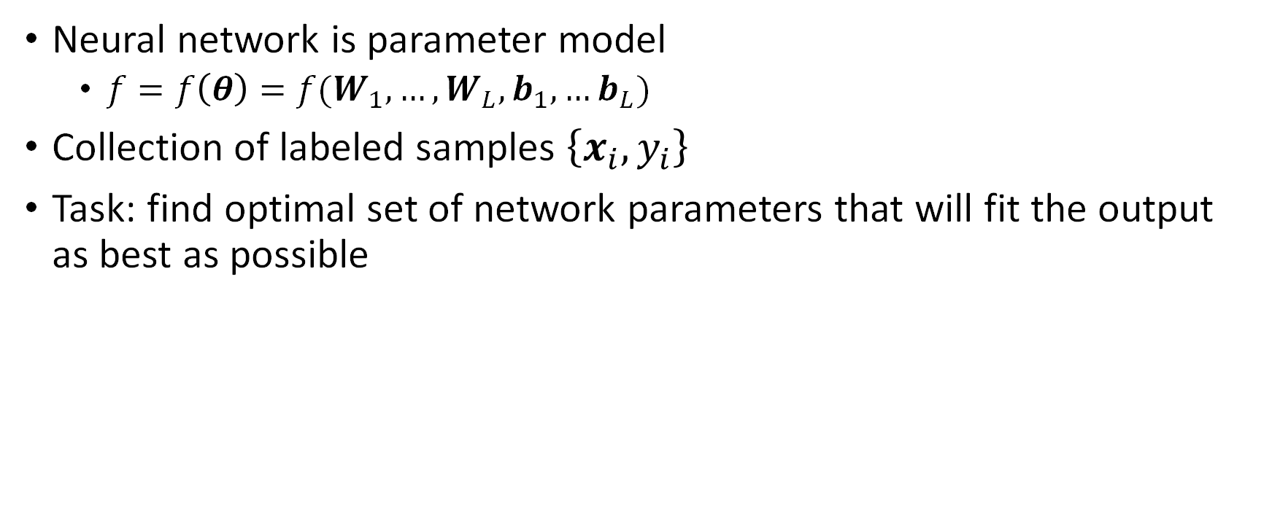
Supervised learning Problem statement
Neural network is parameter model
$f=f\left(θ\right)=f(W_{1},…,W_{L},b_{1},…b_{L})$
Collection of labeled samples $\left\{x_{i},y_{i}\right\}$
Task: find optimal set of network parameters that will fit the output as best as possible

Slide 17
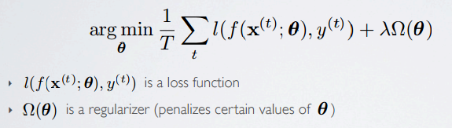
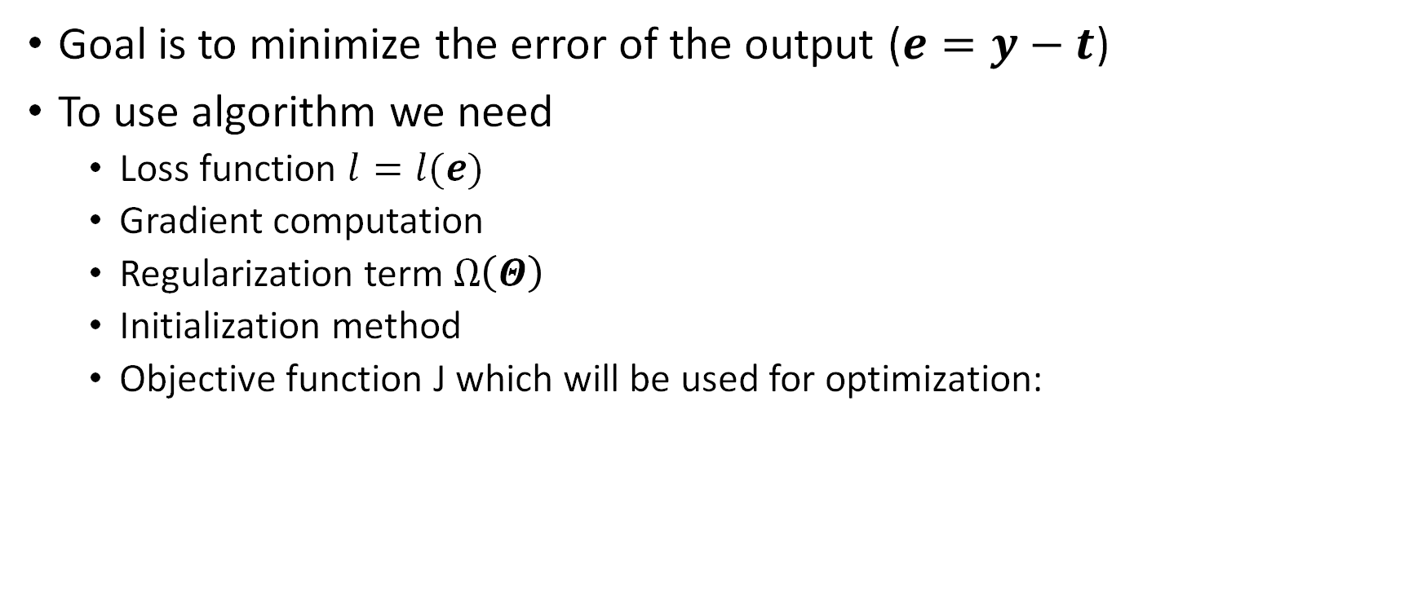
Supervised learning Optimization function
Goal is to minimize the error of the output ($e=y−t$)
To use algorithm we need
Loss function $l=l(e)$
Gradient computation
Regularization term $Ω\left(Θ\right)$
Initialization method
Objective function J which will be used for optimization:

Slide 18
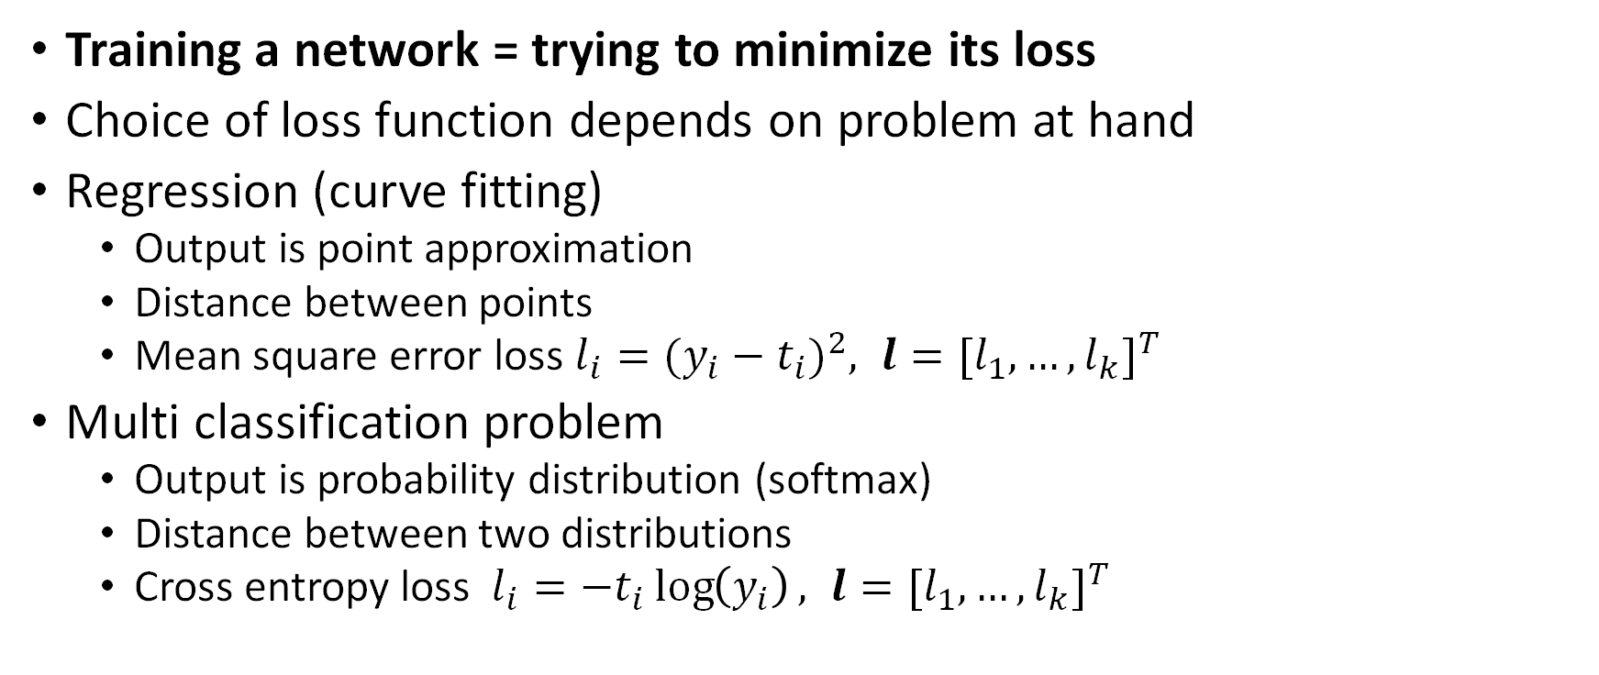
Supervised learning Loss function
Training a network = trying to minimize its loss
Choice of loss function depends on problem at hand
Regression (curve fitting)
Output is point approximation
Distance between points
Mean square error loss $l_{i}={(y_{i}−t_{i})}^{2}, l={[l_{1},…,l_{k}]}^{T}$
Multi classification problem
Output is probability distribution (softmax)
Distance between two distributions
Cross entropy loss $l_{i}=−t_{i}\log\left(y_{i}\right), l={[l_{1},…,l_{k}]}^{T}$

Slide 19
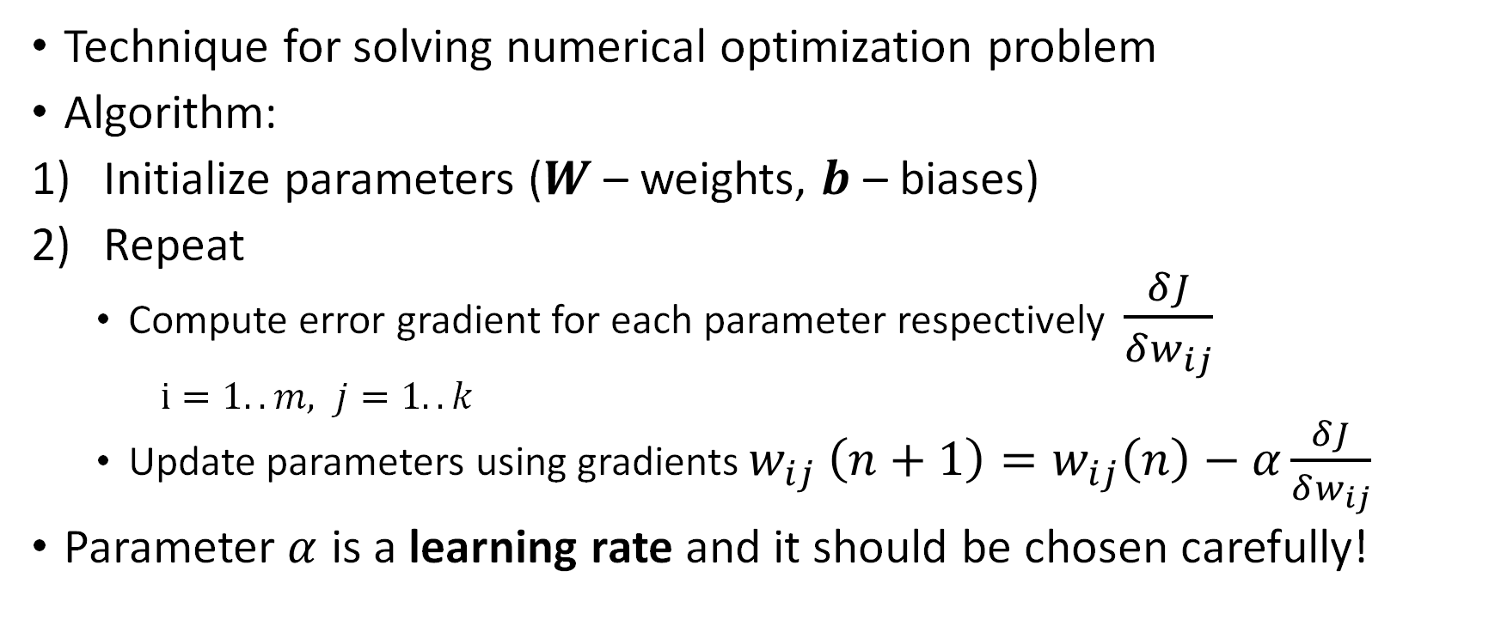
Gradient descent
Technique for solving numerical optimization problem
Algorithm:
Initialize parameters ($W$ – weights, $b$ – biases)
Repeat
Compute error gradient for each parameter respectively $\frac{δJ}{δw_{ij}}$
$i=1..m, j=1..k$
Update parameters using gradients $w_{ij} \left(n+1\right)=w_{ij}\left(n\right)−α\frac{δJ}{δw_{ij}}$
Parameter $α$ is a learning rate and it should be chosen carefully!

Slide 20
Backpropagation
Backward propagation of errors
Training algorithm for supervised learning of multilayer feedforward networks using gradient descent
Processing elements with continuous differentiable activation functions
Calculates the gradient of the loss function with respect to the neural network's weights
Modify the network weights by moving along the negative gradient

Slide 21
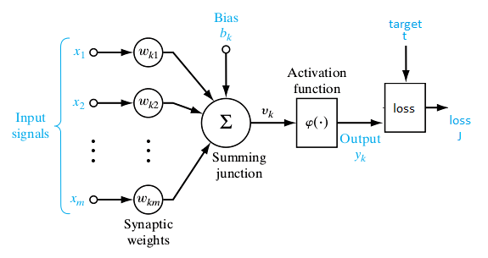
Gradient computation
Need to compute partial derivatives of loss with respect to parameters
First compute gradients in output layer
Loss can be viewed as additional layer

Slide 22
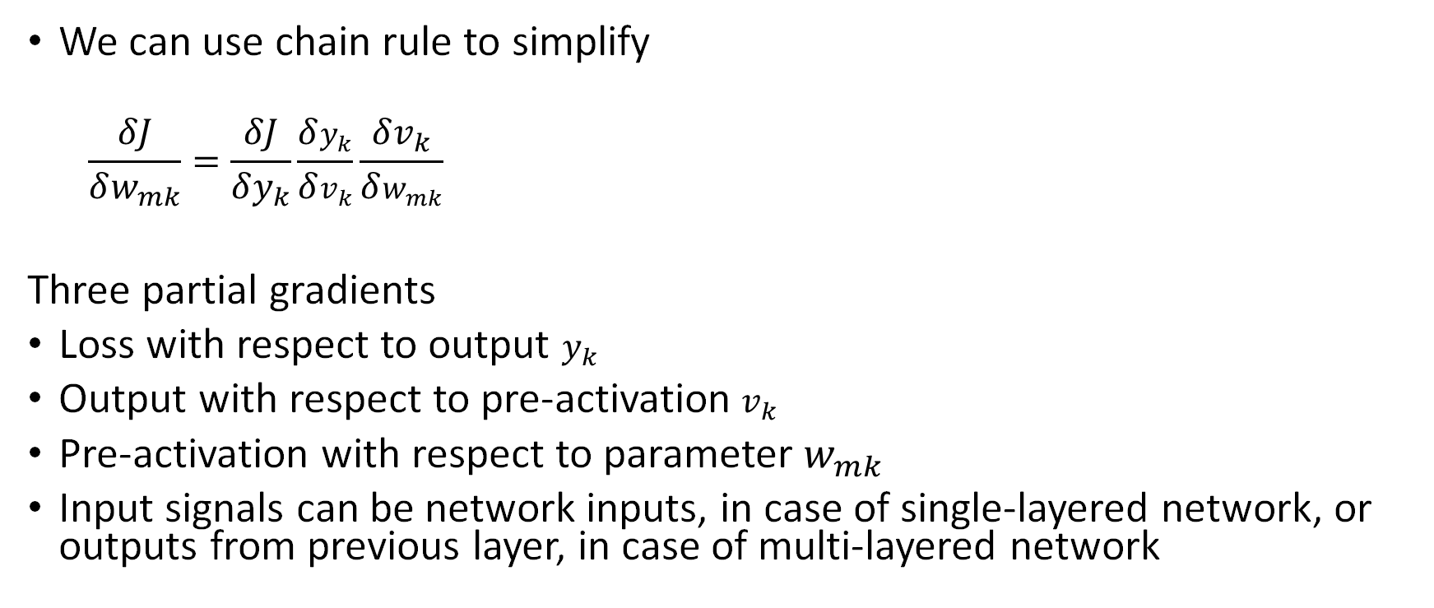
Chain rule Output layer
We can use chain rule to simplify
$$\frac{δJ}{δw_{mk}}=\frac{δJ}{δy_{k}}\frac{δy_{k}}{δv_{k}}\frac{δv_{k}}{δw_{mk}}$$
Three partial gradients
Loss with respect to output $y_{k}$
Output with respect to pre-activation $v_{k}$
Pre-activation with respect to parameter $w_{mk}$
Input signals can be network inputs, in case of single-layered network, or outputs from previous layer, in case of multi-layered network

Slide 23
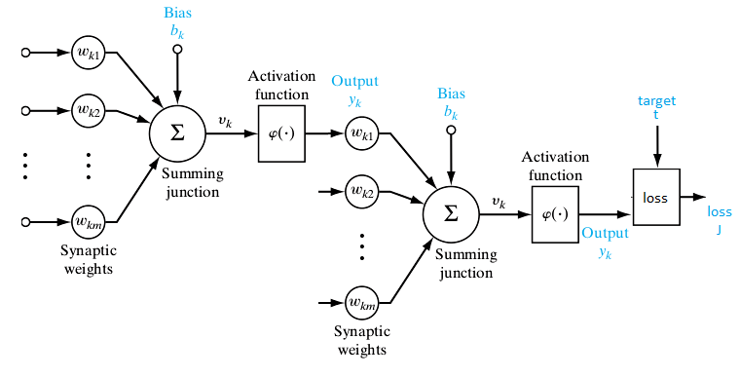
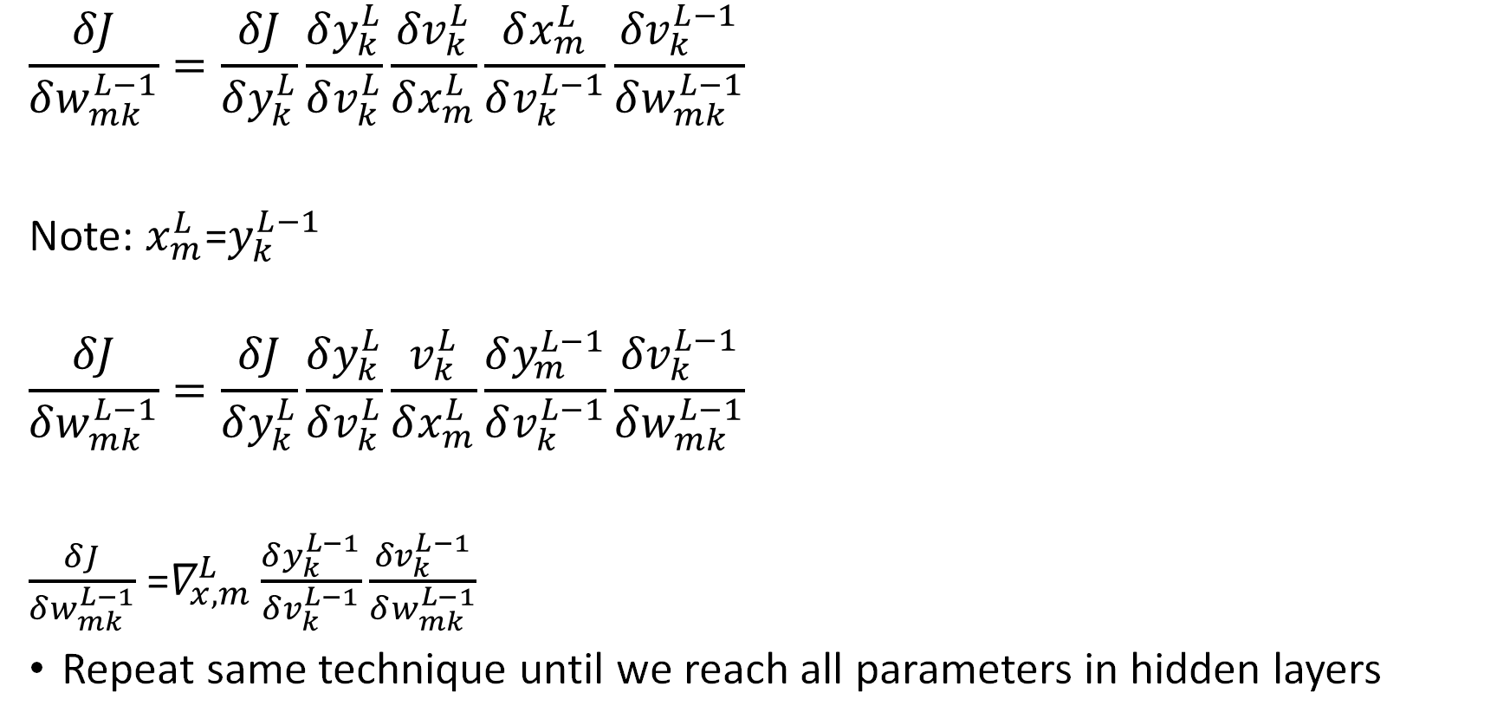
Backpropagation Output -> hidden layer
$$\frac{δJ}{δw_{mk}^{L−1}}=\frac{δJ}{δy_{k}^{L}}\frac{δy_{k}^{L}}{δv_{k}^{L}}\frac{{δv}_{k}^{L}}{δx_{m}^{L}}\frac{δx_{m}^{L}}{δv_{k}^{L−1}}\frac{{δv}_{k}^{L−1}}{δw_{mk}^{L−1}}$$
Note: $x_{m}^{L}$=$y_{k}^{L−1}$
$$\frac{δJ}{δw_{mk}^{L−1}}=\frac{δJ}{δy_{k}^{L}}\frac{δy_{k}^{L}}{δv_{k}^{L}}\frac{v_{k}^{L}}{δx_{m}^{L}}\frac{δy_{m}^{L−1}}{δv_{k}^{L−1}}\frac{{δv}_{k}^{L−1}}{δw_{mk}^{L−1}}$$
$\frac{δJ}{δw_{mk}^{L−1}}$=$∇_{x,m}^{L}\frac{δy_{k}^{L−1}}{δv_{k}^{L−1}}\frac{{δv}_{k}^{L−1}}{δw_{mk}^{L−1}}$
Repeat same technique until we reach all parameters in hidden layers

Slide 24

Gradient calculus Loss function gradient
Cross entropy
$l_{k}=−t_{k}\log\left(y_{k}^{L}\right)$
$\frac{δl}{δy_{k}^{L}}=−\frac{t_{k}}{y_{k}^{L}}$
Squared error
$l_{k}={(y_{k}^{L}−t_{k})}^{2}$
$\frac{δl}{δy_{k}^{L}}=2(y_{k}^{L}−t_{k})$

Slide 25
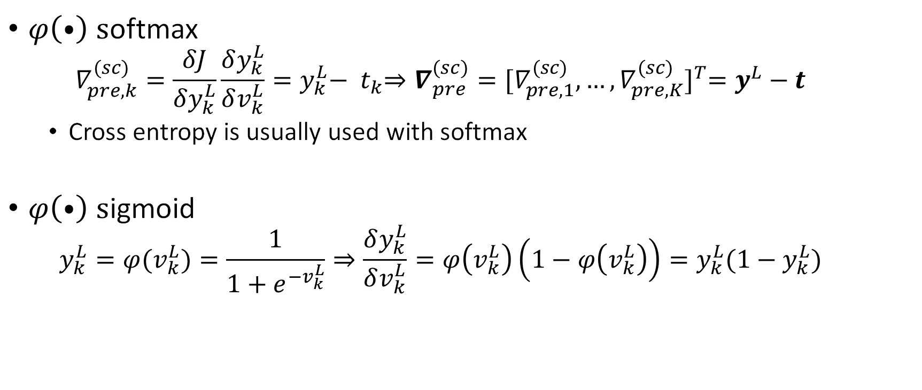
Gradient calculus Pre-activation gradient
$φ\left(⦁\right) s$oftmax
$$∇_{pre,k}^{(sc)}=\frac{δJ}{δy_{k}^{L}}\frac{δy_{k}^{L}}{δv_{k}^{L}}=y_{k}^{L}−{ t}_{k}⇒∇_{pre}^{(sc)}={[∇_{pre,1}^{(sc)},…,∇_{pre,K}^{(sc)}]}^{T}=y^{L}−t$$
Cross entropy is usually used with softmax
$φ\left(⦁\right) s$igmoid
$$y_{k}^{L}=φ(v_{k}^{L})=\frac{1}{1+e^{−v_{k}^{L}}}⇒\frac{δy_{k}^{L}}{δv_{k}^{L}}=φ\left(v_{k}^{L}\right)\left(1−φ\left(v_{k}^{L}\right)\right)=y_{k}^{L}(1−y_{k}^{L})$$

Slide 26
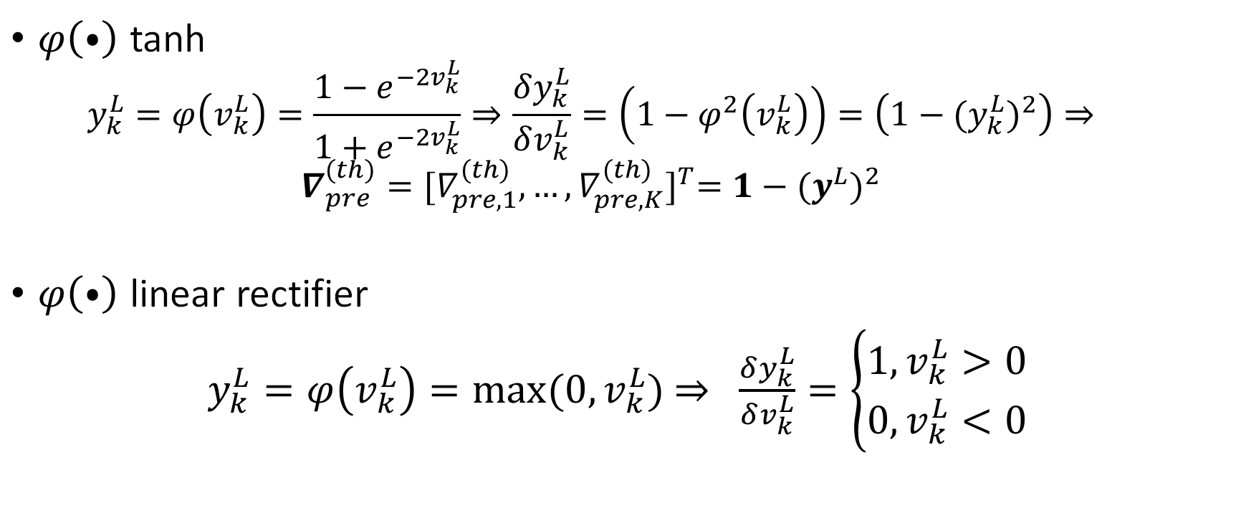
Gradient calculus Pre-activation gradient
$φ\left(⦁\right)$ tanh
$$y_{k}^{L}=φ\left(v_{k}^{L}\right)=\frac{1−e^{−2v_{k}^{L}}}{1+e^{−2v_{k}^{L}}}⇒\frac{δy_{k}^{L}}{δv_{k}^{L}}=\left(1−φ^{2}\left(v_{k}^{L}\right)\right)=\left(1−{{(y}_{k}^{L})}^{2}\right)⇒$$
$$∇_{pre}^{(th)}={[∇_{pre,1}^{(th)},…,∇_{pre,K}^{(th)}]}^{T}=1−{{(y}^{L})}^{2}$$
$φ\left(⦁\right)$ linear rectifier
$y_{k}^{L}=φ\left(v_{k}^{L}\right)=max⁡(0,v_{k}^{L})$ $⇒$ $\frac{δy_{k}^{L}}{δv_{k}^{L}}=\left\{\begin{aligned}1,v_{k}^{L}>0 \\ 0,v_{k}^{L}<0\end{aligned}\right.$

Slide 27
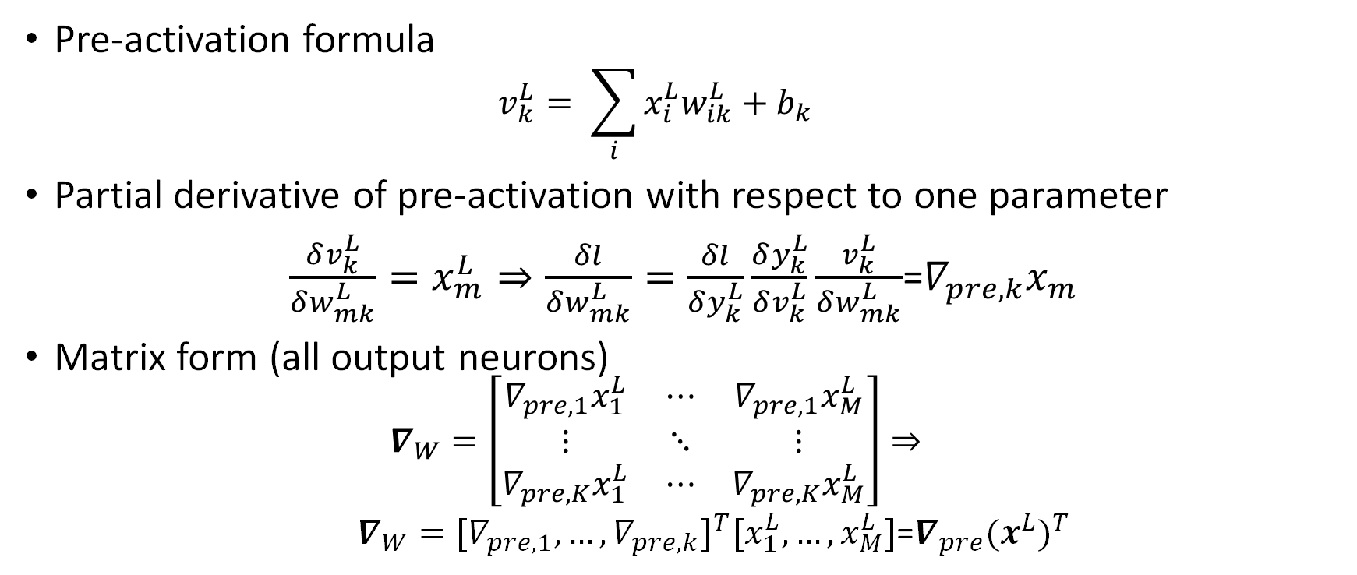
Gradient calculus Parameters gradient
Pre-activation formula
$$v_{k}^{L}= \sum_{i}{x_{i}^{L}w_{ik}^{L}}+b_{k}$$
Partial derivative of pre-activation with respect to one parameter
$\frac{δv_{k}^{L}}{δw_{mk}^{L}}=x_{m}^{L}⇒\frac{δl}{δw_{mk}^{L}}=\frac{δl}{δy_{k}^{L}}\frac{δy_{k}^{L}}{δv_{k}^{L}}\frac{v_{k}^{L}}{δw_{mk}^{L}}$=$∇_{pre,k}x_{m}$
Matrix form (all output neurons)
$$∇_{W}=\left[\begin{matrix}∇_{pre,1}x_{1}^{L} & ⋯ & ∇_{pre,1}x_{M}^{L} \\ ⋮ & ⋱ & ⋮ \\ ∇_{pre,K}x_{1}^{L} & ⋯ & ∇_{pre,K}x_{M}^{L}\end{matrix}\right]⇒$$
$∇_{W}={[∇_{pre,1}, …,∇_{pre,k}]}^{T}[x_{1}^{L},…,x_{M}^{L}]$=$∇_{pre}{(x^{L})}^{T}$

Slide 28
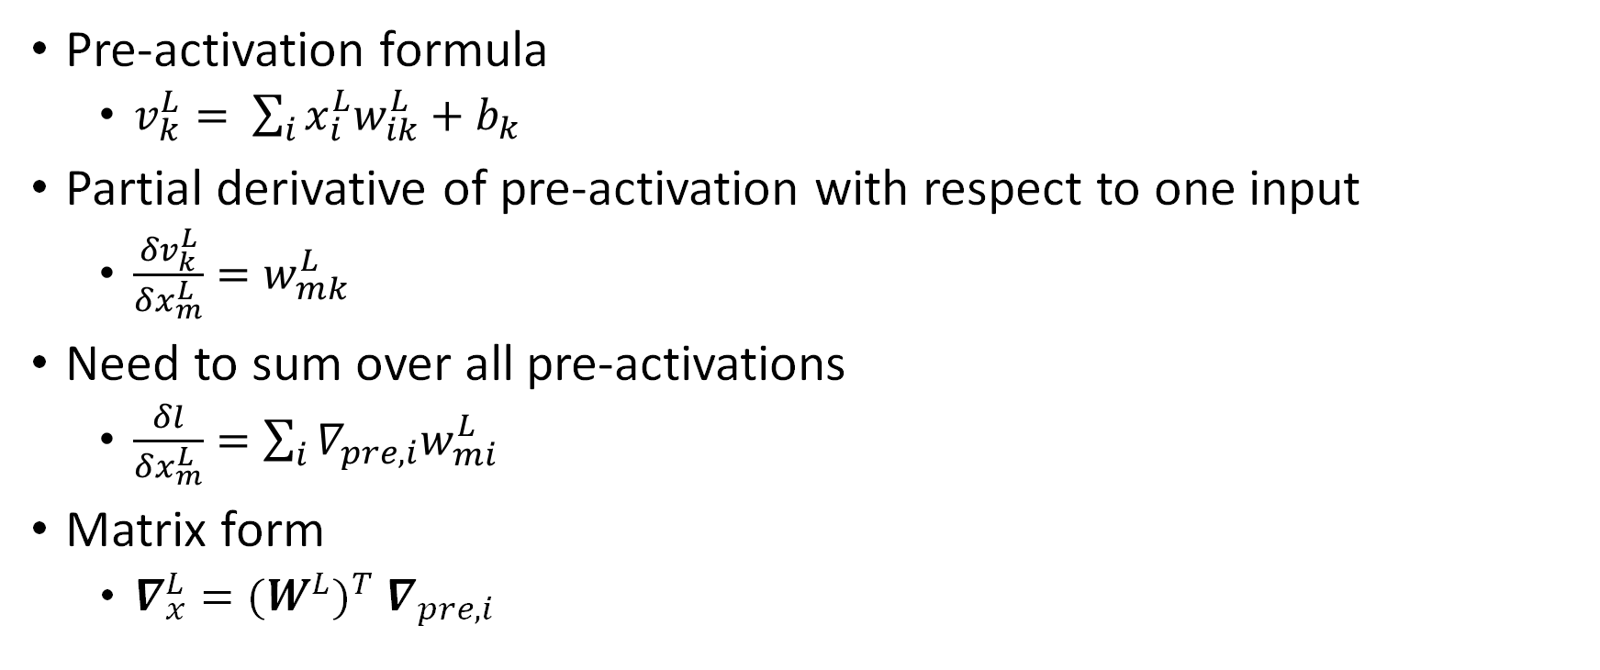
Gradient calculus Inputs gradients
Pre-activation formula
$v_{k}^{L}= \sum_{i}{x_{i}^{L}w_{ik}^{L}}+b_{k}$
Partial derivative of pre-activation with respect to one input
$\frac{δv_{k}^{L}}{δx_{m}^{L}}=w_{mk}^{L}$
Need to sum over all pre-activations
$\frac{δl}{δx_{m}^{L}}=\sum_{i}{∇_{pre,i}w_{mi}^{L}}$
Matrix form
$∇_{x}^{L}={{(W^{L})}^{T} ∇}_{pre,i}$

Slide 29
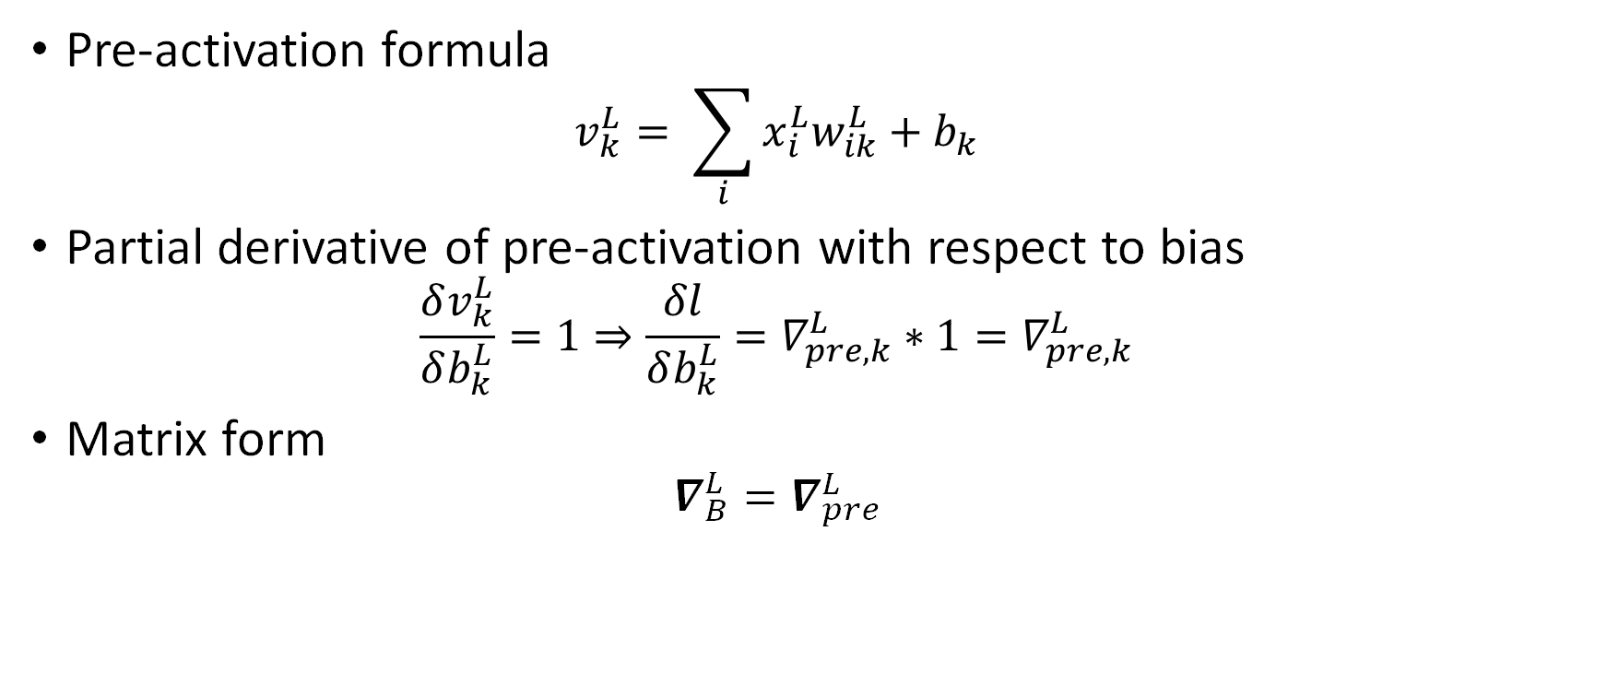
Gradient calculus Bias gradients
Pre-activation formula
$$v_{k}^{L}= \sum_{i}{x_{i}^{L}w_{ik}^{L}}+b_{k}$$
Partial derivative of pre-activation with respect to bias
$$\frac{δv_{k}^{L}}{δb_{k}^{L}}=1⇒\frac{δl}{δb_{k}^{L}}=∇_{pre,k}^{L}∗1=∇_{pre,k}^{L}$$
Matrix form
$$∇_{B}^{L}=∇_{pre}^{L}$$

Slide 30
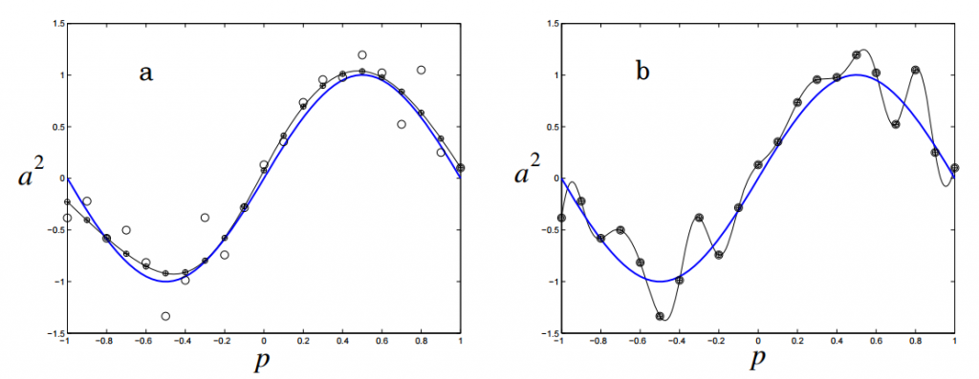

Regularization
Large weights in a neural network are a sign of a more complex network that has overfit the training data
The model will have a low accuracy if it is overfitting
Second term in objective function
Also called weight decay
λ the tuning parameter that decides how much we want to penalize the flexibility of our model

Slide 31
Regularization λ
Prevents network to converge to complex solution (overfitting)
Prevents high weights and forces sparsity
Selecting a good value of λ is critical
Cross validation comes in handy for this purpose
The value of λ should be carefully selected
λ ↗ ⇒ reduces the value of coefficients ⇒ reducing the variance (good)
At one point (λ max), the model starts loosing important properties ⇒ bias ↗ ⇒ underfitting

Slide 32
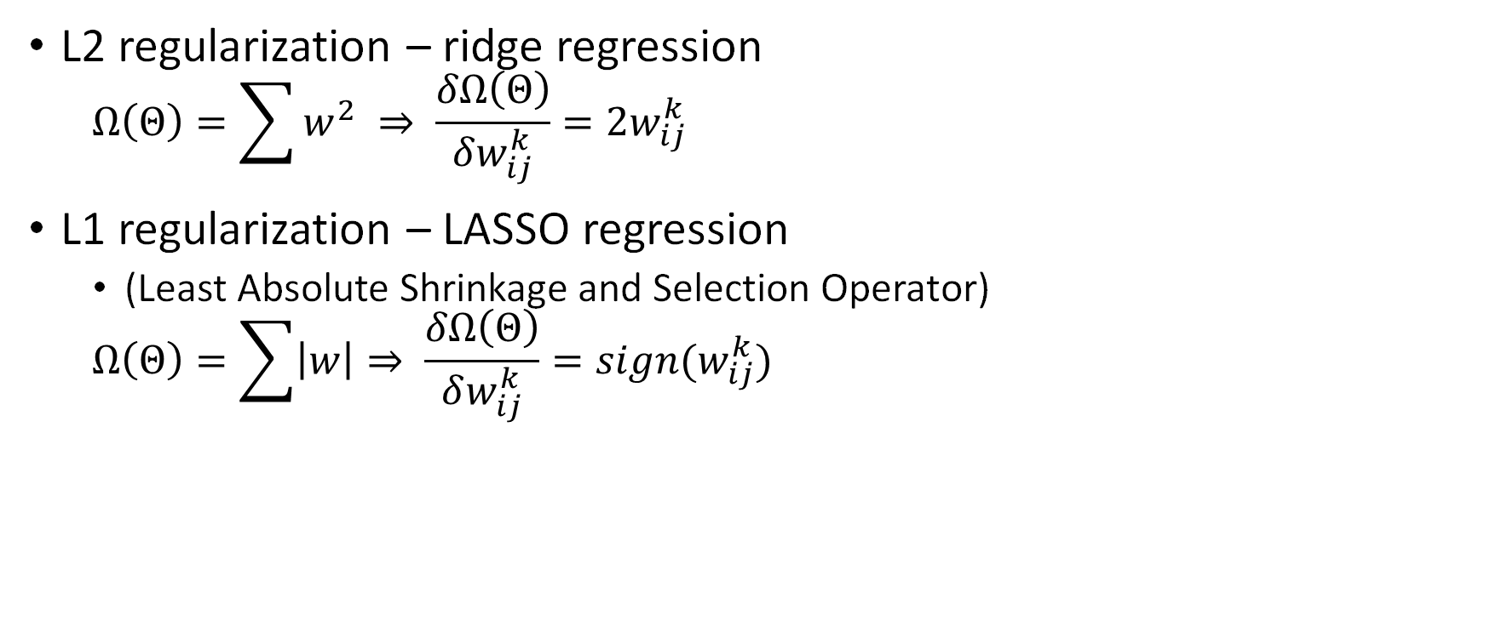
Regularization
L2 regularization – ridge regression
$$Ω\left(Θ\right)=\sum{w^{2}} ⇒ \frac{δΩ\left(Θ\right)}{δw_{ij}^{k}}=2w_{ij}^{k}$$
L1 regularization – LASSO regression
(Least Absolute Shrinkage and Selection Operator)
$$Ω\left(Θ\right)=\sum{\left|w\right|}⇒ \frac{δΩ\left(Θ\right)}{δw_{ij}^{k}}=sign(w_{ij}^{k})$$

Slide 33
Regularization in neural networks Dropout
At each training stage, individual nodes are either
"dropped out" of the net with probability 1 − p
or kept with probability p
so that a reduced network is left
Only the reduced network is trained on the data in that stage
The removed nodes are then reinserted into the network with their original weights
Computationally inexpensive but powerful regularization method
Better accuracy at the cost of slower convergence
Prevents coadaptation of neurons, makes network more robust
Injects noise
Exponential family of networks with shared weights

Slide 34
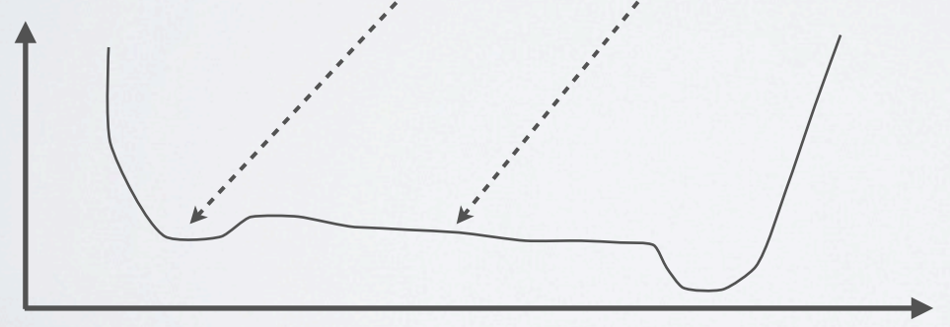
Backpropagation Pros and cons
Pros
Linear in number of weights
Easy to implement
Matrix multiplications
Nonlinearities
Cons
Nonconvex optimization problem
Local minima
Searching for global solution is tedious

Slide 35
Backpropagation Learning factors
Initial weights
Learning constant
Cost function
Update rule
Size and nature of the training set
Architecture (number of layers and number of nodes per layer)

Slide 36
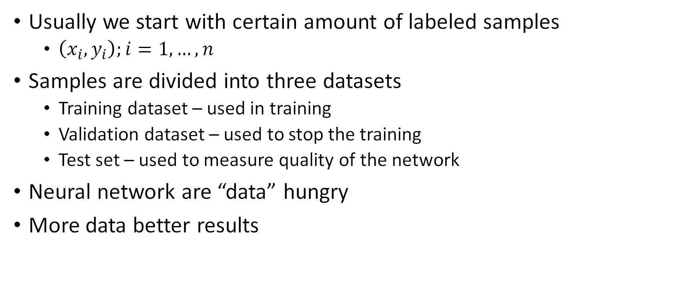
Best practices Input datasets
Usually we start with certain amount of labeled samples
$\left(x_{i},y_{i}\right);i=1,…,n$
Samples are divided into three datasets
Training dataset – used in training
Validation dataset – used to stop the training
Test set – used to measure quality of the network
Neural network are “data” hungry
More data better results

Slide 37
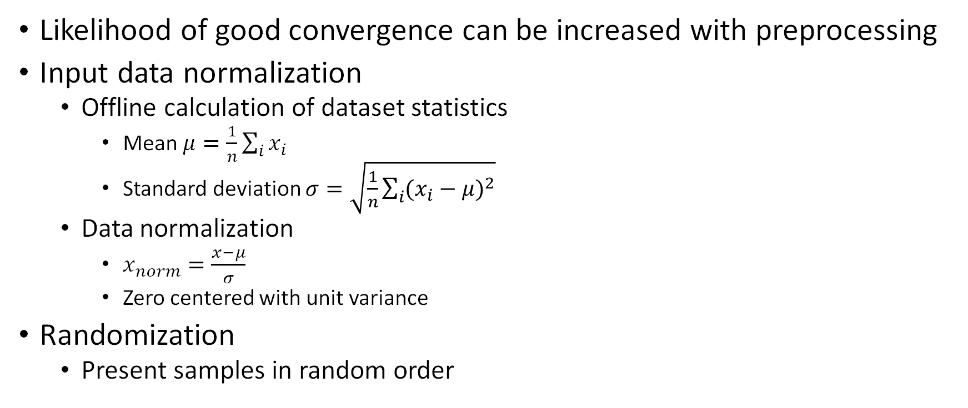
Best practices Input data preprocessing
Likelihood of good convergence can be increased with preprocessing
Input data normalization
Offline calculation of dataset statistics
Mean $μ=\frac{1}{n}\sum_{i}{x_{i}}$
Standard deviation $σ=\sqrt{\frac{1}{n}\sum_{i}{{(x_{i}−μ)}^{2}}}$
Data normalization
$x_{norm}=\frac{x−μ}{σ}$
Zero centered with unit variance
Randomization
Present samples in random order

Slide 38
Best practices Input data augmentation
Always need more data (slow labeling)
Synthesize many “realistic” examples from a few real ones
Translation, rotation, scaling…
Horizontal flip
Lighting change

Slide 39
Best practices Architecture selection
Choose number of hidden units
Dictated by amount of input data an problem complexity
Some empirical formulas
In practice search is performed
Train several networks
Choose the best one
“Best” is compromise
accuracy
efficiency

Slide 40
Best practices Nonconvexity problems
Convex objective function
Gradient descent finds global minima
NN objective function is nonconvex
Permuting neurons from hidden layer yields same loss value
Multiple minima -> nonconvexity
Can get stuck in local minima
Plateaus
Small error decrease
Hard to tell whether to stop or continue

Slide 41
Best practices Convergence speed
Learning rate needs to be adjusted during the course of training
Start with higher learning rate
Decrease learning rate as convergence speed slows down
Bouncing in minima
Are we at plateau?
Momentum
Technique to increase convergence speed
Update weights in current iteration using gradients from previous one
Also helps in avoiding local minima

Slide 42
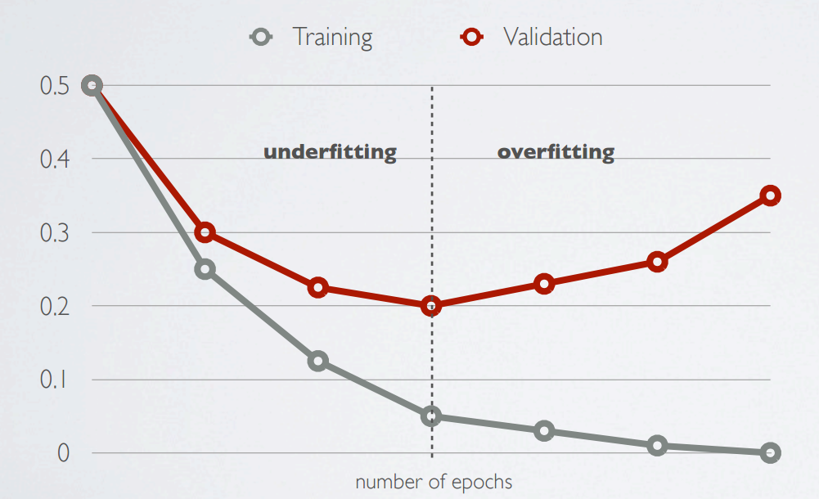
Best practices When to stop training process
Pick network when validation error starts increasing

Slide 43

Question?

Slide 44
Useful links
https://missinglink.ai/guides/neural-network-concepts/7-types-neural-network-activation-functions-right/
https://en.wikipedia.org/wiki/Loss_functions_for_classification
https://towardsdatascience.com/common-loss-functions-in-machine-learning-46af0ffc4d23

