Slide 1
RATING BASED RECOMMENDER SYSTEM WITH GRAPHSAGE
Dejan Gjer
mentor: Mladen Nikolić

Slide 2
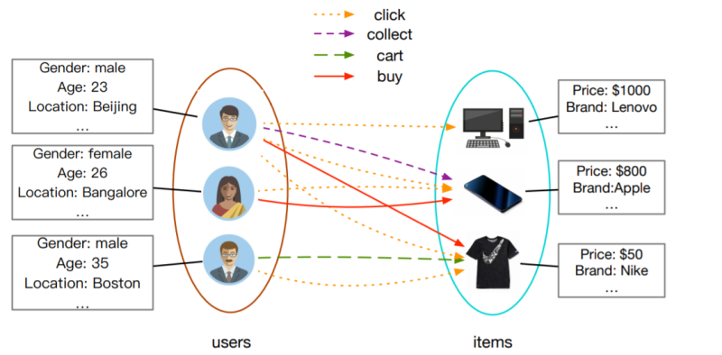
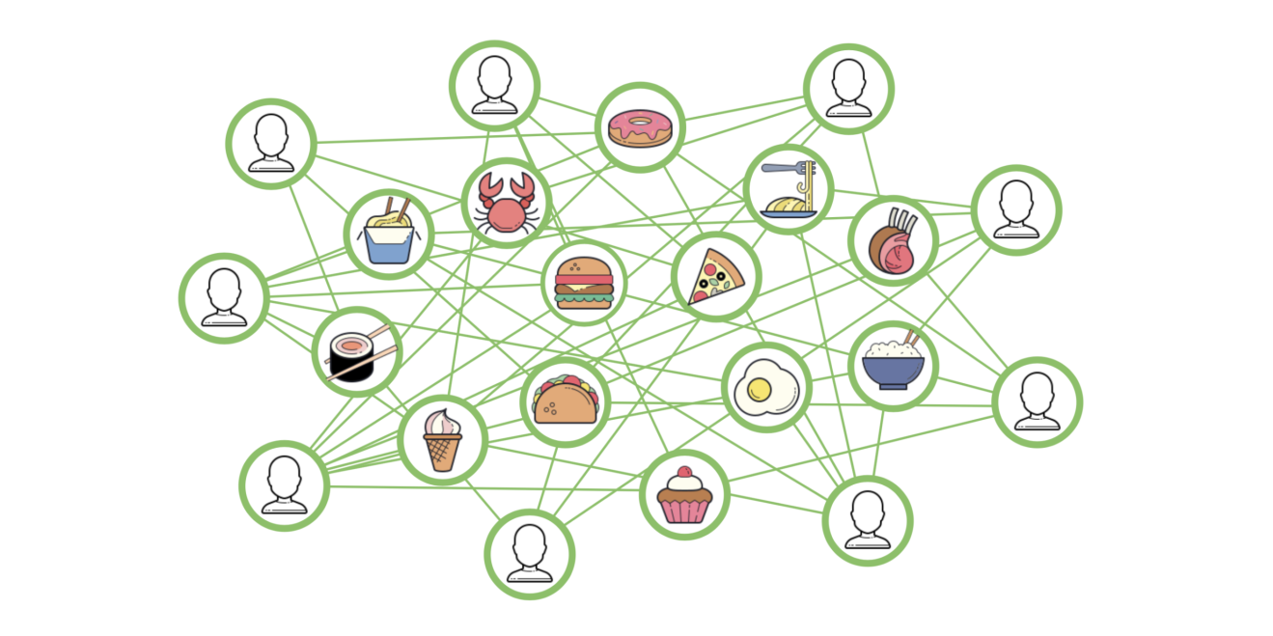
Graph based recommender systems

Slide 3
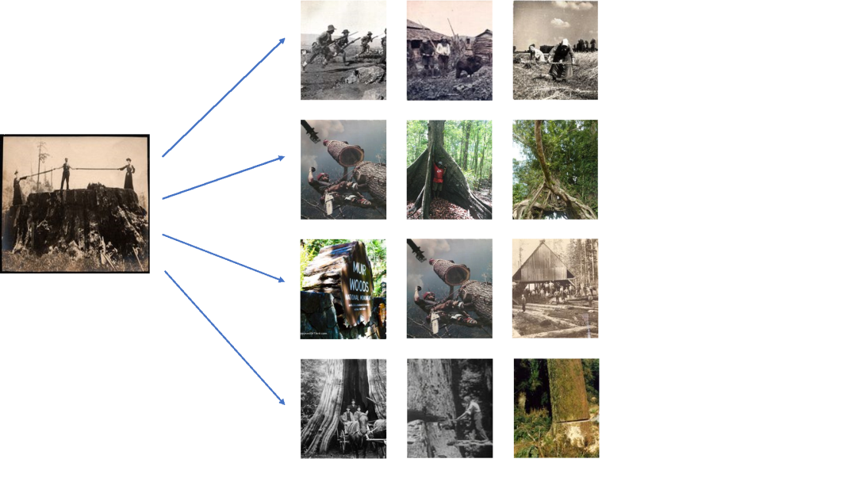
GraphSage
Inductive Representation Learning on Large Graphs - paper (2018) - link
PinSage (Pinterest) – link (paper)
UberEats - link

Slide 4
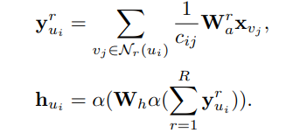

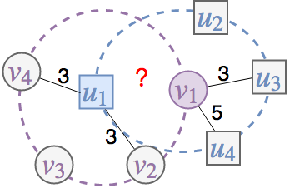
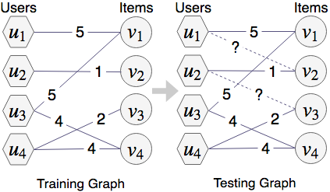
STAR-GCN
STAR-GCN: Stacked and Reconstructed Graph Convolutional Networks for
Recommender Systems – paper (2019)
Transductive vs Inductive learning
Label leakage issue -> sample and remove

Slide 5
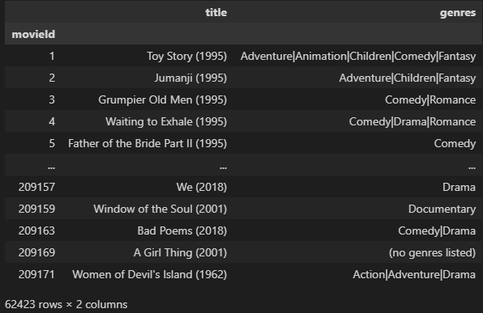
MovieLens
MovieLens 25M
62 423 movies
162 541 users
25 000 095 ratings
Preprocessing
Tags
Movie features
 | Train | Validation | Test
Edges (%) | 70 | 10 | 20
 | Users | Movies | Ratings | Features
Large | 162 541 | 27 832 | 24 859 484 | 5511
Small | 4891 | 8726 | 723 634 | 4564

Slide 6
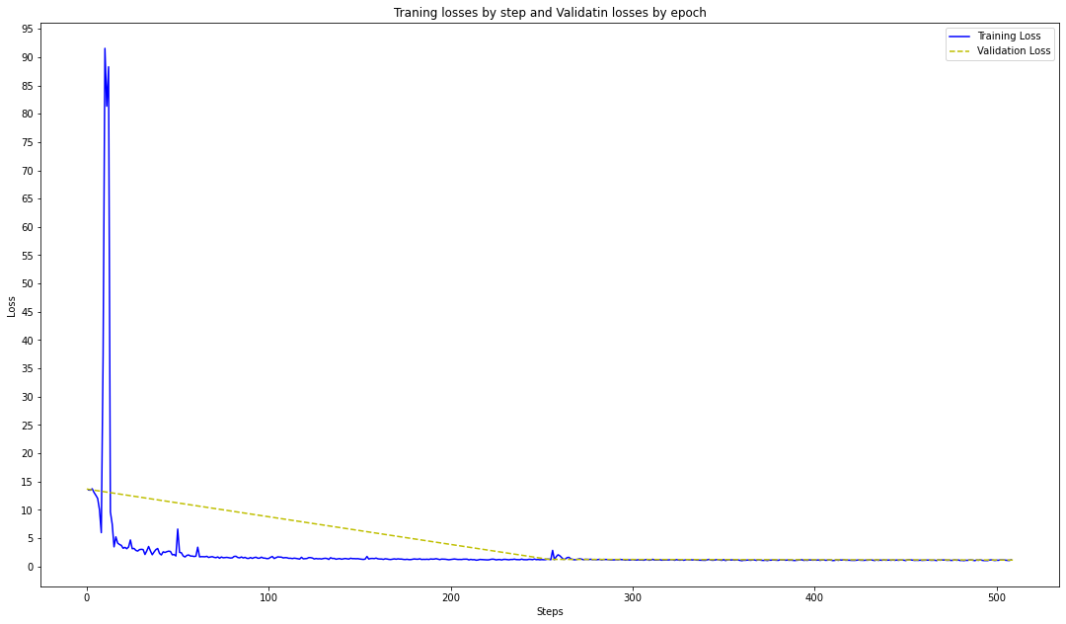
Implementation and results
Number of layers
Rating regularization

Slide 7
Implementation and results
 | Dataset | RMSE
GRALS [Rao et al., 2015] | ML-100k | 0.945
STAR-GCN | ML-1M | 0.832
STAR-GCN | ML-10M | 0.770
This model | ML-25M (small) | 1.037
This model | ML-25M (large) | 1.049
This model + rating reg. | ML-25M (small) | 1.025

Slide 8
Hvala na pažnji!

