Slide 1
MANAGING THE DEVELOPMENT OF LARGE SOFTWARE SYSTEMS
by Dr. Winston W. Royce

Slide 2
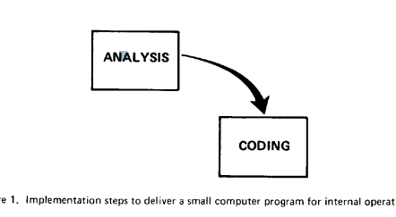
There are two essential steps common to all computer program developments, regardless of size or complexity

Slide 3
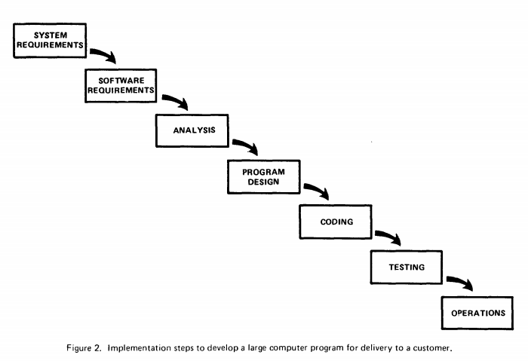
I believe in this concept, but the implementation described above is risky and invites failure

Slide 4
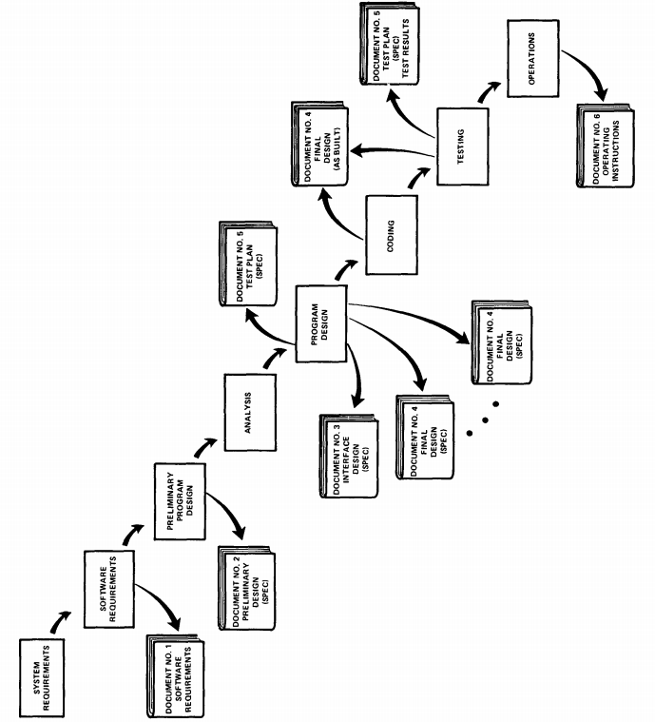
DOKUMENTACIJA

Slide 5
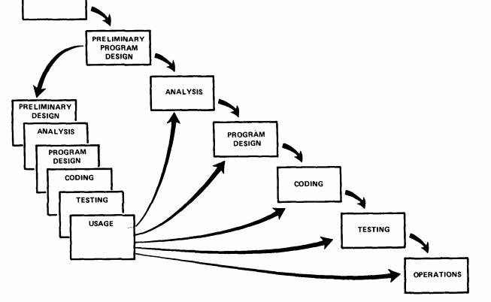
Prototip

Slide 6
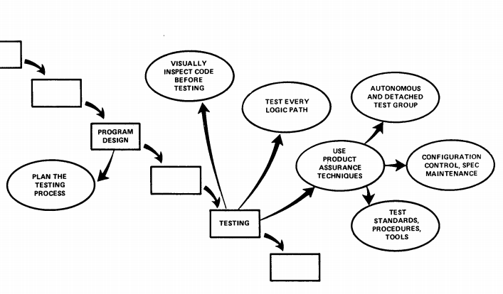
Testiranje

Slide 7
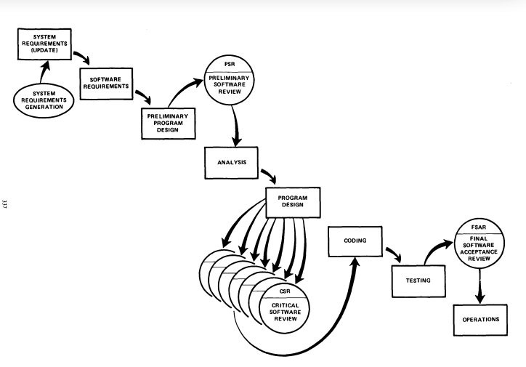
Review

Slide 8
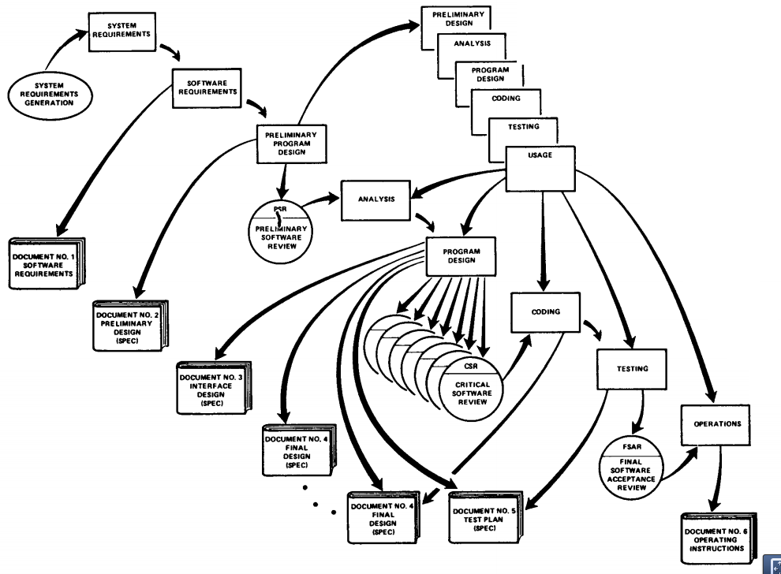
Projekat

