Slide 1



Sensitivity Analysis and Surrogate Modeling of PEM Fuel Cells
Supervised by:
Dr. Giuseppe Casalicchio
Presented by:
Dejvis Toptani
Nathaly Vergel Serrano
Camila Bermudez Valderrama
August 1st, 2025
In collaboration with:
Luis Winkler (ZSW Ulm)
Prof. Herbert Palm (UAS Munich)

Slide 2
Outline
1. Motivation: Understanding PEMFC
2. Model validity
3. Sensitivity analysis
4. Surrogate modeling
5. Future work

Slide 3
1. Motivation
Understanding Proton Exchange Membrane (PEM) Fuel Cells
Notes:
PEM fuel cells are central to the transition toward clean energy. However, modeling them accurately involves solving complex systems of differential and algebraic equations, which can be computationally expensive. This limits their practical utility in fast design or optimization pipelines. That’s why our project focused on identifying the most influential parameters through sensitivity analysis, and using that insight to build an analytical and interpretable surrogate model, that is, a simplified faster version that retains key behavior.

Slide 4
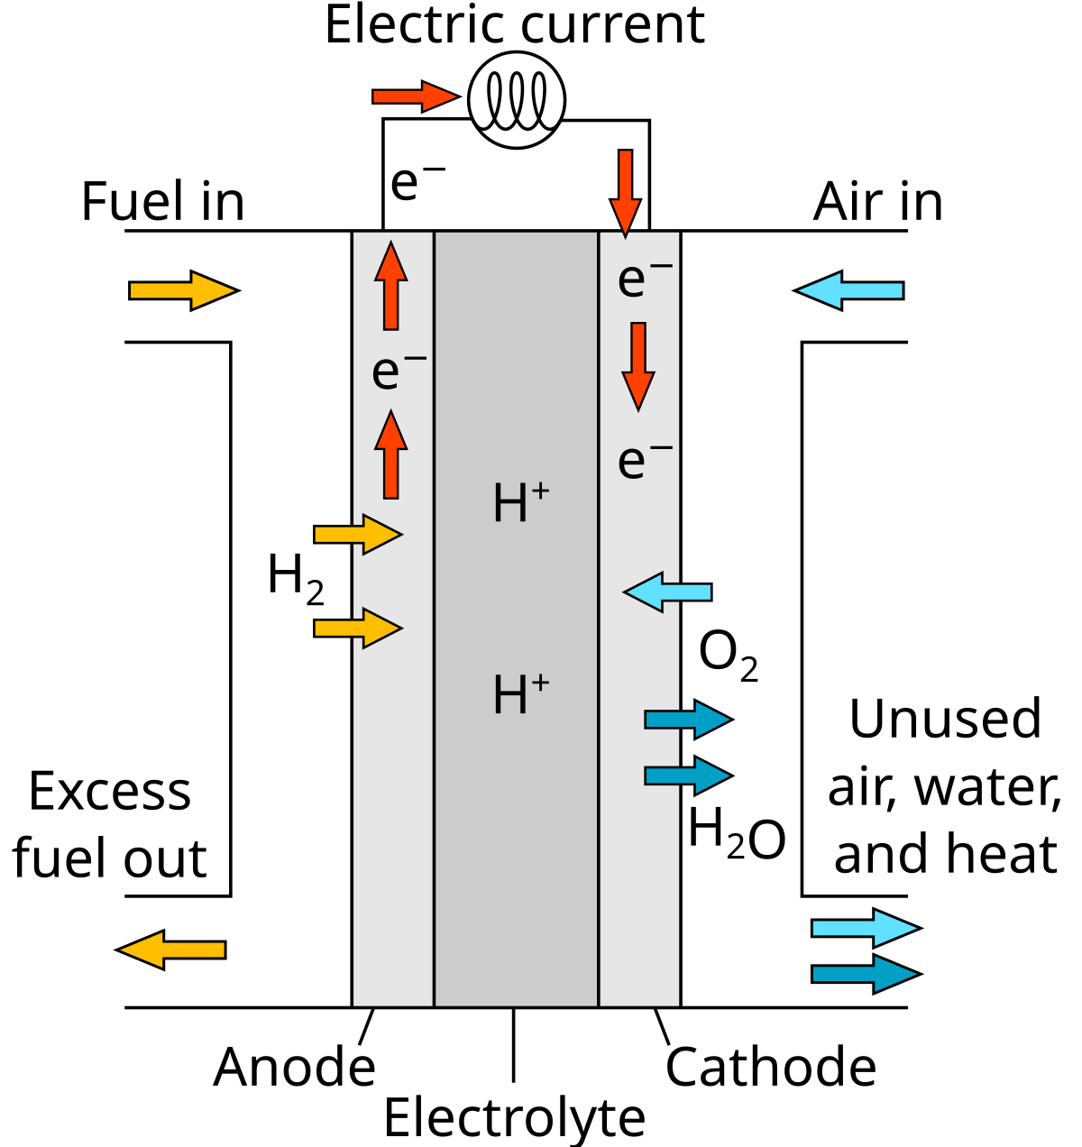
Understanding PEMFCs through surrogates
1. Motivation
Model Validity | Sensitivity Analysis | Surrogate Model | Future Work
What are PEM Fuel Cells?
Challenges with models
Proton Exchange Membrane (PEM) fuel cells (FC) convert hydrogen and oxygen into electricity, emitting only water as subproduct.
Used in automotive and backup power systems
Promising for a clean energy future!
PEMFCs’ complex behaviour is only partially understood
Modeled using accurate but expensive physics-based simulators (e.g. AlphaPEM)
Models have no closed form: they rely on solving complex DAEs
Goal of project partners
Perform model calibration using Fisher Information Matrix-based Optimal Experimental Design (FIM-OED)
They need an analytically closed-form surrogate model that
allows faster simulations
enables exact partial derivative computation
Figure 1. Operating principle of a PEM fuel cell: hydrogen and oxygen react to produce electricity and water. Source: Wikipedia - PEM fuel cell
Notes:
Context:
PEM Fuel Cells are modeled via high-fidelity physics-based simulations (e.g., AlphaPEM).
These models are accurate but rely on solving complex DAEs and require significant computational time.
Model outputs depend on many undetermined physical parameters (e.g., porosity, kinetics) that must be calibrated to match real system behavior.
Challenge:
To calibrate these parameters systematically, the team wants to use Optimal Experimental Design (OED) based on the Fisher Information Matrix (FIM).
FIM-based methods require efficient access to model derivatives (∂output/∂parameter).
Problem:
Current models are black-box or numerical → No analytical form → Derivatives must be approximated → Expensive, noisy, or unstable.
Goal:
Develop an analytical closed-form surrogate model of the PEMFC behavior.
Use techniques like symbolic regression (e.g., PySR) to derive interpretable, differentiable expressions that:
- Accurately mimic the simulation outputs.
- Enable fast and exact computation of derivatives.
- Serve as a foundation for FIM-based OED and robust parameter calibration.

Slide 5
Project goals: From Sensitivities to Surrogates
1. Motivation
Model Validity | Sensitivity Analysis | Surrogate Model | Future Work
AlphaPEM is a 1D, physics-based PEM fuel cell model that employs differential-algebraic equations (DAEs) to simulate polarization behavior (the current–voltage relationship).
Gass et al, (2025)
01
02
Sensitivity Analysis (SA)
Surrogate Model (SM)
Develop an analytically closed-form surrogate model
Uses key features from SA
Faithful to AlphaPEM
Interpretable and computationally efficient
Identify and quantify the influence of input features on AlphaPEM
Select a subset of most influential features
Notes:
Problem
Proton Exchange Membrane (PEM) fuel cells are promising clean energy sources, especially for high-power applications like electric vehicles and backup systems. However, understanding how they operate—especially when integrated into complex systems like powertrains—is still challenging. Existing physical models are often too complex and computationally demanding, making them impractical for real-time analysis or optimization.

Slide 6
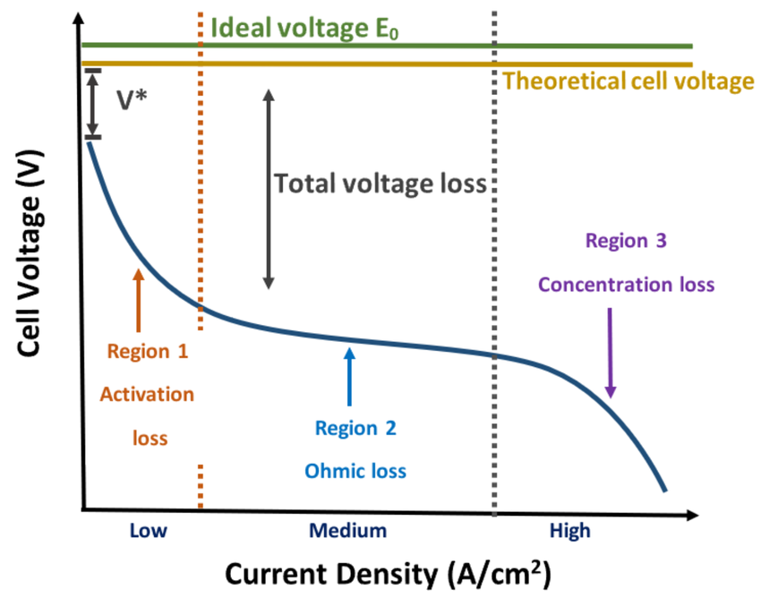
Input-Output framework for AlphaPEM
1. Motivation
Model Validity | Sensitivity Analysis | Surrogate Model | Future Work
Input features
Functional output
Variable (19)
Sensitivity analysis
Operating conditions (7)
Undetermined physical parameters (12)
AlphaPEM
Black-box, complex simulator
Fixed (14)
Accesible physical parameters (7)
Current density parameters (7)
Polarization curve (PC)
Evaluates performance under different loads and operating conditions
Figure 2: AlphaPEM is a “black-box” simulator that maps a given configuration (a combination of physical parameters and operating conditions) to a polarization curve, characterizing fuel cell performance.

Slide 7
1. Introduction and motivation
IRD| Sensitivity Analysis | Surrogate Model | Conclusions and next steps
Goals
Conduct a sensitivity analysis (SA) on the AlphaPEM model to identify and quantify the influence of the input features on the performance of PEM fuel cells.
Using the features from the SA develop an interpretable and analytically closed-form surrogate model that captures key behaviors of the AlphaPEM model while maintaining accuracy, with a focus on interpretability and computational efficiency.
Model validy
Interpretable Regional Descriptors
1
Sensitivity Analysis
- Sobol analysis
- TreeSHAP
Surrogate model
Symbolic regression
2
Notes:
Check the text the scheme

Slide 8
1. Motivation
Model Validity| Sensitivity Analysis | Surrogate Model | Future Work
Problem
→ Proton Exchange Membrane (PEM) fuel cells are complex clean-energy systems combining physical and electrochemical processes.
→ Their behavior in real-world applications remains partially understood.
→ Existing models are accurate but computationally demanding.
Notes:
Problem
Proton Exchange Membrane (PEM) fuel cells are promising clean energy sources, especially for high-power applications like electric vehicles and backup systems. However, understanding how they operate—especially when integrated into complex systems like powertrains—is still challenging. Existing physical models are often too complex and computationally demanding, making them impractical for real-time analysis or optimization.

Slide 9
2. Model Validity
Parameter ranges in which the model is valid
Notes:
We started by sampling across the full input space defined by expert- and literature-based ranges. However, we quickly noticed that many configurations were invalid — meaning the model produced unphysical results or numerical errors. Since AlphaPEM takes 1.5 minutes per run, this was inefficient. This led us to focus on the concept of model validity: defining which parts of the input space actually yield usable simulation results.

Slide 10
Asessing the Model Validity of AlphaPEM
Motivation
2. Model validity
Sensitivity Analysis | Surrogate Model | Future Work
What is model validity?
Finding the region of the input hyperspace where AlphaPEM leads to a physically meaningful, simulation-successful polarization curve.
Sampling in high dimensions: Why model validity matters
We “sample” AlphaPEM by varying 19 input parameters independently
Project partners and author (Gass, 2025) provided wide ranges
However:
(!) Many configurations yield invalid outputs (e.g. negative or excessive voltages)
(!) AlphaPEM is expensive (≈1.5 min per run) → computationally wasteful
Notes:
Motivation to use IRD – we were sampling from the whole space

Slide 11
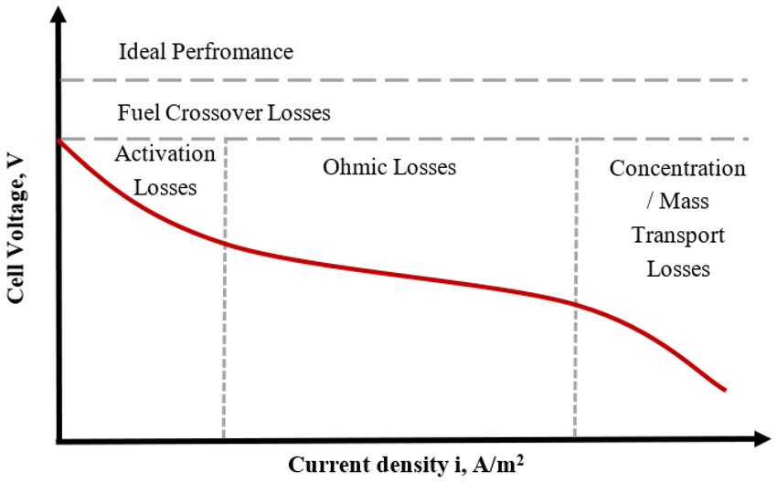
Goal: Finding a valid hyperbox
Motivation
2. Model validity
Sensitivity Analysis | Surrogate Model | Future Work
Find a region (hyperbox) where sampled configurations are consistently valid. That is, the probability of finding a valid polarization curve is very high (>0.9)
What’s a valid
polarization curve?
It starts within the expected voltage range (0.0–1.23 V)
Decreases monotonically (within a 5 mV tolerance) with current density
It maintains positive voltage at and mid current densities (until 2.0 A/cm²)
Figure 3: Valid polarization curve: within 0–1.23 V, monotonic, and positive up to 2.0 A/cm². Source: ResearchGate
Notes:
Motivation to use IRD – we were sampling from the whole space

Slide 12



Motivation
2. Model validity
Sensitivity Analysis | Surrogate Model | Future Work
Interpretable Regional Descriptors (IRD) Hyperbox-based local explanations
Dandl et al. (2022)
IRDs are interpretable hyperboxes in input space where a model’s prediction remains stable
Originally used for model explanation, here applied to find regions yielding valid simulation outputs
We used the PRIM method, adapted to return a hyperbox with high validity precision
Valid
Invalid
01
02
03
04
Labeled configs
Training a classifier
Find valid region
Valid hyperbox
Input: 2000+ configs labeled as valid or invalid based on resulting PCs
Roughly balanced dataset
Method: PRIM
(peeling & pasting)
Goal: find largest hyperbox around a reference valid config with ≥90% validity rate
A box-constrained region where AlphaPEM simulations are likely valid
Model: Random Forest
→ Predicts the prob. a config will yield a valid output
→ Metrics (test set): Precision = 0.91, F1-score = 0.94
Notes:
Motivation to use IRD – we were sampling from the whole space

Slide 13
Resulting hyperbox from IRD
Motivation
2. Model validity
Sensitivity Analysis | Surrogate Model | Future Work
 |  |  | Original range |  | Regional descriptor
 | Feature | Reference configuration | Lower | Upper | Lower | Upper | Range reduction (%)
Operational Condition | Tfc | 347.15 | 333.02 | 362.97 | 339.01 | 357.17 | 39%
 | Pa_des | 200000.00 | 130040.00 | 299920.00 | 138530.00 | 282930.00 | 15%
 | Pc_des | 200000.00 | 110040.00 | 297510.00 | 119410.00 | 269390.00 | 20%
 | Sa | 1.30 | 1.30 | 1.30 | 1.30 | 1.30 | 0%
 | Sc | 2.00 | 1.10 | 3.00 | 1.15 | 3.00 | 3%
 | Phi_a_des | 0.50 | 0.50 | 0.50 | 0.50 | 0.50 | 0%
 | Phi_c_des | 0.60 | 0.10 | 0.70 | 0.27 | 0.66 | 35%
Undetermined Physical Parameter | epsilon_gdl | 0.70 | 0.55 | 0.80 | 0.59 | 0.76 | 33%
 | tau | 1.02 | 1.00 | 4.00 | 1.00 | 3.57 | 14%
 | epsilon_mc | 0.40 | 0.15 | 0.40 | 0.16 | 0.40 | 4%
 | epsilon_c | 0.27 | 0.15 | 0.30 | 0.17 | 0.29 | 14%
 | e | 5 | 3 | 5 | 3 | 5 | 0%
 | Re | 5.70E-07 | 5.1E-07 | 5.0E-06 | 5.1E-07 | 4.8E-06 | 5%
 | i0_c_ref | 2.79 | 0.1 | 499.5 | 0.1 | 82.3 | 84%
 | kappa_co | 27.20 | 0.0 | 40.0 | 17.9 | 40.0 | 45%
 | kappa_c | 1.61 | 0.0 | 100.0 | 0.0 | 2.2 | 98%
 | a_slim | 0.06 | 0.0 | 1.0 | 0.1 | 1.0 | 8%
 | b_slim | 0.11 | 0.0 | 1.0 | 0.0 | 1.0 | 4%
 | a_switch | 0.64 | 0.0 | 1.0 | 0.1 | 0.9 | 20%
Reference configuration
x_interest is taken from Tables 3.3 and 3.4 of Gass' thesis and corresponds to a validated polarization curve from the EH-31 experimental fuel cell
Immutable features: fixed to reference value
Large range reductions for i0_c_ref, kappa_co, and kappa_c indicate these parameters must be tightly constrained to ensure valid polarization curves
Table 1: Comparison of the original parameter ranges and the validated input region (IRD-derived hyperbox) identified using the PRIM method. The "IRD range" corresponds to the largest subregion where ≥90% of sampled configurations lead to valid, physically meaningful outputs from AlphaPEM.
Notes:
Motivation to use IRD – we were sampling from the whole space

Slide 14
Final set of input parameters for sampling of AlphaPEM
Motivation
2. Model validity
Sensitivity Analysis | Surrogate Model | Future Work
Color palette for visualizations
# | Parameter | Description | Range
1 | Tfc | Desired fuel cell temperature (K) | [333, 363]
2 | Pa_des | Desired anode pressure (Pa) | [130000, 300000]
3 | Sc | Stoichiometric ratio of oxygen | [1.1, 3.0]
4 | Phi_c_des | Desired cathode relative humidity | [0.1, 0.7]
5 | epsilon_gdl | GDL porosity (dimensionless) | [0.55, 0.8]
6 | tau | Pore structure coefficient (dimensionless) | [1.0, 4.0]
7 | epsilon_mc | Volume fraction of ionomer in catalyst layer (dimensionless) | [0.15, 0.4]
8 | epsilon_c | Compression ratio of GDL (dimensionless) | [0.15, 0.3]
9 | e | Capillary exponent (integer) | [3, 4, 5]
10 | Re | Electron conduction resistance (Ω·m²) | [5.0e-7, 5.0e-6]
11 | i0_c_ref | Cathode exchange current density (A/m²) | [0.001, 80]
12 | kappa_co | Crossover correction coefficient (mol/(m·s·Pa)) | [15, 40]
13 | kappa_c | Overpotential correction exponent (dimensionless) | [0, 2.5]
Fixed parameters
The following parameters were fixed to simplify the model:
Sa = 1.3
Phi_a_des = 0.5
a_slim = 0
b_slim = 1
a_switch = 0.99
Pc_des is derived from Pa_des − 20000 Pa
Table 2: Final 13 input parameters for valid AlphaPEM simulations, selected in collaboration with project partners and AlphaPEM’s author Raphael Gass. Operating conditions were intentionally left unrestricted; undetermined physical parameters were fixed or constrained based on IRD-guided model validity analysis.
Notes:
Motivation to use IRD – we were sampling from the whole space

Slide 15

Introduction and motivation
Sensitivity Analysis | Surrogate Model | Conclusions and next steps
2. IRD
Sampling from AlphaPEM
→ Due to the lack of empirical data, we used Latin Hypercube Sampling to uniformly explore the full input space.
→ No dependencies between features were assumed.
What is a valid polarization curve?
→ It starts within the expected voltage range (0.0–1.23 V)
→ Decreases monotonically (within a 5 mV tolerance)
→ It maintains positive voltage at low current densities.
Notes:
Motivation to use IRD – we were sampling from the whole space

Slide 16
Introduction and motivation
Sensitivity Analysis | Surrogate Model | Conclusions and next steps
2. IRD
What is the Interpretable Regional Descriptors (IRD)?
How does it work?
Clustering and labeling output curves based on shape (validity criteria).
Training interpretable models (typically decision trees or rule-based classifiers) to map input features to curve types.
Generating regional descriptors: rules or conditions that explain which input combinations lead to each type of curve.
IRD helps explain "where" in the input space certain types of output behavior occur.
What is the output?
Interpretable rules or regions
(e.g., "Region A: high humidity, low temperature → flat voltage curves").
In R it is implemented in the package XXXXXX
Notes:
What is IRD? How does it work? Where is it implemented?

Slide 17
Introduction and motivation
Sensitivity Analysis | Surrogate Model | Conclusions and next steps
2. IRD
Our results!
Notes:
Comparison of the results

Slide 18
3. Sensitivity analysis

Slide 19
Introduction and motivation | IRD
3. Sensitivity Analysis
Surrogate Model | Conclusions and next steps
What is a sensitivity analysis?
It is a method used to determine how changes in input variables influence the output of a model.
It helps identify which inputs have the most significant effect on the results and how robust the model is to variations or uncertainty in those inputs.
What is the Goal?
Quantify the influence of each input on the output.
Prioritize the most impactful variables.
Guide model simplification, optimization.
Increase understanding of the system's behavior under different conditions.

Slide 20
Introduction and motivation | IRD
3. Sensitivity Analysis
Surrogate Model | Conclusions and next steps
what we tried -> Sobol Alpha PEM- Sobol in XGBoost-SHAP in XGBoost

Slide 21

Introduction and motivation | IRD
3. Sensitivity Analysis
Surrogate Model | Conclusions and next steps
Region-based SA
Advantages: Localized insights about most important features per region.
AlphaPEM is accurate, but simulations are computationally expensive.
Sensitivity analysis (especially Sobol) needs thousands of evaluations.
Not feasible to run AlphaPEM directly at that scale.
Activation [0;0.4)
Ohmic [0.4; 1.6)
Mass transport [1.6; Inf)
Regions
definition
Idea: We train fast, accurate models to approximate AlphaPEM
Surrogate model
Compute SHAP values (model explainability).
Run Sobol analysis (variance decomposition).
Explore inputs cheaply and flexibly.
XGBoost
Random Forest
Figure XX: Valid polarization curve: within 0–1.23 V, monotonic, and positive up to 2.0 A/cm². Source: ResearchGate

Slide 22
Introduction and motivation | IRD
3. Sensitivity Analysis
Surrogate Model | Conclusions and next steps
SA methods
Approaches
Sobol Indices quantify how much of the output variance is due to each input (individually and via interactions).
1
AlphaPEM
Sobol Indices
In the implementation we have first order indices (S1) and interaction indices (S2)
$$S1, S2 ∈\left[0,1\right] S1+S2≈1$$
SHAP values explain how much each feature contributes to a model’s prediction.
XGBoost
Sobol Indices
2
High accuracy, efficient with large datasets, handles complex interactions well.
SHAP Values
Sample strategy Sobol sequences
Random Forest
Robust to noise, less sensitive to hyperparameters, offers rough uncertainty estimates via tree variance.
It generates quasi-random sequences that are uniformly distributed sample points in high-dimensional spaces.
3

Slide 23




Introduction and motivation | IRD
3. Sensitivity Analysis
Surrogate Model | Conclusions and next steps
AlphaPEM
Sobol
S1 Indices
For the Sobol’s implementation:
N = 2046 (sample size) → 57,288 configurations
Parameter | Activation | Ohmic | Mass Transport
Tfc | 0.027 ± 0.05 | 0.045 ± 0.04 | 0.051 ± 0.04
Pa_des | 0.015 ± 0.05 | 0.058 ± 0.04 | 0.067 ± 0.04
Sc | 0.003 ± 0.05 | 0.017 ± 0.04 | 0.014 ± 0.04
Phi_c_des | -0.001 ± 0.03 | 0.009 ± 0.03 | 0.002 ± 0.03
epsilon_gdl | 0.025 ± 0.03 | 0.022 ± 0.04 | 0.003 ± 0.04
tau | 0.206 ± 0.13 | 0.199 ± 0.08 | 0.149 ± 0.06
epsilon_mc | 0.03 ± 0.06 | 0.038 ± 0.06 | 0.039 ± 0.04
epsilon_c | 0.001 ± 0.05 | 0.007 ± 0.04 | -0.006 ± 0.03
e | 0.017 ± 0.02 | 0.025 ± 0.03 | 0.024 ± 0.04
Re | -0.019 ± 0.04 | 0.009 ± 0.03 | 0.035 ± 0.04
i0_c_ref | 0.16 ± 0.06 | 0.108 ± 0.04 | 0.106 ± 0.04
kappa_co | -0.009 ± 0.05 | 0.001 ± 0.04 | -0.009 ± 0.04
kappa_c | 0.081 ± 0.03 | 0.039 ± 0.03 | 0.009 ± 0.03
Sum S1 | 0.5352 | 0.5779 | 0.4842
Average Confidence | 0.0501 | 0.0428 | 0.0377
$${Pa}_{des}$$
$$φ_{cdes}$$
$$ε_{gdl}$$
$$τ$$
$$ε_{mc}$$
$$ε_{c}$$
$${i0}_{c ref}$$
$$κ_{co}$$
$$κ_{c}$$
*Confidence is based on bootstrapping-like resampling

Slide 24
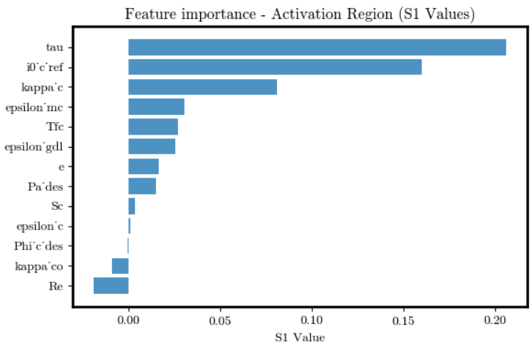
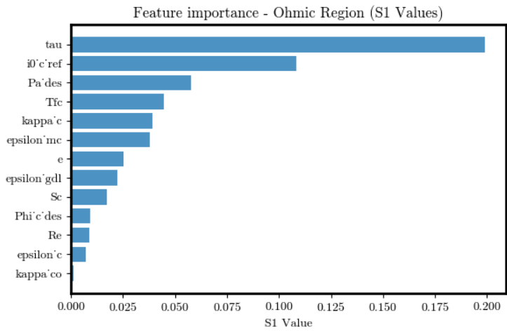
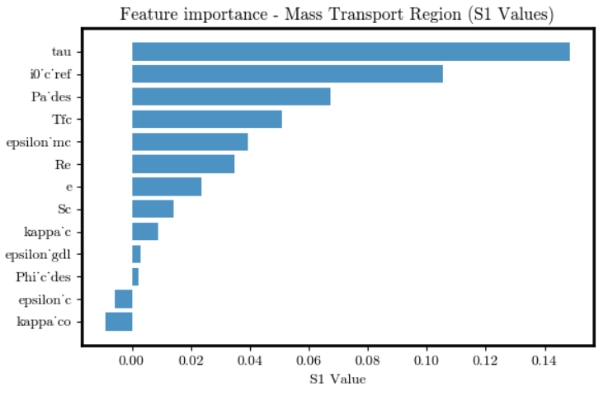
Introduction and motivation | IRD
3. Sensitivity Analysis
Surrogate Model | Conclusions and next steps
AlphaPEM
Activation
Ohmic
Sobol
Feature
Importance
Mass Transport
Pending update

Slide 25
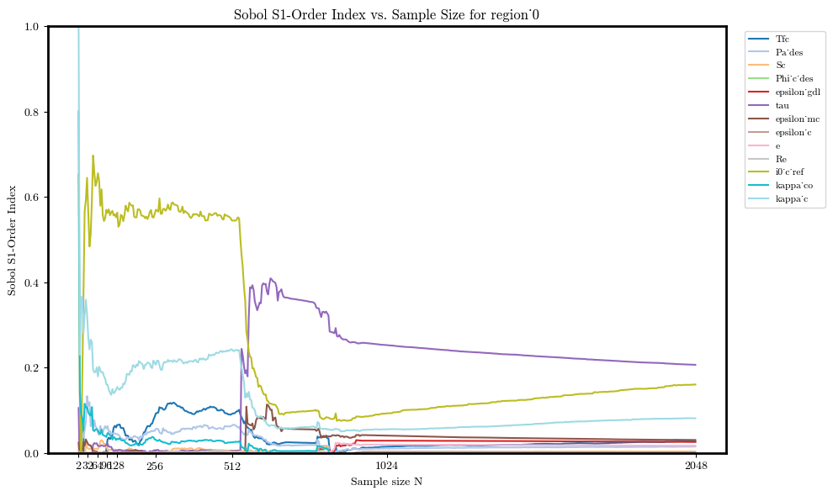
Introduction and motivation | IRD
3. Sensitivity Analysis
Surrogate Model | Conclusions and next steps
AlphaPEM
Sobol
S1 Indices
Activation
Pending update

Slide 26
Introduction and motivation | IRD
3. Sensitivity Analysis
Surrogate Model | Conclusions and next steps
AlphaPEM
Sobol
S1 Indices
Ohmic
Pending update

Slide 27
Introduction and motivation | IRD
3. Sensitivity Analysis
Surrogate Model | Conclusions and next steps
AlphaPEM
Sobol
S1 Indices
Mass Transport
Pending update

Slide 28
Introduction and motivation | IRD
3. Sensitivity Analysis
Surrogate Model | Conclusions and next steps
VERIFY INFORMATION
XGBoost
 | Activation | Ohmic | Mass transport
MAE | 0.0042 ± 0.0001 | 0.0235 ± 0.0003 | 0.0275 ± 0.0004
RMSE | 0.0001 ± 0.0000 | 0.0045 ± 0.0002 | 0.0054 ± 0.0003
R-squared | 0.8437 ± 0.0047 | 0.7946 ± 0.0092 | 0.8388 ± 0.0102
Data preparation
We are fitting the voltage as a function of the 13 features & the current density.
Only valid polarization curves (~55k configurations)
Final dataset size: XXXX
*Unit:
Watts/cm²
Train the model
XGBoost with nested CV
Inner 3-fold CV: for tuning XGBoost hyperparameters.
Outer 5-fold CV: to assess generalization performance.
RESIDUALS PLOT

Slide 29
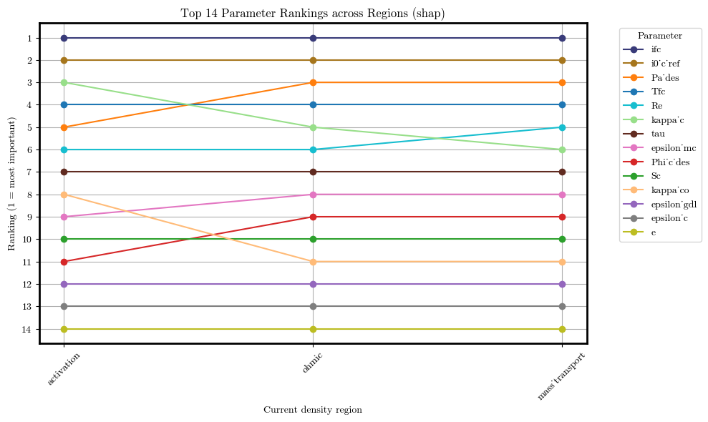











Introduction and motivation | IRD
3. Sensitivity Analysis
Surrogate Model | Conclusions and next steps
XGBoost
SHAP
Rankings per
Region
$$ifc$$
$${i0}_{c ref}$$
$${Pa}_{des}$$
$$Tfc$$
$$Re$$
$$κ_{c}$$
$$τ$$
$$ε_{mc}$$
$$φ_{cdes}$$
Union of all selected features across regions
$$Sc$$
$$κ_{co}$$
$$ε_{gdl}$$
Total importance
explained >95% - 11 features
$$ε_{c}$$
$$e$$
Pa_des
Phi_c_des
Re
SC
Tfc
epsilon_mc
i0_c_ref
Ifc
kappa_c
kappa_co
Tau
$${Pa}_{des}$$
$$φ_{cdes}$$
$$Re$$
$$Sc$$
$$Tfc$$
$$ε_{mc}$$
$${i0}_{c ref}$$
$$ifc$$
$$κ_{c}$$
$$κ_{co}$$
Figure XX: Comparison of parameter rankings across current density regions based on SHAP values. Lines track changes in feature importance from activation to ohmic to mass transport regions, where a lower rank indicates higher influence on model output.
$$τ$$

Slide 30
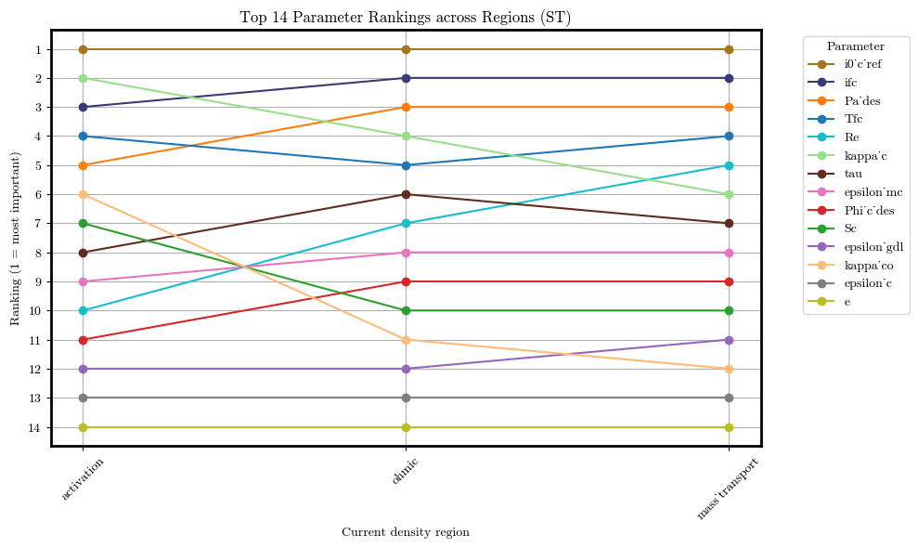







Introduction and motivation | IRD
3. Sensitivity Analysis
Surrogate Model | Conclusions and next steps
XGBoost
Sobol
Rankings per
Region
$${i0}_{c ref}$$
$$ifc$$
$${Pa}_{des}$$
$$Tfc$$
$$Re$$
$$κ_{c}$$
$$τ$$
$$ε_{mc}$$
$$φ_{cdes}$$
$$Sc$$
Union of all selected features across regions
$$ε_{gdl}$$
$$κ_{co}$$
Total importance
explained >95% - 10 features
$$ε_{c}$$
$$e$$
Pa_des
Phi_c_des
Re
Tfc
epsilon_mc
i0_c_ref
Ifc
kappa_c
kappa_co
tau
$${Pa}_{des}$$
$$φ_{cdes}$$
$$Re$$
$$Tfc$$
$$ε_{mc}$$
$${i0}_{c ref}$$
$$ifc$$
$$κ_{c}$$
$$κ_{co}$$
$$τ$$
Figure XX: Comparison of parameter rankings across current density regions based on Sobol values. Lines track changes in feature importance from activation to ohmic to mass transport regions, where a lower rank indicates higher influence on model output.

Slide 31



















Introduction and motivation | IRD
3. Sensitivity Analysis
Surrogate Model | Conclusions and next steps
XGBoost
Mean |SHAP|
Sobol (ST)
Comparing
Rankings per
Method
Feature | Activation | Ohmic | Mass transport
ifc | 1 | 1 | 1
i0_c_ref | 2 | 2 | 2
kappa_c | 3 | 5 | 6
Tfc | 4 | 4 | 4
Pa_des | 5 | 3 | 3
Re | 6 | 6 | 5
tau | 7 | 7 | 7
kappa_co | 8
epsilon_mc | 9 | 8 | 8
Phi_c_des |  | 9 | 9
Sc |  | 10 | 10
Feature | Activation | Ohmic | Mass transport
i0_c_ref | 1 | 1 | 1
kappa_c | 2 | 4 | 6
ifc | 3 | 2 | 2
Tfc | 4 | 5 | 4
Pa_des | 5 | 3 | 3
kappa_co | 6
Phi_c_des |  |  | 9
Re |  | 7 | 5
epsilon_mc |  | 8 | 8
tau |  | 6 | 7
$$ifc$$
$${i0}_{c ref}$$
$${i0}_{c ref}$$
$$κ_{c}$$
$$κ_{c}$$
$$ifc$$
$$Tfc$$
$$Tfc$$
$${Pa}_{des}$$
$${Pa}_{des}$$
$$Re$$
$$κ_{co}$$
$$τ$$
$$φ_{cdes}$$
$$κ_{co}$$
$$Re$$
$$ε_{mc}$$
$$ε_{mc}$$
$$φ_{cdes}$$
$$τ$$
$$Sc$$
Figure XX: Ranking position of selected features based on total Sobol index across polarization regions. Features are selected so that the accumulated ST equals a threshold (0.95).
Figure XX: Ranking positions of selected features based on SHAP values across polarization regions. Features are selected such that their cumulative mean absolute SHAP values account for at least 95% of the total importance in each region.
Common features (intersection):
Adittional features:
$${Pa}_{des}$$
$$Tfc$$
$${i0}_{c ref}$$
$$ifc$$
$$κ_{c}$$

Slide 32
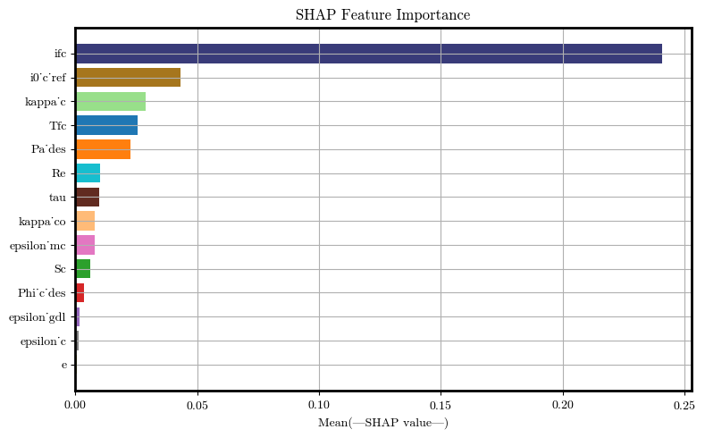
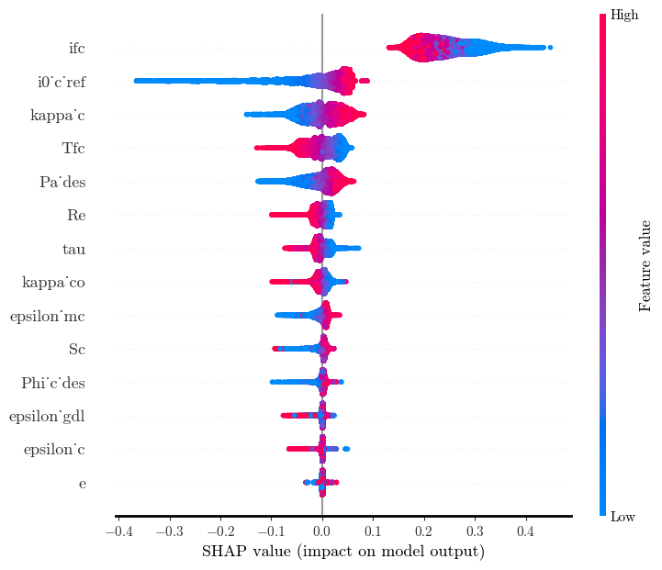




Introduction and motivation | IRD
3. Sensitivity Analysis
Surrogate Model | Conclusions and next steps
XGBoost
SHAP
Feature
Importance
Feature importance
Summary plot
$$ifc$$
$$ifc$$
$${i0}_{c ref}$$
$${i0}_{c ref}$$
$$κ_{c}$$
$$κ_{c}$$
$$Tfc$$
$$Tfc$$
Activation
$${Pa}_{des}$$
$${Pa}_{des}$$
$$Re$$
$$Re$$
$$τ$$
$$τ$$
$$κ_{co}$$
$$κ_{co}$$
$$ε_{mc}$$
$$ε_{mc}$$
$$Sc$$
$$Sc$$
$$φ_{cdes}$$
$$φ_{cdes}$$
$$ε_{gdl}$$
$$ε_{gdl}$$
$$ε_{c}$$
$$ε_{c}$$
$$e$$
$$e$$
Figure XX: SHAP feature importance ranking based on the XGBoost model, showing the top contributors to the output in the Activation region.
Figure XX: SHAP summary plot showing feature impact on the XGBoost model for the Activation region. Color indicates feature value; horizontal spread reflects influence.

Slide 33





Introduction and motivation | IRD
3. Sensitivity Analysis
Surrogate Model | Conclusions and next steps
XGBoost
Sobol
Feature | S1 | S1 CI | ST | ST CI | S2 Total | S2 CI
i0_c_ref | 0.4344 | (0.41, 0.459) | 0.4422 | (0.425, 0.459) | 0.0050 | (-0.119, 0.129)
kappa_c | 0.1834 | (0.169, 0.198) | 0.2108 | (0.202, 0.219) | -0.0006 | (-0.021, 0.019)
ifc | 0.1870 | (0.175, 0.199) | 0.1939 | (0.186, 0.202) | 0.0000 | (0.0, 0.0)
Tfc | 0.0768 | (0.068, 0.086) | 0.0818 | (0.079, 0.085) | 0.0018 | (-0.184, 0.187)
Pa_des | 0.0466 | (0.038, 0.055) | 0.0739 | (0.07, 0.078) | 0.0725 | (-0.078, 0.223)
kappa_co | 0.0098 | (0.006, 0.014) | 0.0183 | (0.017, 0.019) | 0.0114 | (-0.001, 0.024)
Sc | 0.0057 | (0.003, 0.009) | 0.0136 | (0.013, 0.014) | 0.0070 | (-0.044, 0.058)
tau | 0.0040 | (0.001, 0.007) | 0.0095 | (0.009, 0.01) | -0.0069 | (-0.041, 0.028)
epsilon_mc | 0.0032 | (0.001, 0.006) | 0.0071 | (0.007, 0.007) | -0.0007 | (-0.027, 0.026)
Re | 0.0017 | (-0.001, 0.004) | 0.0056 | (0.005, 0.006) | 0.0007 | (-0.013, 0.014)
Phi_c_des | 0.0024 | (0.001, 0.004) | 0.0046 | (0.004, 0.005) | -0.0168 | (-0.048, 0.014)
epsilon_gdl | -0.0003 | (-0.002, 0.001) | 0.0026 | (0.002, 0.003) | 0.0070 | (-0.014, 0.028)
epsilon_c | -0.0005 | (-0.002, 0.001) | 0.0023 | (0.002, 0.002) | 0.0052 | (-0.007, 0.017)
e | 0.0004 | (-0.0, 0.001) | 0.0004 | (0.0, 0.0) | -0.0027 | (-0.007, 0.002)
$${i0}_{c ref}$$
$$κ_{c}$$
$$ifc$$
Activation
$$Tfc$$
$${Pa}_{des}$$
N = 8.192
→ 245,760 configurations
Sum S1 = 0.9547
Sum S2 = 0.0830
Sum S1 + S2 = 1.0377
Sum ST = 1.0665
$$κ_{co}$$
$$Sc$$
$$τ$$
$$ε_{mc}$$
$$Re$$
$$φ_{cdes}$$
$$ε_{gdl}$$
$$ε_{c}$$
$$e$$
Figure XX: Sobol sensitivity indices for the Activation region based on the XGBoost model, showing first-order (S1), total-order (ST), and second-order (S2) effects with confidence intervals. Parameters i0_ref, κ_c, and ifc exhibit the highest influence on model output.

Slide 34
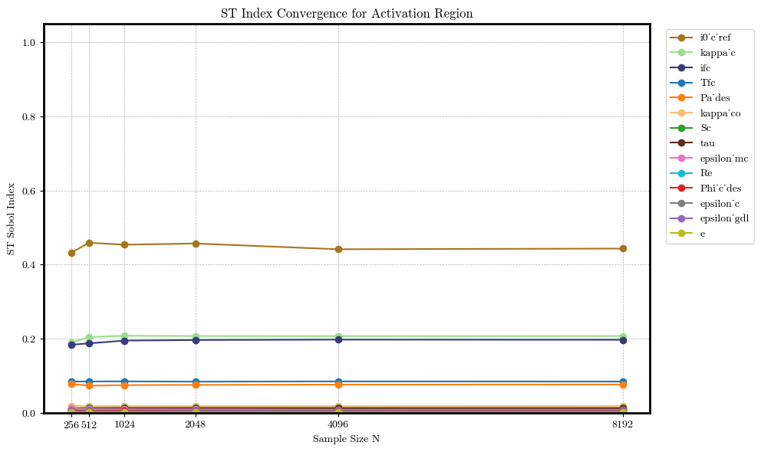

Introduction and motivation | IRD
3. Sensitivity Analysis
Surrogate Model | Conclusions and next steps
XGBoost
Sobol
ST
$${i0}_{c ref}$$
$$κ_{c}$$
$$ifc$$
$$Tfc$$
$${Pa}_{des}$$
$$κ_{co}$$
$$Sc$$
$$τ$$
$$ε_{mc}$$
Activation
$$Re$$
$$φ_{cdes}$$
$$ε_{c}$$
N = 8.192
→ 245,760 configurations
Sum S1 = 0.9547
Sum S2 = 0.0830
Sum S1 + S2 = 1.0377
Sum ST = 1.0665
$$ε_{gdl}$$
$$e$$
Figure XX: Convergence of total-order (ST) Sobol indices for features in the Activation region across increasing sample sizes. The indices stabilize as sample size grows, with i0'_c ref, κ_c, and ifc showing the highest total contributions to output variance.

Slide 35
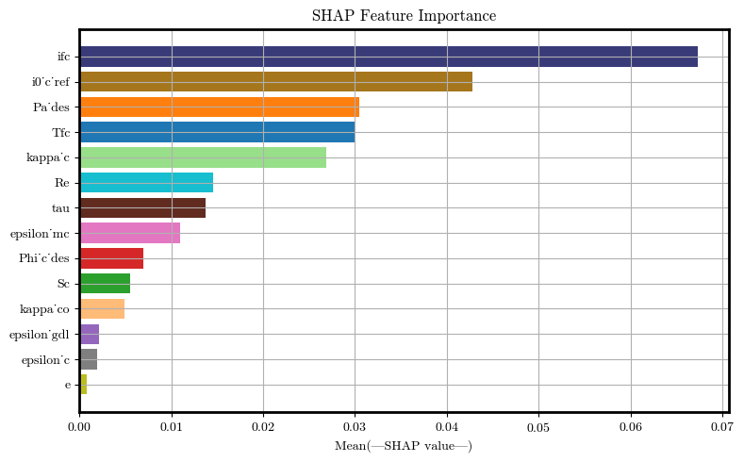
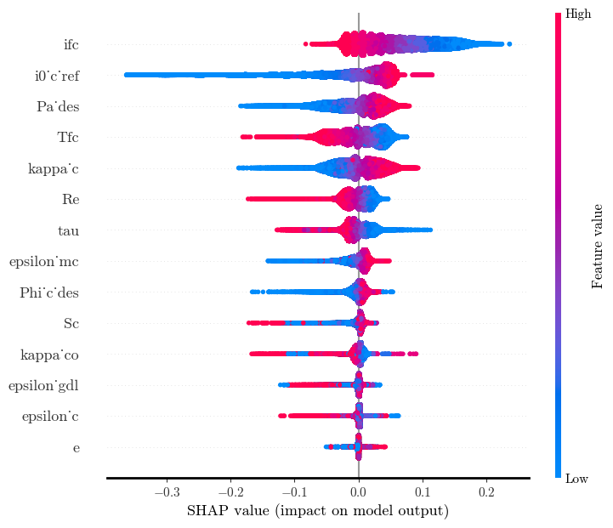
Introduction and motivation | IRD
3. Sensitivity Analysis
Surrogate Model | Conclusions and next steps
XGBoost
SHAP
Feature
Importance
Feature importance
Summary plot
$$ifc$$
$$ifc$$
$${i0}_{c ref}$$
$${i0}_{c ref}$$
$${Pa}_{des}$$
$${Pa}_{des}$$
$$Tfc$$
$$Tfc$$
Ohmic
$$κ_{c}$$
$$κ_{c}$$
$$Re$$
$$Re$$
$$τ$$
$$τ$$
$$ε_{mc}$$
$$ε_{mc}$$
$$φ_{cdes}$$
$$φ_{cdes}$$
$$Sc$$
$$Sc$$
$$κ_{co}$$
$$κ_{co}$$
$$ε_{gdl}$$
$$ε_{gdl}$$
$$ε_{c}$$
$$ε_{c}$$
$$e$$
$$e$$
Figure XX: SHAP feature importance ranking based on the XGBoost model, showing the top contributors to the output in the Ohmic region.
Figure XX: SHAP summary plot showing feature impact on the XGBoost model for the Ohmic region. Color indicates feature value; horizontal spread reflects influence.

Slide 36




Introduction and motivation | IRD
3. Sensitivity Analysis
Surrogate Model | Conclusions and next steps
XGBoost
Sobol
Feature | S1 | S1 CI | ST | ST CI | S2 Total | S2 CI
i0_c_ref | 0.3046 | (0.285, 0.324) | 0.3145 | (0.3, 0.329) | 0.0055 | (-0.089, 0.1)
ifc | 0.2770 | (0.262, 0.292) | 0.2881 | (0.277, 0.299) | 0.0000 | (0.0, 0.0)
Pa_des | 0.1069 | (0.096, 0.118) | 0.1319 | (0.126, 0.138) | 0.0479 | (-0.158, 0.254)
kappa_c | 0.0958 | (0.085, 0.107) | 0.1191 | (0.114, 0.124) | 0.0007 | (-0.016, 0.017)
Tfc | 0.1050 | (0.095, 0.115) | 0.1164 | (0.112, 0.121) | 0.0102 | (-0.193, 0.213)
tau | 0.0183 | (0.014, 0.023) | 0.0286 | (0.027, 0.03) | 0.0088 | (-0.049, 0.066)
Re | 0.0151 | (0.01, 0.02) | 0.0231 | (0.022, 0.024) | 0.0026 | (-0.025, 0.031)
epsilon_mc | 0.0116 | (0.007, 0.016) | 0.0193 | (0.018, 0.02) | -0.0039 | (-0.047, 0.039)
Phi_c_des | 0.0083 | (0.005, 0.012) | 0.0151 | (0.014, 0.016) | -0.0051 | (-0.058, 0.048)
Sc | 0.0017 | (-0.001, 0.004) | 0.0096 | (0.009, 0.01) | -0.0058 | (-0.047, 0.036)
kappa_co | 0.0020 | (-0.0, 0.004) | 0.0063 | (0.006, 0.007) | 0.0023 | (-0.004, 0.009)
epsilon_gdl | 0.0003 | (-0.002, 0.002) | 0.0039 | (0.003, 0.004) | 0.0051 | (-0.021, 0.031)
epsilon_c | -0.0004 | (-0.002, 0.001) | 0.0034 | (0.003, 0.004) | 0.0008 | (-0.014, 0.016)
e | 0.0003 | (-0.0, 0.001) | 0.0005 | (0.0, 0.001) | -0.0016 | (-0.006, 0.003)
$${i0}_{c ref}$$
$$ifc$$
$${Pa}_{des}$$
$$κ_{c}$$
Ohmic
$$Tfc$$
N = 8.192
→ 245,760 configurations
Sum S1 = 0.9464
Sum S2 = 0.0675
Sum S1 + S2 = 1.0139
Sum ST = 1.0799
$$τ$$
$$Re$$
$$ε_{mc}$$
$$φ_{cdes}$$
$$Sc$$
$$κ_{co}$$
$$ε_{gdl}$$
$$ε_{c}$$
$$e$$
Figure XX: Sobol sensitivity indices for the Ohmic region based on the XGBoost model, showing first-order (S1), total-order (ST), and second-order (S2) effects with confidence intervals. Parameters i0_ref, κ_c, and ifc exhibit the highest influence on model output.

Slide 37
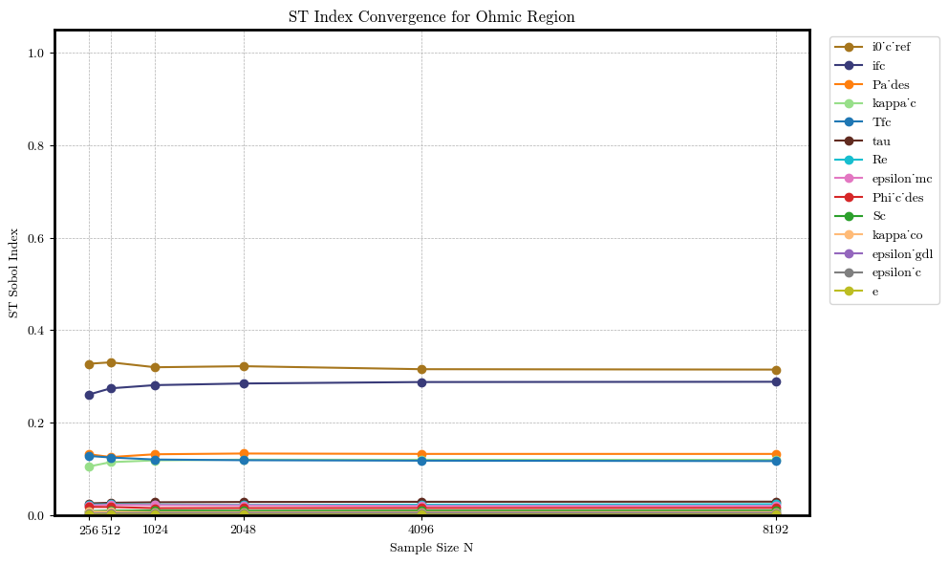

Introduction and motivation | IRD
3. Sensitivity Analysis
Surrogate Model | Conclusions and next steps
XGBoost
Sobol
ST
$${i0}_{c ref}$$
$$ifc$$
$${Pa}_{des}$$
$$κ_{c}$$
$$Tfc$$
$$τ$$
$$Re$$
$$ε_{mc}$$
$$φ_{cdes}$$
Ohmic
$$Sc$$
$$κ_{co}$$
$$ε_{gdl}$$
N = 8.192
→ 245,760 configurations
Sum S1 = 0.9464
Sum S2 = 0.0675
Sum S1 + S2 = 1.0139
Sum ST = 1.0799
$$ε_{c}$$
$$e$$
Figure XX: Convergence of total-order (ST) Sobol indices for features in the Ohmic region across increasing sample sizes. The indices stabilize as sample size grows, with i0'_c ref, κ_c, and ifc showing the highest total contributions to output variance.

Slide 38
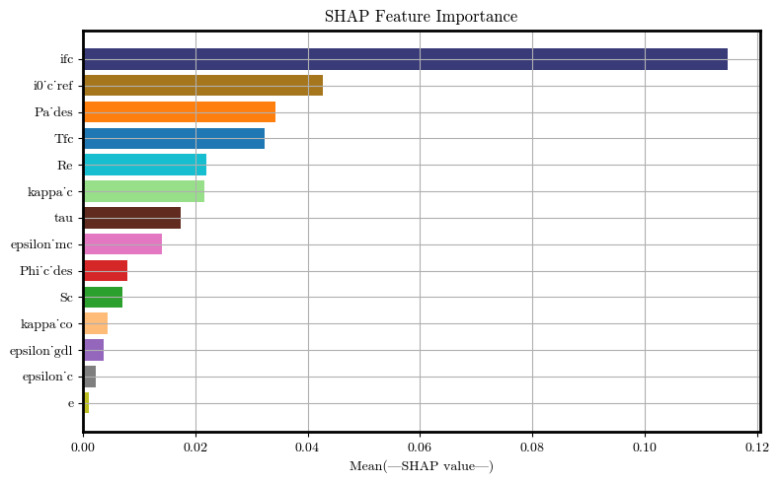
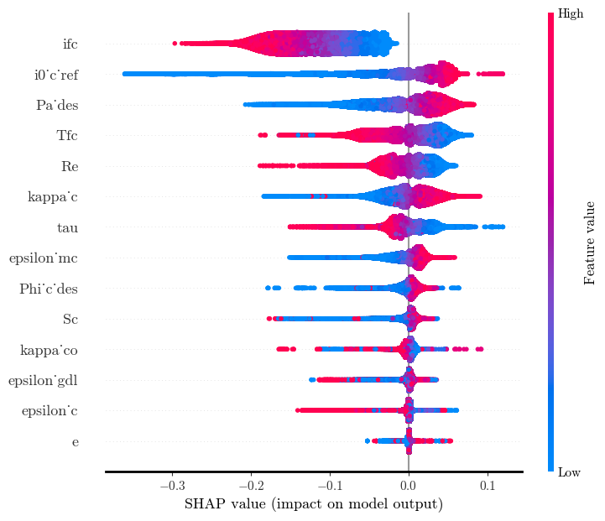


Introduction and motivation | IRD
3. Sensitivity Analysis
Surrogate Model | Conclusions and next steps
XGBoost
SHAP
Feature
Importance
Feature importance
Summary plot
$$ifc$$
$$ifc$$
$${i0}_{c ref}$$
$${i0}_{c ref}$$
$${Pa}_{des}$$
$${Pa}_{des}$$
$$Tfc$$
$$Tfc$$
Mass Transport
$$Re$$
$$Re$$
$$κ_{c}$$
$$κ_{c}$$
$$τ$$
$$τ$$
$$ε_{mc}$$
$$ε_{mc}$$
$$φ_{cdes}$$
$$φ_{cdes}$$
$$Sc$$
$$Sc$$
$$κ_{co}$$
$$κ_{co}$$
$$ε_{gdl}$$
$$ε_{gdl}$$
$$ε_{c}$$
$$ε_{c}$$
$$e$$
$$e$$
Figure XX: SHAP feature importance ranking based on the XGBoost model, showing the top contributors to the output in the Mass Transport region.
Figure XX: SHAP summary plot showing feature impact on the XGBoost model for the Mass Transport region. Color indicates feature value; horizontal spread reflects influence.

Slide 39

Introduction and motivation | IRD
3. Sensitivity Analysis
Surrogate Model | Conclusions and next steps
XGBoost
Sobol
Feature | S1 | S1 CI | ST | ST CI | S2 Total | S2 CI
i0_c_ref | 0.2734 | (0.255, 0.291) | 0.2852 | (0.272, 0.299) | 0.0044 | (-0.08, 0.089)
ifc | 0.1726 | (0.161, 0.185) | 0.1863 | (0.179, 0.194) | 0.0000 | (0.0, 0.0)
Pa_des | 0.1524 | (0.14, 0.165) | 0.1853 | (0.178, 0.193) | 0.0381 | (-0.203, 0.28)
Tfc | 0.1282 | (0.118, 0.139) | 0.1486 | (0.142, 0.155) | -0.0148 | (-0.232, 0.203)
Re | 0.0696 | (0.06, 0.079) | 0.0830 | (0.08, 0.086) | 0.0045 | (-0.05, 0.059)
kappa_c | 0.0361 | (0.028, 0.044) | 0.0608 | (0.058, 0.063) | 0.0023 | (-0.009, 0.013)
tau | 0.0426 | (0.036, 0.049) | 0.0550 | (0.052, 0.058) | 0.0069 | (-0.066, 0.08)
epsilon_mc | 0.0290 | (0.022, 0.036) | 0.0395 | (0.038, 0.041) | -0.0114 | (-0.076, 0.053)
Phi_c_des | 0.0104 | (0.006, 0.015) | 0.0235 | (0.021, 0.025) | -0.0081 | (-0.076, 0.06)
Sc | 0.0047 | (0.001, 0.009) | 0.0190 | (0.018, 0.02) | 0.0176 | (-0.046, 0.082)
epsilon_gdl | 0.0010 | (-0.002, 0.004) | 0.0093 | (0.009, 0.01) | 0.0076 | (-0.032, 0.047)
kappa_co | 0.0023 | (-0.0, 0.005) | 0.0057 | (0.005, 0.006) | -0.0004 | (-0.007, 0.006)
epsilon_c | -0.0009 | (-0.003, 0.001) | 0.0048 | (0.004, 0.006) | 0.0066 | (-0.011, 0.025)
e | 0.0003 | (-0.001, 0.001) | 0.0008 | (0.001, 0.001) | -0.0022 | (-0.009, 0.005)
$${i0}_{c ref}$$
$$ifc$$
$${Pa}_{des}$$
Mass Transport
$$Tfc$$
$$Re$$
N = 8.192
→ 245,760 configurations
Sum S1 = 0.9217
Sum S2 = 0.0510
Sum S1 + S2 = 0.9727
Sum ST = 1.1068
$$κ_{c}$$
$$τ$$
$$ε_{mc}$$
$$φ_{cdes}$$
$$Sc$$
$$ε_{gdl}$$
$$κ_{co}$$
$$ε_{c}$$
$$e$$
Figure XX: Sobol sensitivity indices for the Mass Transport region based on the XGBoost model, showing first-order (S1), total-order (ST), and second-order (S2) effects with confidence intervals. Parameters i0_ref, Pa_des, and ifc exhibit the highest influence on model output.

Slide 40
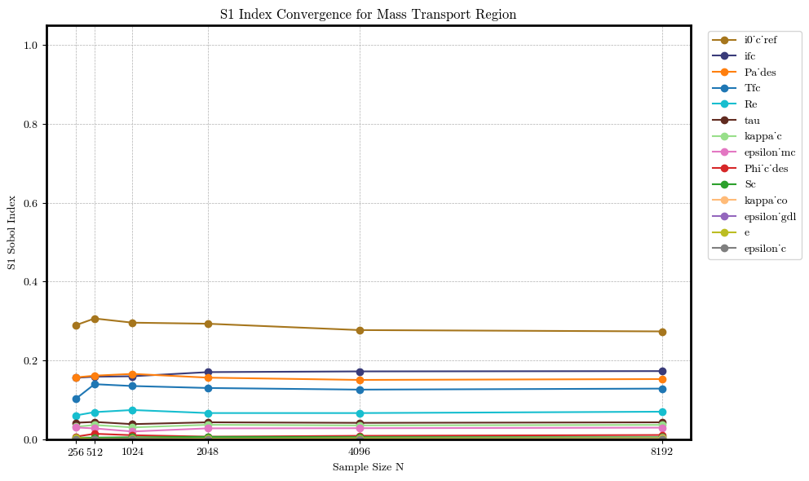
Introduction and motivation | IRD
3. Sensitivity Analysis
Surrogate Model | Conclusions and next steps
XGBoost
Sobol
ST
$${i0}_{c ref}$$
$$ifc$$
$${Pa}_{des}$$
$$Tfc$$
$$Re$$
$$τ$$
$$κ_{c}$$
$$ε_{mc}$$
$$φ_{cdes}$$
Mass Transport
$$Sc$$
$$κ_{co}$$
$$ε_{gdl}$$
N = 8.192
→ 245,760 configurations
Sum S1 = 0.9217
Sum S2 = 0.0510
Sum S1 + S2 = 0.9727
Sum ST = 1.1068
$$e$$
$$ε_{c}$$
Figure XX: Convergence of total-order (ST) Sobol indices for features in the Mass transport region across increasing sample sizes. The indices stabilize as sample size grows, with i0'_c ref, Pa_des, and ifc showing the highest total contributions to output variance.

Slide 41
Introduction and motivation | IRD
3. Sensitivity Analysis
Surrogate Model | Conclusions and next steps
VERIFY INFORMATION
RandomForest
 | Activation | Ohmic | Mass transport
MAE | 0.0042 ± 0.0001 | 0.0235 ± 0.0003 | 0.0275 ± 0.0004
RMSE | 0.0001 ± 0.0000 | 0.0045 ± 0.0002 | 0.0054 ± 0.0003
R-squared | 0.8437 ± 0.0047 | 0.7946 ± 0.0092 | 0.8388 ± 0.0102
Data preparation
We are fitting the voltage as a function of the 13 features & the current density.
Only valid polarization curves (~55k configurations)
Final dataset size: XXXX
*Unit:
Watts/cm²
Train the model
XGBoost with nested CV
Inner 3-fold CV: for tuning XGBoost hyperparameters.
Outer 5-fold CV: to assess generalization performance.
RESIDUALS PLOT

Slide 42
Dejvis
4. Surrogate model

Slide 43
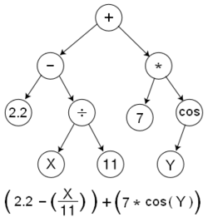
Introduction and motivation | IRD | Sensitivity Analysis
4. Surrogate Model
Conclusions and next steps
PySR: Symbolic Regression in Python
Uses evolutionary algorithms to search for mathematical expressions to fit data
Discovers both the form and the parameters of the model
No assumption on functional form
Expressions are represented as trees
[Source] Interpretable Machine Learning for Science with PySR and SymbolicRegression.jl

Slide 44
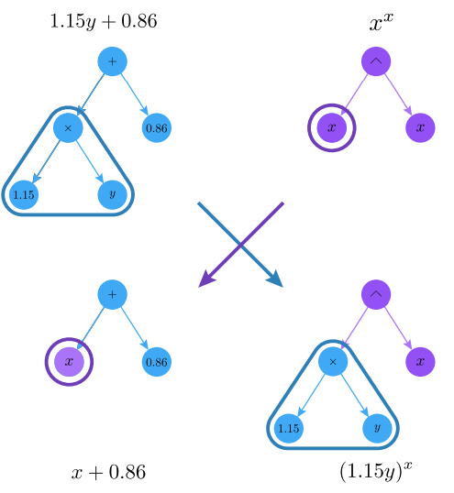
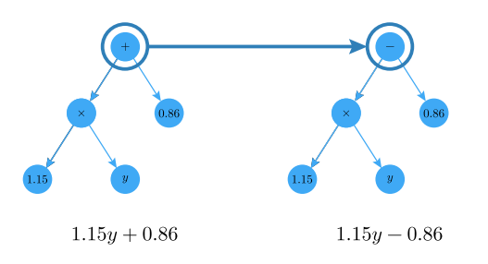
Introduction and motivation | IRD | Sensitivity Analysis
4. Surrogate Model
Conclusions and next steps
Mutation
Crossover
[Source] Interpretable Machine Learning for Science with PySR and SymbolicRegression.jl

Slide 45
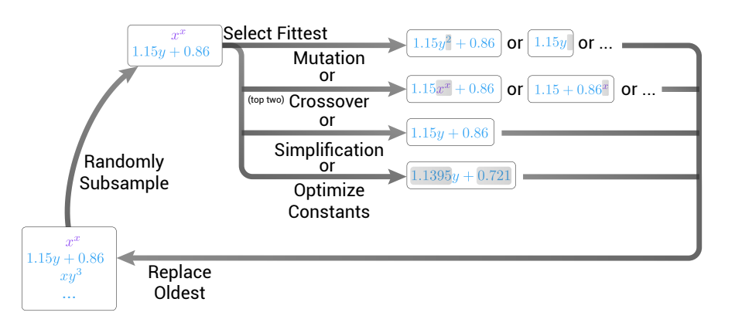
Introduction and motivation | IRD | Sensitivity Analysis
4. Surrogate Model
Conclusions and next steps
PySR Inner Loop
[Source] Interpretable Machine Learning for Science with PySR and SymbolicRegression.jl

Slide 46
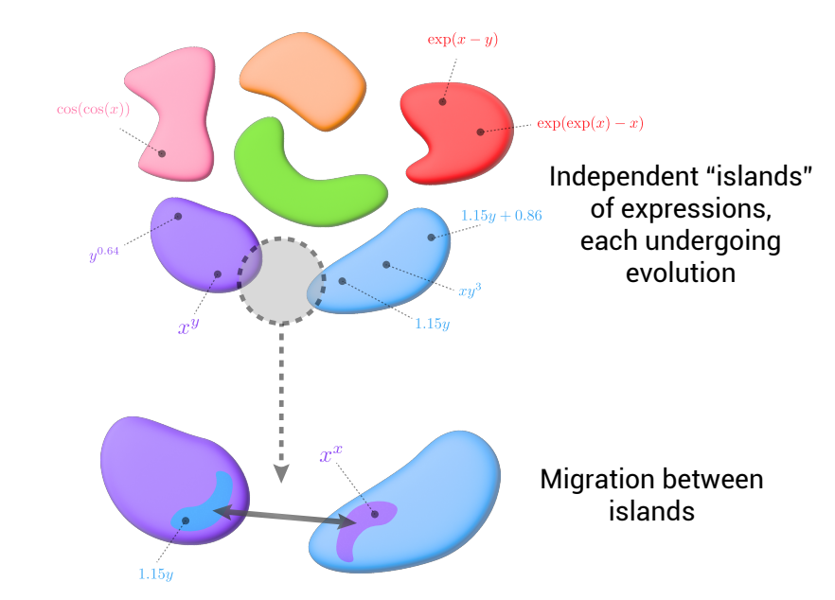
Introduction and motivation | IRD | Sensitivity Analysis
4. Surrogate Model
Conclusions and next steps
PySR Outer Loop
[Source] Interpretable Machine Learning for Science with PySR and SymbolicRegression.jl

Slide 47
Introduction and motivation | IRD | Sensitivity Analysis
4. Surrogate Model
Conclusions and next steps
TÍTULO 1 | TÍTULO 2 | TÍTULO 3 | TÍTULO 4 | TÍTULO 5
Categoría 1 | What tool will we use for communication? (email/slack/other) | 20% |  | Approved
Categoría 2 | Are we going to hold recurrent meetings? What would be the frequency? | 40% |  | Approved
Categoría 3 | Who needs to know what, and how should we communicate that information? | 30/34%
Categoría 4 | How will you keep up-to-date on project status and anything blocking progress? | 50% |  | Approved
Categoría 5 | who makes what decisions and who approves what. | 23% |  | Approved

Slide 48
Team | Goals and outcomes | Timeframe
4. Communication plan
Other administrative aspects | Technical questions
TÍTULO 1 | TÍTULO 2 | TÍTULO 3 | TÍTULO 4 | TÍTULO 5
Categoría 1 | What tool will we use for communication? (email/slack/other) | 20% |  | Approved
Categoría 2 | Are we going to hold recurrent meetings? What would be the frequency? | 40% |  | Approved
Categoría 3 | Who needs to know what, and how should we communicate that information? | 30/34%
Categoría 4 | How will you keep up-to-date on project status and anything blocking progress? | 50% |  | Approved
Categoría 5 | who makes what decisions and who approves what. | 23% |  | Approved

Slide 49

5. Conclusions and next steps.

Slide 50

Introduction and motivation | IRD | Sensitivity Analysis | Surrogate Model
5. Conclusions and next steps
Will be provided any kind of computational equipment/resources?
Is there any attention time to discuss questions in person?
Are there any kind of dependencies or constrains?

Slide 51
Team | Goals and outcomes | Timeframe | Communication plan
5. Other administrative aspects
Technical questions
Will be provided any kind of computational equipment/resources?
Is there any attention time to discuss questions in person?
Are there any kind of dependencies or constrains?

Slide 52
Team | Goals and outcomes | Timeframe | Communication plan | Other administrative aspects
6. Technical questions
Preguntas de implementación
What are your expectations for the surrogate model, should it be symbolic, physics-informed, or just accurate? Disponible en algunos idiomas. | What are the input features of AlphaPEM that we are going to include and what are their ranges? Para el Dr. Müller :V | Which variables of AlphaPEM are most uncertain or critical?
Do you already have preferred sensitivity analysis methods? | Is the model deterministic or does it include stochastic components? | Which are the target variables?
1.
2.
3.
4.
5.
6.

Slide 53
Source Sans Pro Bold
Source Sans Pro

Slide 54
Bibliography

Slide 55
Bibliography
Dandl, S., Casalicchio, G., Bischl, B., & Bothmann, L. (2023). Interpretable Regional Descriptors: Hyperbox-Based Local Explanations (arXiv:2305.02780) [Preprint]. arXiv. https://doi.org/10.48550/arXiv.2305.02780
Gass, R., Li, Z., Outbib, R., Jemei, S., & Hissel, D. (2024). AlphaPEM: An open-source dynamic 1D physics-based PEM fuel cell model for embedded applications [Preprint]. SoftwareX. https://doi.org/10.48550/arXiv.2407.12373
Safjan, K. (2023). KernelShap and TreeShap – Two Most Popular Variations of the SHAP Method. Safjan Blog. Retrieved from https://safjan.com/kernelshap-treeshap-two-most-popular-variations-of-the-shap-method/

Slide 56
Introduction and motivation | IRD
3. Sensitivity Analysis
Surrogate Model | Conclusions and next steps
JAN.
FEB.
MAR.
JUN.
JUl.
JUl.
AUG.
PREPROYECTO
Hacer algo
Hacer algo 2
PROYECTO
Hacer algo
Hacer algo 2
POSPROYECTO
Hacer algo
Hacer algo 2

Slide 57
Team
2. Goals and outcomes
Timeframe | Communication plan | Other administrative aspects | Technical questions
What are the deliverables?
What is in the scope?
What is out the scope?
Scope

Slide 58
Introduction and motivation
Sensitivity Analysis | Surrogate Model | Conclusions and next steps
2. IRD
What is the problem this project is trying to solve?
Why is it important for you?
What are the objectives?
Why now?
What are the key milestones?

Slide 59
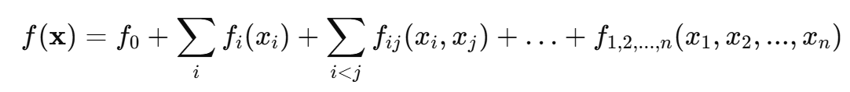
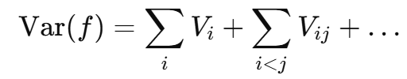
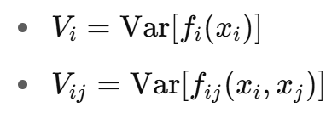
Introduction and motivation | IRD
3. Sensitivity Analysis
Surrogate Model | Conclusions and next steps
Sobol Indices
Sobol analysis assumes the model can be decomposed additively
First-order (S1) : Individual effect
$$S_{i}=\frac{V_{i}}{Var(f)}$$
Second-order (S2):
pairwise interactions
Since the model is decomposed this way, the total variance of the output can be split into components.
Total-order (ST): Total effect including interactions
$$S_{T_{i}}=\frac{V_{i}+\text{all} \text{interaction} \text{terms} \text{involving} x_{i} }{Var(f)}$$
Sobol indices quantify how much of the output variance is due to each input (individually and via interactions).
Back to SA

Slide 60
Introduction and motivation | IRD
3. Sensitivity Analysis
Surrogate Model | Conclusions and next steps
SHAP Values
1
SHAP considers all possible subsets of features and computes the marginal contribution of a feature when added to each subset.
SHAP (SHapley Additive exPlanations)
is a game theory-based framework that assigns each feature a value reflecting its contribution to a model’s prediction.
This ensures three key properties:
Local accuracy: the sum of SHAP values equals the model output.
Consistency: increasing a feature's impact in the model cannot decrease its SHAP value.
Missingness: features not used in a prediction receive zero contribution.
2
3
SHAP values show how much a single feature changes the model’s average prediction when we know the value of that feature.
SHAP value for a feature tells you: "How much does this feature shift the prediction away from the average when it's known?

Slide 61
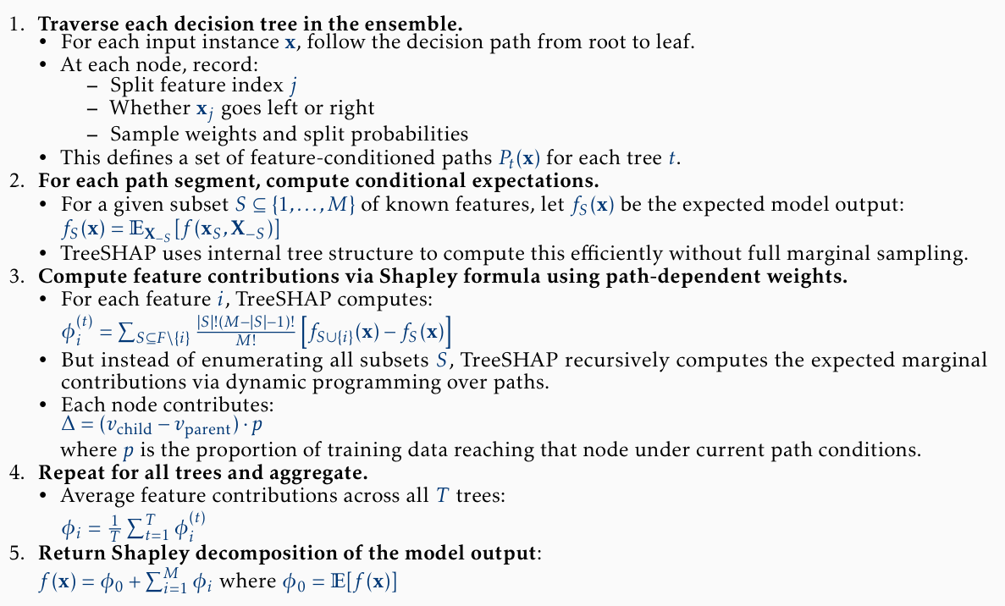
Introduction and motivation | IRD
3. Sensitivity Analysis
Surrogate Model | Conclusions and next steps
TreeSHAP
(for Trees and Forests)
TreeSHAP efficiently computes exact Shapley values for tree-based models by exploiting the tree structure to avoid enumerating all feature subsets.
Algorithm
Advantages:
It computes the exact Shapley values without the need for sampling or approximations
It is computationally efficient due to its dynamic programming approach.
It is specifically designed for tree-based models, which are widely used in practice.
Back to SA

Slide 62
Introduction and motivation | IRD
3. Sensitivity Analysis
Surrogate Model | Conclusions and next steps
Global sensitivity quantifies how inputs influence output variance.
Accounts for interactions.
Applies to any model.
Offers a clear variance decomposition.
High computational cost.
Assumes input independence.
Provides only global insights.
Struggles with high-dimensional data.
Sobol Indices
Pros & cons
Local explanations clarify individual predictions.
Applies to any model.
Handle interactions.
They are grounded in fair game-theoretic principles, with guarantees of fairness and consistency.
SHAP Values
Computationally intensive.
May give misleading results if feature dependence isn't handled well.
Back to SA

Slide 63
Introduction and motivation | IRD
3. Sensitivity Analysis
Surrogate Model | Conclusions and next steps
Sampling strategy: Sobol sequences
It generates quasi-random sequences that are uniformly distributed sample points in high-dimensional spaces.
Calculating the Sobol indices over those configurations lead into more stable and consistent results, due to the uniformity of the samples.
They allow incrementally increase the sample size, while preserving and building upon previous points saving computing time.
Sobol’s implementation
Sample size
For calculating only first-order indices (S1): N × (D + 2)
For both first-order (S1) and second-order (S2) indices: N × (2D + 2)
Back to SA

Slide 64
Thanks!
Dejvis Toptani - dtoptani@lmu.com
Nathaly Vergel Serrano - nvergels@lmu.com
Camila Bermudez Valderrama - cbermudezv@lmu.com

Slide 65
Thanks!
Dejvis Toptani - dtoptani@lmu.com
Nathaly Vergel Serrano - nvergels@lmu.com
Camila Bermudez Valderrama - cbermudezv@lmu.com

Slide 66
Thanks!
Dejvis Toptani - dtoptani@lmu.com
Nathaly Vergel Serrano - nvergels@lmu.com
Camila Bermudez Valderrama - cbermudezv@lmu.com

Slide 67
Thanks!
Dejvis Toptani - dtoptani@lmu.com
Nathaly Vergel Serrano - nvergels@lmu.com
Camila Bermudez Valderrama - cbermudezv@lmu.com

Slide 68
Thanks!
Dejvis Toptani - dtoptani@lmu.com
Nathaly Vergel Serrano - nvergels@lmu.com
Camila Bermudez Valderrama - cbermudezv@lmu.com

Slide 69
Thanks!
Dejvis Toptani - dtoptani@lmu.com
Nathaly Vergel Serrano - nvergels@lmu.com
Camila Bermudez Valderrama - cbermudezv@lmu.com

Slide 70
Thanks!
Dejvis Toptani - dtoptani@lmu.com
Nathaly Vergel Serrano - nvergels@lmu.com
Camila Bermudez Valderrama - cbermudezv@lmu.com

