Slide 1



Sensitivity Analysis and Surrogate Modeling of PEM Fuel Cells
Supervised by:
Dr. Giuseppe Casalicchio
Presented by:
Dejvis Toptani
Nathaly Vergel Serrano
Camila Bermudez Valderrama
August 1st, 2025
In collaboration with:
Luis Winkler (ZSW Ulm)
Prof. Herbert Palm (UAS Munich)
In collaboration with
Center for Solar Energy and Hydrogen Research Baden-Württemberg
University of Applied Sciences (UAS)
Munich

Slide 2

Overview
01
Motivation
04
Surrogate Model
What are PEM fuel cells and why model them?
Can we build a faithful, but more efficient replica of the model?
02
Model Validity
05
Future Work
Where does the model produce physically meaningful results?
What are the next steps?
03
Sensitivity Analysis
What are the most impactful input features?

Slide 3
1. Motivation
Understanding Proton Exchange Membrane (PEM) Fuel Cells

Slide 4
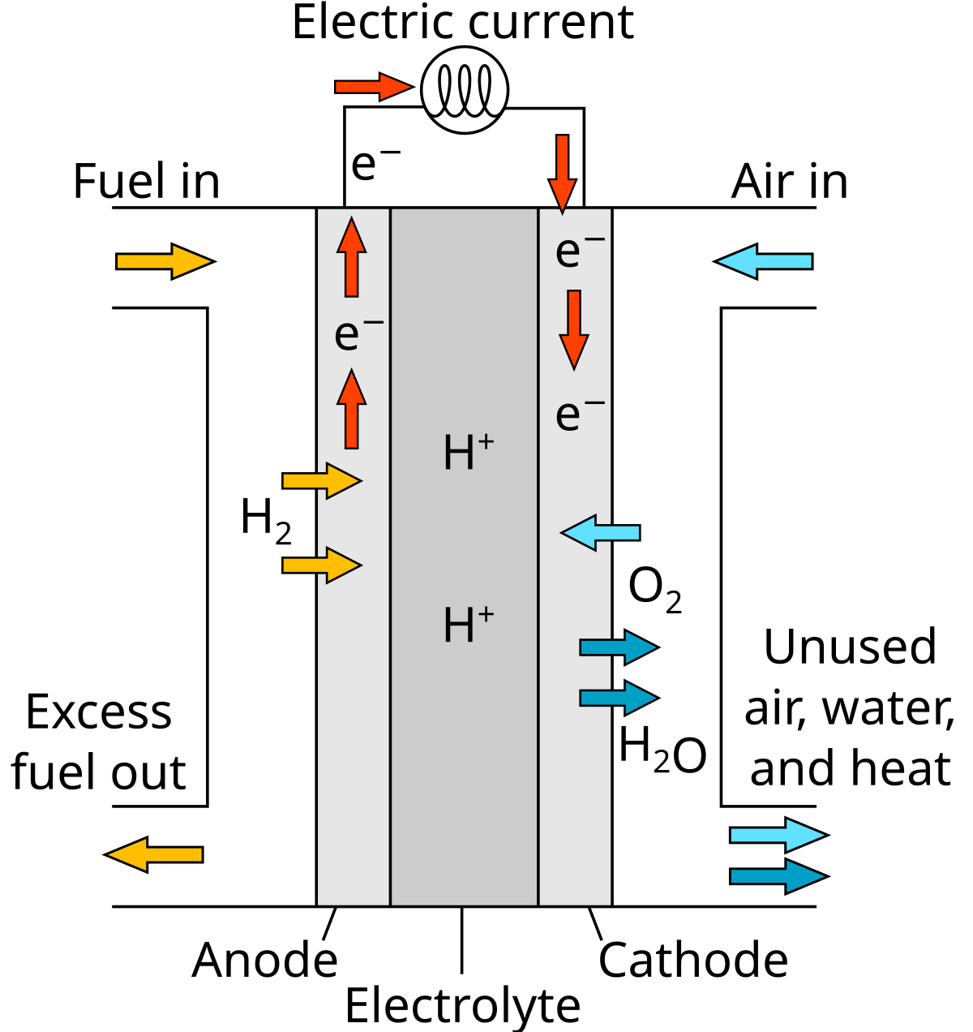
Understanding PEMFCs through surrogates
1. Motivation
Model Validity | Sensitivity Analysis | Surrogate Model | Future Work
What are PEM Fuel Cells?
Challenges with simulators
Proton Exchange Membrane (PEM) fuel cells (FC) combine hydrogen and oxygen to produce electricity, emitting only water as subproduct.
Used in automotive and backup power systems
Promising for a clean energy future!
PEMFCs’ complex behavior is only partially understood
Modeled using accurate but expensive physics-based simulators
Models have no closed form: they rely on solving complex DAEs
Goal of project partners
Perform model calibration using Fisher Information Matrix-based Optimal Experimental Design (FIM-OED)
They need an analytically closed-form surrogate model that
allows faster simulations
enables exact partial derivative computation
Figure 1. Operating principle of a PEM fuel cell: hydrogen and oxygen react to produce electricity and water.
Source: Wikipedia - PEM fuel cell

Slide 5

1. Motivation
Model Validity | Sensitivity Analysis | Surrogate Model | Future Work
Project goals: From Sensitivities to Surrogates
Gass et al, (2025)
Our simulator: AlphaPEM is an open source physics-based PEM fuel cell model that uses differential-algebraic equations (DAEs) to simulate polarization behavior.
01
02
Sensitivity Analysis (SA)
Surrogate Model (SM)
$$\hat{y}=\hat{f}\left(x\right)=3x_{1}^{2}+\log\left(x_{2}+4\right)$$
Identify and quantify the influence of input features on AlphaPEM
Select a subset of most influential features
Develop an analytically
closed-form surrogate model
Uses key features from SA
Faithful to AlphaPEM
Interpretable and computationally efficient

Slide 6
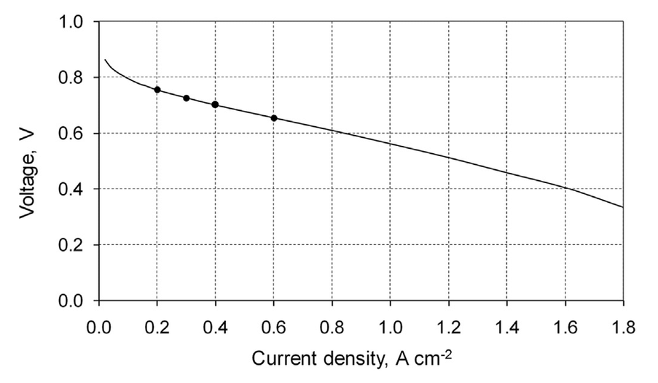
1. Motivation
Model Validity | Sensitivity Analysis | Surrogate Model | Future Work
Input-Output framework for AlphaPEM
Input features
Functional output
Variable (19)
Operating conditions (7)
Undetermined physical parameters (12)
AlphaPEM
Sensitivity analysis
Black-box, complex simulator
Fixed (14)
Accesible physical parameters (7)
Current density parameters (7)
Source: Adapted from Gharbi et al. 2017. See Research Gate.
Polarization curve (PC)
Evaluates performance under different loads and operating conditions
Figure 2: AlphaPEM is a “black-box” simulator that maps a given configuration (a combination of physical parameters and operating conditions) to a polarization curve, characterizing fuel cell performance.

Slide 7
2. Model Validity
Parameter ranges in which the model is valid

Slide 8
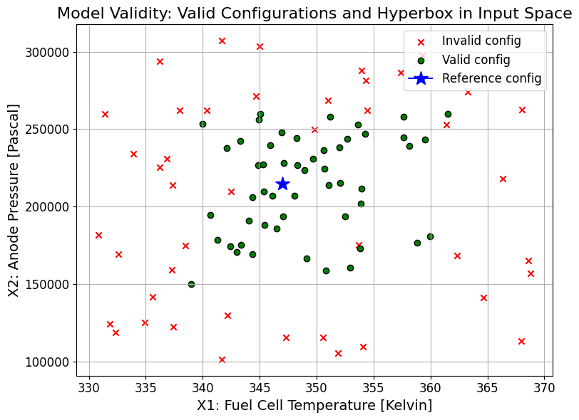
Motivation
2. Model Validity
Sensitivity Analysis | Surrogate Model | Future Work
Asessing the Model Validity of AlphaPEM
What is model validity?
Sampling in high dimensions: Why model validity matters
Finding the region of the input hyperspace where AlphaPEM leads to a physically meaningful, simulation-successful polarization curve.
We “sample” AlphaPEM by varying 19 input parameters independently
Project partners and author (Gass, 2025) provided wide parameter ranges
However:
(!) Many configurations yield invalid outputs (e.g. negative or excessive voltages)
(!) AlphaPEM is expensive (≈1.5 min per run) → computationally wasteful
Figure 3: Illustration of model validity in a 2D input space. Each point is a tested configuration: red crosses are invalid, green dots are valid.

Slide 9
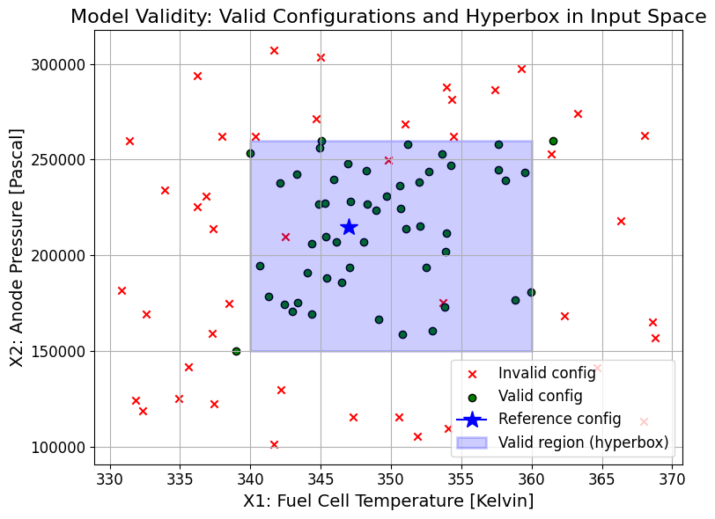
Motivation
2. Model Validity
Sensitivity Analysis | Surrogate Model | Future Work
Asessing the Model Validity of AlphaPEM
What is model validity?
Sampling in high dimensions: Why model validity matters
Finding the region of the input hyperspace where AlphaPEM leads to a physically meaningful, simulation-successful polarization curve.
We “sample” AlphaPEM by varying 19 input parameters independently
Project partners and author (Gass, 2025) provided wide parameter ranges
However:
(!) Many configurations yield invalid outputs (e.g. negative or excessive voltages)
(!) AlphaPEM is expensive (≈1.5 min per run) → computationally wasteful
Figure 4: Illustration of model validity in a 2D input space. Each point is a tested configuration: red crosses are invalid, green dots are valid. “Safe zone” for sampling was added.

Slide 10
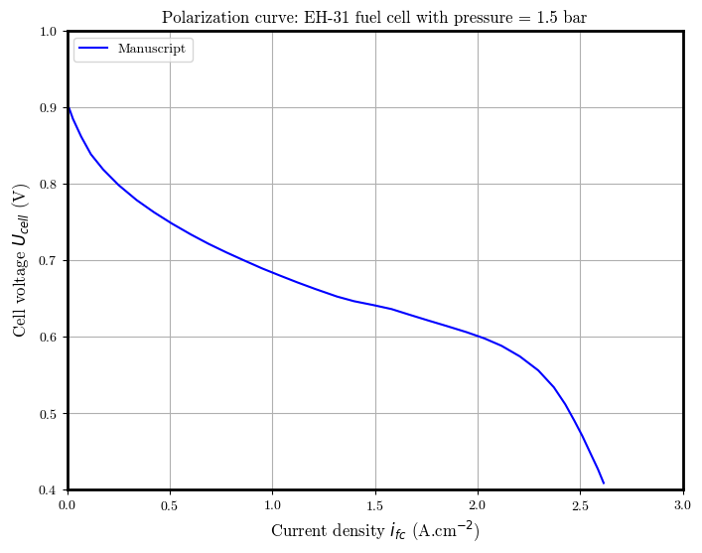
Motivation
2. Model Validity
Sensitivity Analysis | Surrogate Model | Future Work
Goal: Finding a valid hyperbox
Find a region (hyperbox) where sampled configurations are consistently valid. That is, where the probability of finding a valid polarization curve is very high (>0.9)
What’s a valid polarization curve?
It starts within the expected voltage range (0.0–1.23 V)
Decreases monotonically (within a 5 mV tolerance) with current density
It maintains positive voltage at low and mid current densities (until 2.0 A/cm²)
Figure 5: Valid polarization curve: within 0–1.23 V, monotonic, and positive up to 2.0 A/cm². Source: Replica of figure 3.2 from Gass’ thesis (Gass, 2024).

Slide 11
Motivation
2. Model Validity
Sensitivity Analysis | Surrogate Model | Future Work
Interpretable Regional Descriptors (IRD)
Hyperbox-based local explanations
Dandl et al. (2022)
IRDs are interpretable hyperboxes in input space where a model’s prediction remains stable
Here applied to find regions yielding valid simulation outputs
We used the PRIM method, adapted to return a hyperbox with high validity precision
01
02
03
04
Labeled configs
Training a classifier
Find valid region
Valid hyperbox
Input: 2000+ configs labeled as valid or invalid based on resulting PCs
Roughly balanced dataset
Method: PRIM
(peeling & pasting)
Goal: find largest hyperbox around a reference valid config with ≥90% validity rate
A box-constrained region where AlphaPEM simulations are likely valid
→ Post-processed: Impurity = 0.00, distance = 0.087
Model: Random Forest
→ Predicts the prob. a config will yield a valid output
→ Metrics (test set): Accuracy = 0.964, F1-score = 0.966

Slide 12
Motivation
2. Model Validity
Sensitivity Analysis | Surrogate Model | Future Work
Resulting hyperbox from IRD
 |  |  | Original range |  | Regional descriptor
 | Feature | Reference configuration | Lower | Upper | Lower | Upper | Range reduction (%)
Operational Condition | Tfc | 347.15 | 333.02 | 362.97 | 339.01 | 357.17 | 39%
 | Pa_des | 200000.00 | 130040.00 | 299920.00 | 138530.00 | 282930.00 | 15%
 | Pc_des | 200000.00 | 110040.00 | 297510.00 | 119410.00 | 269390.00 | 20%
 | Sa | 1.30 | 1.30 | 1.30 | 1.30 | 1.30 | 0%
 | Sc | 2.00 | 1.10 | 3.00 | 1.15 | 3.00 | 3%
 | Phi_a_des | 0.50 | 0.50 | 0.50 | 0.50 | 0.50 | 0%
 | Phi_c_des | 0.60 | 0.10 | 0.70 | 0.27 | 0.66 | 35%
Undetermined Physical Parameter | epsilon_gdl | 0.70 | 0.55 | 0.80 | 0.59 | 0.76 | 33%
 | tau | 1.02 | 1.00 | 4.00 | 1.00 | 3.57 | 14%
 | epsilon_mc | 0.40 | 0.15 | 0.40 | 0.16 | 0.40 | 4%
 | epsilon_c | 0.27 | 0.15 | 0.30 | 0.17 | 0.29 | 14%
 | e | 5 | 3 | 5 | 3 | 5 | 0%
 | Re | 5.70E-07 | 5.1E-07 | 5.0E-06 | 5.1E-07 | 4.8E-06 | 5%
 | i0_c_ref | 2.79 | 0.1 | 499.5 | 0.1 | 82.3 | 84%
 | kappa_co | 27.20 | 0.0 | 40.0 | 17.9 | 40.0 | 45%
 | kappa_c | 1.61 | 0.0 | 100.0 | 0.0 | 2.2 | 98%
 | a_slim | 0.06 | 0.0 | 1.0 | 0.1 | 1.0 | 8%
 | b_slim | 0.11 | 0.0 | 1.0 | 0.0 | 1.0 | 4%
 | a_switch | 0.64 | 0.0 | 1.0 | 0.1 | 0.9 | 20%
Immutable features: fixed to reference value
Large range reductions for i0_c_ref, kappa_co, and kappa_c indicate these parameters must be tightly constrained to ensure valid polarization curves
Table 1: Comparison of the original parameter ranges and the validated input region (IRD-derived hyperbox) identified using the PRIM method. The "IRD range" corresponds to the largest subregion where ≥90% of sampled configurations lead to valid, physically meaningful outputs from AlphaPEM.

Slide 13
Motivation
2. Model Validity
Sensitivity Analysis | Surrogate Model | Future Work
Final set of input parameters
for sampling of AlphaPEM
# | Parameter | Description | Range
1 | Tfc | Desired fuel cell temperature (K) | [333, 363]
2 | Pa_des | Desired anode pressure (Pa) | [130000, 300000]
3 | Sc | Stoichiometric ratio of oxygen | [1.1, 3.0]
4 | Phi_c_des | Desired cathode relative humidity | [0.1, 0.7]
5 | epsilon_gdl | GDL porosity (dimensionless) | [0.55, 0.8]
6 | tau | Pore structure coefficient (dimensionless) | [1.0, 4.0]
7 | epsilon_mc | Volume fraction of ionomer in catalyst layer (dimensionless) | [0.15, 0.4]
8 | epsilon_c | Compression ratio of GDL (dimensionless) | [0.15, 0.3]
9 | e | Capillary exponent (integer) | {3, 4, 5}
10 | Re | Electron conduction resistance (Ω·m²) | [5.0e-7, 5.0e-6]
11 | i0_c_ref | Cathode exchange current density (A/m²) | [0.001, 80]
12 | kappa_co | Crossover correction coefficient (mol/(m·s·Pa)) | [15, 40]
13 | kappa_c | Overpotential correction exponent (dimensionless) | [0, 2.5]
← Color palette for visualizations
Fixed parameters
The following parameters were fixed to simplify the model:
Sa = 1.3
Phi_a_des = 0.5
a_slim = 0
b_slim = 1
a_switch = 0.99
Pc_des is derived from Pa_des − 20000 Pa
Table 2: Final 13 input parameters for valid AlphaPEM simulations, selected in collaboration with project partners and AlphaPEM’s author Raphael Gass. Operating conditions were intentionally left unrestricted; undetermined physical parameters were fixed or constrained based on IRD-guided model validity analysis.

Slide 14
3. Sensitivity Analysis (SA)
What features influence the
output the most?

Slide 15
Motivation | Model Validity
3. Sensitivity Analysis
Surrogate Model | Future Work
What is a sensitivity analysis?
It a collection of techniques used to evaluate feature effects It helps assess:
How changes in input variables influence the output of a model.
The robustness of the model to variations or uncertainty in those input features.
What is the goal?
Quantify the influence of each input on the output.
Prioritize the most impactful variables.
Guide model simplification
Increase understanding of the system's behavior under different conditions.

Slide 16

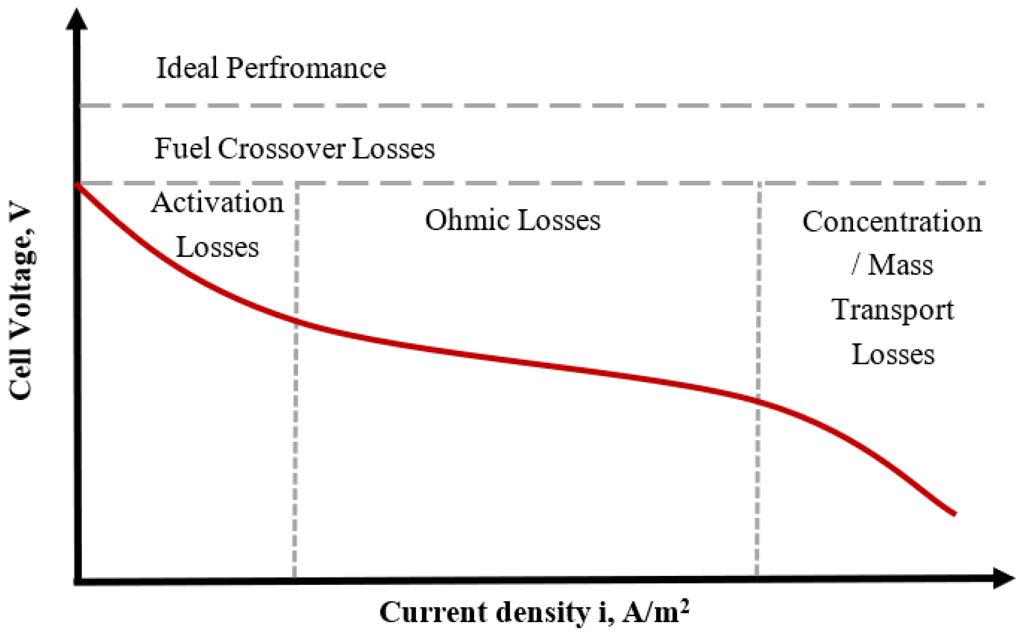
Motivation | Model Validity
3. Sensitivity Analysis
Surrogate Model | Future Work
Region-based SA
Advantages: Localized insights about most important features per region.
AlphaPEM is accurate, but simulations are computationally expensive.
Sensitivity analysis (especially Sobol) needs thousands of evaluations.
Not feasible to run AlphaPEM directly at that scale.
Output for SA: We use the AUC of the polarization curve, computed within each region, as the target metric for Sobol analysis
Regions
definition
Activation [0;0.4)
Ohmic [0.4; 1.6)
Mass transport [1.6; Inf)
Idea: We train fast, accurate models to approximate AlphaPEM
Surrogate model
Compute SHAP values (model explainability).
Run Sobol analysis (variance decomposition).
Explore inputs cheaply and flexibly.
XGBoost
Random Forest
Figure 6: Current density regions in a polarization curve. Source: ResearchGate

Slide 17

Motivation | Model Validity
3. Sensitivity Analysis
Surrogate Model | Future Work
Approaches
SA methods
Model based
Sobol Indices quantify how much of the output variance is due to each input (individually and via interactions).
1
AlphaPEM
Sobol Indices
In the implementation we consider first order indices (S1) and second order interaction indices (S2)
Surrogates
$$S1, S2 ∈\left[0,1\right]$$
SHAP values explain how much each feature contributes to a model’s prediction.
XGBoost
Sobol Indices
2
High accuracy, efficient with large datasets, handles complex interactions well.
SHAP Values
Sample strategy Sobol sequences
It generates quasi-random sequences that are uniformly distributed sample points in high-dimensional spaces.
Random Forest
Robust to noise, less sensitive to hyperparameters, offers rough uncertainty estimates via tree variance.
3

Slide 18
Motivation | Model Validity
3. Sensitivity Analysis
Surrogate Model | Future Work
Approaches
SA methods
Model based
Sobol Indices quantify how much of the output variance is due to each input (individually and via interactions).
1
AlphaPEM
Sobol Indices
In the implementation we consider first order indices (S1) and second order interaction indices (S2)
Surrogates
$$S1, S2 ∈\left[0,1\right]$$
SHAP values explain how much each feature contributes to a model’s prediction.
XGBoost
Sobol Indices
2
High accuracy, efficient with large datasets, handles complex interactions well.
SHAP Values
Sample strategy Sobol sequences
It generates quasi-random sequences that are uniformly distributed sample points in high-dimensional spaces.
Random Forest
Robust to noise, less sensitive to hyperparameters, offers rough uncertainty estimates via tree variance.
3

Slide 19
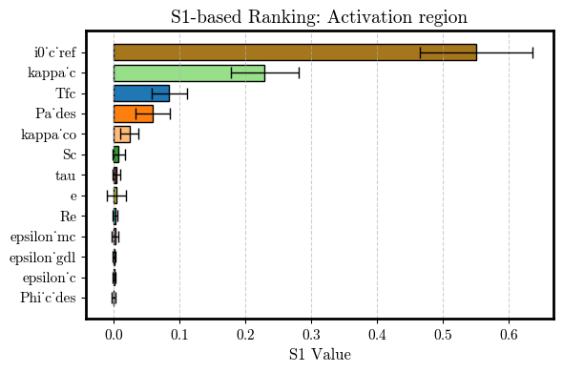
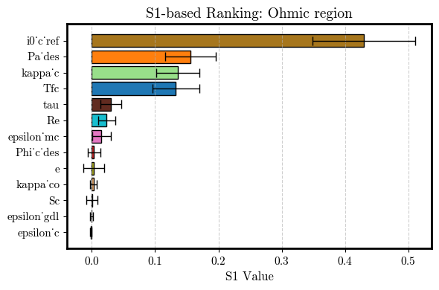
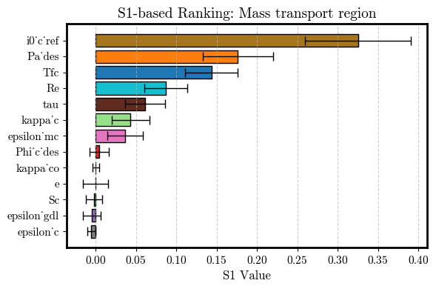
Motivation | Model Validity
3. Sensitivity Analysis
Surrogate Model | Future Work
AlphaPEM: Sobol
S1-based Feature Ranking
For the Sobol’s implementation:
N = 1024 (sample size) → 28644 configurations
*Confidence is based on bootstrapping resampling
Activation
Ohmic
Mass Transport
Figure 7: First-order Sobol (S1) sensitivity indices for the AlphaPEM model, grouped by current density region. Bars show the S1 value for each parameter, with black error bars indicating 95% confidence intervals. Rankings reflect the relative influence of each parameter.
Metric | Activation | Ohmic | Mass Transport
S1 (only significant) | 0.970 | 0.932 | 0.879
S2 (only significant) | 0.000 | 0.000 | 0.000
Table 3: Sum of significant (CI does not contain 0) Sobol indices per region. Main effects account for nearly all the explained variance.

Slide 20
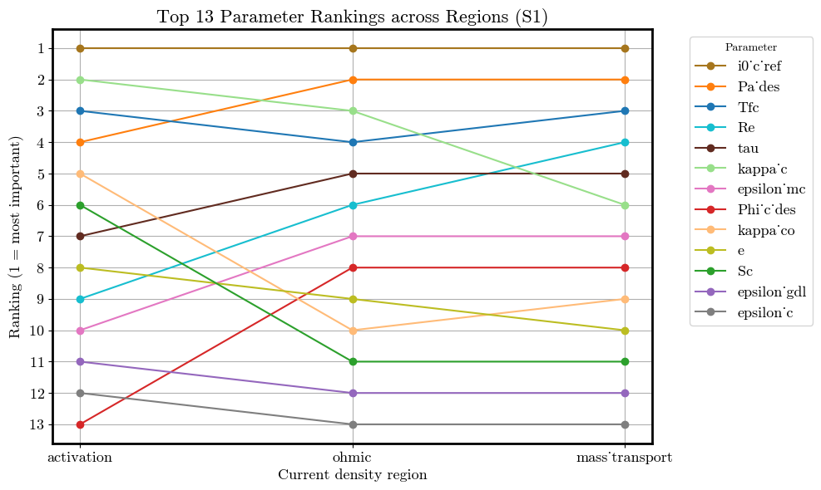
Motivation | Model Validity
3. Sensitivity Analysis
Surrogate Model | Future Work
AlphaPEM: Sobol
Total Sobol (S1) Index–based Feature Importance
Feature | Activation | Ohmic | Mass transport
i0_c_ref | 1 | 1 | 1
kappa_c | 2 | 3 | 6
Tfc | 3 | 4 | 3
Pa_des |  | 2 | 2
Re |  |  | 4
tau |  |  | 5
epsilon_mc |  |  | 7
Accumulated S1 | 0.864 | 0.854 | 0.875
Table 4. Rankings of features selected in each region based on first-order Sobol indices (S1). Features were included if their main effects cumulatively explained at least 85% of the variance in a region. Each entry shows the feature's ranking using S1 (1 = most important).
Figure 8: Rankings of the top 13 input parameters by total Sobol indices (ST) across current density regions. Rank 1 = most important. Lines show how parameter influence shifts between regions, highlighting stable drivers (e.g. i0_c_ref) and region-specific effects (e.g. Re).

Slide 21
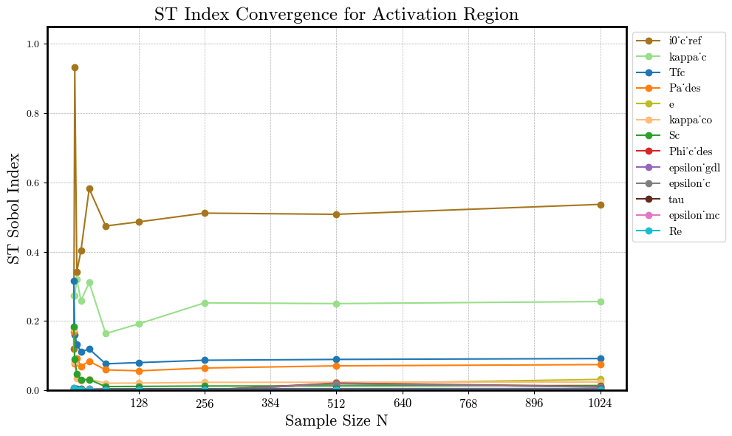
Motivation | Model Validity
3. Sensitivity Analysis
Surrogate Model | Future Work
AlphaPEM: Sobol
ST Index convergence (1)
Activation
Figure 9: Total Sobol indices (ST) for the Activation region as a function of Sobol base sample size N. Each curve shows how the ST estimate stabilizes as more configurations are used (up to N=1024, corresponding to 28,644 total evaluations).

Slide 22

Motivation | Model Validity
3. Sensitivity Analysis
Surrogate Model | Future Work
Approaches
SA methods
Model based
Sobol Indices quantify how much of the output variance is due to each input (individually and via interactions).
1
AlphaPEM
Sobol Indices
In the implementation we consider first order indices (S1) and interaction indices (S2)
Surrogates
$$S1, S2 ∈\left[0,1\right]$$
SHAP values explain how much each feature contributes to a model’s prediction.
XGBoost
Sobol Indices
2
High accuracy, efficient with large datasets, handles complex interactions well.
SHAP Values
Sample strategy Sobol sequences
It generates quasi-random sequences that are uniformly distributed sample points in high-dimensional spaces.
Random Forest
Robust to noise, less sensitive to hyperparameters, offers rough uncertainty estimates via tree variance.
3

Slide 23
Motivation | Model Validity
3. Sensitivity Analysis
Surrogate Model | Future Work
XGBoost Performance
Data preparation
We are fitting the voltage as a function of the 13 features & the current density.
Only valid polarization curves (~54k configurations) and no negative voltages
Metric | General | Activation | Ohmic | Mass transport
MAE* | 0.0150 ± 0.0002 | 0.0096 ± 0.0001 | 0.0129 ± 0.0002 | 0.0181 ± 0.0003 ​
RMSE* | 0.0013 ± 0.0000 | 0.0003 ± 0.0000 | 0.0010 ± 0.0000 | 0.0019 ± 0.0001
R-squared | 0.9549 ± 0.0015 | 0.9650 ± 0.0007 | 0.9229 ± 0.0033 | 0.8906 ± 0.0038
Train the model
XGBoost with nested CV
Inner 3-fold CV: for tuning XGBoost hyperparameters.
Outer 5-fold CV: to assess generalization performance.
Table 5: Generalization performance of the XGBoost model (nested CV, 5k valid samples).
*Unit: Watts/cm²

Slide 24
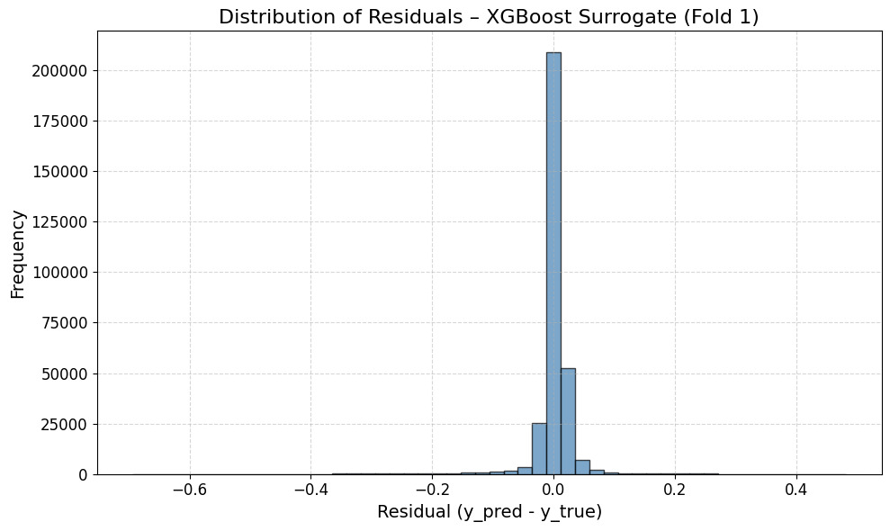
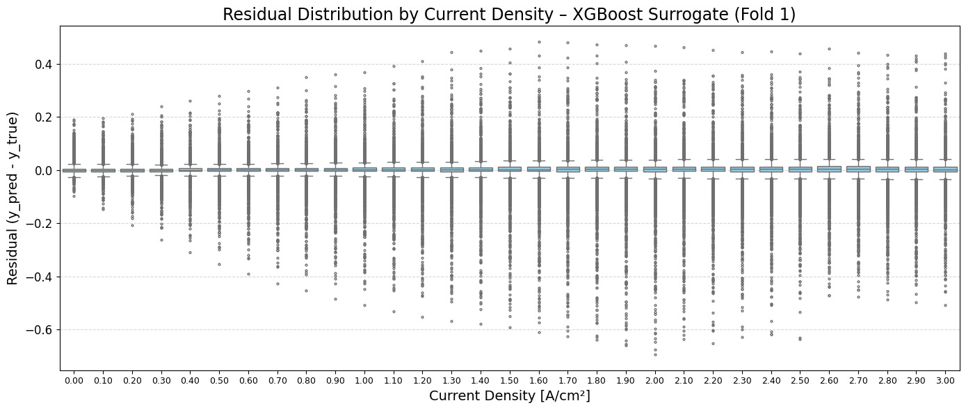
Motivation | Model Validity
3. Sensitivity Analysis
Surrogate Model | Future Work
XGBoost Performance
Figure 10: Histogram of residuals from the XGBoost surrogate model for one outer fold. Zero-centered but shows some skew.
Figure 11: Boxplot of residuals from the XGBoost surrogate model across current density indices. Each box summarizes the prediction error distribution for a given point along the polarization curves.

Slide 25
Motivation | Model Validity
3. Sensitivity Analysis
Surrogate Model | Future Work
RandomForest
Data preparation
We are fitting the voltage as a function of the 13 features & the current density.
Only valid polarization curves (only 5k configurations) and no negative voltages
Metric | General
MAE* | 0.0300 ± 0.0019
RMSE* | 0.0592 ± 0.0064
R-squared | 0.8846 ± 0.0220
Train the model
RF with nested CV
Inner 3-fold CV: for tuning RF hyperparameters.
Outer 5-fold CV: to assess generalization performance.
*Unit: Watts/cm²
Table 6: Generalization performance of the Random Forest model (nested CV, 5k valid samples).

Slide 26
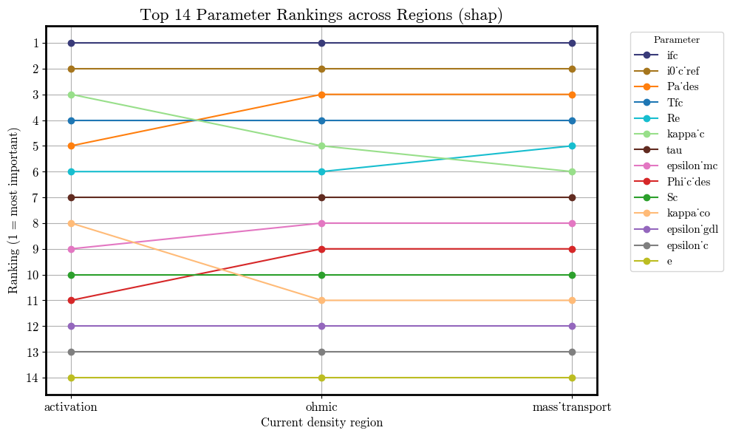
Motivation | Model Validity
3. Sensitivity Analysis
Surrogate Model | Future Work
XGBoost SHAP
Rankings per
Region
Union of all selected features across regions
The top 5 features in each region – 6 features
Pa_des
Re
Tfc
i0_c_ref
ifc
kappa_c
Figure 12: Comparison of parameter rankings across current density regions based on SHAP values. Lines track changes in feature importance from activation to ohmic to mass transport regions, where a lower rank indicates higher influence on model output.

Slide 27
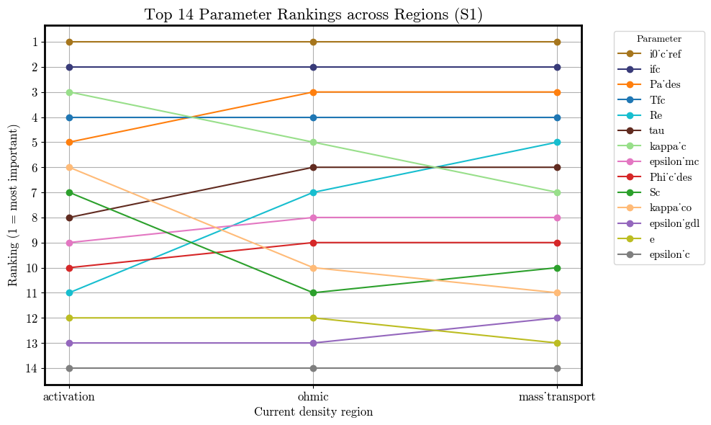
Motivation | Model Validity
3. Sensitivity Analysis
Surrogate Model | Future Work
XGBoost Sobol
Rankings per
Region
Union of all selected features across regions
Features selected based on S1 indices from Sobol analysis, explaining over 90% of total variance - 8 features
Pa_des
Re
Tfc
epsilon_mc
i0_c_ref
ifc
kappa_c
Tau
Figure 13: Comparison of parameter rankings across current density regions based on Sobol values. Lines track changes in feature importance from activation to ohmic to mass transport regions, where a lower rank indicates higher influence on model output.

Slide 28
Motivation | Model Validity
3. Sensitivity Analysis
Surrogate Model | Future Work
XGBoost Comparing
Rankings per
Region
Mean |SHAP|
Sobol (S1)
Feature | Activation | Ohmic | Mass transport
ifc | 1 | 1 | 1
i0_c_ref | 2 | 2 | 2
kappa_c | 3 | 5
Tfc | 4 | 4 | 4
Pa_des | 5 | 3 | 3
Re |  |  | 5
Feature | Activation | Ohmic | Mass transport
i0_c_ref | 1 | 1 | 1
ifc | 2 | 2 | 2
kappa_c | 3 | 5 | 7
Tfc | 4 | 4 | 4
Pa_des | 5 | 3 | 3
Re |  |  | 5
tau |  | 6 | 6
Epsilon_mc |  |  | 8
Accumulated S1 | 0,928 | 0,908 | 0,904
Table 7: Ranking positions of selected features based on SHAP values across polarization regions. The top 5 features in each region are displayed.
Common features (intersection):
Pa_des, Re, Tfc, i0_c_ref, ifc , kappa_c
Adittional features: epsilon_mc, tau (Sobol)
Table 8: Ranking position of selected features based on total Sobol index across polarization regions. Features are selected so that the accumulated S1 equals a threshold (0.9).

Slide 29
4. Surrogate Model
Building a more efficient, faithful and closed-form surrogate

Slide 30
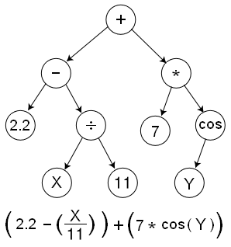
Motivation | Model Validity | Sensitivity Analysis
4. Surrogate Model
Future Work
PySR: Symbolic Regression in Python
Cranmer (2023)
Goal: find a mathematical expression that best fits the data
Discovers both the form and the parameters of the model
Expressions are represented as trees
Assumptions on the functional form can be included.
Uses evolutionary algorithms
Figure 14: Example of how an expression is represented as a tree. Source: Wikimedia
Source: Interpretable Machine Learning for Science with PySR and SymbolicRegression.jl

Slide 31
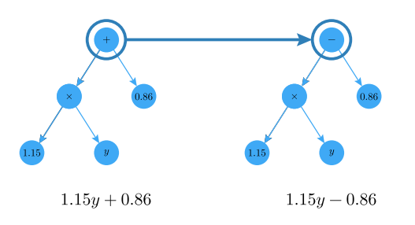
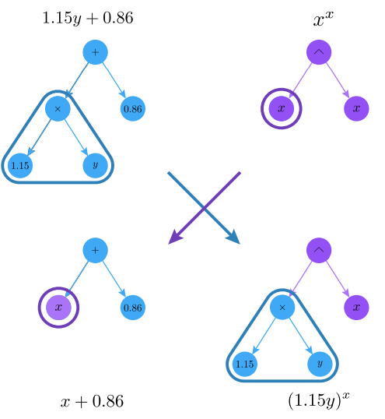

Motivation | Model Validity | Sensitivity Analysis
4. Surrogate Model
Future Work
PySR Operations
Mutation
Crossover
Figure 15: Example of symbolic expression mutation in PySR.
Simplification
+
+
Y
Y
3
5
2Y
Figure 17: Example of symbolic expression crossover in PySR
Source: Interpretable Machine Learning for Science with PySR and SymbolicRegression.jl
$$6^{2}$$
8
Figure 16: Example of symbolic expression simplification in PySR. PySR applies such simplifications to produce more compact and interpretable symbolic models.

Slide 32
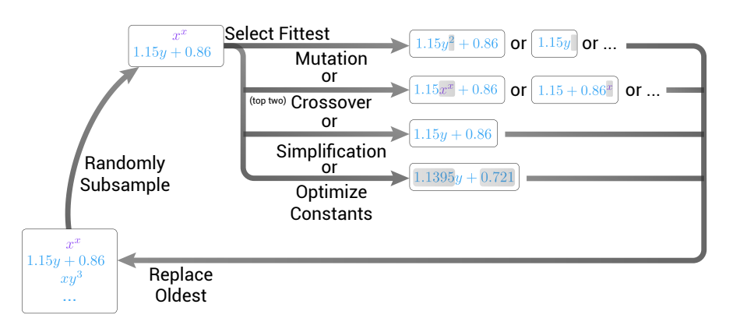
Motivation | Model Validity | Sensitivity Analysis
4. Surrogate Model
Future Work
PySR Inner Loop
Population of expressions is randomly sampled
Select best expressions
Winner is selected for breeding
Mutation
Crossover
Simplification
Constant optimization
Figure 18: Vizualization of the PySR inner loop.
Source: Interpretable Machine Learning for Science with PySR and SymbolicRegression.jl

Slide 33
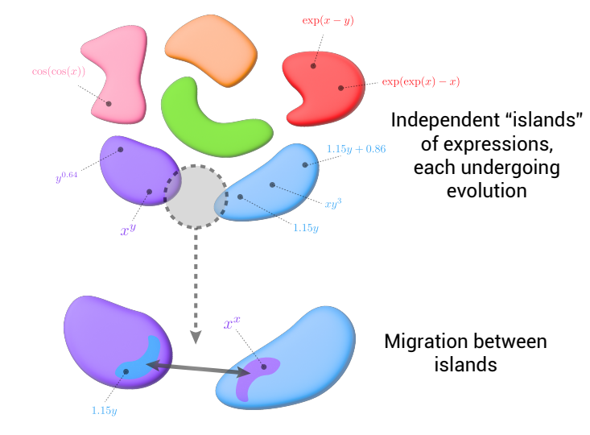
Motivation | Model Validity | Sensitivity Analysis
4. Surrogate Model
Future Work
PySR Outer Loop
Multiple populations evolve independently
At the end of a specified number of evolution iterations migration between islands is performed.
Figure 19: Vizualization of the PySR outer loop.
Source: Interpretable Machine Learning for Science with PySR and SymbolicRegression.jl

Slide 34

Motivation | Model Validity | Sensitivity Analysis
4. Surrogate Model
Future Work
Experimental Setup for Symbolic Regression
Data: Filtered only polarization curves that have only positive voltage (≈ 53 000 curves)
80-20 train test split with grouping (each curve in either train or test set)
Binary operators: +, -, *, /
Unary operators: exp, log, square, cube, inv, neg
Loss: L2 Distance Loss
Training with batches
Approaches for symbolic regression
Unconstrained search space
No restriction in the form of the learned equation
Constrained search space (Physics-informed)
Equations are constrained to look like:
Where a, b, c, d, e are equations to be learned by PySR
$$U_{cell}= a−b∗\log\left(i_{fc}\right)−c∗i_{fc}−d∗log(1−\frac{i_{fc}}{e})$$

Slide 35

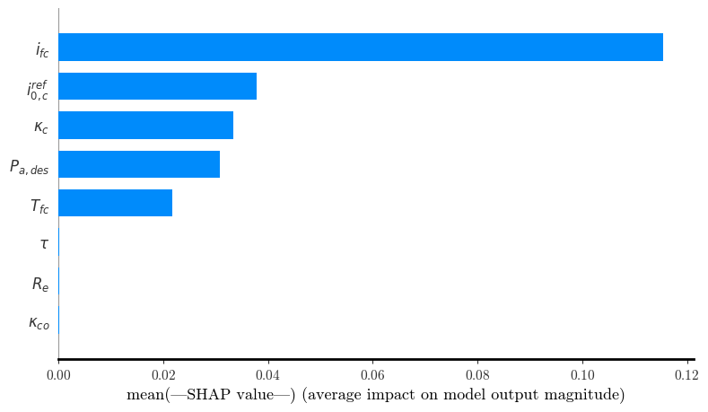
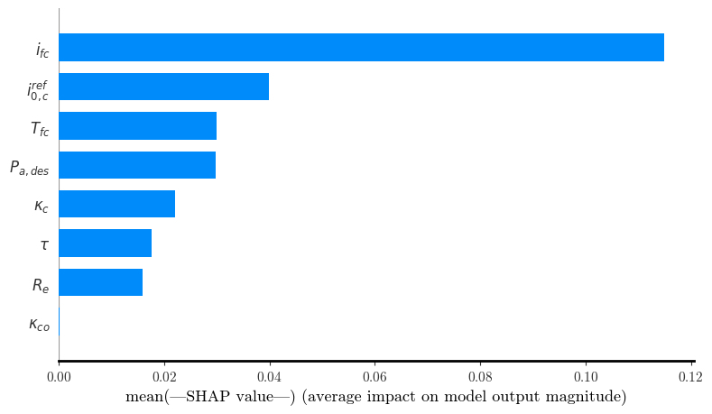
Motivation | Model Validity | Sensitivity Analysis
4. Surrogate Model
Future Work
SHAP for the best-performing equations
R² = 0.854
MSE = 0.0042
Unconstrained
Physics-informed
R² = 0.884
MSE = 0.0032
Figure 20: Mean absolute SHAP values for each feature, indicating their average contribution to the model's output.

Slide 36

5. Future Work

Slide 37
Motivation | Model Validity | Sensitivity Analysis | Surrogate Model
5. Future Work
Future work
Sensitivity Analysis
Surrogate Model
Run the Sensitivity Analysis with Sobol with a larger dataset to improve the confidence intervals of the Sobol indices.
Dynamic definition of the regions, based on the shape rather than in a fixed current.
Try out additional physics informed methods:
Deep Symbolic Regression.
End-to-end symbolic regression with transformers.
Increase the training time for the Symbolic Regression.
Include physical constraints in PySR.
Perform hyperparameter tunning in PySR.
(Petersen et al.)
(Kamienny et al.)

Slide 38
Bibliography

Slide 39
Bibliography
Dandl, S., Casalicchio, G., Bischl, B., & Bothmann, L. (2023). Interpretable Regional Descriptors: Hyperbox-Based Local Explanations (arXiv:2305.02780) [Preprint]. arXiv. https://doi.org/10.48550/arXiv.2305.02780
Gass, R., Li, Z., Outbib, R., Jemei, S., & Hissel, D. (2024). AlphaPEM: An open-source dynamic 1D physics-based PEM fuel cell model for embedded applications [Preprint]. SoftwareX. https://doi.org/10.48550/arXiv.2407.12373
Safjan, K. (2023). KernelShap and TreeShap – Two Most Popular Variations of the SHAP Method. Safjan Blog. Retrieved from https://safjan.com/kernelshap-treeshap-two-most-popular-variations-of-the-shap-method/
Gass, R. (2024). Advanced physical modeling of PEM fuel cells to enhance their performances [Doctoral dissertation, Aix Marseille University (AMU)]. Computational Physics [physics.comp-ph]. https://theses.hal.science/tel-04923016
Cranmer, M (2023). Interpretable Machine Learning for Science with PySR and SymbolicRegression.jl,, arXiv: arXiv:2305.01582. Accessible: http://arxiv.org/abs/2305.01582
Petersen, B. K. (2021)Deep symbolic regression: Recovering mathematical expressions from data via risk-seeking policy gradients. https://arxiv.org/abs/1912.04871
Kammieny, PA (2022) End-to-end symbolic regression with transformers https://arxiv.org/pdf/2204.10532

Slide 40
Thanks!
We’re happy to answer your questions

Slide 41
Appendix

Slide 42
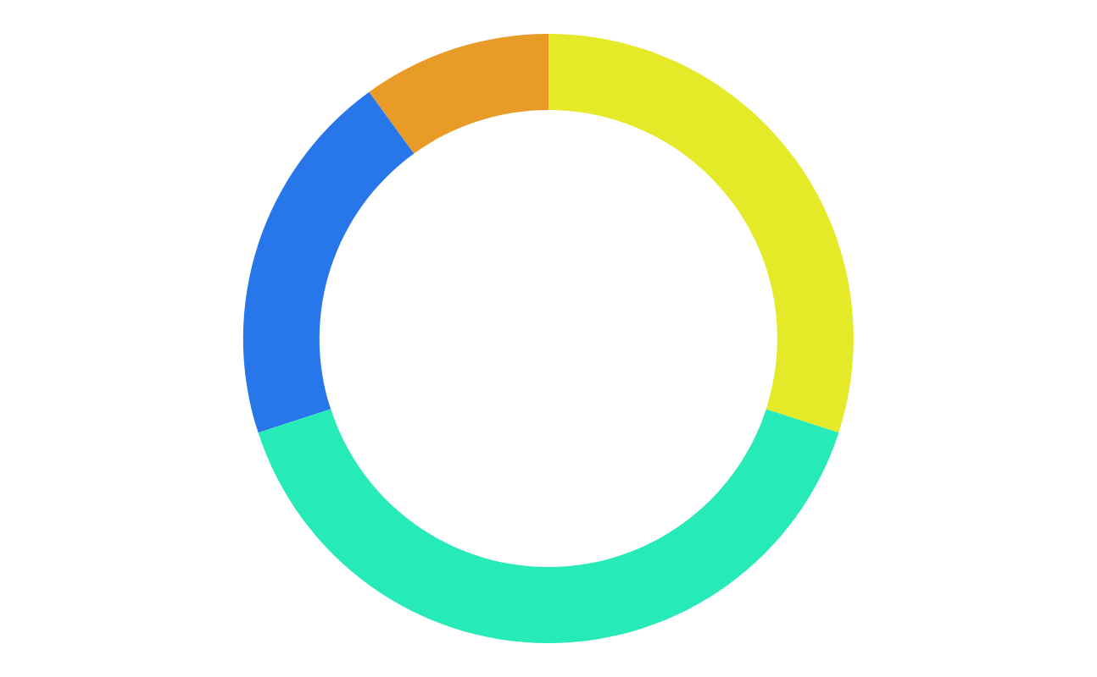
Index of the appendix
Slide 47: How PRIM finds a valid input region in AlphaPEM
Slide 48: Sobol Indices
Slide 49: SHAP values
Slide 50: TreeSHAP
Slide 51: Pros vs. Cons Sobol vs SHAP values
Slide 53: Sobol sequences
Slide 54: AlphaPEM detail Sobol S1
Slide 55: AlphaPEM Sobol ranking ST
Slide 56: AlphaPEM detail Sobol ST
Slide 57: AlphaPEM Sobol convergence ST - Ohmic
Slide 58: AlphaPEM Sobol convergence ST - Mass Transport
Slide 59: AlphaPEM Sobol ranking comparison ST
Slide 60: XGBoost hyperparameter tuning
Slide 61: XGBoost SHAP – Activation
Slide 62: XGBoost Sobol S1– Activation
Slide 63: XGBoost Sobol convergence ST– Activation
Slide 64: XGBoost SHAP – Ohmic
Slide 65: XGBoost Sobol S1– Ohmic
Slide 66: XGBoost Sobol convergence ST– Ohmic
Slide 67: XGBoost SHAP – Mass Transport
Slide 68: XGBoost Sobol S1 – Mass Transport
Slide 69: XGBoost Sobol convergence ST– Mass Transport

Slide 43
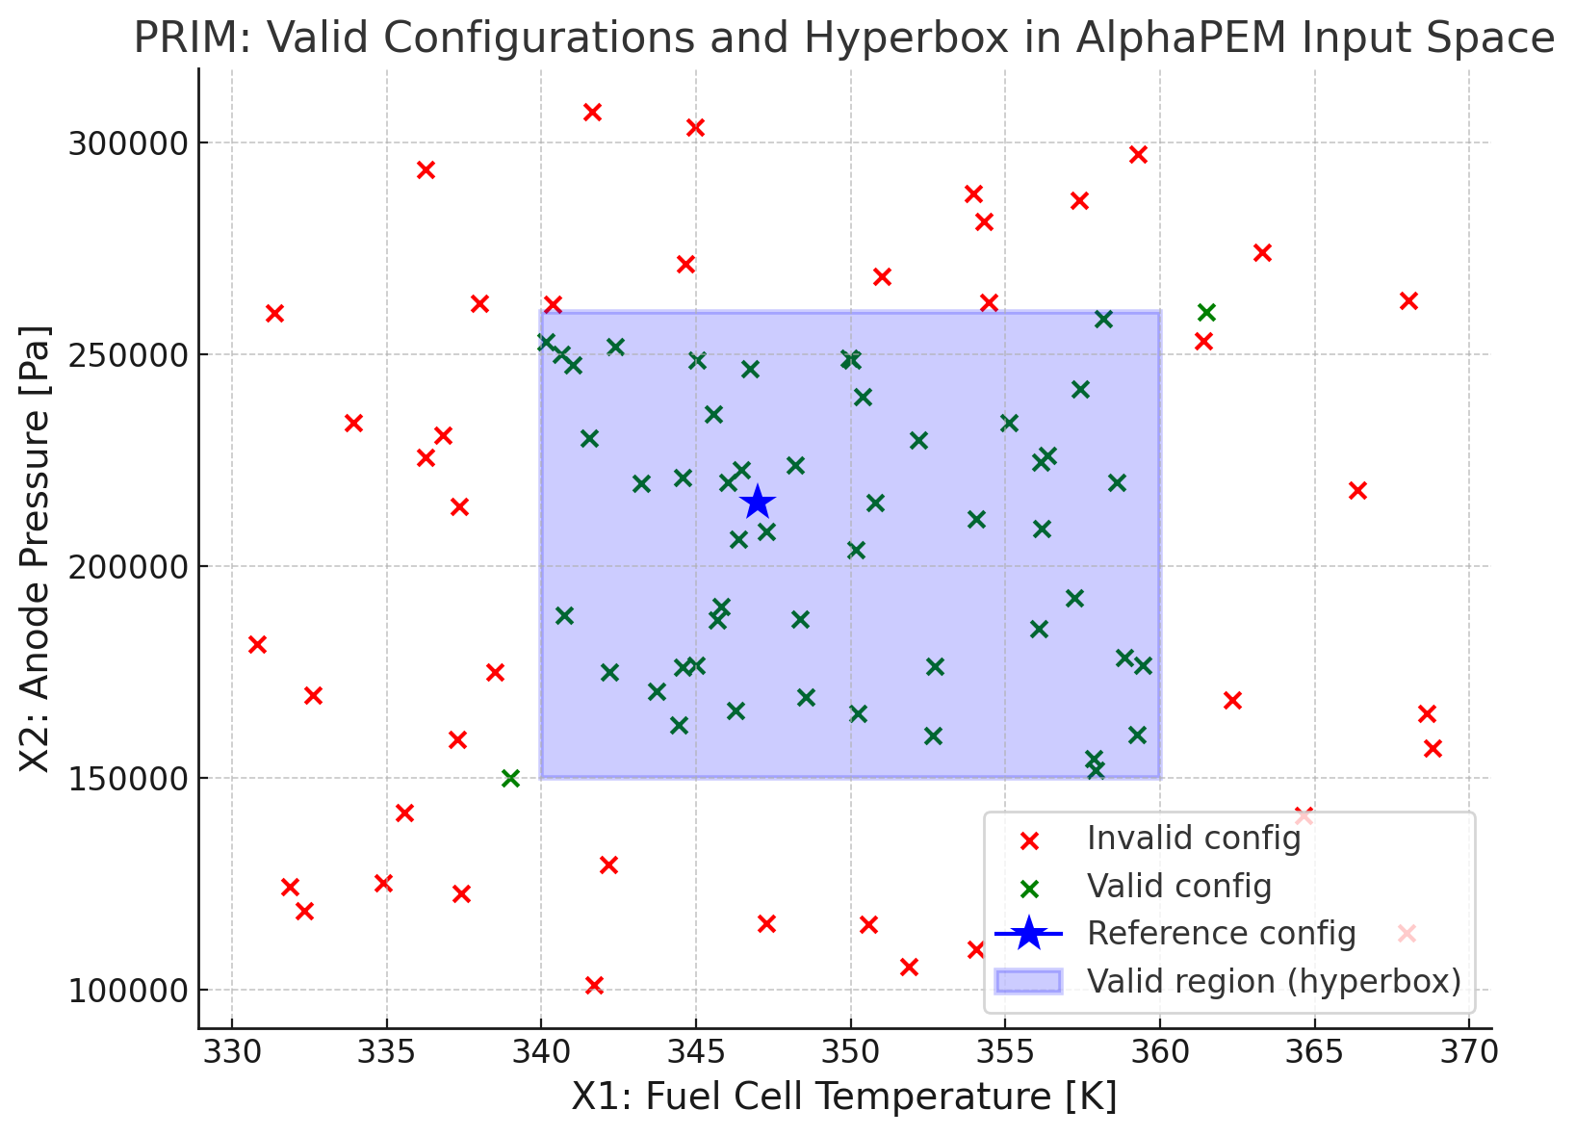
Motivation
2. Model Validity
Sensitivity Analysis | Surrogate Model | Future Work
How PRIM finds a valid input region in AlphaPEM
PRIM Steps
Start with all data (both valid and invalid points)
Peeling phase:
Gradually shrink the box by removing slices (e.g., lowest 5% of temperature or highest 5% of pressure)
Keep only slices that increase prediction precision (proportion of valid configs)
Stop when precision = 1: when all predictions inside are valid)
Pasting phase:
Try adding slices back (if they don’t reduce precision)
Figure: Valid input region (blue) found by PRIM around the reference point (★); only includes configurations with valid polarization curves.

Slide 44
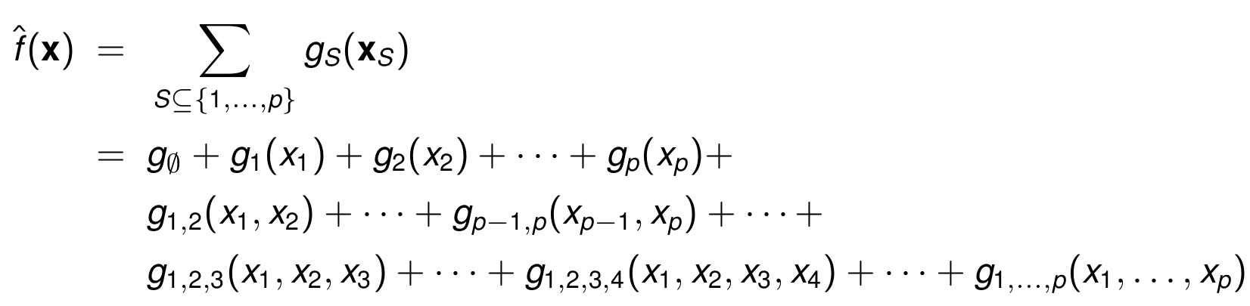





Introduction and motivation | IRD
3. Sensitivity Analysis
Surrogate Model | Conclusions and next steps
Sobol Indices
Sobol analysis assumes the model can be decomposed additively
First-order (S1) : Individual effect
$$S_{i}=\frac{V_{i}}{Var(f)}$$
Second-order (S2):
pairwise interactions
Since the model is decomposed this way, the total variance of the output can be split into components.
Total-order (ST): Total effect including interactions
$$S_{T_{i}}=\frac{V_{i}+\text{all} \text{interaction} \text{terms} \text{involving} x_{i} }{Var(f)}$$
Sobol indices quantify how much of the output variance is due to each input (individually and via interactions).
Back to SA
Source: Advanced Machine Learning course material

Slide 45
Introduction and motivation | IRD
3. Sensitivity Analysis
Surrogate Model | Conclusions and next steps
SHAP Values
SHAP considers all possible subsets of features and computes the marginal contribution of a feature when added to each subset.
1
SHAP (SHapley Additive exPlanations)
is a game theory-based framework that assigns each feature a value reflecting its contribution to a model’s prediction.
This ensures three key properties:
Local accuracy: the sum of SHAP values equals the model output.
Consistency: increasing a feature's impact in the model cannot decrease its SHAP value.
Missingness: features not used in a prediction receive zero contribution.
2
3
SHAP values show how much a single feature changes the model’s average prediction when we know the value of that feature.
SHAP value for a feature tells you: "How much does this feature shift the prediction away from the average when it's known?

Slide 46
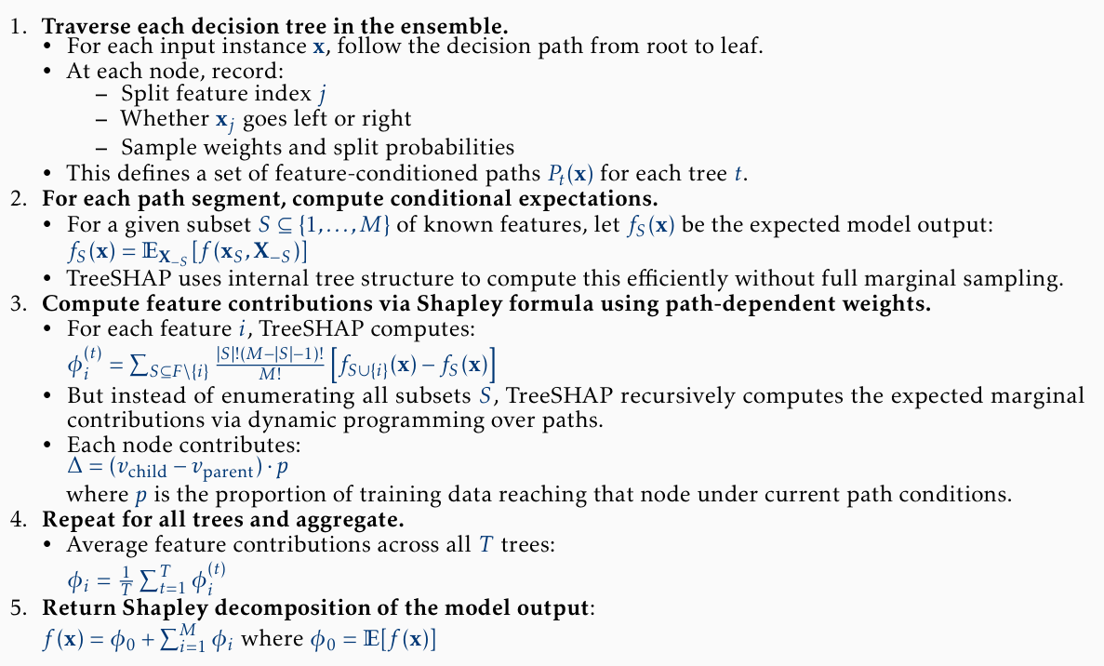
Introduction and motivation | IRD
3. Sensitivity Analysis
Surrogate Model | Conclusions and next steps
TreeSHAP
(for Trees and Forests)
TreeSHAP efficiently computes exact Shapley values for tree-based models by exploiting the tree structure to avoid enumerating all feature subsets.
Algorithm
Advantages:
It computes the exact Shapley values without the need for sampling or approximations
It is computationally efficient due to its dynamic programming approach.
It is specifically designed for tree-based models, which are widely used in practice.
Back to SA

Slide 47
Introduction and motivation | IRD
3. Sensitivity Analysis
Surrogate Model | Conclusions and next steps
Global sensitivity quantifies how inputs influence output variance.
Accounts for interactions.
Applies to any model.
Offers a clear variance decomposition.
High computational cost.
Assumes input independence.
Provides only global insights.
Struggles with high-dimensional data.
Sobol Indices
Pros & cons
Local explanations clarify individual predictions.
Applies to any model.
Handle interactions.
They are grounded in fair game-theoretic principles, with guarantees of fairness and consistency.
SHAP Values
Computationally intensive.
May give misleading results if feature dependence isn't handled well.
Back to SA

Slide 48
Introduction and motivation | IRD
3. Sensitivity Analysis
Surrogate Model | Conclusions and next steps
Sampling strategy: Sobol sequences
It generates quasi-random sequences that are uniformly distributed sample points in high-dimensional spaces.
Calculating the Sobol indices over those configurations lead into more stable and consistent results, due to the uniformity of the samples.
They allow incrementally increase the sample size, while preserving and building upon previous points saving computing time.
Sobol’s implementation
Sample size
For calculating only first-order indices (S1): N × (D + 2)
For both first-order (S1) and second-order (S2) indices: N × (2D + 2)
Back to SA

Slide 49
Introduction and motivation | IRD
3. Sensitivity Analysis
Surrogate Model | Conclusions and next steps
AlphaPEM: Sobol
For the Sobol’s implementation:
N = 1024 (sample size) → 28644 configurations
S1 Indices
*Confidence is based on bootstrapping-like resampling
 | Activation |  | Ohmic |  | Mass Transport
Parameter | S1 index CI (95%) | Ranking | S1 index CI (95%) | Ranking | S1 index CI (95%) | Ranking
i0_c_ref | 0.550 ± 0.09 | 1 | 0.429 ± 0.08 | 1 | 0.325 ± 0.07 | 1
kappa_c | 0.229 ± 0.05 | 2 | 0.136 ± 0.03 | 3 | 0.043 ± 0.02 | 6
Tfc | 0.085 ± 0.03 | 3 | 0.133 ± 0.04 | 4 | 0.144 ± 0.03 | 3
Pa_des | 0.059 ± 0.03 | 4 | 0.156 ± 0.04 | 2 | 0.176 ± 0.04 | 2
kappa_co | 0.024 ± 0.01 | 5 | 0.003 ± 0.01 | 10 | 0.000 ± 0.00 | 9
tau | 0.005 ± 0.01 | 7 | 0.030 ± 0.02 | 5 | 0.062 ± 0.02 | 5
Re | 0.002 ± 0.00 | 9 | 0.023 ± 0.01 | 6 | 0.087 ± 0.03 | 4
epsilon_mc | 0.002 ± 0.01 | 10 | 0.015 ± 0.01 | 7 | 0.037 ± 0.02 | 7
Phi_c_des | 0.000 ± 0.00 | 13 | 0.004 ± 0.01 | 8 | 0.005 ± 0.01 | 8
epsilon_gdl | 0.001 ± 0.00 | 11 | -0.001 ± 0.00 | 12 | -0.005 ± 0.01 | 12
epsilon_c | 0.001 ± 0.00 | 12 | -0.001 ± 0.00 | 13 | -0.005 ± 0.00 | 13
Sc | 0.008 ± 0.01 | 6 | 0.000 ± 0.01 | 11 | -0.002 ± 0.01 | 11
e | 0.004 ± 0.01 | 8 | 0.003 ± 0.02 | 9 | -0.000 ± 0.02 | 10
Sum | 0.97 |  | 0.93 |  | 0.867
Avg Conf | 0.0192 |  | 0.0216 |  | 0.0228
Table XX: First-order Sobol indices (S1) with 95% bootstrapped confidence intervals for each input parameter across the three current density regions of the AlphaPEM model. Rankings indicate relative importance within each region.

Slide 50
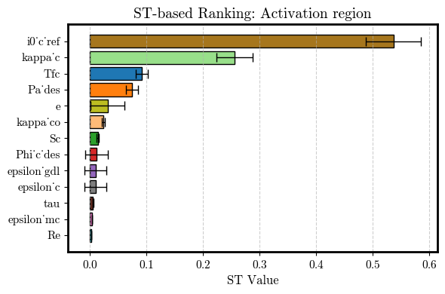
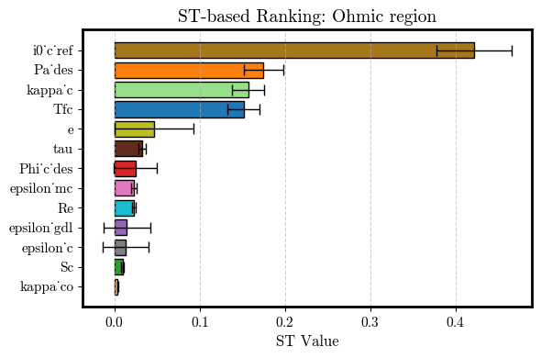
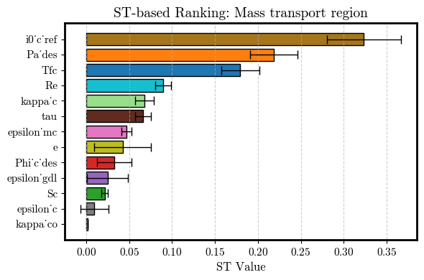
Motivation | Model validity
3. Sensitivity Analysis
Surrogate Model | Future Work
AlphaPEM: Sobol
For the Sobol’s implementation:
N = 1024 (sample size) → 28644 configurations
ST-based Feature Ranking
*Confidence is based on bootstrapping-like resampling
Activation
Ohmic
Mass Transport
Figure XX: Total Sobol (ST) sensitivity indices for the AlphaPEM model, grouped by current density region: Activation, Ohmic, and Mass Transport. Bars show the ST value for each parameter, with black error bars indicating 95% confidence intervals. Rankings reflect the relative influence of each parameter within the region.

Slide 51
Motivation | Model validity
3. Sensitivity Analysis
Surrogate Model | Future Work
AlphaPEM: Sobol
For the Sobol’s implementation:
N = 1024 (sample size) → 28644 configurations
ST Indices
*Confidence is based on bootstrapping-like resampling
 | Activation |  | Ohmic |  | Mass Transport
Parameter | ST index | Ranking | ST index | Ranking | ST index | Ranking
i0_c_ref | 0.550 ± 0.09 | 1 | 0.429 ± 0.08 | 1 | 0.325 ± 0.07 | 1
kappa_c | 0.229 ± 0.05 | 2 | 0.136 ± 0.03 | 3 | 0.043 ± 0.02 | 6
Tfc | 0.085 ± 0.03 | 3 | 0.133 ± 0.04 | 4 | 0.144 ± 0.03 | 3
Pa_des | 0.059 ± 0.03 | 4 | 0.156 ± 0.04 | 2 | 0.176 ± 0.04 | 2
kappa_co | 0.024 ± 0.01 | 5 | 0.003 ± 0.01 | 10 | 0.000 ± 0.00 | 9
tau | 0.005 ± 0.01 | 7 | 0.030 ± 0.02 | 5 | 0.062 ± 0.02 | 5
Re | 0.002 ± 0.00 | 9 | 0.023 ± 0.01 | 6 | 0.087 ± 0.03 | 4
epsilon_mc | 0.002 ± 0.01 | 10 | 0.015 ± 0.01 | 7 | 0.037 ± 0.02 | 7
Phi_c_des | 0.000 ± 0.00 | 13 | 0.004 ± 0.01 | 8 | 0.005 ± 0.01 | 8
epsilon_gdl | 0.001 ± 0.00 | 11 | -0.001 ± 0.00 | 12 | -0.005 ± 0.01 | 12
epsilon_c | 0.001 ± 0.00 | 12 | -0.001 ± 0.00 | 13 | -0.005 ± 0.00 | 13
Sc | 0.008 ± 0.01 | 6 | 0.000 ± 0.01 | 11 | -0.002 ± 0.01 | 11
e | 0.004 ± 0.01 | 8 | 0.003 ± 0.02 | 9 | -0.000 ± 0.02 | 10
Sum | 0.97 |  | 0.93 |  | 0.867
Avg Conf | 0.0192 |  | 0.0216 |  | 0.0228
Table XX: Total Sobol indices (ST) with 95% bootstrapped confidence intervals for each input parameter across the three current density regions of the AlphaPEM model. Rankings indicate relative importance within each region.

Slide 52
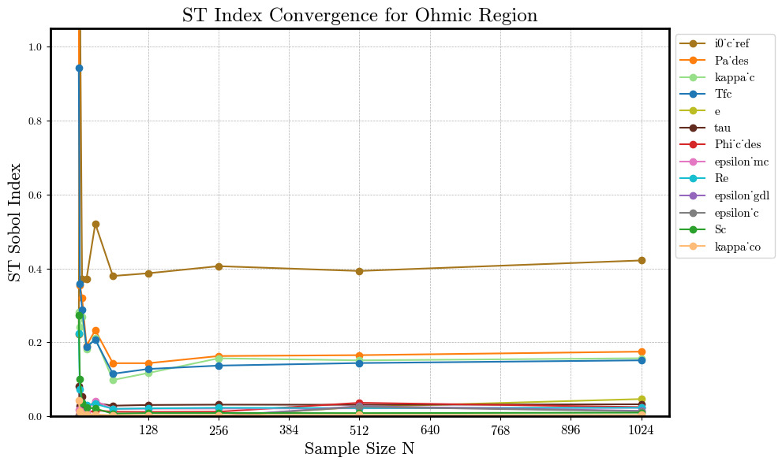
Motivation | Model validity
3. Sensitivity Analysis
Surrogate Model | Future Work
AlphaPEM: Sobol
Ohmic
ST Index convergence (2)
Figure: Total Sobol indices (ST) for the Ohmic region as a function of Sobol base sample size N. Each curve shows how the ST estimate stabilizes as more configurations are used (up to N=1024, corresponding to 28,644 total evaluations). This helps assess the reliability and convergence behavior of the sensitivity estimates per parameter.

Slide 53
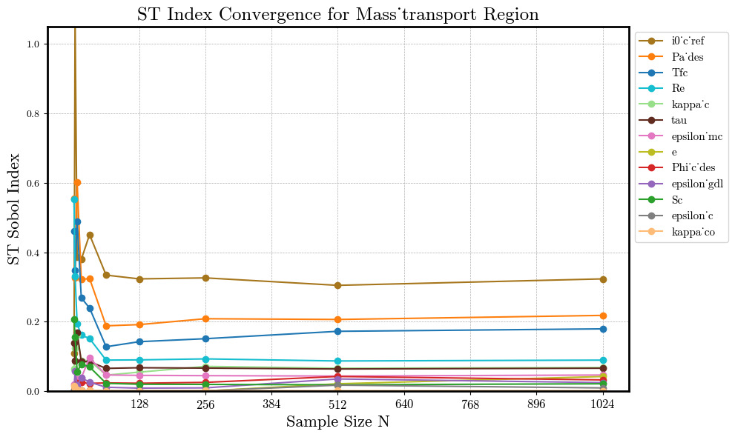
Motivation | Model validity
3. Sensitivity Analysis
Surrogate Model | Future Work
AlphaPEM: Sobol
Mass transport
ST Index convergence (3)
Figure: Total Sobol indices (ST) for the Mass transport region as a function of Sobol base sample size N. Each curve shows how the ST estimate stabilizes as more configurations are used (up to N=1024, corresponding to 28,644 total evaluations). This helps assess the reliability and convergence behavior of the sensitivity estimates per parameter.

Slide 54
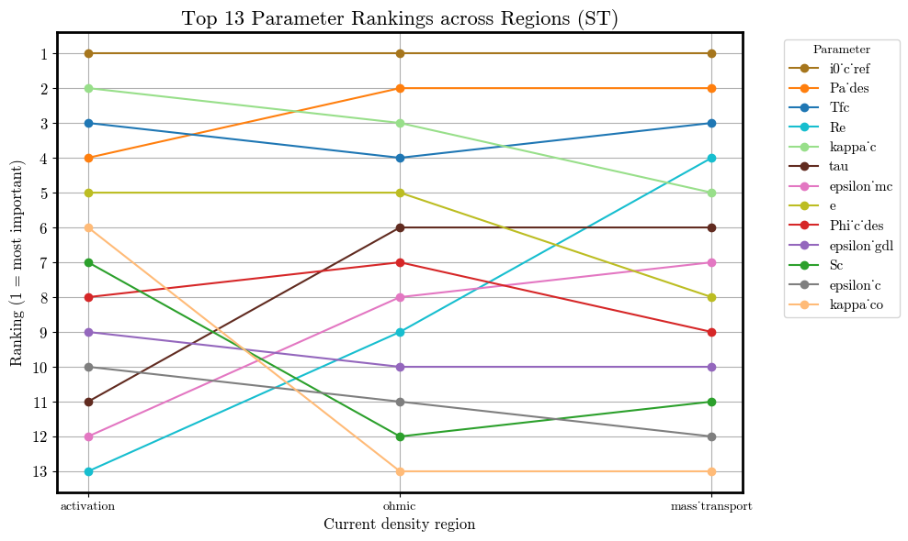
Motivation | Model validity
3. Sensitivity Analysis
Surrogate Model | Future Work
AlphaPEM: Sobol
Total Sobol (ST) Index–based Feature Importance
Figure: Ranking of the top 13 input parameters based on total Sobol indices (ST) across the three current density regions of the AlphaPEM model. Rank 1 indicates the most influential parameter in a given region. Lines track how each parameter’s importance changes between regions, revealing stable drivers (e.g., i_0c_ref​​) and region-specific effects (e.g. Re).

Slide 55
Motivation | Model Validity
3. Sensitivity Analysis
Surrogate Model | Future Work
XGBoost hyperparameter tuning
Data preparation
We are fitting the voltage as a function of the 13 features & the current density.
Only valid polarization curves (~55k configurations)
XGBRegressor
n_estimators: [300, 500, 700]
max_depth: [6, 8, 10]
learning_rate: [0.01, 0.05]
subsample: [0.8, 1.0]
colsample_bytree: [0.8, 1.0]
Train the model
XGBoost with nested CV
Inner 3-fold CV: for tuning XGBoost hyperparameters.
Outer 5-fold CV: to assess generalization performance.
Best configuration
colsample_bytree: 0.8
learning_rate: 0.05
max_depth: 8
n_estimators: 700
subsample: 0.8
Back to XGBoost

Slide 56
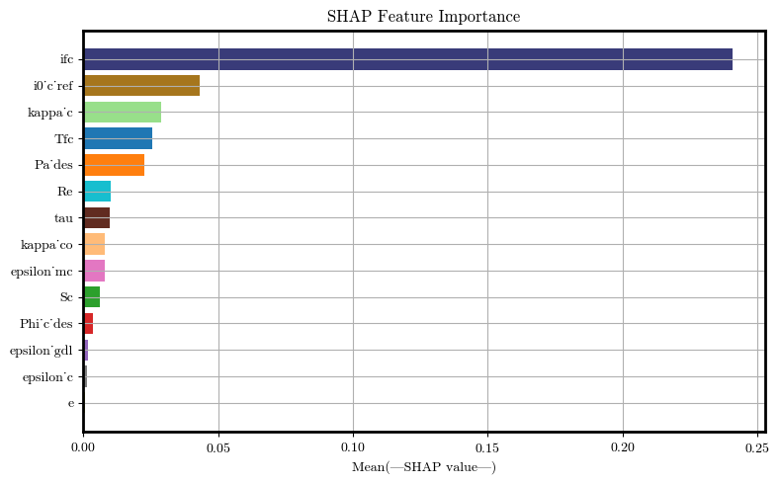
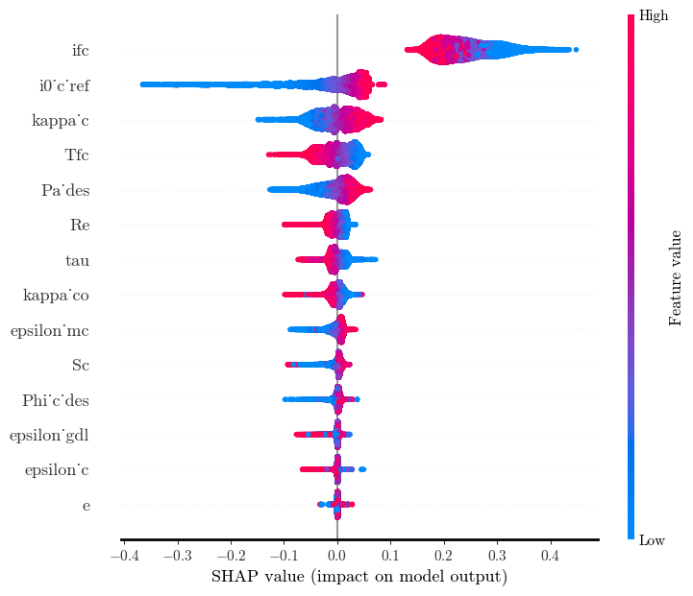








Introduction and motivation | IRD
3. Sensitivity Analysis
Surrogate Model | Conclusions and next steps
XGBoost
SHAP
Feature
Importance
Feature importance
Summary plot
$$ifc$$
$$ifc$$
$${i0}_{c ref}$$
$${i0}_{c ref}$$
$$κ_{c}$$
$$κ_{c}$$
$$Tfc$$
$$Tfc$$
Activation
$${Pa}_{des}$$
$${Pa}_{des}$$
$$Re$$
$$Re$$
$$τ$$
$$τ$$
$$κ_{co}$$
$$κ_{co}$$
$$ε_{mc}$$
$$ε_{mc}$$
$$Sc$$
$$Sc$$
$$φ_{cdes}$$
$$φ_{cdes}$$
$$ε_{gdl}$$
$$ε_{gdl}$$
$$ε_{c}$$
$$ε_{c}$$
$$e$$
$$e$$
Figure XX: SHAP feature importance ranking based on the XGBoost model, showing the top contributors to the output in the Activation region.
Figure XX: SHAP summary plot showing feature impact on the XGBoost model for the Activation region. Color indicates feature value; horizontal spread reflects influence.

Slide 57












Introduction and motivation | IRD
3. Sensitivity Analysis
Surrogate Model | Conclusions and next steps
XGBoost
Sobol
Feature | S1 | S1 CI | ST | ST CI | S2 Total | S2 CI
i0_c_ref | 0.4344 | (0.41, 0.459) | 0.4422 | (0.425, 0.459) | 0.0050 | (-0.119, 0.129)
kappa_c | 0.1834 | (0.169, 0.198) | 0.2108 | (0.202, 0.219) | -0.0006 | (-0.021, 0.019)
ifc | 0.1870 | (0.175, 0.199) | 0.1939 | (0.186, 0.202) | 0.0000 | (0.0, 0.0)
Tfc | 0.0768 | (0.068, 0.086) | 0.0818 | (0.079, 0.085) | 0.0018 | (-0.184, 0.187)
Pa_des | 0.0466 | (0.038, 0.055) | 0.0739 | (0.07, 0.078) | 0.0725 | (-0.078, 0.223)
kappa_co | 0.0098 | (0.006, 0.014) | 0.0183 | (0.017, 0.019) | 0.0114 | (-0.001, 0.024)
Sc | 0.0057 | (0.003, 0.009) | 0.0136 | (0.013, 0.014) | 0.0070 | (-0.044, 0.058)
tau | 0.0040 | (0.001, 0.007) | 0.0095 | (0.009, 0.01) | -0.0069 | (-0.041, 0.028)
epsilon_mc | 0.0032 | (0.001, 0.006) | 0.0071 | (0.007, 0.007) | -0.0007 | (-0.027, 0.026)
Re | 0.0017 | (-0.001, 0.004) | 0.0056 | (0.005, 0.006) | 0.0007 | (-0.013, 0.014)
Phi_c_des | 0.0024 | (0.001, 0.004) | 0.0046 | (0.004, 0.005) | -0.0168 | (-0.048, 0.014)
epsilon_gdl | -0.0003 | (-0.002, 0.001) | 0.0026 | (0.002, 0.003) | 0.0070 | (-0.014, 0.028)
epsilon_c | -0.0005 | (-0.002, 0.001) | 0.0023 | (0.002, 0.002) | 0.0052 | (-0.007, 0.017)
e | 0.0004 | (-0.0, 0.001) | 0.0004 | (0.0, 0.0) | -0.0027 | (-0.007, 0.002)
$${i0}_{c ref}$$
$$κ_{c}$$
$$ifc$$
Activation
$$Tfc$$
$${Pa}_{des}$$
N = 8.192
→ 245,760 configurations
Sum S1 = 0.9547
Sum S2 = 0.0830
Sum S1 + S2 = 1.0377
Sum ST = 1.0665
$$κ_{co}$$
$$Sc$$
$$τ$$
$$ε_{mc}$$
$$Re$$
$$φ_{cdes}$$
$$ε_{gdl}$$
$$ε_{c}$$
$$e$$
Figure XX: Sobol sensitivity indices for the Activation region based on the XGBoost model, showing first-order (S1), total-order (ST), and second-order (S2) effects with confidence intervals. Parameters i0_ref, κ_c, and ifc exhibit the highest influence on model output.

Slide 58
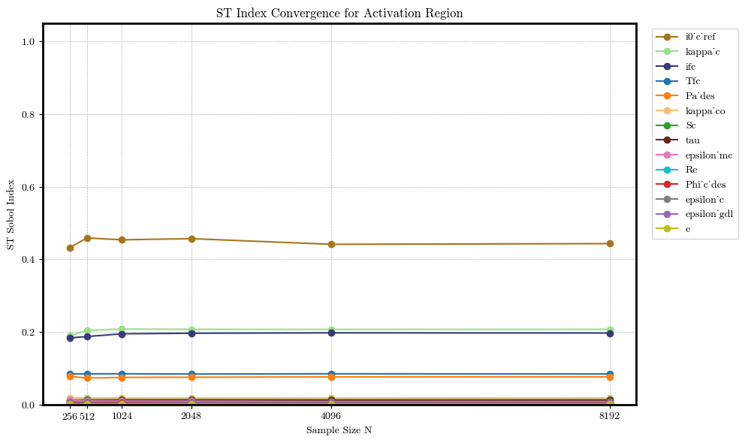
Introduction and motivation | IRD
3. Sensitivity Analysis
Surrogate Model | Conclusions and next steps
XGBoost
Sobol
ST
$${i0}_{c ref}$$
$$κ_{c}$$
$$ifc$$
$$Tfc$$
$${Pa}_{des}$$
$$κ_{co}$$
$$Sc$$
$$τ$$
$$ε_{mc}$$
Activation
$$Re$$
$$φ_{cdes}$$
$$ε_{c}$$
N = 8.192
→ 245,760 configurations
Sum S1 = 0.9547
Sum S2 = 0.0830
Sum S1 + S2 = 1.0377
Sum ST = 1.0665
$$ε_{gdl}$$
$$e$$
Figure XX: Convergence of total-order (ST) Sobol indices for features in the Activation region across increasing sample sizes. The indices stabilize as sample size grows, with i0'_c ref, κ_c, and ifc showing the highest total contributions to output variance.

Slide 59
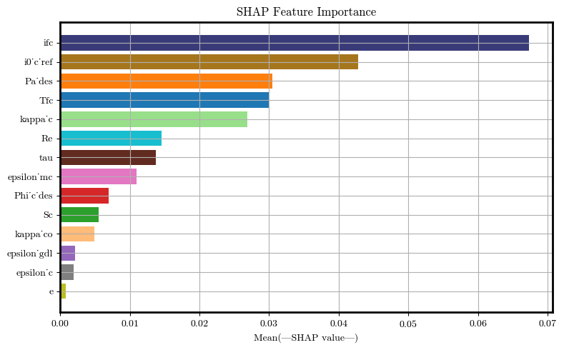
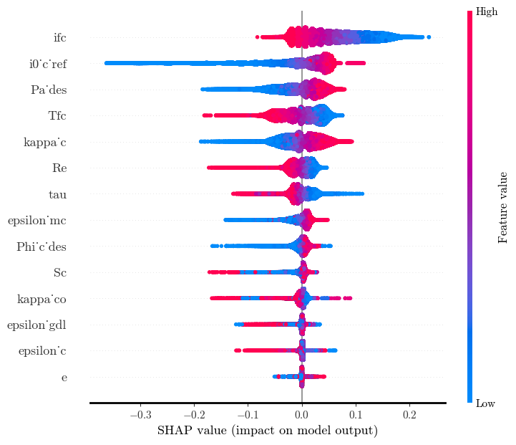
Introduction and motivation | IRD
3. Sensitivity Analysis
Surrogate Model | Conclusions and next steps
XGBoost
SHAP
Feature
Importance
Feature importance
Summary plot
$$ifc$$
$$ifc$$
$${i0}_{c ref}$$
$${i0}_{c ref}$$
$${Pa}_{des}$$
$${Pa}_{des}$$
$$Tfc$$
$$Tfc$$
Ohmic
$$κ_{c}$$
$$κ_{c}$$
$$Re$$
$$Re$$
$$τ$$
$$τ$$
$$ε_{mc}$$
$$ε_{mc}$$
$$φ_{cdes}$$
$$φ_{cdes}$$
$$Sc$$
$$Sc$$
$$κ_{co}$$
$$κ_{co}$$
$$ε_{gdl}$$
$$ε_{gdl}$$
$$ε_{c}$$
$$ε_{c}$$
$$e$$
$$e$$
Figure XX: SHAP feature importance ranking based on the XGBoost model, showing the top contributors to the output in the Ohmic region.
Figure XX: SHAP summary plot showing feature impact on the XGBoost model for the Ohmic region. Color indicates feature value; horizontal spread reflects influence.

Slide 60





Introduction and motivation | IRD
3. Sensitivity Analysis
Surrogate Model | Conclusions and next steps
XGBoost
Sobol
Feature | S1 | S1 CI | ST | ST CI | S2 Total | S2 CI
i0_c_ref | 0.3046 | (0.285, 0.324) | 0.3145 | (0.3, 0.329) | 0.0055 | (-0.089, 0.1)
ifc | 0.2770 | (0.262, 0.292) | 0.2881 | (0.277, 0.299) | 0.0000 | (0.0, 0.0)
Pa_des | 0.1069 | (0.096, 0.118) | 0.1319 | (0.126, 0.138) | 0.0479 | (-0.158, 0.254)
kappa_c | 0.0958 | (0.085, 0.107) | 0.1191 | (0.114, 0.124) | 0.0007 | (-0.016, 0.017)
Tfc | 0.1050 | (0.095, 0.115) | 0.1164 | (0.112, 0.121) | 0.0102 | (-0.193, 0.213)
tau | 0.0183 | (0.014, 0.023) | 0.0286 | (0.027, 0.03) | 0.0088 | (-0.049, 0.066)
Re | 0.0151 | (0.01, 0.02) | 0.0231 | (0.022, 0.024) | 0.0026 | (-0.025, 0.031)
epsilon_mc | 0.0116 | (0.007, 0.016) | 0.0193 | (0.018, 0.02) | -0.0039 | (-0.047, 0.039)
Phi_c_des | 0.0083 | (0.005, 0.012) | 0.0151 | (0.014, 0.016) | -0.0051 | (-0.058, 0.048)
Sc | 0.0017 | (-0.001, 0.004) | 0.0096 | (0.009, 0.01) | -0.0058 | (-0.047, 0.036)
kappa_co | 0.0020 | (-0.0, 0.004) | 0.0063 | (0.006, 0.007) | 0.0023 | (-0.004, 0.009)
epsilon_gdl | 0.0003 | (-0.002, 0.002) | 0.0039 | (0.003, 0.004) | 0.0051 | (-0.021, 0.031)
epsilon_c | -0.0004 | (-0.002, 0.001) | 0.0034 | (0.003, 0.004) | 0.0008 | (-0.014, 0.016)
e | 0.0003 | (-0.0, 0.001) | 0.0005 | (0.0, 0.001) | -0.0016 | (-0.006, 0.003)
$${i0}_{c ref}$$
$$ifc$$
$${Pa}_{des}$$
$$κ_{c}$$
Ohmic
$$Tfc$$
N = 8.192
→ 245,760 configurations
Sum S1 = 0.9464
Sum S2 = 0.0675
Sum S1 + S2 = 1.0139
Sum ST = 1.0799
$$τ$$
$$Re$$
$$ε_{mc}$$
$$φ_{cdes}$$
$$Sc$$
$$κ_{co}$$
$$ε_{gdl}$$
$$ε_{c}$$
$$e$$
Figure XX: Sobol sensitivity indices for the Ohmic region based on the XGBoost model, showing first-order (S1), total-order (ST), and second-order (S2) effects with confidence intervals. Parameters i0_ref, κ_c, and ifc exhibit the highest influence on model output.

Slide 61
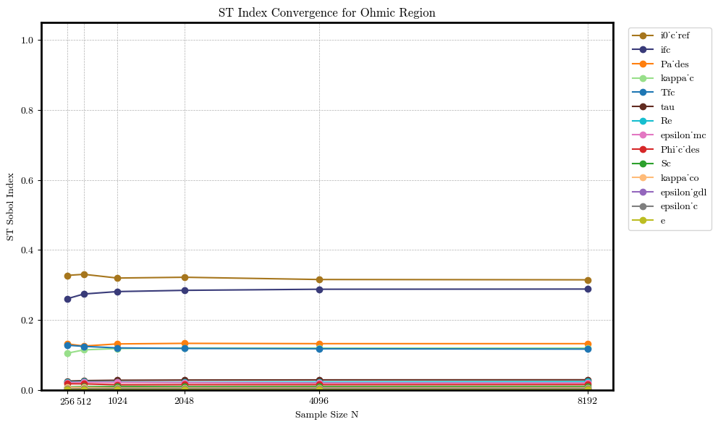


Introduction and motivation | IRD
3. Sensitivity Analysis
Surrogate Model | Conclusions and next steps
XGBoost
Sobol
ST
$${i0}_{c ref}$$
$$ifc$$
$${Pa}_{des}$$
$$κ_{c}$$
$$Tfc$$
$$τ$$
$$Re$$
$$ε_{mc}$$
$$φ_{cdes}$$
Ohmic
$$Sc$$
$$κ_{co}$$
$$ε_{gdl}$$
N = 8.192
→ 245,760 configurations
Sum S1 = 0.9464
Sum S2 = 0.0675
Sum S1 + S2 = 1.0139
Sum ST = 1.0799
$$ε_{c}$$
$$e$$
Figure XX: Convergence of total-order (ST) Sobol indices for features in the Ohmic region across increasing sample sizes. The indices stabilize as sample size grows, with i0'_c ref, κ_c, and ifc showing the highest total contributions to output variance.

Slide 62
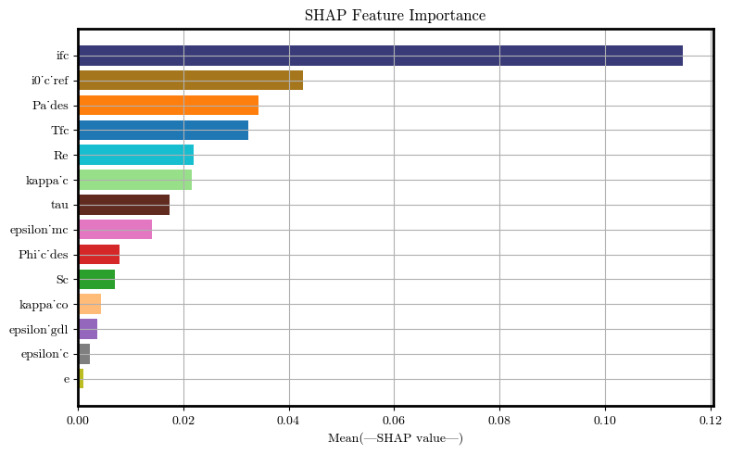
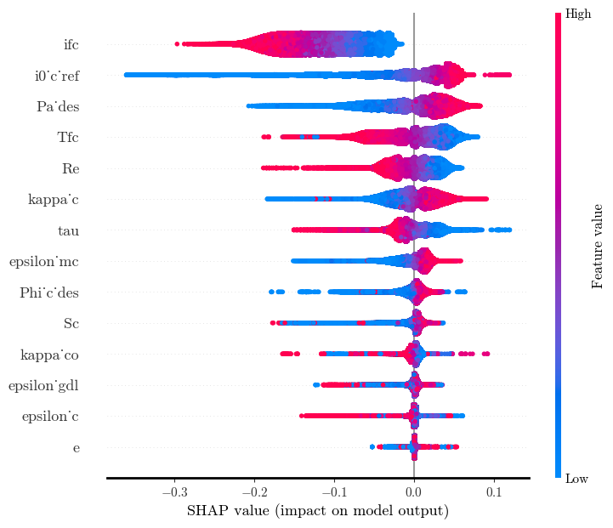


Introduction and motivation | IRD
3. Sensitivity Analysis
Surrogate Model | Conclusions and next steps
XGBoost
SHAP
Feature
Importance
Feature importance
Summary plot
$$ifc$$
$$ifc$$
$${i0}_{c ref}$$
$${i0}_{c ref}$$
$${Pa}_{des}$$
$${Pa}_{des}$$
$$Tfc$$
$$Tfc$$
Mass Transport
$$Re$$
$$Re$$
$$κ_{c}$$
$$κ_{c}$$
$$τ$$
$$τ$$
$$ε_{mc}$$
$$ε_{mc}$$
$$φ_{cdes}$$
$$φ_{cdes}$$
$$Sc$$
$$Sc$$
$$κ_{co}$$
$$κ_{co}$$
$$ε_{gdl}$$
$$ε_{gdl}$$
$$ε_{c}$$
$$ε_{c}$$
$$e$$
$$e$$
Figure XX: SHAP feature importance ranking based on the XGBoost model, showing the top contributors to the output in the Mass Transport region.
Figure XX: SHAP summary plot showing feature impact on the XGBoost model for the Mass Transport region. Color indicates feature value; horizontal spread reflects influence.

Slide 63

Introduction and motivation | IRD
3. Sensitivity Analysis
Surrogate Model | Conclusions and next steps
XGBoost
Sobol
Feature | S1 | S1 CI | ST | ST CI | S2 Total | S2 CI
i0_c_ref | 0.2734 | (0.255, 0.291) | 0.2852 | (0.272, 0.299) | 0.0044 | (-0.08, 0.089)
ifc | 0.1726 | (0.161, 0.185) | 0.1863 | (0.179, 0.194) | 0.0000 | (0.0, 0.0)
Pa_des | 0.1524 | (0.14, 0.165) | 0.1853 | (0.178, 0.193) | 0.0381 | (-0.203, 0.28)
Tfc | 0.1282 | (0.118, 0.139) | 0.1486 | (0.142, 0.155) | -0.0148 | (-0.232, 0.203)
Re | 0.0696 | (0.06, 0.079) | 0.0830 | (0.08, 0.086) | 0.0045 | (-0.05, 0.059)
kappa_c | 0.0361 | (0.028, 0.044) | 0.0608 | (0.058, 0.063) | 0.0023 | (-0.009, 0.013)
tau | 0.0426 | (0.036, 0.049) | 0.0550 | (0.052, 0.058) | 0.0069 | (-0.066, 0.08)
epsilon_mc | 0.0290 | (0.022, 0.036) | 0.0395 | (0.038, 0.041) | -0.0114 | (-0.076, 0.053)
Phi_c_des | 0.0104 | (0.006, 0.015) | 0.0235 | (0.021, 0.025) | -0.0081 | (-0.076, 0.06)
Sc | 0.0047 | (0.001, 0.009) | 0.0190 | (0.018, 0.02) | 0.0176 | (-0.046, 0.082)
epsilon_gdl | 0.0010 | (-0.002, 0.004) | 0.0093 | (0.009, 0.01) | 0.0076 | (-0.032, 0.047)
kappa_co | 0.0023 | (-0.0, 0.005) | 0.0057 | (0.005, 0.006) | -0.0004 | (-0.007, 0.006)
epsilon_c | -0.0009 | (-0.003, 0.001) | 0.0048 | (0.004, 0.006) | 0.0066 | (-0.011, 0.025)
e | 0.0003 | (-0.001, 0.001) | 0.0008 | (0.001, 0.001) | -0.0022 | (-0.009, 0.005)
$${i0}_{c ref}$$
$$ifc$$
$${Pa}_{des}$$
Mass Transport
$$Tfc$$
$$Re$$
N = 8.192
→ 245,760 configurations
Sum S1 = 0.9217
Sum S2 = 0.0510
Sum S1 + S2 = 0.9727
Sum ST = 1.1068
$$κ_{c}$$
$$τ$$
$$ε_{mc}$$
$$φ_{cdes}$$
$$Sc$$
$$ε_{gdl}$$
$$κ_{co}$$
$$ε_{c}$$
$$e$$
Figure XX: Sobol sensitivity indices for the Mass Transport region based on the XGBoost model, showing first-order (S1), total-order (ST), and second-order (S2) effects with confidence intervals. Parameters i0_ref, Pa_des, and ifc exhibit the highest influence on model output.

Slide 64
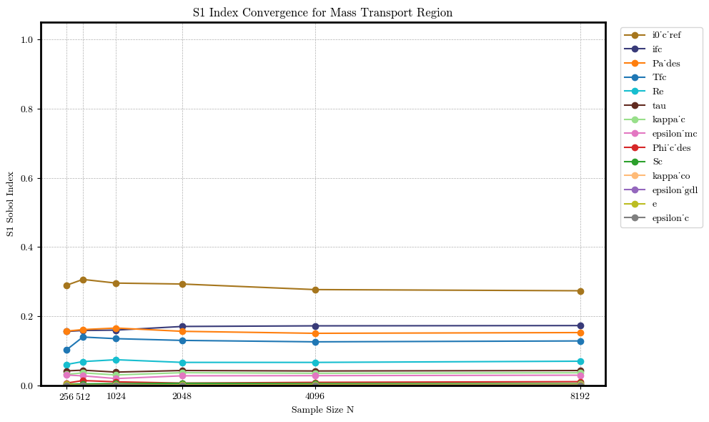
Introduction and motivation | IRD
3. Sensitivity Analysis
Surrogate Model | Conclusions and next steps
XGBoost
Sobol
ST
$${i0}_{c ref}$$
$$ifc$$
$${Pa}_{des}$$
$$Tfc$$
$$Re$$
$$τ$$
$$κ_{c}$$
$$ε_{mc}$$
$$φ_{cdes}$$
Mass Transport
$$Sc$$
$$κ_{co}$$
$$ε_{gdl}$$
N = 8.192
→ 245,760 configurations
Sum S1 = 0.9217
Sum S2 = 0.0510
Sum S1 + S2 = 0.9727
Sum ST = 1.1068
$$e$$
$$ε_{c}$$
Figure XX: Convergence of total-order (ST) Sobol indices for features in the Mass transport region across increasing sample sizes. The indices stabilize as sample size grows, with i0'_c ref, Pa_des, and ifc showing the highest total contributions to output variance.

Slide 65




Motivation | Model Validity | Sensitivity Analysis
4. Surrogate Model
Future Work
Top 5 Equations for PySR with unconstrained search space
Equation | R² | MSE
 | 0.854 | 0.0042
 | 0.8496 | 0.0043
 | 0.8473 | 0.0043
 | 0.8329 | 0.0048
 | 0.828 | 0.0049
Table 9: Top 5 equations based on R² with unconstrained search space.

Slide 66
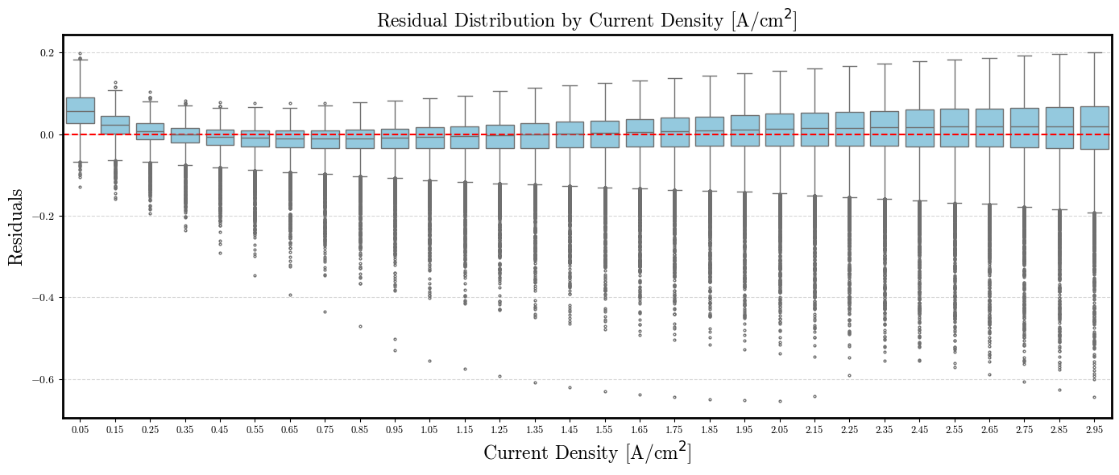
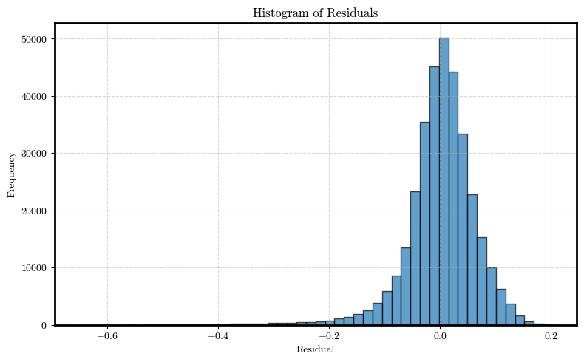
Motivation | Model Validity | Sensitivity Analysis
4. Surrogate Model
Future Work
Residuals for the equation with the best R² (unconstrained)
Figure 21: Residuals of the best equation for different current density values. Residuals increase with the current density.
Figure 22: Histogram of the residuals of the best equation.

Slide 67
Motivation | Model Validity | Sensitivity Analysis
4. Surrogate Model
Future Work
Top 5 Equations for PySR with constrained search space (physics- informed)
Equation | R² | MSE
 | 0.884 | 0.0032
 | 0.884 | 0.0032
 | 0.884 | 0.0032
 | 0.8749 | 0.0036
 | 0.8735 | 0.0038
Table 10: Top 5 equations based on R² with constrained search space (physics-informed).

Slide 68
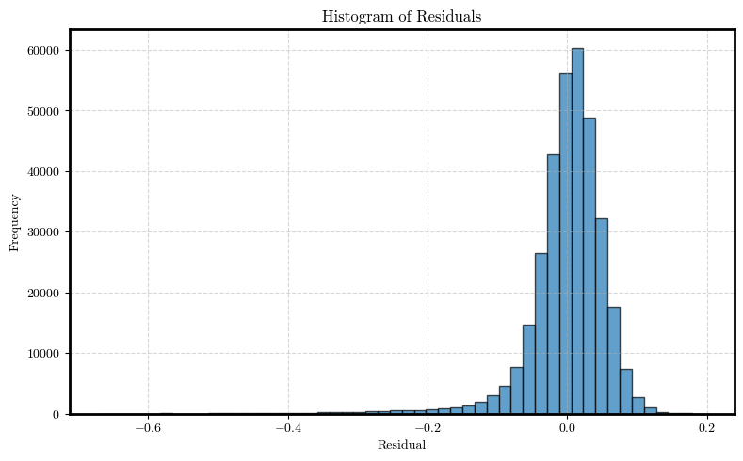
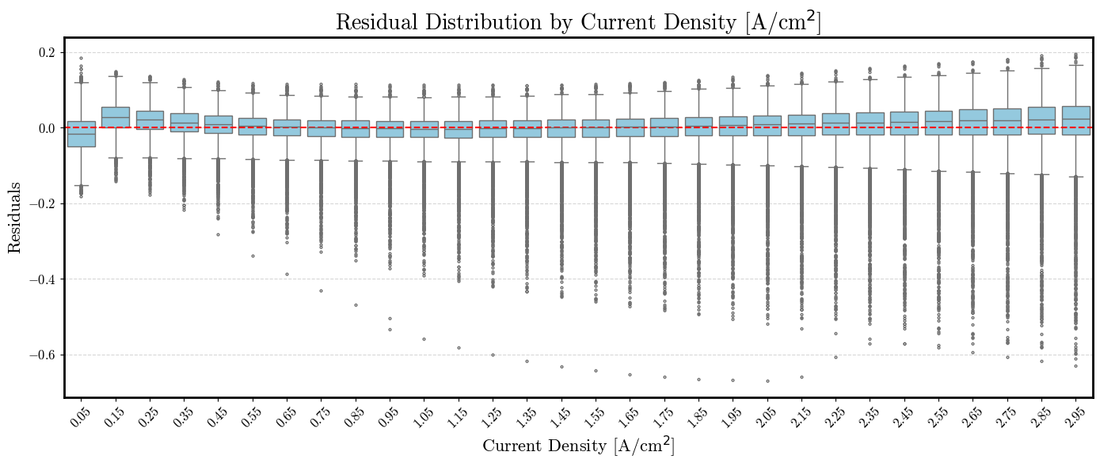
Motivation | Model Validity | Sensitivity Analysis
4. Surrogate Model
Future Work
Residuals for the equation with the best R² (physics-informed)
Figure 23: Residuals of the best equation for different current density values. Residuals increase with the current density.
Figure 24: Histogram of the residuals of the best equation.

