Slide 1

Formal Verification Overview in Neural Networks
Erel Dekel Boaz Gurevich

Slide 2


Introduction to Formal Verification
Crucial for ensuring the correctness of systems especially in safety-critical applications
Two main types: Model Checking and Theorem Proving each use different approach to verify system properties

Slide 3



Key Concepts in Formal Verification
Specification – Formal description of desired system behavior
Model – Mathematical representation of the system. states and transitions
Properties – Specific claims or assertions about particular aspects of the system. Fairness, Liveness and Safety

Slide 4



Challenges in Formal Verification of Neural Networks
Scalability – large number of parameters and complex architectures
Non-linearities – activation functions complicates the verification
Robustness Verification – Ensuring NN are robust against adversarial attack

Slide 5



Maraboupy: Python Interface for Neural Network Verification
Key Features – User friendly interface which supports various NN architectures
Functionality – Imports NN from formats, specify constraints on inputs and outputs, use SMT to prove/disprove properties and generate counterexample
Use Cases– property checking and mostly robustness verification

Slide 6



Introduction to Reinforcement Learning
Concept – Type of ML where an agent learn how to interact with the environment through actions
Key Components – Agent, Environment, State, Action, Reward, Policy
Application – Game playing, robotics and autonomous systems

Slide 7
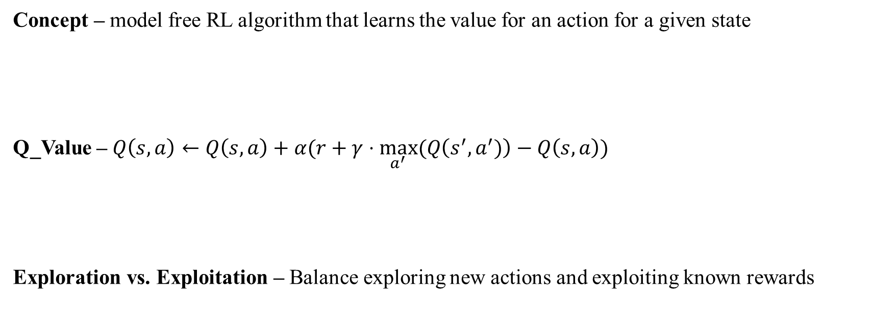
Understanding Q-Learning
Concept – model free RL algorithm that learns the value for an action for a given state
Q_Value – $Q\left(s,a\right)←Q\left(s,a\right)+α(r+γ⋅\max_{a^{′}}⁡(Q\left(s^{′},a^{′})\right)−Q\left(s,a\right))$
Exploration vs. Exploitation – Balance exploring new actions and exploiting known rewards

Slide 8
Deep Q-Learning (DQL)
Concept – using NN to approximate the Q function
Scalability –Avoiding large Q-table in case of high-dimensional states and complex environments
Stability – Can lead to divergence with the slight change in hyperparameters and learning rates
Experience replay and target model

Slide 9
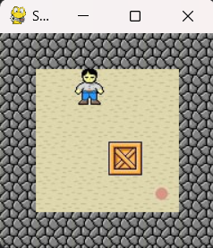
Code – The Sokoban Game

Slide 10
Code – The Model
Simple – One FC hidden layer with ReLU activation function
CNN – One Convolutional and Pooling layer before one FC hidden layer with ReLU

Slide 11
Code – The Agent
Learning – Use previous steps to adjust model parameters
Stability – Using target model and Prioritized replay to speedup the convergence
Exploration – Decay slowly the exploration steps
ONNX – Export model to ONNX format

Slide 12
Code – The Reward System
Simple – Evaluate transition by “done”, “waste” and “move” rewards
HotCold – Evaluate states before and after and give same positive/negative rewards based on the evaluations

Slide 13
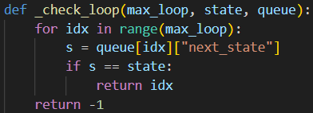

Code – The Verification
Marabou – Unsuccessful reading ONNX format NN
Loop detection – Verification by changing previous moves rewards when detecting loops

Slide 14
Results and Conclusion

