Slide 1

Formal Verification Overview in Neural Networks
Erel Dekel Boaz Gurevich

Slide 2


Introduction To Formal Verification
Crucial for ensuring the correctness of systems especially in safety-critical applications
Two main types: Model Checking and Theorem Proving each use different approach to verify system properties

Slide 3



Key Concepts in Formal Verification
Specification – Formal description of desired system behavior
Model – Mathematical representation of the system. states and transitions
Properties – Specific claims or assertions about particular aspects of the system. Fairness, Liveness and Safety

Slide 4



Challenges In Formal Verification of Neural Networks
Scalability – Large number of parameters and complex architectures
Non-linearities – Activation functions complicate the verification
Robustness Verification – Ensuring NN are robust against adversarial attacks

Slide 5



Maraboupy: Python Interface For Neural Network Verification
Key Features – User friendly interface which supports various NN architectures
Functionality – Imports NN from formats, specifies constraints on inputs and outputs, uses SMT to prove/disprove properties and generates counter-examples
Use Cases– Property checking and mostly robustness verification

Slide 6
Introduction to Reinforcement Learning
Concept – Type of ML where an agent learns how to interact with the environment through actions
Key Components – Agent, Environment, State, Action, Reward, Policy
Application – Game playing, robotics, autonomous systems, etc.

Slide 7
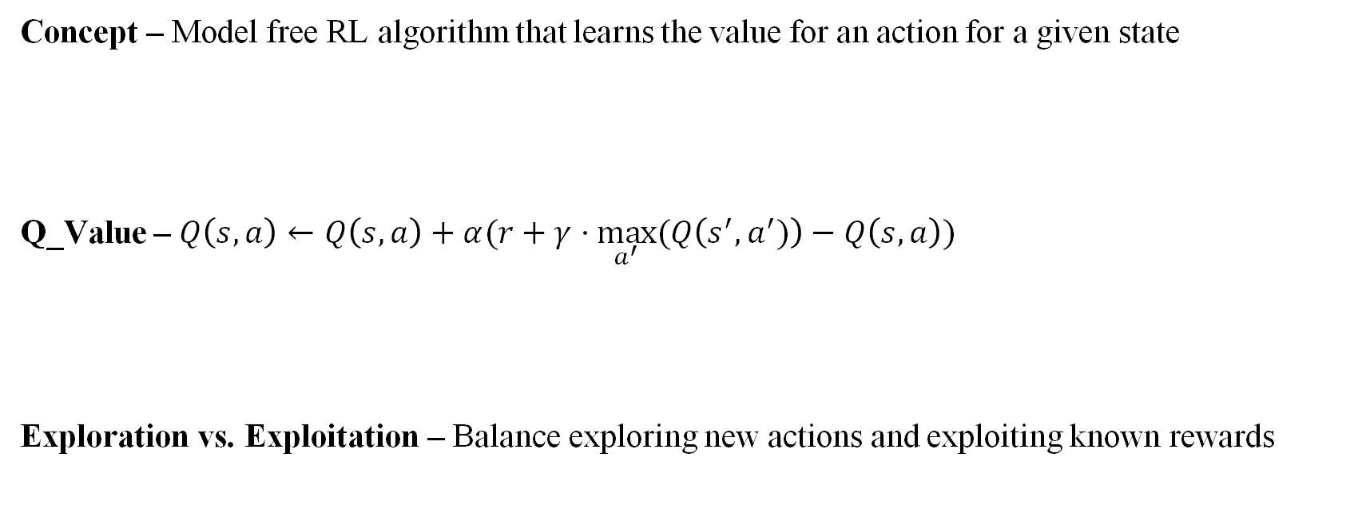
Understanding Q-Learning
Concept – Model free RL algorithm that learns the value for an action for a given state
Q_Value – $Q\left(s,a\right)←Q\left(s,a\right)+α(r+γ⋅\max_{a^{′}}⁡(Q\left(s^{′},a^{′})\right)−Q\left(s,a\right))$
Exploration vs. Exploitation – Balance exploring new actions and exploiting known rewards

Slide 8
Deep Q-Learning (DQL)
Concept – Using a Deep Neural Network to approximate the Q function
Scalability – Avoiding large Q-table in case of high-dimensional states and complex environments
Stability – Can lead to divergence with the slightest changes in hyper-parameters and learning rates

Slide 9
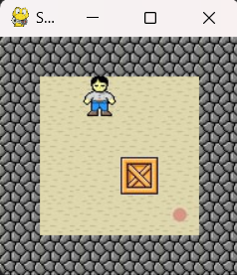
Code – The Sokoban Game
Objective – Push all boxes to targets
Implementation – More control over the level generation, graphics and state processing

Slide 10
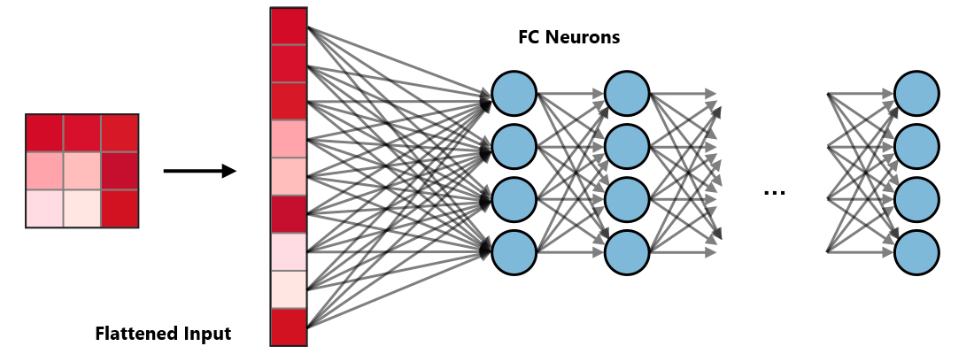
Code – The Model
Simple – One FC hidden layer with ReLU activation function
CNN – One Convolutional and Pooling layer before one FC hidden layer with ReLU

Slide 11
Code – The Agent
Learning – Use previous steps to adjust model parameters
Stability – Using target model and Prioritized replay to speed up the convergence
Exploration – Decay slowly the exploration steps
ONNX – Export model to ONNX format

Slide 12

Code – The Reward System
Simple – Evaluate a transition by “done”, “waste” and “move” rewards
HotCold – Rewards based on state improvement: positive if better, negative if worse

Slide 13
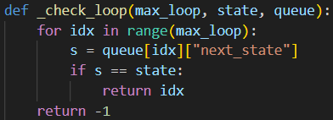

Code – The Verification
Marabou – Unsuccessful decoding of ONNX model
Loop Detection – Verification by changing previous moves rewards when detecting loops

Slide 14
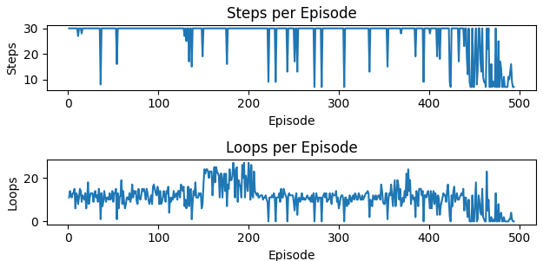
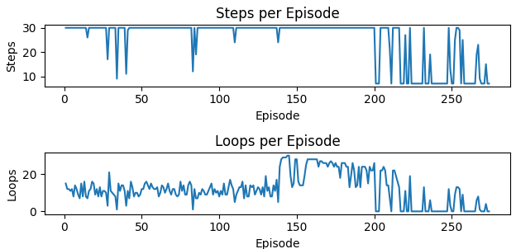
Results And Conclusion
The verification results in faster convergence

