Slide 1

supervisors: Avraham Raviv & Hillel Kugler
FORMAL VERIFICATION METHODS FOR SOLVING SPATIAL GAMES
authors: Boaz Gurevich & Erel Dekel

Slide 2
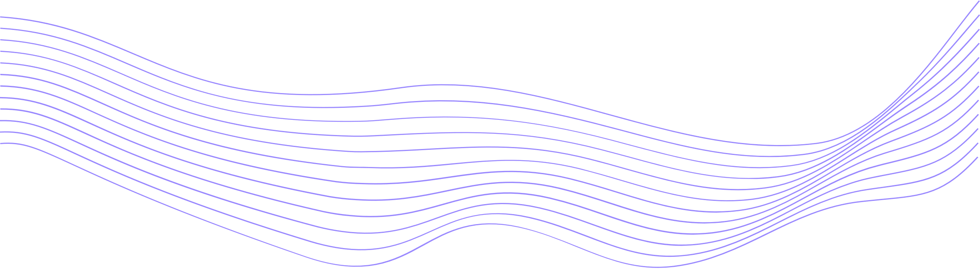
Formal Verification uses mathematical techniques to prove a system's correctness, ensuring it meets specified requirements. It's crucial for safety-critical applications.

Slide 3



MODEL
A mathematical representation of the system
Key Concepts in Formal Verification
SPECIFICATION
Formal description of desired system behavior
PROPERTIES
Specific claims or assertions about particular aspects of the system

Slide 4
Neural Networks
Neural Networks (NNs) are composed of layers, where each layer applies a transformation to the input data
The network uses forward propagation to predict the output, and backpropagation to adjust the weights based on the error
In this case, we used layers such as Linear, ReLU, Conv2d, and MaxPool2d

Slide 5

Reinforcement Learning
The objective is to train an agent to choose optimal action by interacting with the environment
Key-Components: Agent, Environment, State, Action, Reward, Policy
Goal: The agent should maximize the future reward
Applications: Game playing, robotics, autonomous systems, etc.

Slide 6
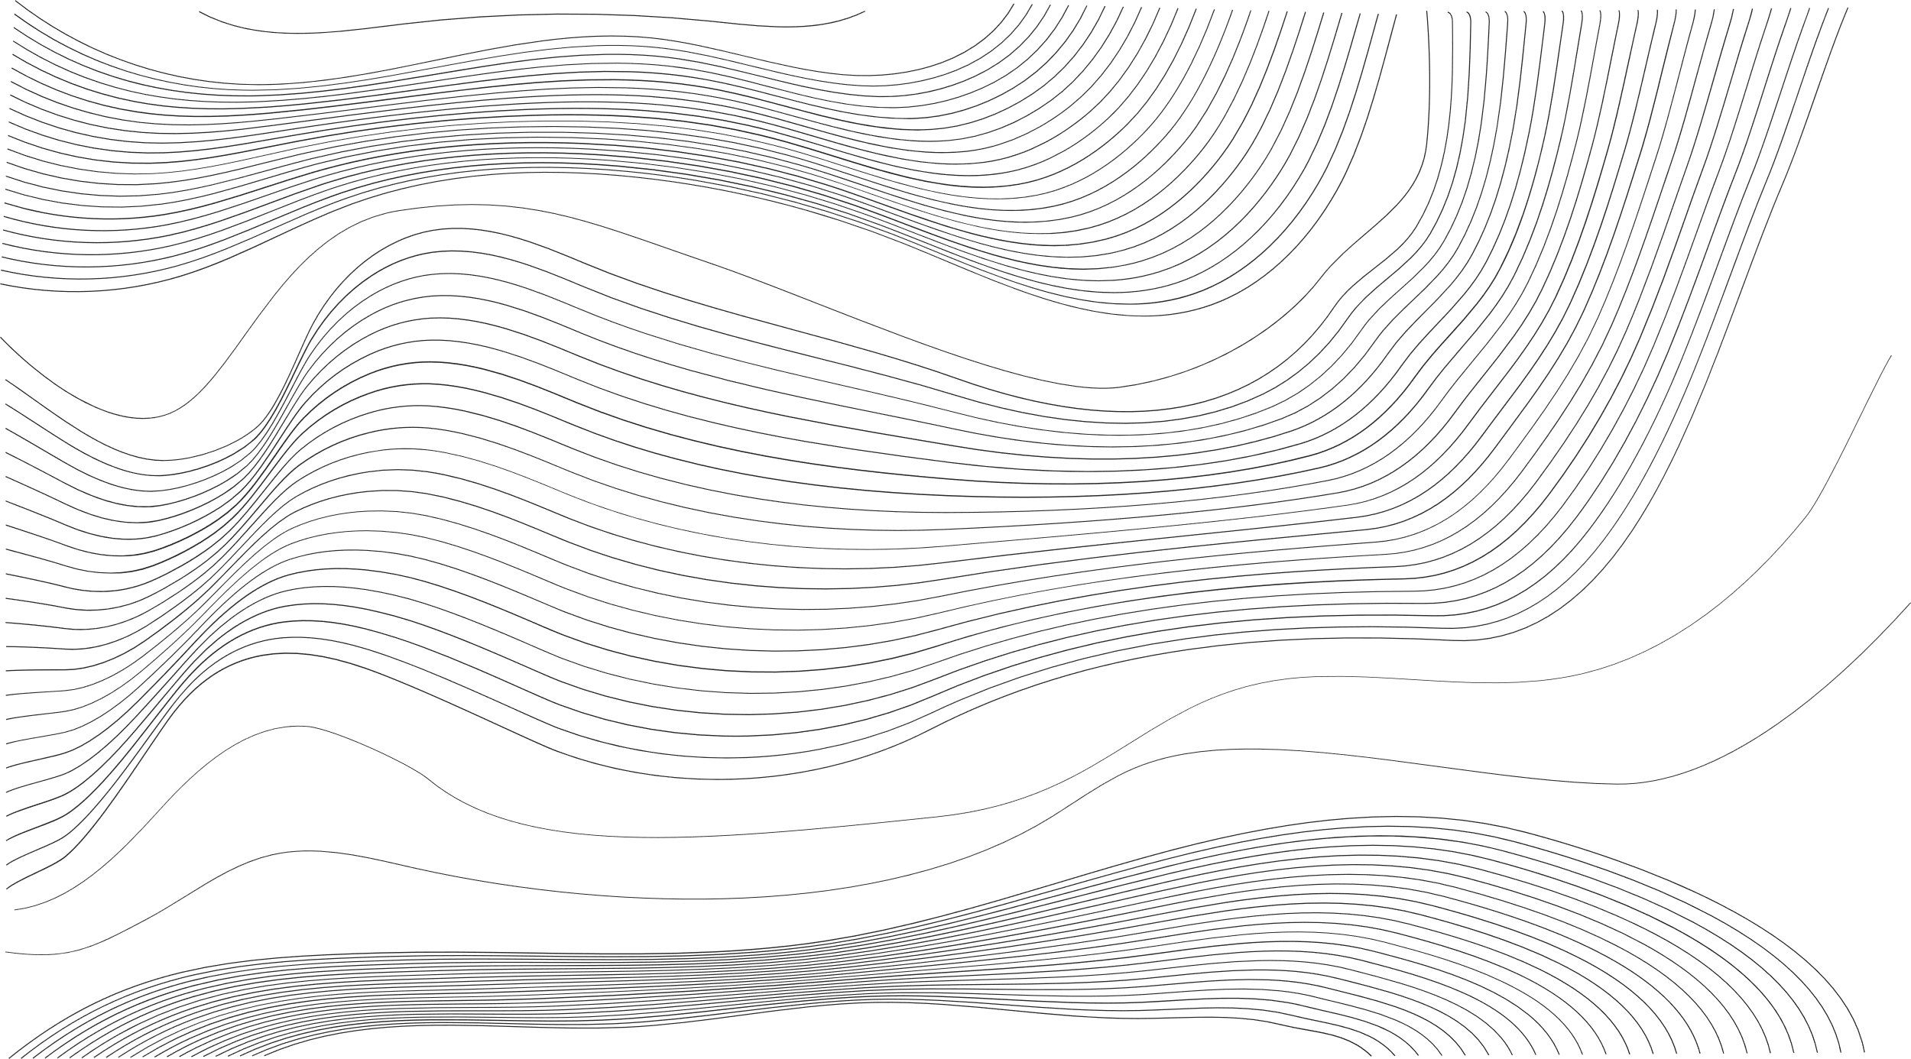
Model Free Value based RL algorithm
Construct an action-value function that estimates future rewards from state s and action a.
Q-Learning Algorithm
Balance exploration of new actions vs. exploitation known ones

Slide 7
STEP 1
STEP 2
Observe current state of the environment
Select action using exploration strategy
Q-Learning Iteration
STEP 3
STEP 4
Execute action and get next state and reward
Update the Q-table based on the transition

Slide 8
CONCEPT
Using Neural Network to approximate the Action-Value function
Deep RL (DRL)
SCALABILITY
Efficient for large, high-dimensional, and complex environments
COMPLEXITY
Requires more computation and careful tuning of neural networks.

Slide 9

Challenges in Formal Verification of Neural Networks
Scalability: Large number of parameters and complex architectures
Non-linearities: Activation functions complicate the verification
Robustness: Ensuring NN are robust against adversarial attacks

Slide 10
Marabou
Python Interface for Neural Network Verification
Key Features: User-friendly interface that supports various NN architectures
Functionality: Imports NN from formats, specifies constraints on inputs and outputs, uses SMT to prove/disprove properties, and generates counter-examples
Use Cases: Property checking and mostly robustness verification

Slide 11
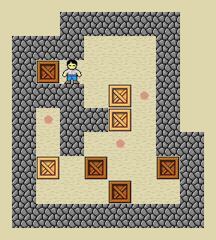
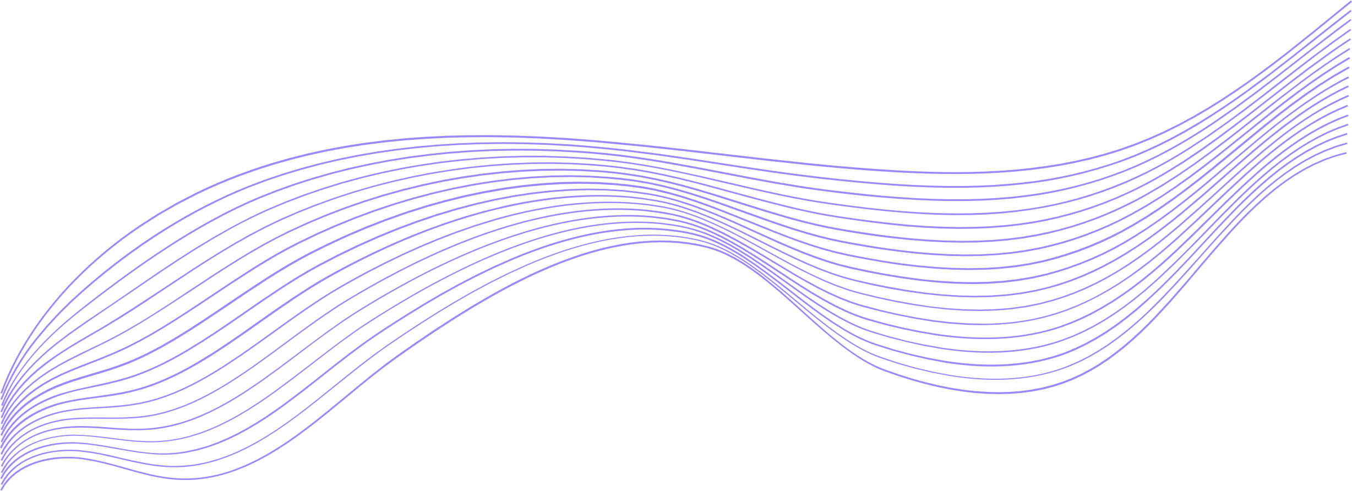
The Sokoban Game
Use the keeper to push of the box into the targets

Slide 12


Simple Reward
Hot or Cold
Reward different rewards if the step was:
Use variation of BFS to calculate state value
Wasteful, did not change the state
Estimate the value of the state before and the state after the step
Final, the game is solved
Step, did not solve the game
Reward positively if better and negatively if worse

Slide 13
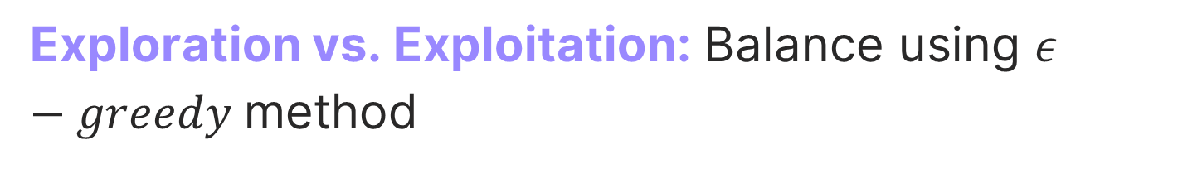
Learning: Use replay buffer, MSE loss function and ADAM optimizer
Exploration vs. Exploitation: Balance using $ε−greedy$method
The Agent
Prioritized Replay: Store good steps to speed up the learning
Target Model: Using 2nd model to update the main model
Export ONNX: Marabou and Visualize the Neural Network

Slide 14
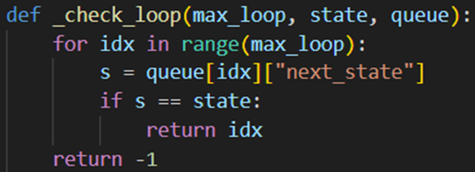
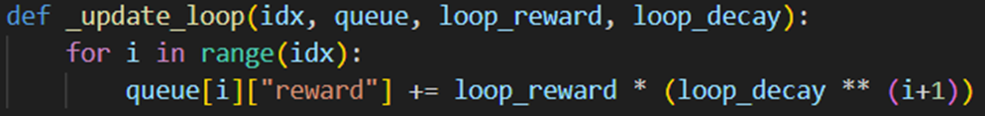
The Verification
Using Maraboupy was unsuccessful, some operations in ONNX format weren’t recognized
Instead, We coded previous loop detection to simulate verification

Slide 15
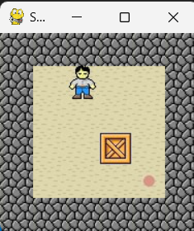
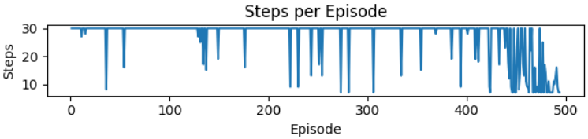
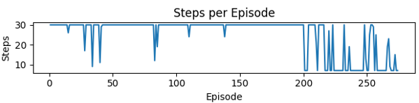
Results
On this simulation the verification speed the learning by 45%

Slide 16
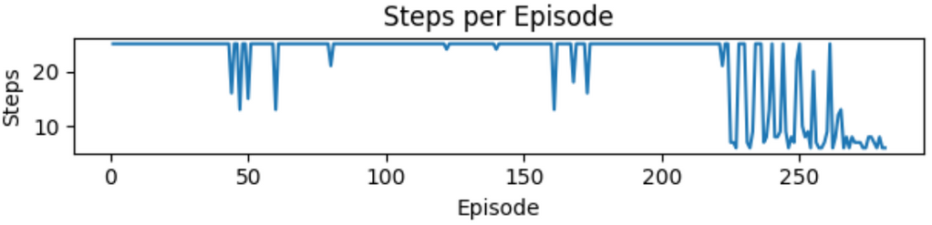
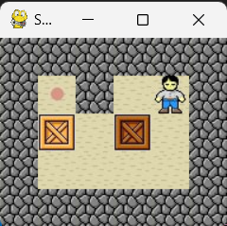
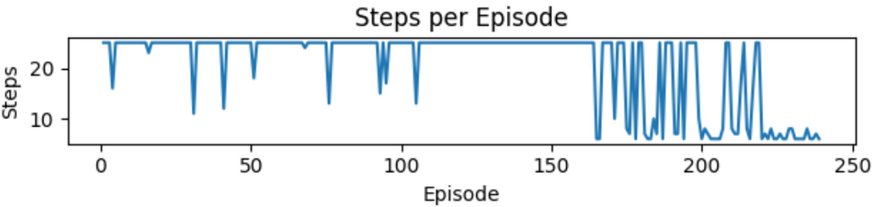
Results
On this simulation the verification speed the learning by 15%

Slide 17
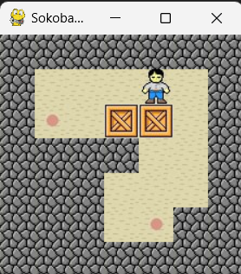
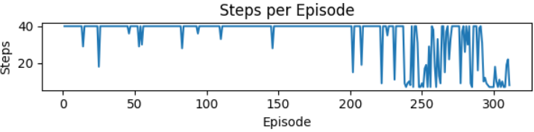
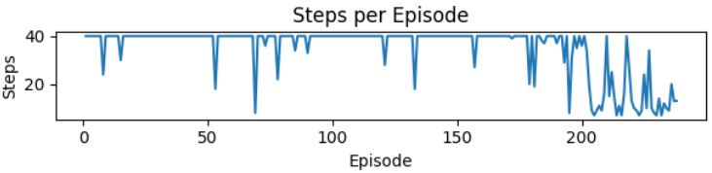
Results
On this simulation the verification speed the learning by 23%

