Slide 1


Slide 2

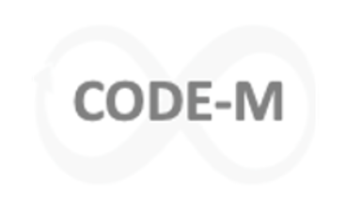
CODE-M
Genome Scale Metabolic Modelling
Dr Stephen Chapman
stephen.chapman@liverpool.ac.uk
350 Biosciences Building
Notes:
Talk to you today about an area of biology called Bioinformatics, or otherwise known as computational biology. All about how to get ocmoiuters to work for us enhance biological knowledge.

Slide 3
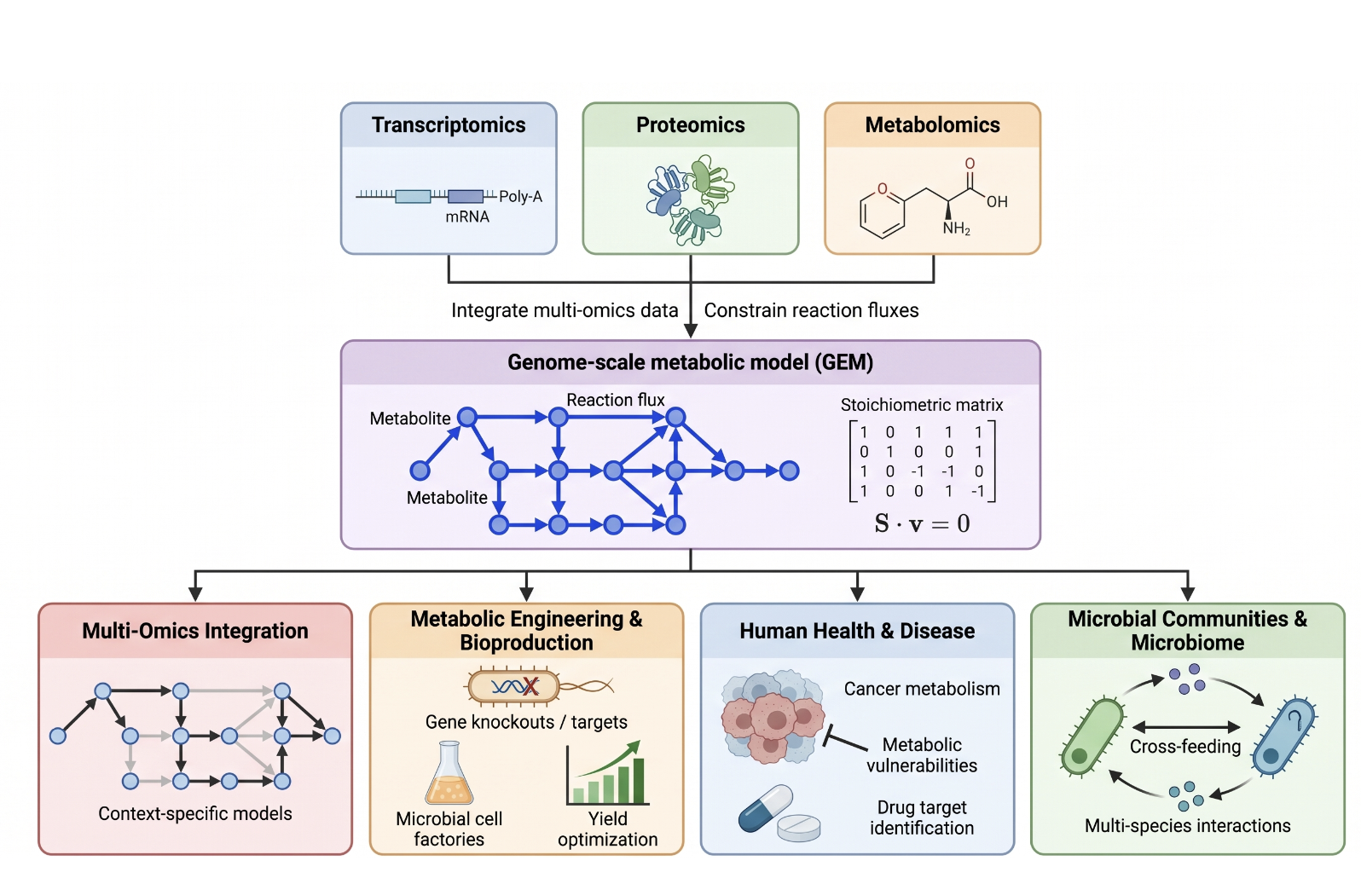
Genome Scale Metabolic modelling

Slide 4
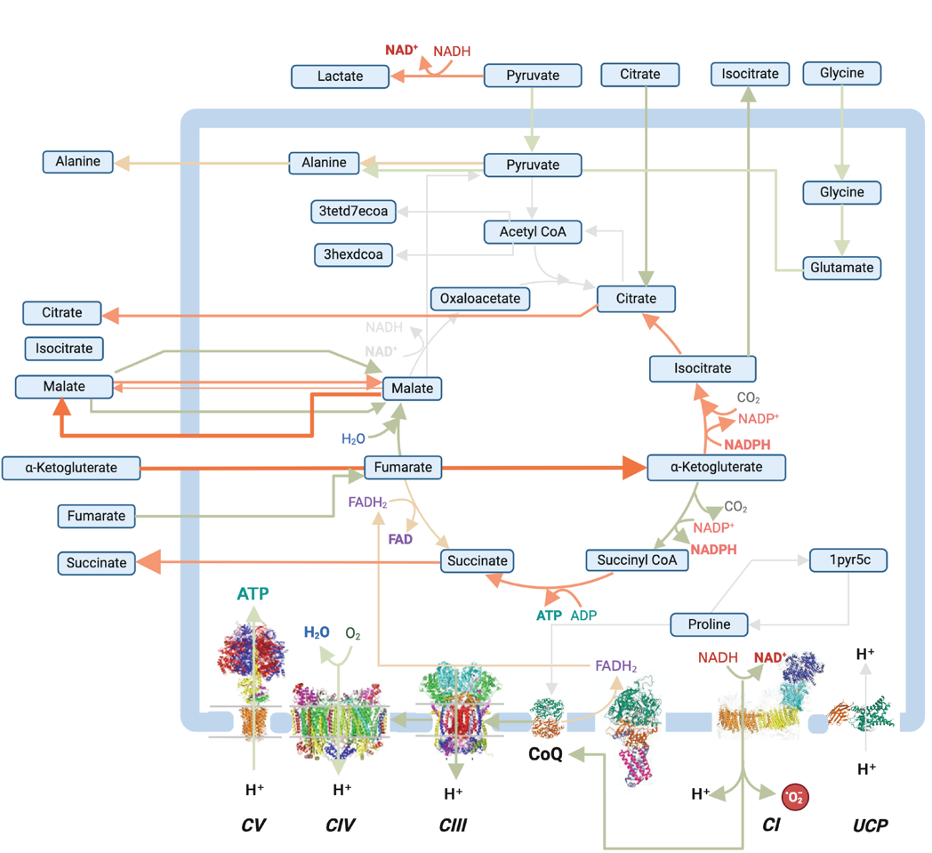
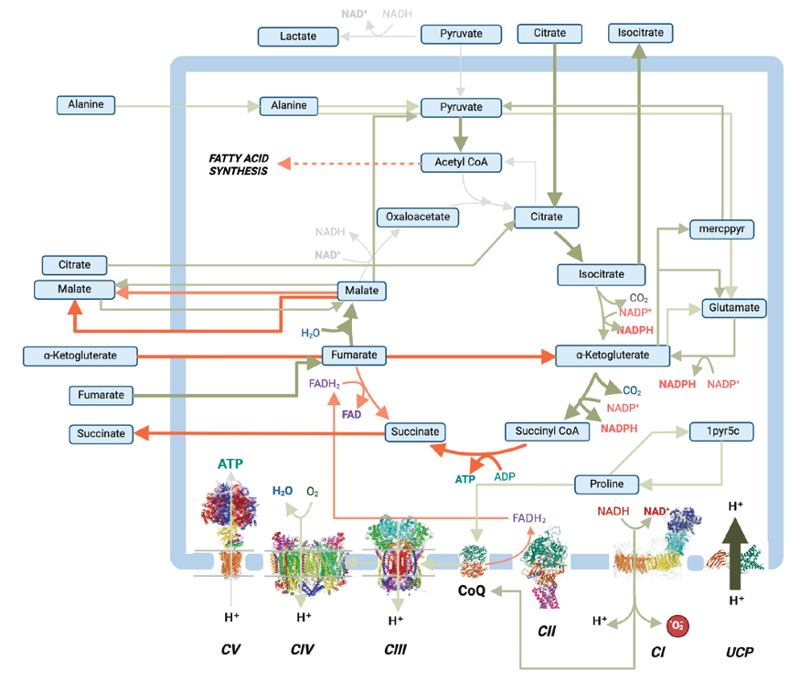

Genome scale metabolic modelling predicts metabolic fluxes through a metabolic network

Slide 5

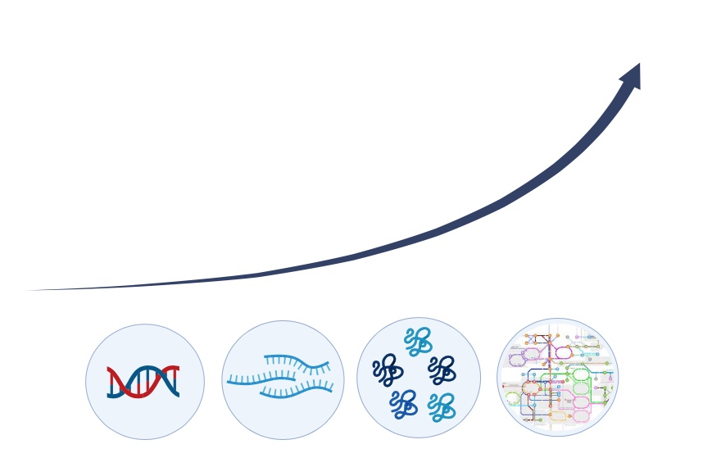


Genome Scale Metabolic Models Explain how Changes in the Environment Lead to Changes in the Phenotype
Systems Biology looks at complete biological systems = holistic
Avoids looking at single genes or single proteins in isolation = reductionism
Metabolism is the closest omic layer to the phenotype
DNA
mRNA
protein
metabolites
transcription
translation
environment
genome
transcriptome
proteome
metabolome
phenotype

Slide 6
Day 1: Basics of metabolic modelling
Tue 27th October: online
Explain the genome → transcriptome → metabolome relationship and explore ‘omic databases
Describe what a GSMM contains and download one as SBML from BiGG.
Simulate a GSMM using FBA in COBRApy
Interpret an FBA solution and visualise fluxes on an Escher map
Time | Session | Lead / format
09:30–10:00 | Welcome, the environment–phenotype problem | Stephen — talk
10:00–11:00 | Lecture 1: Intro to systems biology; omics data | Stephen — lecture
11:00–12:00 | Lecture 2: What is a GSMM? | Stephen — lecture + live demo 2_1.ipynb
12:00–13:00 | Lunch | —
13:00–14:15 | Lecture 3: Flux Balance Analysis — constraints, objective, linear programming; intro to FVA; limitations & applications | Stephen — lecture
14:15–15:45 | Hands-on: load an E. coli model, set the medium, run FBA, read the summary, visualise with Escher | Stephen — Guided notebook 3_1.ipynb
15:45–16:00 | Wrap-up & bridge to Day 2 (where do models come from?) | Stephen
16:00–17:00 | Drop-in clinic — install Tier 1 (cobrapy + Escher + Jupyter) on own laptops | All facilitators

Slide 7
Day 2: Metabolic Model Reconstruction
Wed 28th October: online
Build a small model from scratch in cobrapy (metabolites, reactions, bounds, GPRs, objective) and save it as SBML.
Explain the stages of a modern reconstruction pipeline (genome → annotation → draft network → gap-filling → curation).
Build Models with ModelSEED and compare them with curated ones
Time | Session | Lead / format
09:30–09:45 | Recap of Day 1; the reconstruction problem | Francesco
09:45–12:00 | Hands-on: build the toy model from scratch in COBRApy; add GPRs; save SBML; run FBA & Escher | Notebook (Day 2 part A)
12:00–13:00 | Lunch | —
13:00–14:00 | Reconstruction pipelines – annotation, draft networks, gap-filling, curation; manual vs automated; tool landscape(CarveMe, modelSEED,, gapseq, KBASE) | Francesco — Lecture
14:00–15:30 | Hands-on : modelSEED based reconstruction | Notebook (Day 2 part B)
15:30–16:00 | Discussion: how far to trust an automated reconstruction; quality metrics (MEMOTE) | Francesco — discussion
16:00–17:00 | Drop-in clinic | All facilitators

Slide 8
Day 3: Data Integration and Advanced analysis
Thursday 29th October: Liverpool
Run pFBA and FVA on a genome-scale model and interpret the difference from plain FBA.
Identify essential genes/reactions and use knockouts to redirect flux toward a target product
Understand how various omics-integration algorithms constrain a GSMM
Assessment: Show us what you know
Time | Session | Lead / format
09:30–09:45 | Recap; from single-model analysis to design and communities | Francesco
09:45–11:00 | Hands-on: analysing real models — pFBA, FVA, robustness; aerobic vs anaerobic media | Francesco / Stephen — Guided notebook
11:00–12:00 | Hands-on: gene/reaction essentiality; strain optimisation — knockouts to boost ethanol/acetate | Francesco / Stephen — Guided notebook
12:00–13:00 | Lunch | —
13:00–14:00 | Omics integration: GPRs to reaction scores; constraint- vs objective-based methods | Stephen— lecture
14:00–15:30 | Assessment: Show us what you know | Francesco / Stephen — Notebook assessment.ipynb
15:30–16:00 | Wrap-up: where to go next; resources; feedback | Francesco/Stephen
16:00–17:00 | Drop-in clinic | All facilitators

Slide 9
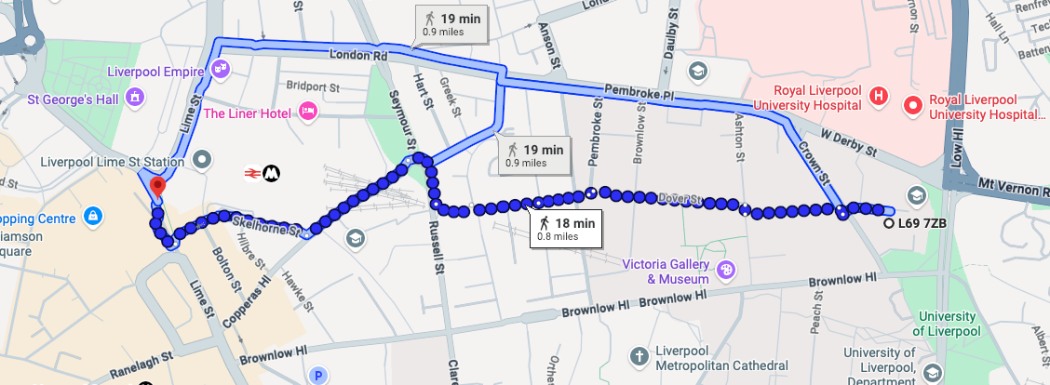
Day 3: Data Integration and Advanced analysis
Thursday 29th October: Liverpool
MerseyBIO (Crown street, L69 7ZB)

Slide 10




A little bit about me
2011
2015
2019
2024
PhD Systems Biology: modelled photosynthesis using FBA
Postdoc1: Modelled DHA production using FBA
Postdoc 2:
Modelled human cell signaling using logical modelling
Postdoc 3:
Modelled human and mouse mitochondrial metabolism using FBA
Lecturer: Computational Biology and statistics
  Modelling Liver cancer
  Modelling Brain cancer
  Modelling Rice met.

Slide 11
Lecture 1: Systems Biology: 10-11am

